Slide 1
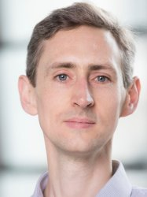
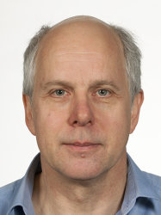
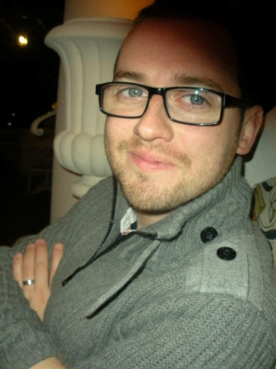
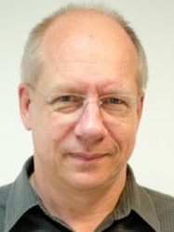
Physics of medical imaging and radiotherapy
BSc/MSci Physics level 3
7.5 ECTS course in term 2
Prof Chris Dunsby
christopher.dunsby@imperial.ac.uk
Prof Ken Long
k.long@imperial.ac.uk
Dr James McGinty
james.mcginty@imperial.ac.uk
Prof Uwe Oelfke
uwe.oelfke@icr.ac.uk
Notes:
Brief intro to lecturers. Highlight level and ECTS – no prerequisites.

Slide 2
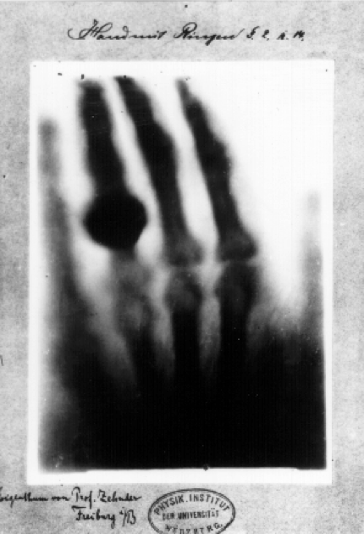
The discovery of X-rays (Röntgen 1895) kick-started the field of medical imaging
Notes:
Medical imaging just over 100 years old

Slide 3
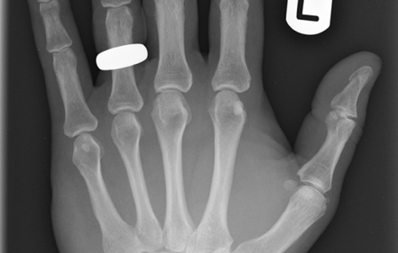
Developments in understanding and technology has led to far superior image quality
Notes:
Quality of data improved significantly due to improved understanding, optimisation of parameters and developments in technology.

Slide 4
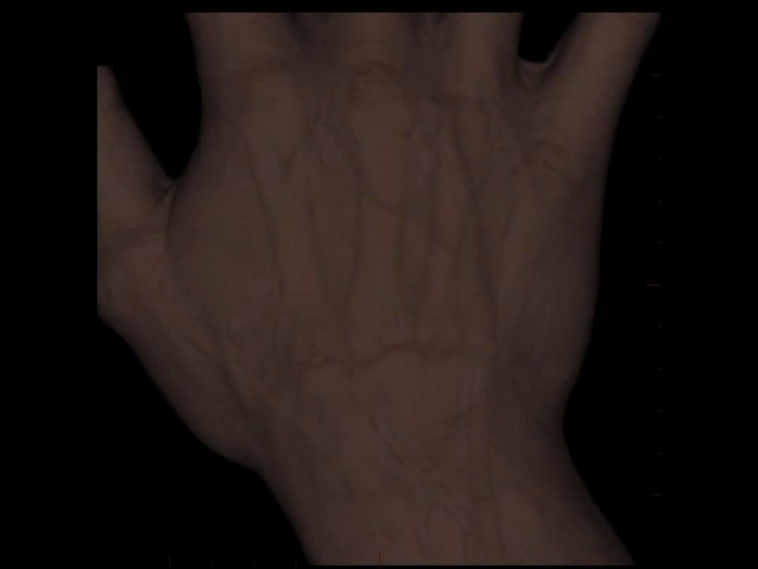
and has been extended to full 3D tomography
Notes:
Moved from 2D imaging to full 3D tomography

Slide 5
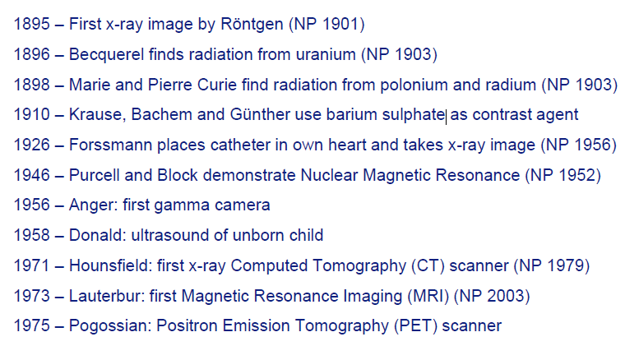
Key developments in medical imaging
Mansfield
Notes:
Started with discovery of X-rays, but have seen many modalities developed since. The importance of medical imaging is underlined by the numerous Nobel prizes awarded for key advancements.

Slide 6
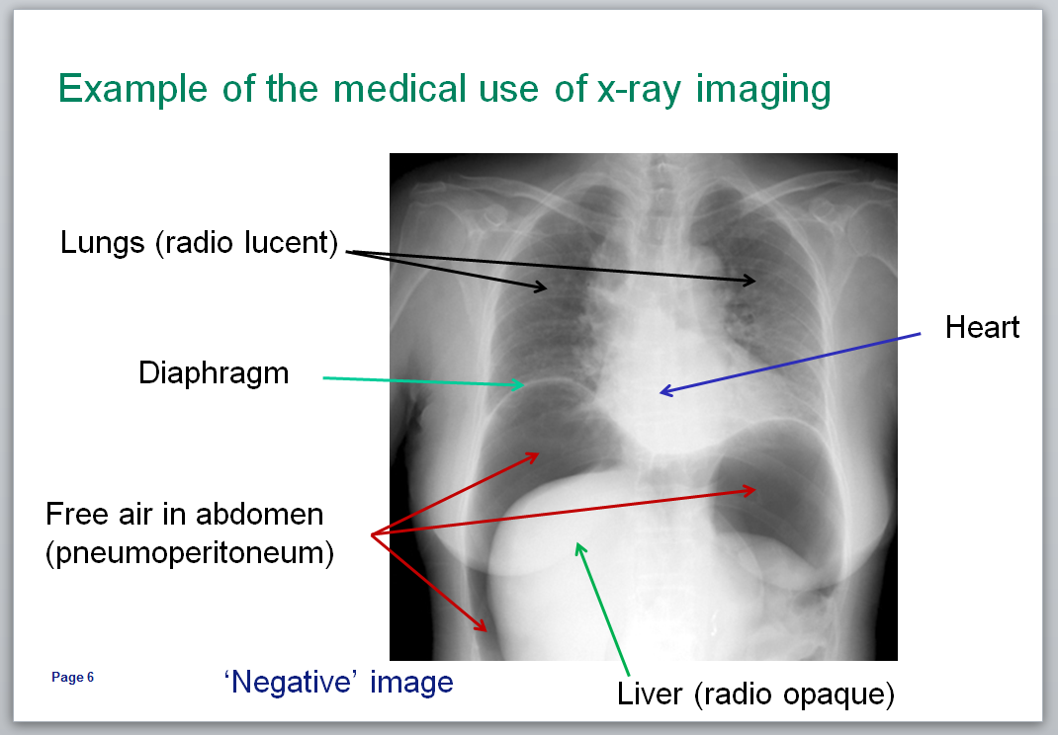
Aims:
insight into the state of the art of medical imaging technology
to introduce the physical principles behind:
  interaction of radiation with
  biological tissue
  generation & detection of
  radiation
  signal and image processing
  radiation used for therapy
Don’t worry, you will not be expected to learn biological/medical terms.
Notes:
Basic aim of the course is to introduce key physical principles underlining the main medical imaging and therapy techniques (given on next slides)

Slide 7
Course Structure:
Overall
  19 lectures/seminars covering core examinable material
  Assessed by a summer examination
  55% contribution to course mark
You will get
  Lectures; number varies, but, usually between 1 and 3 per week
  Additional study material
  1st in-person seminar
    Introduction to Projects and Problem Sheet exercise
  In-person seminars 2 & 3
    Work on “Problem Sheet” exercise
  4th in-person seminar
    Peer-assessment of “Problem Sheet” exercise – more details in a bit…
Notes:
Describe course structure – make it clear that “course work” is done in groups

Slide 8
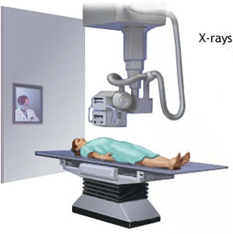
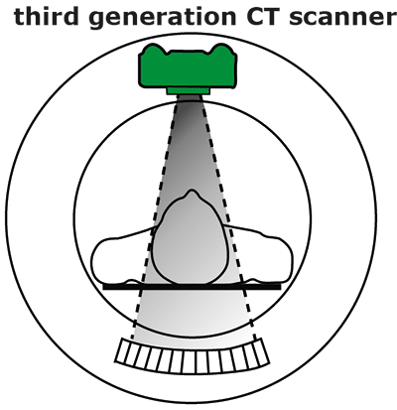
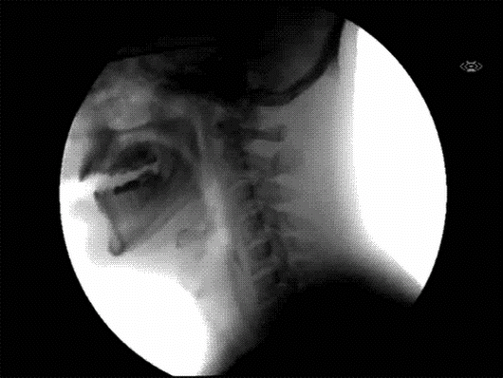
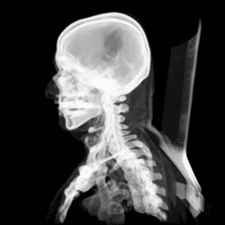
Lectures 2—6: X-ray imaging and tomography
X-ray
X-ray CT
Dr James McGinty
james.mcginty@imperial.ac.uk
Notes:
Topics covered

Slide 9
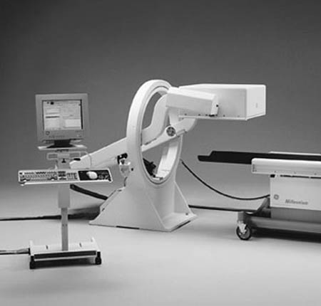
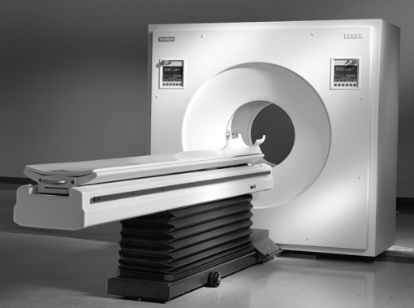
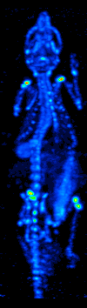
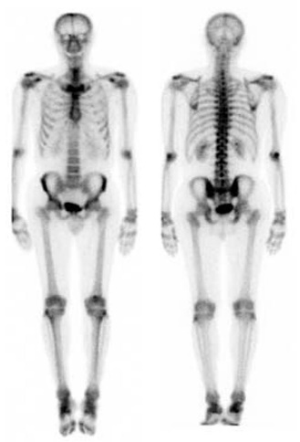
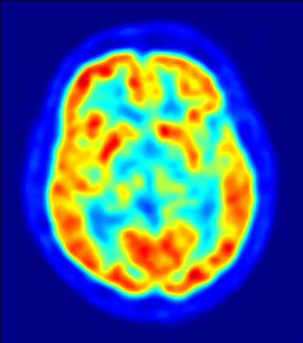
Lectures 7-9: Nuclear imaging
Gamma camera
SPECT
PET
Chris Dunsby
christopher.dunsby@imperial.ac.uk
Notes:
Topics covered

Slide 10
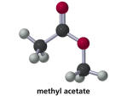
Radiopharmaceutical
compound tagged with a radionuclide
accumulation, or rate of uptake or clearance of radiopharmaceutical should be related to a physiologic, biochemical or molecular process, target or function
radionuclide should produce emissions that can be detected outside the body (primarily gamma rays or annihilation photons)
radiopharmaceutical introduced in very tiny amounts (~nanograms)
Notes:
What are desirable properties of a radiopharmaceutical
No pharmacologic effects, that’s why called radiotracer - doesn’t perturb system being studied but traces it
Differences between pharmaceutical and radiopharmaceutical

Slide 11
Lectures 7-9: Nuclear imaging
Gamma camera
PMTs
Scintillator
Collimator
Notes:
Topics covered

Slide 12
PET: annihilation coincidence detection
Side view:
Front view:
Coincidence?
Electronics,
processing &
display
Detectors

Slide 13
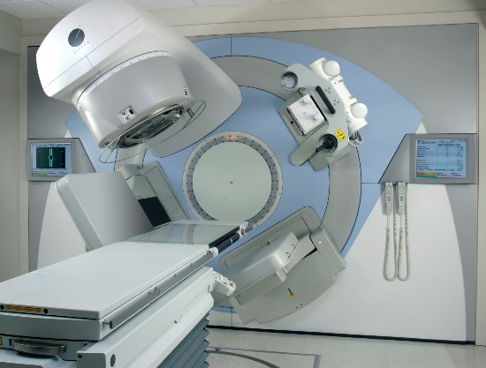
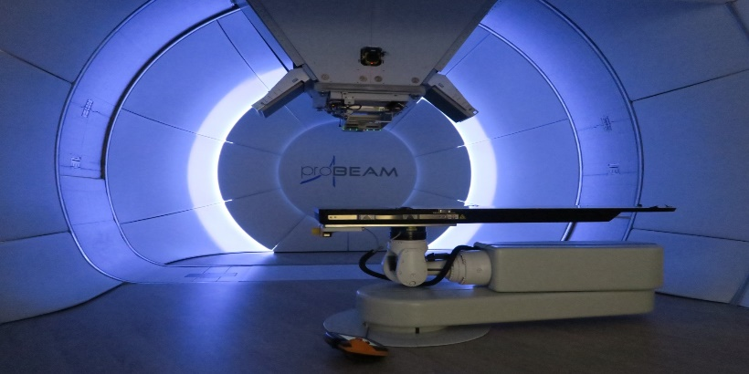
Lectures 10—12: Radiotherapy
X-ray/photon therapy
Proton-beam therapy
Prof Uwe Oelfke
ICR/RMH
uoelfke@ic.ac.uk &
uwe.oelfke@icr.ac.uk
Notes:
Topics covered

Slide 14
Radiotherapy overview
RT Physics L1/L2
Lecture I
Cancer: Clinical Motivation of RT
Radiation
Basic Physics/Dose
Dose
Calculation/Delivery
Radiobiology
Cells/Cell Death
RT Concepts
TP/IMRT/IGRT
Proton & Ions
Basic Physics/Dose
Radiobiology
Protons & Ions
Clinical Applications of RT
Lecture II
Notes:
TP – treatment planning
IMRT - intensity-modulated radiation therapy
IGRT - Image-Guided Radiation Therapy

Slide 15
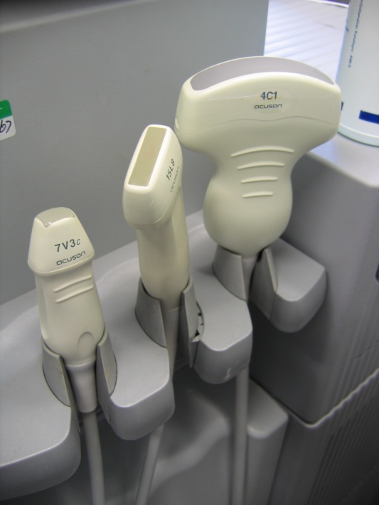
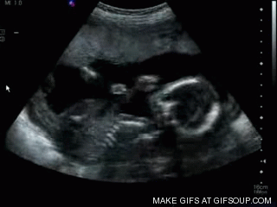
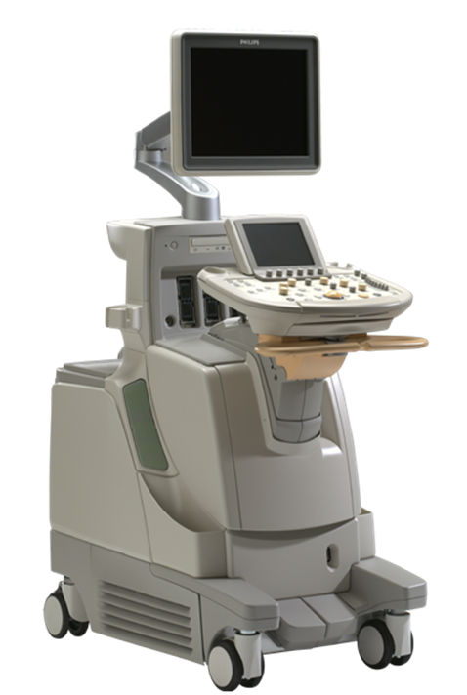
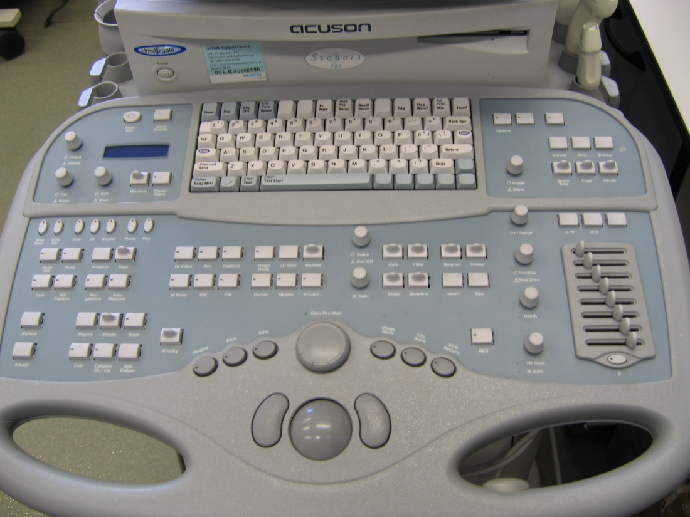
Lectures 13-15: Ultrasound Imaging
Ultrasound
Prof Chris Dunsby
christopher.dunsby@imperial.ac.uk
Safe, gentle, cheap
Notes:
Topics covered

Slide 16
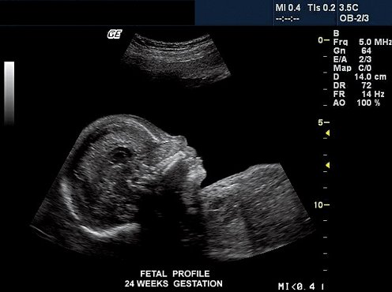
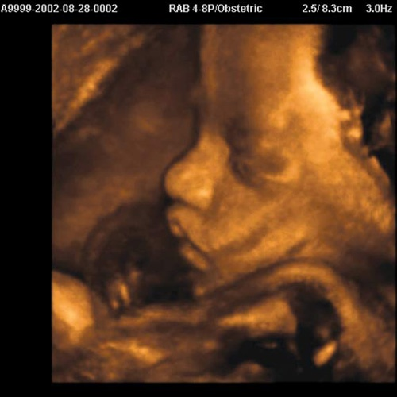
2D Cross-sectional image
3D surface-rendered image

Slide 17
Overview of ultrasound imaging lectures
Physics of ultrasound
  ultrasound waves
  wave propagation
  interaction with biological media
Engineering
  hardware and software components for ultrasound imaging
  design criteria – resolution
  compromises

Slide 18
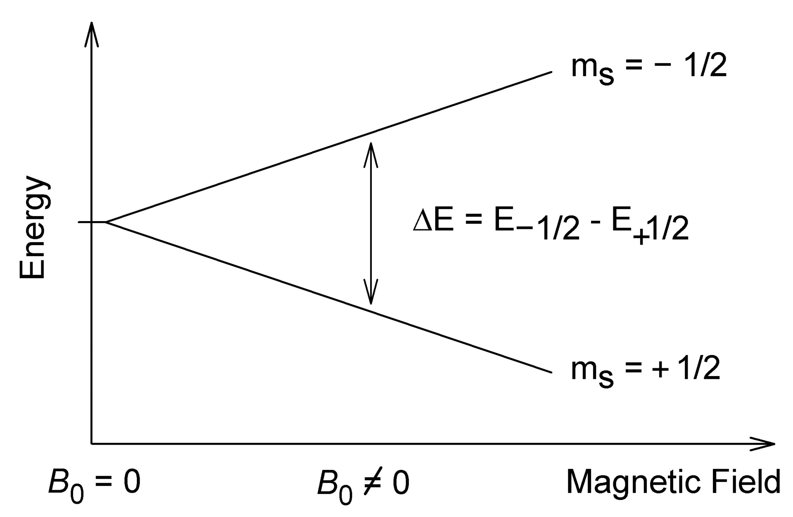
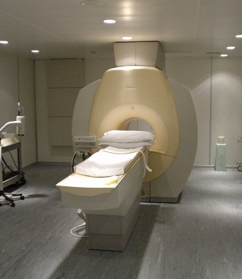
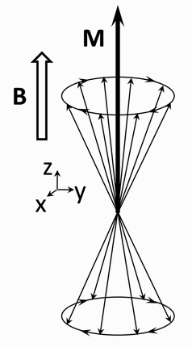
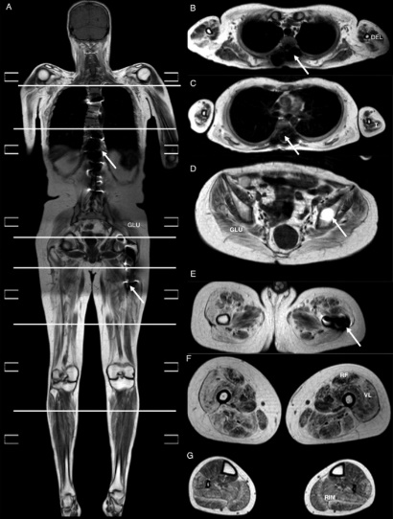
Lectures 16—19 and Seminar 6: MRI
MRI
Prof Ken Long
k.long@imperial.ac.uk
Notes:
Topics covered

Slide 19
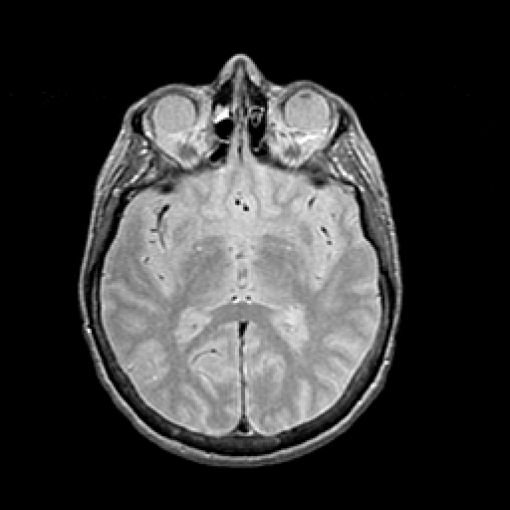
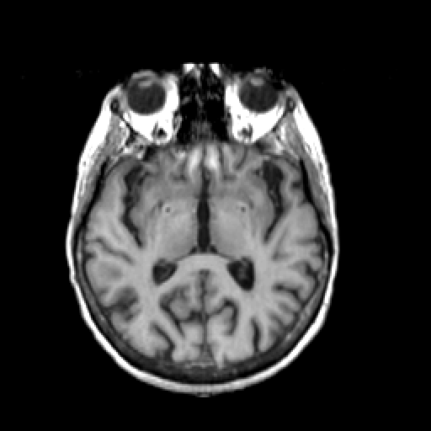
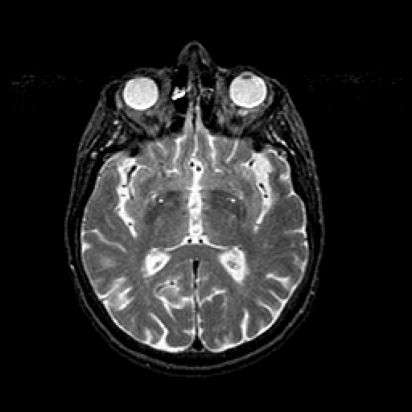
MRI - multi contrast
Proton Density Weighted
T1 Weighted
T2 Weighted

Slide 20
Course Structure: Weeks 7-11
Problem Sheet Question and Answer exercise
  Worth 10% of the final mark
  Topic will be linked to that of the Project, see following slides
  Work in a group of ~4
  Group members will be the same as for Project
Working in your group you:
  Will prepare a problem sheet-style (NOT an exam-style) question with answers
  Will have time to work on your PS Q&A in class (15:00 25/02/25, 17:00 28/02/25)
  Should aim to spend further time on this exercise outside class
  Should aim that someone else in the class should take ~40 mins to complete it
  Will assess the problem sheet-style question and answers prepared by 3 other groups
  Will have time in class for discussing the other group’s Q&As (3pm 10/03/25)
  Assign a single mark (out of 10) from your group for each of the other 3 groups’ questions
  This will then be combined with a mark (out of 10) from a member of academic staff to give the overall mark for the exercise (out of 20)
Notes:
Describe course structure – make it clear that “course work” is done in groups

Slide 21
Course Structure: Weeks 7-11
Group project on an advanced topic
  We will release the list of potential projects at end of week 7
  At start of week 7, you will be asked to give your ranked preference for the projects on offer
  We will tell you your group and assigned project topic at the PS Q&A session at end of week 8
  Working with your group, you need to prepare a report
  It is up to you to arrange meetings with your project supervisor
The Report – deadline 5pm 2nd May
  35% of final mark
  Max. 5 pages and max. 1500 words per group member (so max. 20 pages and max 6000 words for group of 4)
  Marked by member of academic staff
Report peer questionnaire
  “For the report, each group member will return a survey on the relative contributions of all group members. If the contribution of any group member differs from the average by more than 20%, then each group member's mark will be scaled by the average of the relative contributions returned by the other group members.”
Notes:
Describe course structure – make it clear that “course work” is done in groups

