Slide 1
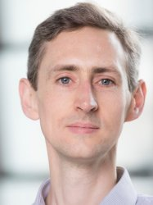
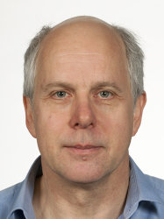
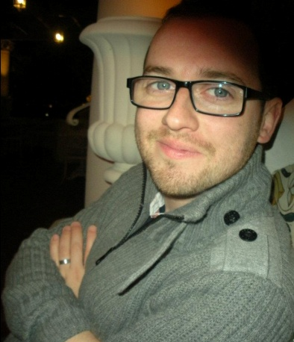
Physics of medical imaging and radiotherapy
BSc/MSci Physics level 3
7.5 ECTS course in term 2
Prof Chris Dunsby
Prof Ken Long
Dr James McGinty
Replaces the two 3 ECTS Medical Imaging courses:
X-ray & Ultrasound and Nuclear Diagnostics & MRI
Notes:
Brief intro to lecturers. Highlight level and ECTS – no prerequisites.
Replaces two short Medical Imaging courses

Slide 2
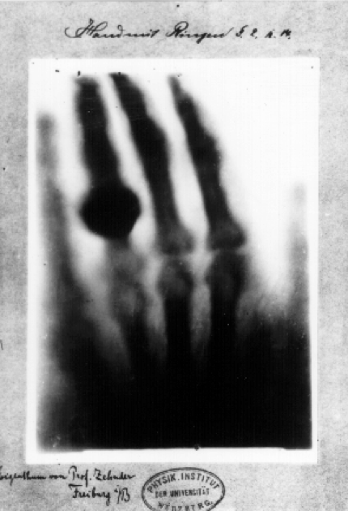
The discovery of X-rays (Röntgen 1895) kick-started the field of medical imaging
Notes:
Medical imaging just over 100 years old

Slide 3
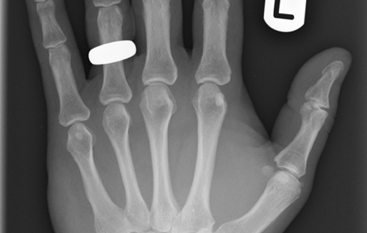
Developments in understanding and technology has led to far superior image quality
Notes:
Quality of data improved significantly due to improved understanding, optimisation of parameters and developments in technology.

Slide 4
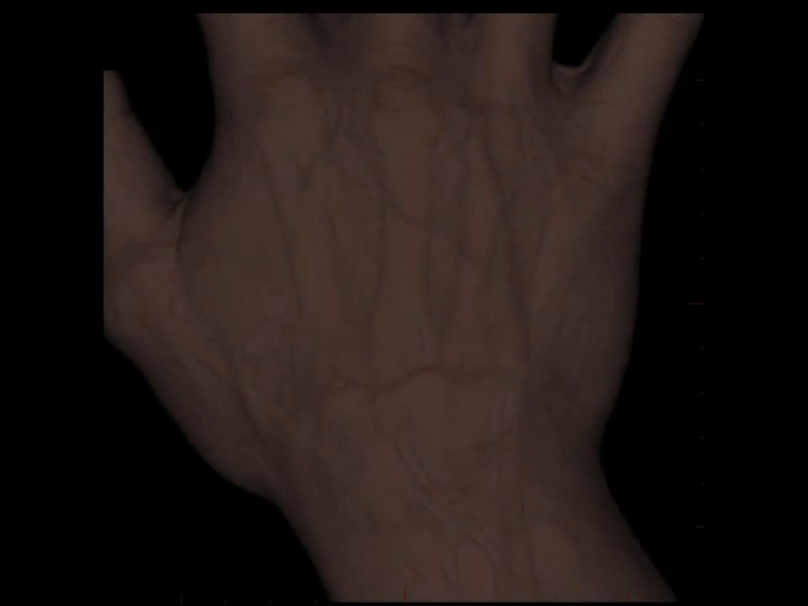
and has been extended to full 3D tomography
Notes:
Moved from 2D imaging to full 3D tomography

Slide 5
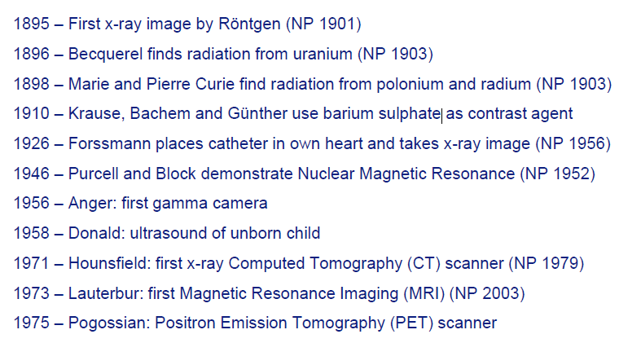
Key developments in medical imaging
Notes:
Started with discovery of X-rays, but have seen many modalities developed since. The importance of medical imaging is underlined by the numerous Nobel prizes awarded for key advancements.

Slide 6
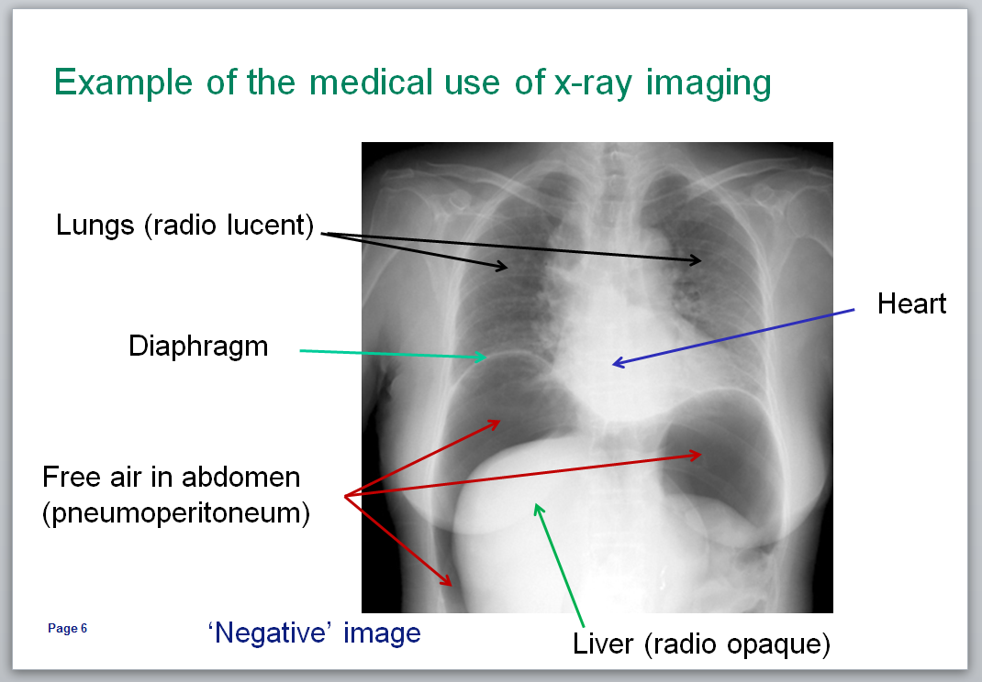
Aims:
insight into the state of the art of medical imaging technology
to introduce the physical principles behind:
  interaction of radiation with
  biological tissue
  generation & detection of
  radiation
  signal and image processing
  radiation used for therapy
Don’t worry, you will not be expected to learn biological/medical terms.
Notes:
Basic aim of the course is to introduce key physical principles underlining the main medical imaging and therapy techniques (given on next slides)

Slide 7
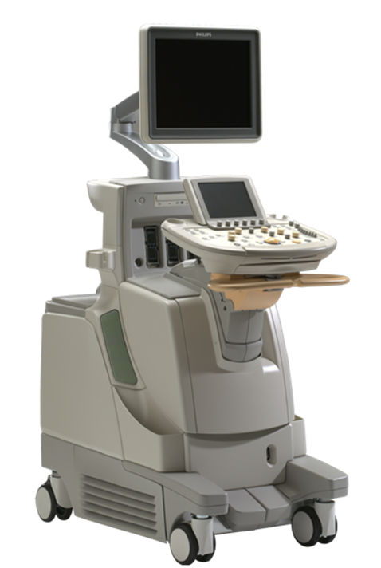
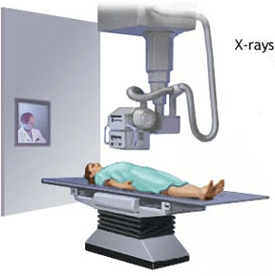
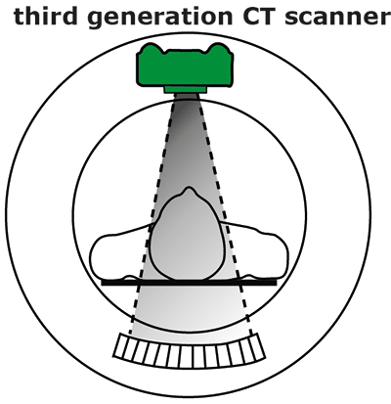
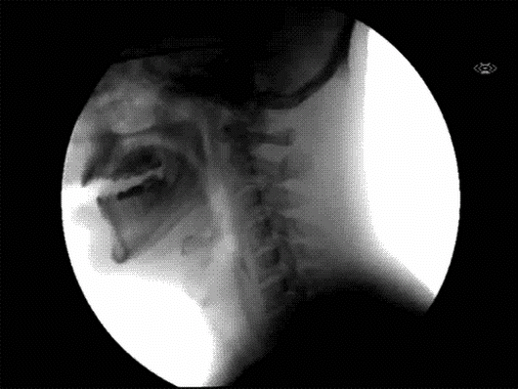
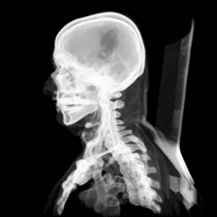
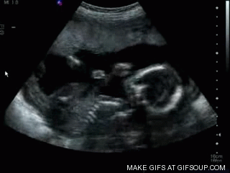
X-ray
X-ray CT
Ultrasound
Notes:
Topics covered

Slide 8
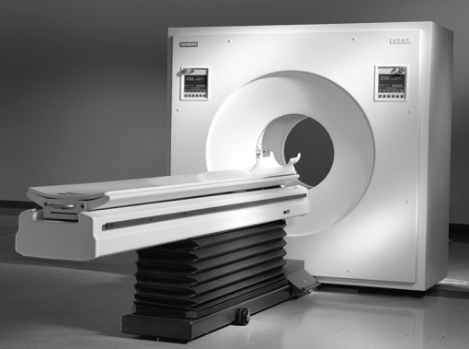
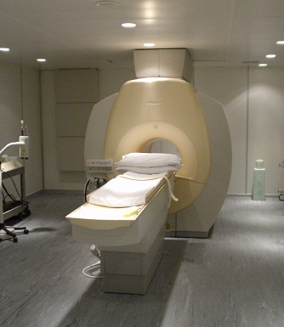
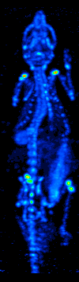
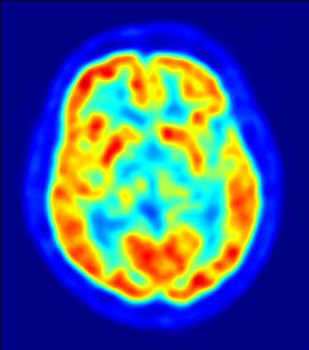
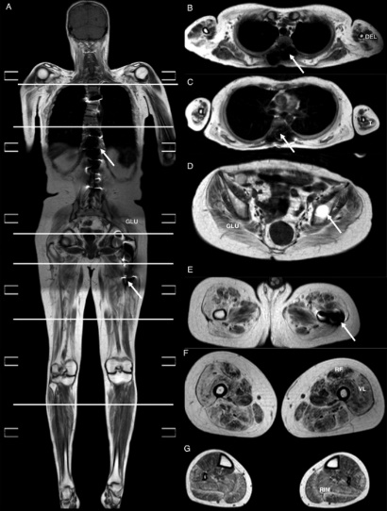
PET
MRI
γ-cam/SPECT
Notes:
Topics covered

Slide 9
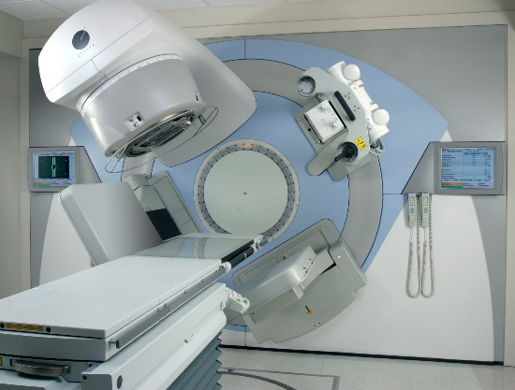
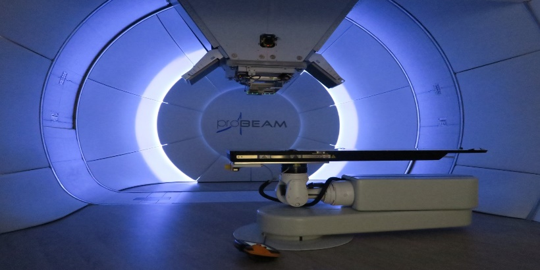
X-ray therapy
Proton-beam therapy
Notes:
Topics covered

Slide 10
Course Structure
Weeks 1 - 7
  18 lectures/seminars covering core examinable material
  Assessed by a summer examination
  50% contribution to course mark
Weeks 7 - 11
  Mid-course exercise (5%)
  Research and submit a report on an advanced topic (30%)
  Presentation on topic (15%)
  Done in groups of 4-5
  50% contribution to course mark
Notes:
Describe course structure – make it clear that “course work” is done in groups

Slide 11
Physics of medical imaging and radiotherapy
BSc/MSci Physics level 3
7.5 ECTS course in term 2
Prof Chris Dunsby
Prof Ken Long
Dr James McGinty
An introduction to the physics behind the major medical imaging and radiotherapy methods used clinically today
Notes:
Happy to answer questions during Options Fair on Tuesday

