Slide 1
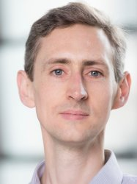
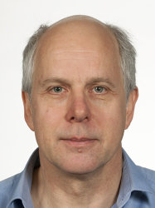
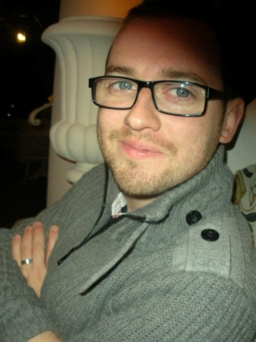
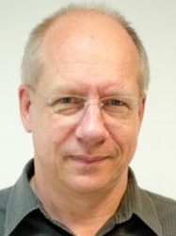
Physics of medical imaging and radiotherapy
BSc/MSci Physics level 3
7.5 ECTS course in term 2
Prof Chris Dunsby
christopher.dunsby@imperial.ac.uk
Prof Ken Long
k.long@imperial.ac.uk
Dr James McGinty
james.mcginty@imperial.ac.uk
Prof Uwe Oelfke
uwe.oelfke@icr.ac.uk
In previous years this ran two 3 ECTS Medical Imaging courses:
X-ray & Ultrasound and Nuclear Diagnostics & MRI
Notes:
Brief intro to lecturers. Highlight level and ECTS – no prerequisites.
Replaces two short Medical Imaging courses

Slide 2
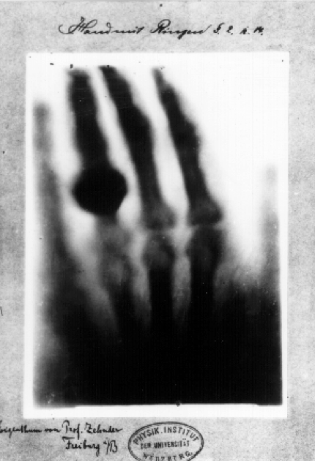
The discovery of X-rays (Röntgen 1895) kick-started the field of medical imaging
Notes:
Medical imaging just over 100 years old

Slide 3
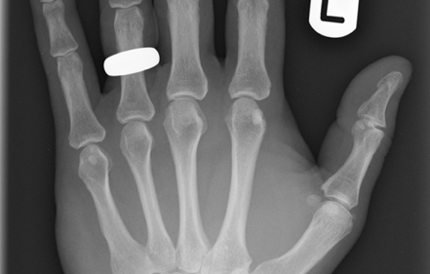
Developments in understanding and technology has led to far superior image quality
Notes:
Quality of data improved significantly due to improved understanding, optimisation of parameters and developments in technology.

Slide 4
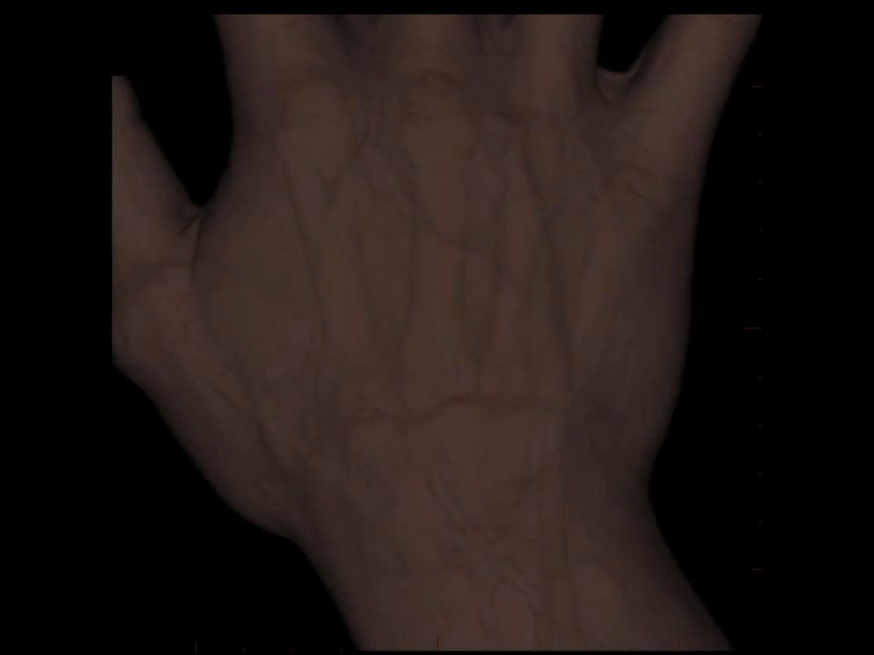
and has been extended to full 3D tomography
Notes:
Moved from 2D imaging to full 3D tomography

Slide 5
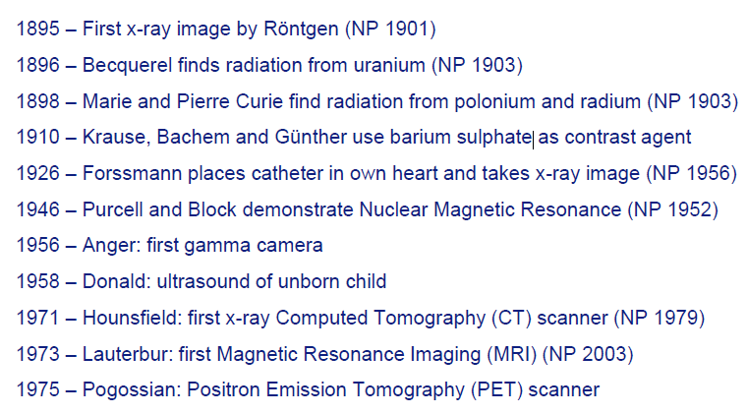
Key developments in medical imaging
Notes:
Started with discovery of X-rays, but have seen many modalities developed since. The importance of medical imaging is underlined by the numerous Nobel prizes awarded for key advancements.

Slide 6
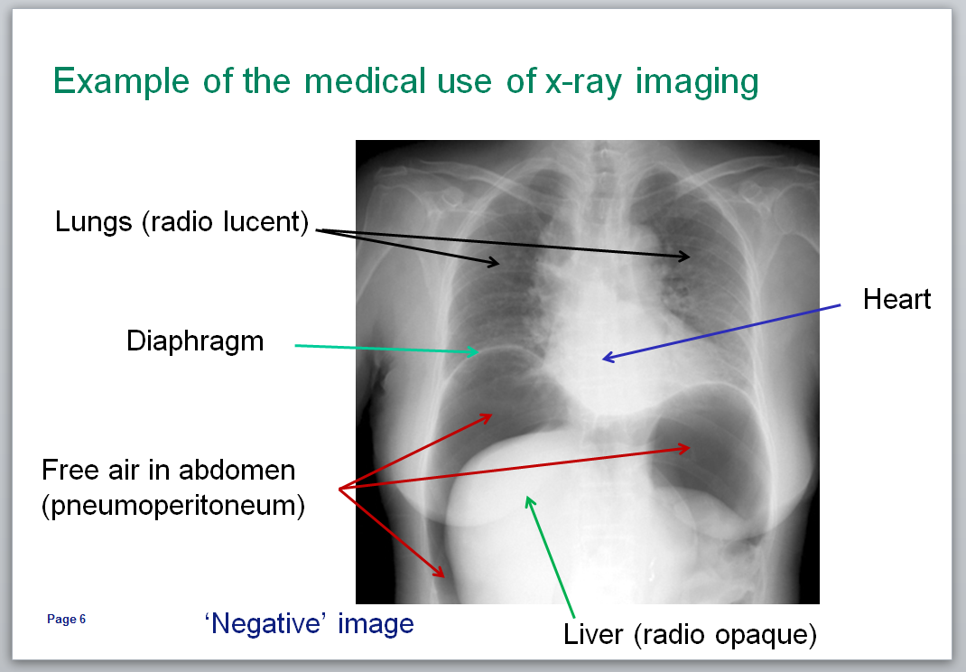
Aims:
insight into the state of the art of medical imaging technology
to introduce the physical principles behind:
interaction of radiation with biological tissue
generation & detection of radiation
signal and image processing
radiation used for therapy
Don’t worry, you will not be expected to learn biological/medical terms.
Notes:
Basic aim of the course is to introduce key physical principles underlining the main medical imaging and therapy techniques (given on next slides)

Slide 7
Course Structure: Weeks 1 - 6
Overall
18 lectures/seminars covering core examinable material
Assessed by a summer examination
50% contribution to course mark
Each week you will get
2 online lectures each consisting of ~4 recorded sections
Additional study material
1 in-person seminar
For the seminar, you will be assigned a topic from the additional study material to explain to other students in a group of 4 – more details in a bit…
Notes:
Describe course structure – make it clear that “course work” is done in groups

Slide 8
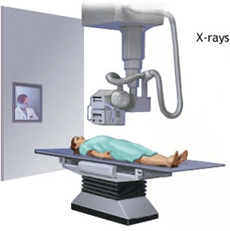
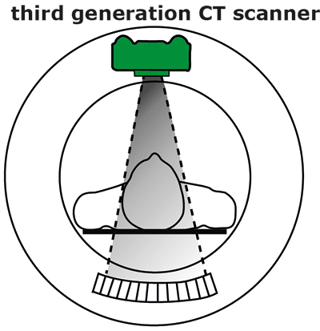
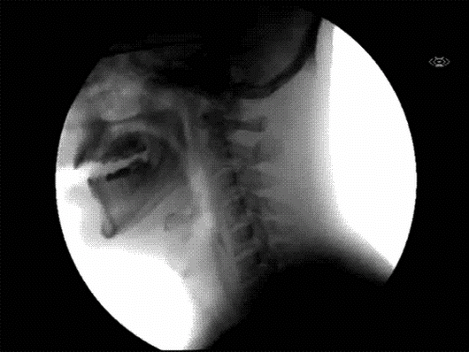
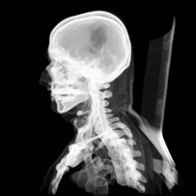
Lectures 1-3 and Seminars 2&3: X-ray imaging and tomography
X-ray
X-ray CT
Dr James McGinty
james.mcginty@imperial.ac.uk
Notes:
Topics covered

Slide 9
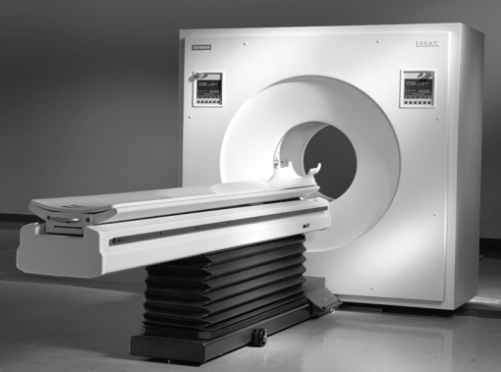
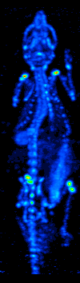
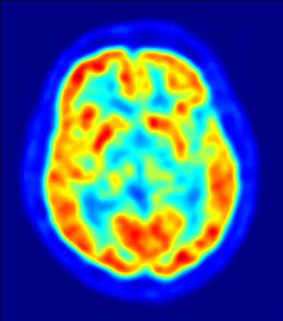
Lectures 4-5 and Seminar 4: Nuclear imaging
γ-cam/SPECT
PET
Prof Chris Dunsby
christopher.dunsby@imperial.ac.uk
Notes:
Topics covered

Slide 10
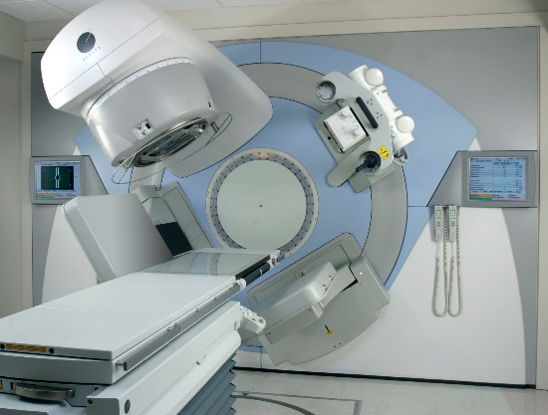
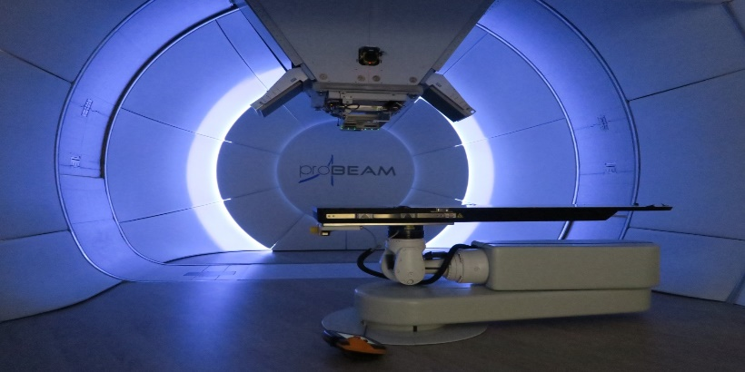
Lectures 6-7 and Seminar 5: Radiotherapy
X-ray/photon therapy
Proton-beam therapy
Prof Uwe Oelfke
uwe.oelfke@icr.ac.uk
Notes:
Topics covered

Slide 11
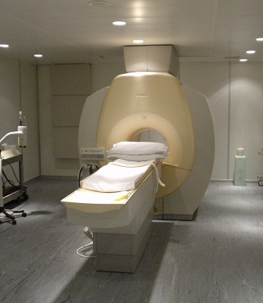
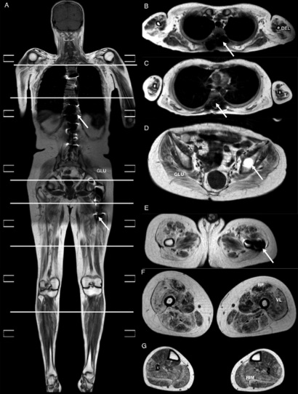
Lectures 8-10 and Seminar 6: MRI
MRI
Prof Ken Long
k.long@imperial.ac.uk
Notes:
Topics covered

Slide 12
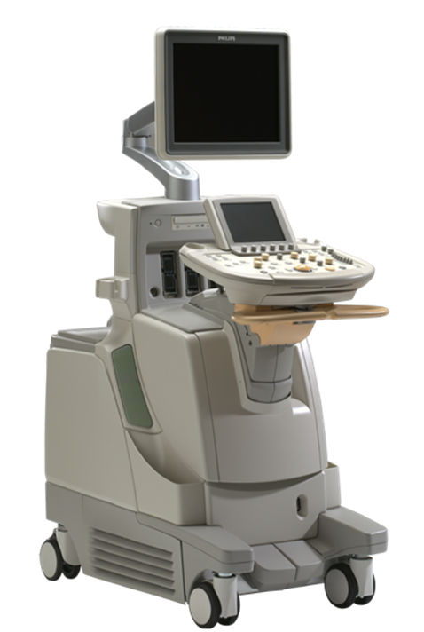
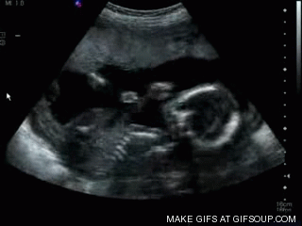
Lectures 11-12 and Seminar 7: Ultrasound Imaging
Ultrasound
Prof Chris Dunsby
christopher.dunsby@imperial.ac.uk
Notes:
Topics covered

Slide 13
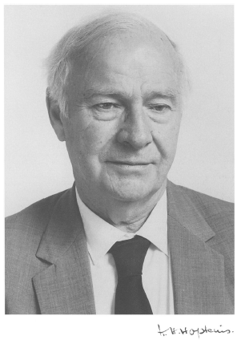
Format for seminars
Learning by teaching
Harold Hopkins “Only when you try to teach something do you discover whether you truly understand it.”
Richard Feynman – The Feynman Technique
Pretend to explain a concept to an inanimate object, e.g. a rubber duck
Identify gaps in your knowledge
Review notes and textbooks
Explain it to someone else
You will be assigned a specific topic to explain for each seminar
You will prepare a 10-minute explanation of the topic during the week
During the seminar, you will explain your topic to others in a group of 4

Slide 14
Explaining material to your group
You will all have seen the additional study material
The aim of the exercise is for you to improve your understanding of a topic by having to explain it to others
Aim is for your group to help you by providing constructive and positive questions
Prepare a short set of notes to help remind you of the key points that you want to make
You don’t need to prepare slides (unless you really want to) – pencil and paper works well
You choose what and how much of the assigned topic to cover, it’s up to you

Slide 15
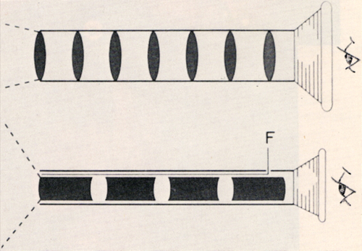
Aside: Rigid (Hopkins) endoscopes
high quality image
is the basis for most modern rigid endoscopes
large number of pixels
can offer a very large field of view, e.g. 80°…
…but can’t see round corners!
Hopkins’ rod lenses greatly simplifies alignment and manufacture (bottom)
http://www.karlstorz.com/cps/rde/xchg/SID-03A4C631-05538108/karlstorz-en/hs.xsl/2411.htm

Slide 16

Aside: Flexible fibre bundle endoscopes
image guided by fibre bundle
each core guides light by total internal reflection
up to 30,000 cores in a bundle
used routinely for flexible clinical endoscopy until the development of miniature CCD cameras

Slide 17
Course Structure: Weeks 7-8
Problem Sheet Question and Answer exercise
Worth 5% of the final mark
Topic will be linked to that of the Project, see following slides
Group members will be the same as for Project
Working in a group you will:
Week 7
Prepare a problem sheet-style question with answers on an assigned topic
The question and answers should take you 2-3 hours to prepare
Aim is that someone else in the class should take ~20 mins to complete it
Week 8
Individually assess the problem sheet-style question and answers prepared by 3 other groups
During seminar 7, your group will assign a single mark (out of 10) for each of the other 3 groups’ questions
This will then be combined with a mark (out of 10) from a member of academic staff to give the overall mark for the exercise (out of 20)
Notes:
Describe course structure – make it clear that “course work” is done in groups

Slide 18
Course Structure: Weeks 7-11
Group project on an advanced topic
In week 6 you will be asked to give your ranked preference for the projects on offer
We will tell you your group and assigned project topic early in week 7
Working with your group, you need to prepare a report and a presentation
You will get 2 meetings with your project supervisor in weeks 9 and 10
The report – deadline 5pm 25th March
30% of final mark
One 20-page report prepared by group working together
Marked by member of academic staff
Peer questionnaire – each member of group will be asked to rate the contribution of each other group member
Any member contributing more or less than 20% of the average will have their individual mark adjusted pro-rata
The presentation – 22nd March 1-3pm
15% of final mark
15-minute presentation by group working together
Each group to will provide a single mark (out of 10) for the presentation by each other group
This will then be combined with a mark from a member of academic of staff (out of 10) to give the overall mark for the presentation (out of 20)
Notes:
Describe course structure – make it clear that “course work” is done in groups

Slide 19
For Seminar 2 next week (21st January)
You need to finish watching all of the sections for Lectures 1 & 2
You need to read and digest the additional study material provided by James McGinty
You need to prepare to spend 5-10 minutes explaining your allocated topic (from the additional study material) to other members of your group
The topics are:
Characteristic radiation, bremsstrahlung and effect of anode material, tube voltage, tube current and filtering on x-ray spectrum
X-ray detectors
Rayleigh scattering, photoelectric absorption and k-edge, Compton scattering
Contrast agents, digital subtraction and dual-energy imaging

