Slide 1
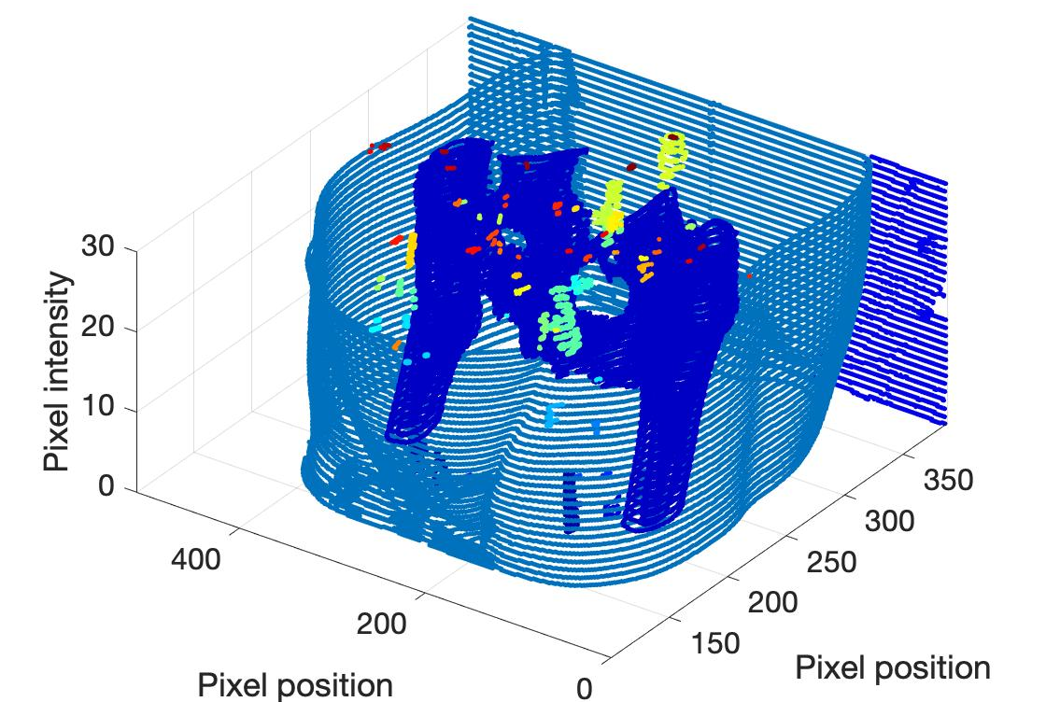
Automatic Features detection on 3D CT-Scans

Slide 2
Phantoms

Slide 3
Make use of intensity’s derivatives
Gradient norm

Slide 4
Make use of intensity’s derivatives
Horizontal Derivative
Vertical Derivative

Slide 5
Different algorithms
Otsu method
Canny edge detector
Find peaks combined with directional derivatives
Laplacian method
Others (statistical method)

Slide 6
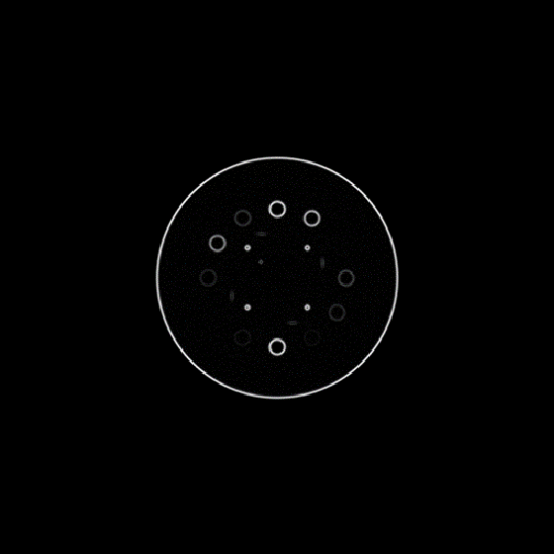
Canny edge detector and Otsu method
Two thresholds

Slide 7
Canny edge detector and Otsu method
Non maximum suppression

Slide 8
Canny edge detector and Otsu method
Hysteresis

Slide 9
What is the difference between Canny and Otsu?
Canny
Canny Algorithm uses arbitrary thresholds to classify pixels in three categories to then apply hysteresis.
Otsu uses a statistical (user independent) method to determine a single threshold.
This threshold is found by splitting pixels in two categories of intensity
The optimal division is the one that minimises the variance in each category
Otsu

Slide 10
Directional derivative
Find peaks
Find peaks

Slide 11
Directional derivative
Hysteresis

Slide 12
Border separation
 |  |  |  |  |  |  | X
 |  |  |  |  |  |  | X
 |  |  |  |  |  | X
 |  |  |  |  |  | X
 |  |  |  |  | X
 |  |  |  | X
 |  | X | X
X | X

Slide 13
Border separation
 |  |  |  |  |  |  | X
 |  |  |  |  |  |  | X
 |  |  |  |  |  | X
 |  |  |  |  |  | X
 |  |  |  |  | X
 |  | X | X
X | X

Slide 14
Border separation
 |  |  |  |  |  |  | X
 |  |  |  |  |  |  | X
 |  |  |  |  |  | X
 |  |  |  |  |  | X
 |  |  |  |  | X
 |  | X | X
X | X

Slide 15
Border separation
 |  |  |  |  |  |  | X
 |  |  |  |  |  |  | X
 |  |  |  |  |  | X
 |  |  |  |  |  | X
 |  | X
X | X

Slide 16
Border separation
 |  |  |  |  |  |  | X
 |  |  |  |  |  |  | X
 |  |  |  |  |  | X
X | X

Slide 17
Border separation
 |  |  |  |  |  |  | X
 |  |  |  |  |  |  | X
X

Slide 18
Border separation
 |  |  |  |  |  |  | X

Slide 19
Border separation

Slide 20
Border separation
Recursive algorithm
Rewrite the algorithm in an iterative
Final version in C++ to compensate the complexity

Slide 21
Application to real 2D images/Pelvis
Canny

Slide 22
Application to real 2D images/Pelvis
Otsu

Slide 23
Application to real 2D images/Head and Neck
Otsu

Slide 24
Application to real 3D images/Pelvis
Otsu

Slide 25
Application to real 3D images/Head and Neck
Otsu

Slide 26
Further work and Conclusion
Improvement on algorithms
Application of algorithms on small portion of the image to optimize parameters locally.
Remove high contrast features and re-apply Otsu multiple time.
Machine learning
Determine the parameters of the previous algorithm with machine learning.
Fully machine learning based method.
Require a big dataset and computing power.

