Slide 1
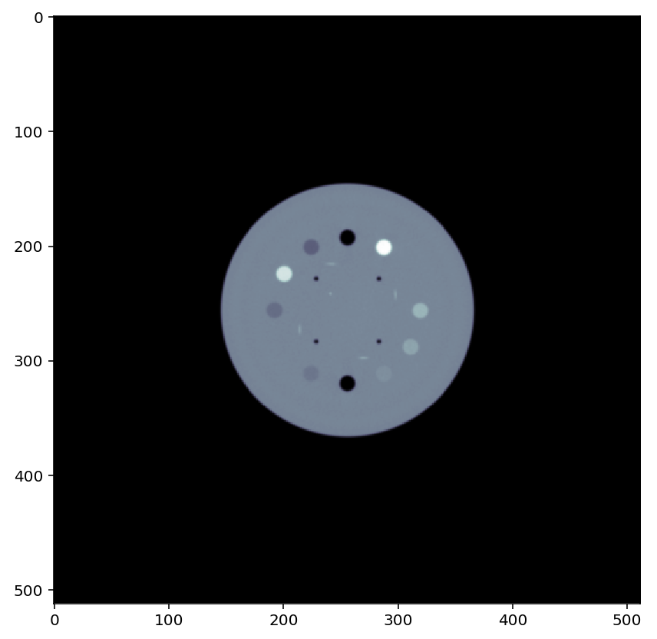
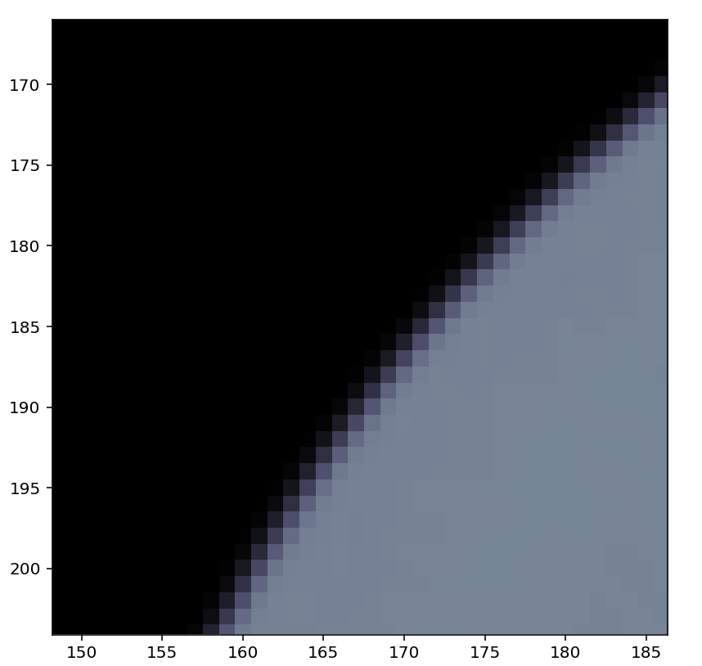
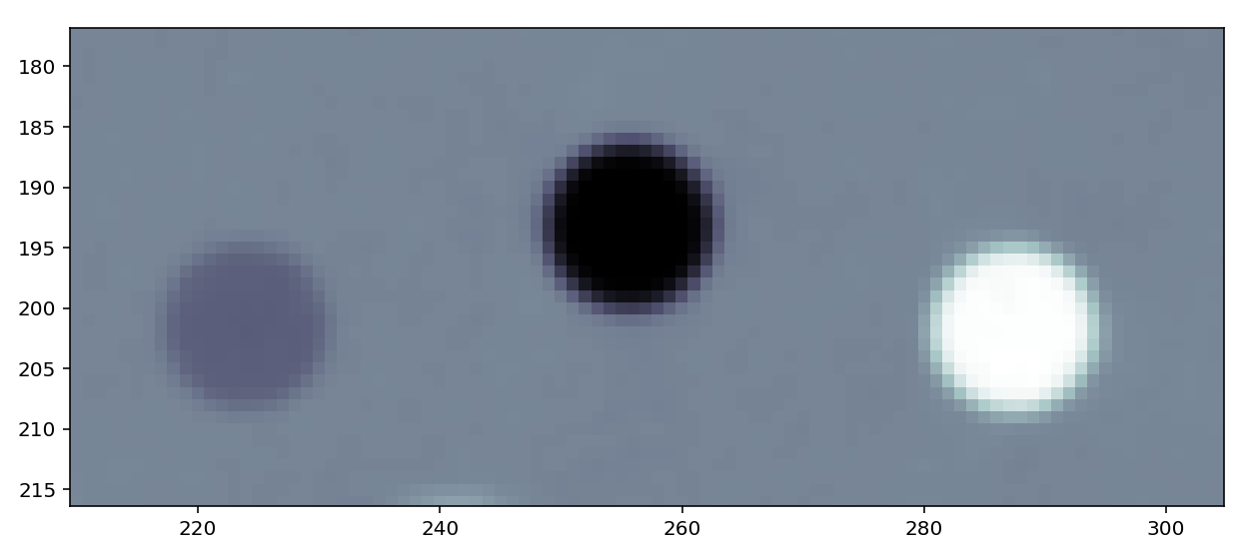
GAUSSIAN FILTER $σ=0.6$

Slide 2
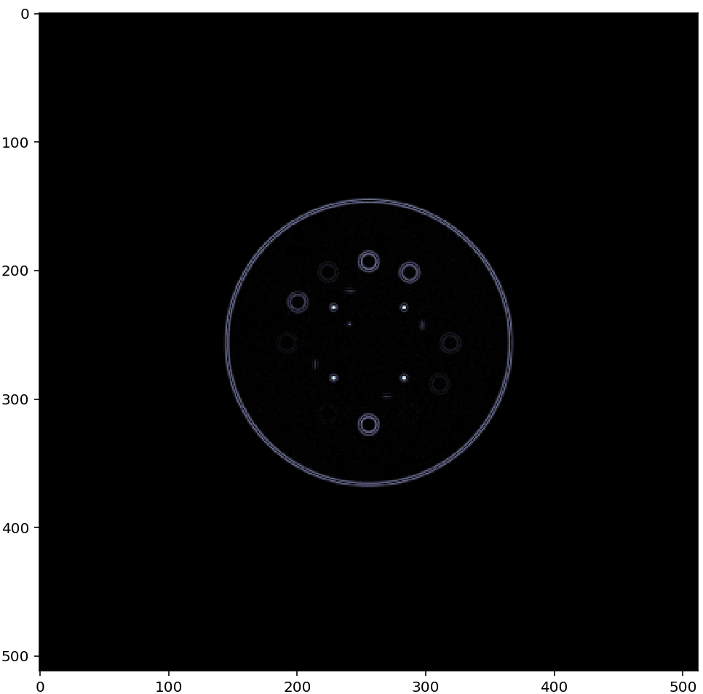
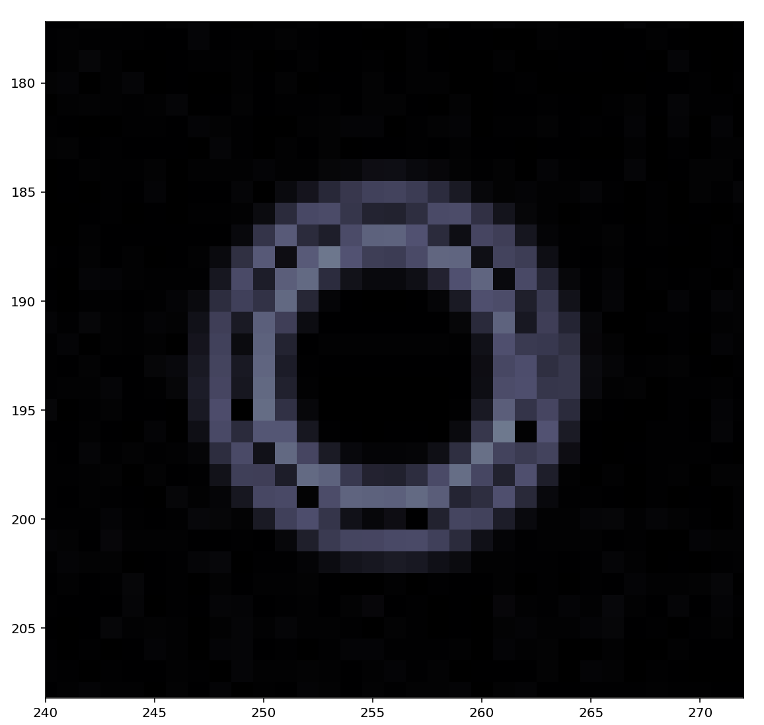
LAPLACIAN OPERATOR: FINITE DIFFERENCE METHOD

Slide 3
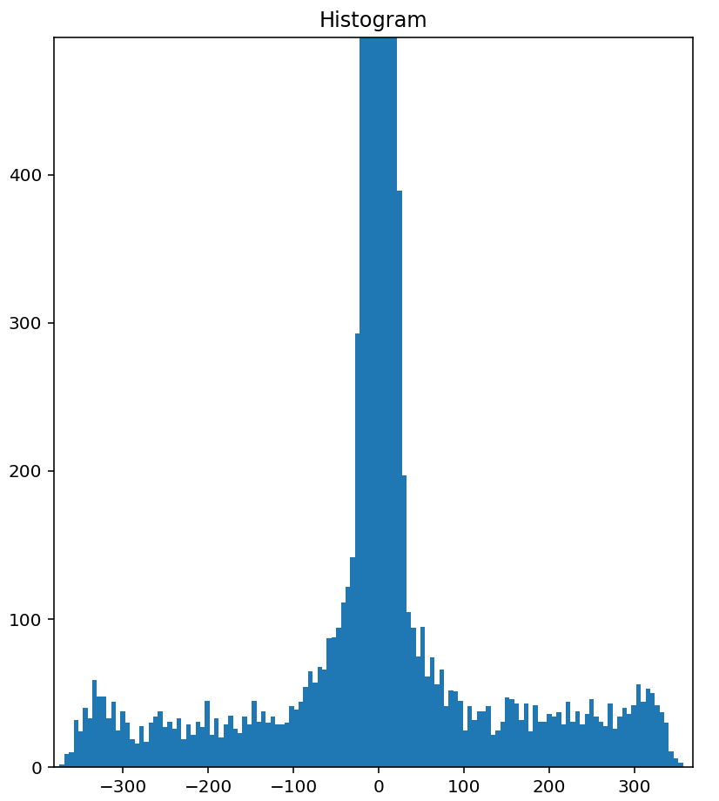
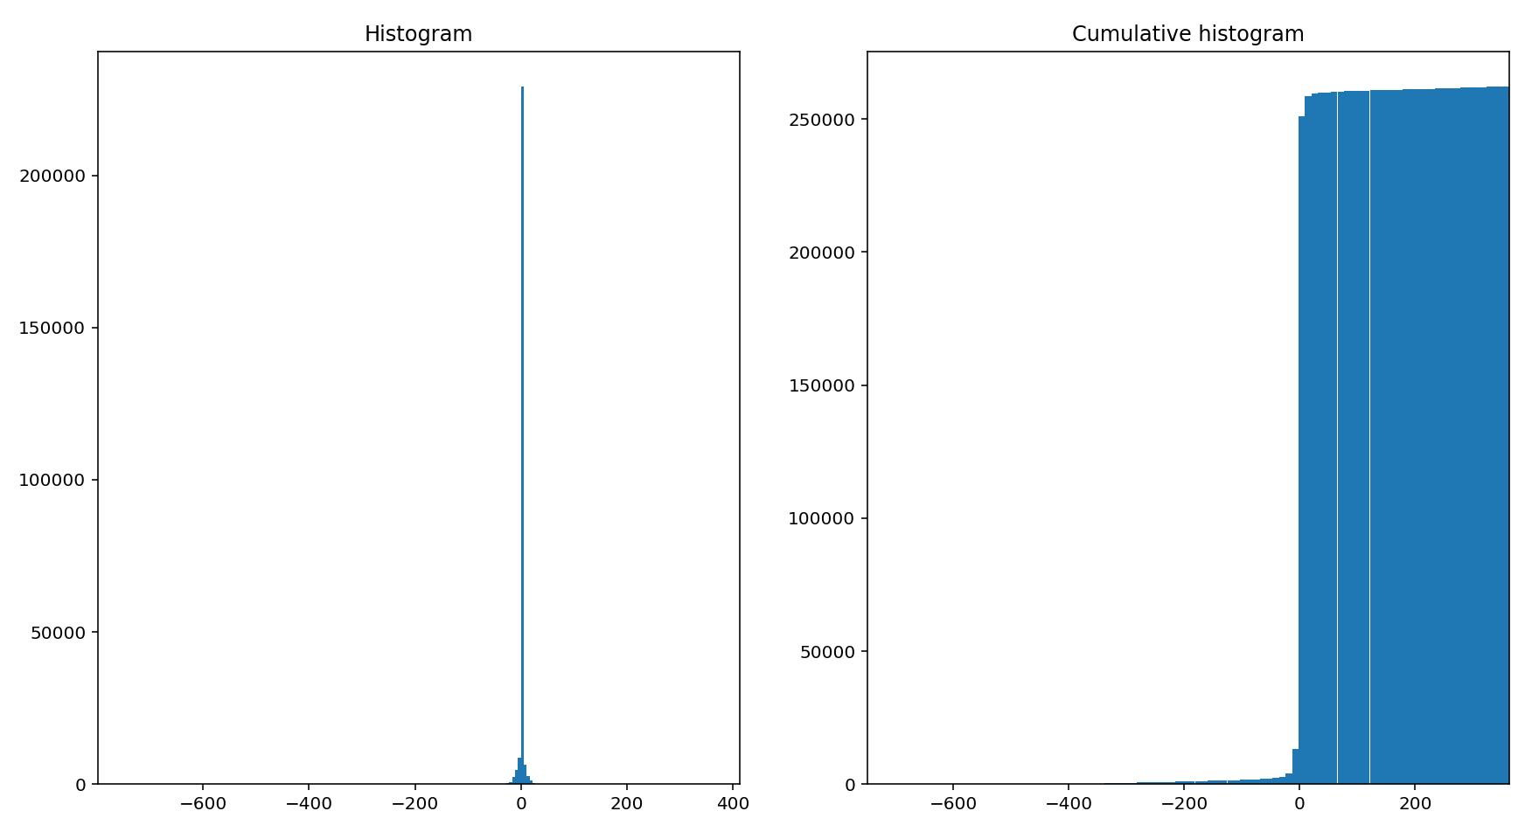
THRESOLDING BY HISTOGRAM
99% of pixels
Bins = 200
Thresold of intensity
Aim: display ca .99% of pixels
-> thanks to the cumulative histogram, it gives a thresold of intensity
-> display all pixels of intensity superior of the previous thresold

Slide 4
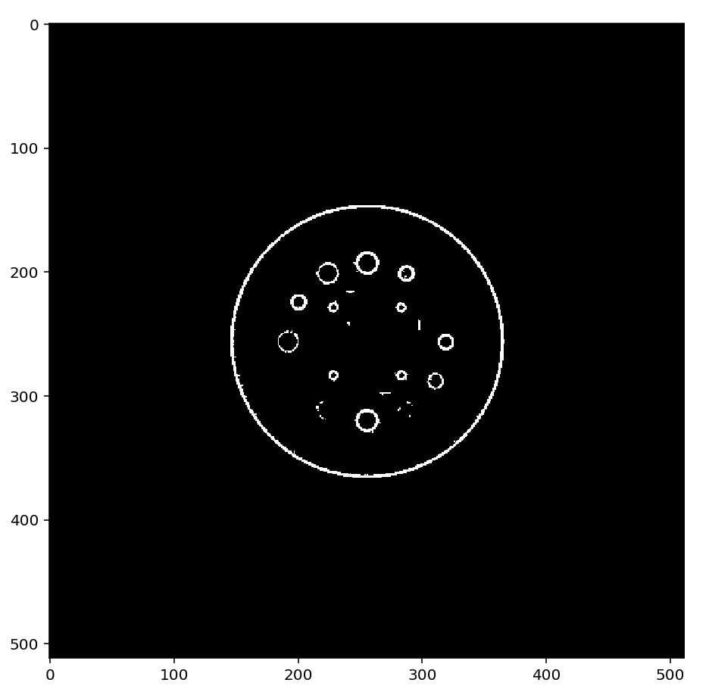
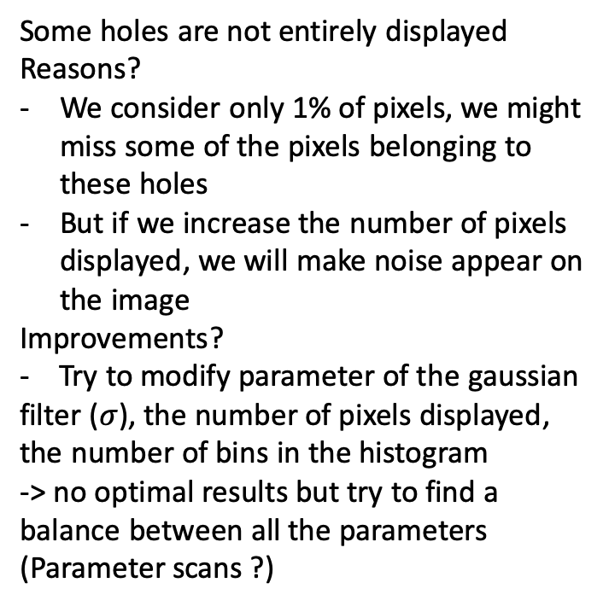
Some holes are not entirely displayed
Reasons?
We consider only 1% of pixels, we might miss some of the pixels belonging to these holes
But if we increase the number of pixels displayed, we will make noise appear on the image
Improvements?
- Try to modify parameter of the gaussian filter ($σ$), the number of pixels displayed, the number of bins in the histogram
-> no optimal results but try to find a balance between all the parameters (Parameter scans ?)

Slide 5
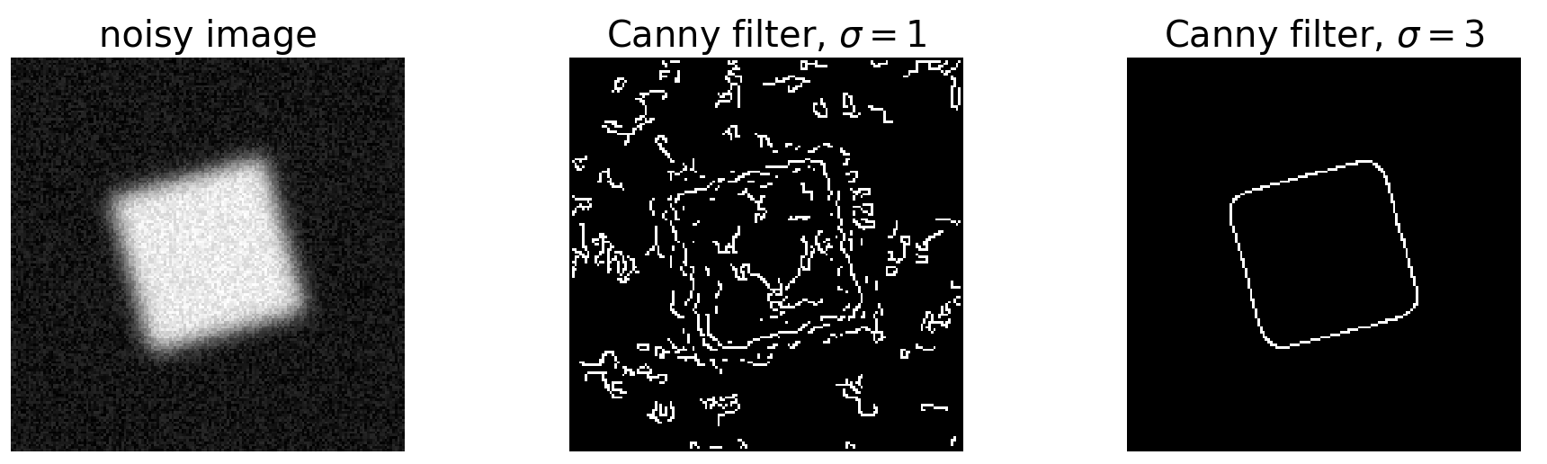
CANNY FILTER

Slide 6
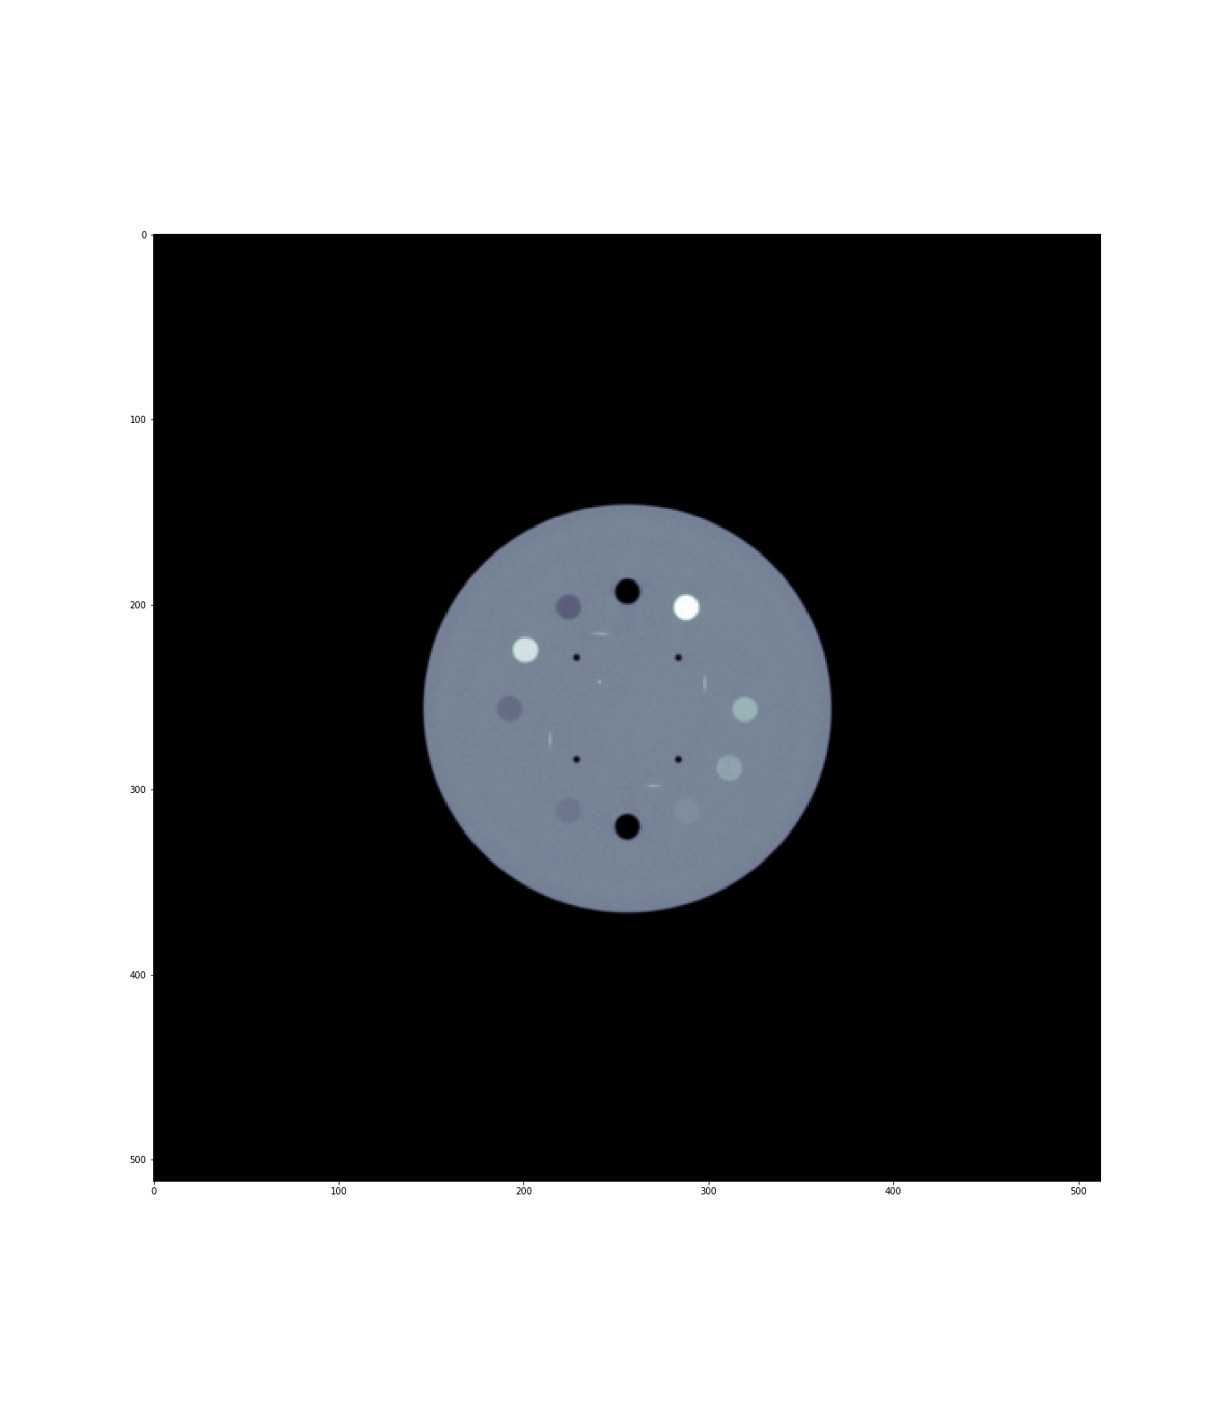
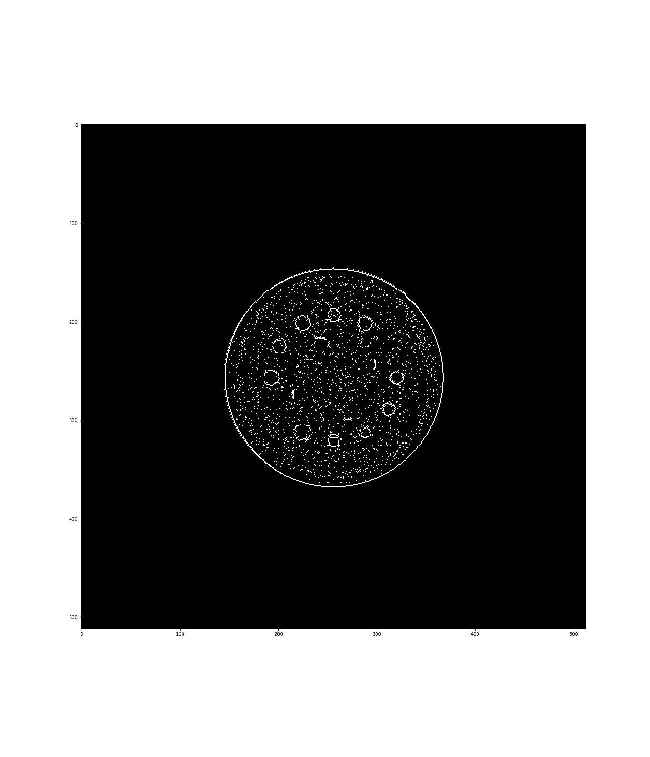
Subset method
Original image
Final result

Slide 7
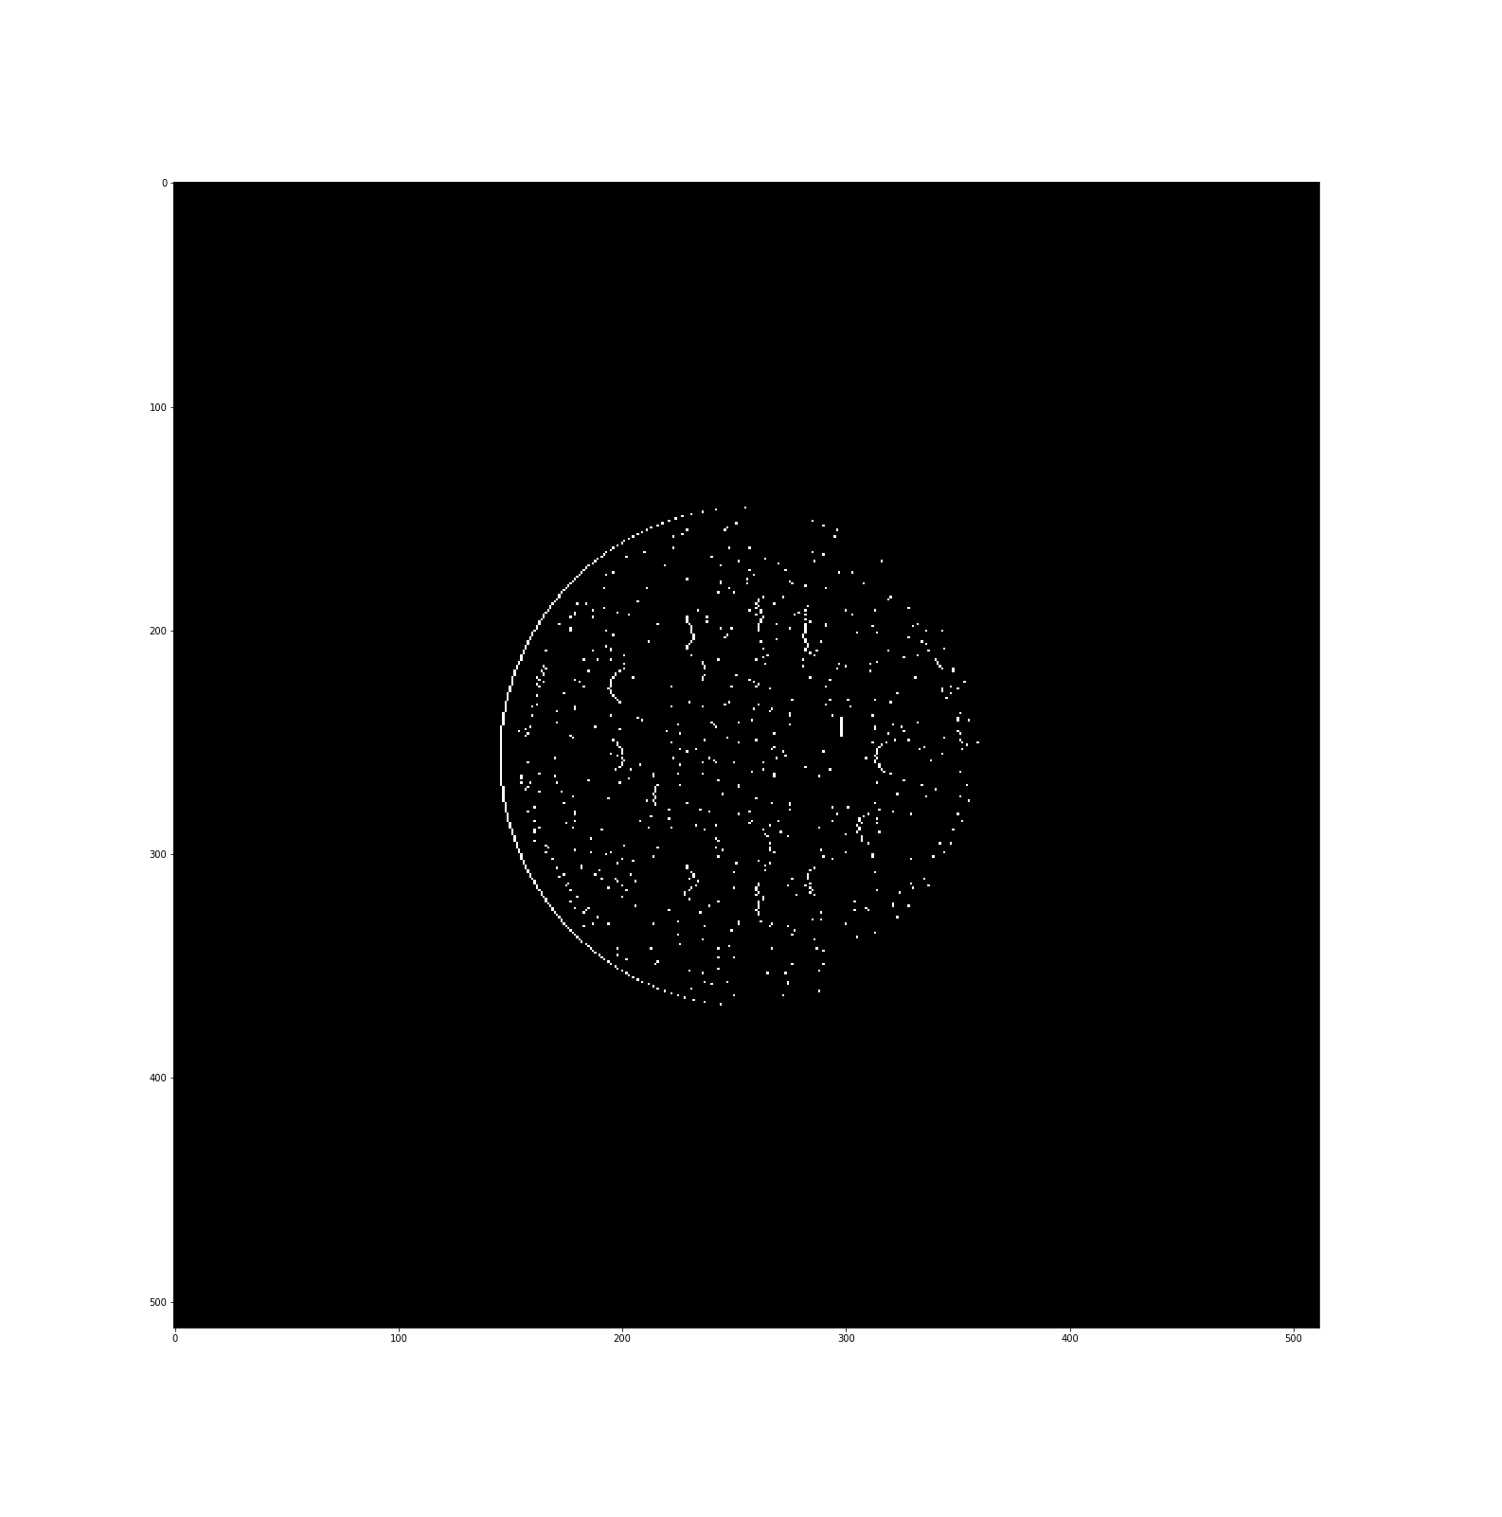
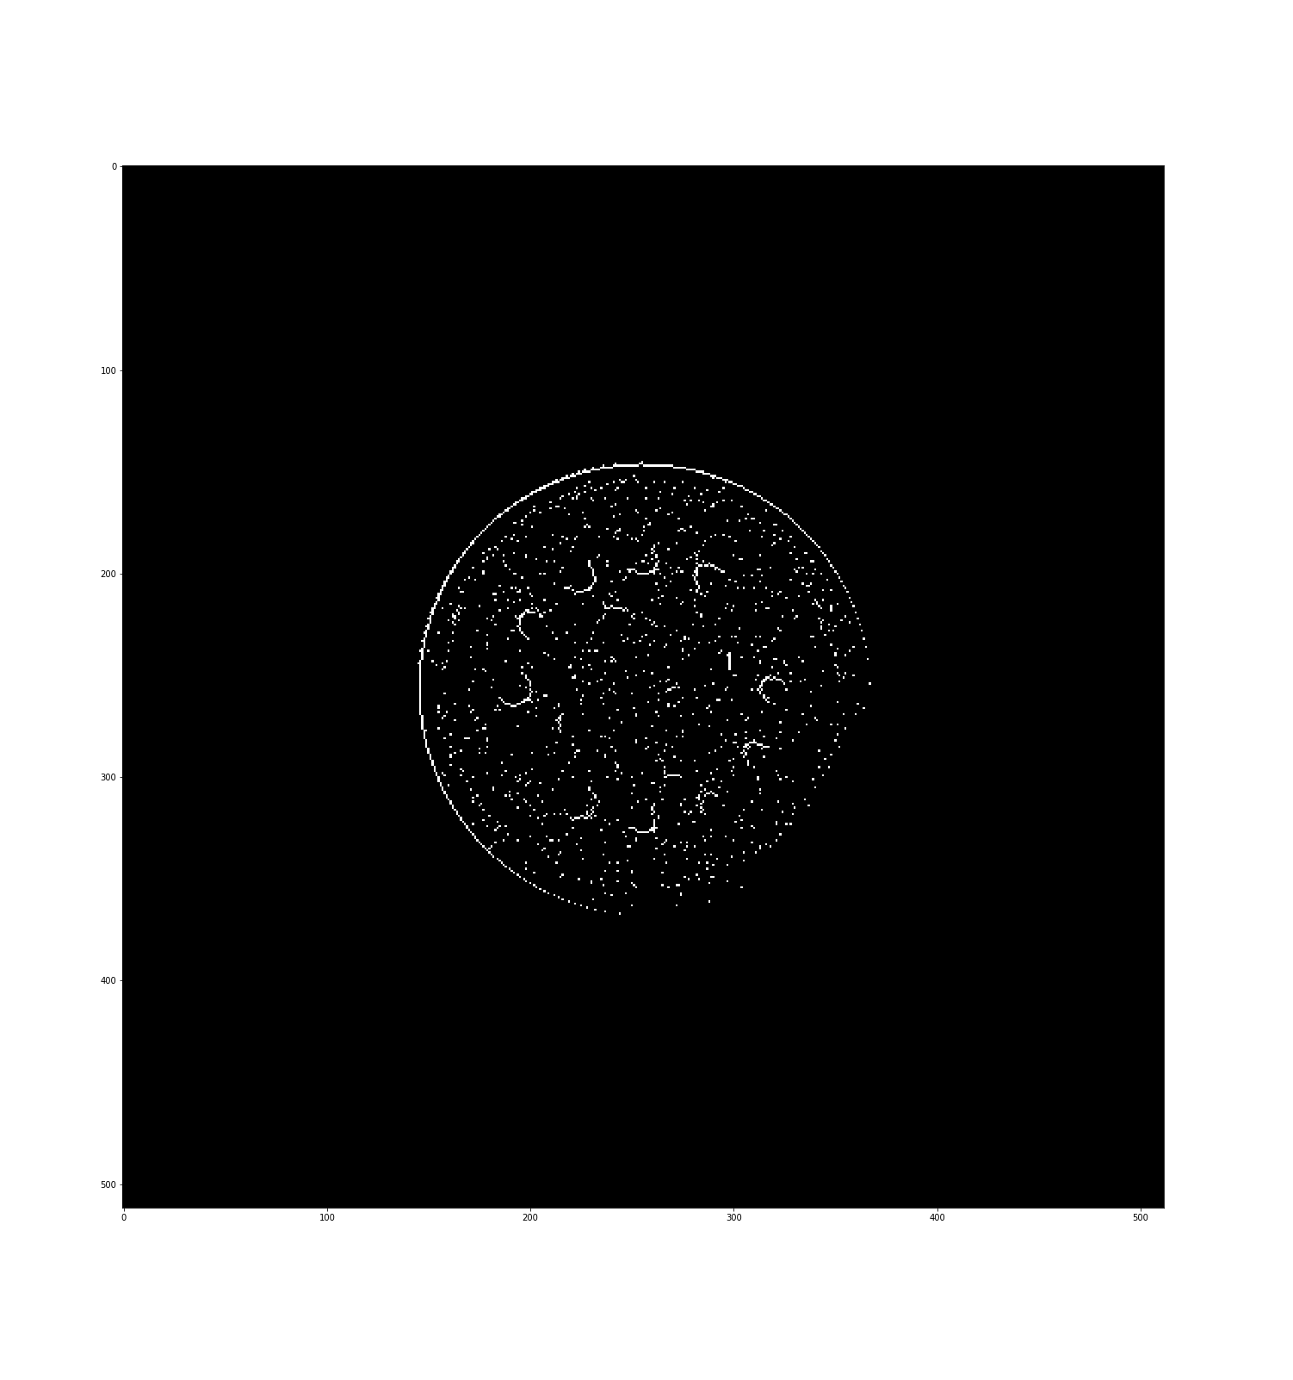
Subset method
Left → Right
Top → Bottom

Slide 8
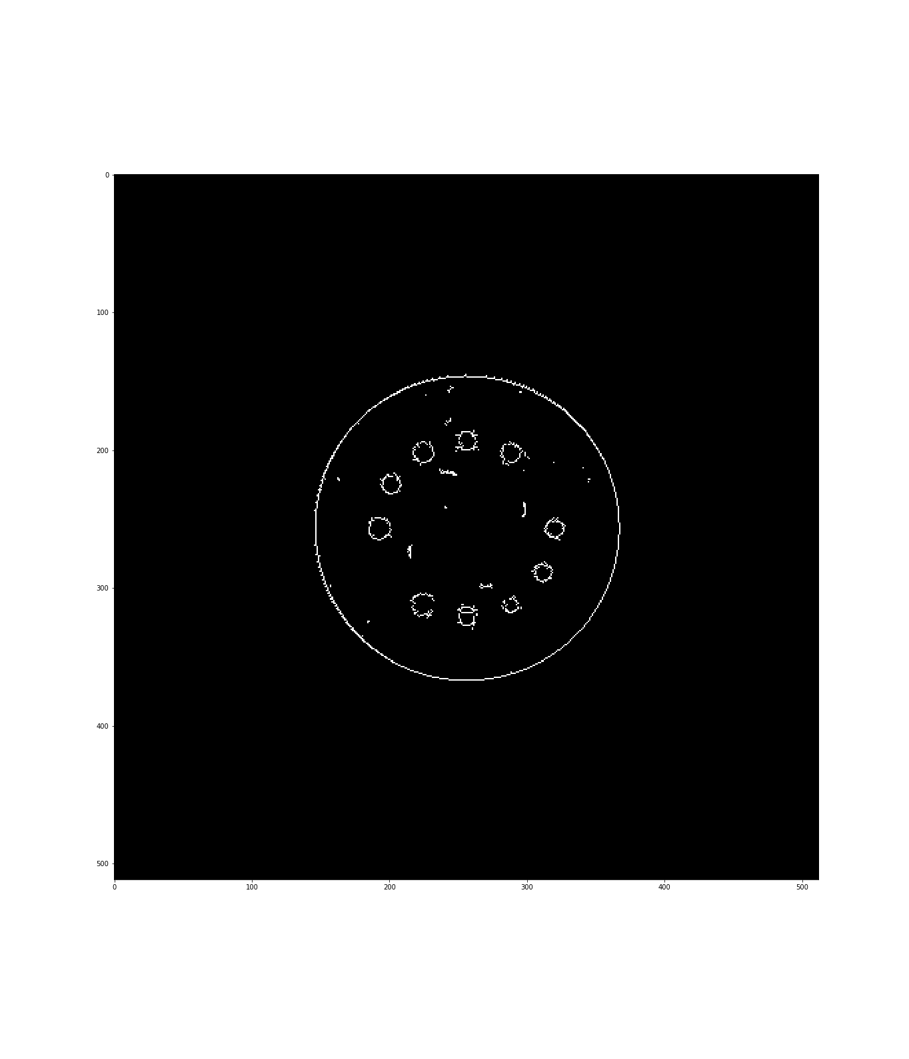
Subset method
Final Result
Noise Filter for isolated pixels

Slide 9
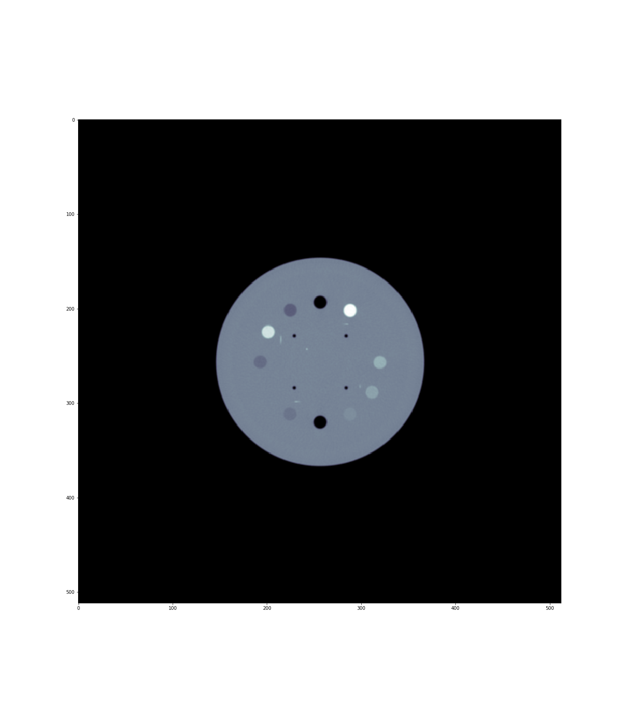
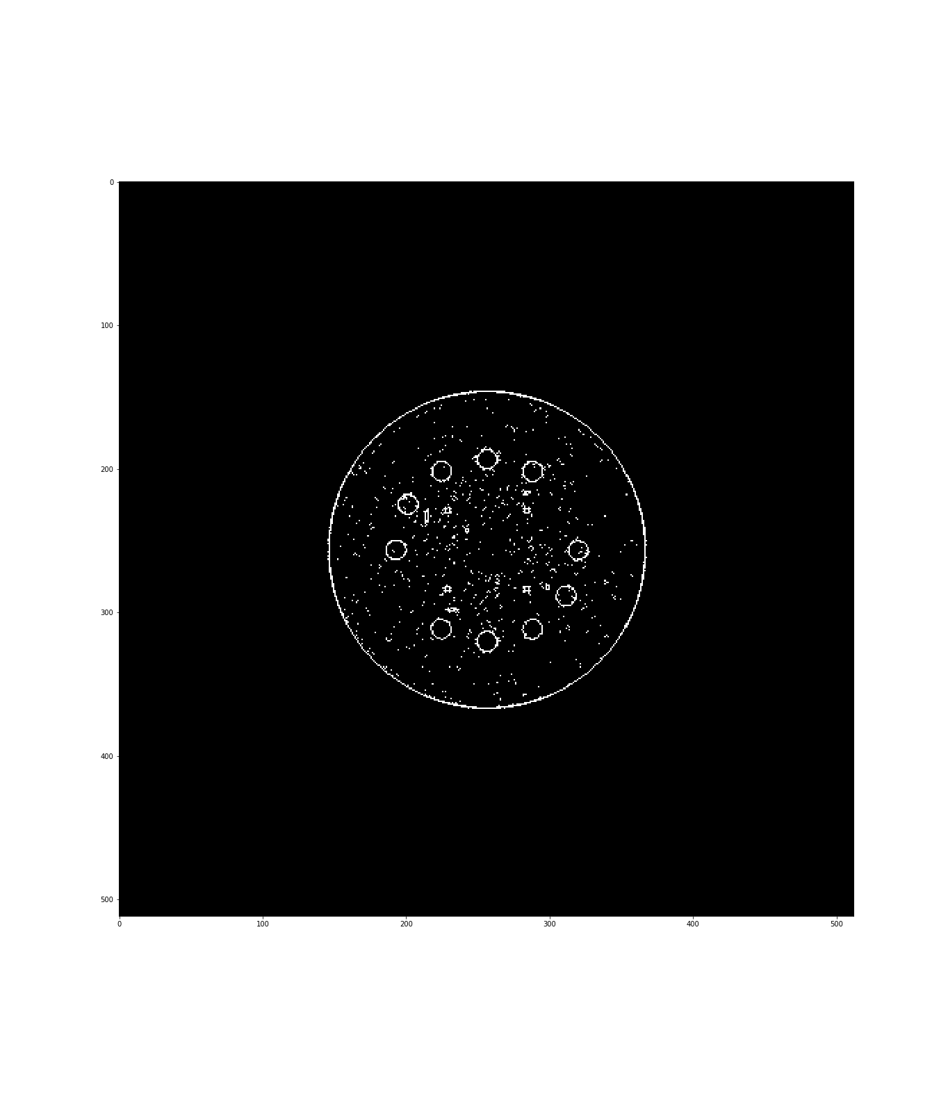
Derivative method
Original image
Final result

Slide 10

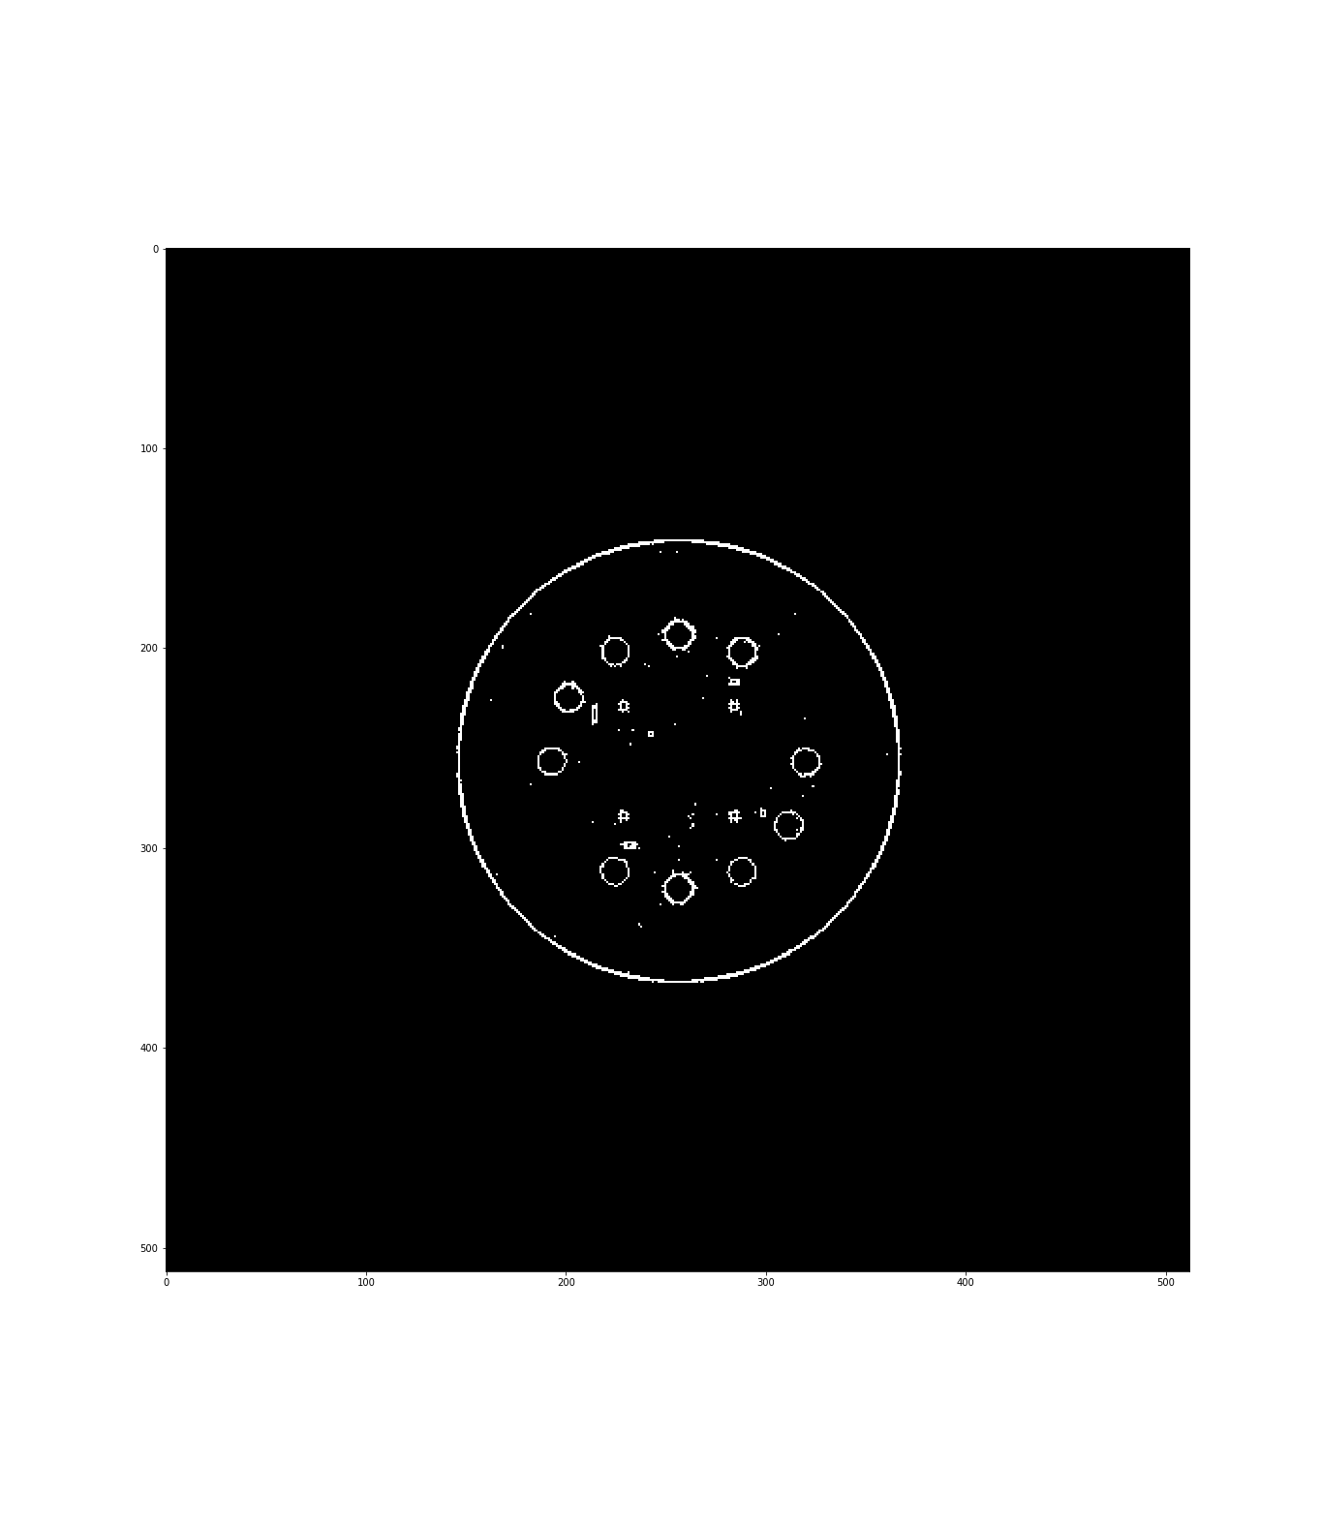
Derivative method
Gausian Filter
Final result

Slide 11
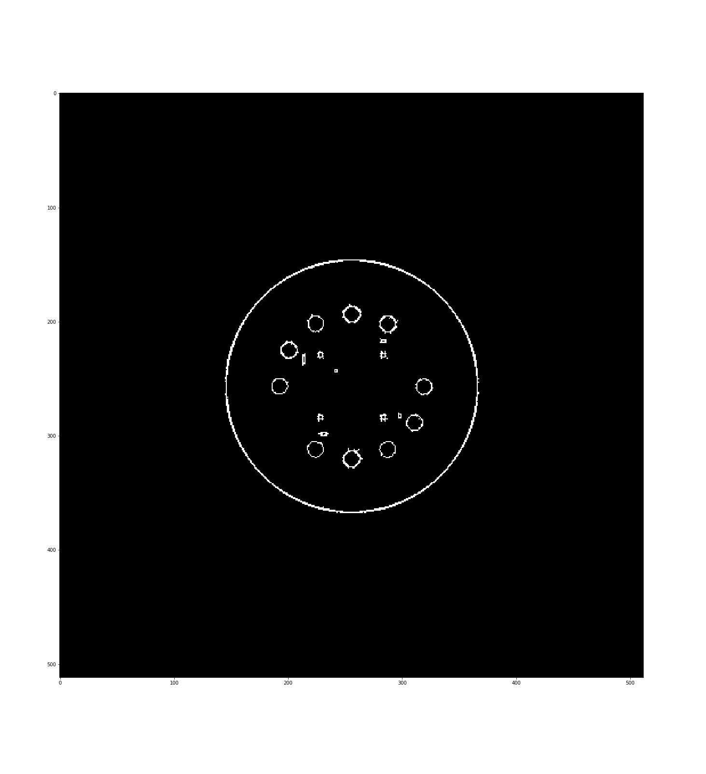
Derivative method
Final result with Gaussian Filter
Noise Filter for isolated pixels

Slide 12
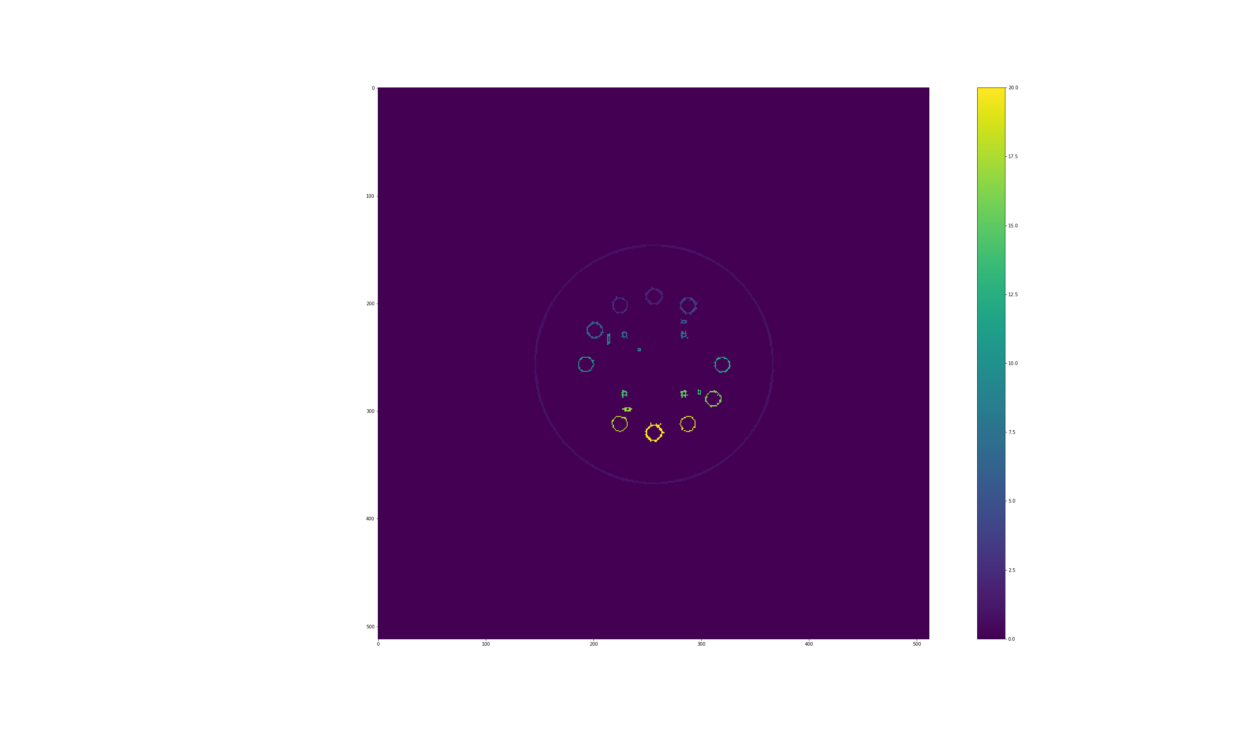
Derivative method
Seperated Border

