Slide 1
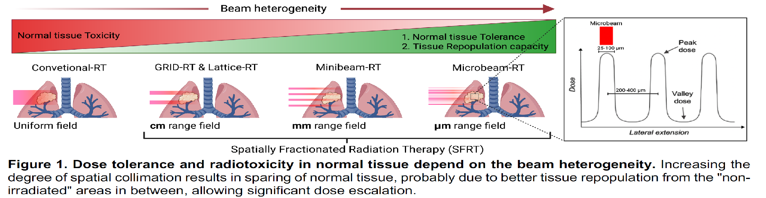
Biology of heterogeneous dose deposition
Robert J Griffin, PhD
Sabbatical Researcher, Institut Curie 2023-2024
Department of Radiation Oncology
University of Arkansas for Medical Sciences
Little Rock, AR USA
Courtesy of Fernandez Paloma and Djonov

Slide 2
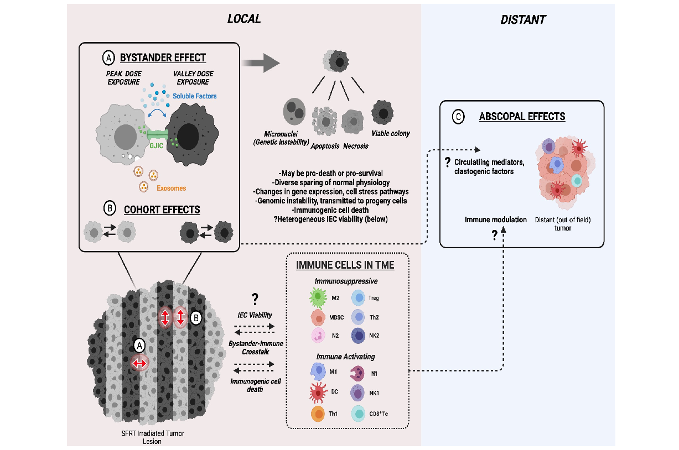
Biological effects and mechanisms of SFRT
Current model of local and distant non-targeted effects in spatially fractionated radiotherapy.

Slide 3
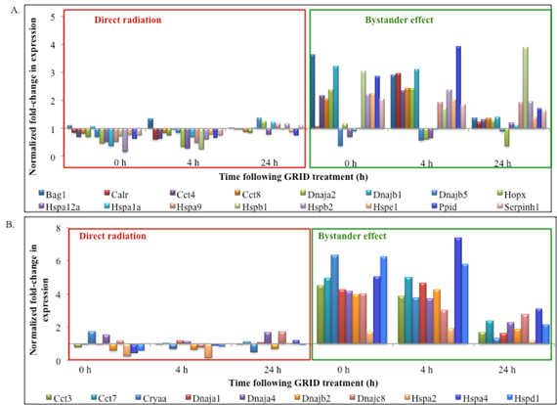
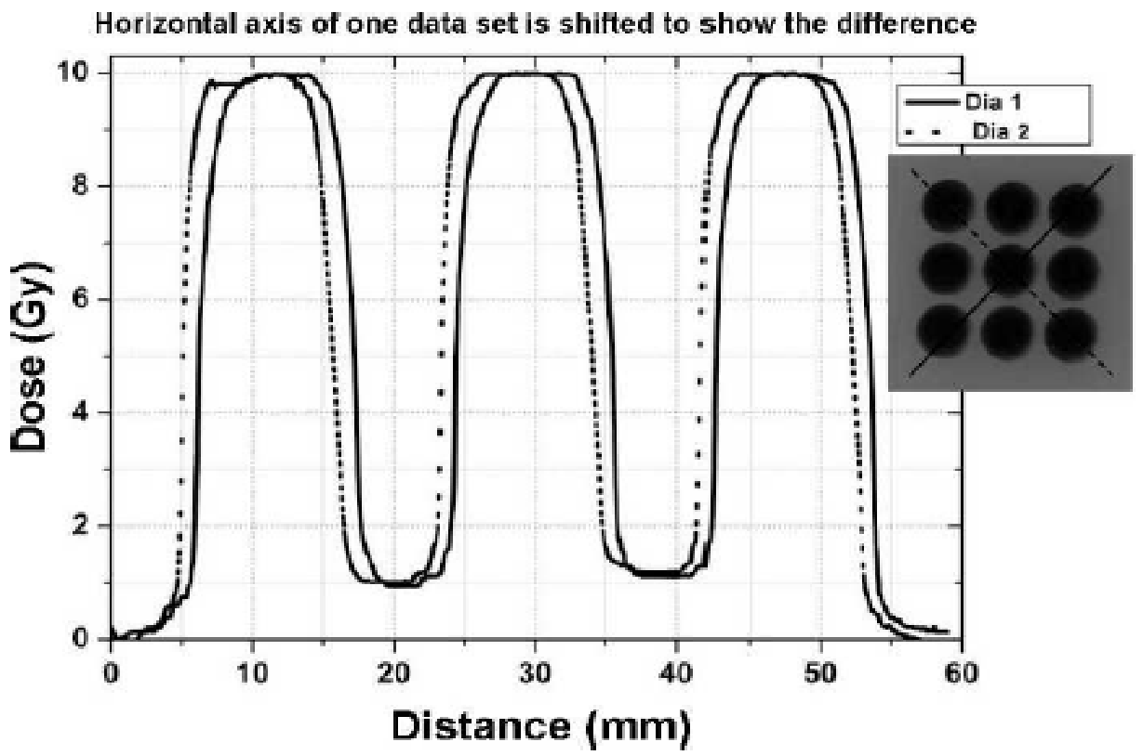
Radiation-induced bystander signaling easily detected in vitro.
**Bystander killing is muted in hypoxic bystander cells from single dish harvest.
Hypoxia also induces HIF1 which drives immune evasion by PDL1**
Asur, Koonce, Griffin et al, Rad Res, 2012

Slide 4
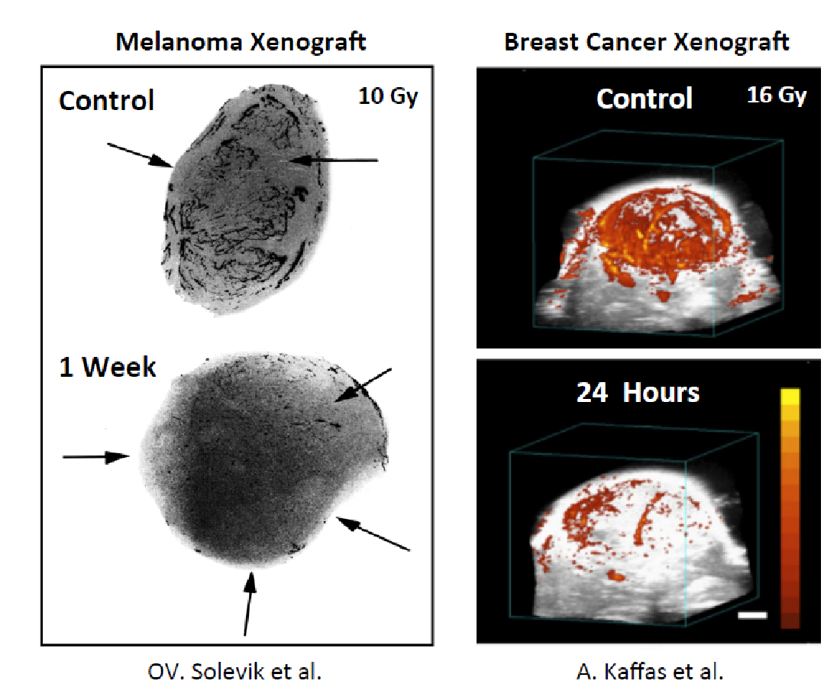
Tumour vascular damage by high single dose radiation: relevant to peak dose in SFRT

Slide 5
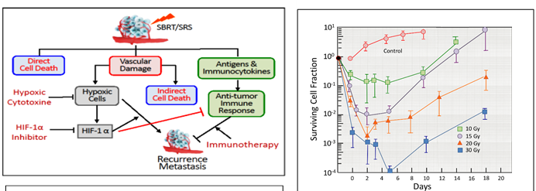
In tumor microenvironment, vascular damage in addition to direct cell kill after high radiation doses leads to multiple indirect biological effects
Preferential Tumor Vascular Damage Is the Common Antitumor Mechanism of High-Dose Hypofractionated Radiation Therapy: SABR, Spatially Fractionated Radiation Therapy, and FLASH Radiation Therapy
Chang W Song ¹, Stephanie Terezakis ², Woo-Yoon Park ³, Sun-Ha Paek ⁴, Mi-Sook Kim ⁵, L Chinsoo Cho ², Robert J Griffin ⁶

Slide 6
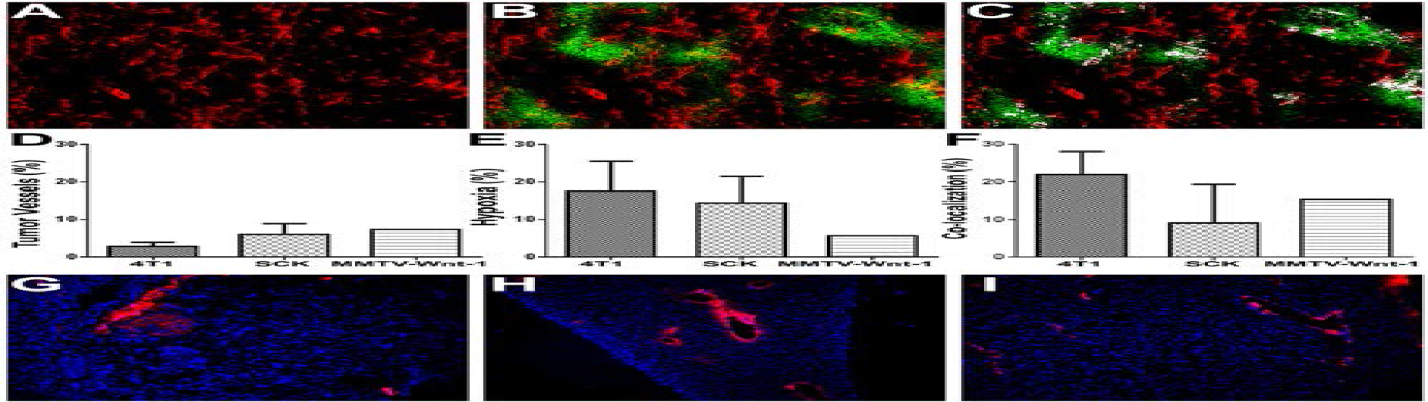
Existence of hypoxic blood vessels and endothelial cells in solid tumor models
4T1 mammary gland carcinoma tumor tissue
Overall tumor vessels; stained for marker CD31 (red).
Tumor hypoxia; Hypoxia marker anti-Pimonidazole
(green)
Hypoxic blood vessels; Tumor hypoxia (green) is co- localized (white) with microvasculature (red)
Koonce et al, PLoS ONE, 2015

Slide 7
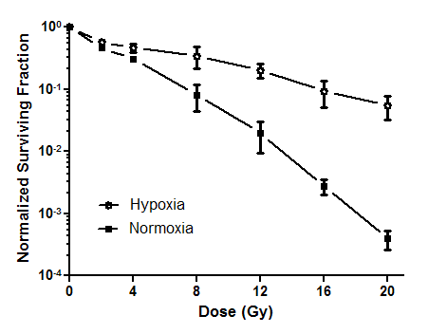
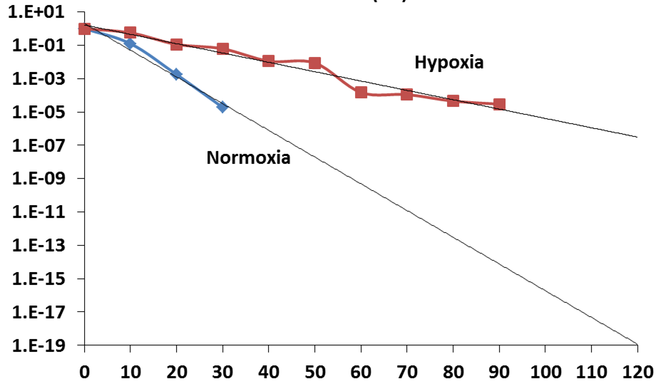
Hypoxia protects endothelial (and other) cells from
radiation-induced cell death
Clonogenic survival- 2H11 endothelial cells
~2 log difference at 20 Gy
Dose (Gy)
What is the dose threshold for hypoxic radioprotection?
How high can we go before hypoxic protection disappears?
Is this protection relevant for SFRT?
Koonce et al, PLoS ONE, 2015

Slide 8
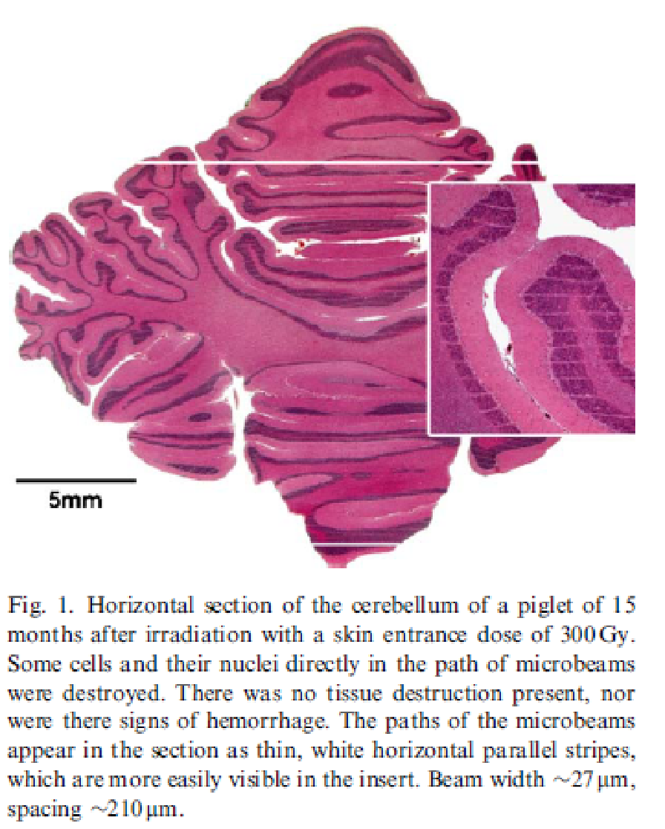
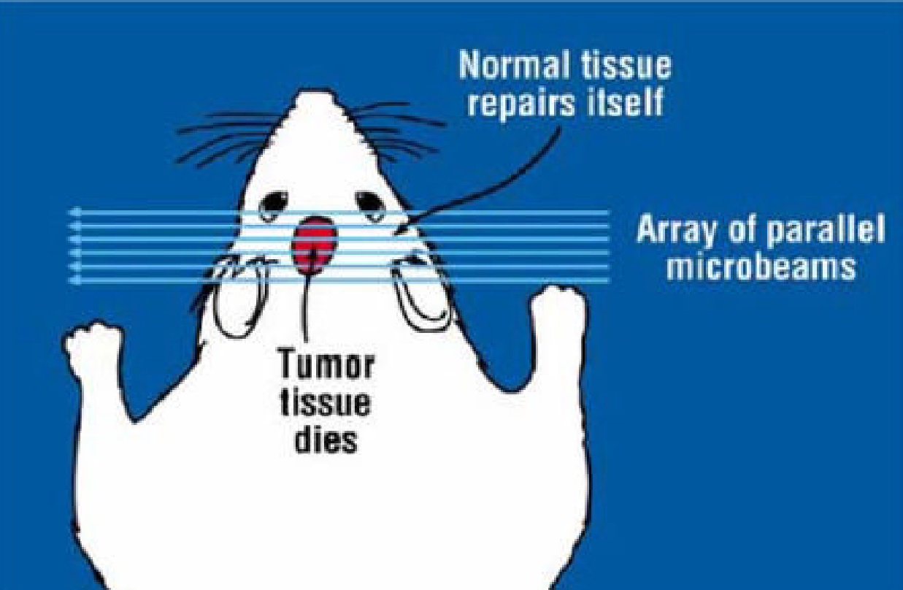
Microbeam spatial fractionation:
Negligible normal tissue response

Slide 9
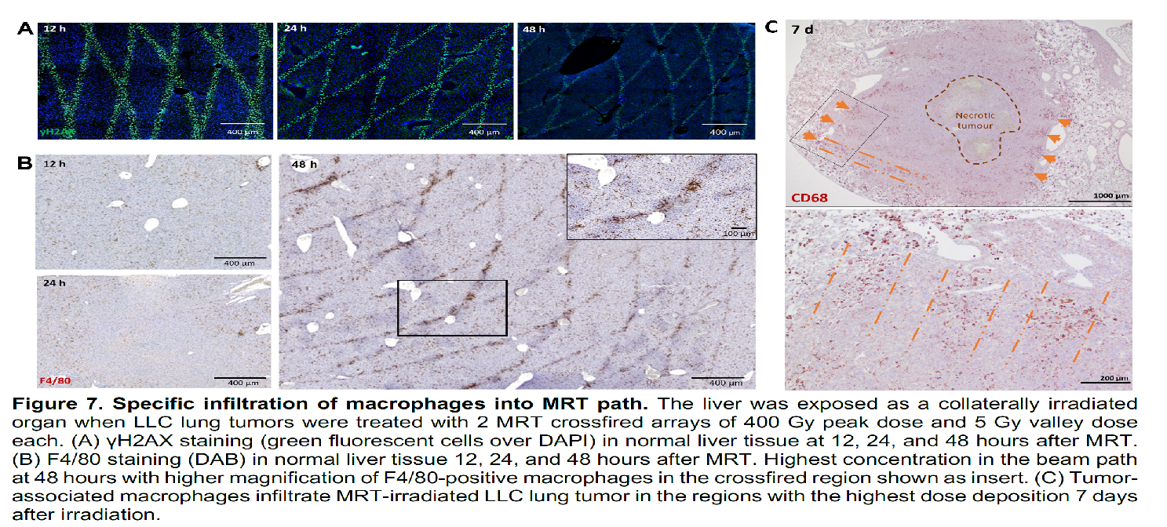
Macrophages target the paths high dose microbeam therapy in normal and tumor tissue
Trappetti V, Djonov V. et al. Biomedicines. 2022

Slide 10
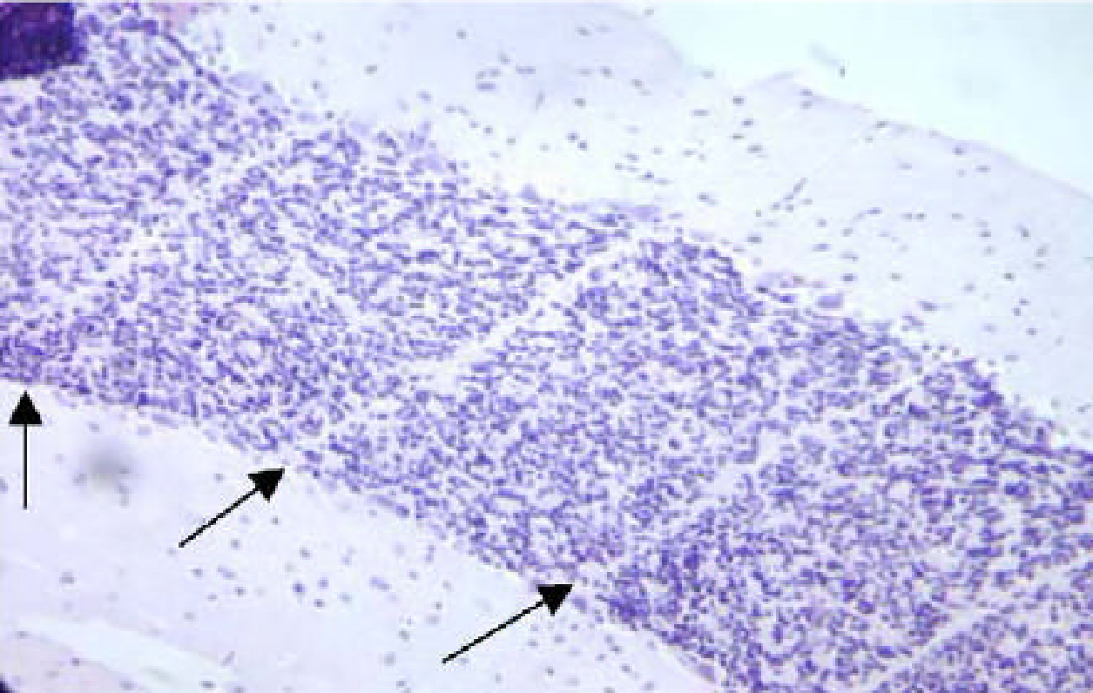
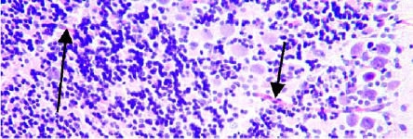
Normal tissue still retains ability to recover as demonstrated with microbeam SFRT Brauer-Krisch et al. ESRF
16 d after MRT; cerebellum
16 d after MRT; cerebellum, evidence of vascular bridging/repair

Slide 11
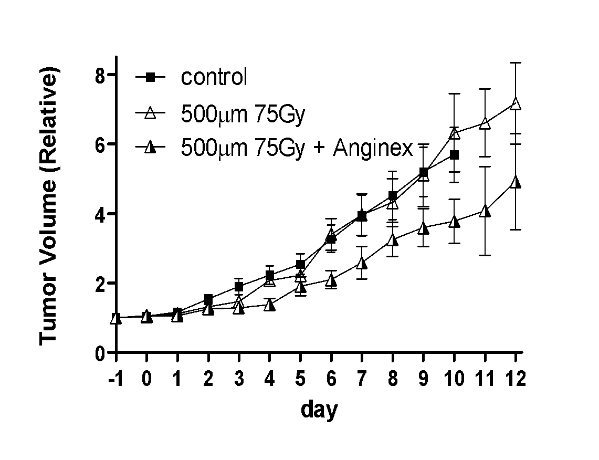
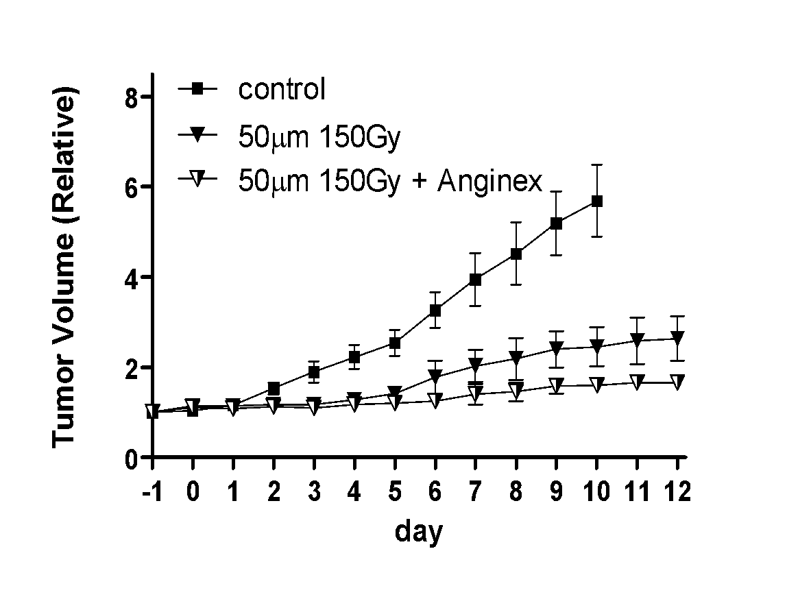


Tumor growth delay induced by microbeam doses of 75-150 Gy enhanced with anti-angiogenic peptide; valley dose ~7-9 Gy
500 μm beam 2000 μm ctc
50 μm beam 200 μm ctc
Griffin, Dings, Koonce, Corry, Moros et al. Radiation Res 2012
Notes:
Blocking the angiogenic response in the valley regions can also be effective in increasing tumor control after MRT of 4T1 murine breast tumors.

Slide 12
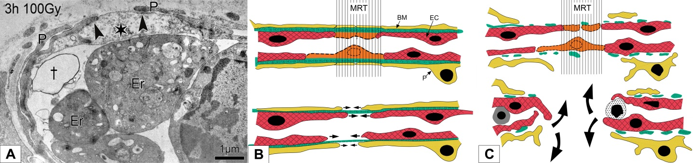
Spatially fractionated microbeam radiation: vascular-mediated mechanisms of action
Hypothesis: MRT effects are mediated by selective vascular disruption
MRT 🡪 vascular damage in the immature capillaries 🡪 insufficient supply 🡪 tissue injury
i.e. immature tumor microvasculature more sensitive than the surrounding normal tissue capillaries
Djonov V. et al.
CAM vessels
Normal tissue vessels
Tumor vessels

Slide 13
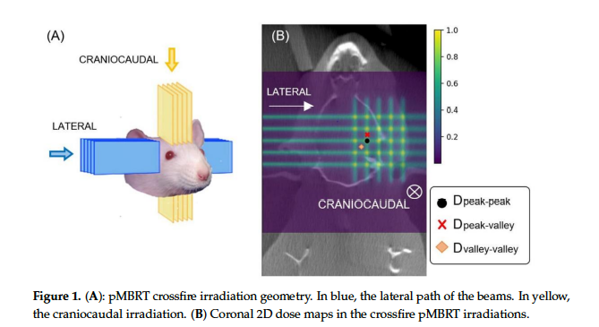
Minibeam allows even more dose to tumor with normal tissue sparing
Bertho A, Ortiz R, Juchaux M,, Prezado Y. et al. First Evaluation of Temporal and Spatial Fractionation in Proton Minibeam Radiation Therapy of Glioma-Bearing Rats. Cancers (Basel). 2021 Sep 28;13(19):4865. doi: 10.3390/cancers13194865. PMID: 34638352; PMCID: PMC8507607.

Slide 14
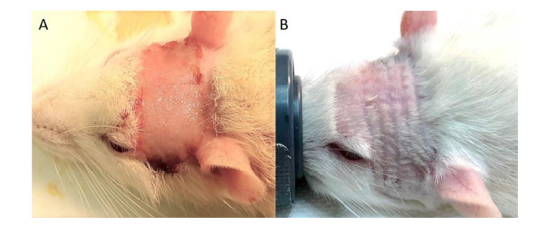
Bertho A, Ortiz R, Juchaux M,, Prezado Y. et al. First Evaluation of Temporal and Spatial Fractionation in Proton Minibeam Radiation Therapy of Glioma-Bearing Rats. Cancers (Basel). 2021 Sep 28;13(19):4865. doi: 10.3390/cancers13194865. PMID: 34638352; PMCID: PMC8507607.

Slide 15
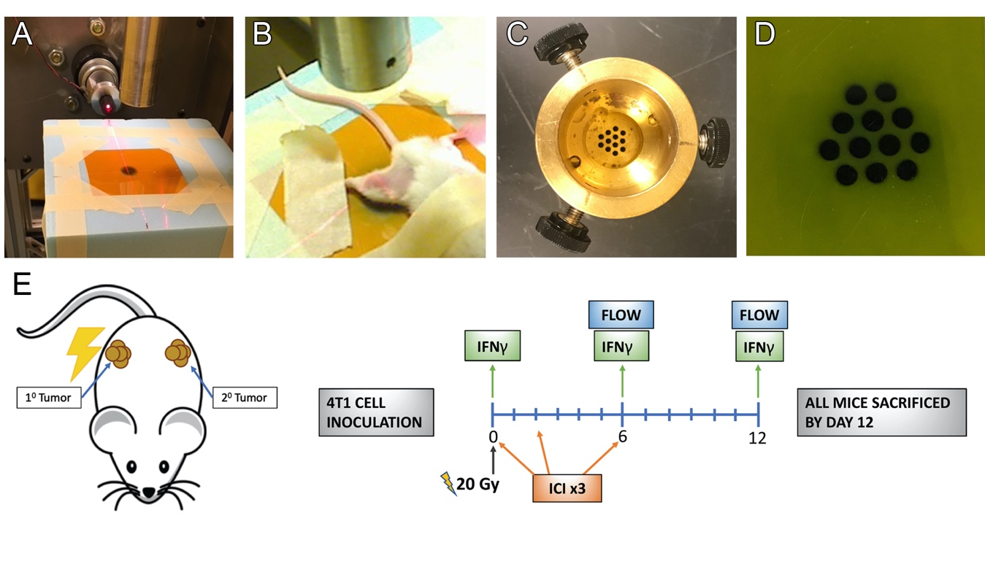
Combining GRID and immunotherapy: scaled at the mouse level
Johnsrud et at, Rad Research 2020

Slide 16
White blood cell trafficking after GRID vs whole tumor radiotherapy

Slide 17
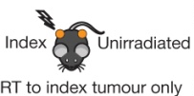
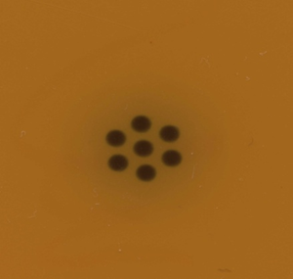
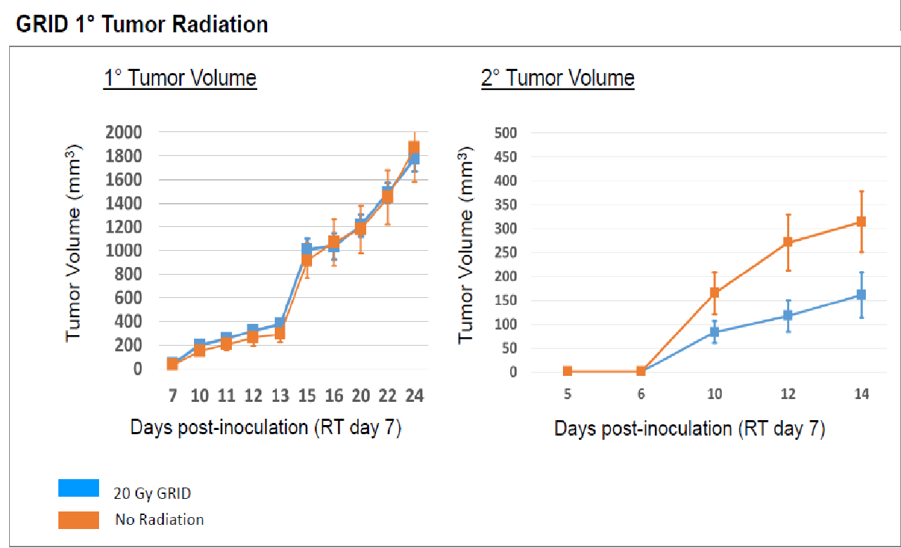

Slide 18
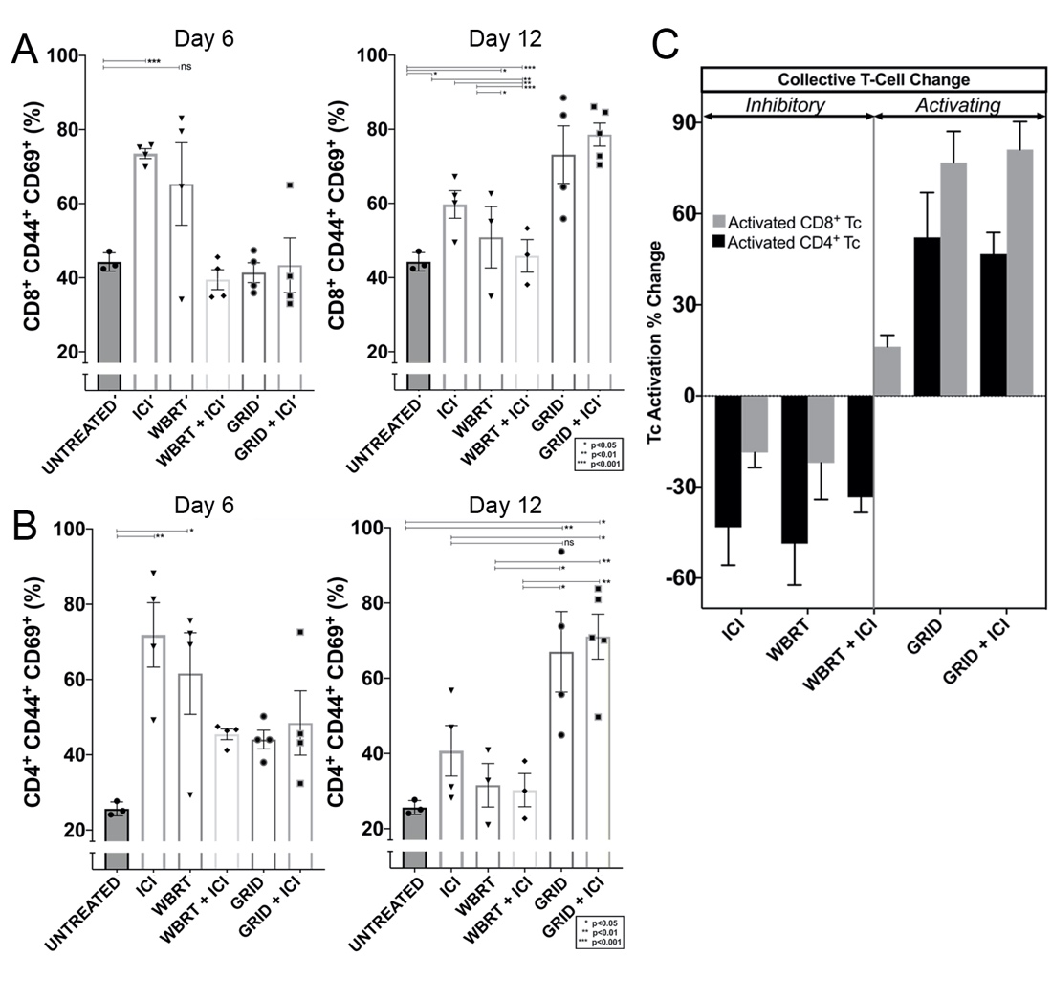
Immune activation in NON-irradiated tumor after local GRID 20 Gy and anti-PDL1/anti CTLA4 treatment
Comparison of GRID to whole tumor radiation (WBRT) in 4T1 tumors
(A) CD8+ T cell activation and (B) CD4+ T cell activation in non-irradiated tumor at day 6 and day 12. (C) Collective T cell activation changes in non-irradiated tumor from day 6 to day 12
Johnsrud, Griffin et al. Rad Research 2020
Notes:
(A) CD8+ T cell activation and (B) CD4+ T cell activation in non-irradiated tumor at day 6 and day 12. (C) Collective T cell activation changes in non-irradiated tumor from day 6 to day 12

Slide 19
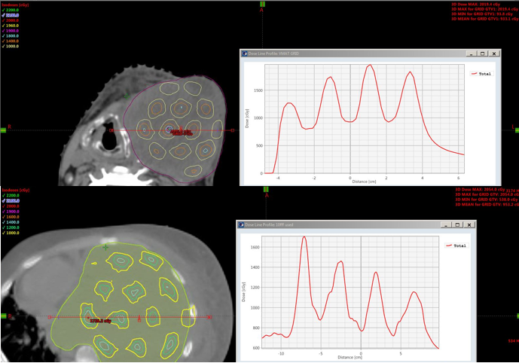
Feasibility study of 3D-VMAT based GRID therapy
Zhang X, Galhardo E, Griffin RJ, Penagaricano J. In press, TCRT 2022

Slide 20
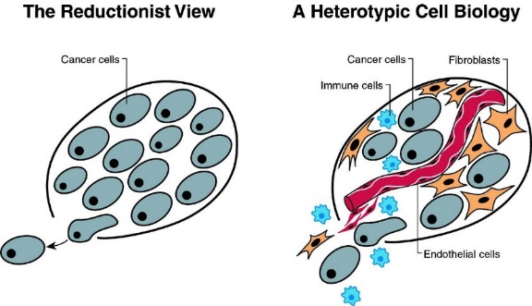
SUMMARY
Some thoughts:
Implications of dose constraints (peak/valley) in tumor & normal tissues important.
Evidence supports multiple biological mechanisms (bystander, vascular, immune).
A minimum peak dose of 10-20 Gy necessary to induce needed vascular/bystander damage in oxic and hypoxic volumes to stimulate immunity.
Valley dose important for primary tumor response.
Therefore, maximal control of dose deposition desirable.

Slide 21
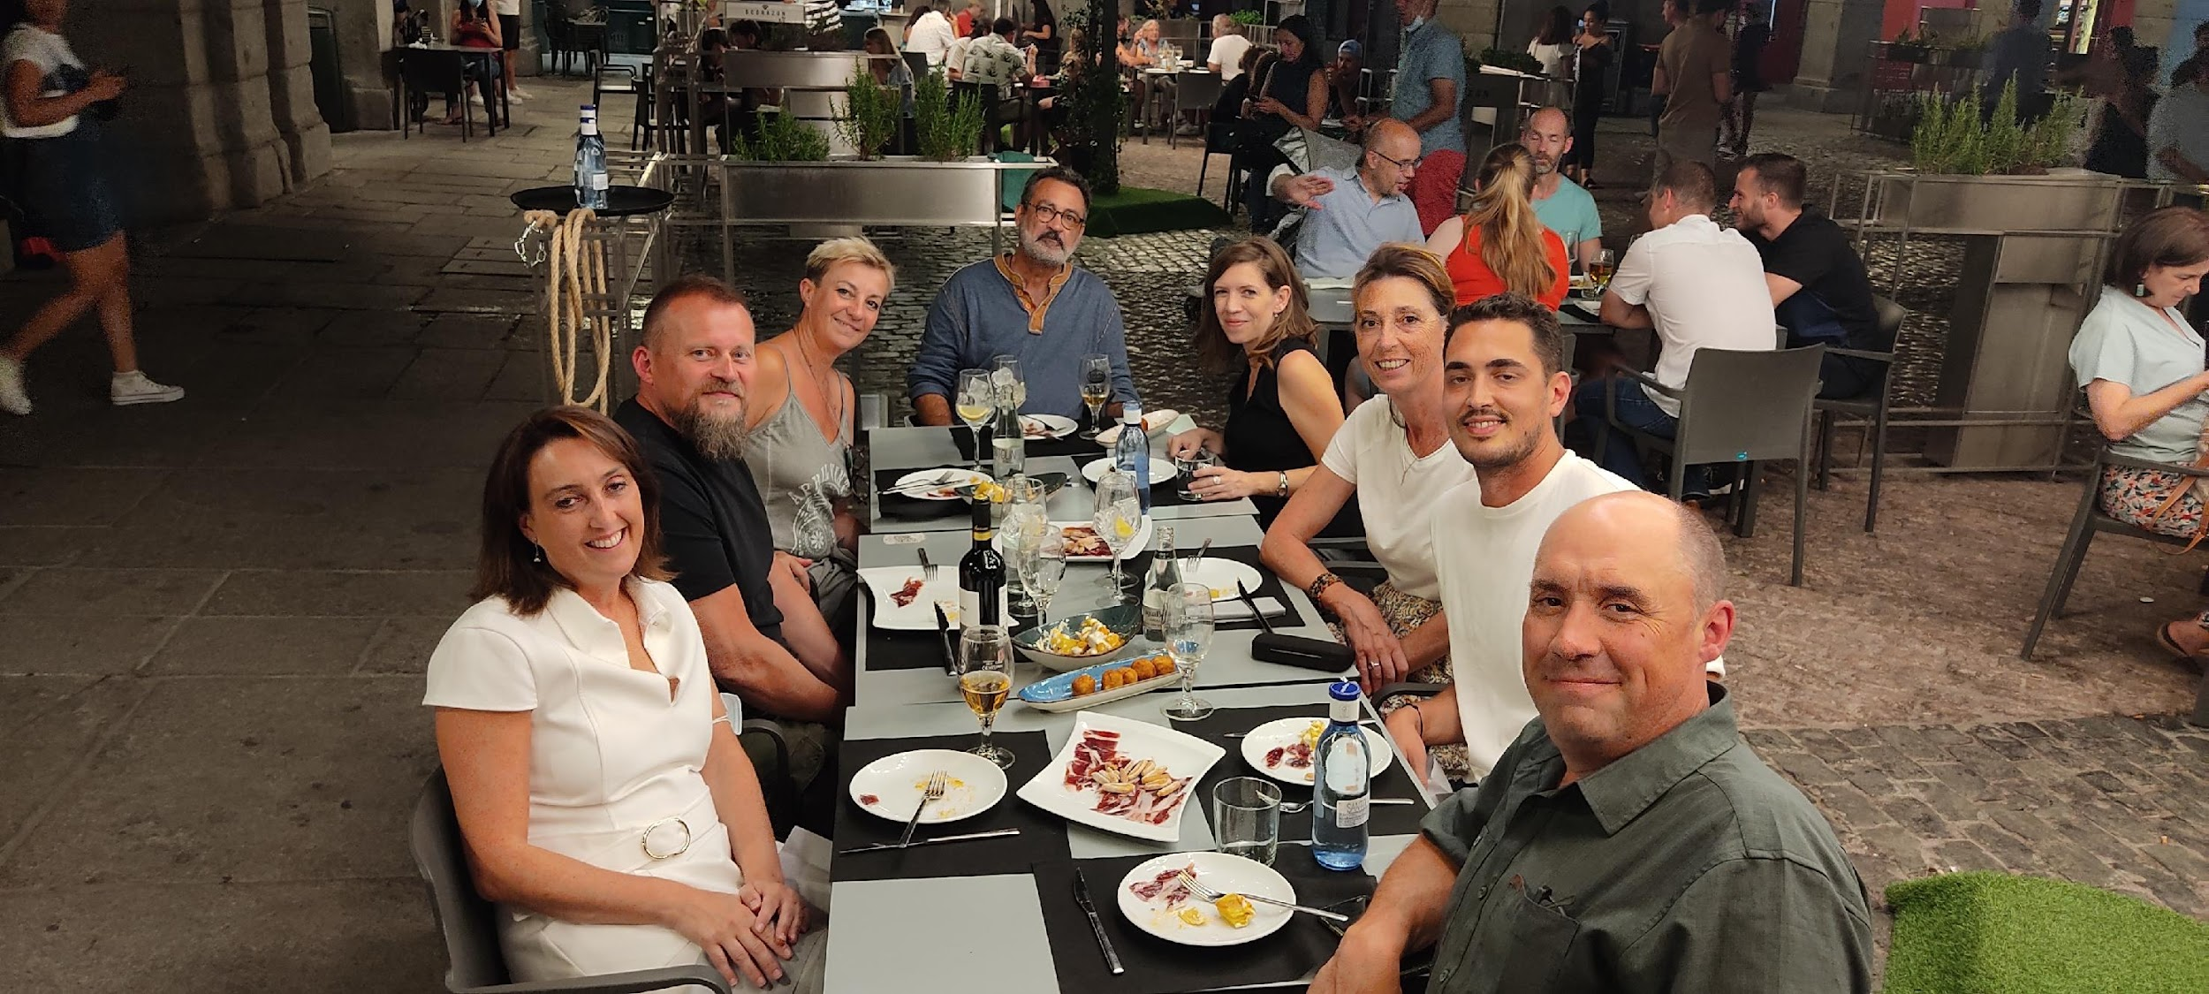
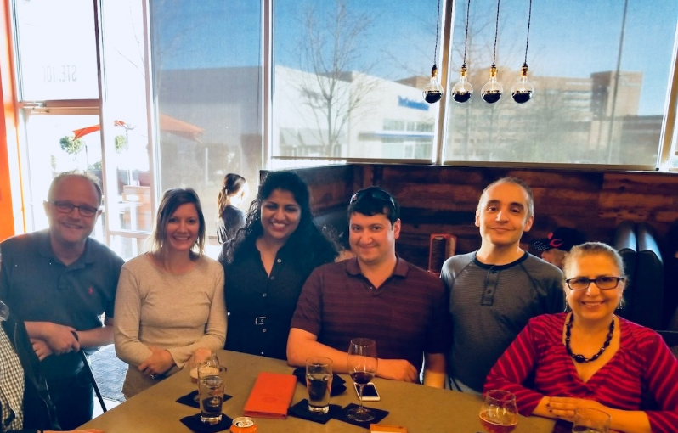
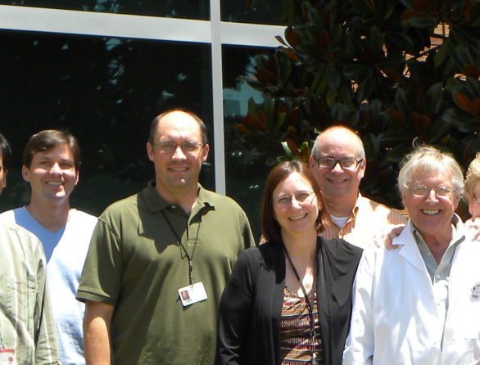

Acknowledgements
Nathan Koonce, PhD
Samir Jenkins, PhD
Jose Penagaricano, MD
Azemat Jamshidi-Parsian
Ruud Dings, PhD
Andrew Johnsrud, MD, Stanford University
Xin Zhang, PhD Boston University
Chang W. Song, PhD University of Minnesota
Yolanda Prezado,PhD, Institut Curie
NCI CA107160, NCI CA44114
Winthrop P. Rockefeller Cancer Institute
ESRF, Grenoble, FR Elke Brauer-Krisch, PhD

Slide 22
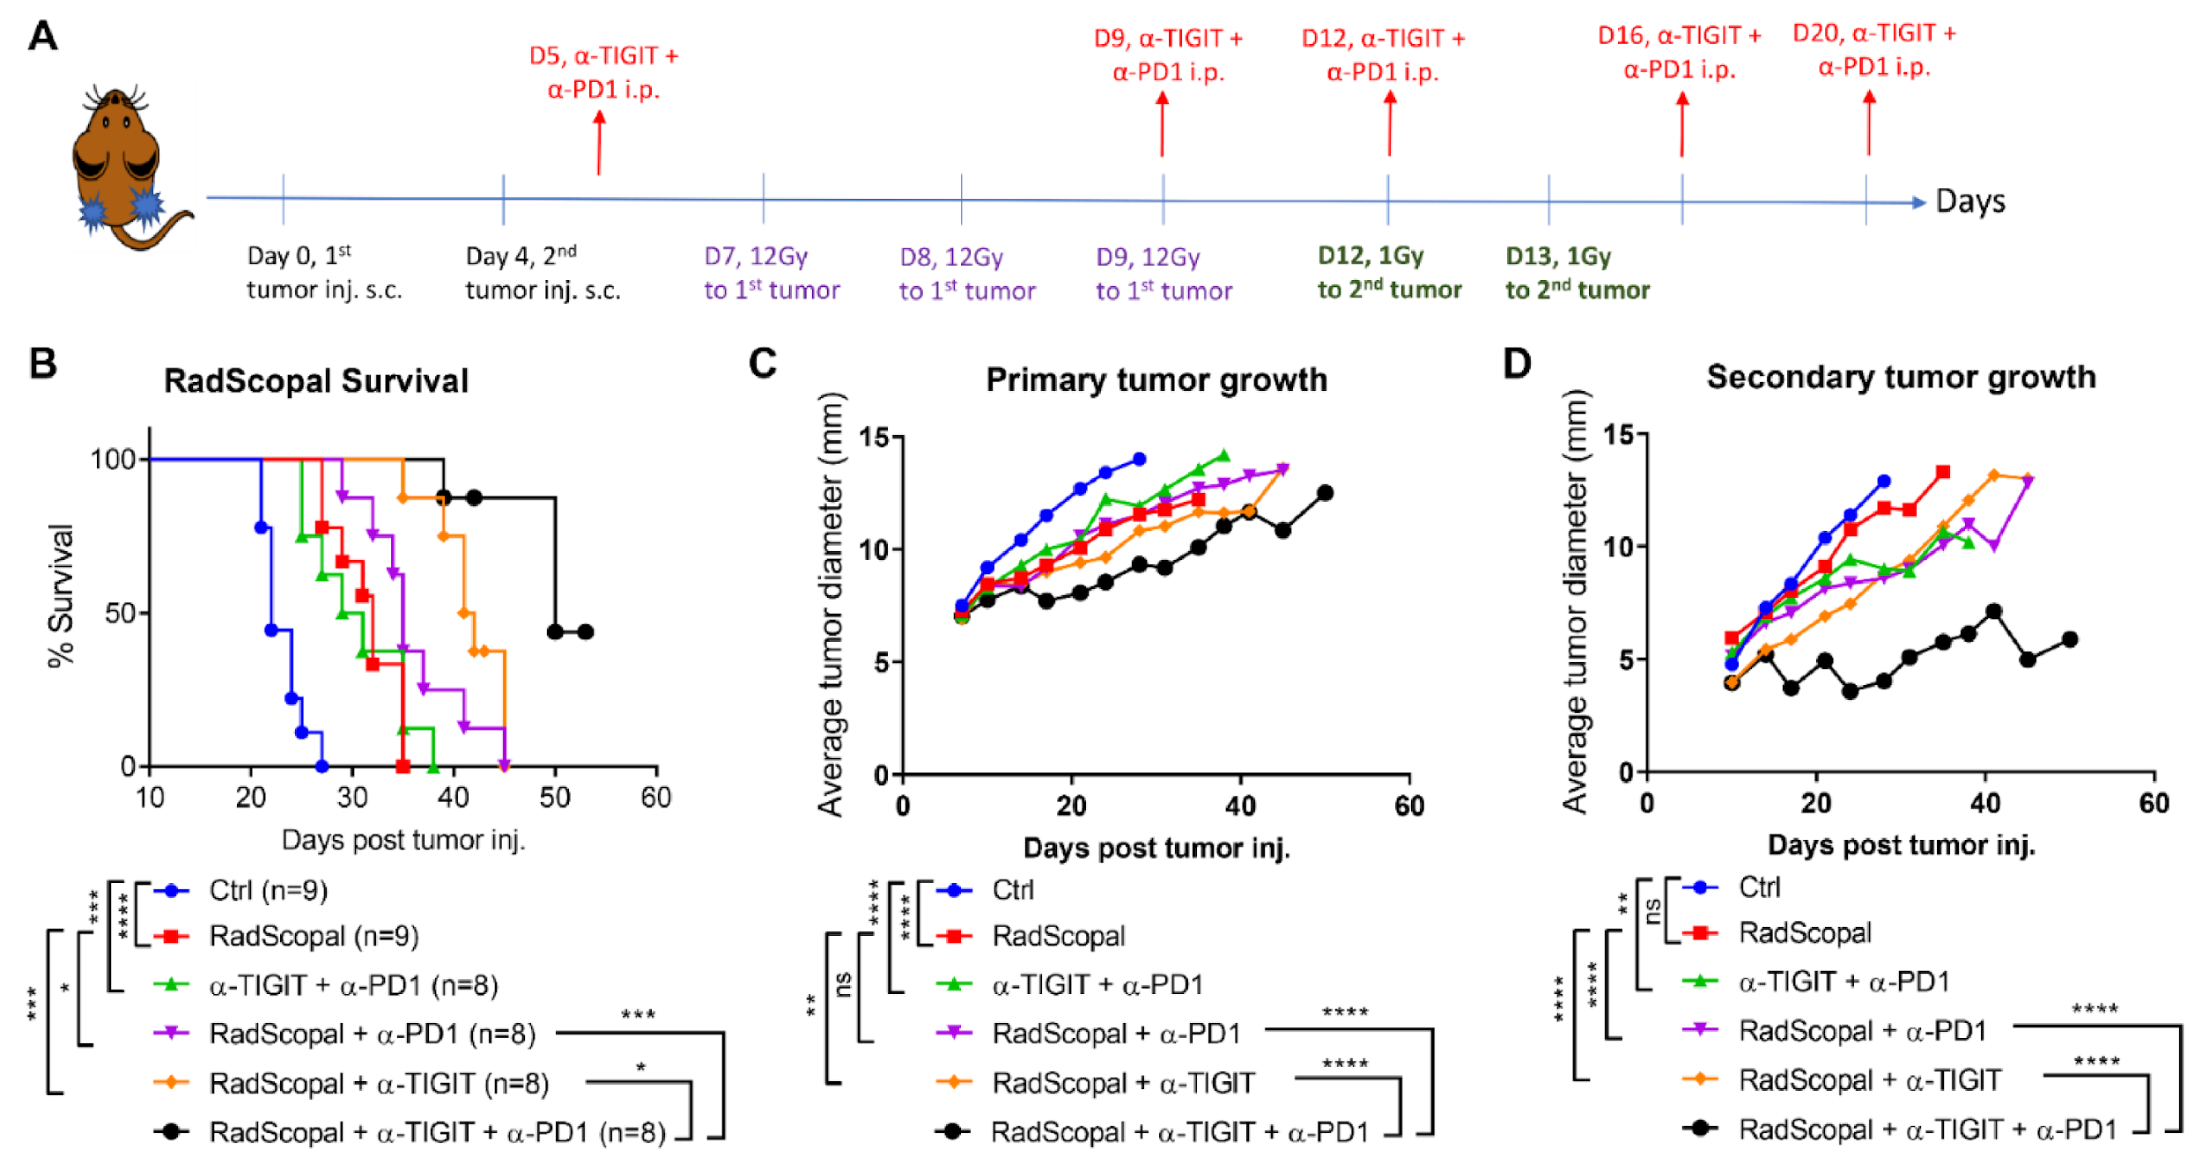
‘One tumor peak, distant tumor valley’ : Radscopal effect with Immunotherapy
GRID is multiple simultaneous Radscopal effects ?
Barsoumian, Hampartsoum B, Welsh J et al. “High Plus Low Dose Radiation Strategy in Combination with TIGIT and PD1 Blockade to Promote Systemic Antitumor Responses.” Cancers vol. 14,1 221. 3 Jan. 2022, doi:10.3390/cancers14010221

Slide 23
High- and low-dose radiotherapy
Cold or immune-desert tumors are unlikely to respond to immune checkpoint blockade.
Hypofractionation:
  Has direct tumoricidal effects
  Release of tumor-associated antigens
  Activation of dendritic cells
  Upregulation of cytokines
Low-dose radiotherapy (up to 2Gy):
  Re-program tumor microenvironment (polarizing macrophage induction, production of IL-12 & IFN-γ, recruitment of T-cells)
  Mobilization of antitumor immunity with both CD4+ and CD8+ T cells.
Herrera Cancer Disc, 2022
Monjazeb Clin Cancer Res, 2021
Barsoumian J Immunother Cancer, 2020

Slide 24
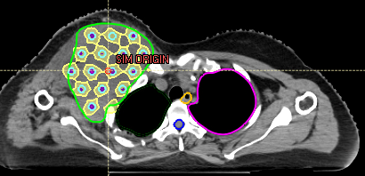
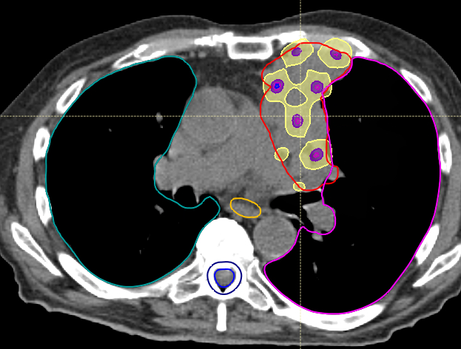

Obtaining a valley dose of “around “1Gy in clinical GRID therapy
Case | Prescription (Gy) | VPDR | Valley dose (Gy) | Peak dose (Gy)
1 | 15 | 0.05 | 0.8 | 15.04
2 | 20 | 0.11 | 2.21 | 20.45
3 | 20 | 0.06 | 1.13 | 20.08
4 | 20 | 0.05 | 1.05 | 20.05
5 | 18 | 0.10 | 1.79 | 18.01
6 | 18 | 0.09 | 1.70 | 18.00
7 | 15 | 0.08 | 1.16 | 15.01
8 | 15 | 0.09 | 1.38 | 15.01
9 | 15 | 0.09 | 1.33 | 15.02
10 | 15 | 0.08 | 1.27 | 15.03
ARC THERAPY for GRID
Feasibility Study of 3D-VMAT-Based GRID Therapy.
Spatially fractionated radiotherapy (GRID) using helical tomotherapy.
Zhang TCRT, 2022
Zhang JACMP, 2016

Slide 25
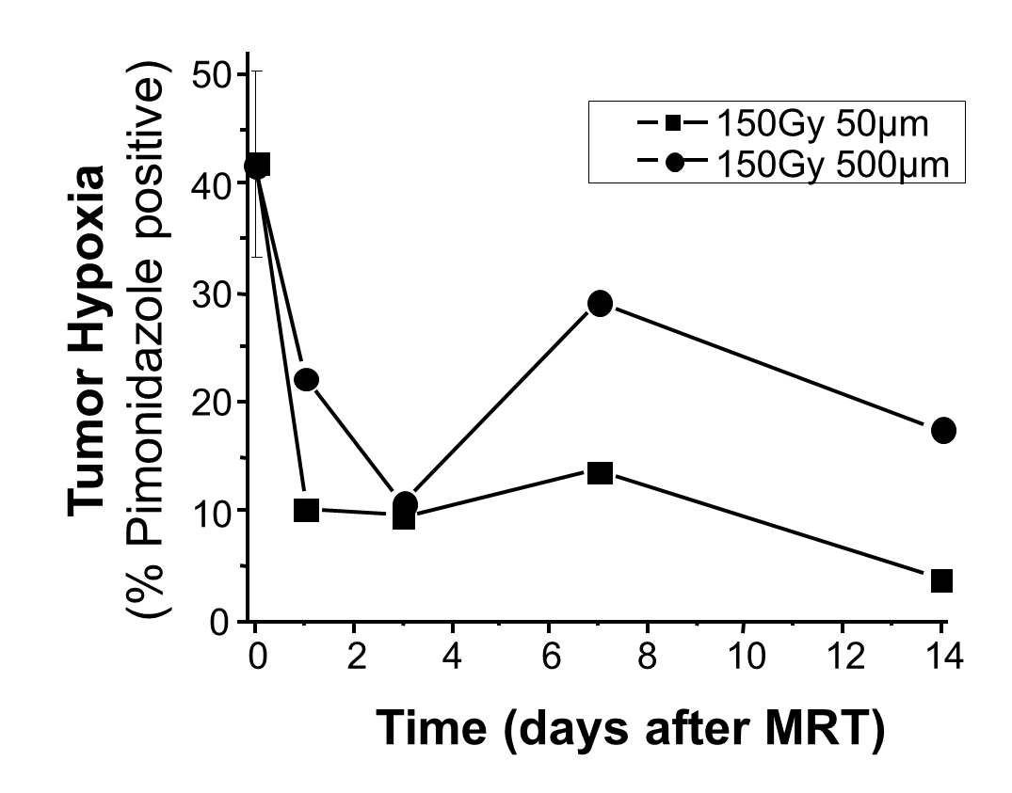
Microbeam, high dose radiation induces reoxygenation; a pathway for drug and/or immune system access?
Griffin RJ, Dings, Koonce, Corry, Moros et al. Radiation Res 2012
50
150Gy 50µm
150Gy 500µm
40
30
Tumor Hypoxia
(% Pimonidazole positive)
20
10
0
0
2
4
6
8
10
12
14
Time (days after MRT)
Figure 4: Pimonidazole positive staining in tumors over 2 weeks post MRT at 150 Gy peak dose with varying beam width. Three untreated tumors were averaged at time 0, the other points are the mean staining in one animal of each group.
Notes:
Tumor hypoxia was reduced compared to control after a single MRT exposure in 4T1 murine breast tumors

