Slide 1



Investigating the radiobiology of protons with increasing LET in head and neck tumour models
Professor Jason Parsons
Institute of Cancer and Genomic Sciences
School of Physics and Astronomy

Slide 2
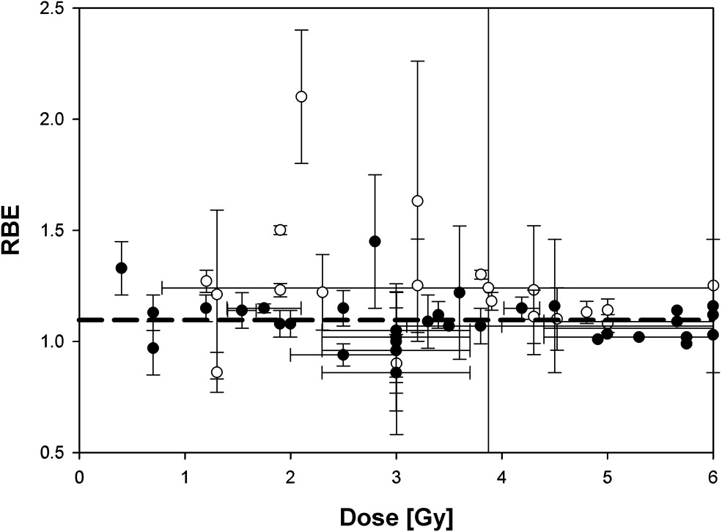
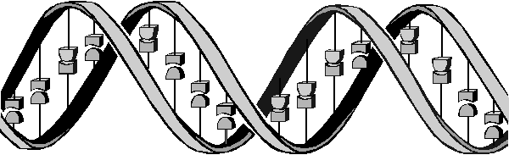
The advantages but also biological uncertainties following proton beam therapy (PBT)
-in vitro
-in vivo
Tumour
X-rays
Bragg peak
Distal fall-off
Low-LET radiation tracks
Relative dose
High-LET radiation tracks
protons
LET (protons)
Depth in tissue
Taken from Paganetti and van Luijk (2013) Sem Rad Oncol
Further research exploiting the biological impact of PBT is vital for establishing RBE and optimal clinical treatment for tumours.
Vitti and Parsons (2019) Cancers

Slide 3
Major research questions/aims
Do protons, particularly at increasing LET, lead to changes in the molecular (DNA) and cellular (survival/RBE) profiles.
Can the effectiveness of protons (particularly at high-LET) be further exacerbated using drugs/inhibitors.
What is the impact of reduced oxygen (hypoxia) on photon versus proton efficacy.
What is the effect of dose rate (FLASH) on proton radiobiology.
R01CA256854-01

Slide 4
Major research questions/aims
Do protons, particularly at increasing LET, lead to changes in the molecular (DNA) and cellular (survival/RBE) profiles.
Can the effectiveness of protons (particularly at high-LET) be further exacerbated using drugs/inhibitors.
What is the impact of reduced oxygen (hypoxia) on photon versus proton efficacy.
What is the effect of dose rate (FLASH) on proton radiobiology.
R01CA256854-01

Slide 5
“Relatively” high-LET protons cause a decrease in cell survival due to CDD formation compared to low-LET protons
UMSCC74A
160
UMSCC74A
140
*
120
*
Enzyme-modified (DSB+CDD)
100
***
80
**
****
60
40
20
CDD
0
*
SF2, p<0.02; RBE=1.7
***
UMSCC6
**
*p<0.005, **p<0.002, ***p<0.001
120
100
80
60
40
20
*p<0.02, **p<0.01, ***p<0.005, ****p<0.001
0
SF2, p<0.01; RBE=1.9
Carter et al., (2018) Int J Rad Oncol Biol Phys
Fabbrizi et al., (2021) Methods Protoc
58 MeV (1 keV/μm); 11 MeV (12 keV/μm)

Slide 6
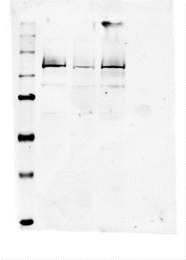
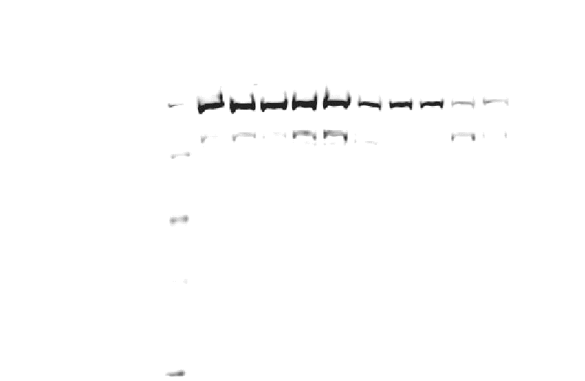
Modulation of proton-induced cellular sensitivity following DUB siRNA knockdown
HeLa
*p<0.01, **p<0.005, ***p<0.002, ****p<0.001
11 MeV protons
USP6 siRNA
NT siRNA
NT siRNA
USP6 siRNA
USP6
Hours post-CHX
PARP-1
0
0.5
1
2
4
0
0.5
1
2
4
XRCC1
PARP-1
APE1
Actin
Actin
*p<0.01, **p<0.005, ***p<0.001
1.0 0.3
PARP-1/actin ratio
11 MeV
11 MeV
58 MeV
58 MeV
Carter et al., (2019) Int J Rad Oncol Biol Phys
Nickson, Fabbrizi et al., (2021) Front Oncol

Slide 7
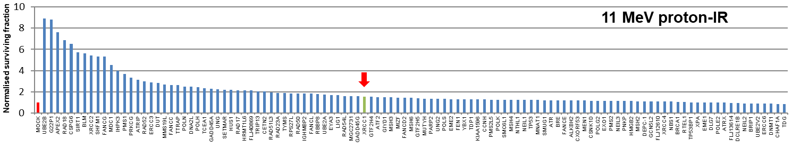
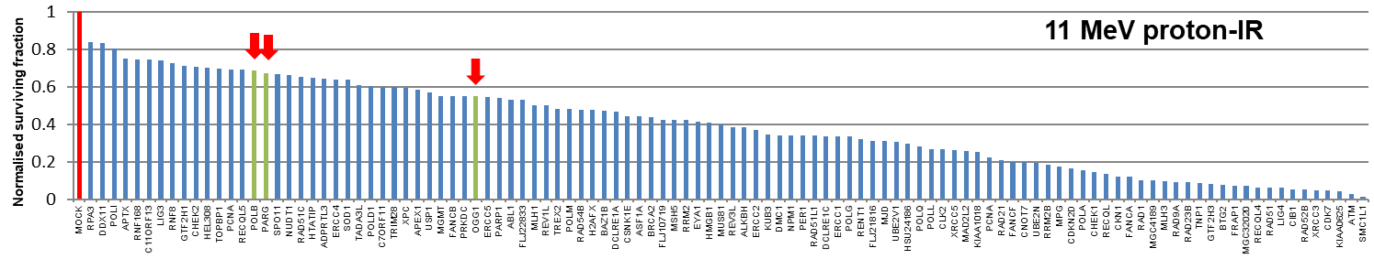
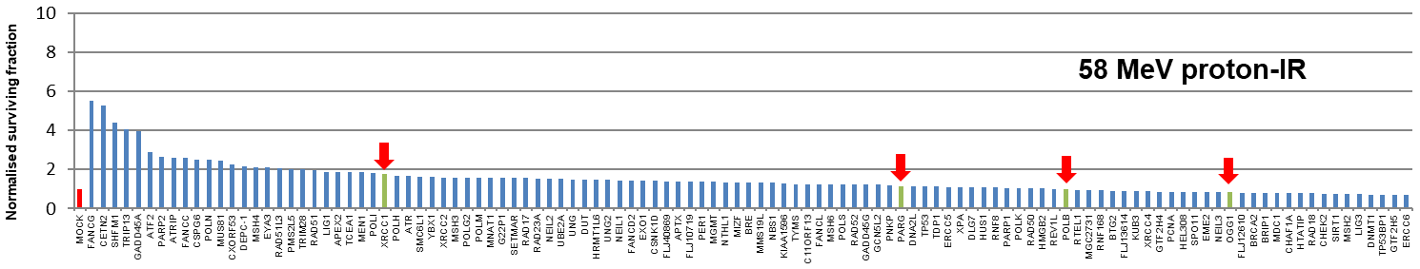
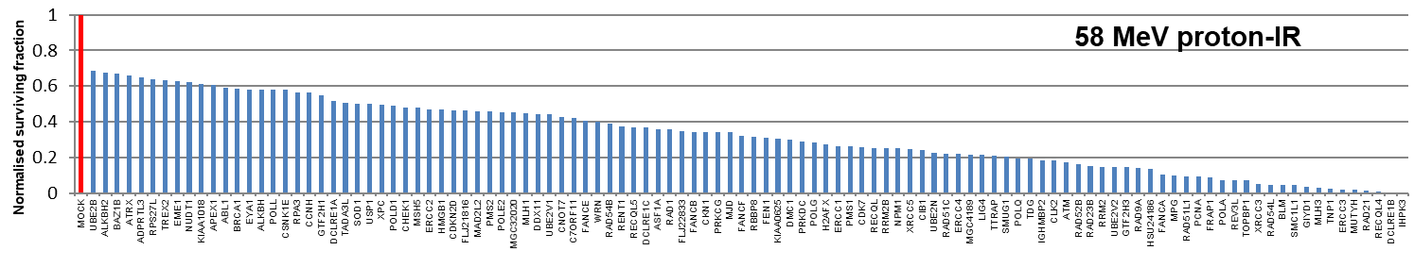
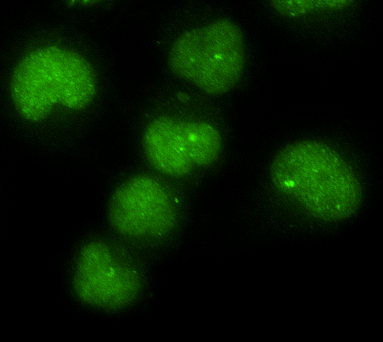
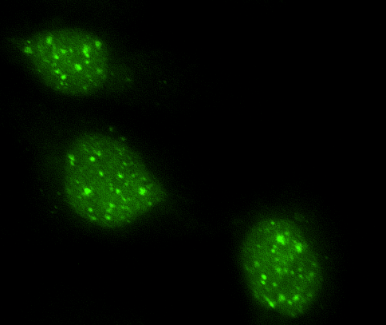
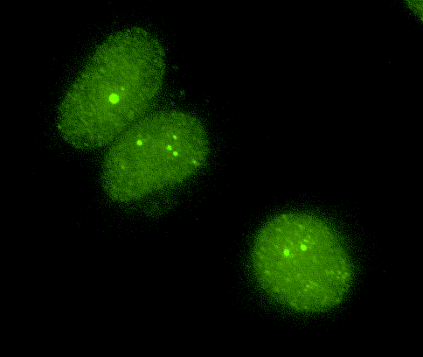
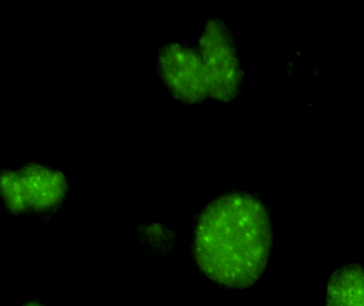
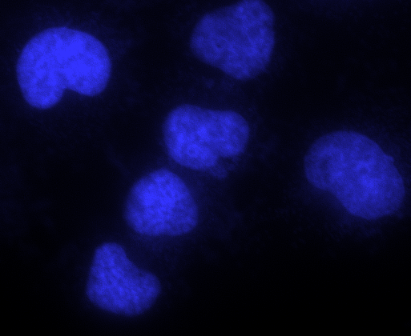
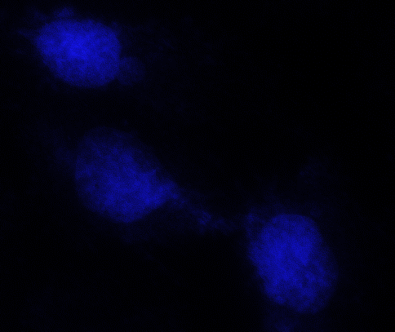
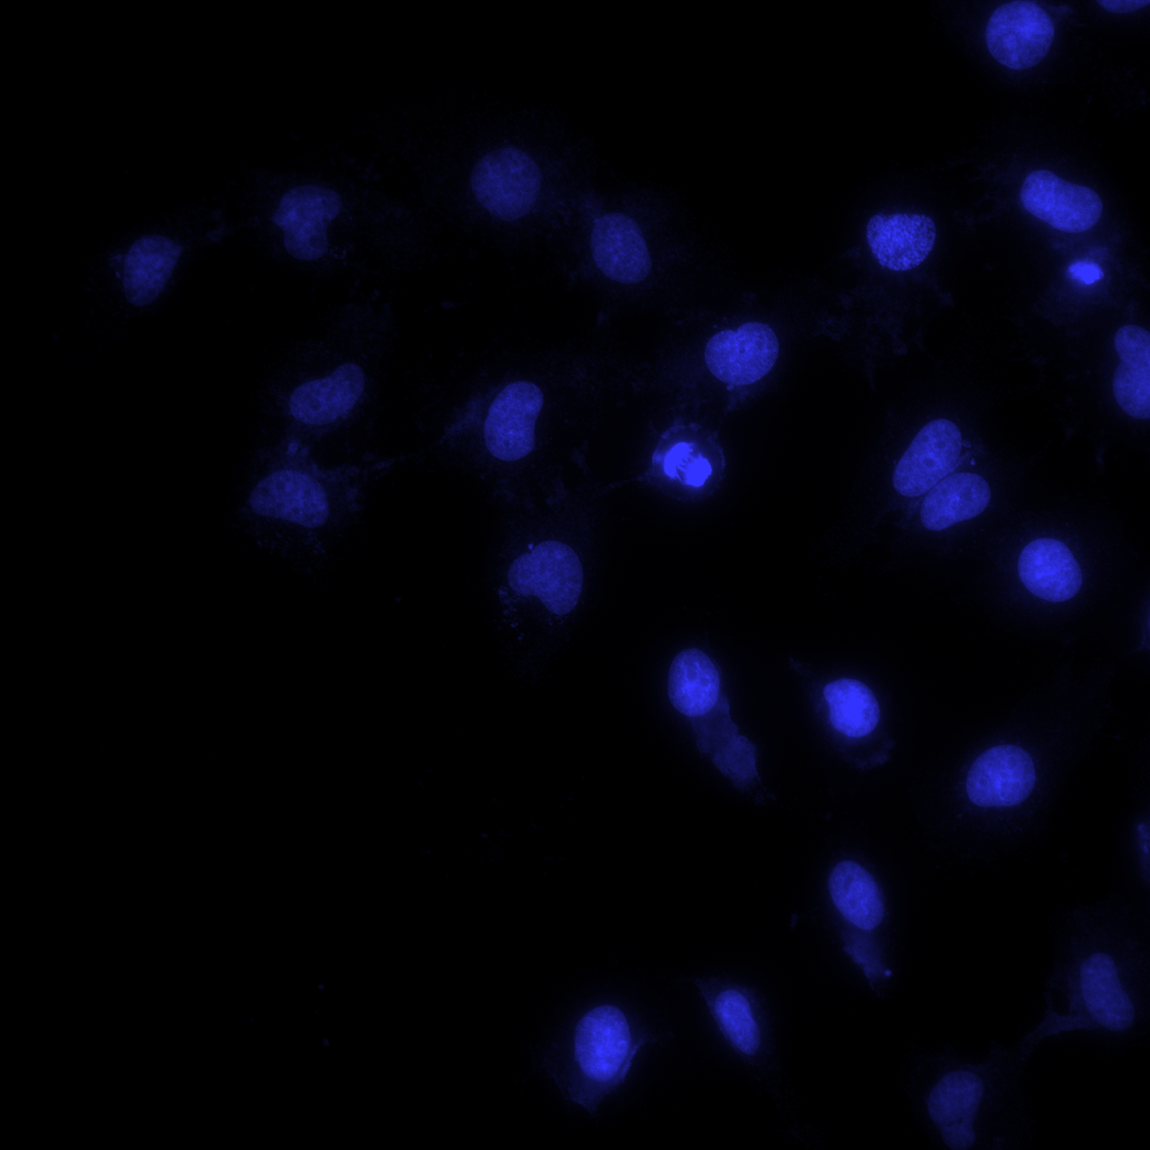
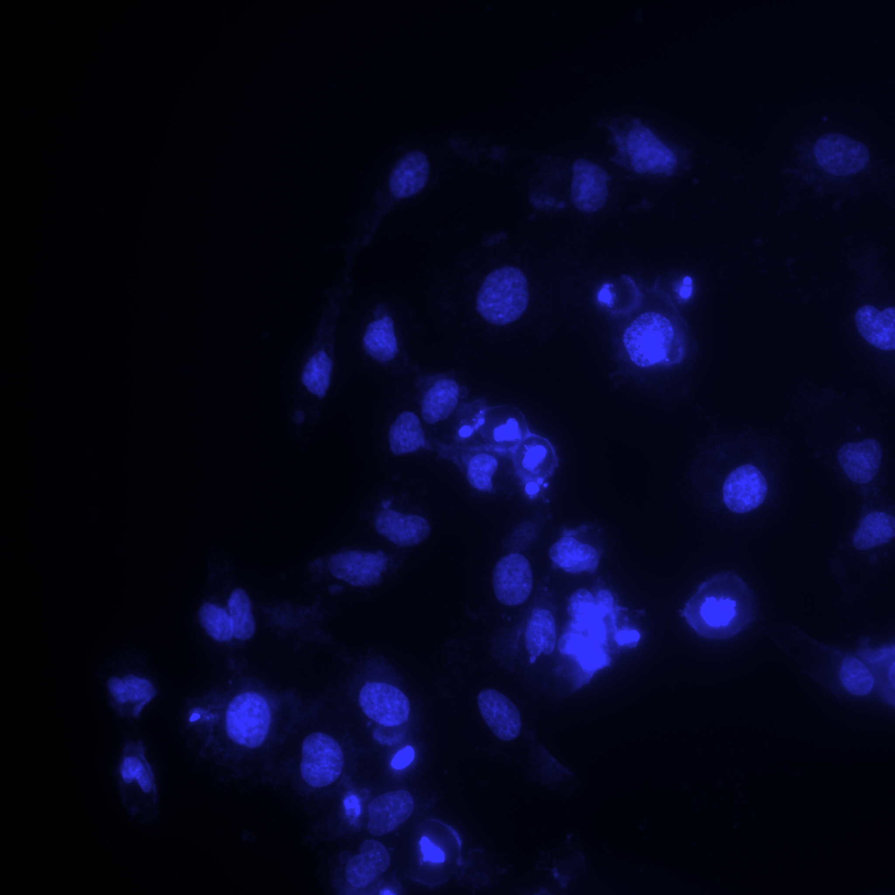
Modulation of proton-induced cellular sensitivity following DDR siRNA
HeLa
11 MeV
58 MeV
FaDu
11 MeV
58 MeV
FaDu
Control
24 h
Control
24 h
*p<0.01, **p<0.005, ***p<0.0005
OGG1
DAPI
Fabbrizi, Nickson et al., (in review)
11 MeV
58 MeV
11 MeV
58 MeV

Slide 8
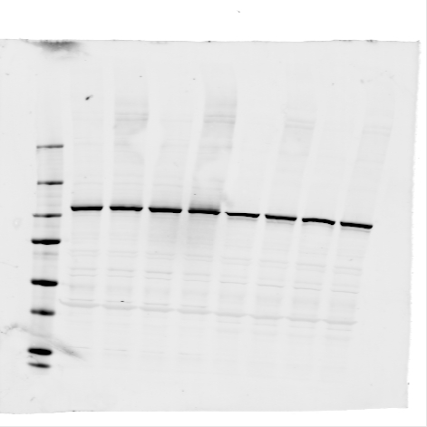
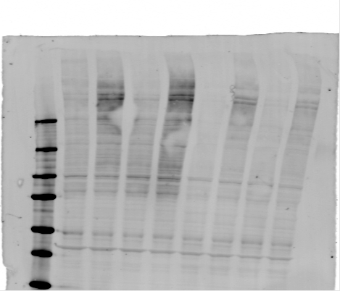
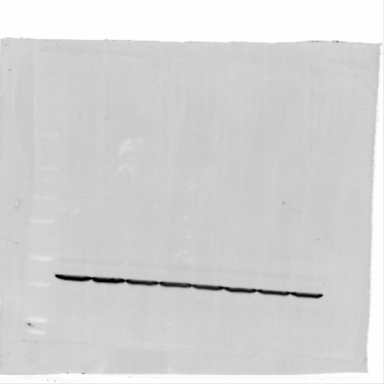
Targeting OGG1 and PARG sensitises cells to high-LET protons
HeLa
11 MeV
58 MeV
PARGi
PARGi (+IR)
DMSO
DMSO (+IR)
PARP-1
250
PAR
150
FaDu
100
75
Actin
*p<0.0001,
FaDu
*p<0.05, **p<0.01, ***p<0.001, ****p<0.0001
11 MeV
58 MeV
Fabbrizi, Nickson et al., (in review)
Collaborations with Thomas Helleday and Helen Bryant

Slide 9
Major research questions/aims
Do protons, particularly at increasing LET, lead to changes in the molecular (DNA) and cellular (survival/RBE) profiles.
Can the effectiveness of protons (particularly at high-LET) be further exacerbated using drugs/inhibitors.
What is the impact of reduced oxygen (hypoxia) on photon versus proton efficacy.
What is the effect of dose rate (FLASH) on proton radiobiology.
R01CA256854-01

Slide 10
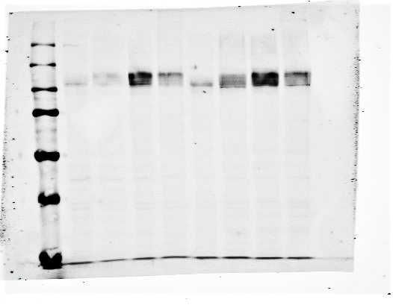
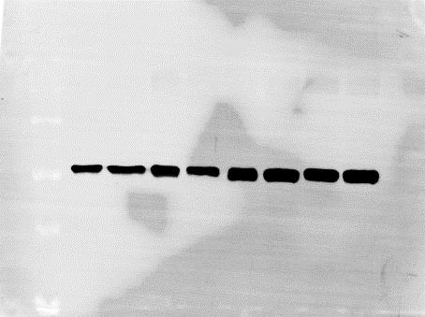
Hypoxia-induced radioresistance and identifying strategies to overcome this.
UMSCC6
Hours in hypoxia
N
3
6
24
UMSCC6
UMSCC74A
HIF-1α
FaDu
Actin
UMSCC74A
Hours in hypoxia
N
3
6
24
HIF-1α
Actin
Normoxia
Hypoxia (1 %)
Hypoxia (1 %)
Detroit
R15
FaDu
Hill, Rocha et al., (in review)

Slide 11
Major research questions/aims
Do protons, particularly at increasing LET, lead to changes in the molecular (DNA) and cellular (survival/RBE) profiles.
Can the effectiveness of protons (particularly at high-LET) be further exacerbated using drugs/inhibitors.
What is the impact of reduced oxygen (hypoxia) on photon versus proton efficacy.
What is the effect of dose rate (FLASH) on proton radiobiology.
R01CA256854-01

Slide 12
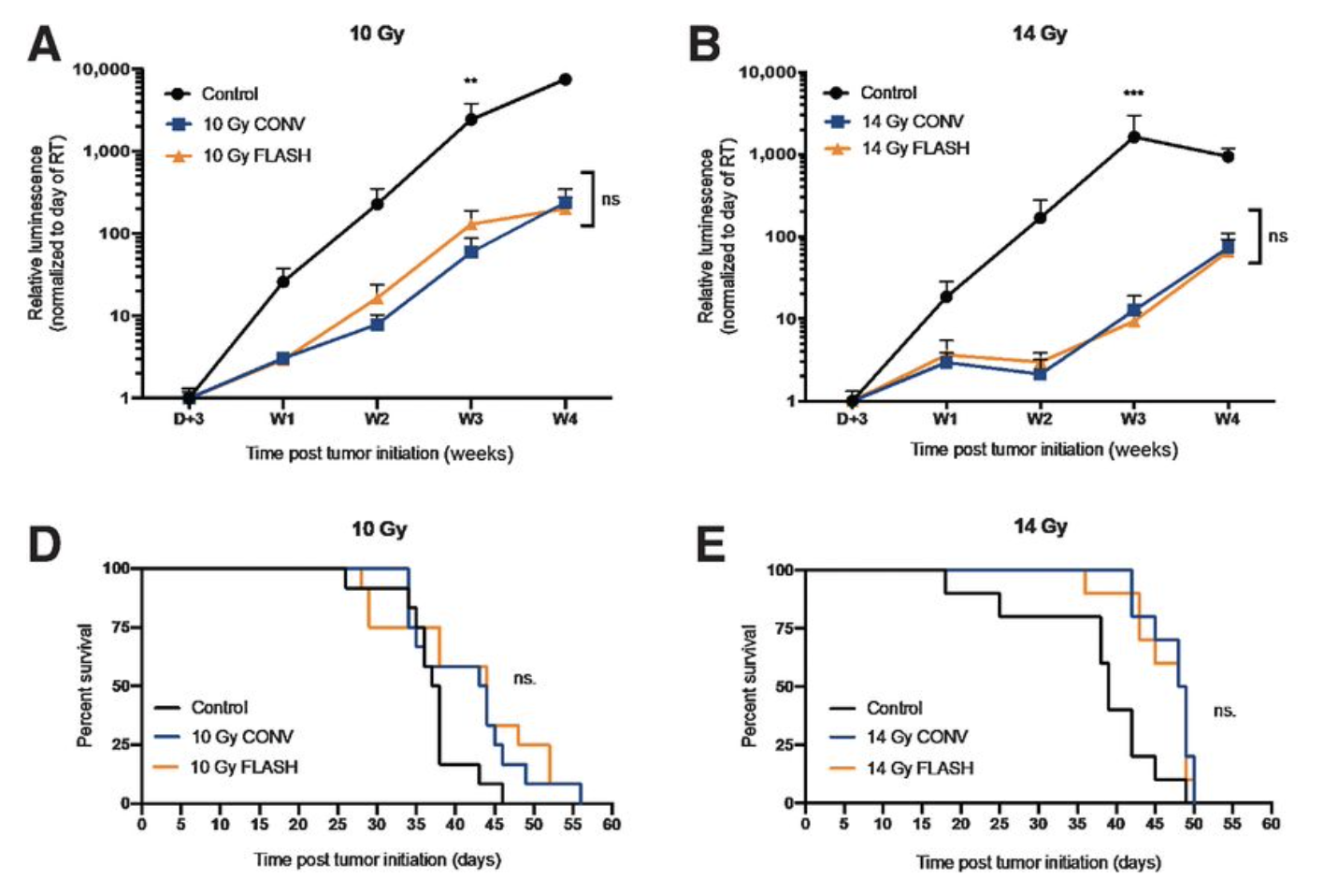
Examine the radiobiology of FLASH high-LET radiation.
Using high-dose rates (>40 Gy/s; versus ~5 Gy/min).
FLASH stimulates normal tissue sparing.
Glioblastoma
Vozenin et al (2018) Clin Cancer Res
Bourhis et al (2019) Radiother Oncol
Montay-Gruel et al (2021) Clin Cancer Res
Evidence of tumour cell killing effect of FLASH required.
Mechanism of action unclear (oxygen, radicals, metabolism, DNA damage/repair?).
Opportunity for utilisation of FLASH protons/particles and influence of LET.
Hughes and Parsons (2020) Int J Mol Sci

Slide 13
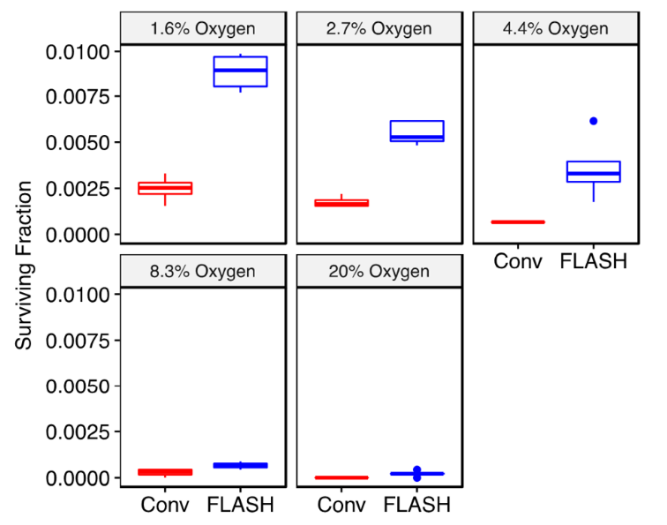
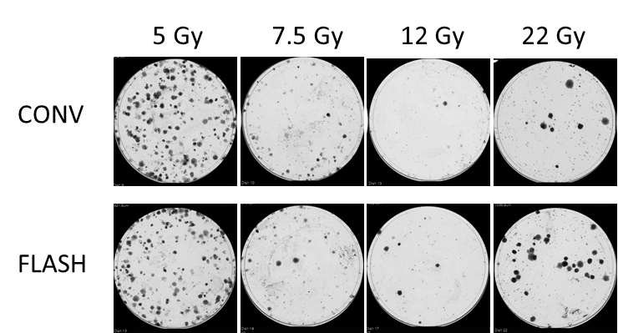
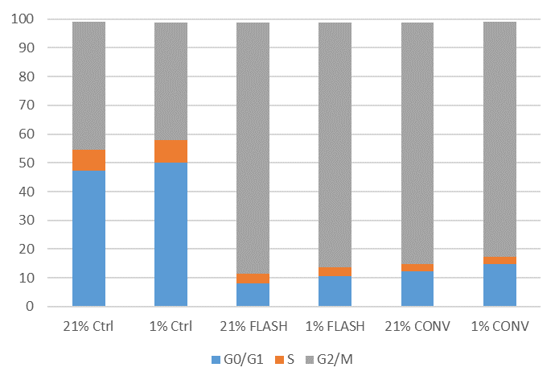
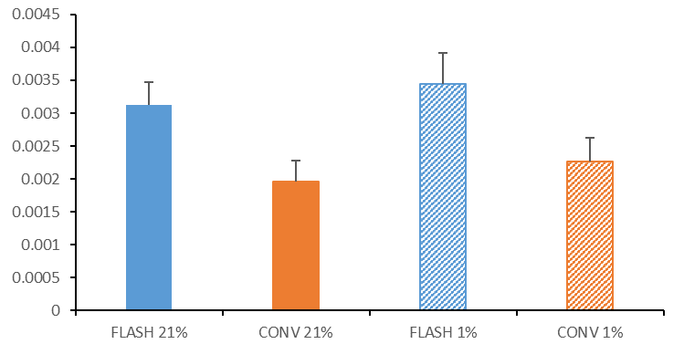
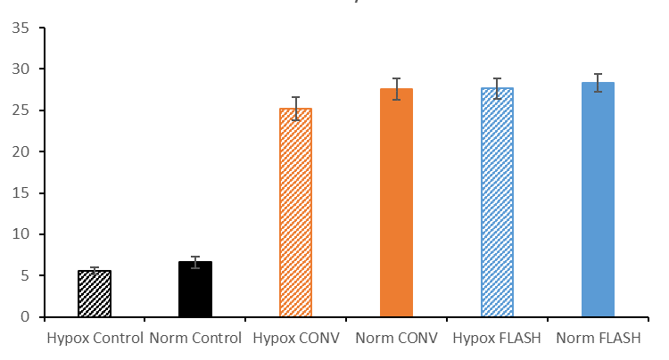
Examining the radiobiology of FLASH high-LET radiation
DU145 prostate cancer cells (18 Gy electrons)
HeLa cells (protons)
Courtesy of Kristoffer Petersson
FaDu cells (cell cycle)
HeLa cells (survival)
FaDu cells (γH2AX)
*
*
Collaborations with Stuart Green, Tzany Wheldon, Tony Price, Ben Phoenix and Kristoffer Petersson

Slide 14
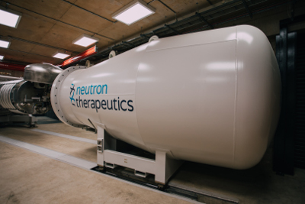
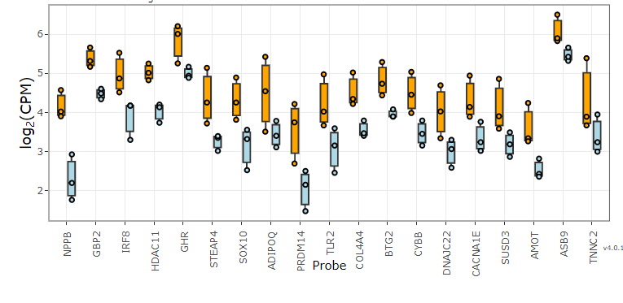
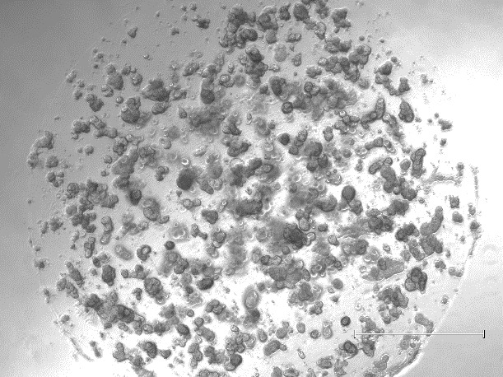
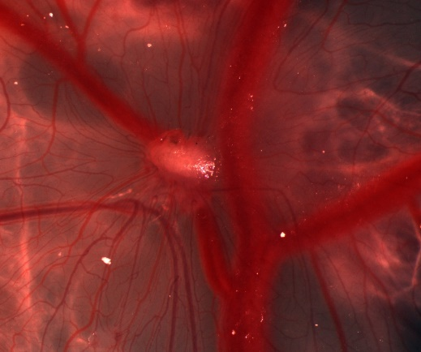
Current radiobiology research focus
Thermal neutrons
¹⁰B
Tumour cell
⁴He
⁷Li
Normal cell
Transcriptomic and proteomic analysis post-irradiation
11 MeV
59 MeV
High flux accelerator neutron source for BNCT
Development of chick embryo model
Development of patient-derived organoids (Inge Tinhofer-Keilholz – Charité Berlin)

Slide 15
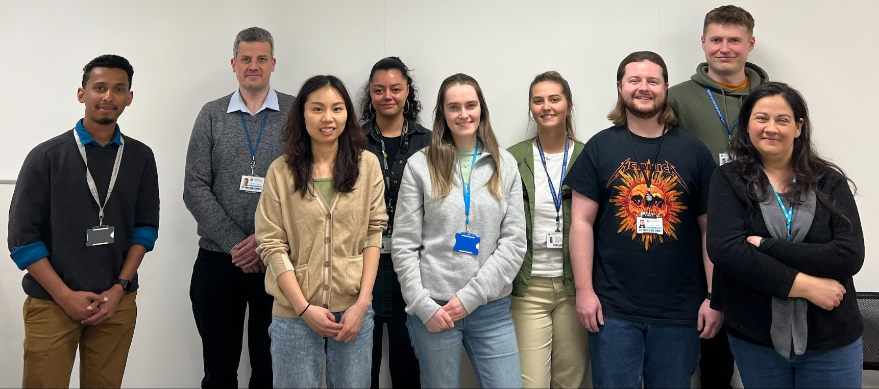



Acknowledgements
Parsons Group
Rachel Carter
Katie Nickson
Terpsi Vitti
Maria Rita Fabbrizi
Jonathan Hughes
Alice Ormrod
Chun Li
Lizzie Duffacy
Amalia Goula
Karthik Vaidya
Rhianna Hill
George Duffield
Emma Melia
Leah Punshon
Laura Hawkins
Alex Bembridge
Stuart Green
Tzany Kokalova-Wheldon
Ben Phoenix
Tony Price
Hisham Mehanna
Colin Watts
Oxford Institute for Radiation Oncology
Imperial College London
University of Glasgow
Ken Long
Anthony Chalmers
Mark Hill
James Thompson
Kristoffer Petersson
AstraZeneca
Clatterbridge Cancer Centre
Stephen Durant
Alan Lau
Andrzej Kacperek
Charité, Berlin
University of Liverpool
Thanks to
Inge Tinhofer-Keilholz
Mike Clague, Sylvie Urbe
Sonia Rocha, Terry Jones
Helen Bryant
Thomas Helleday

