Slide 1

LhARA the Laser-hybrid Accelerator for Radiobiological Applications

Slide 2
Radiotherapy; the challenge
Cancer: second most common cause of death globally
  Radiotherapy indicated in half of all cancer patients
Significant growth in global demand anticipated:
  14.1 million new cases in 2012 ⇢ 24.6 million by 2030
  8.2 million cancer deaths in 2012 ⇢ 13.0 million by 2030
Scale-up in provision essential:
  Projections above based on reported cases (i.e. high-income countries)
  Opportunity: save 26.9 million lives in low/middle income countries by 2035
Provision on this scale requires:
  Development of new and novel techniques … integrated in a
  Cost-effective system to allow a distributed network of RT facilities
Atun, Lancet Oncol. 2015 Sep;16(10):1153-86

Slide 3
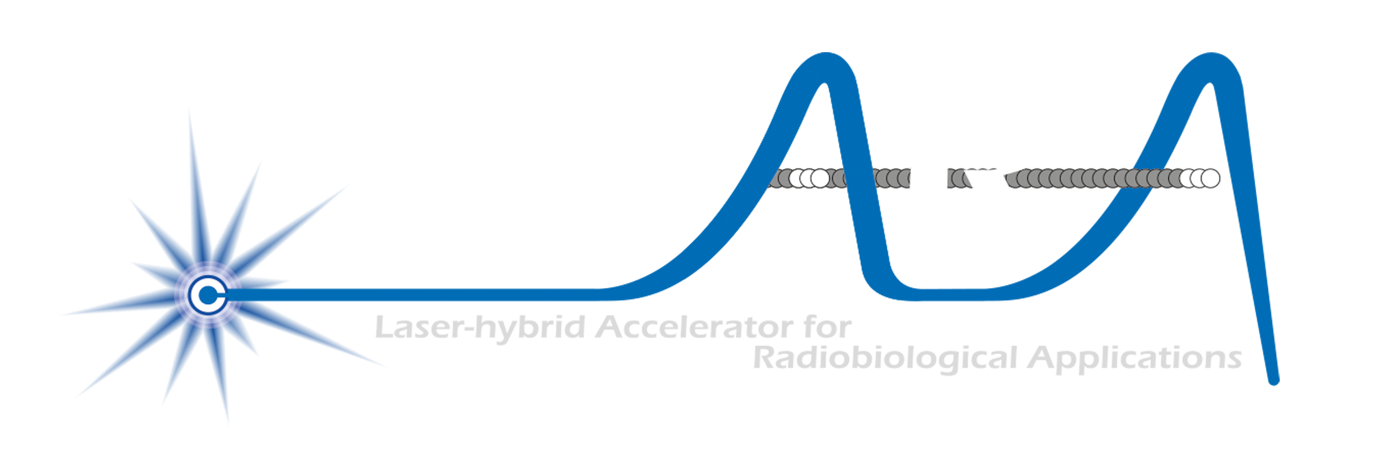



Our ambition is to:
Deliver a systematic and definitive radiation biology programme
Prove the feasibility of laser-driven hybrid acceleration
Lay the technological foundations for the transformation of PBT
  automated, patient-specific proton and ion beam therapy

Slide 4
Laser-hybrid Accelerator for Radiobiological Applications
A novel, hybrid, approach:
Laser-driven, high-flux proton/ion source
  Overcome instantaneous dose-rate limitation
    Capture at >10 MeV
  Delivers protons or ions in very short pulses
    Bunches as short as 10—40 ns
  Triggerable; arbitrary pulse structure
Novel “electron-plasma-lens” capture & focusing
  Strong focusing (short focal length) without the use of high-field solenoid
Fast, flexible, fixed-field post acceleration
  Variable energy
    Protons: 15—127 MeV
    Ions: 5—34 MeV/u
Front. Phys., 29 September 2020; DOI: 10.3389/fphy.2020.567738

Slide 5

The case for fundamental radiobiology
Relative biological effectiveness:
  Defined relative to reference X-ray beam
  Known to depend on:
    Energy, ion species
    Dose & dose rate
    Tissue type
    Biological endpoint
Yet:
  p-treatment planning uses 1.1
  Effective values are used for C⁶⁺
Maximise the efficacy of PBT now & in the future:
  Require systematic programme to develop
  full understanding of radiobiology
Paganetti,
van Luijk
(2013)
SemRadOncol

Slide 6
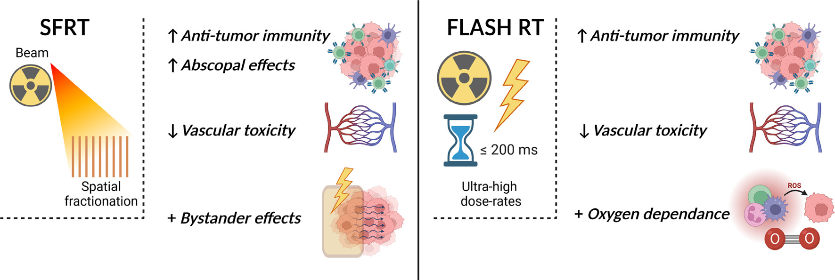
Radiobiology in new regimens
T. Schneider, C. Fernandez-Palomo, Annaïg Bertho et al.
> 40 Gy/s
Dose escalation in the tumour possible – larger tumor control prob.

Slide 7
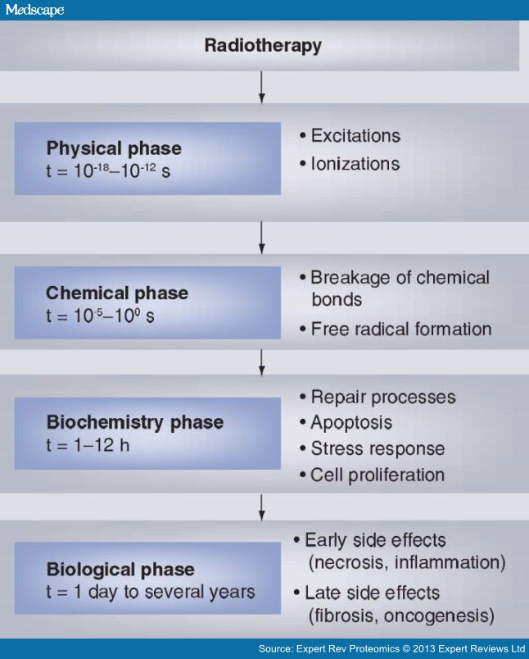
Radiobiology in new regimens
Time
domain
Space
domain
The ideally
flexible beam facility
can deliver it all!
⇒ substantial
opportunity for a
step-change in
understanding!
Ion
species
Energy
Multidisciplinary approach essential
In combination
and with chemo/immuno Therapies

Slide 9
Status: resources
2-year Preliminary Activity – Project start 01Oct22
To serve ITRF: 2 + 3-year project
in 6 work packages:
  Project Management
  Laser-driven proton and ion source
  Proton and ion capture
  Real-time dose-deposition profiling
  Novel, automated, end-station development
  Facility design and integration
First two years of
“Five-year plan”
CCAP-TN-10

Slide 10
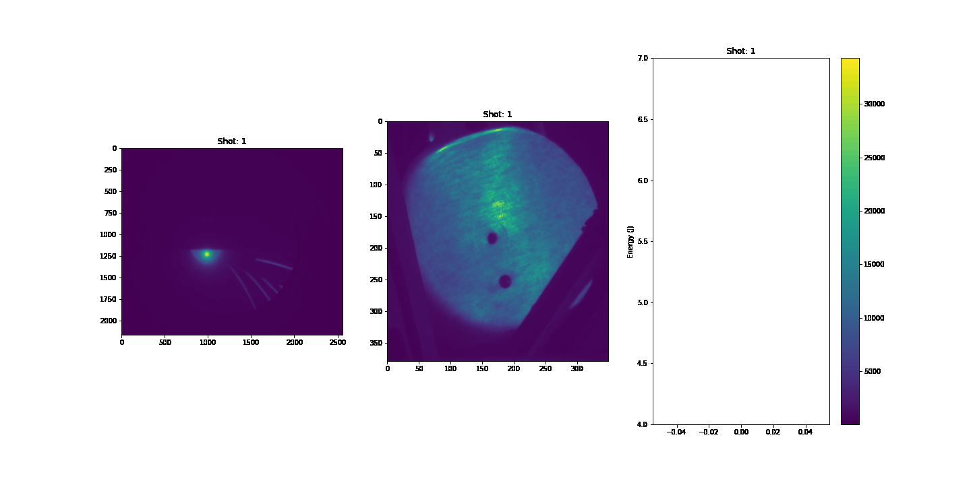
Status: highlights by workpackage
Source
Capture
Early
Later
SCAPA; summer’23
End-point stability
Hydrodynamic/PIC simulations
Debris investigation
Instrumentation:
  PROBIES
Towards high rep. rate:
  5 Hz (SCAPA), 100 Hz (IC)
Target development
Towards experiment validation:
PIC simulation:
  Loading of Penning-Malmberg trap
  Magnetotron and dioctron frequency
Delayed recruitment now complete:
  Accelerating progress for year 2
Stability
E_{p} vs shot
^{max}

Slide 11
Status: highlights by workpackage
Ionacoustic
Endstation
Design & integration
Updated Stage 1 baseline
FFA revision in progress
Gas-jet test run @ DCF
Instrumentation review:
  Engage with novel instr^{m}
Peer-group consultation
  General
  In-vitro rbio
  Next:
    In-vivo
Working towards proof of principle experiment on CALA at LMU in 2024
Source detail

Slide 12
LhARA: pre-construction phase
LhARA, multidisciplinary radiobiology programme
Inclusive, incremental, systematic
Exploiting facilities in UK, Europe, and internationally
Proof-of-principle, radiobiology demonstrator
Early start on biological science programme
Incremental integration of prototype LhARA systems

Slide 13
W/s objectives
LhARA will provide unique source of protons/ions:
  Arbitrary time structure, including FLASH
  Magnetically focused minibeams at FLASH dose rates
  Max rep rate 10 Hz => min time between bunches 0.1s
Need to match this performance with instrumentation:
  E.g. time-resolved “super-resolution” imaging @ 60 Hz
  High degree of automation, feedback, image processing …
Strategic w/s: can we find exciting areas for collaboration

