Slide 1
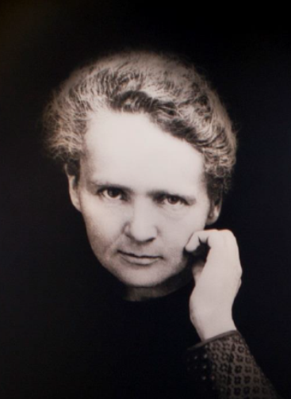

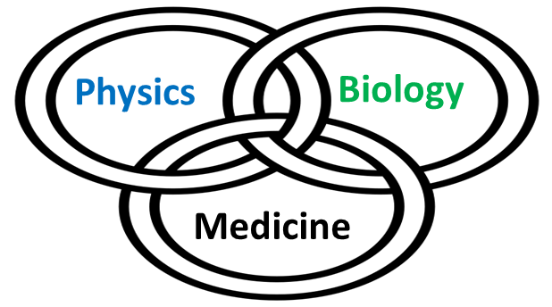




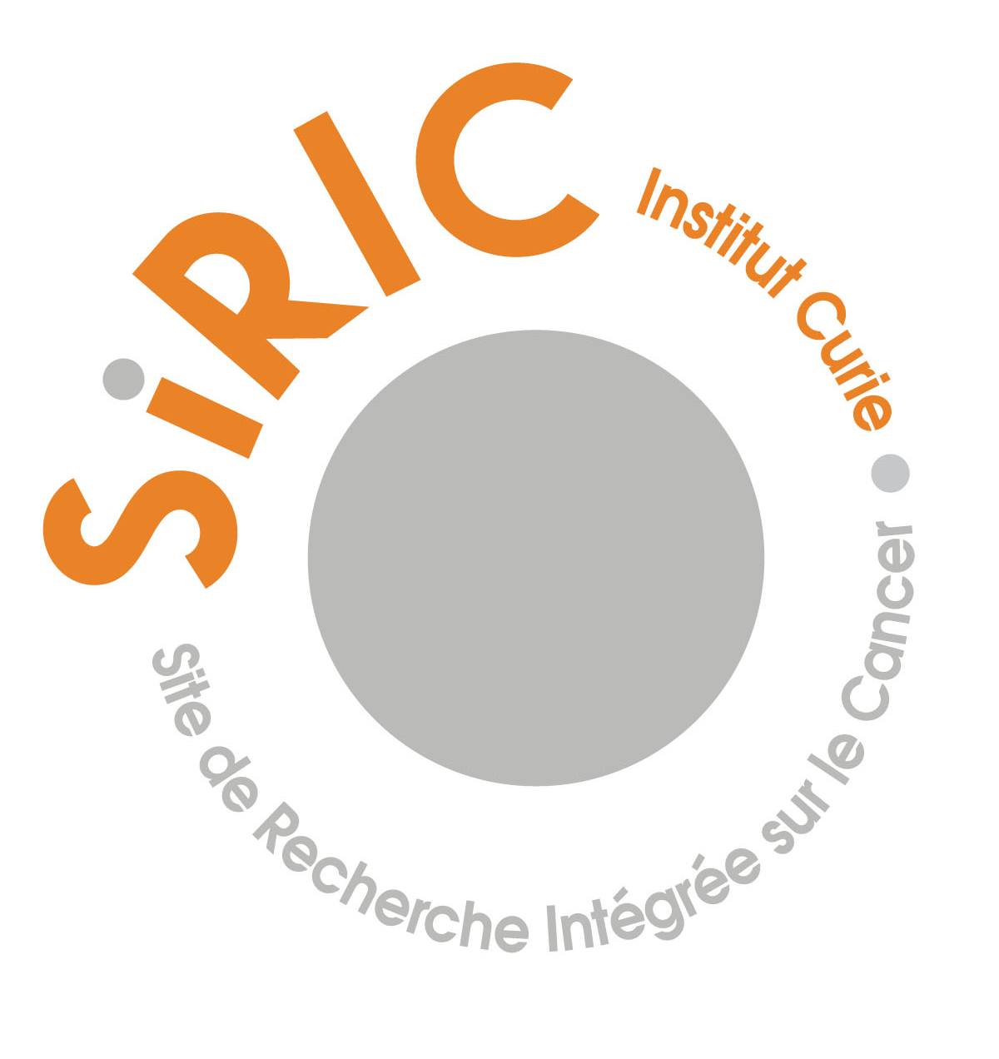

Minibeam radiation therapy:
from photons to charged particles
Yolanda Prezado, PhD, HDR

Slide 2
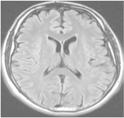
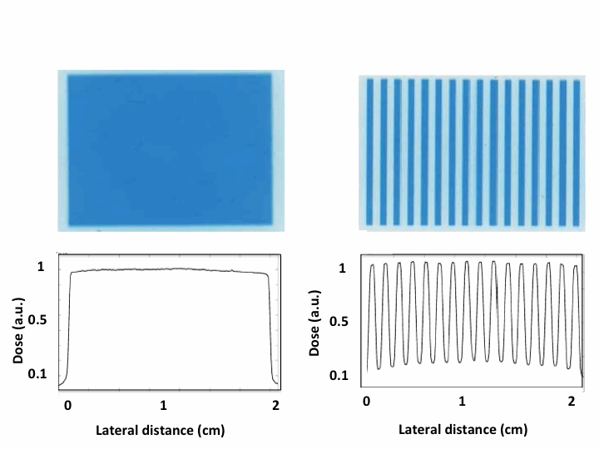
Spatial fractionation of the dose in Radiation Therapy
Standard radiotherapy
Spatial fractionated radiotherapy
x-rays minibeam radiation therapy
Large beam sizes
(> 1 cm²)
Homogeneous
dose distributions
Narrow beam sizes spaced by areas of low dose
+
Heterogeneous distributions
< 1 mm
+
> 1 cm
1-2 mm

Slide 3
Spatial fractionation of the dose in Radiation Therapy
Standard RT
Spatial fractionated radiotherapy
x-rays minibeams radiation therapy
Large beam sizes
(> 1 cm²)
Homogeneous
dose distributions
< 1 mm
> 1 cm
+
1-2 mm
Distinct biological mechanisms not yet understood
Remarkable increase of normal rat brain resistance.
Dilmanian et al. 2006, Prezado et al., Rad. Research 2015
Dose escalation in the tumor possible→ higher tumor control

Slide 4
SFRT types: GRID/MBRT/MRT
GRID therapy
Minibeam RT (MBRT)
Microbeam RT (MBRT)
1 cm
0.6 mm
0.05 mm
MV beams
LINACs
Mainly kV beams
Origin-> large synchrotrons

Slide 5
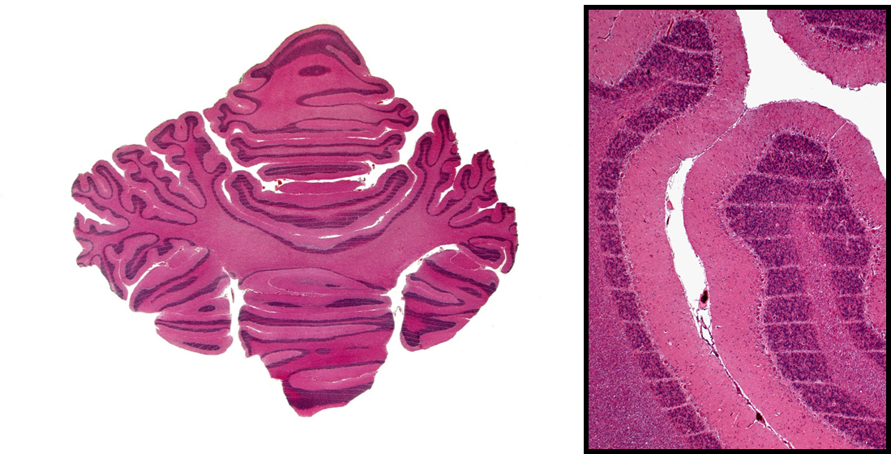
Microbeam Radiation therapy
MRT uses 50 µm-wide beams, spaced by 400 µm
Slatkin et al. Med. Phys. 1992
Differential effect normal tissue versus tumor observed in animal experiments
Normal (brain) is able to withstand
more than 300 Gy/one fraction
Tumor control effectiveness in glioma-bearing rodents
600 Gy
Laissue et al, SPIE 2001
Laissue et al, Int.J. Cancer 1998

Slide 6

Drawbacks of MRT
Requires extremely high dose rates
Scarce beamtime at synchrotrons
Difficult realization of clinical trials
Not favourable dosimetry (low-energy X-rays)
High doses to control tumors 300-600 Gy.
Good compromise: Minibeam radiation therapy
Dilmanian et al., PNAS 2006

Slide 7
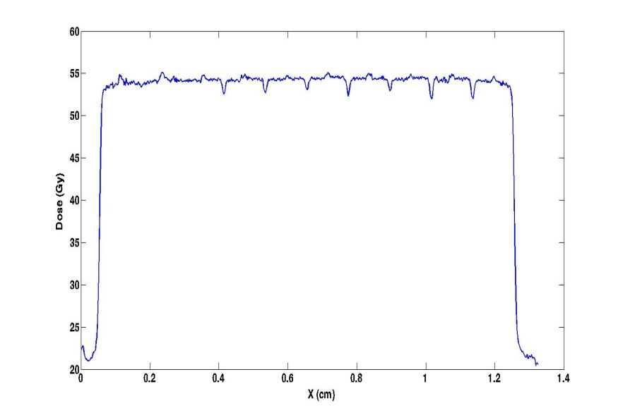

Minibeam radiation therapy: a good compromise
Beam widths: 500-700 µm; center-to-center distance: beam width x 2
Gain in normal tissue sparing
maintained
Doses as high as 100 Gy/one fraction
well-tolerated by rat brain
(Dilmanian 2006, Prezado 2015).
Tumor control in glioma-bearing rats
Deman 2012, Prezado 2012.
&
Interlacing possible

Slide 8
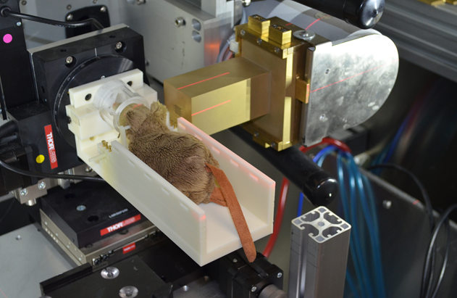
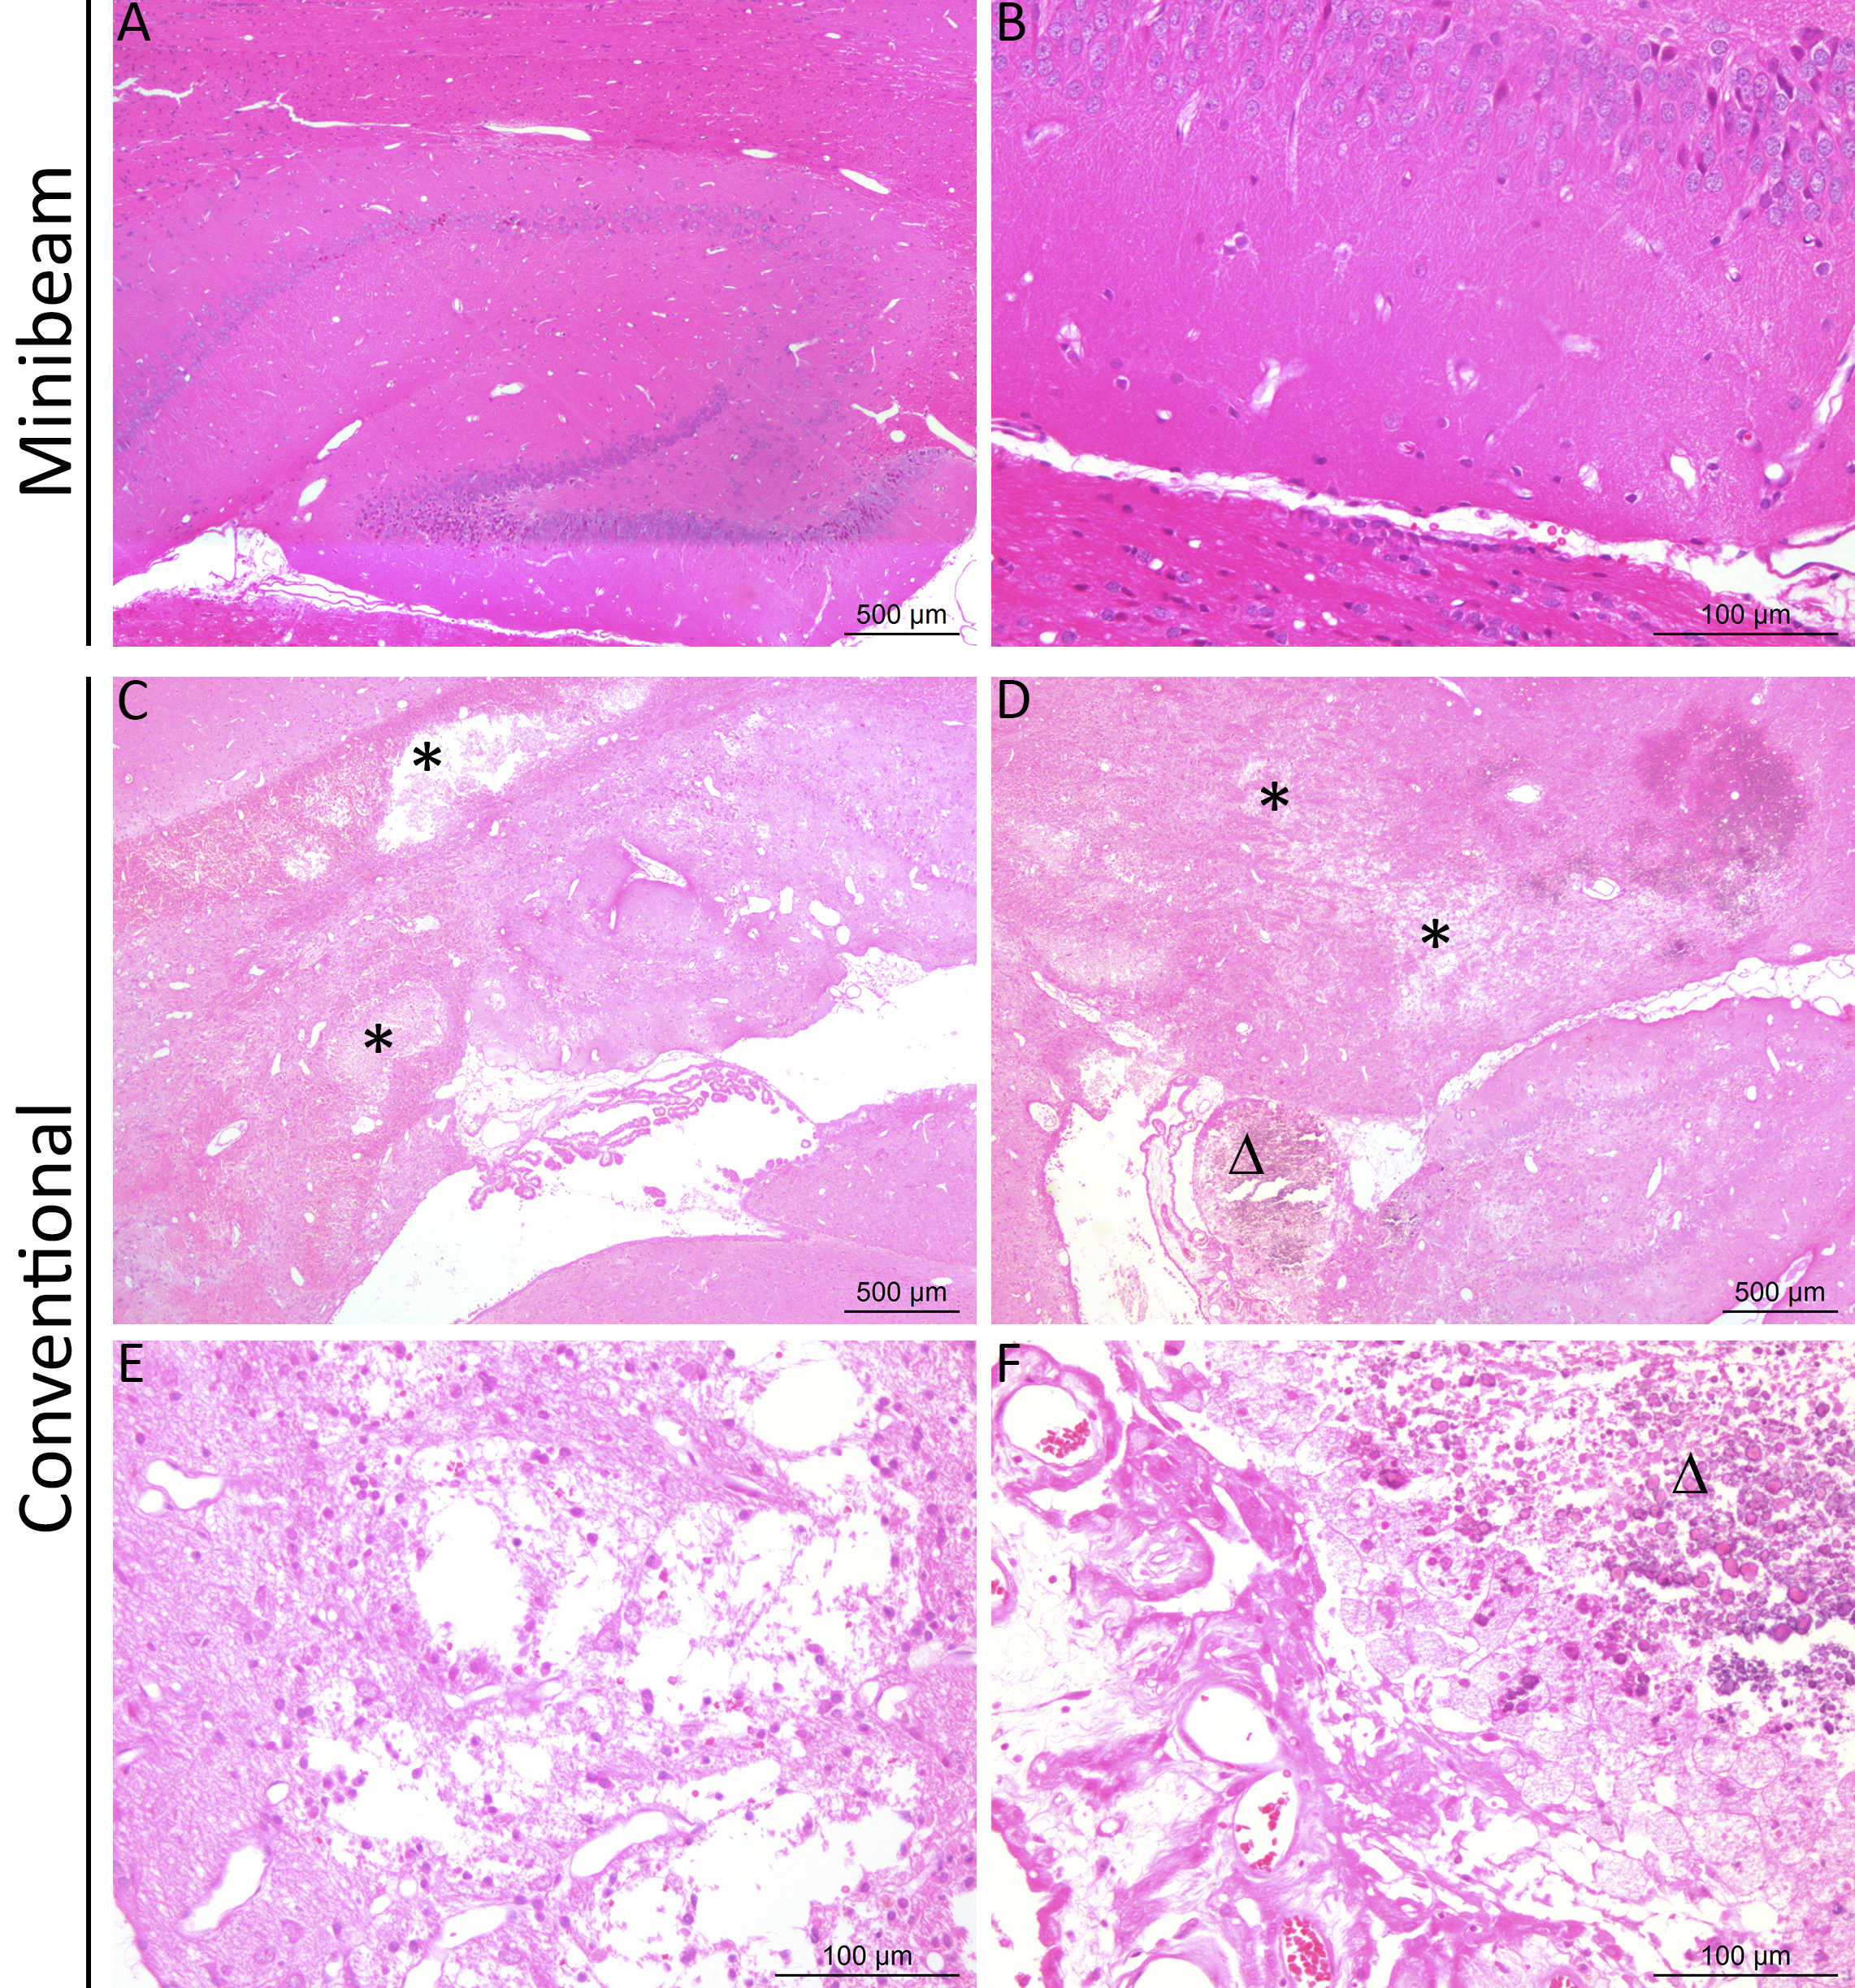
Minibeam radiation therapy: a good compromise
Beam widths: 500-700 µm → transfer to low cost equipment possible
Prezado & Dos Santos et al. Scie. Reports 2017
Proof of concept
Gain in normal tissue tolerances
Whole rat brain irradiation (20 Gy average)
Tumor control effectiveness
F98 glioma-bearing rats
8
8

Slide 9

Moving forward…
Proton minibeam radiation therapy (PROTONMBRT)

Slide 10
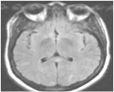
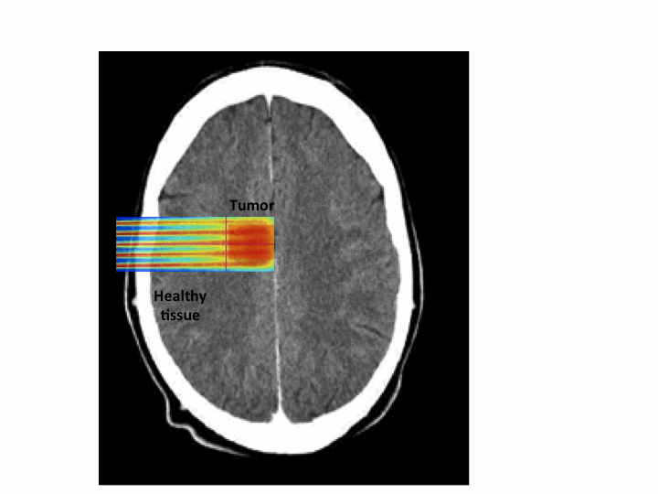
PROTONMBRT: an innovative therapeutic approach
Minibeam radiation therapy
Protons and their specific physics and biology
Proton minibeam radiation therapy
Prezado et al. Med. Phys.2013
Tumor
First implementation worldwide at a Orsay proton therapy centre (I. Curie)
(Peucelle, Martinez,… and Prezado, Med. Phys. 2015)

Slide 11
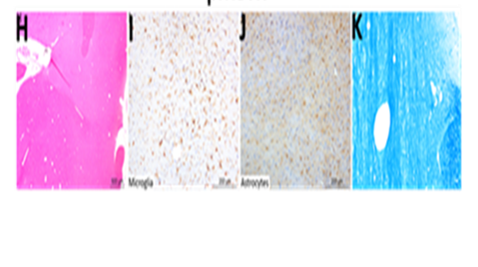
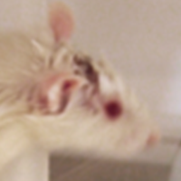
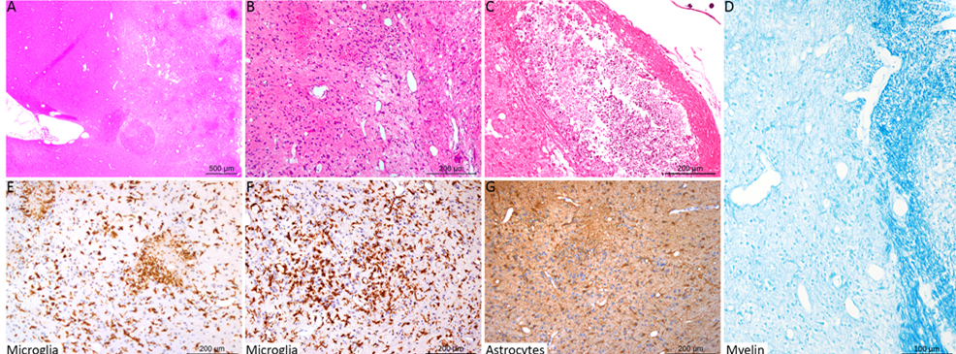
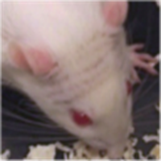
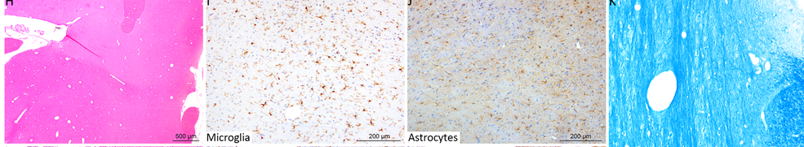
Proton minibeam radiation therapy spares normal brain
First evaluation of normal brain response (Prezado et al. Scie. Rep. 2017)
Whole brain irradiations (normal rats, 7-weeks old). Long-term follow up (6 m)
Standard PT (25 Gy/one fraction)
pMBRT (25 Gy average dose-
58 Gy peak dose/one fraction)
VERSUS
Skin: moist desquamation
Permanent epilation
Important brain damage
No skin damage
Reversible epilation
No brain damage observed
No cognitive effects observed
NET REDUCTION IN NEUROTOXICITY

Slide 12
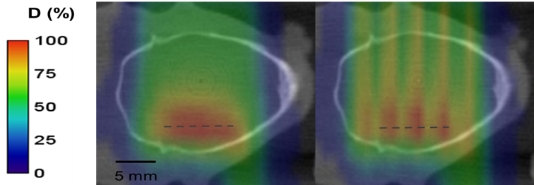
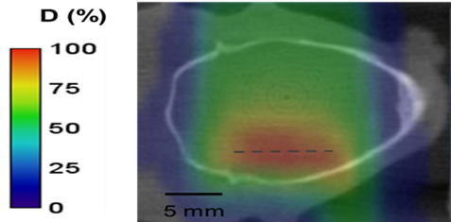
Tumor control effectiveness in glioma (RG2) bearing rats
Standard PT
Tumor
pMBRT
pMBRT → 67 % of long-term survivals (free of tumor).
Among the best results ever obtained with radiotherapy alone
Prezado et al., Red Journal 2019
Tumor
25 Gy/one fraction

Slide 13
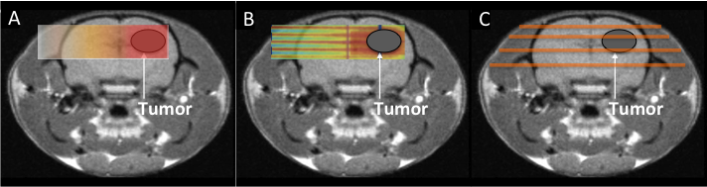
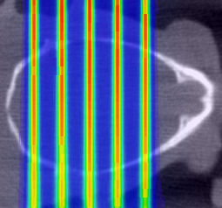
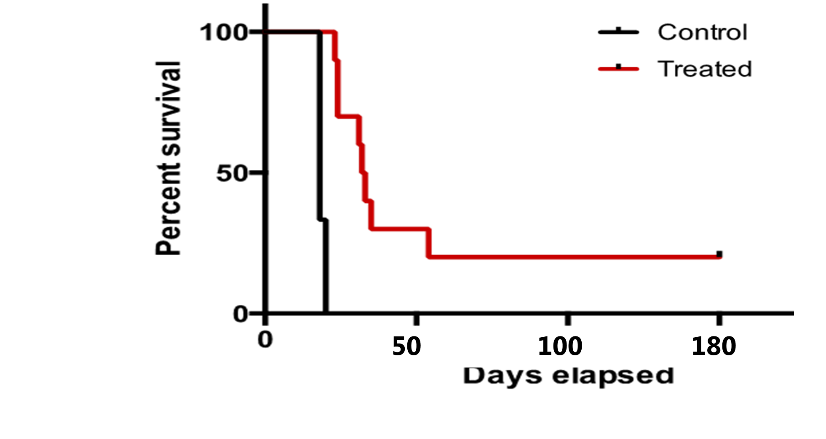
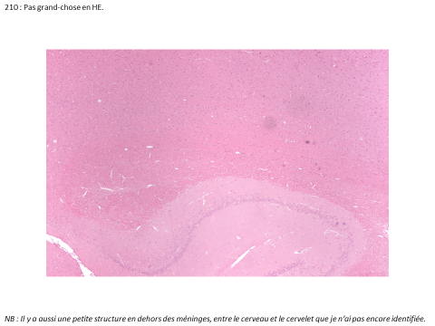
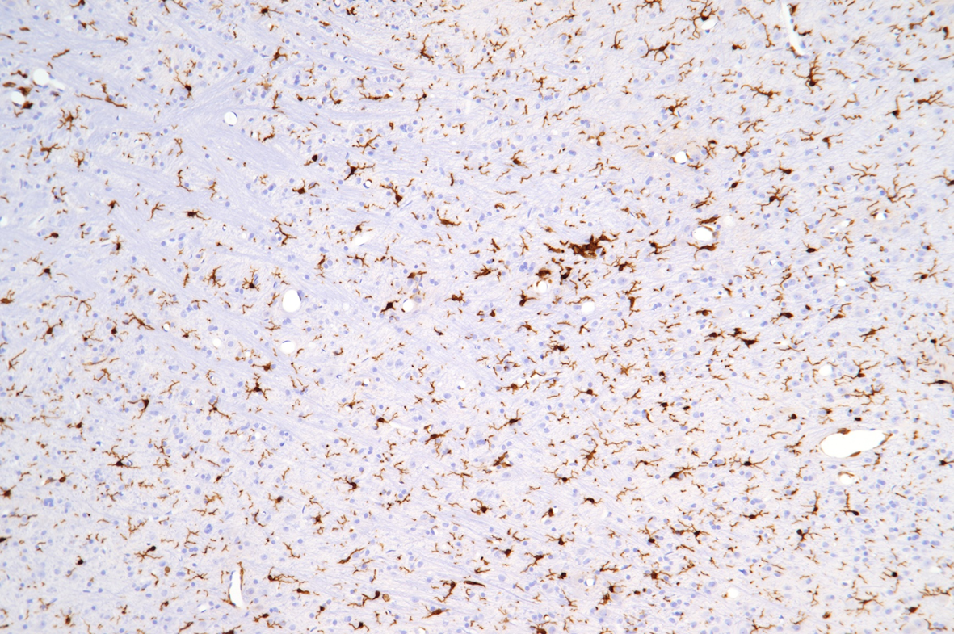
pMBRT provides tumor control even with highly heterogeneous dose distributions
INHOMOGENOUS dose distribution
70 Gy in the peak → 30 Gy average
Whole brain irradiation, 8 days after implantation (n=10)
Without significant toxicity
Prezado et al. Scie. Reports 2018

Slide 14
Proton minibeam radiation therapy widens the therapeutic window for gliomas

Slide 15

Short term objectives (3-5 years)
To reach Phase I/II clinical trials
PROTONMBRT
Proof of concept in
small animals
Clinical trials
ERC consolidator grant (2019-2024)
Generation of intense minibeams at a clinical center
Challenging dosimetry (extremely small field sizes)
Radiobiology
  -To find the physical parameters maximizing the therapeutic index
  -To unravel the biological mechanisms

Slide 16
Implementation at a clinical PBSPBS
MC (TOPAS) versus IBA nano RAZOR diode
6 Gy/min in the peak
Less neutron production
L. De Marzi et al. Med. Phys 2018

Slide 17
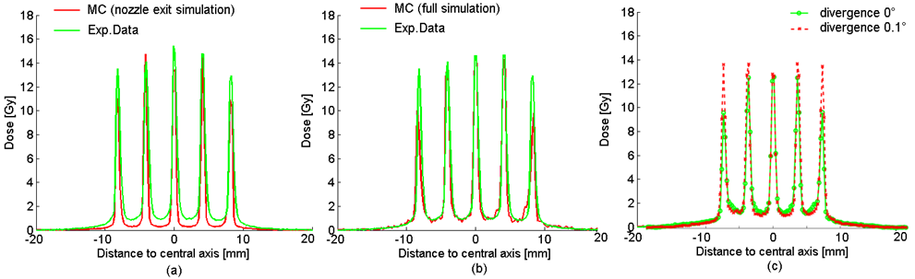
Dosimetry studies
PROTONMBRT: an innovative therapeutic approach
PTW Microdiamond (61009)
IBA nano-RAZOR diode
High spatial resolution (1 µm) in one direction,
2.2 mm in the others
High spatial resolution (60 µm) in all three dimensions
De Marzi et al. Med. Phys. 2018

Slide 18
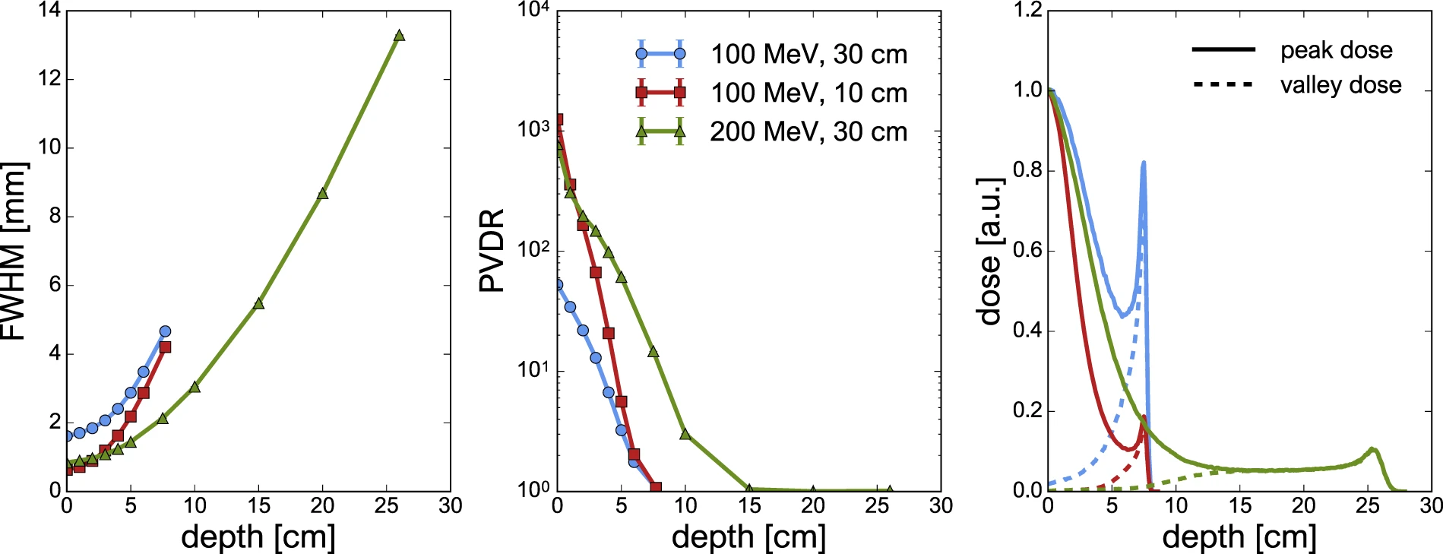
Magnetically focussed proton minibeams at a clinical center
T. Schneider et al. Scientific Reports 2020

Slide 19
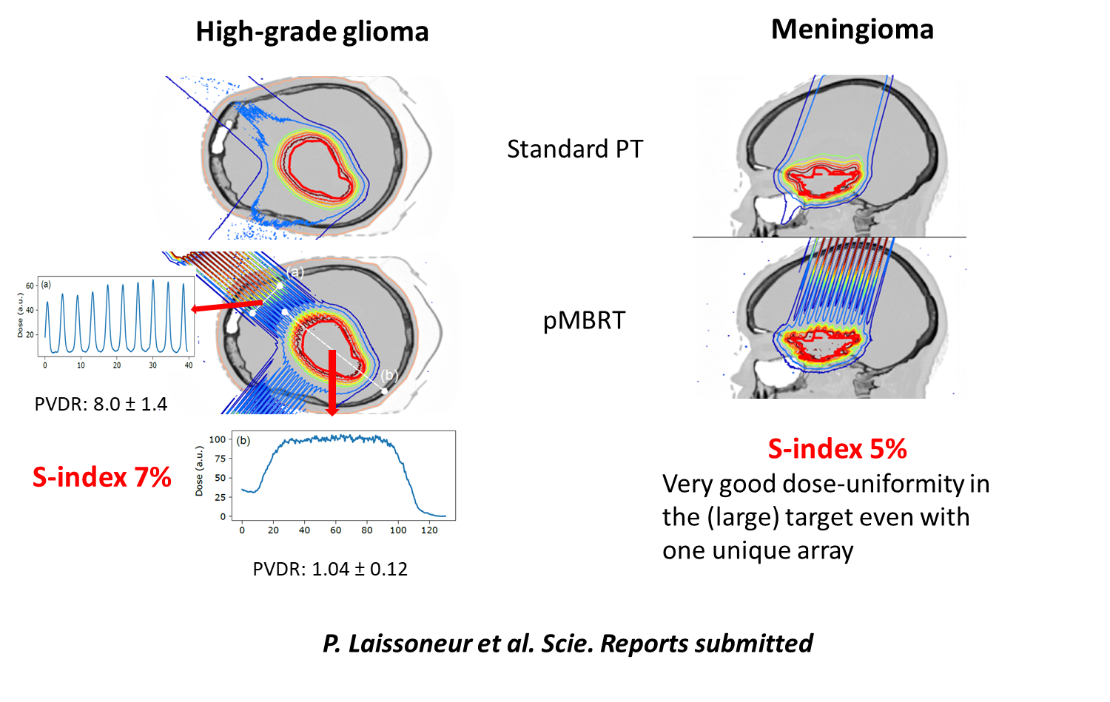
First evaluation of treatment plans
P. Lansonneur et al. Scie. Reports 2020

Slide 20
Moving forward…
Heavy ions minibeam radiation therapy

Slide 21
Heavy ions MBRT: Advantages
Reduced MSC →high PVDR in normal tissue
Narrow beams possible (500 µm)
Gonzalez, Peucelle and Prezado, Med. Phys 2017
Possible synergies of MBRT effects with the higher capacity of ions to inhibit angiogenesis and activate immune system

Slide 22
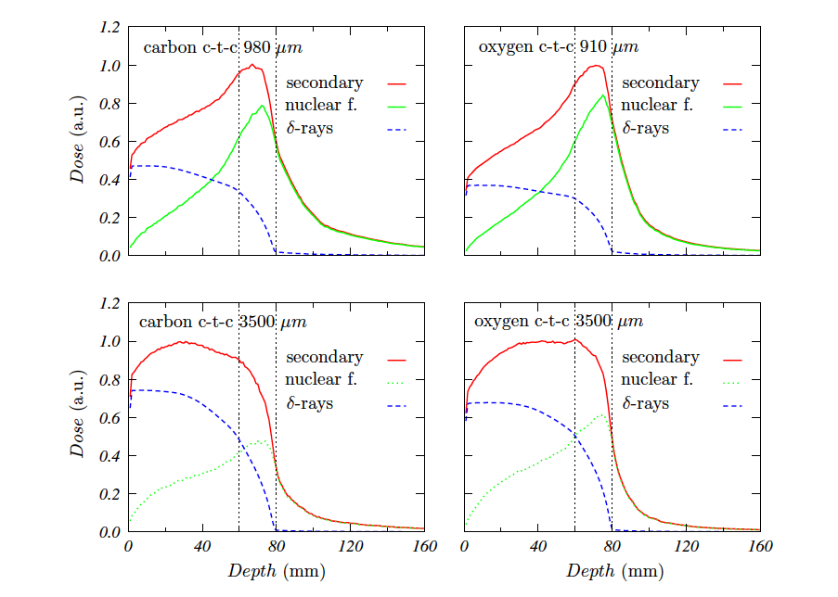
Heavy ions MBRT: impact on valleys
Large beam spacing (ctc) minimize
the contribution of high LET fragments to the valleys
Heavier fragments
are dominant in the valleys at the target position, which might favor tumor control.
Tumor
Larger Beam spacing
Tumor
Gonzalez, Peucelle and Prezado, Med. Phys 2017

Slide 23

Very heavy ions MBRT
Ne, Si and Ar ions used in the past, extremely efficient for the treatment of hypoxic tumors (Castro 1994)
HOWEVER, abandoned due to important side effects in normal tissues
Our hypothesis
Very heavy ions (low OER) + MBRT (sparing of normal tissue)
Improvement of therapeutic index
Peucelle, Martinez and Prezado, Med. Phys. 2015

Slide 24

Final reflections
The dose delivery method may have an important impact on biological response.
Not need to deposit a lethal dose in each of the tumor cells to kill it.
Non-targeted effects can play a major role in RT treatments
Charged particles (p, heavy ions) allow to fully profit from the advantages of spatially fractionated radiotherapy

Slide 25
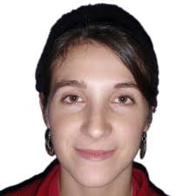


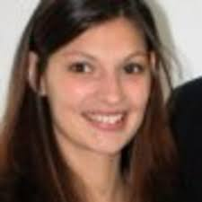

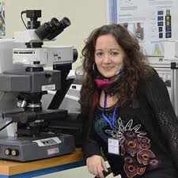
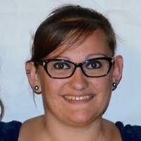


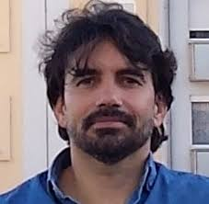
NARA team (former members)
Acknowledgments
Acknowledgments
C. Guardiola
C. Lamirault
R. Delorme
T. Schneider
I. Martinez
M. Dos Santos
J. Bergs
C. Peucelle
W. Gonzalez
Biology Service of IMNC: M. Juchaux

Slide 26
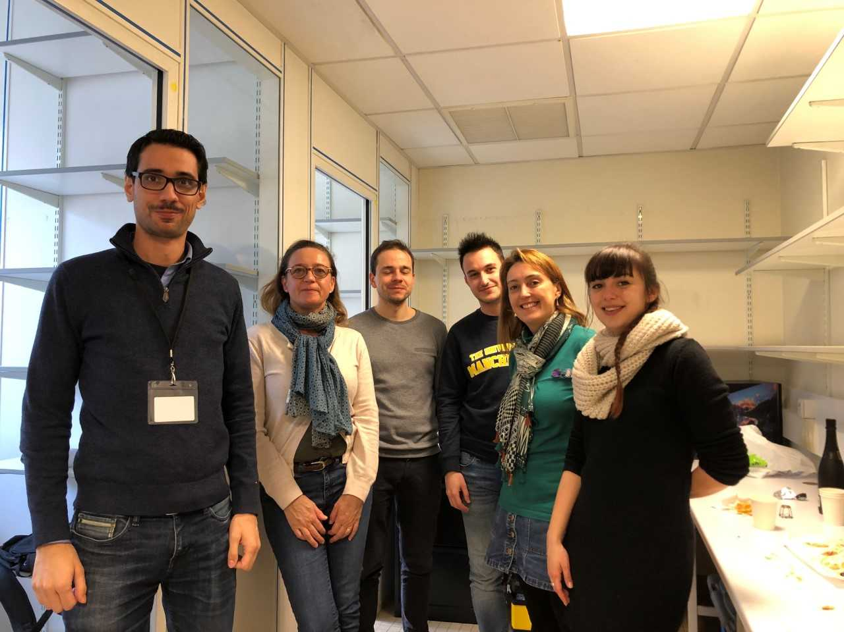
NARA team
Acknowledgments

Slide 27
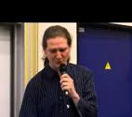
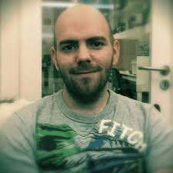
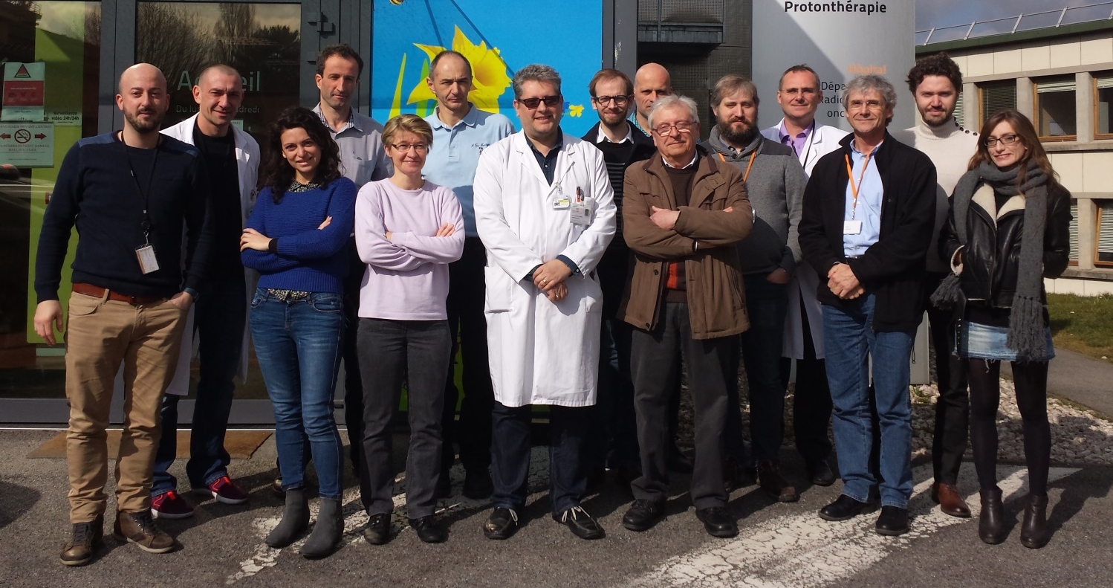

Acknowledgments
Institut Curie
Institut Pasteur
G. Jouvion
D. Hardy
Orsay Proton
therapy Center
A.Patriarca
L. De Marzi
C. Nauraye
R. Dendale
E. Hierso
Experimental RT
platform
F. Pouzoulet
D. Labiod
C. Roulin
IR4M
C. Sebrie

Slide 28
Thank you very much for your attention!
yolanda.prezado@curie.fr

