Slide 1
Using simulation to understand the biological response to proton radiation, from nanodosimetry to treatment planning
Mike Merchant,
Division of Cancer Science, University of Manchester
Patient Scale
Tissue
Cell
DNA
Radiation
Patient Outcome
How much, where, when?
How fast?!
Outcome measures
Patient characteristics, tumour characteristics
LhARA Radiobiology meeting
10th July 2020

Slide 2
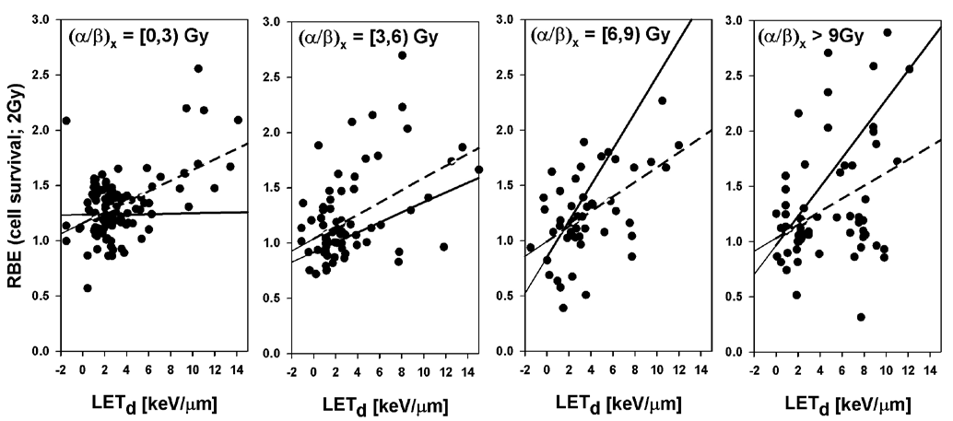
Proton RBE (survival) – in vitro
Why do we need a model?
We don’t understand survival following proton radiation at a cell level
Patient Scale
Tissue
Cell
DNA
Paganetti, H. Relative Biological Effectiveness (RBE) Values for Proton Beam Therapy. Variations as a Function of Biological Endpoint, Dose, and Linear Energy Transfer. Physics in Medicine and Biology 2014, 59, R419–R472.
Notes:
Proton RBE as a function of LET up to 15keV/um.
Dashed = no consideration of uncertainties for experiments.
Solid = considering published uncertainties.

Slide 3


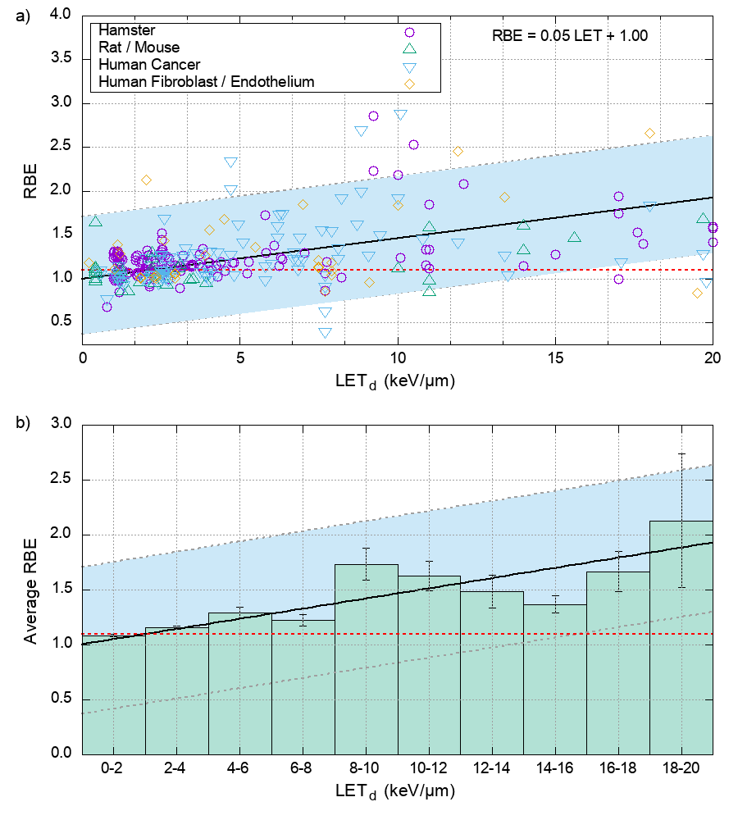
Evidence for Proton RBE (survival)
Proton RBE = 1.1
No significant clinical evidence to suggest under- or over-dosing using constant RBE
  Emerging evidence:
  Underwood et al., Red Journal, 2018
Significant amount of in vitro evidence to support variable RBE in proton therapy
  Paganetti, PIDE database
Patient Scale
Tissue
Energy
Cell
Dose
DNA
Dose rate
Tissue microenvironment
LET
Individual radio sensitivity
Fractionation
Oxygenation
Cell cycle phase
Experimental conditions
Data reproduced from Paganetti, Phys. Med. Biol., 2014
Notes:
Equation

Slide 4
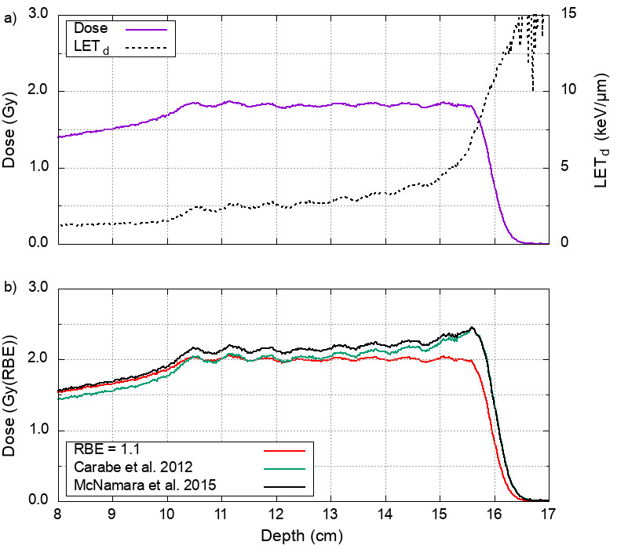
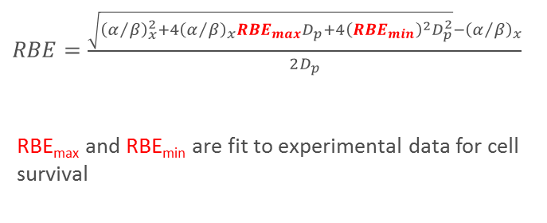
Cell scale approaches to RBE
Phenomenological models
$RBE=\frac{\sqrt{{\left(α/β\right)}_{x}^{2}+4{\left(α/β\right)}_{x}{RBE}_{max}D_{p}+4{\left({RBE}_{min}\right)}^{2}D_{p}^{2}}−{\left(α/β\right)}_{x}}{2D_{p}}$
RBE_{max} and RBE_{min} are fit to experimental data for cell survival
Patient Scale
Many models proposed, but hard to validate using post-treatment imaging.
A major challenge to gain clinical confidence.
(Limited evidence for RBE in vivo)
Tissue
Cell
DNA
Validation
McNamara et al., Phys. Med. Biol., 2015
Carabe et al., Phys. Med. Biol., 2012
Notes:
Phenomenological Models

Slide 5
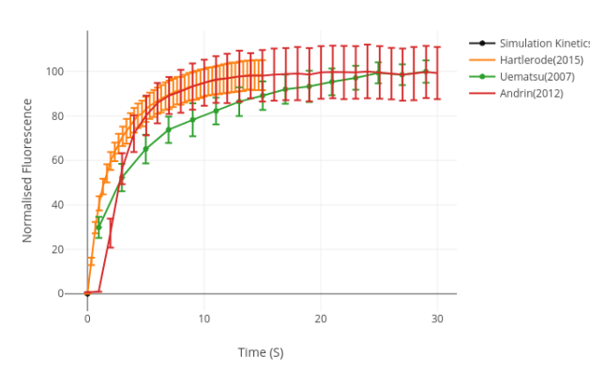
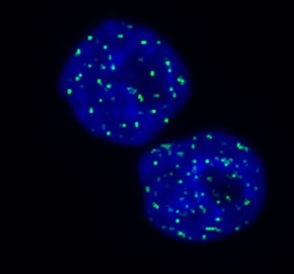
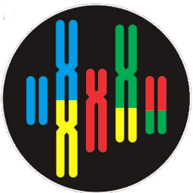
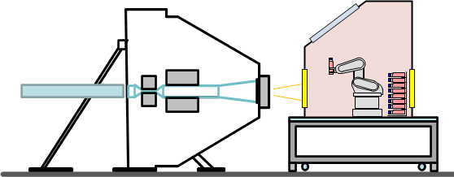
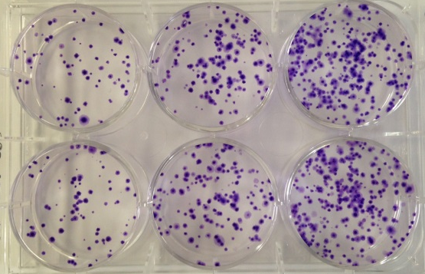
We need to understand what happens before cell death:
What are the mechanisms?
Model Qualification
Multi-assay validation
Measurement
Analysis
Conceptual Model
Protein Kinetics
Model Validation
Simulation
Iteration
Clinical Translation
Reduction of errors
Equipment designed for experimental need
Computerised Model
Development
Model Verification
Foci counting
Understanding the error chain
What is the required experiment to reduce overall uncertainty?
Chromosome Aberrations
Cell survival

Slide 6
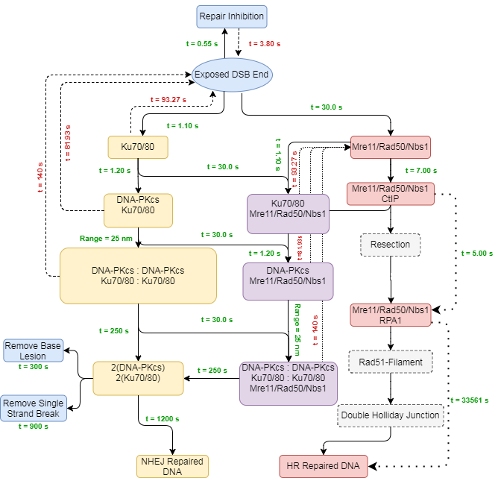
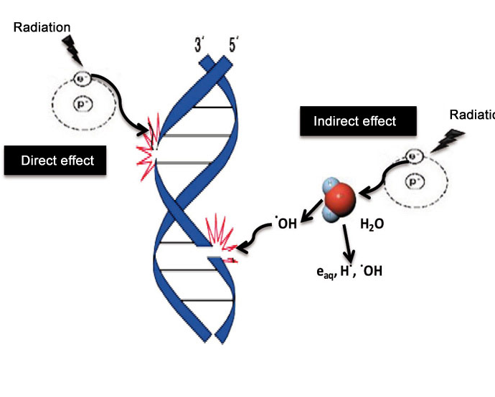
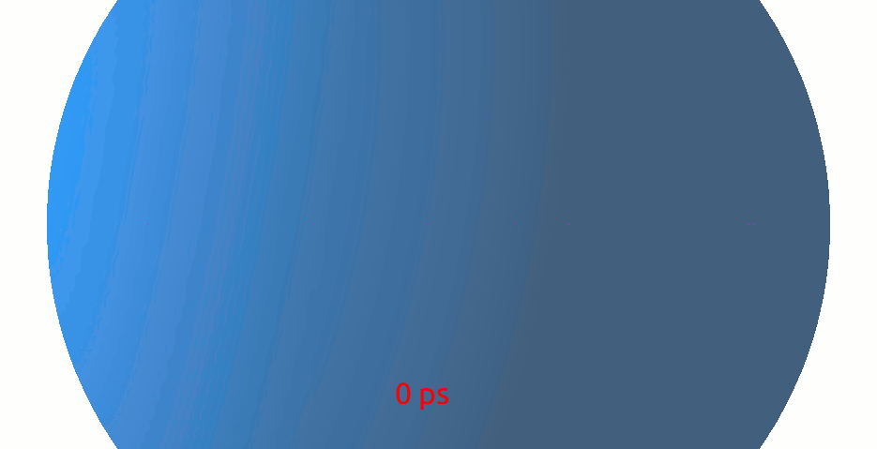
What happens at the DNA level?
3 stages to mechanism of DNA response
Patient Scale
Tissue
Cell
DNA
Physics
Radiation-Chemistry
Repair
Ionisations
Strand breaks
Repair fidelity

Slide 7
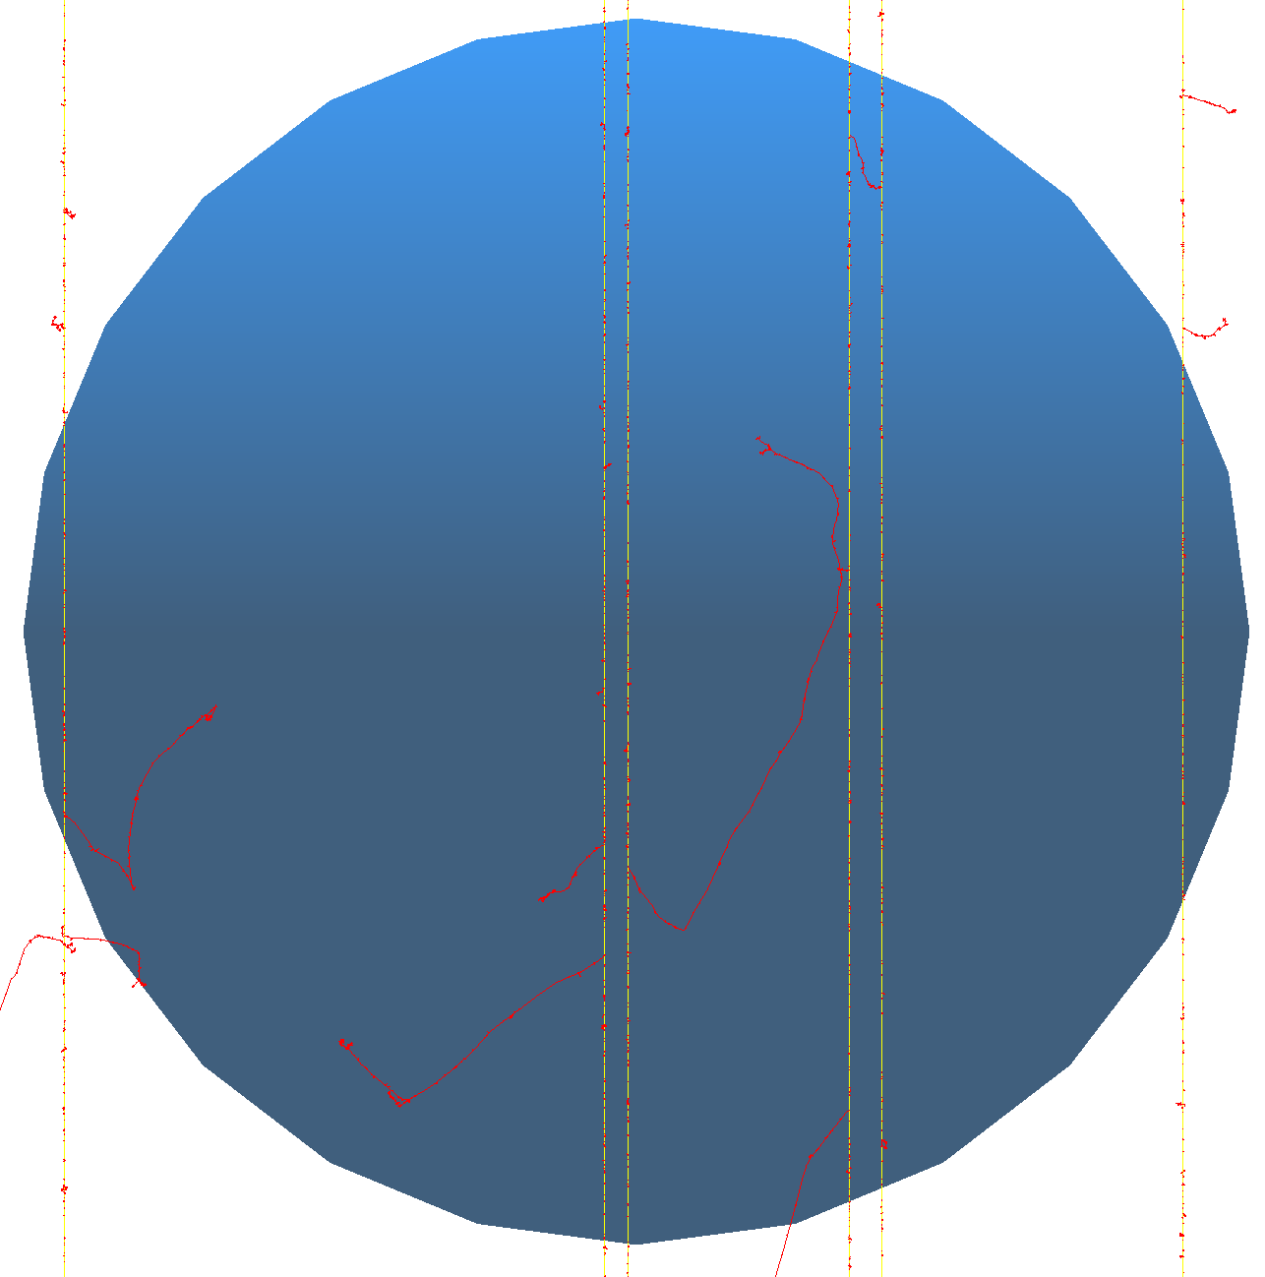
DNA Damage
DNA Double Helix
Chromatin Fibre
Cell Nucleus
Geant4-DNA track structure simulation – protons and other ion species
Energy deposition in DNA can cause a strand break – Mechanism fit to experimental data on plasmid irradiation
OH radicals diffusing to DNA have a probability to cause a strand break – Mechanism fit to proportions proposed in literature
  Damage mechanisms are experimentally measurable (experiments underway)
Breaks on opposite strands separated by 10 bp or less cluster to form a DSB
Model predicts DSB complexity and gives 4D map of position
Notes:
Model of the DNA double helix (including bases and backbones)
The double helix is organised into the chromatin fibre
The chromatin fibres are arranged in the cell nucleus
Geant4 DNA track structure simulation is used to irradiate the geometry with protons, photons, or other ions
Mechanisms of direct DNA damage are included (energy depositions to the bases and backbones are scored)
Mechanisms of indirect damage are included (tracking diffusion of free radicals and reaction of OH radical with DNA)
Parameters of mechanisms are set to reproduce experimental data in the literature
More experiments are planned to further refine these parameters

Slide 8
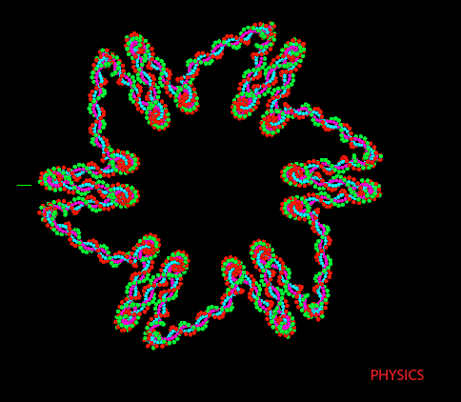
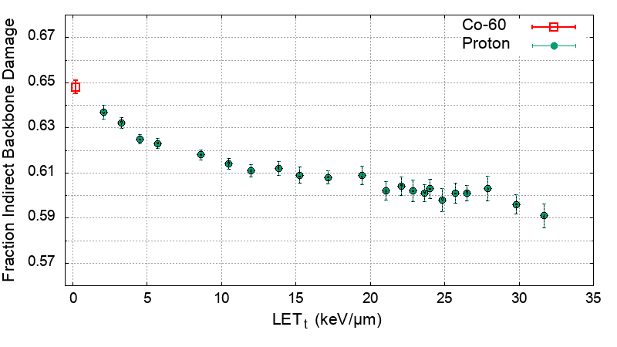
Modelling Direct and Indirect DNA damage
For Co-60 irradiation 65% of the strand breaks are from indirect effects*
Modelling Assumption
If an OH radical steps into a DNA backbone it reacts, set a probability that the reaction causes damage
P=0.5 gives 65% indirect damage
*Ward, Radiat. Res., 1985

Slide 9
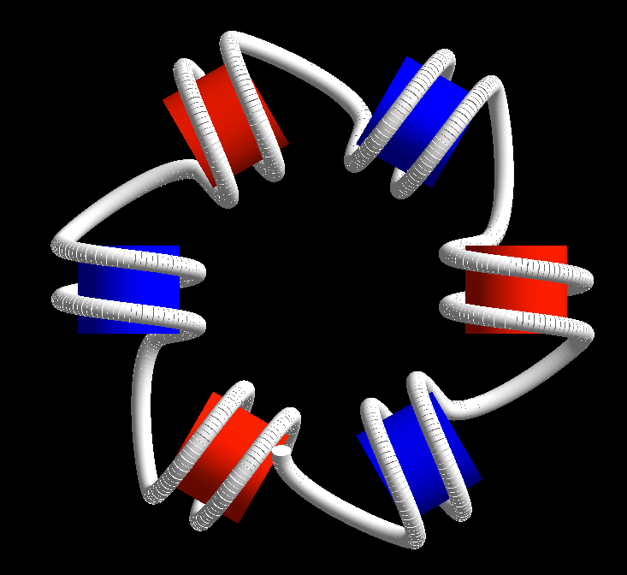
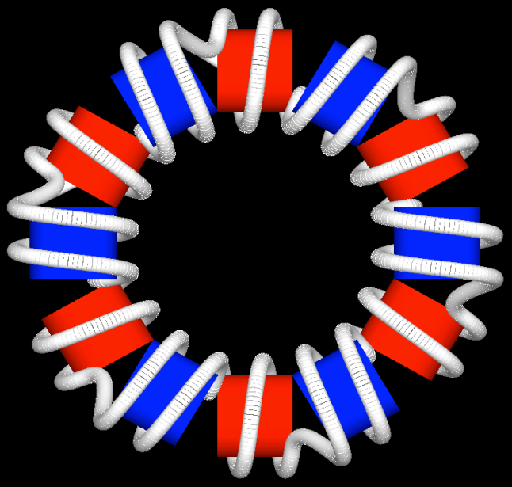
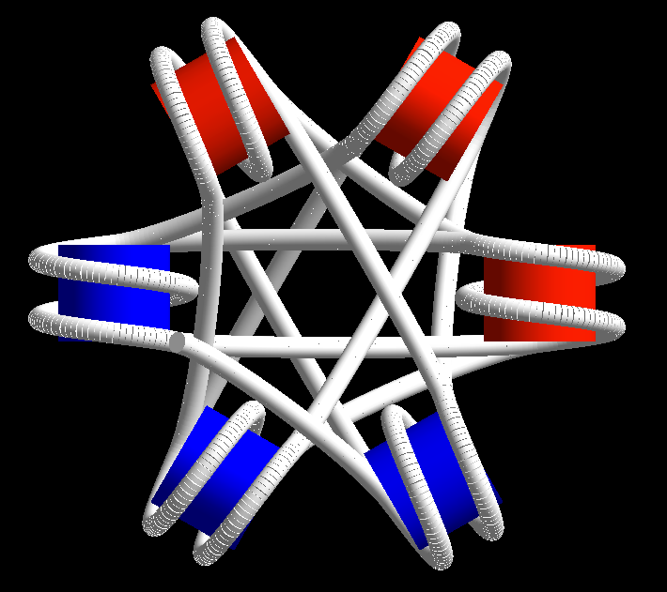
Chromatin Models
Solenoid
Zig-Zag
Cross-Linked
y
x
37 nm
40 nm
37 nm
61 Nucleosomes
4.2 Nuc/11nm
10.8 kbp DNA
61 Nucleosomes
4.2 Nuc/11nm
10.5 kbp DNA
61 Nucleosomes
4.2 Nuc/11nm
12.4 kbp DNA
Henthorn et al. Rad Res 2017
Even modelling chromatin is not simple – we need to know what model of chromatin to use!
Notes:
A few different models
Shows organisation of nucleosome and how they are linked
Built coming out of the screen
Set chromatin density the same
Different amount of dna built

Slide 10
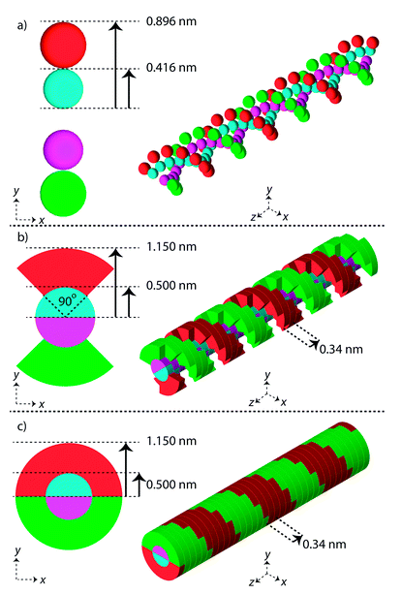
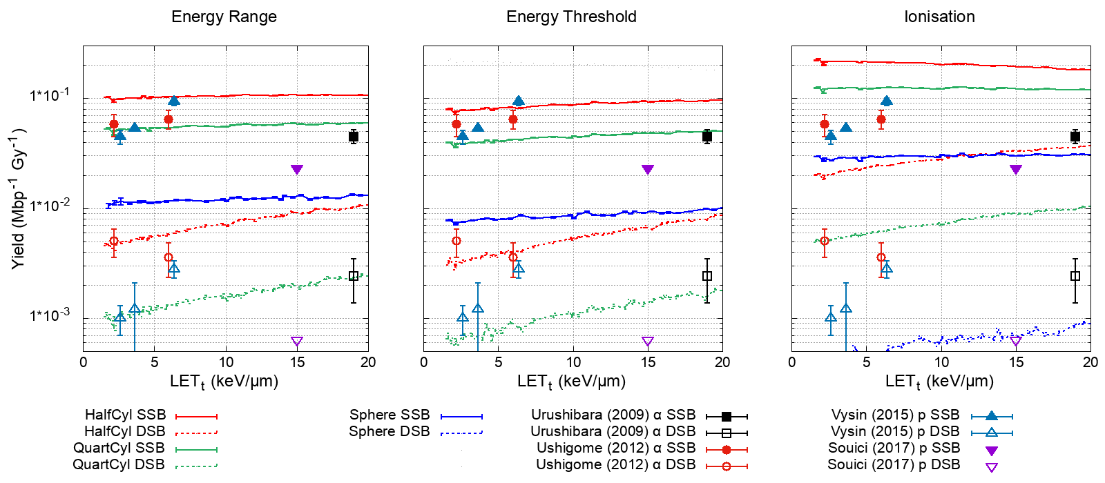
Is the damage model accurate?
Plasmid data:
5 – 37.5 eV
17.5 eV
Sphere
QuartCyl
HalfCyl
Henthorn, N.T., Warmenhoven, J.W., Sotiropoulos, M., Aitkenhead, A.H., Smith, E.A.K., Ingram, S.P., Kirkby, N.F., Chadwick, A.L., Burnet, N.G., Mackay, R.I., Kirkby, K.J. and Merchant, M.J.; Clinically relevant nanodosimetric simulation of DNA damage complexity from photons and protons; RSC advances; 2019.
Notes:
5 - 37.5 eV

Slide 11
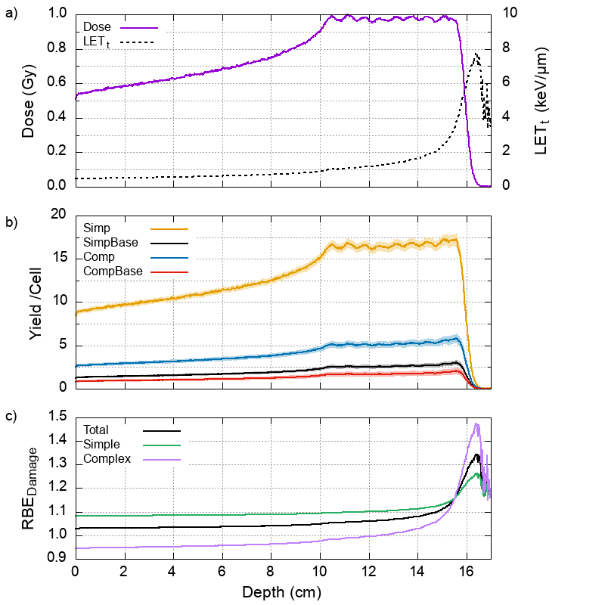
RBE of Damage Complexity
“Simple”
“Complex”
Henthorn, N.T., Warmenhoven, J.W., Sotiropoulos, M., Aitkenhead, A.H., Smith, E.A.K., Ingram, S.P., Kirkby, N.F., Chadwick, A.L., Burnet, N.G., Mackay, R.I., Kirkby, K.J. and Merchant, M.J.; Clinically relevant nanodosimetric simulation of DNA damage complexity from photons and protons; RSC advances; 2019.
Notes:
Using the model predictions we can convert physical dose and track averaged LET into biological predictions
Middle panel shows predictions on types of DSBs that we would expect at a given depth (schematic shows structure of DSB)
Hypothesis in the literature seems to be that complex DSBs are harder to repair and will lead to cell death
Model can also do photons.
Bottom panel shows an RBE of DSB between photon and proton

Slide 12
DNA Repair
DaMaRiS – The DNA Mechanistic Repair Simulator
Warmenhoven, J.W., Henthorn, N.T., Ingram, S.P., Chadwick, A.L., Sotiropoulos, M., Korabel, N., Fedotov, S., Mackay, R.I., Kirkby, K.J. and Merchant, M.J.; Insights into the non-homologous end joining pathway and double strand break end mobility provided by mechanistic in silico modelling; DNA repair; 2020.
Ingram, S.P., Warmenhoven, J.W., Henthorn, N.T., Smith, E.A.K., Chadwick, A.L., Burnet, N.G., Mackay, R.I., Kirkby, N.F., Kirkby, K.J. and Merchant, M.J; Mechanistic modelling supports entwined rather than exclusively competitive DNA double-strand break repair pathway; Scientific reports; 2019.

Slide 13
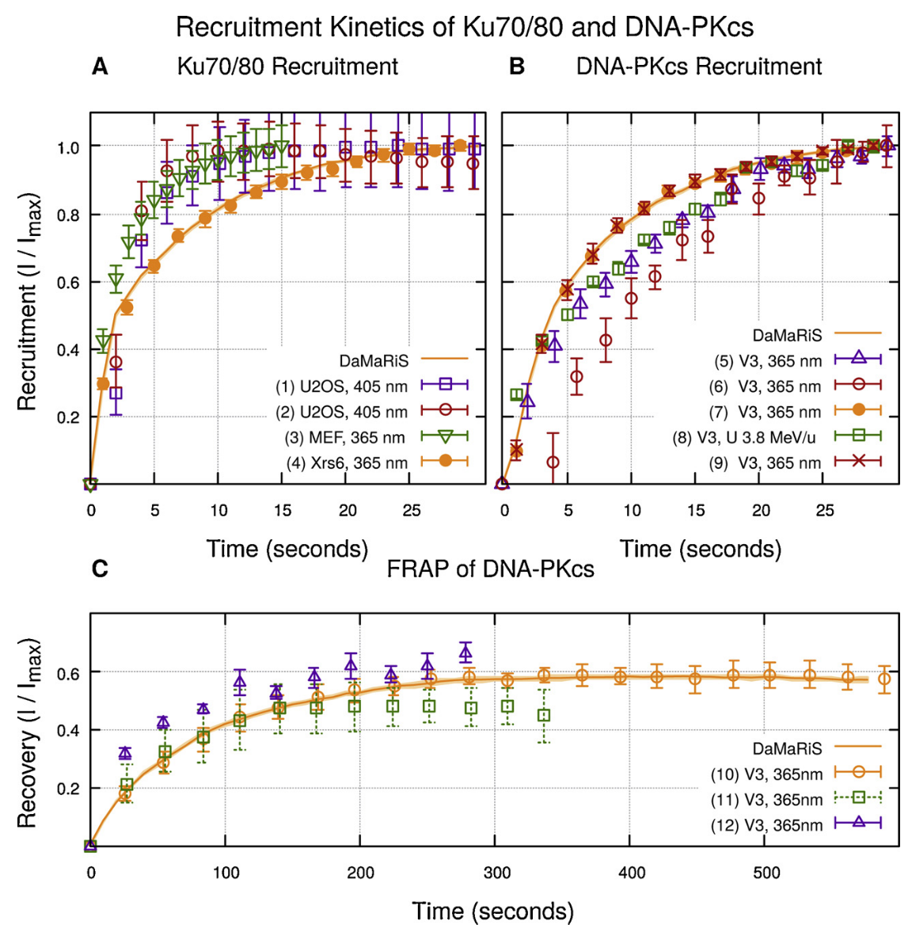
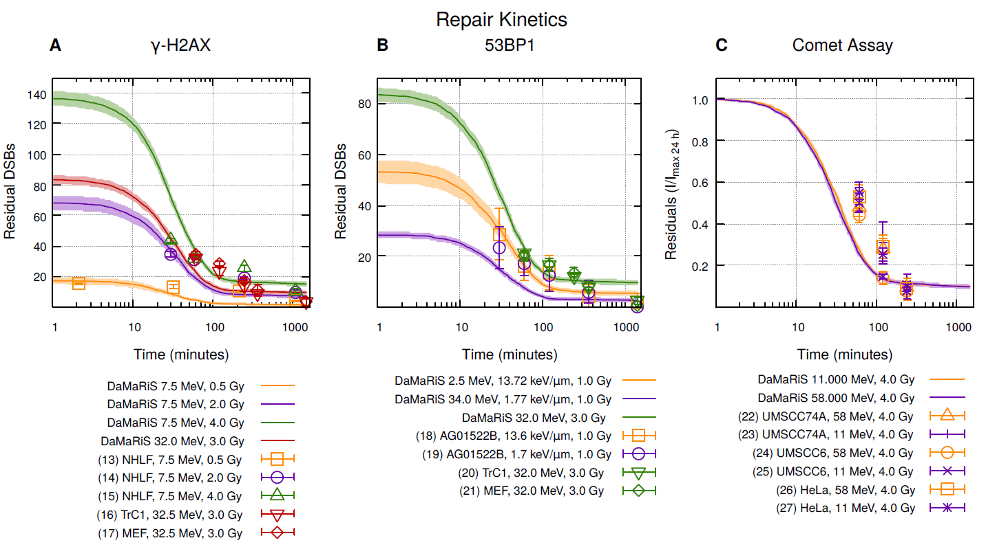
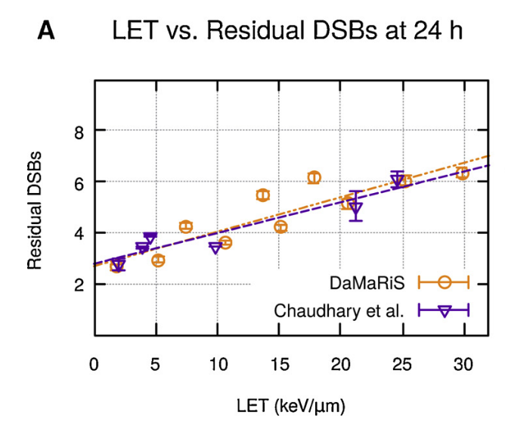
DNA Repair:
Fitting Protein Kinetics
Warmenhoven, J.W., Henthorn, N.T., Ingram, S.P., Chadwick, A.L., Sotiropoulos, M., Korabel, N., Fedotov, S., Mackay, R.I., Kirkby, K.J. and Merchant, M.J.; Insights into the non-homologous end joining pathway and double strand break end mobility provided by mechanistic in silico modelling; DNA repair; 2020.

Slide 14
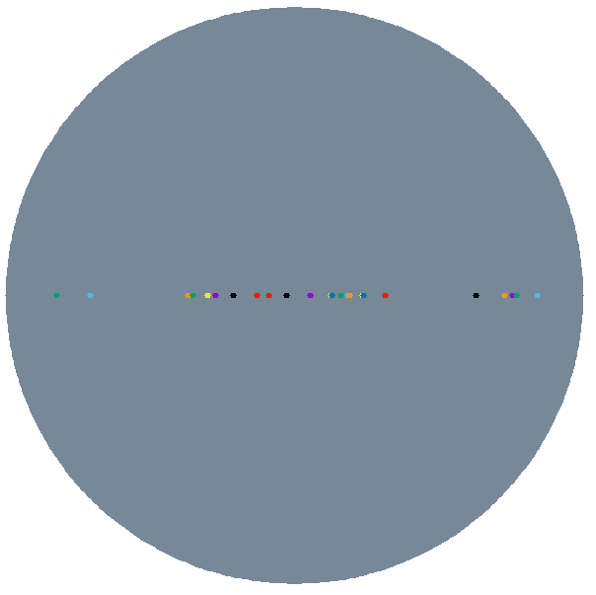
DNA Repair:
Motion of DSBs during repair
Exaggerated motion for visualization
Warmenhoven, J.W., Henthorn, N.T., Ingram, S.P., Chadwick, A.L., Sotiropoulos, M., Korabel, N., Fedotov, S., Mackay, R.I., Kirkby, K.J. and Merchant, M.J.; Insights into the non-homologous end joining pathway and double strand break end mobility provided by mechanistic in silico modelling; DNA repair; 2020.

Slide 15
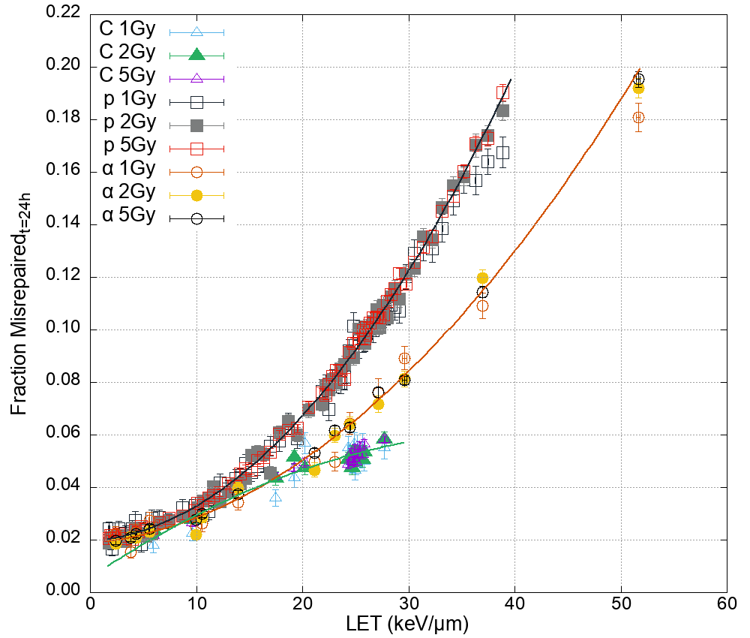
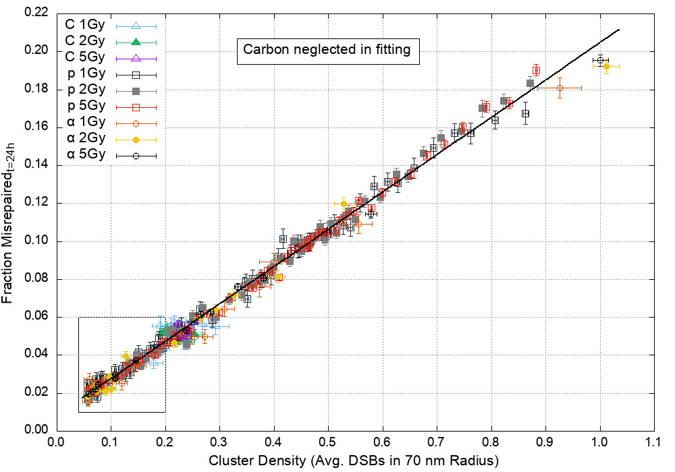
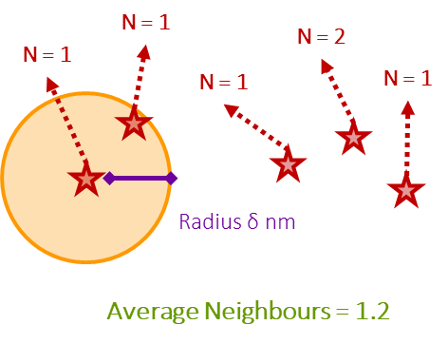
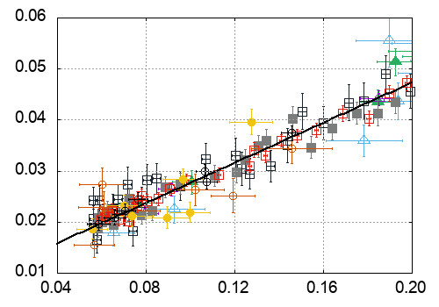
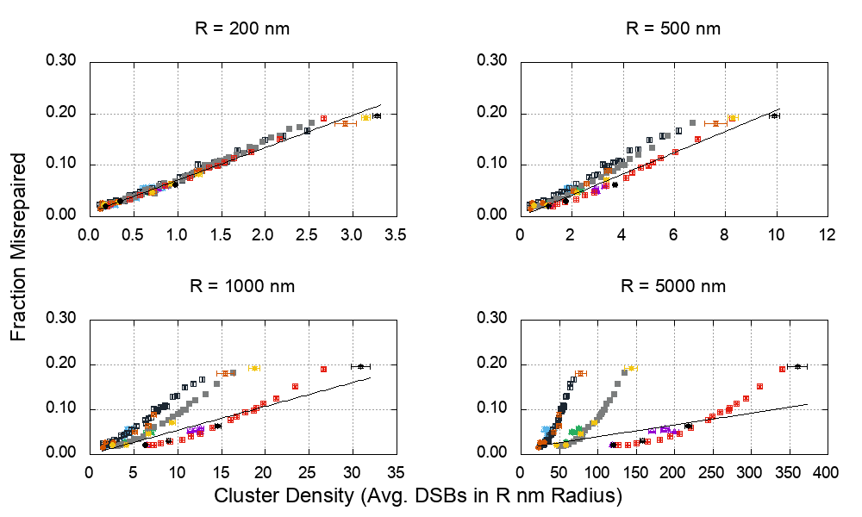
DNA Damage & Repair:
DSB cluster size
Henthorn NT, Warmenhoven JW, Sotiropoulos M, Mackay RI, Kirkby NF, Kirkby KJ, Merchant MJ; In silico non-homologous end joining following ion induced DNA double strand breaks predicts that repair fidelity depends on break density; Scientific reports; 2018.

Slide 16
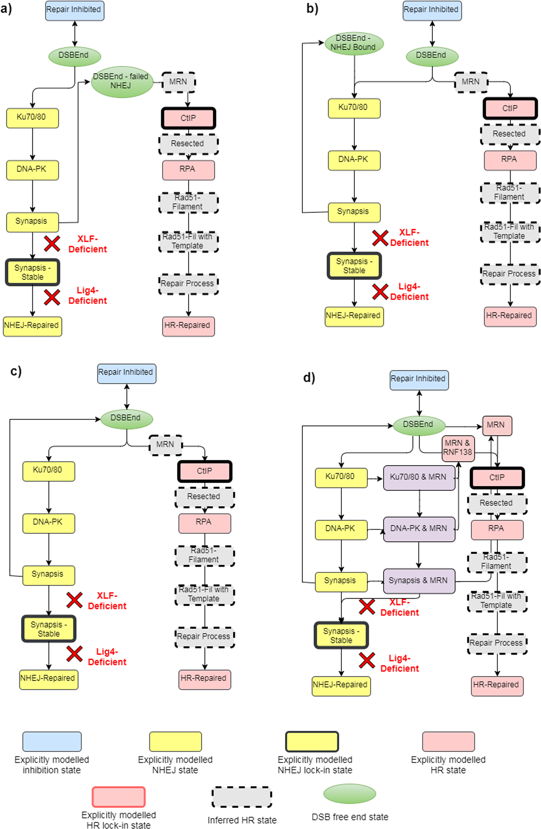
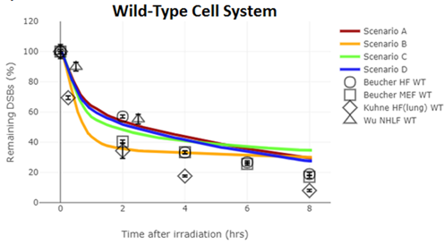
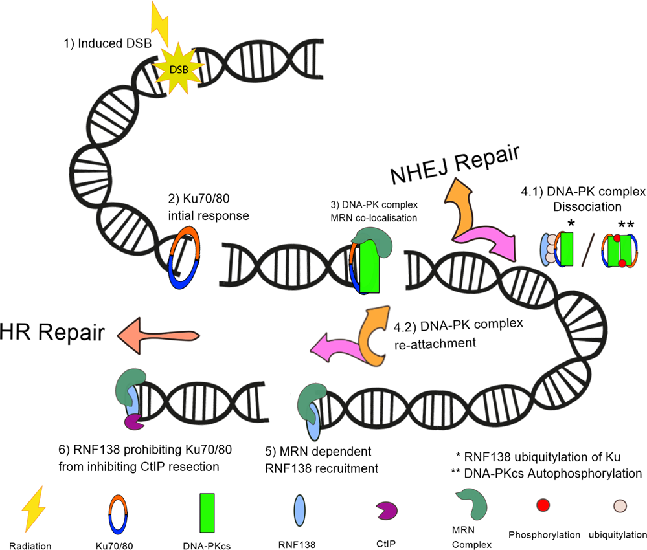
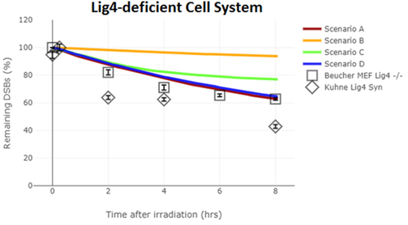
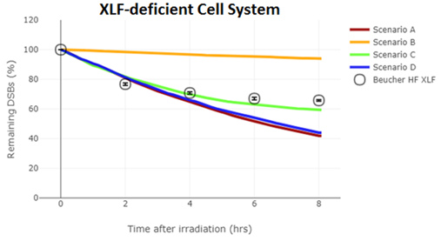
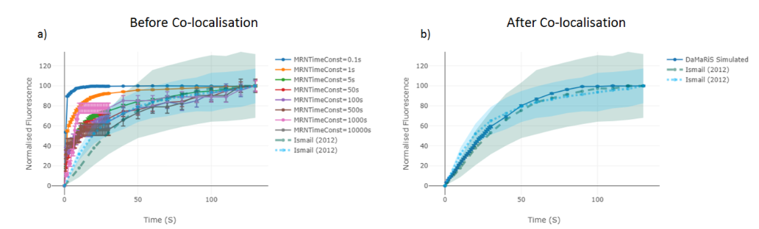
DNA Repair: Pathway interactions
NHEJ First
Competition
Re Competition
Entwined
Ingram, S.P., Warmenhoven, J.W., Henthorn, N.T., Smith, E.A.K., Chadwick, A.L., Burnet, N.G., Mackay, R.I., Kirkby, N.F., Kirkby, K.J. and Merchant, M.J; Mechanistic modelling supports entwined rather than exclusively competitive DNA double-strand break repair pathway; Scientific reports; 2019.

Slide 17
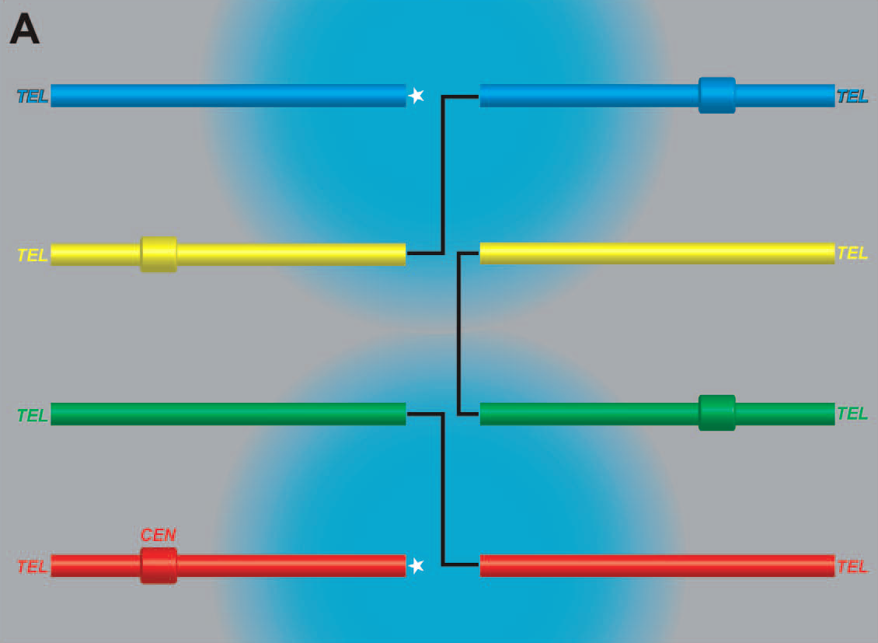
A critical parameter of repair fidelity:
DSB motion
Loucas, B.; Cornforth, M. The LET Dependence of Unrepaired Chromosome Damage in Human Cells: A Break Too Far? Radiat Res 2013

Slide 18
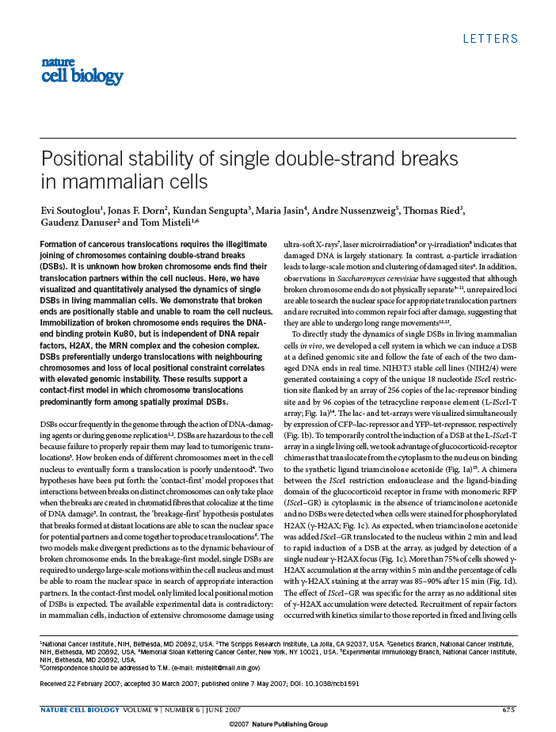
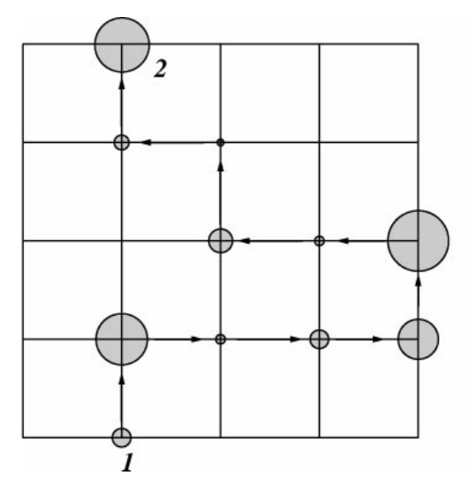
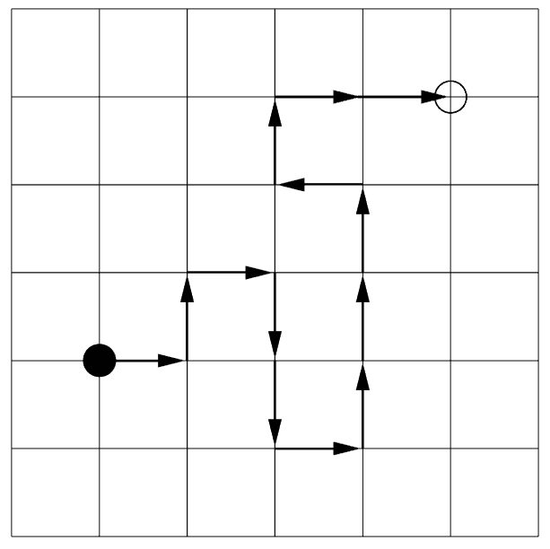
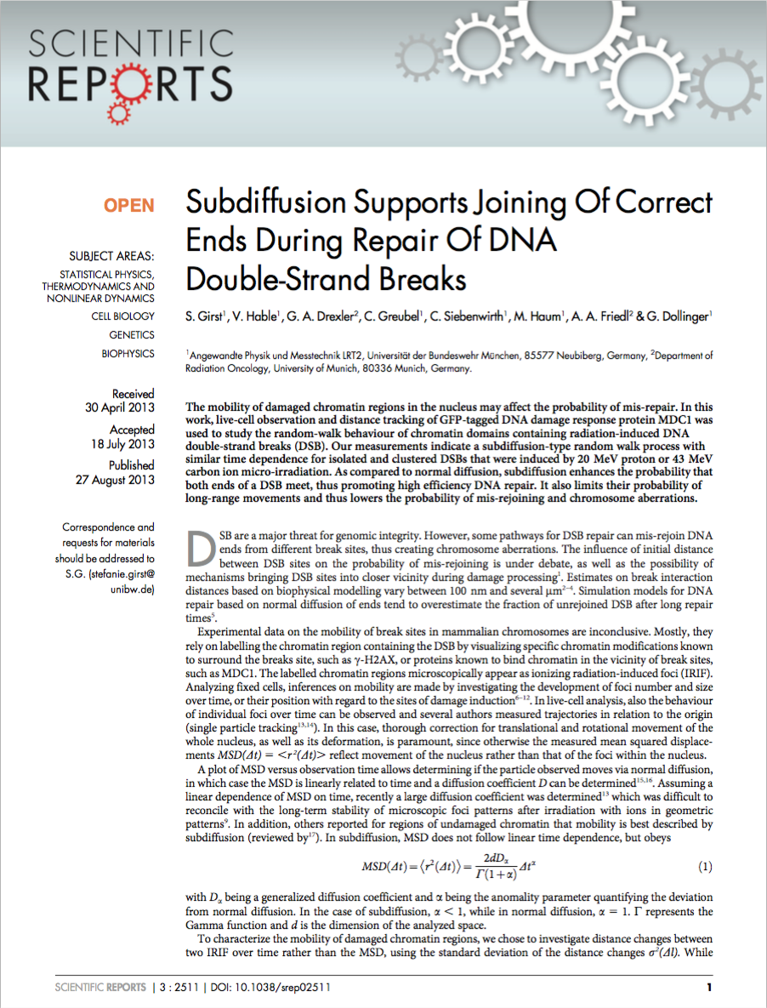
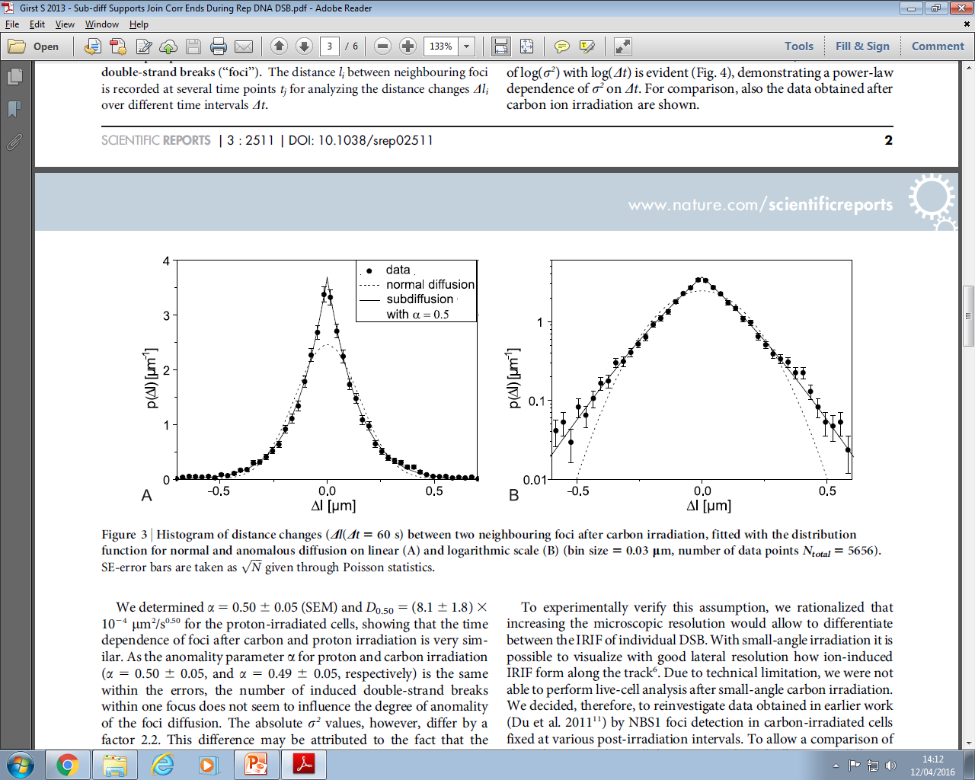
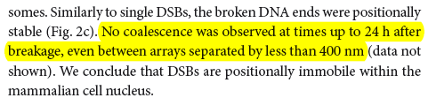

Anomalous diffusion of DSB Ends
‘Standard’ diffusion
Anomalous diffusion
Figure 4. & 5.Metzler, R. and Klafter, J (2000) The Random Walk’s Guide to Anomalous Diffusion: A Fractional Dynamics Approach, Physics Reports
Dr Nickolay Korabel,
Prof Sergei Fedotov

Slide 19
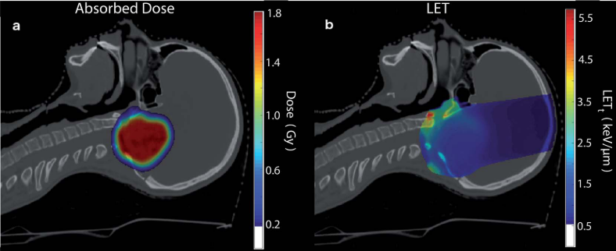
Model Translation:
From DNA scale to Patient Scale
E. Smith et al., Nat. Sci. Rep 2019

Slide 20
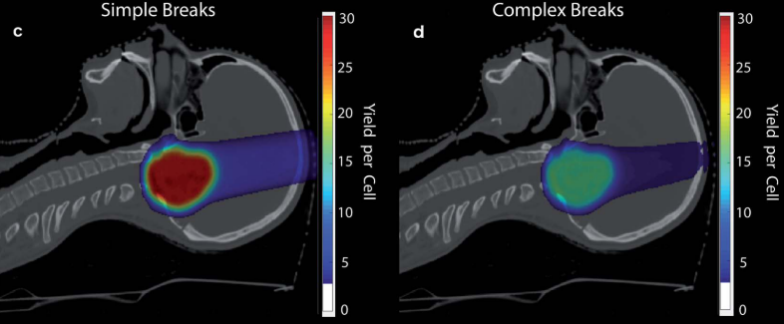
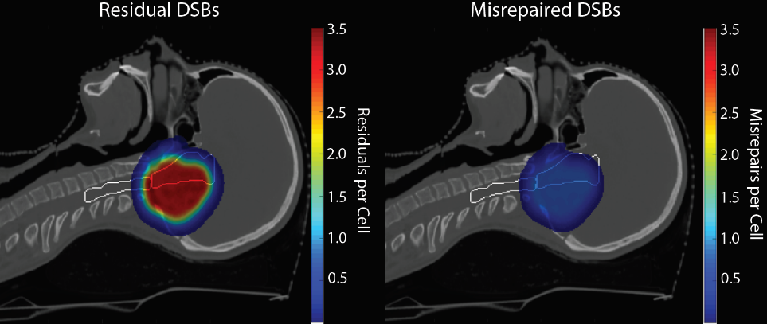
Model Translation:
From DNA scale to Patient Scale
N. Henthorn et al., RSC Advances, 2019
E. Smith et al., Nat. Sci. Rep 2019

Slide 21
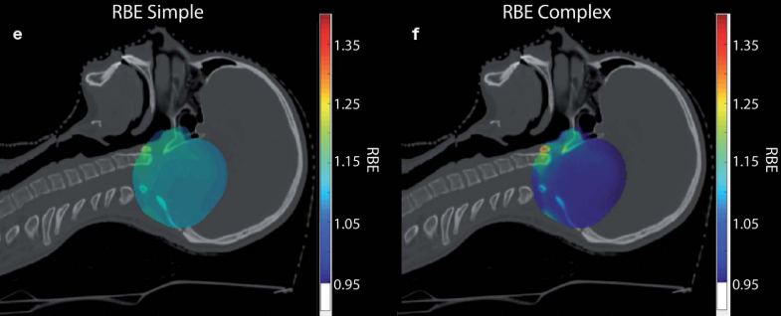
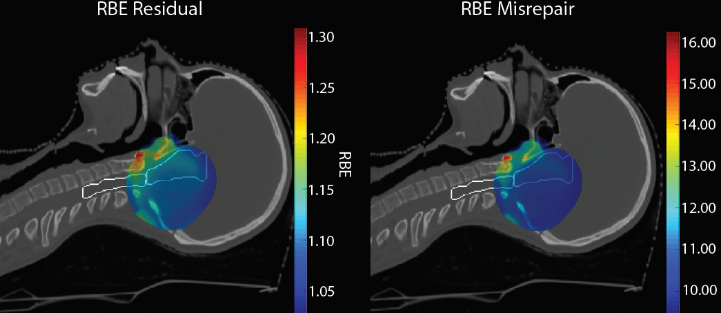
Model Translation:
From DNA scale to Patient Scale
N. Henthorn et al., RSC Advances, 2019
E. Smith et al., Nat. Sci. Rep 2019

Slide 22
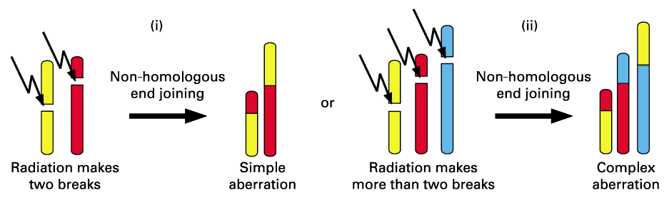
Moving to the Cell Scale:
Chromosome Aberrations
Patient Scale
Tissue
Figure from: Sachs, RK; Levy, D; Hahnfeldt, P; Hlatky, L Quantitative Analysis of Radiation-Induced Chromosome Aberrations.Cytogenetic and genome … 2004
Cell
DNA

Slide 23
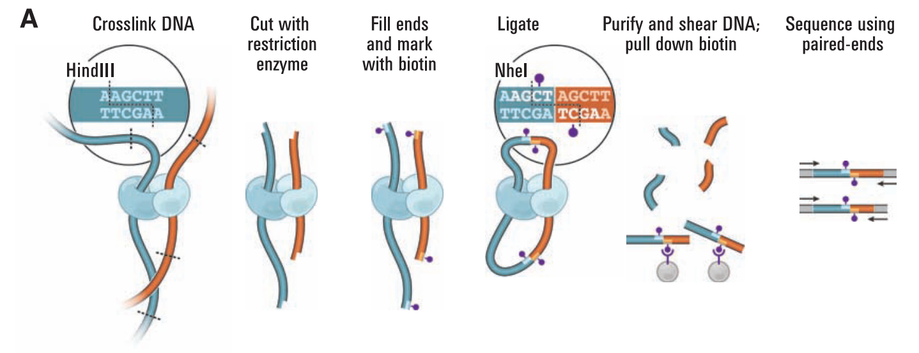

Using genomic data to model cell nucleus:
Hi-C
A biological technique to measure gene-gene contacts
Cells are crosslinked to join nearby chromatin segments
Crosslinked segments are marked and analysed to give contact frequency
Repeats over many cells gives an average contact frequency map
Technique identifies “Topologically Associated Domains”, highlighting frequent gene-gene interactions
Data can be used to reconstruct a 3D geometry
Resolution depends on restriction enzymes, Typically ~10kbp
Liberman-Aiden, E., van Berkum, N.L., Williams, L., Imakaev, M., Ragoczy, T., Telling, A., Amit, I., Lajoie, B.R., Sabo, P.J., Dorschner, M.O., Sandstrom, R., Bernstein, B., Bender, M.A., Groudine, M., Gnirke, A., Stamatoyannopoulos, J., Mirny, L.A., Lander, E.S., and Dekker, J.; Comprehensive mapping of long-range interactions reveals folding priniciples of the human genome; Science; 2009

Slide 24

Using Hi-C data :
A spatial solver
Solving:
46 Chromosomes
15,282 Beads
31,062 Constraints
Ingram, S.P., Henthorn, N.T., Warmenhoven, J.W., Kirkby, N.F., Mackay, R.I., Kirkby, K.J. and Merchant, M.J; Hi-C implementation of genome structure for in silico models of radiation-induced DNA damage. Submitted 2020.

Slide 25



Using Hi-C data: Cell line specific models
IMR90
Human, Normal
Fibroblast
GM12878
Human, Normal
B-Lymphocyte
HMEC
Human, Normal
Dermal Endothelium
Ingram, S.P., Henthorn, N.T., Warmenhoven, J.W., Kirkby, N.F., Mackay, R.I., Kirkby, K.J. and Merchant, M.J; Hi-C implementation of genome structure for in silico models of radiation-induced DNA damage. Submitted 2020.

Slide 26


Radiation interactions at the nucleus scale: Cell line specific prediction of DSB
Ingram, S.P., Henthorn, N.T., Warmenhoven, J.W., Kirkby, N.F., Mackay, R.I., Kirkby, K.J. and Merchant, M.J; Hi-C implementation of genome structure for in silico models of radiation-induced DNA damage. Submitted 2020.

Slide 27


Bridging the DNA and cell scale: Chromosome Aberrations
DNA fragment creation
Patient Scale
Chromosome aberration prediction
(cell fate and mutagenesis)
And…
Micronuclei formation prediction!
Tissue
Cell
DNA

Slide 28

Moving from Cell to Tissue level models:
Cell Cycle Modelling
Integration of cell cycle models with DNA repair models is a major hurdle for bridging timescales ion multiscale modelling.
Will enable mechanistic simulation of response to radiation at a tissue level.
Vital for modelling FLASH, Proton vs photon immune response, mechanisms of inflammation …
Patient Scale
Tissue
Cell
DNA
Waves of age density propagating through the cell cycle
CellCyMUS simulation courtesy of Norman Kirkby, PRECISE, University of Manchester

Slide 29

Thanks for listening!
The people who did most of the work
Dr Nick Henthorn
Dr John Warmenhoven
Dr Nickolay Korabel
Sam Ingram
Ed Smith
Yaping Qi
Charlotte Heaven
Bethany Rothwell
Kristina Small
Hannah Wantsall
Also thanks to:
Prof Karen Kirkby
Prof. Ranald MacKay
Prof. Norman Kirkby
Prof. Sergei Fedotov
Dr Amy Chadwick
Dr Elham Santina
Dr Adam Aitkenhead

