Slide 1
Ion sources and ion therapy linacs: designs and challenges
Alessandra Lombardi
Vittorio Bencini, Martin Breitenfeld, Jean-Baptiste Lallement, Hannes Pahl, Sasha Pikin, Johanna Pitters, Fredrik Wenander .
BE-ABP-HSL

Slide 2
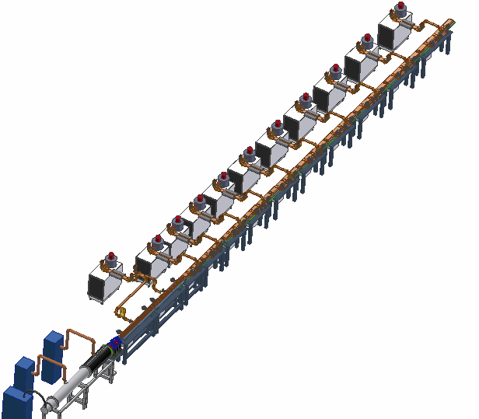
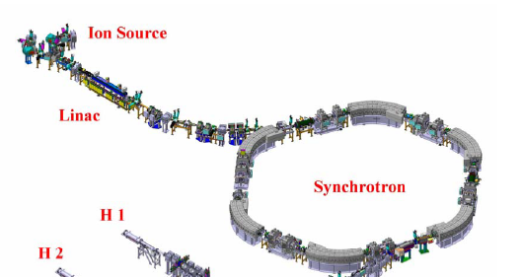
For protons (250 MeV/u) : two available designs
5m long linac + Synchro with radius about 10 m
30 m long linac
SCL– 3 GHz
250 MeV
RFQ – 217 MHz
0.4MeV/u
SCDTL – 3 GHz
35 MeV
IH 7 – 217 MHz 7MeV/u
RFQ – 750 MHz
5 MeV

Slide 3
Ions (q/m=1/2) Where are the challenges?
Challenge 1 : Sources
Helium : commercial source
Carbon 6+ : needs development.
Challenge 2 : Efficient pre-injector
Challenge 3 : LINAC with a “hospital-friendly” footprint

Slide 4
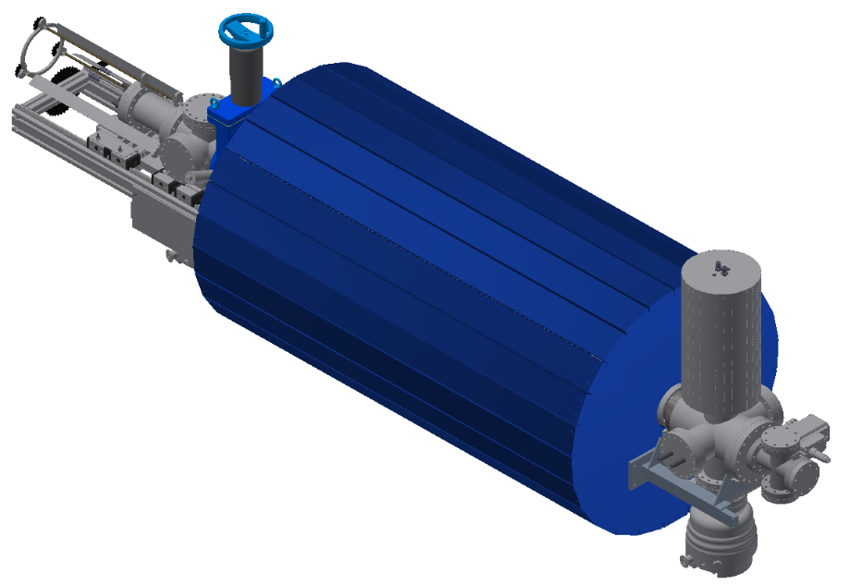
For scale :
1Gray/sec at 400MeV/u
Corresponds to an average current of 1.2nA at the target
Dc for 5µsec 200Hz is 10-3
Peak current at the target 1µA
This is 10^7 Carbon ion per 5µsec pulse
Electron Beam Ion Source
HF-linac requirements:
200 Hz
<5 µs pulses
10⁸ C⁶⁺ ions per pulse
Parameter | Design Value
Main magnet | 2 T
Trap length | 0.25 m
Electron current | 1 A
Current density | 1.5 kA/cm² (3.5 kA/cm², 5 T)
Electron energy | 7.5 keV
Capacity C⁶⁺ | 10⁹ ions pp
Repetition rate C⁶⁺ | 180 Hz (440 Hz, 5 T)
Courtesy TERA foundation
Notes:
Designed a high-compression electron gun for low electron beam energy.
The high compression is necessary to produce high electron current density in the trapping / breeding region in order to rapidly produce C6+ as the therapy linac (CABOTO parameters in our case) requests a bunch of >1E8 C6+ every 2.5 to 3 ms.
The low electron beam energy is important for assuring a high space-charge capacity (i.e. sufficient storage space charge for the carbon ions) and a low beam energy also increases the ionization cross-section, that means the electron stripping goes faster.
The low electron beam energy is one of the main challenges in the design as it easily leads to electron reflection (magnetic mirror effect) when the electrons are injected into the main solenoid (in our case 2 T for the moment, in the optimal device for CABOTO maybe 5 T).
The numbers in the table are the design values. Numbers within parentheses are for the ultimate 5 T solenoid magnet, which would assure that a high repetition rate can be achieved.
An ECRIS can’t be used as they run in cw mode (even afterglow is to be considered cw as the pulse length is then a couple of ms and not the requested < 5 us), and the instantaneous current is not sufficient. An EBIS has the possibility to run with compressed pulsed ion extraction.
In addition, the EBIS can produce a clean beam of 12C6+ without significant contamination of 16O8+ or 14N7+ (all on the same A/Q).

Slide 5
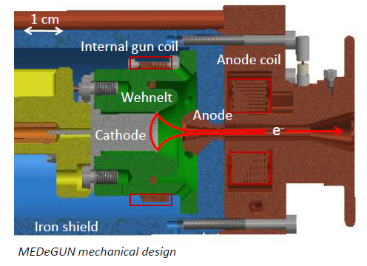
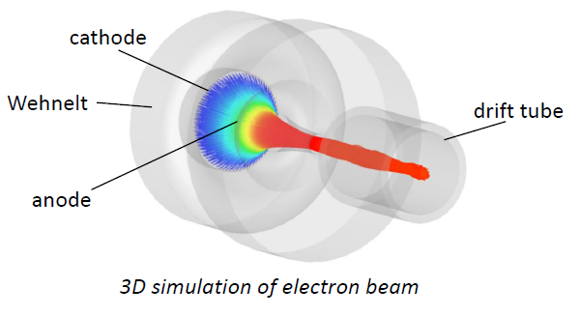
Solution
High-compression Brillouin electron gun*
Low e-beam energy, optimised for capacity and C⁶⁺ production
Excellent vacuum -> clean beam
C⁶⁺ source
Spare source
In-depth simulations
Innovative design Support from EN-MME
* R. Mertzig et al., ”A high-compression electron gun for C⁶⁺ production: concept, simulations and mechanical design”, to be publ.

Slide 6
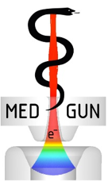
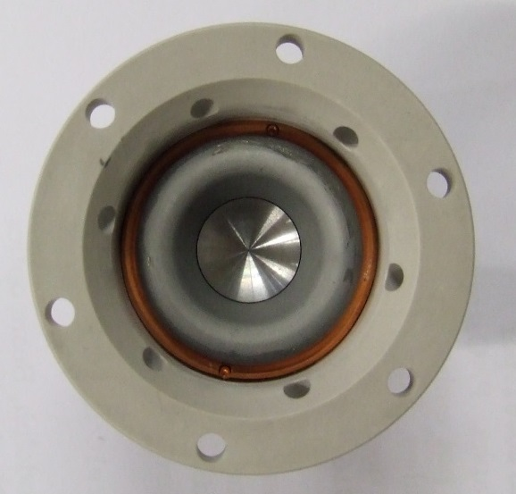
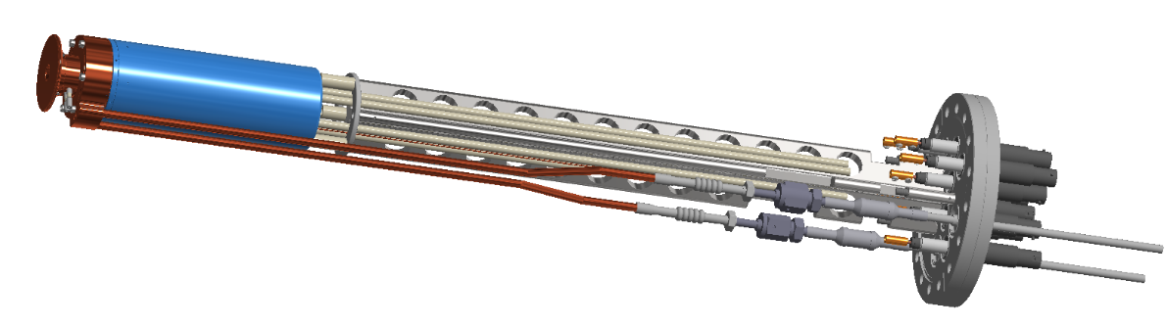
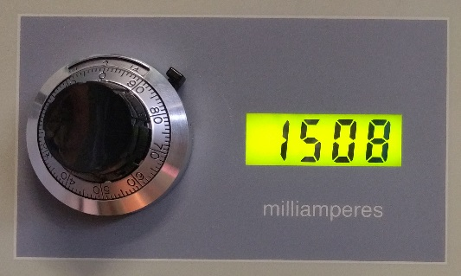
MEDeGUN design
Careful 2D and 3D simulations and error studies
Several novel design concepts
High precision manufacturing
Combined isolator and Wehnelt electrode with inserted cathode
and first results
A 1 A beam at 10 keV was transported through the 2 T solenoid with < 1 mA electron beam losses
Record current 1.5 A, although with higher losses
Notes:
The design was carefully simulated both 2D and 3D. Error studies performed.
Introduced novel design concepts, for instance the combined isolator and Wehnelt electrode. The latter consists in fact of a Mo layer sputtered onto the isolator, which is made out of Shapal (high thermal conductance). The gun design features axial correction coils both at the cathode area and at the anode.
Focused on precision manufacturing and verification.
The design has ‘both belt and suspenders’.
During the first commissioning tests Spring 2017 we reached 1 A at 10 keV with very low electron losses (<1 mA). A record current of 1.5 A was even achieved, although with higher losses (20 mA).

Slide 7
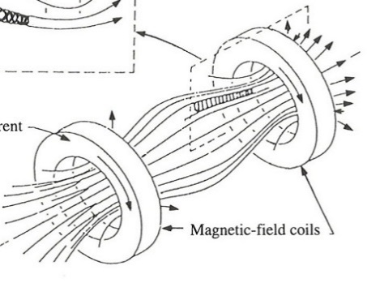
MEDeGUN improvements
Want to demonstrate the propagation of a 1 A at 4 keV electron beam energy in a 2 T solenoidal field
This emulates 1 A at 10 keV in a 5 T field solenoid, which assures a short ionisation time of the ¹²C⁶⁺
Therefore
* Modification of cathode position
* Introduction of gas feeding line
* Improvement of mechanical positioning system of the gun
Magnetic mirror effect
Notes:
First electron beam tests with MEDeGUN very promising (in all honesty, I’m still a bit surprised). However, the low losses is for a 10 keV beam. As soon as the electron beam energy is lowered, the losses rise sharply.
Ideally we would like to operate the MEDeGUN with a 5 T magnet, and not with 2 T as available at TwinEBIS; this is to reach the quick charge breeding. A 5 T magnet would results in more difficult magnet mirror effects when the electrons are about to enter the full magnetic field. As we don’t have a 5 T magnet we try to emulate the situation by lowering the electron beam energy, while keeping the electron current constant. A 5 T magnet with a 10 keV beam corresponds to 4 keV in 2 T. This we’re unfortunately far from reaching.
Having said that, we have a few tracks to follow. We therefore would like to perform one modification of the MEDeGUN itself (move the cathode 50 um backwards as it is difficult to predict the expansion when it’s heated up), and also improve the working conditions for TwinEBIS (mechanical positioning of the gun cross). While doing that we’ll also introduce a gas feed line to the trapping area.
The modifications will be implemented during the autumn 2017 and the tests performed during the winter 2018.

Slide 8
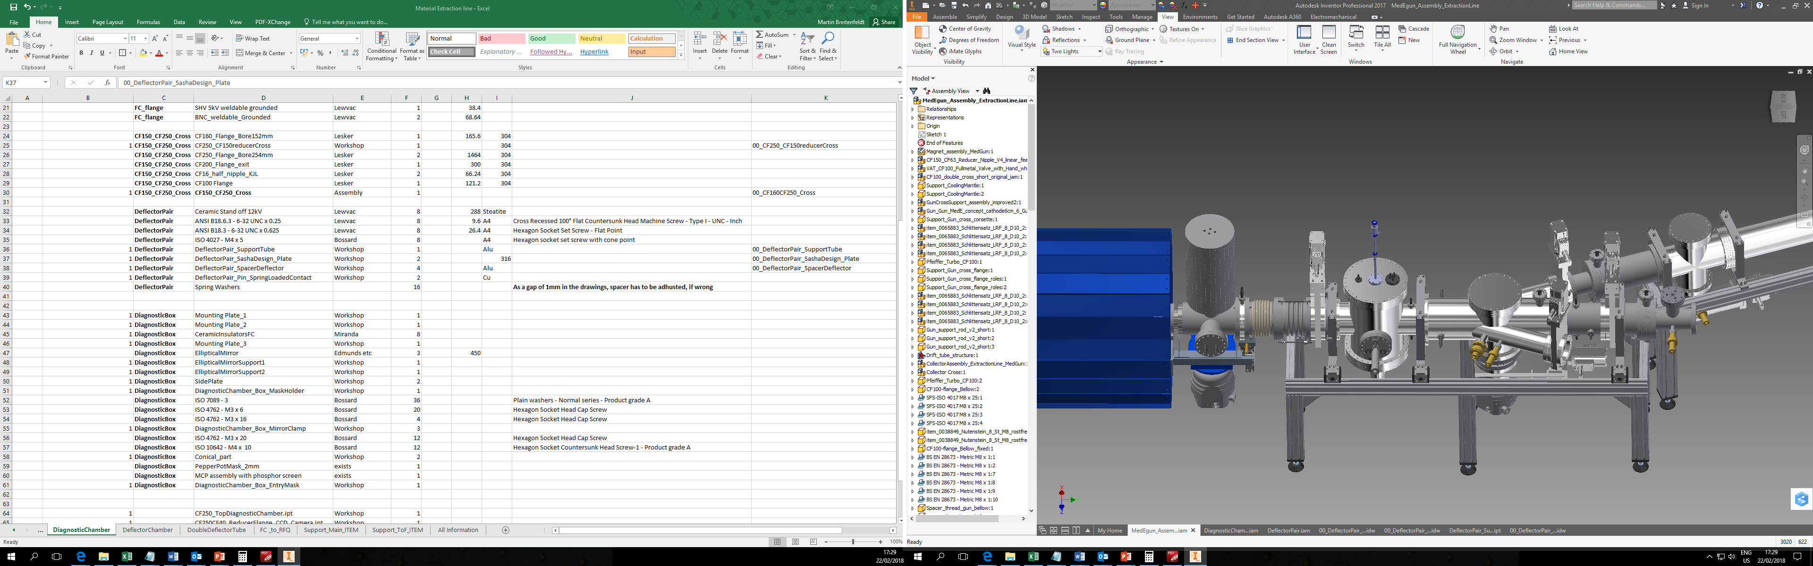
Ion extraction-injection line
Extract ions for characterisation
Number of ¹²C⁶⁺
Pulse length
Transverse emittance
Contamination degree
Extract ¹²C⁶⁺ for injection into high-frequency RFQ
Inject 1+ ions of other treatment elements of possible interest, such as Li, Be and B
Beam line components are ordered,
Installation in winter 2019, measurements to follow.
Beam viewing + pepper-pot emittance meter
TOF branch
750 MHz RFQ branch
Bi-directional FC
EBIS collector cross
Beam injection branch
MEDeGUN
EBIS
Notes:
Until now all effort and investigation have focused on the electron beam and not on the ions.
(Notice that the 2D drawing is projected in an incorrect way just to show the different elements. For example, the valves and the ToF line will be rotated 90 deg.)
The line will allow us to extract ions from the MEDeGUN EBIS and using the FC + ToF establish numbers for charge state distribution, amount of contamination and pulse length.
The pepperpot emittance meter will give us an estimation of the transverse emittance of the full beam (all charge states incl some contaminating ions).
The beam-line is designed for tentative ion injection into a high-frequency RFQ structure designed for A/Q=2.
The third branch is for ion injection. The carbon will be introduced as gas (CH4 or C2H6) into the EBIS. However, in case other treatment ions, such as Li, Be or B are requested, it might be better to injected them as 1+ ions and thereafter charge breed them to desired charge state. The ion injection line is for a later stage but would feature a 1+ ion source for production of the ions and a separator magnet for selection.
The ion extraction-injection line is presently under design. We hope to have production drawings ready by December (AL – we’ve slipped in time here for a couple of reasons I can explain another time). Hardware components with long delivery time already ordered. The plan is to produce the pieces Jan-Mar and install the line in April, thereafter first beam tests in May.

Slide 9
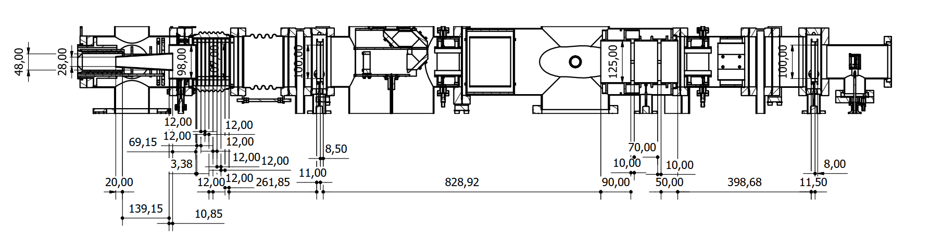
LEBT configuration
LEBT
EBIS
750 MHz RFQ
Electron collector
Extractor
Adaptor
Dividers
Gridded lens
Einzel lens
Gridded lens

Slide 10
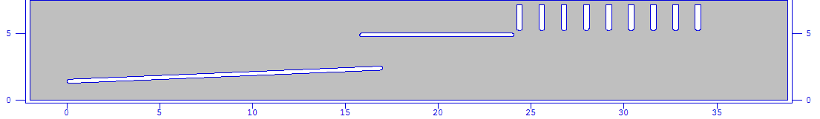
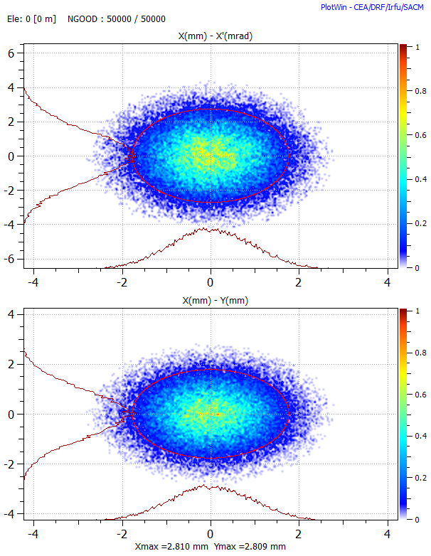
Input distribution
From A. Pikin simulations at z=2cm there is a waist (alpha=0) and the beam parameters are:
Parameter | Value
Ion | ¹²C⁶⁺
Emittance 90% norm. [mm.mrad] | 0.02
Radius [mm] | 3
I/O Energy [KeV/u] | 6.5-15
Current [mA] | 3

Slide 11
Matching method - first step
Extractor/adaptor/dividers
Gridded lens 1
Einzel lens
Gridded lens 2
Parallelize the beam with first gridded lens
Einzel lens to compensate for space-charge defocusing
Focusing into the acceptance with second gridded lens

Slide 12
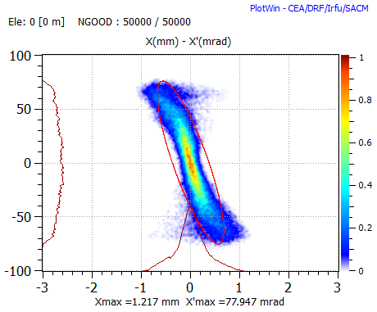
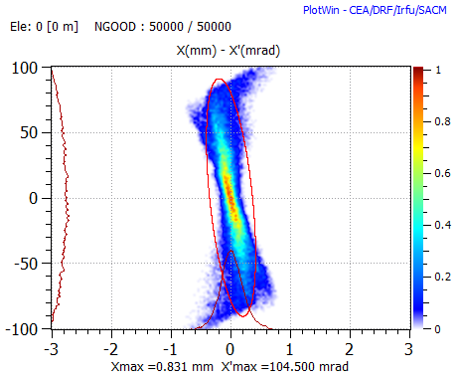
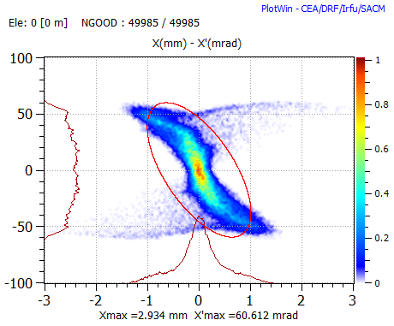
Orientation scan
Parallel
Focused
Defocused
 | Emittance [pi.mm.mrad]
Parallel | 0.034
Defocused | 0.066
Focused | 0.046

Slide 13



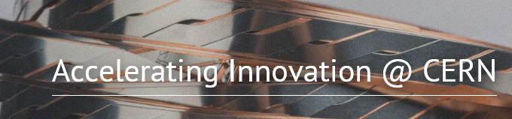
C6+ source at CERN
Use the already exiting TwinEBIS test stand.
The solenoid is suitable (2T) but an adapted higher solenoidal field would be better
Build on the CERN Hadron Sources and Linacs expertise in EBIS ion source
Within 2019 should demonstrate the necessary intensity and emittance.

Slide 14
Ions (q/m=1/2) Where are the challenges?
Challenge 1 : Sources
Challenge 2 : Efficient pre-injector
Challenge 3 : LINAC with a “hospital-friendly” footprint

Slide 15
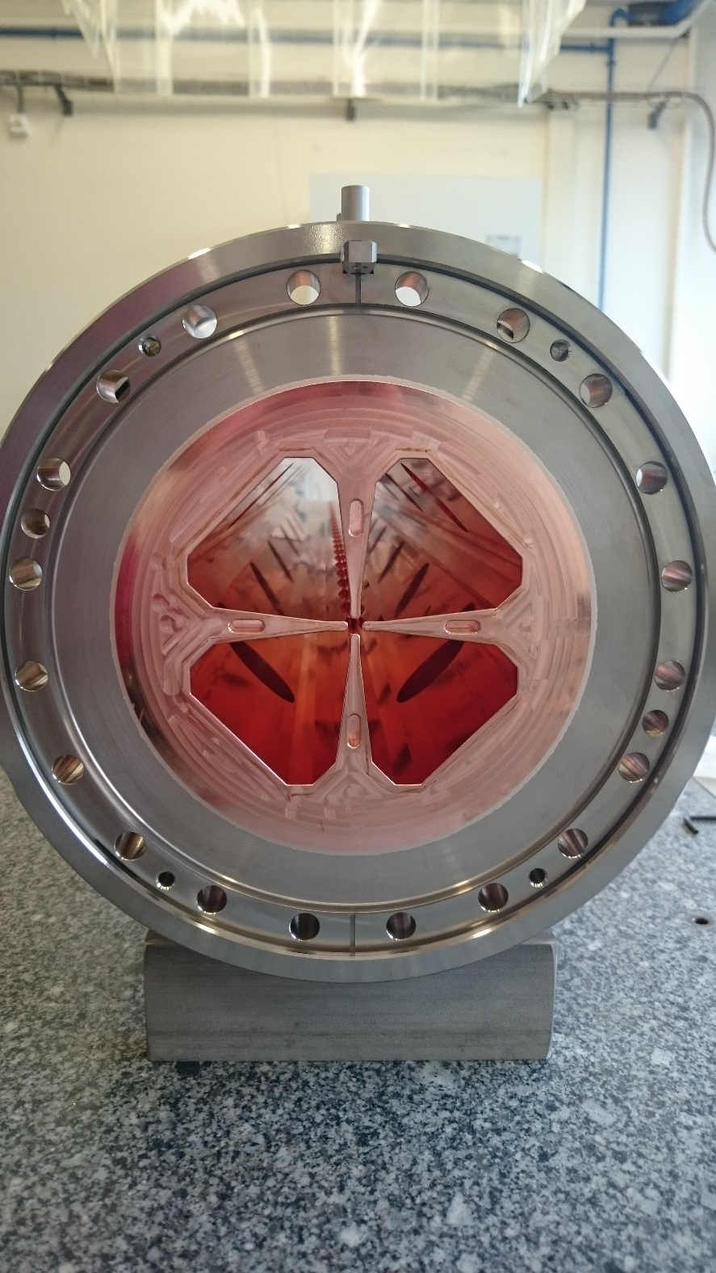
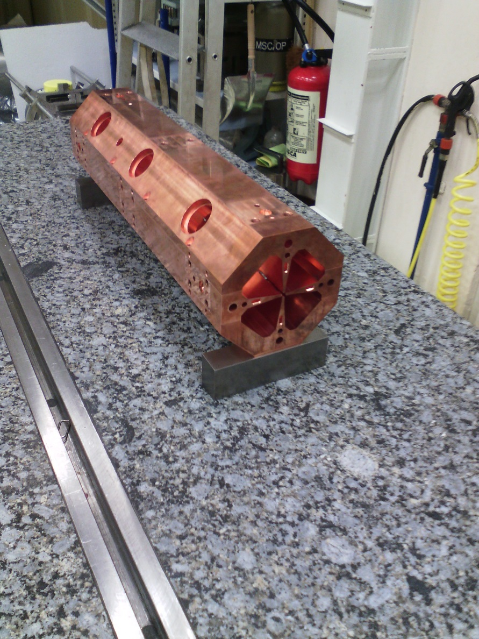
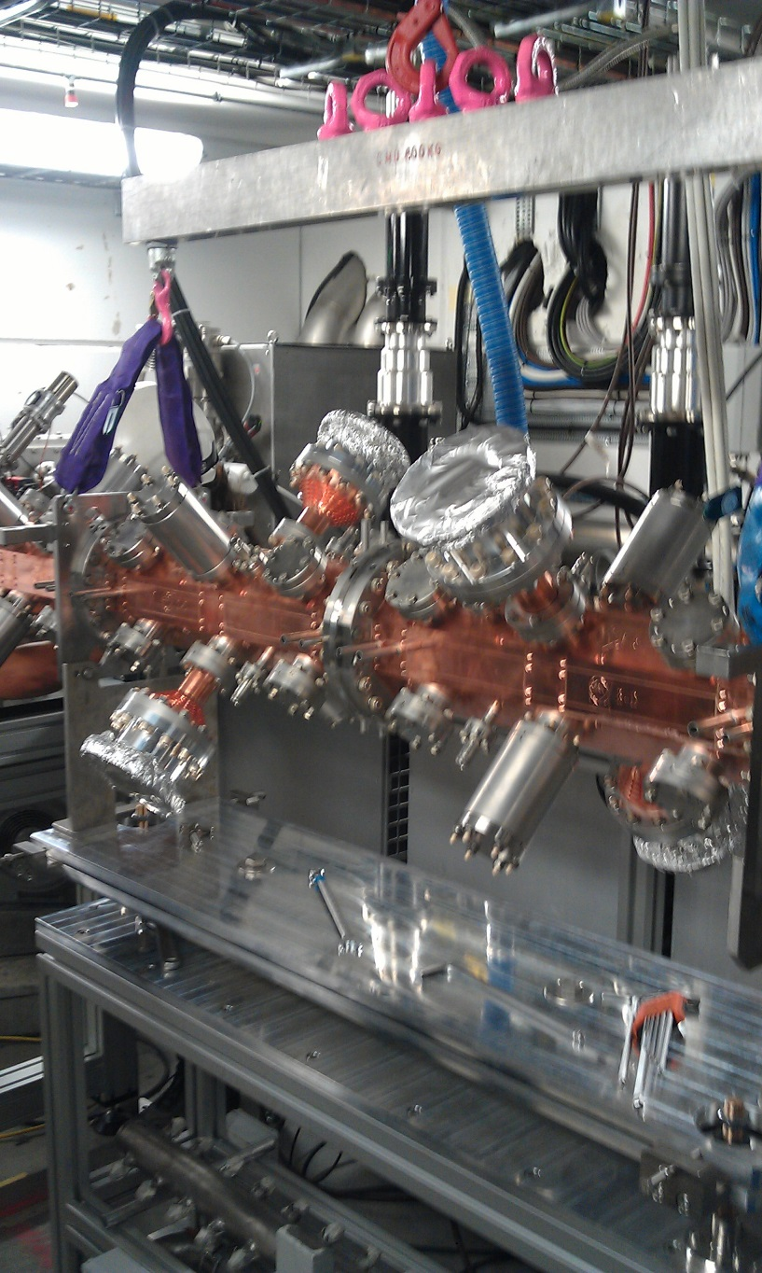
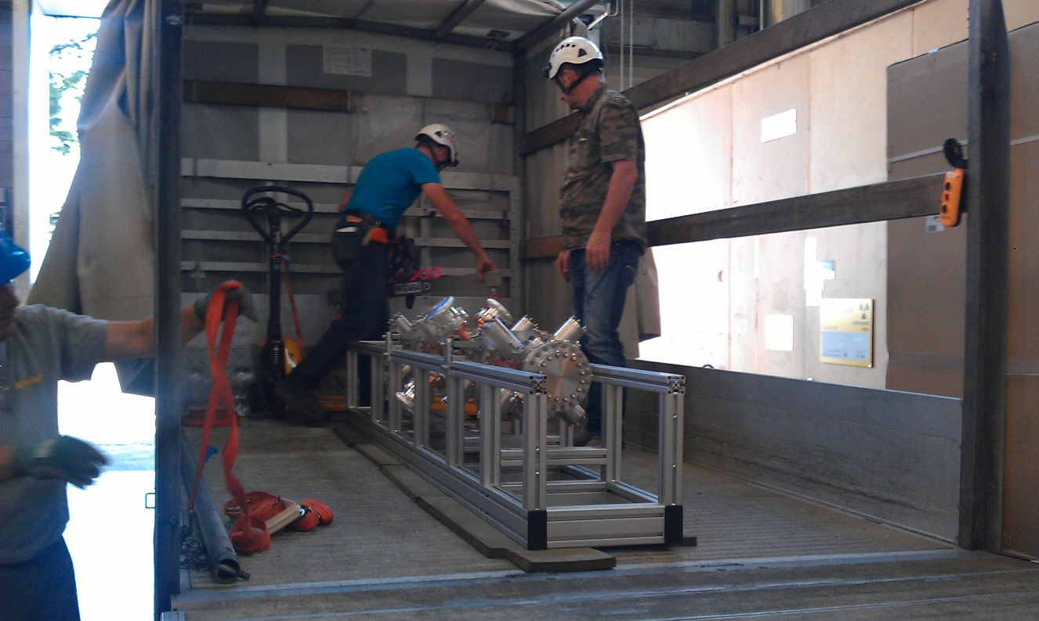
RFQ
750MHz
13 cm diametre

Slide 16

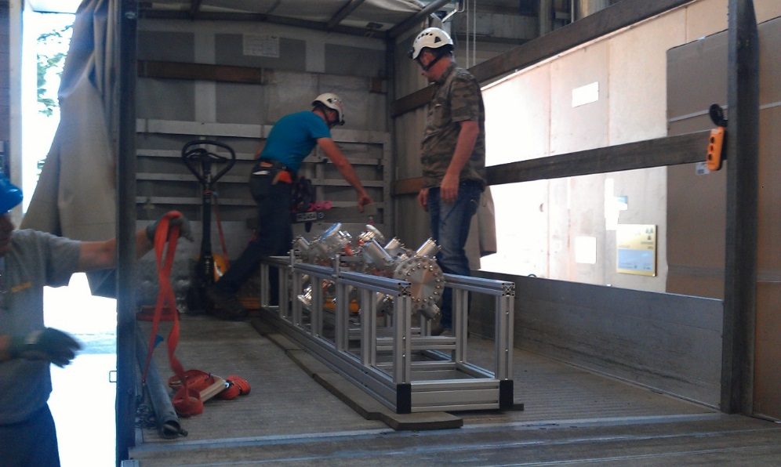
RFQ design and construction- 2015
Source and RFQ parameters
RF Frequency | 750 MHz
Input | 40 keV
Output Energy | 5 MeV
Length | 2m
Vane voltage | 65kV
Peak RF power | 400kW
Duty cycle / max | 0.4% /(5%max)
Input/Output Pulse Current in 3GHz acceptance | 100/30 µA
Transv. emittance 90% | 0.1 pi mm mrad
Average aperture (r0) | 2mm
Maximum modulation | 3
On the truck
Installed after the Proton source
Validates a very different design that can be applied to other ions.
Emittance at 5MeV measured and simulated

Slide 17
Similar design applied to q/m=1/2 and matched to the med-eGUN carbon source
 | Long version | Short version
Length m | 4. m | 2.7
Emax MV/m | 50 MV/m | 50 MV/m
Vane voltage KV | 50kV | 50kV
r0 | 1.4mm | 1.4 mm
rho | 1.3 mm | 1.3
T | 90% | 50%
Nominal emittance rms norm | 0.025 | 0.025
Win/u | 0.015 MeV | 0.015 MeV
Wout/u | 2.5 MeV | 2.5 MeV
q/A | 1/2 | 1/2

Slide 18
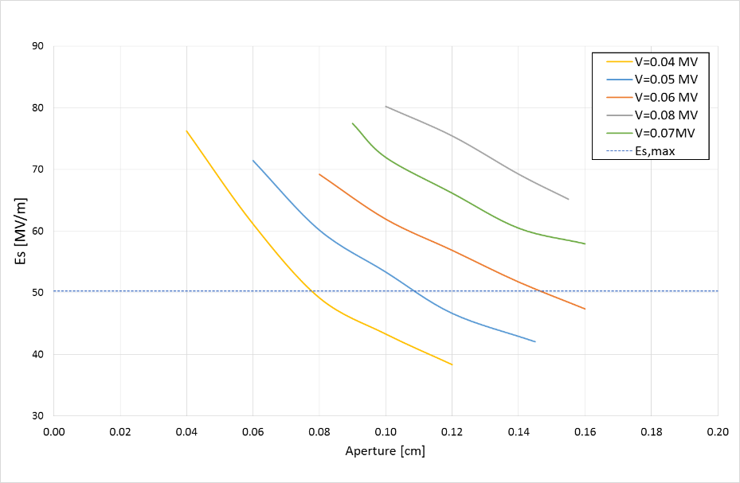
Surface field limitations and other practical considerations
Increased risk of sparking
Need more RF power
Tighter machining and alignment tolerances

Slide 19
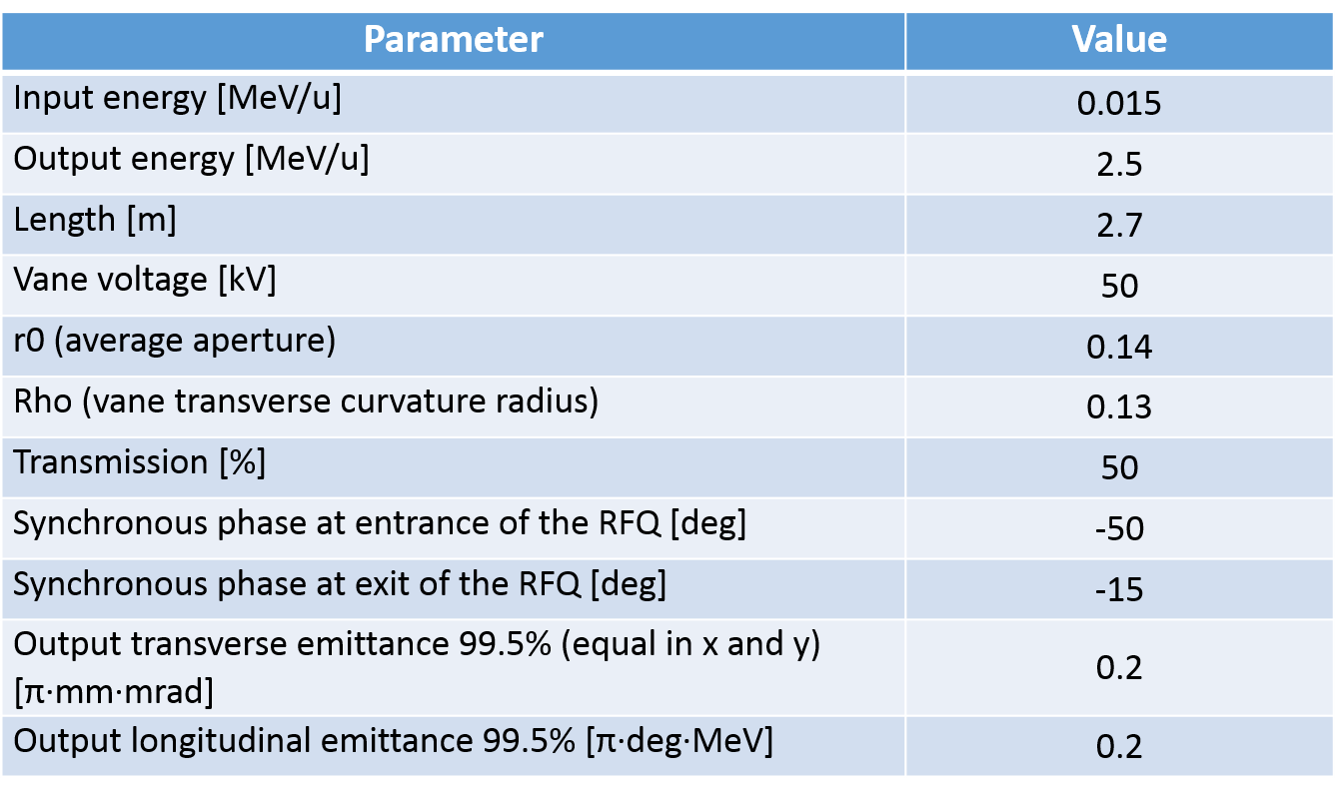
Chosen solution

Slide 20
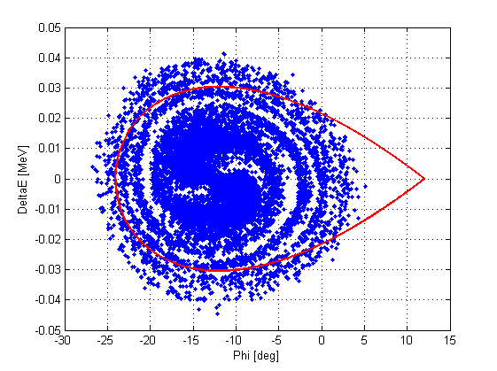
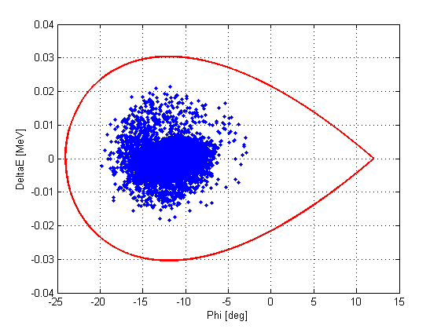
Injecting in a 750MHz IH to 10MeV
Acceptance of the IH-structure (in red) and beam distribution (in blue) in the longitudinal phase space

Slide 21
Once out of the pre-injector
After 5MeV/u the beam dynamics / loss management and the beam quality preservation are less challenging, design exists and the challenge lays in the Radio Frequency Design and Radio Frequency power source efficiency ( see A. Grudiev talk).
Synergies with e-machines already established.

Slide 22
Ions (q/m=1/2) Where are the challenges?
Challenge 1 : Sources
Challenge 2 : Efficient pre-injector
Challenge 3 : LINAC with a “hospital-friendly” footprint

Slide 23
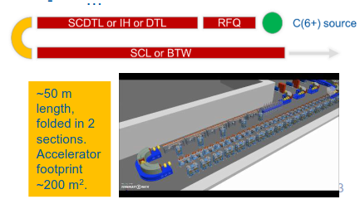
Hospital friendly footprint without loosing real estate gradient
In the bending region there are some 15-20 meters along the beam line that are not used for acceleration. This is not efficient plus it requires complex beam dynamics gymnastics or re-bunching or special magnet design. For protons we (BE-ABP-HSL) have designed a system of interlaced RF cavities and bending magnet that solves this issue. This system should be extended to q/m=1/2).

Slide 24
Concluding remarks
An off-the-shelf linac design for a q/m=1/2 (Helium or Carbon ions) ion facility doesn’t exists
Challenges are identified, they require studies and adaptation of technology developed for scientific linac but there are no show stoppers.
The main technical advantage of the linac is the very fast pulse to pulse modulations of the beam parameters and the potential to deliver the required dose in much shorter time (impact on patient throughput and –most important- mitigating the issues of patient motion). To take full advantage of the linac solution a dose delivery system that matches the speed of the linac has to be engineered.

