Slide 1
Low energy section design of a linear accelerator for carbon ions therapy
V. Bencini

Slide 2
Outline
Introduction
Hadrontherapy
Accelerators for hadrontherapy
The linac solution
TwinEBIS source
Working principles
Output parameters
LEBT
General layout
Matching
Error study
The 750 MHz RFQ
Input parameters
Final design
End to end tracking
Conclusions and next steps

Slide 3
Introduction

Slide 4



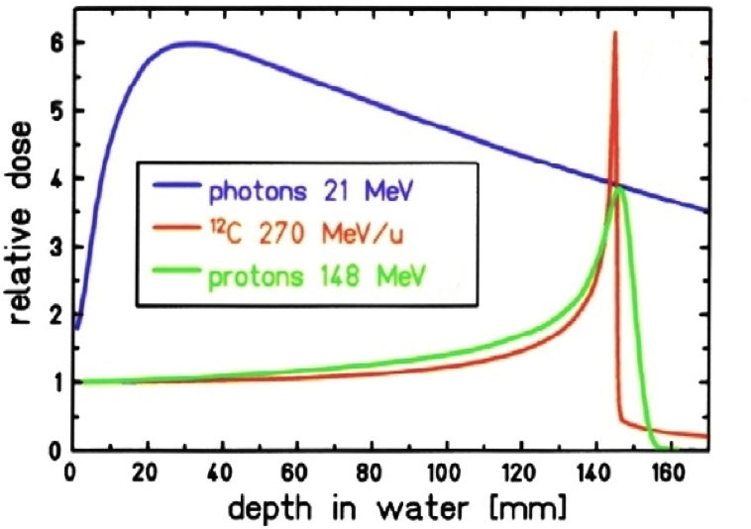
Hadron therapy

Slide 5
Hadron therapy
Tumore

Slide 6
Accelerators for hadron therapy
Features
Small footprint
Drawbacks
Passive energy modulation
Beam emittance
Slow energy modulation
Only for protons

Slide 7
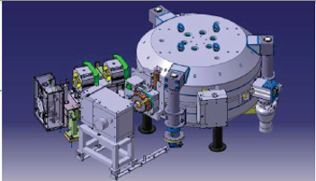
Accelerators for hadron therapy
Cyclotrons
Features
Small footprint
Drawbacks
Passive energy modulation
Beam emittance
Slow energy modulation
Only for protons

Slide 8
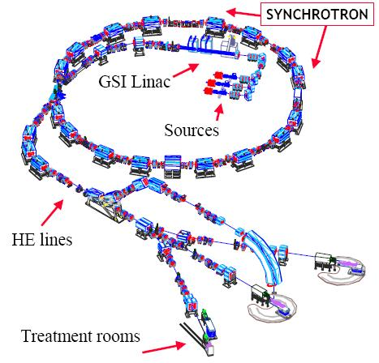
Accelerators for hadron therapy
Cyclotrons
Features
Small footprint
Drawbacks
Passive energy modulation
Beam emittance
Slow energy modulation
Only for protons
Features
Active energy modulation
Both protons and carbon ions
Drawbacks
Slow energy change
Big footprint
Big emittance
Synchrotrons

Slide 9
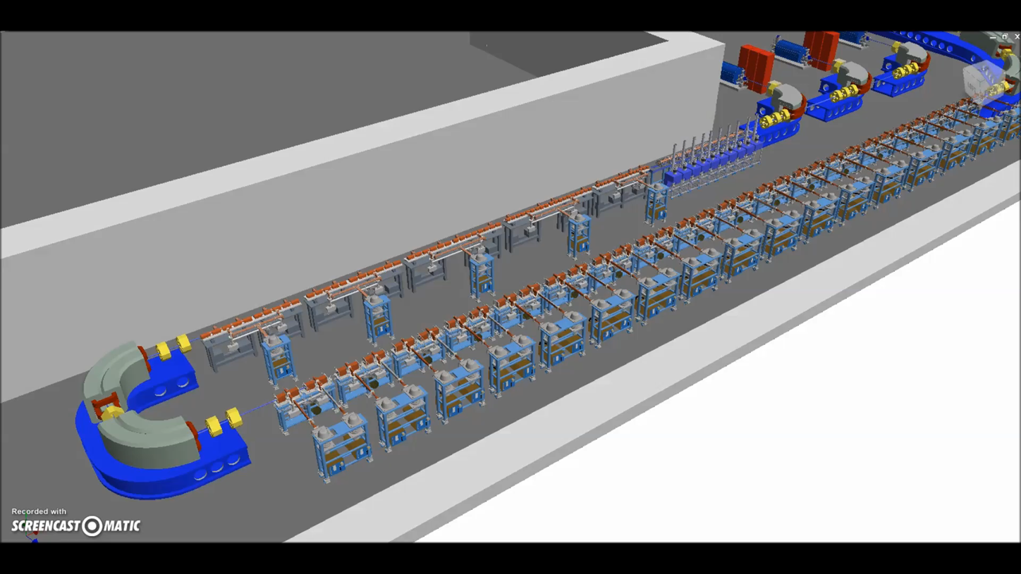
Accelerators for hadron therapy
Cyclotrons
Linacs
Features
Small footprint
Drawbacks
Passive energy modulation
Beam emittance
Slow energy modulation
Only for protons
Features
Active energy modulation
Fast energy modulation
Both protons and carbon ions
Drawbacks
Bigger than cyclotron
‘linear’ footprint
Features
Active energy modulation
Both protons and carbon ions
Drawbacks
Slow energy change
Big footprint
Big emittance
Synchrotrons

Slide 10
The linac solution
0.015 MeV/u
2.5/5 MeV/u
100 MeV/u
TwinEBIS
RFQ
Fixed energy
Patient
All klystrons off
100 MeV/u
Energy modulation
100 MeV/u
Parameter | Value
Frequency | 3 GHz
Species | ¹²C⁶⁺
Current required (average) | 0.8 nA
Final energy | 100-430 MeV/u
Repetition rate | 200 Hz

Slide 11
The linac solution
0.015 MeV/u
2.5/5 MeV/u
100 MeV/u
TwinEBIS
RFQ
Fixed energy
Patient
Some klystrons on
300 MeV/u
300 MeV/u
100 MeV/u
Parameter | Value
Frequency | 3 GHz
Species | ¹²C⁶⁺
Current required (average) | 0.8 nA
Final energy | 100-430 MeV/u
Repetition rate | 200 Hz

Slide 12
The linac solution
0.015 MeV/u
2.5/5 MeV/u
100 MeV/u
TwinEBIS
RFQ
Fixed energy
Patient
All klystrons on
430 MeV/u
Energy modulation
150 MeV/u
Parameter | Value
Frequency | 3 GHz
Species | ¹²C⁶⁺
Current required (average) | 0.8 nA
Final energy | 100-430 MeV/u
Repetition rate | 200 Hz

Slide 13
The linac solution
0.015 MeV/u
2.5/5 MeV/u
100 MeV/u
TwinEBIS
RFQ
Fixed energy
Patient
430 MeV/u
All klystron on
150 MeV/u
Energy modulation
Parameter | Value
Frequency | 3 GHz
Species | ¹²C⁶⁺
Current required (average) | 0.8 nA
Final energy | 100-430 MeV/u
Repetition rate | 200 Hz
One design already proposed (CABOTO - Fondazione TERA)
Next step is to propose an alternative design

Slide 14
The linac solution
0.015 MeV/u
2.5/5 MeV/u
100 MeV/u
TwinEBIS
RFQ
Fixed energy
Patient
430 MeV/u
All klystron on
150 MeV/u
Energy modulation
Parameter | Value
Frequency | 3 GHz
Species | ¹²C⁶⁺
Current required (average) | 0.8 nA
Final energy | 100-430 MeV/u
Repetition rate | 200 Hz
The work here presented will be focused on the low energy section

Slide 15
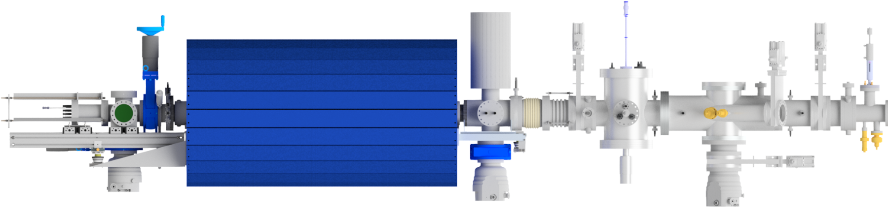

The linac solution – low energy section
TwinEBIS
Electron Beam Ion Source
Pulsed source
Produces 1·10⁹ ¹²C^{6+ ions} in a 5 us pulse (~200 times higher than requirements)
Low Energy Beam Transport (LEBT)
Electrostatic LEBT
Transports and matches the beam into the RFQ acceptance
RFQ
First RF accelerating structure
Acceleration, bunching, focusing
Boost particles to 2.5/5 MeV/u (two designs)

Slide 16
The TwinEBIS source

Slide 17

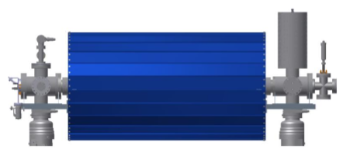
Working principle
How it works?
Courtesy of M. Breitenfeldt

Slide 18
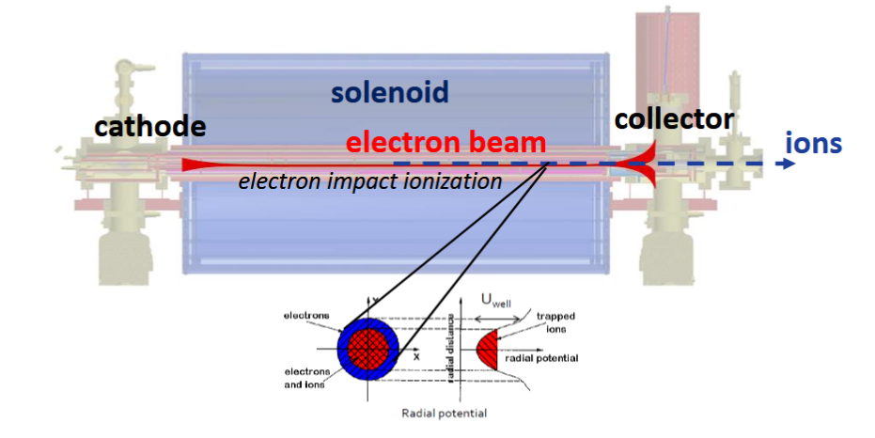
Working principle
How it works?
Charge breeding by ionization with electron beam
Ions kept in a potential trap
Open the trap and extraction of the ions
Courtesy of M. Breitenfeldt
MEDeGUN

Slide 19
Output parameters
How it works?
Charge breeding by ionization with electron beam
Ions kept in a potential trap
Open the trap and extraction of the ions
Design parameter | MEDeGUN
Test site | TwinEBIS, CERN
Main magnet | 2 T
Trap length | 0.25 m
Electron current | 1 A
Current density | 1.5 kA/cm²
Electron energy | 7.5-10 keV
Capacity C⁶⁺ | 1·10⁹ Ions per pulse
Repetition rate | 200 Hz
Current | 160 nA
Courtesy of M. Breitenfeldt
MEDeGUN

Slide 20
The LEBT

Slide 21
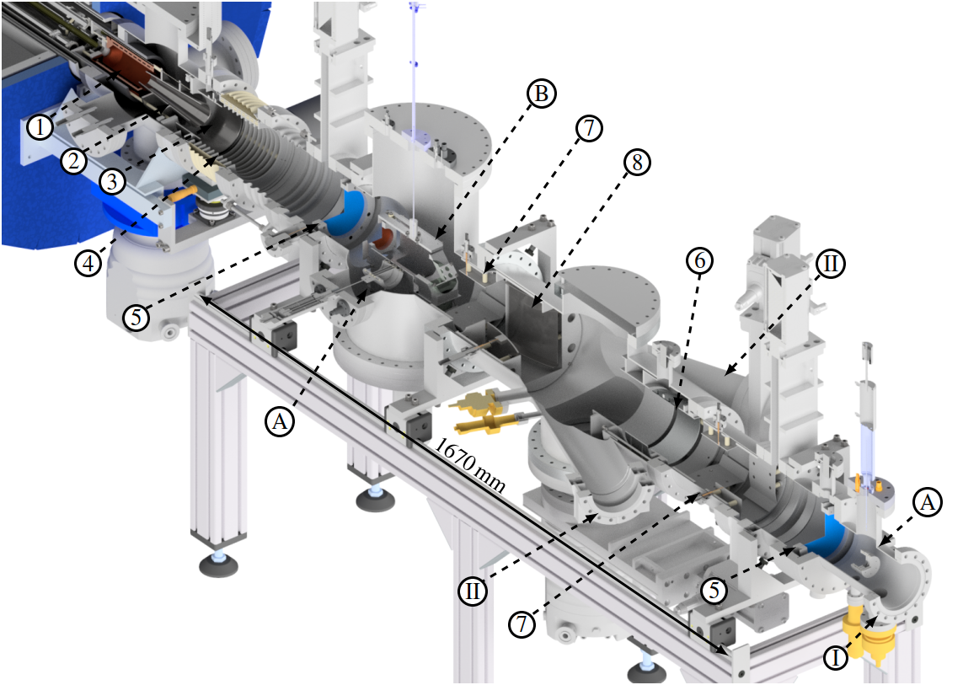
General Layout
Extract ions at the energy of 6.5 keV/u and accelerate them up to 15 keV/u
Electron collector
Extraction electrode
Adaptor electrode
Acceleration gap
Gridded lenses
Einzel lens
Angle deflectors
Switchyard deflector
RFQ port
Additional ports
Faraday cups
Pepperpot

Slide 22
General Layout
Extract ions at the energy of 6.5 keV/u and accelerate them up to 15 keV/u
Electron collector
Extraction electrode
Adaptor electrode
Acceleration gap
Gridded lenses
Einzel lens
Angle deflectors
Switchyard deflector
RFQ port
Additional ports
Faraday cups
Pepperpot
Focusing

Slide 23
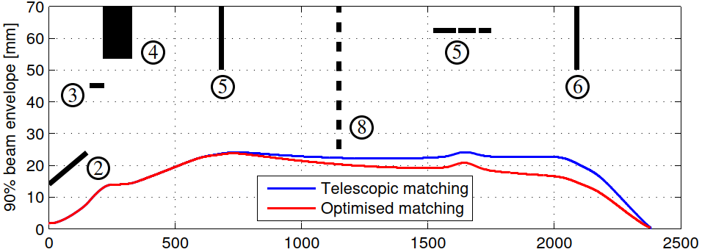

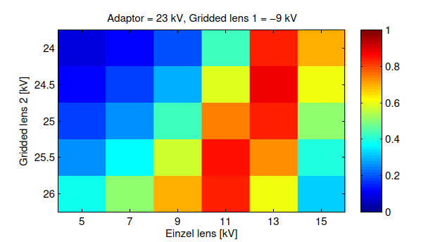
Matching methodology
Step 1 – Telescopic matching
Select voltage on adaptor that gives alpha=0
Select voltage on gridded lens 1 that gives alpha=0
Select voltage on Einzel lens that gives alpha=0
Scan gridded lens to to find best match to accptance
Step 2 – Optimised matching
Use Telescopic matching set-up as starting point
Scan many possible combination of voltages
Obtain transmission maps
Fine scan on gridded lens 2

Slide 24
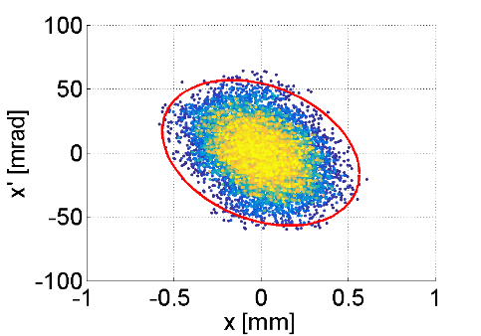
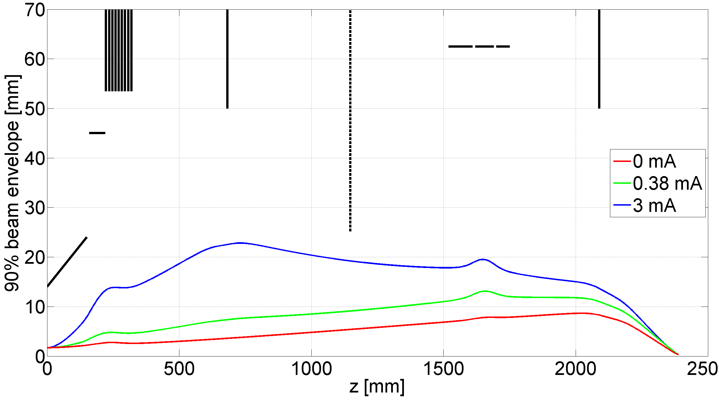
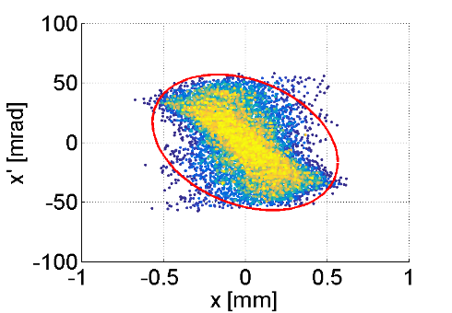
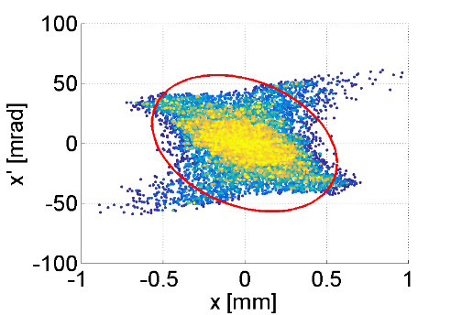
The LEBT – results
Three beam currents were considered: 0 mA (no space charge case), 0.38 mA (current expected from present set up) and 3 mA (max theoretical current form TwinEBIS).
Beam current | 0 mA | 0.38 | 3 mA
Particles into acceptance | 99% | 96% | 88%
o
m
n
n
l
k
q

Slide 25
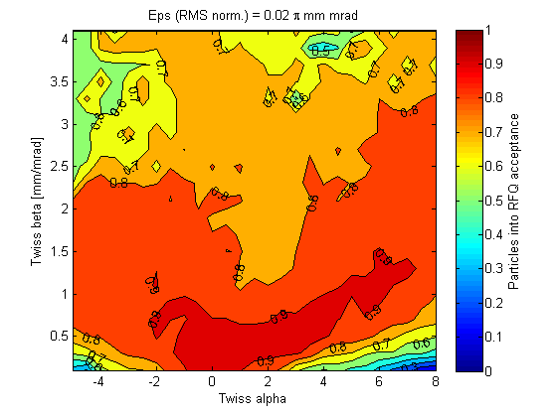
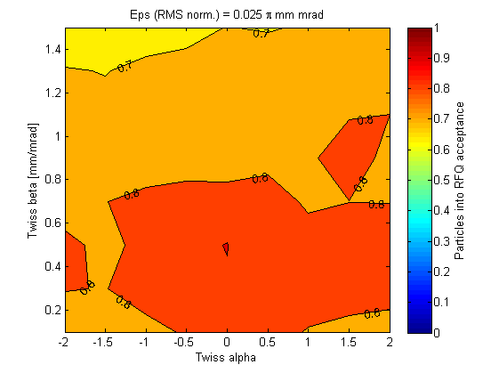
The LEBT – error study
For each emittance value scan Twiss alpha and beta → generate a space of input distributions
Each beam matched to the RFQ acceptance (considering 0.34 mA current)
Select the set of input beam that could be matched into RFQ acceptance with efficiency higher than 90%
Still work in progress

Slide 26
Radio Frequency Quadrupole

Slide 27
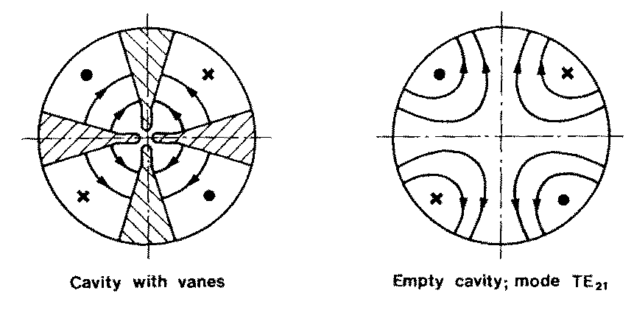
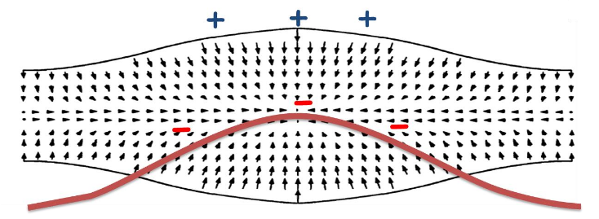
Radio Frequency Quadrupole
RF resonator in TE210 mode (quadrupole)
Modulation of the vane profile induce longitudinal field → ACCELERATION
RF provides temporal structure to the beam

Slide 28
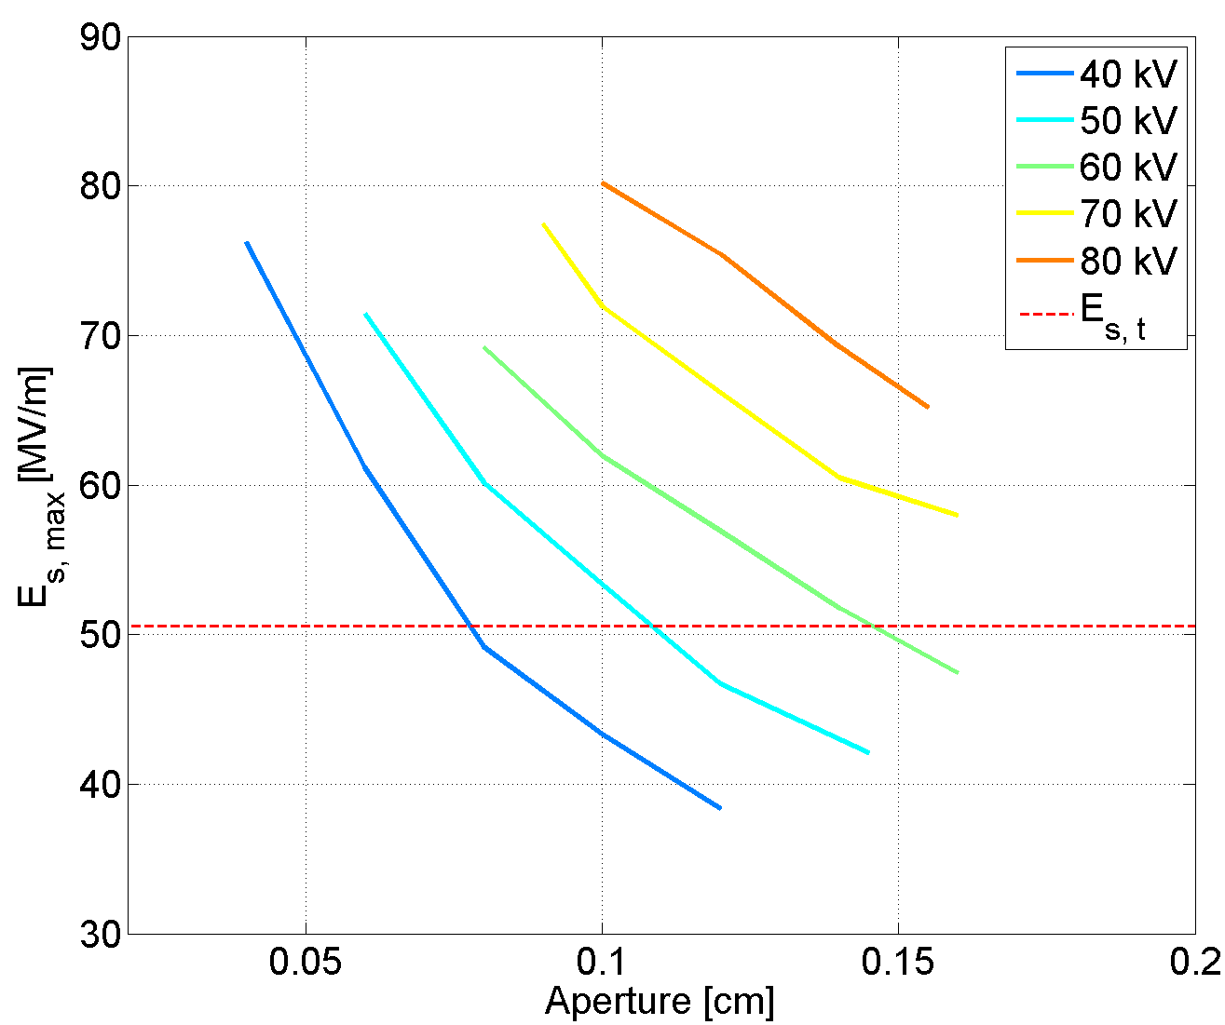
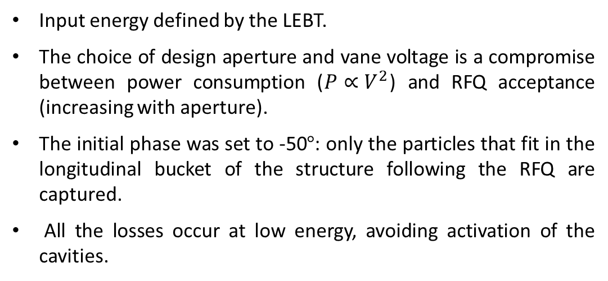
Input parameters
Input energy defined by the LEBT.
The choice of design aperture and vane voltage is a compromise between power consumption ($P∝V^{2}$) and RFQ acceptance (increasing with aperture).
The initial phase was set to -50$°$: only the particles that fit in the longitudinal bucket of the structure following the RFQ are captured.
All the losses occur at low energy, avoiding activation of the cavities.

Slide 29
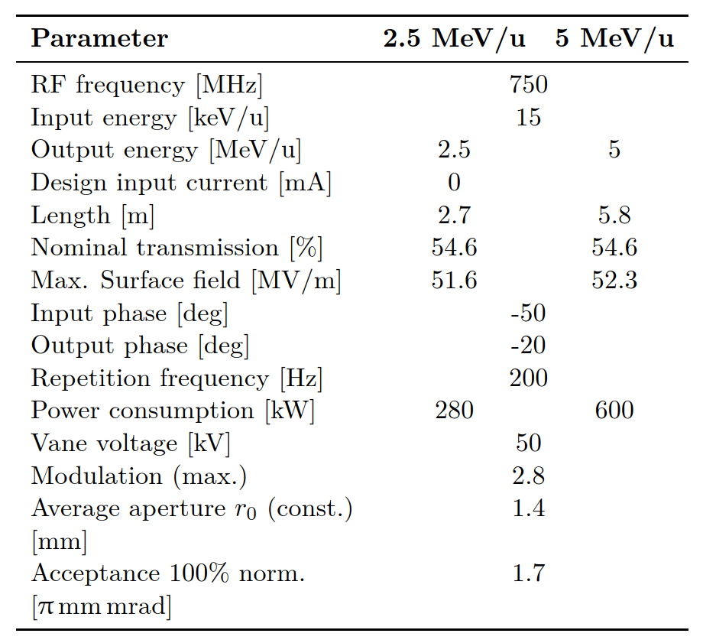
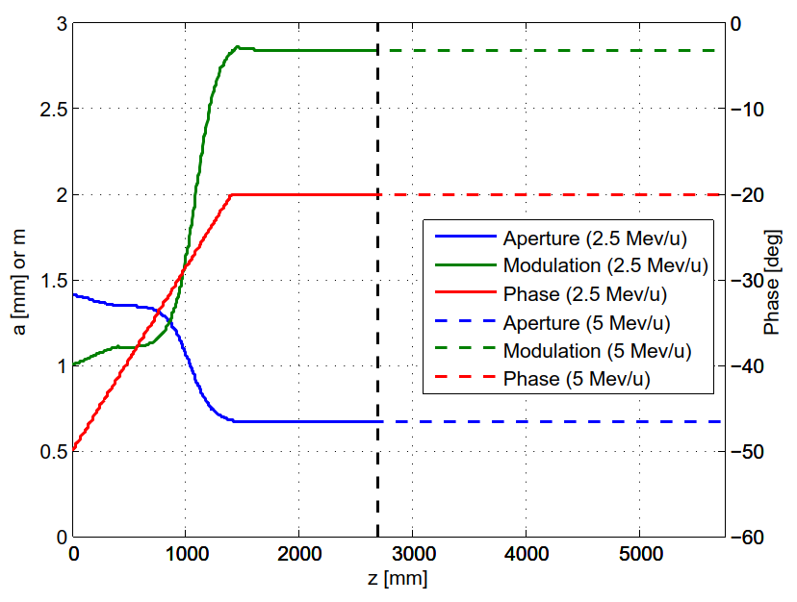
Final design
2.5 MeV/u
5 MeV/u

Slide 30
Final design
2.5 MeV/u
5 MeV/u
Transmission low on purpose

Slide 31
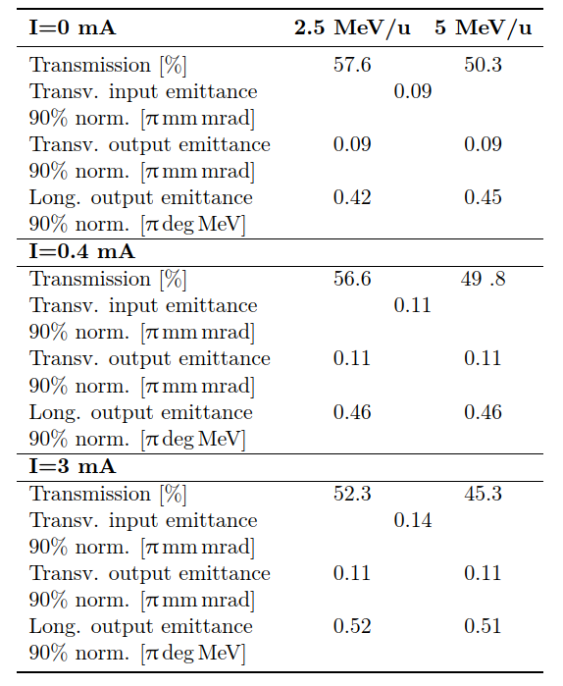
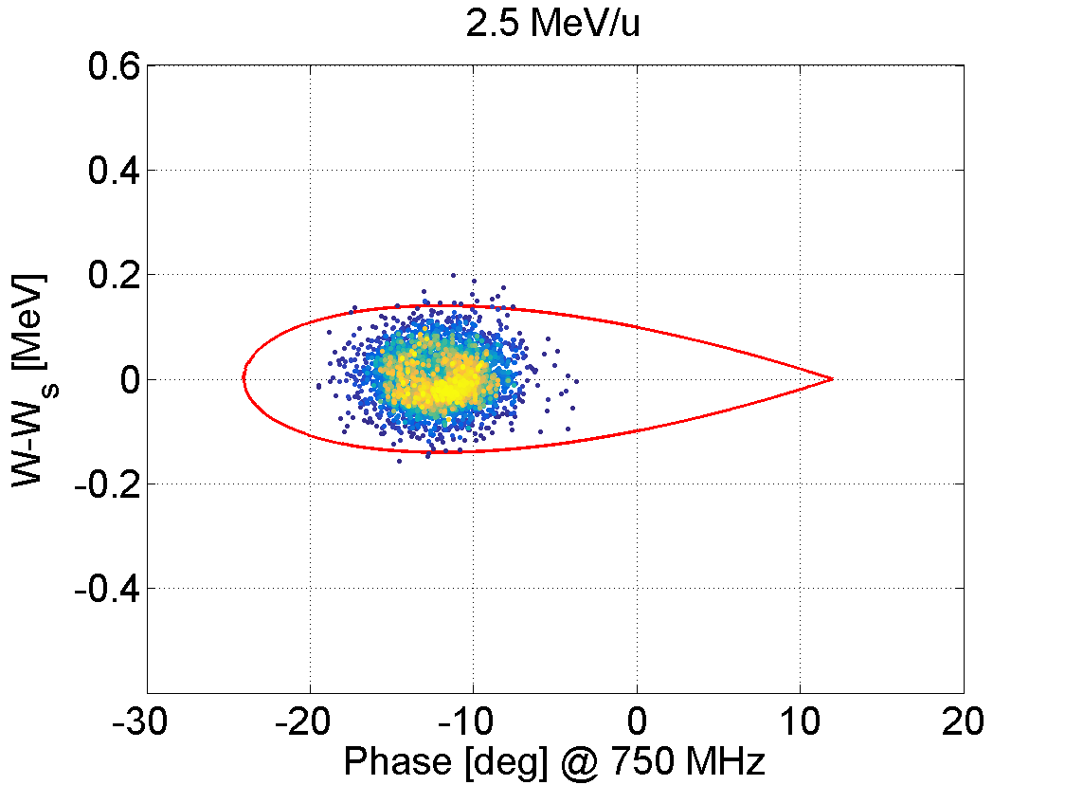
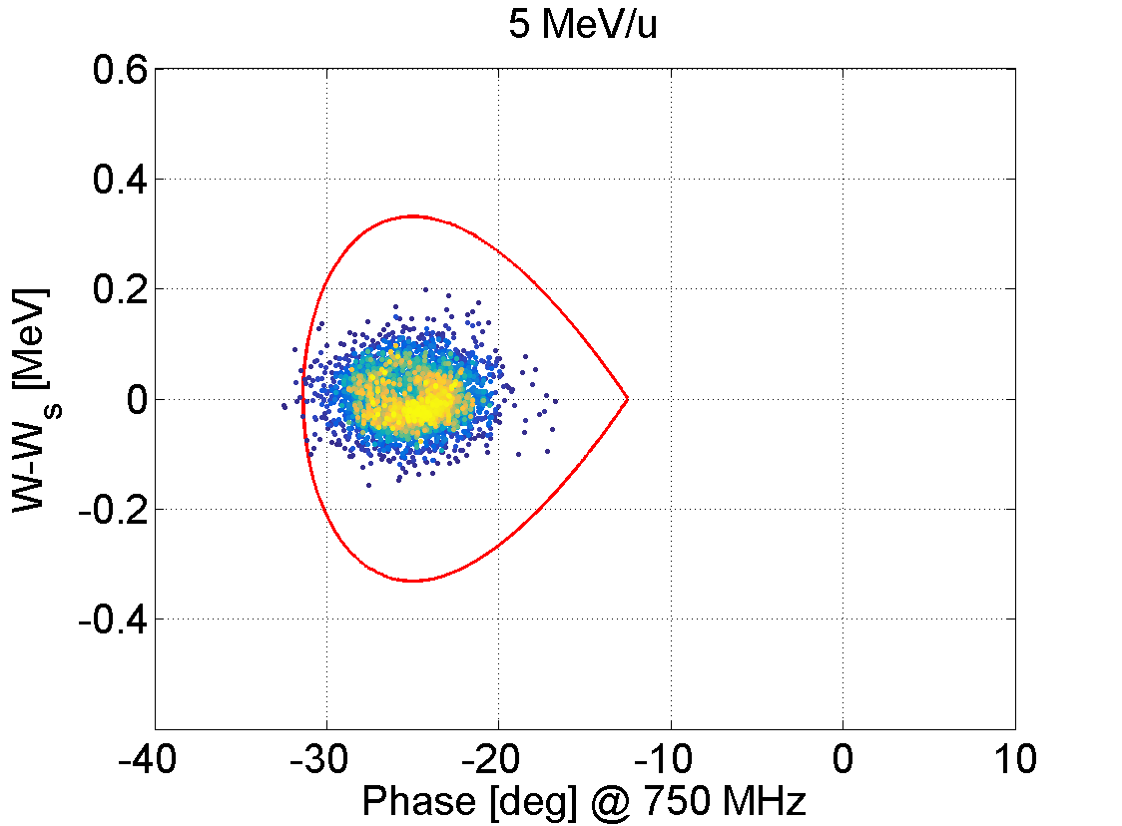
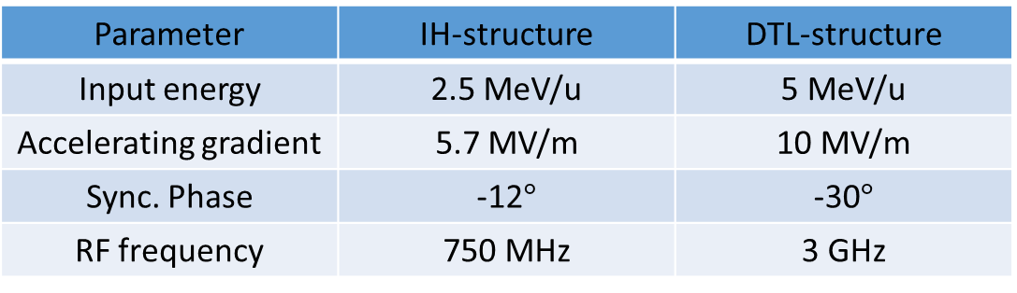
End to end tracking
Two structure could follow the RFQ (two different longitudinal acceptances)
Parameter | IH-structure | DTL-structure
Input energy | 2.5 MeV/u | 5 MeV/u
Accelerating gradient | 5.7 MV/m | 10 MV/m
Sync. Phase | -12$°$ | -30$°$
RF frequency | 750 MHz | 3 GHz

Slide 32
Conclusions and next steps

Slide 33
Conclusions and next steps
Conclusions
LEBT matching was performed at different current and the maximum error on th einput distribution was defined
Tracking through the RFQ shows the capability of the system to provide an ion current that exceeds significantly the clinical requirements.
The EBIS+LEBT+RFQ system would be the perfect injector for a linac for carbon ion therapy.
Next steps
The LEBT will be installed and tested during the next year. Installation, commissioning and measurements will be part of the thesis work.
Collaboration with RF group to select the accelerating structure of the all linac
Beam dynamics design of the linac

Slide 34
Thank you for your attention!

