Slide 1
Centre for the Clinical Application of Particles

Slide 2
Background
Centre for the Clinical Application of Particles

Slide 3
Growing emphasis
Oct12
https://www.gov.uk/government/uploads/system/uploads/attachment_data/file/213044/national-proton-beam-therapy-service-development-programme-strategic-outline-case-16102012.pdf

Slide 4
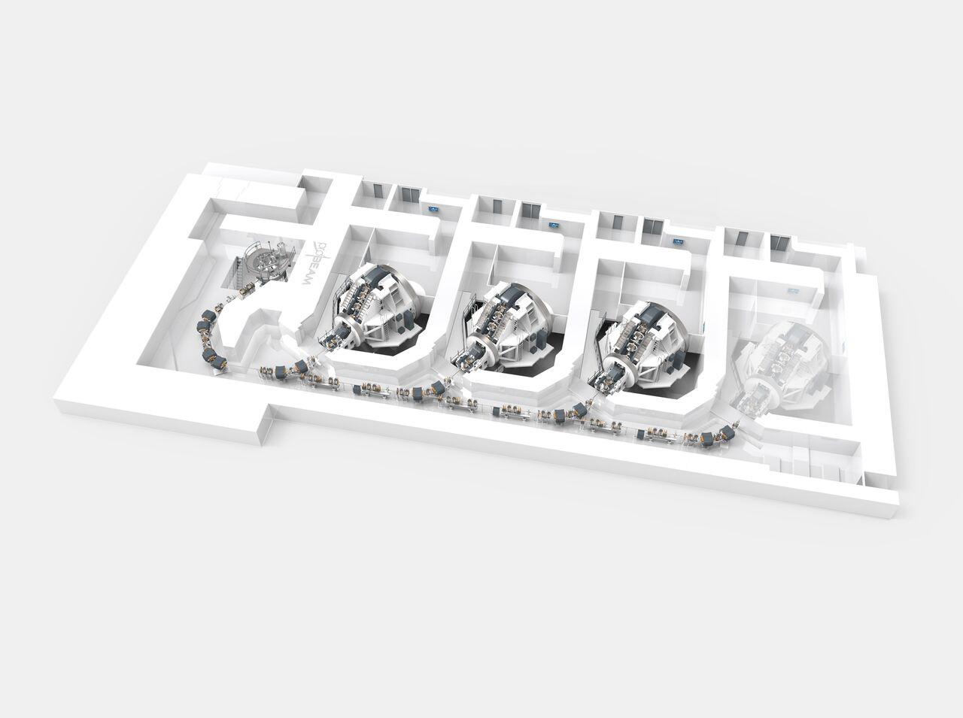
https://www.youtube.com/watch?v=LGVRiMWr-8c&list=PLesD4bjMDtkw0PviuW1UbHzO665DNcIWD&index=5

Slide 5
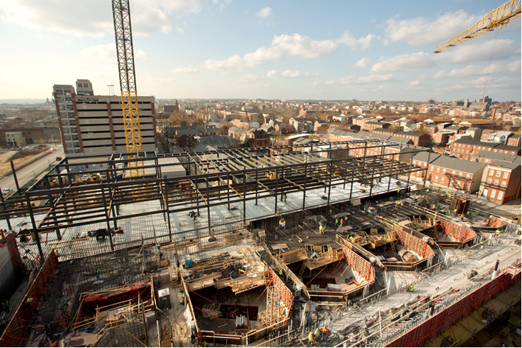
Kirkby

Slide 6
Production facilities, development opportunities
Construction of two NHS centres underway
Private enterprise also seek to contribute
Scaled to meet business plans
Developed on understanding of present need
Likely to generate additional treatment targets:
Additional opportunities and benefits
Opportunities to contribute:
Incremental development
Paradigm shift through innovation

Slide 7
The Centre
Centre for the Clinical Application of Particles

Slide 8
Centre for the Clinical Application of Particles
Mission:
“Develop the technologies, systems, techniques and capabilities necessary to deliver a paradigm shift in the clinical exploitation of particles.”
Context: CCAP within/under:
Cancer Research Centre of Excellence
CRUK Major Centre at Imperial
Collaboration (ab initio):
Faculty of Medicine, the Imperial Academic Health Science Centre, the Department of Physics, the Imperial CRUK Cancer Centre, the Institute of Cancer Research, the John Adams Institute and the Oxford Institute for Radiation Oncology
Led by clinical need

Slide 9
Ambition/long-term vision
Pasternak
Staged development of accelerator facility to serve definitive radiobiology programme
Electrons, protons and ions in single facility
Novel accelerator components that can be scaled up for use in a clinical facility;
Establish influential R&D activity encompassing:
Diagnostics/imaging, simulation/reconstruction, feedback and control

Slide 10
An opportunity
Centre for the Clinical Application of Particles

Slide 11

asd

Slide 12
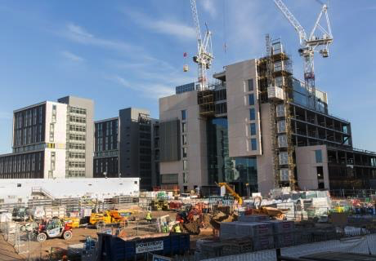
https://www.imperial.ac.uk/white-city-campus/
25-acre development:
Scheduled to open winter 2017/18
Translation and innovation hub:
Seeking transformative ideas

Slide 13
Translational hub for cancer technology
Advance:
Accelerator technology to:
Reduce: foot-print, capital/running costs
Enhance: beam quality, flexibility at delivery
Develop:
Novel detector & diagnostic systems
Real-time imaging, feedback and control
Simulation and algorithms for treatment planning
Radiobiology:
Deliver programme of in-vitro and in-vivo radiobiology measurement alongside and to advance treatment regimes
Ambition:

Slide 14
Capability
Centre for the Clinical Application of Particles

Slide 15
Strong collaboration with broad, relevant expertise
Track record of collaboration on large projects …

Slide 16
J.Pasternak A. Kurup, KL
J.Pozimski
Zulfikar Najmudin
Could not be with us today
And …
Uwe Oelfke (Head of Physics at ICR)
Phil Burrows (Acting Director JAI)
Matt Williams, Dorothy Gujral (Clinical oncologists)
Claire Hardiman, Ruth McLaughlan (Rad. Phys.)
Mark Hill (OIRO, Head of Radiation Biophysics)
… and, of course, others

Slide 17
Seeking to collaborate!

