Slide 1

RCF Diagnostics
Notes:
Calvin Dyson and work completed with

Slide 2
Overview
RCF Protocol
    Lessons Learnt about handling and using RCF
RCF Dose Calibration
Two Methods of using RCF
    Placing RCF (EBT3) around the outer edge of the cell dish
    Placing delaminated EBT3 in front of the cell dish

Slide 3
RCF Protocol
Preparation
  Preparation
Scanner
Clean the Scanner Bed
Let Electronics Warmup: Wait at least 30mins after turning the scanner on
Light Source Warmup: Do 5-10 scans before scanning RCF
Film
Mark the side that gets irradiated
Wait at least 24 hours since irradiation

Slide 4
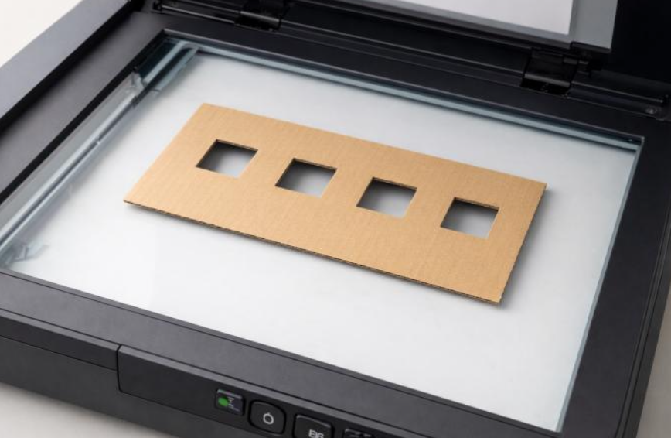
RCF Protocol
Preparation
Handling
Use Gloves
Keep a 1.5cm wide region, starting at the initial position of the light source
Always place the films in the same position
    Position them on the same line to avoid the Lateral Response Artefact (LRA)
    Use a holder to guarantee
Film Orientation: Scan film in both orientations and always use the same orientation in calculation:
    The “same” refers to whether it is a lower or higher pixel count compared with when it’s rotated
Place a glass sheet over the films to hold them down and avoid the Callier effect
Notes:
LRA
The scanner light intensity and/or CCD response is not perfectly uniform.
Sensitivity decreases toward the edges.
Even a uniformly irradiated film shows a U-shaped or parabolic grey-value profile.
Callier
The dependence of measured optical density on the angular distribution of transmitted/scattered light.
OD assumes all light was absorbed. Might have been scattered

Slide 5
RCF Protocol
Preparation
Post-Scan
Check gray-values using an image processing software like ImageJ
    Check that there is no LRA
Store the films in the dark to avoid colour change should further scans be required

Slide 6
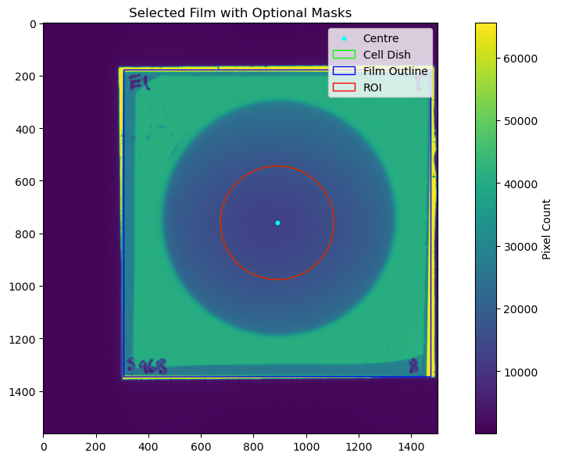
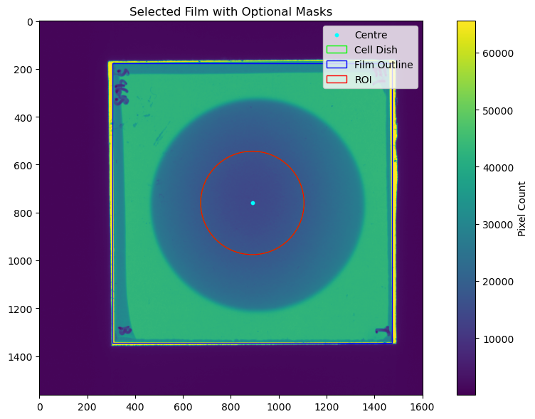
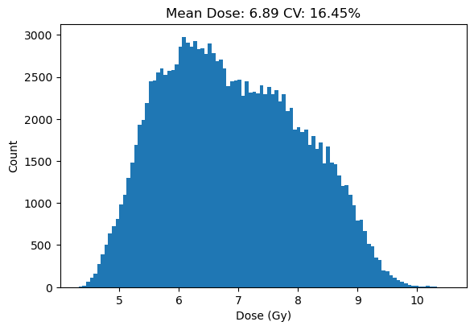
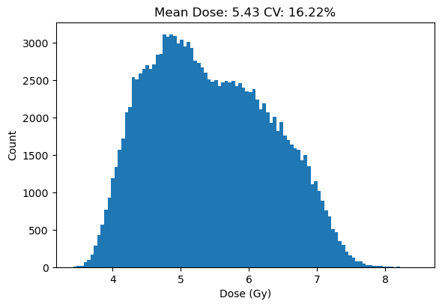
RCF Protocol
Rotation Issue

Slide 7
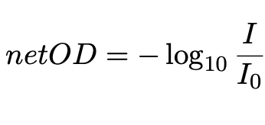
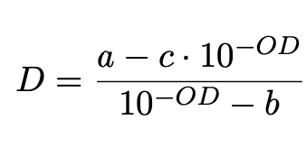
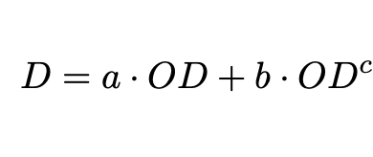
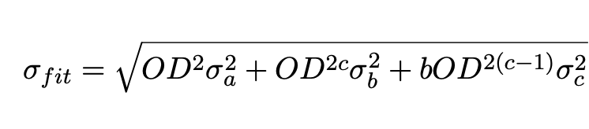
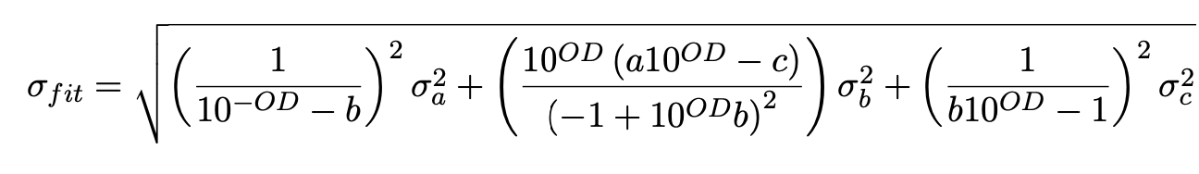
Calibration
Models
  Gafchromic’s Recommended Model
  Polynomial Model

Slide 8
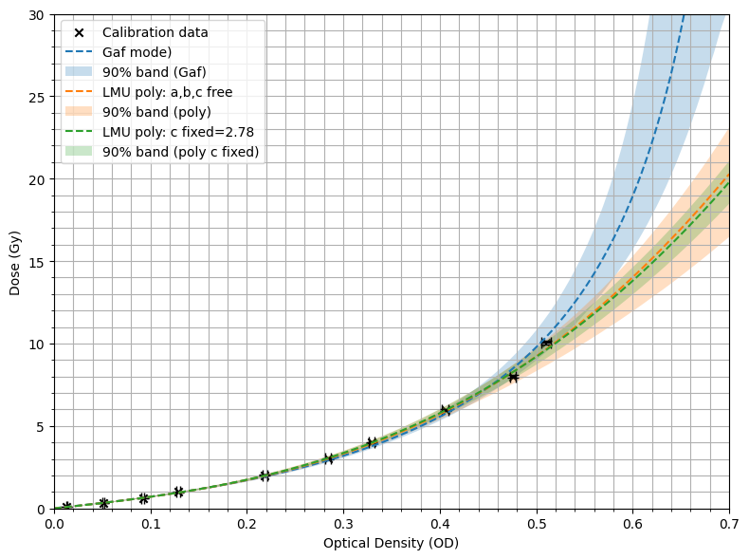
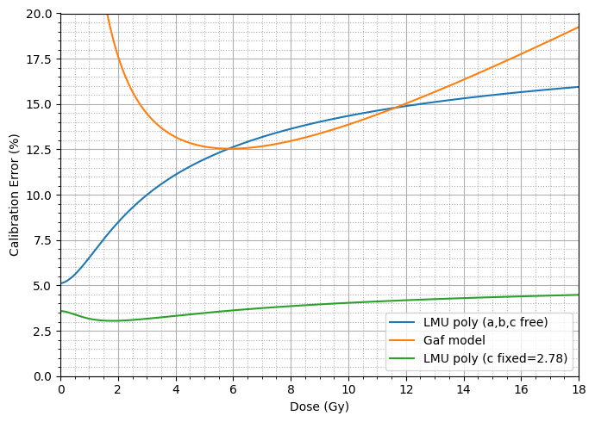
Calibration
Evaluation
Model | a | b | c | 𝜒_{r}²
Gafchromic | 2.13±0.13 | 0.167±0.015 | 2.12±0.13 | 9.87
Polynomial | 6.43±0.33 | 43.7±8.8 | 2.85±0.25 | 9.63
Polynomial (C fixed) | 6.36±0.23 | 41.3±2.4 | 2.78 | 8.55
Devic S et al 2004 Dosimetric properties of improved GafChromic films for seven different digitizers Med.
Phys. 31 2392–401

Slide 9
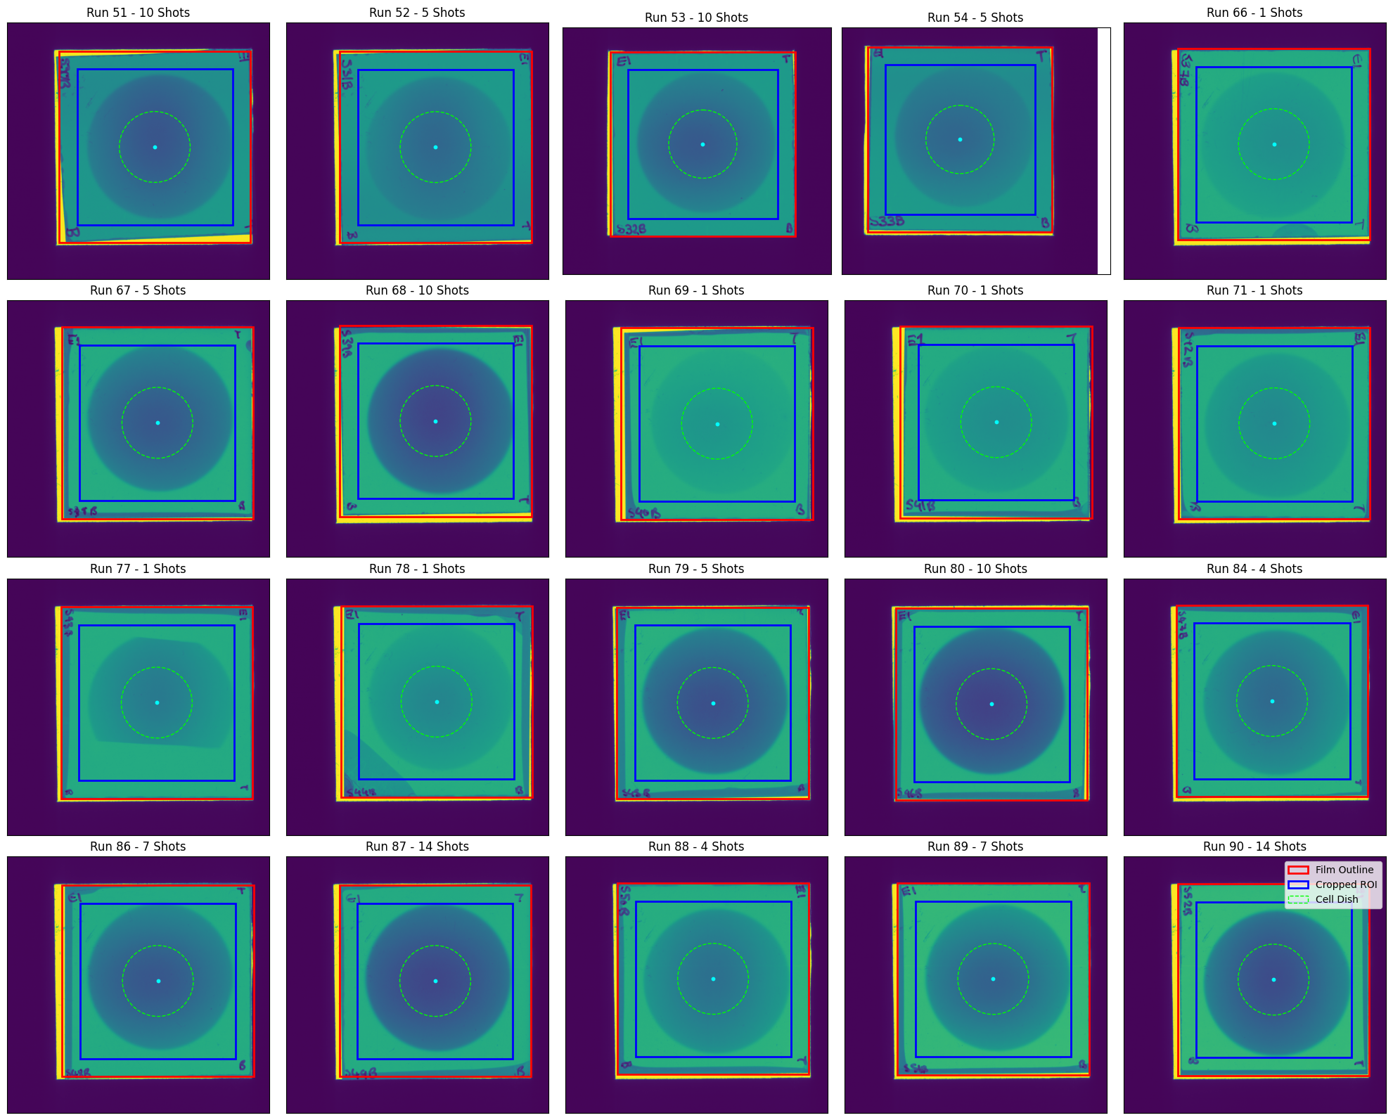
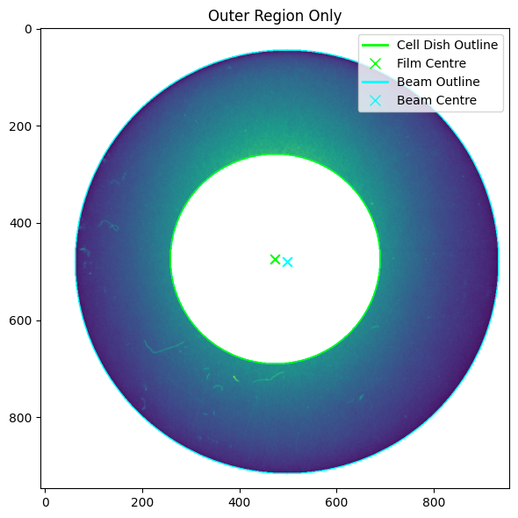
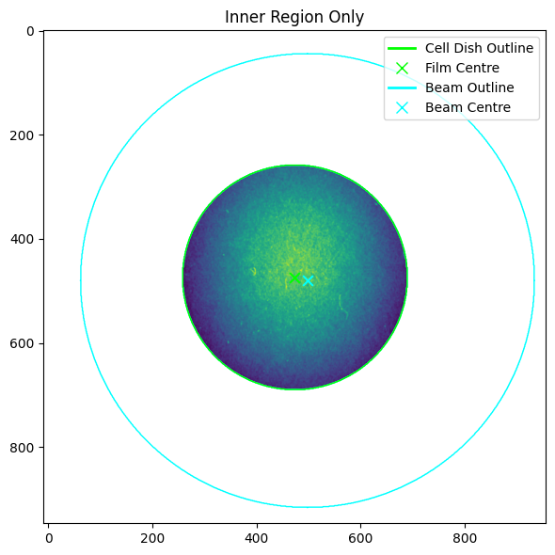
Diagnostic: RCF around the cell dish

Slide 10
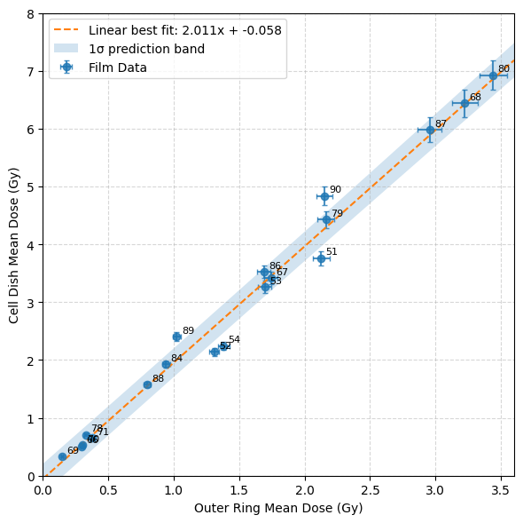
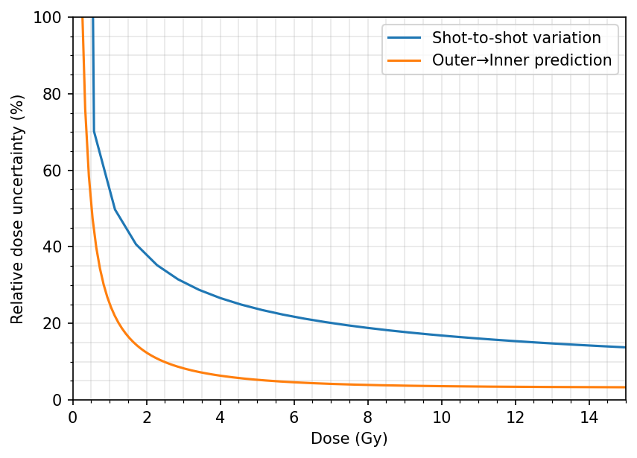
Diagnostic: RCF around the cell dish
Evaluation
Originally completed a linear fit with measured uncertainties:
    𝜒_{r}²: 6.12
Added a new ”film-to-film” uncertainty
    “Beam jitter”?
    Allowed it to vary until 𝜒_{r}² ~1
    Uncertainty on fit became: 0.225 Gy

Slide 11
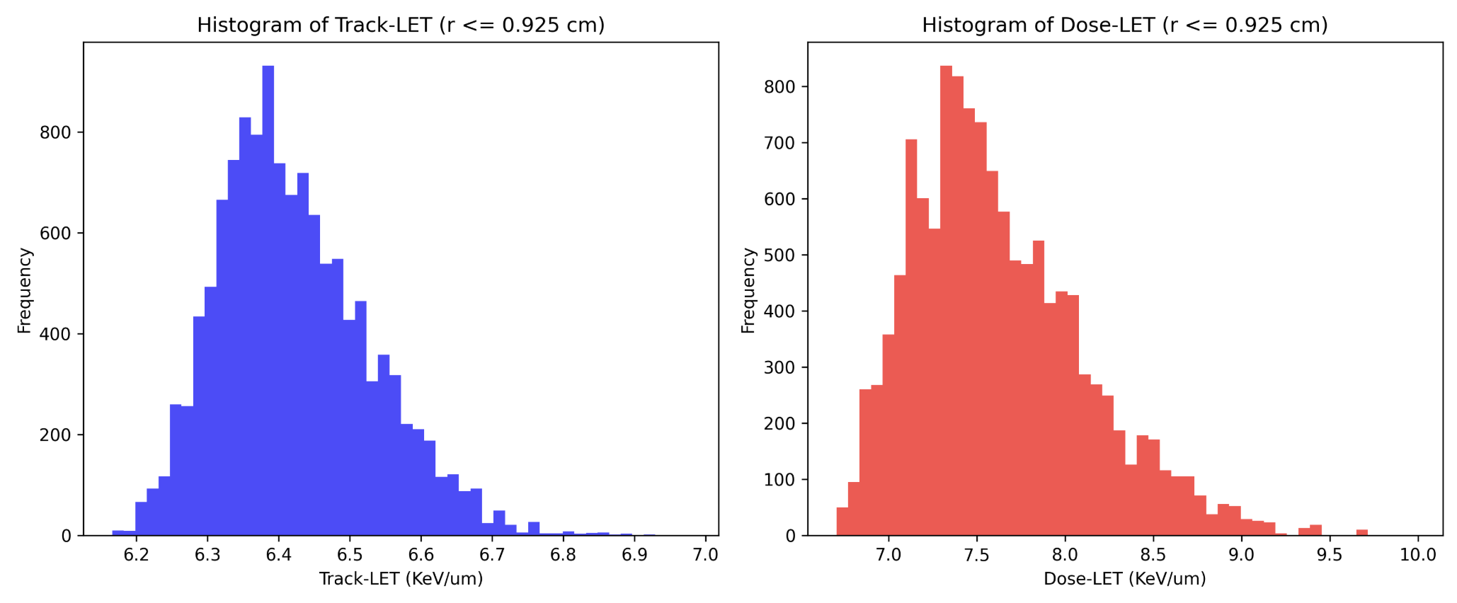
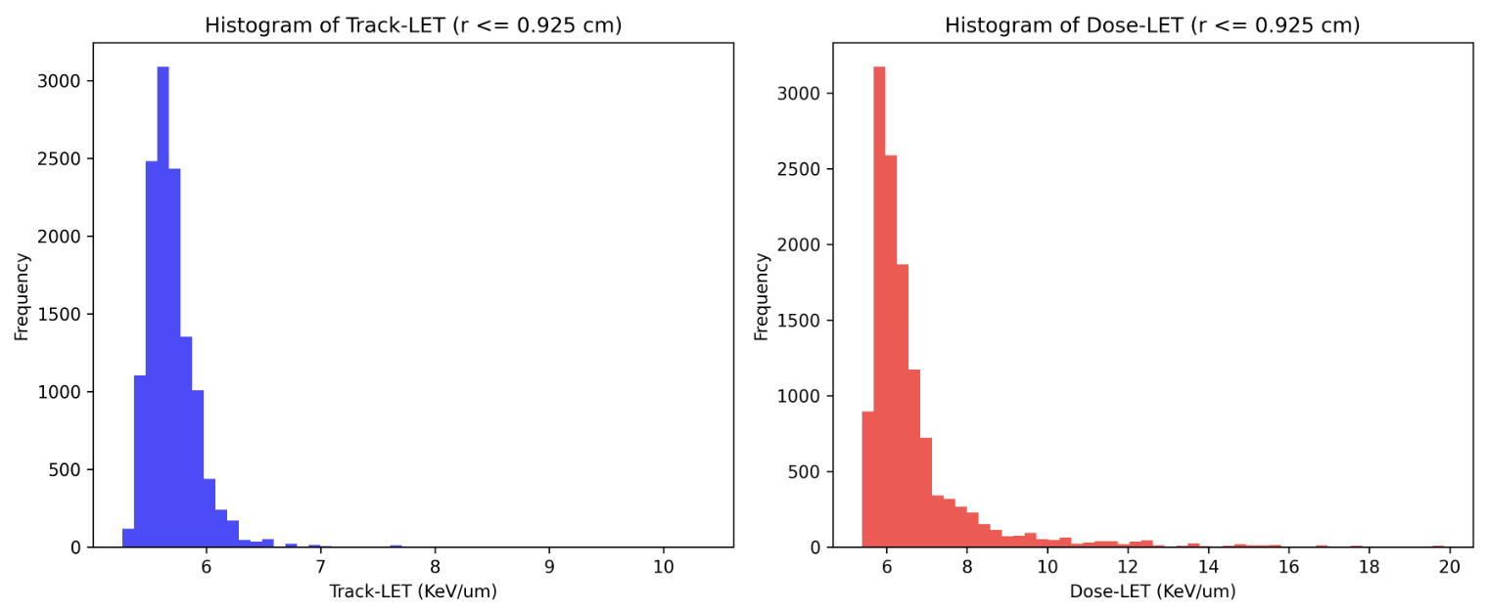
Diagnostic: In-Beam Delaminated EBT3
LET Histograms
RCF:
No RCF:
Notes:
Track-averaged LET:
Track-averaged LET is the average stopping power weighted by particle path length, describing the physical quality of the radiation field.
Dose-averaged LET:
Dose-averaged LET is weighted by deposited energy

Slide 12
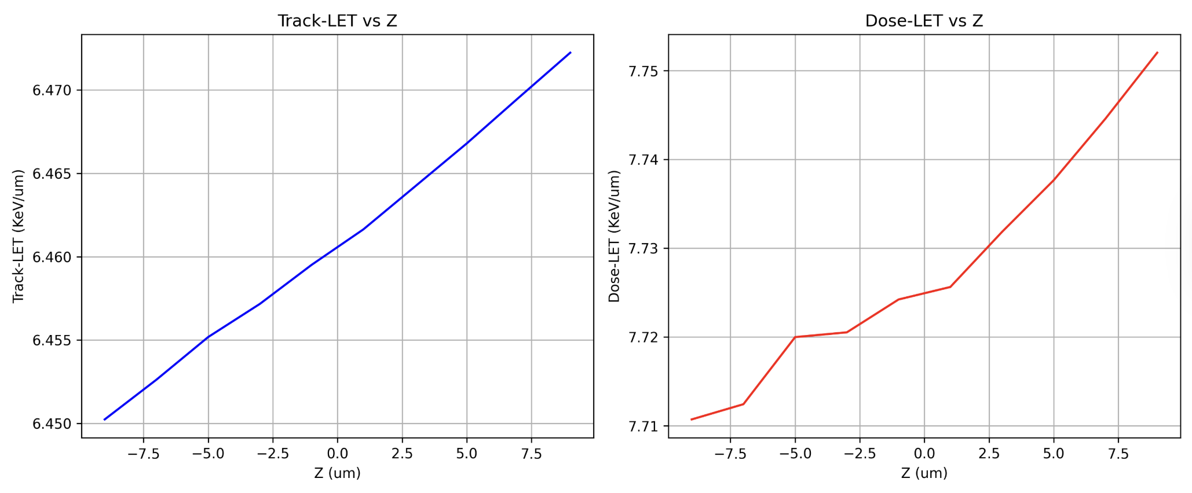
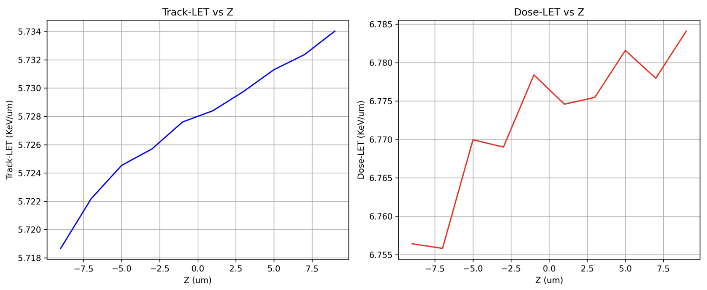
Diagnostic: In-Beam Delaminated EBT3
LET Histograms
RCF:
No RCF:
Notes:
Track-averaged LET:
Track-averaged LET is the average stopping power weighted by particle path length, describing the physical quality of the radiation field.
Dose-averaged LET:
Dose-averaged LET is weighted by deposited energy

Slide 13
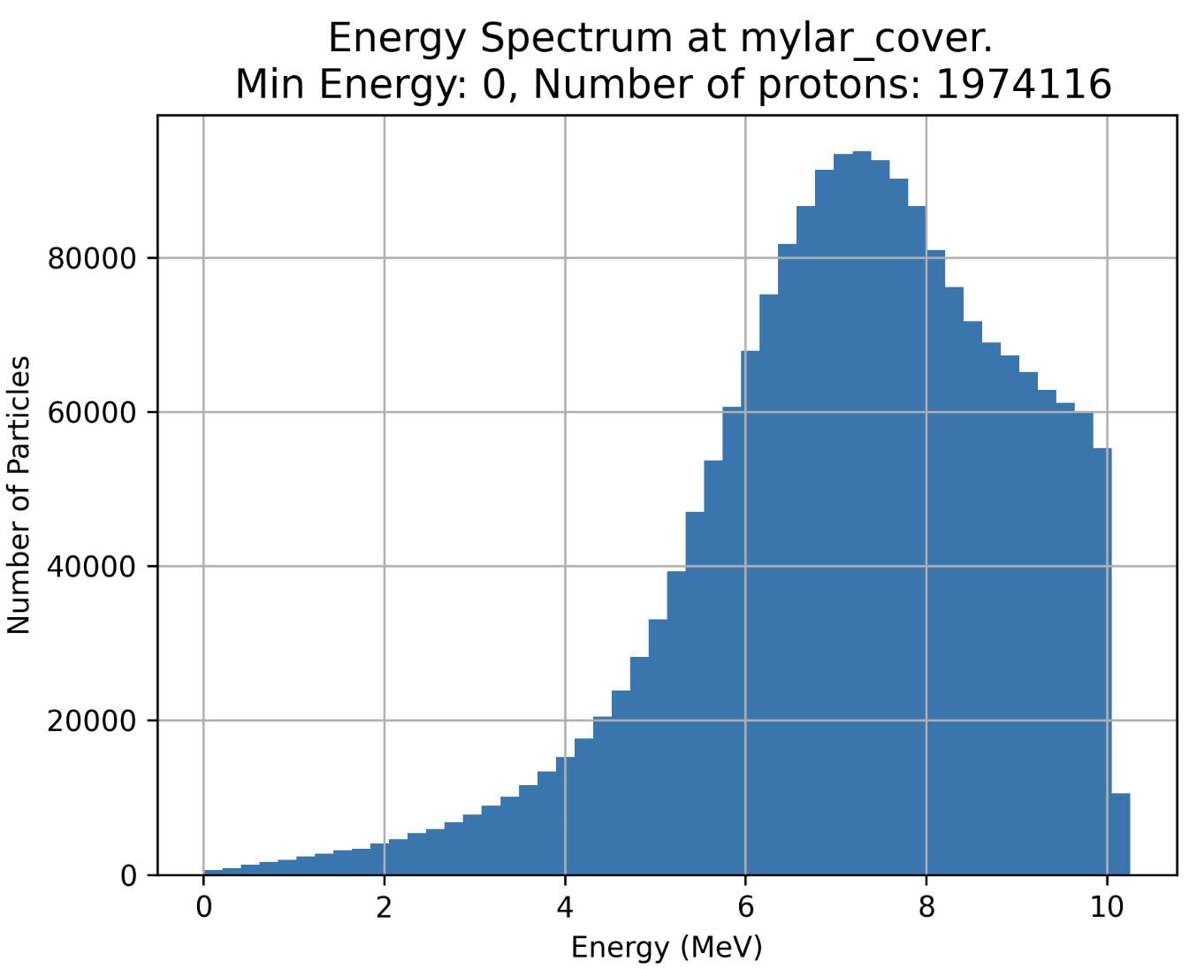
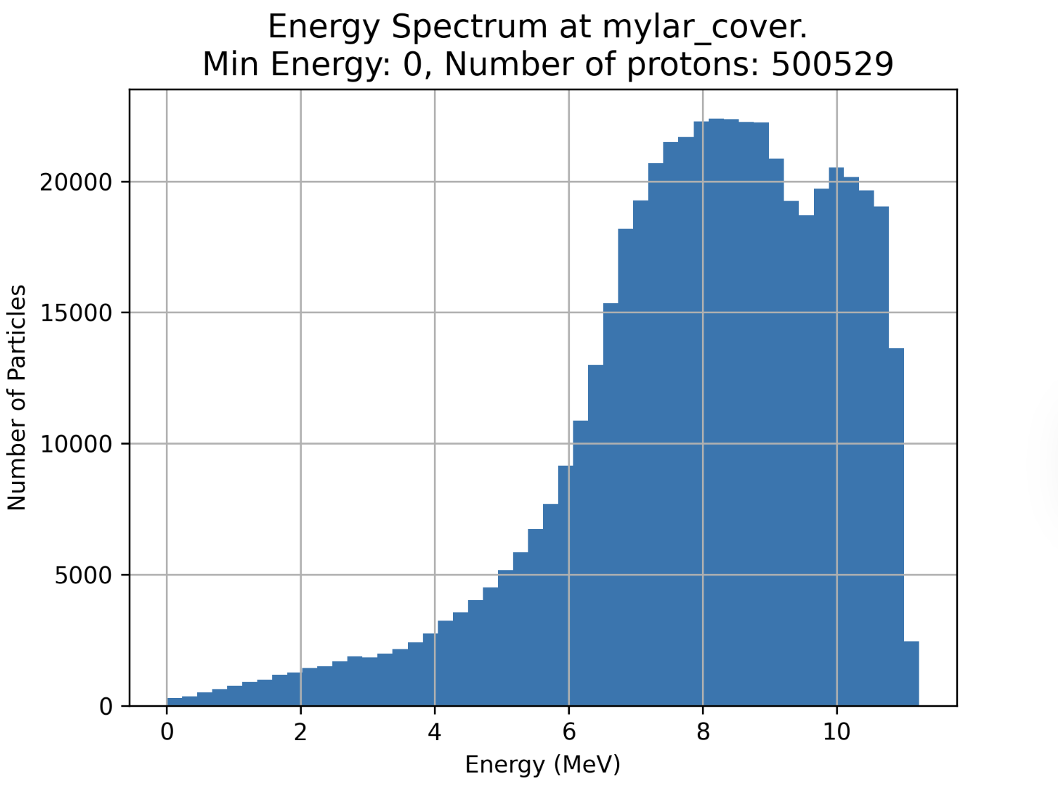
Diagnostic: In-Beam Delaminated EBT3
Energy Spectra
RCF
No RCF

Slide 14
Conclusions
An RCF Protocol has been defined
    Thanks to Diaza
    Need to acquire a glass sheet
Can achieve a lower calibration fit uncertainty by fixing ‘c’ in the Polynomial model
Placing RCF around the cell dish is a viable diagnostic
    Produces a 0.223Gy error due to beam variation
  Placing Delaminated EBT3 does not drastically increase the LET in the cell layer?
    Next: Check how well you can predict the cell dose from the delaminated EBT3 dose
14

