Slide 1
PoPLaR Phase 2:
RCF Analysis
Notes:
Welcome to the simulation of the LION beam with LLO
Calvin Dyson and work completed with

Slide 2
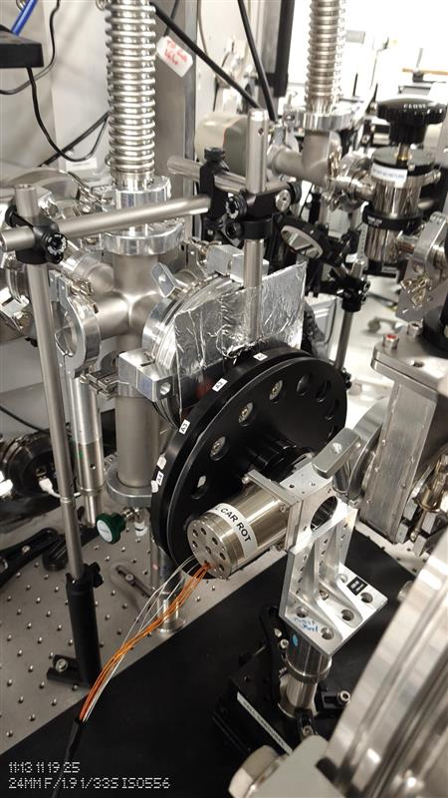
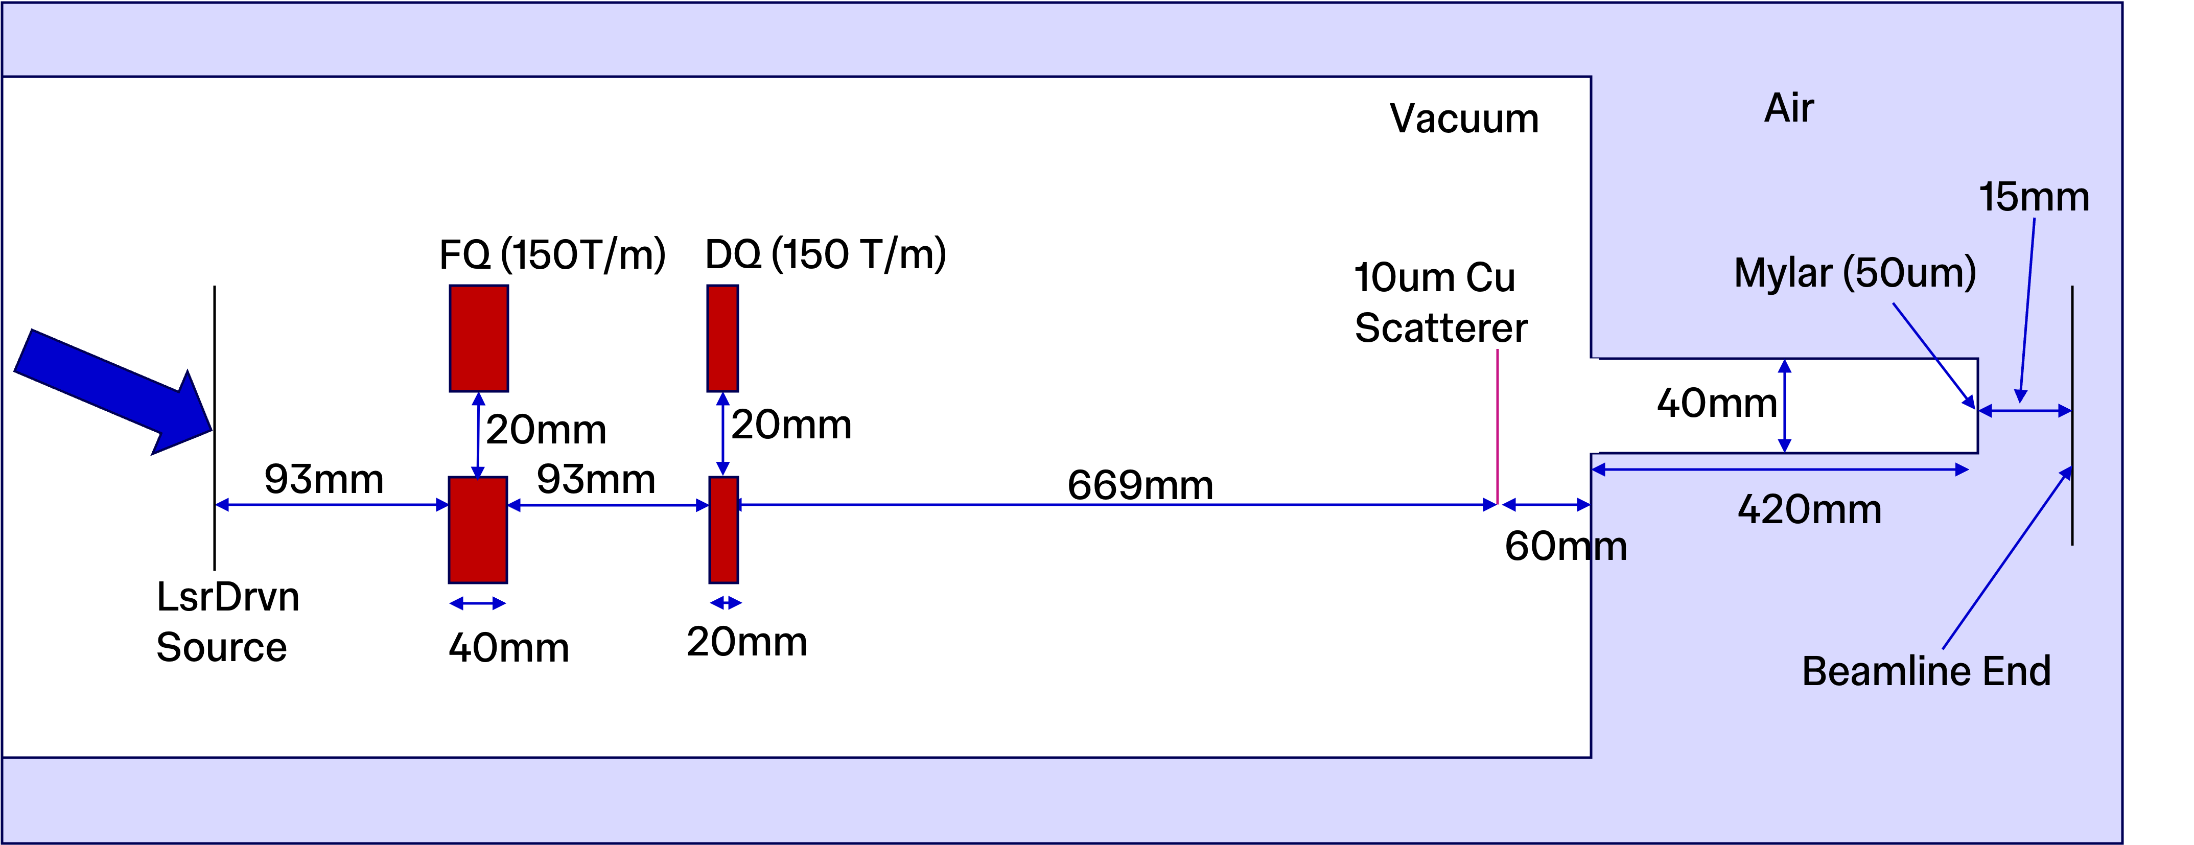
Overview
RCF was used to estimate the dose delivered to the cells
Two Main Sources of Uncertainty
    Temporal (Variation in dose between shots)
    Spatial (Variation in dose across the cell dish)

Slide 3
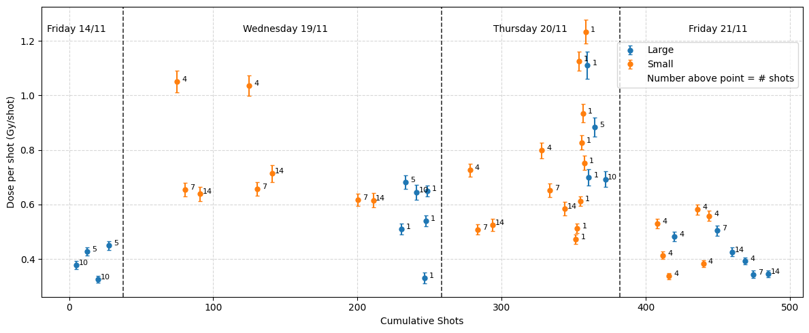
Dataset
Collected 50 Films
    20 larger than the cell dish
    30 smaller than the cell dish
Used the larger films to estimate the conversion of the smaller films to the full cell dish area
Range of shots taken: 1-14
    Key shot numbers are 4, 7 and 14 shots
Range of Dose Delivered: 0.01 – 9.99 Gy
Notes:
Mention:
Large Variation
No Clear dependence on shot number
Potential Dependence on Smaller Film Size

Slide 4

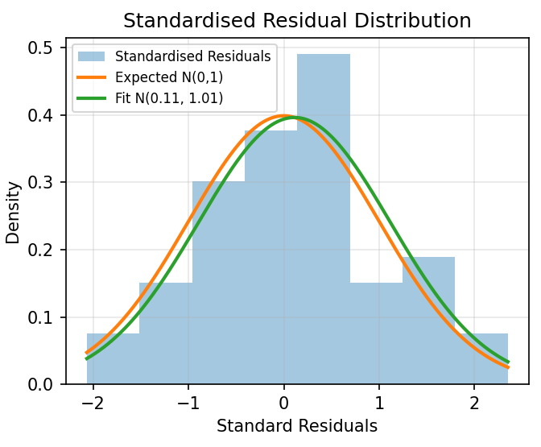
Estimating Dose Delivered
Shot-to-shot Variation
Performed a Maximum Likelihood Fit on the mean dose and the shot-to-shot variation
Assumes normally distributed shot-to-shot variation.
N_{i} = Number of Shots, 𝜇 = Mean Dose per Shot,
𝜎_{shot} = Shot-to-shot Variation, 𝜎_{D} = Measurement Error
Result:
    𝜇 = 0.57 Gy
    𝜎_{shot} = 0.4 Gy
    𝜎_{D} = 0.03 Gy
    𝜒_{red}² = 1.05 (p=0.384)

Slide 5
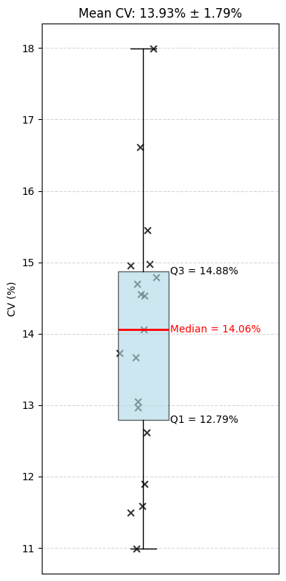
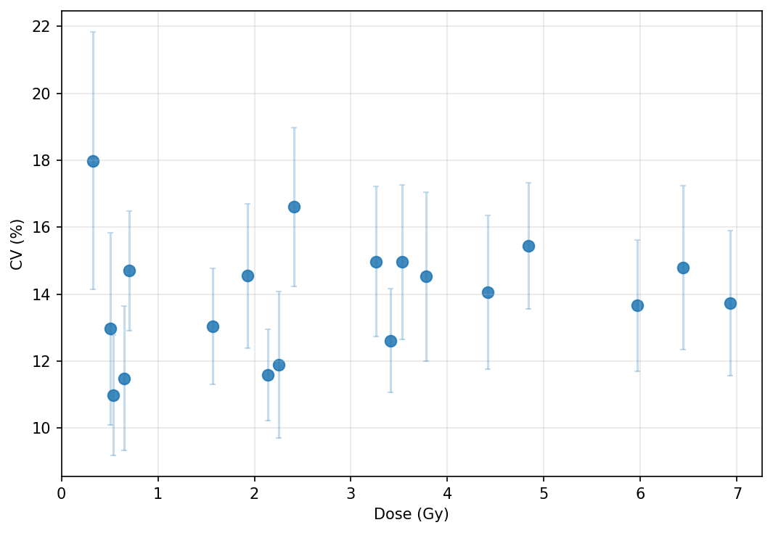
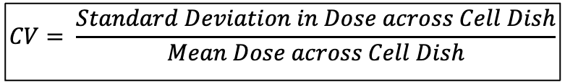
Estimating Dose Delivered
Spatial Variation
$$CV= \frac{Standard Deviation in Dose across Cell Dish}{Mean Dose across Cell Dish}$$
20 Large Films
Mean CV: 13.93%
No obvious dependence on mean dose

Slide 6
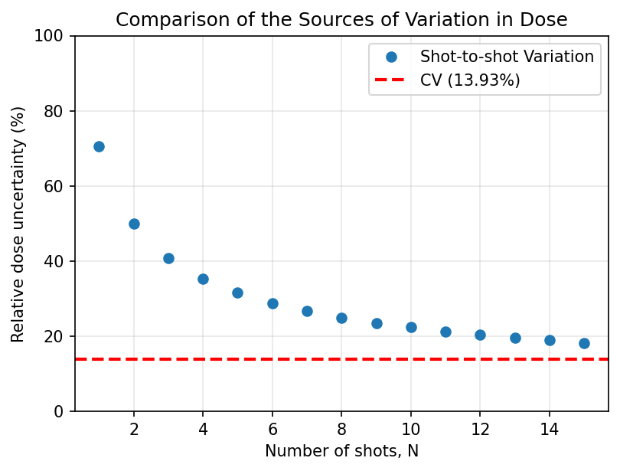
Estimating Dose Delivered
Compare Dose Variation Sources
Main Error is shot-to-shot variation
Need to reduce the spatial variation as well
CV becomes the bigger proportional error at 26 shots (or 14.8 Gy)

Slide 7
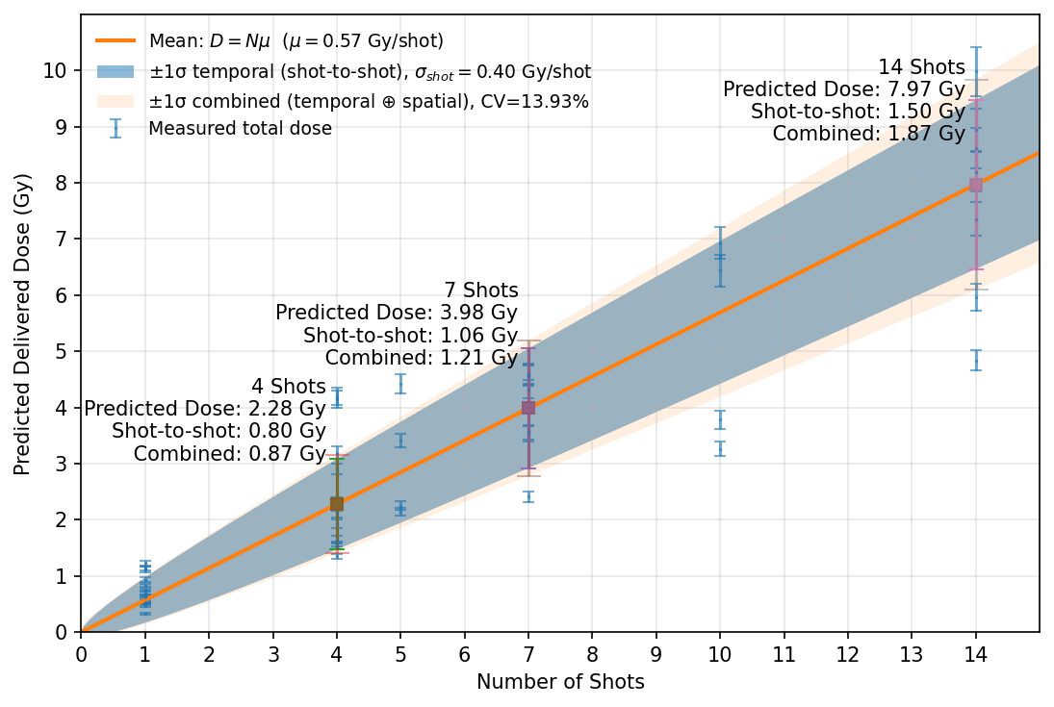
Estimating Dose Delivered
Final Results
Shots | Predicted Dose /Gy | Uncertainty /Gy
4 | 2.28 | 0.87
7 | 3.98 | 1.21
14 | 7.97 | 1.87

Slide 8
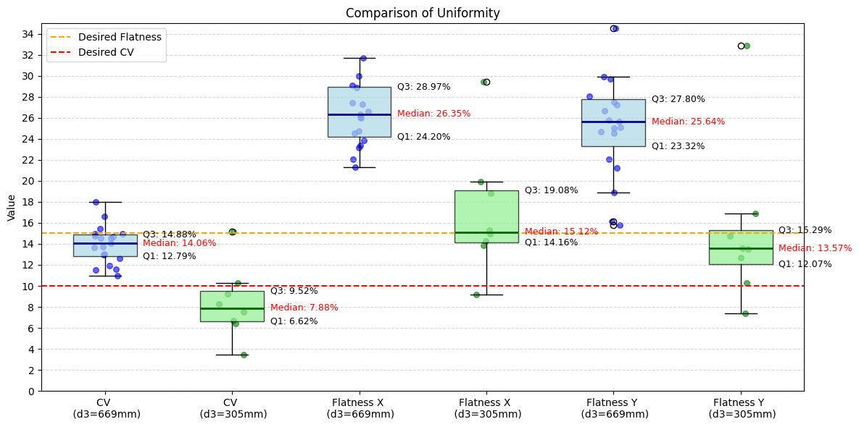
Uniformity Improvement
Move Copper Scatterer Closer

Slide 9
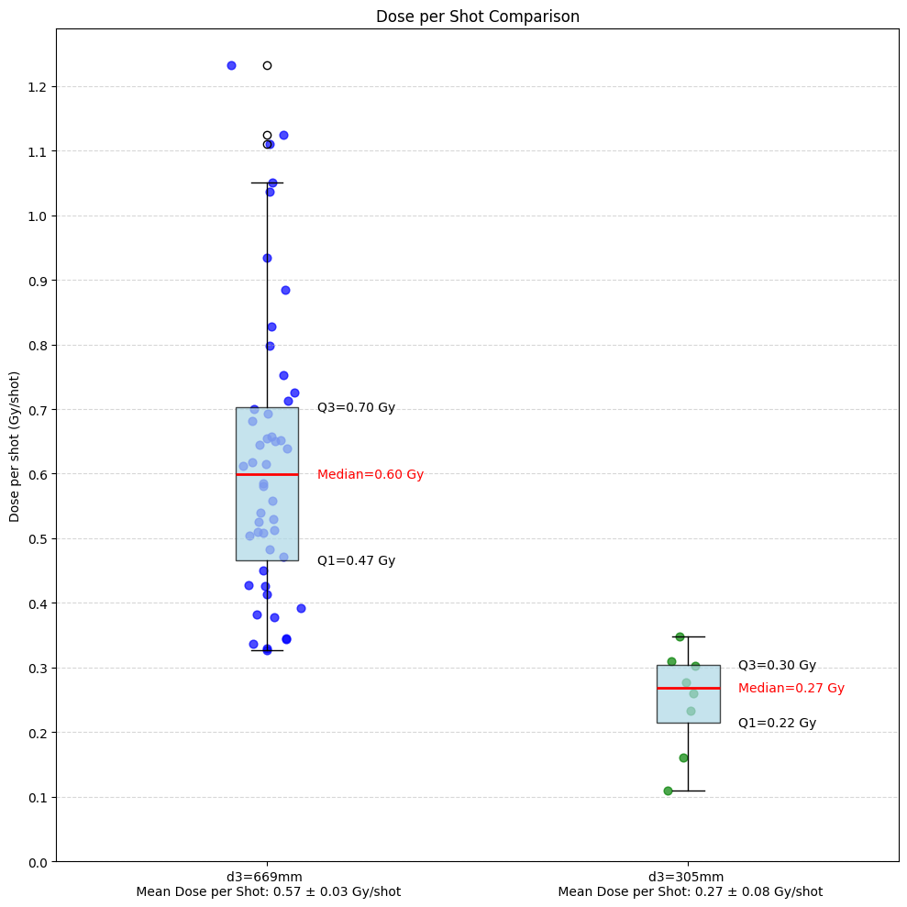
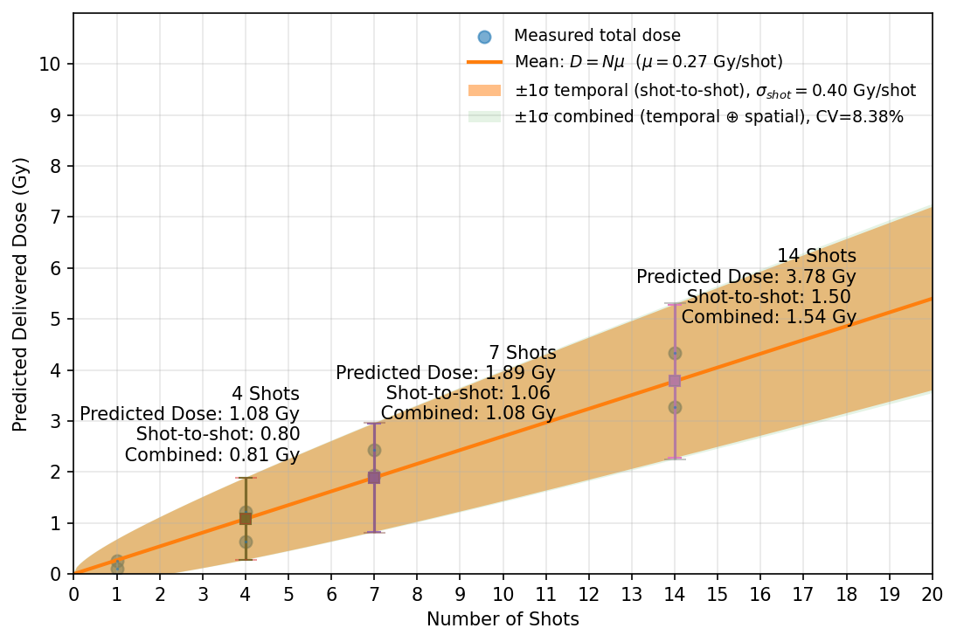
Uniformity Improvement
Move Copper Scatterer Closer

Slide 10
Conclusions and Future
Shot-to-Shot Variation is the biggest uncertainty
    Requires in-beam diagnostic
Delivered roughly twice the dose as expected
  Spatial Non-Uniformity Considerable
      Moving the scatterer closer does improve uniformity
      Delivers a little less than half the dose per shot
10

