Slide 1

Radiobiology research at SCAPA - PoPLaR
Emma Melia
University of Birmingham
24.02.2026

Slide 2
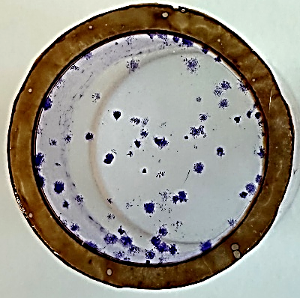
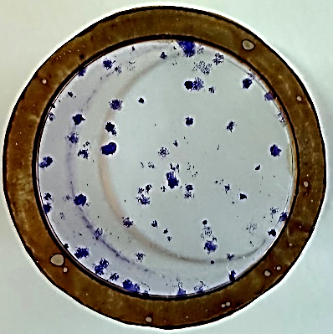
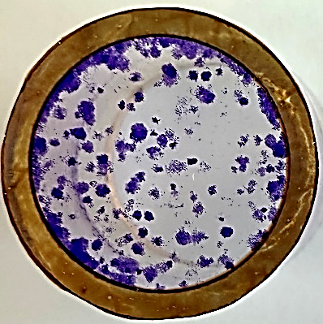
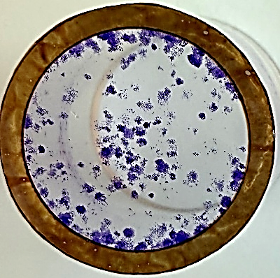
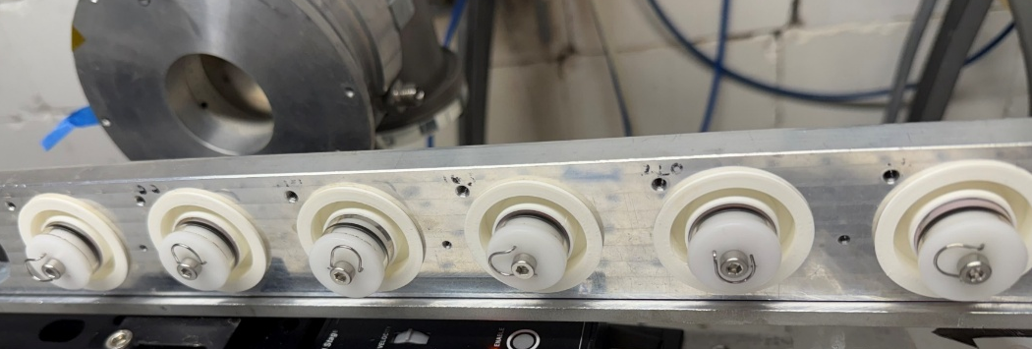
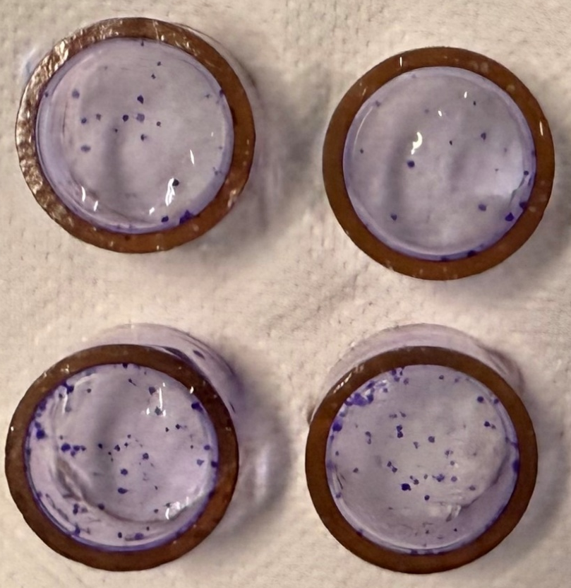
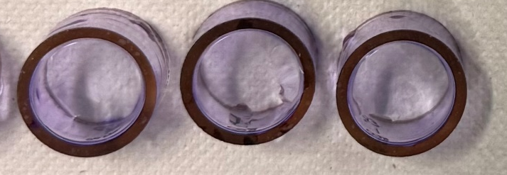
Optimisation
Control
1Gy
2Gy
4Gy
200
200
800
800
X-ray
Pre-plated
Horizontal
Control
(not mock IR)
Horizontal
Proton
Pre-plated
Vertical

Slide 3
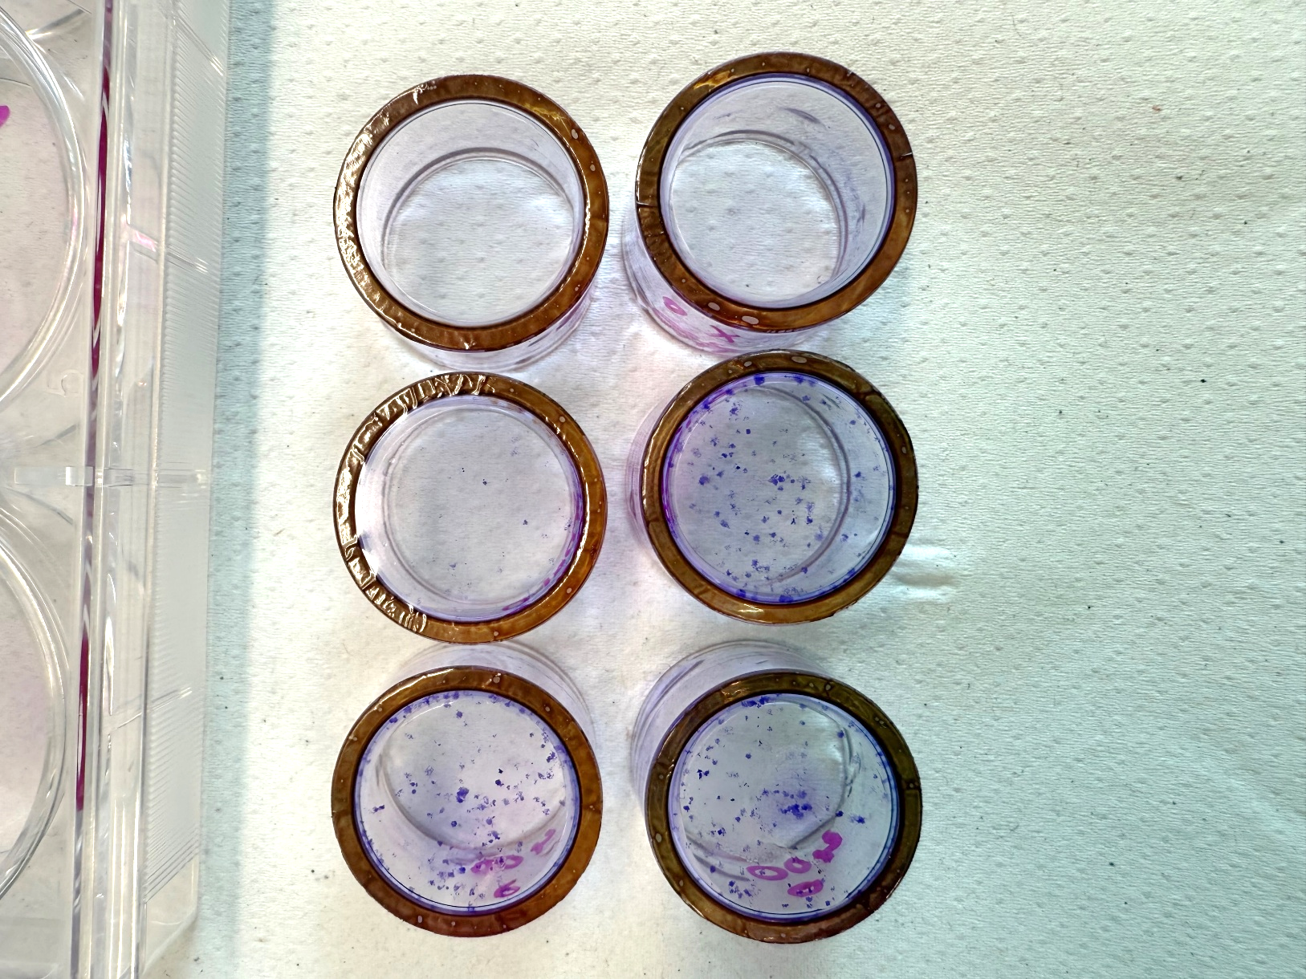
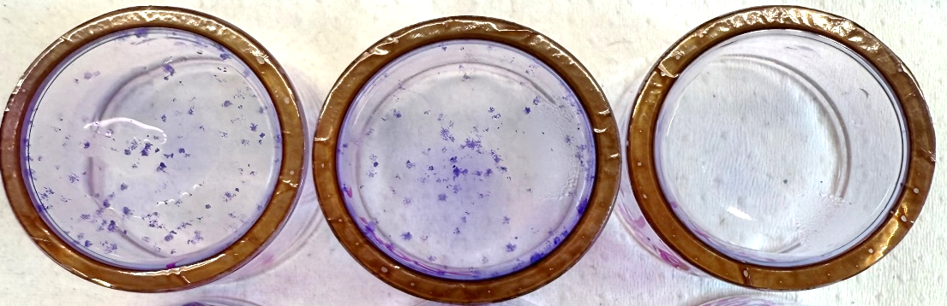
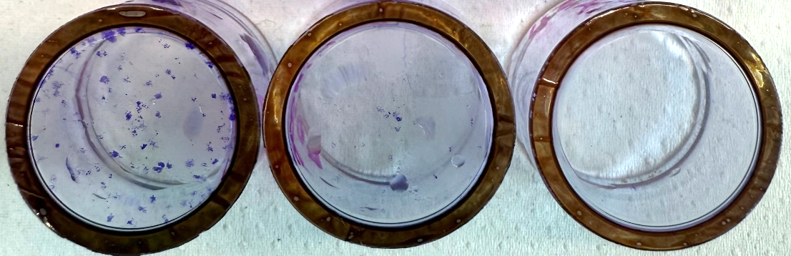
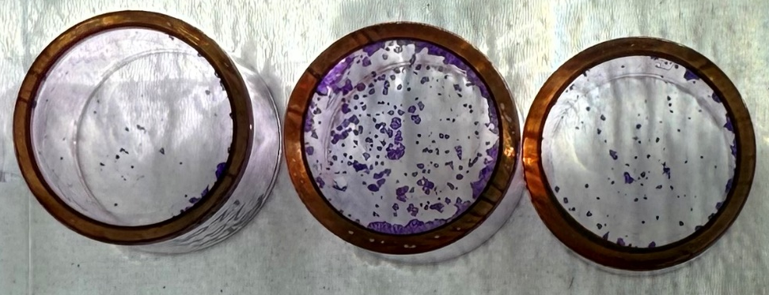
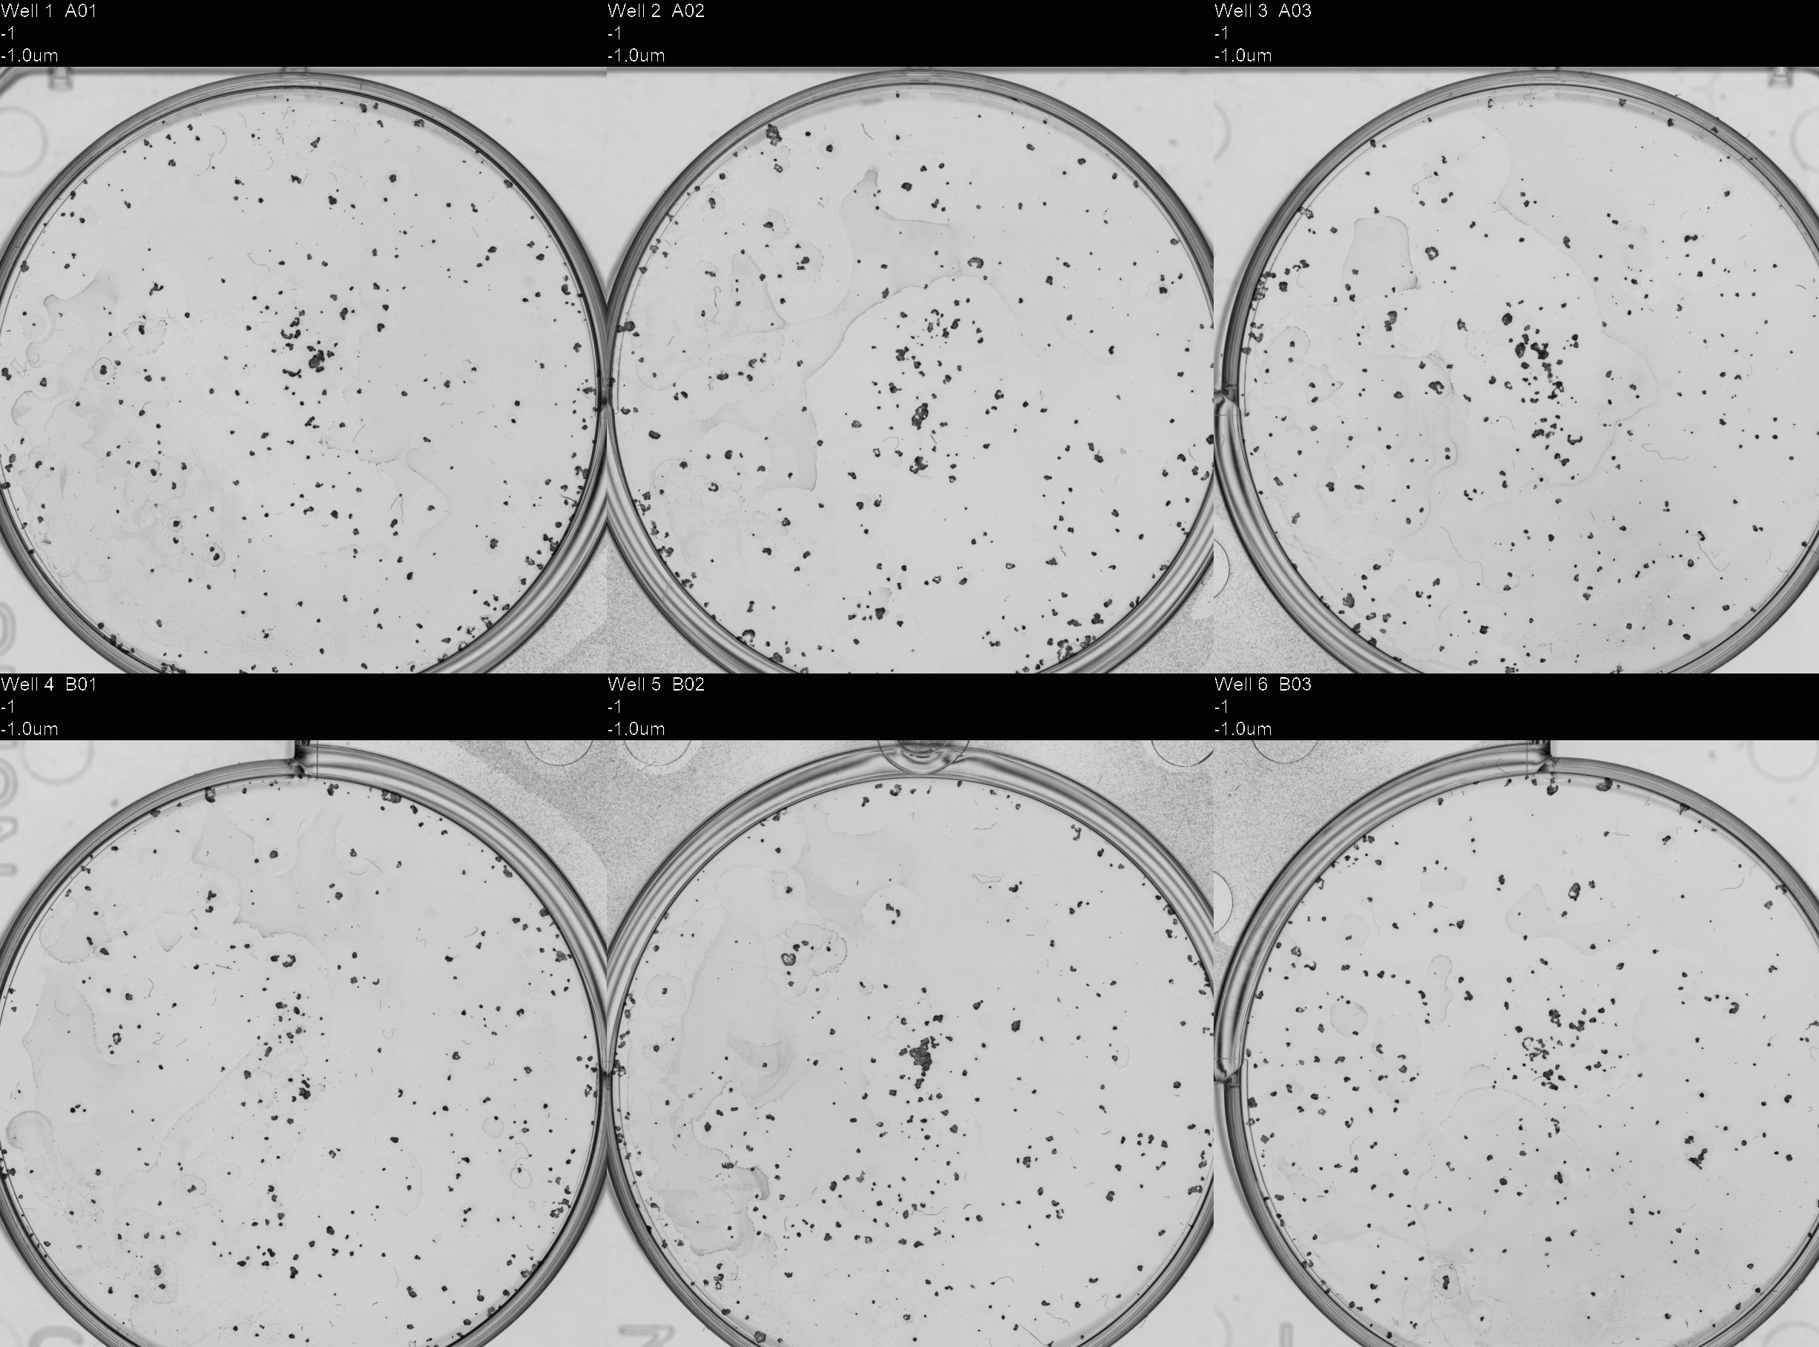
Optimisation
1ml + 6-well
0.5ml + Lid
No Media + Lid
1Gy
400
1ml + 6-well
0.5ml + Lid
No Media + Lid
0Gy
400
X-ray
Pre-plated
Vertical
Proton
Pre-plated
Proton
Post-plated
Vertical
Vertical

Slide 4
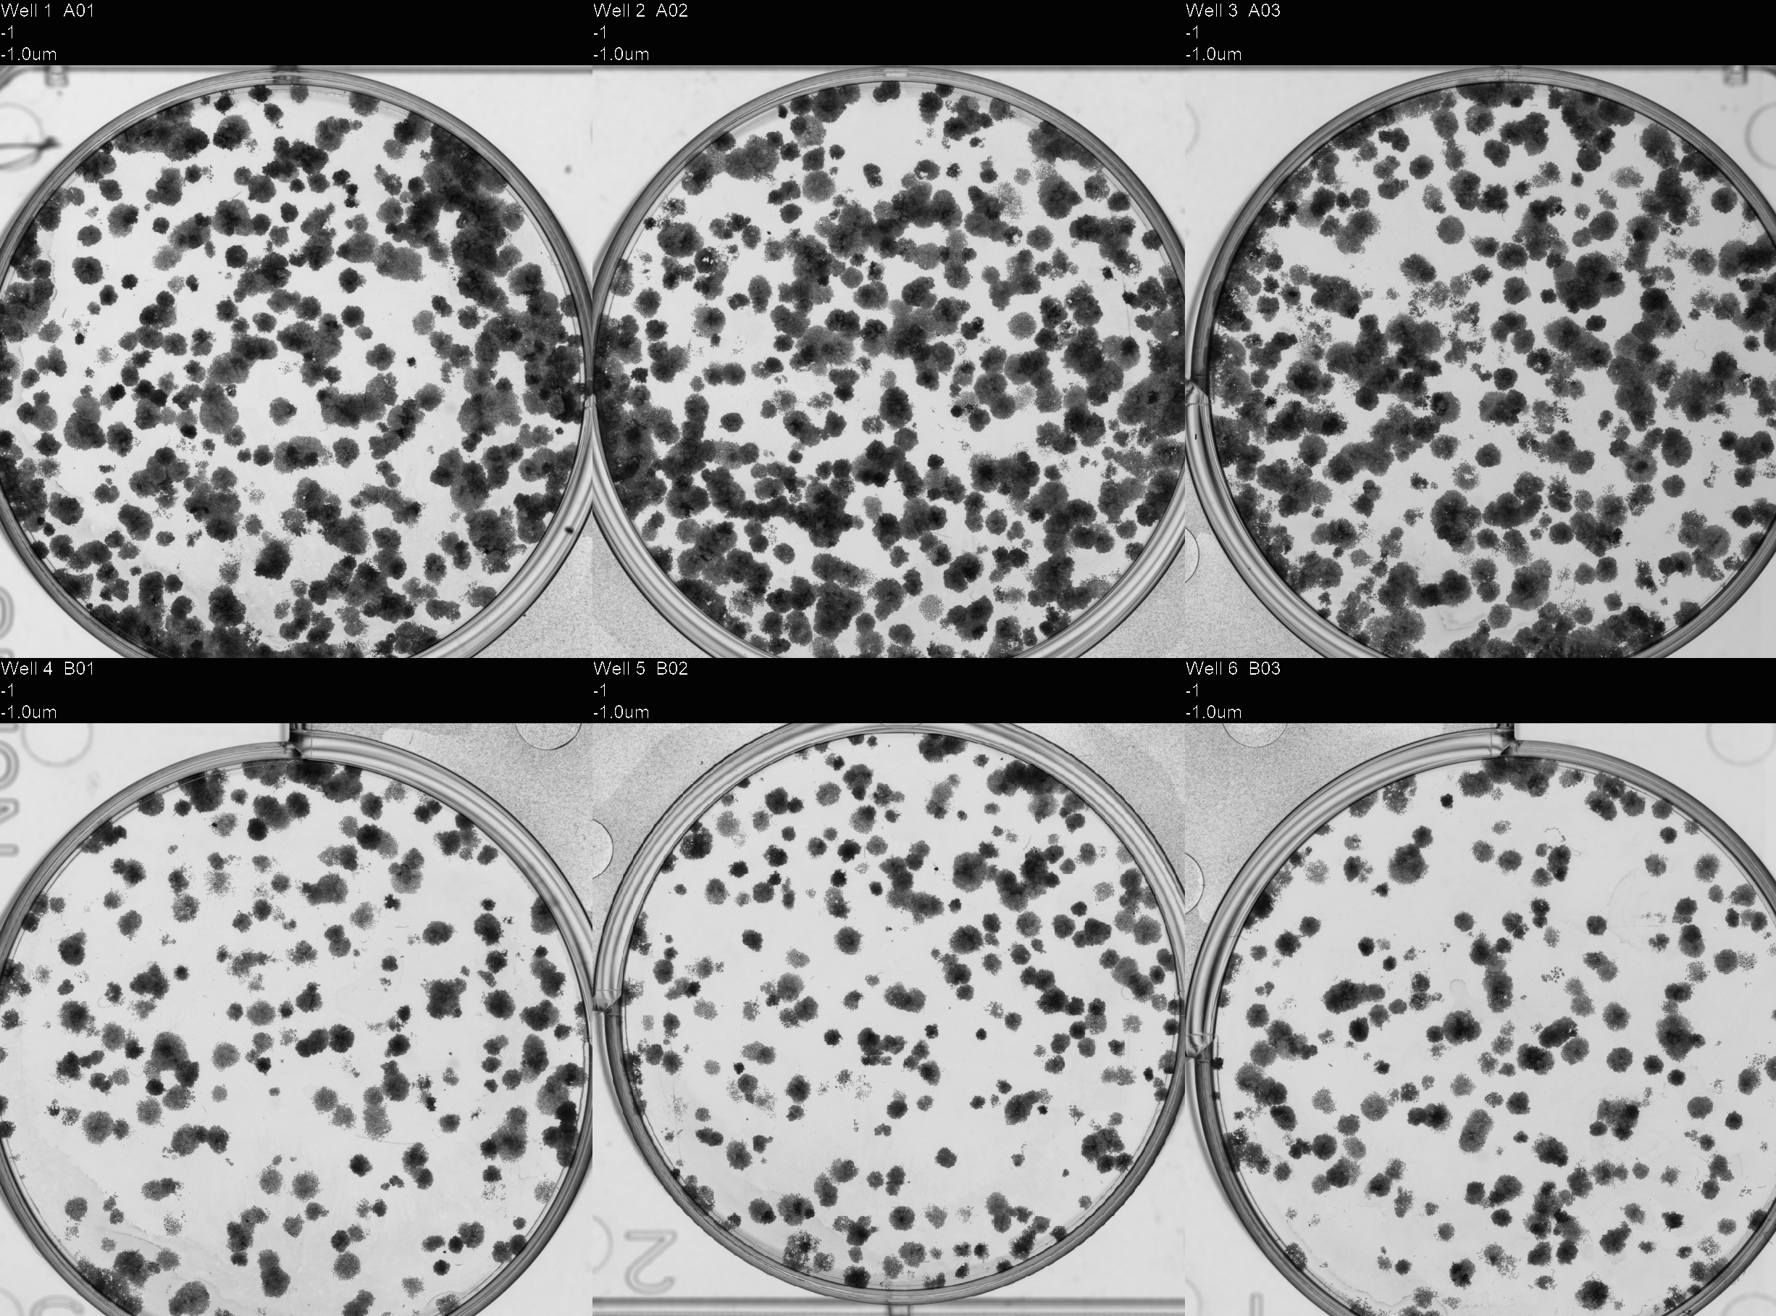
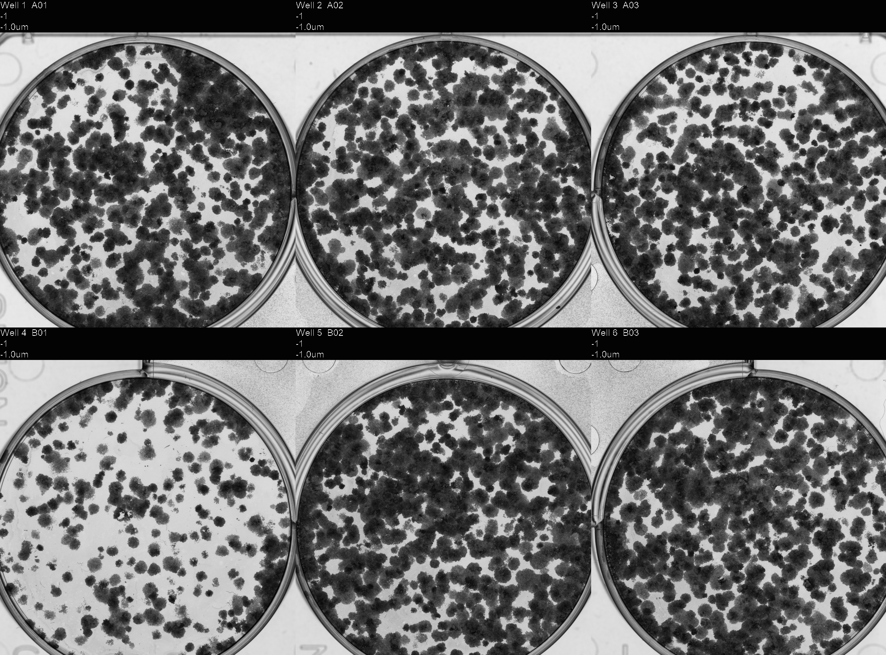
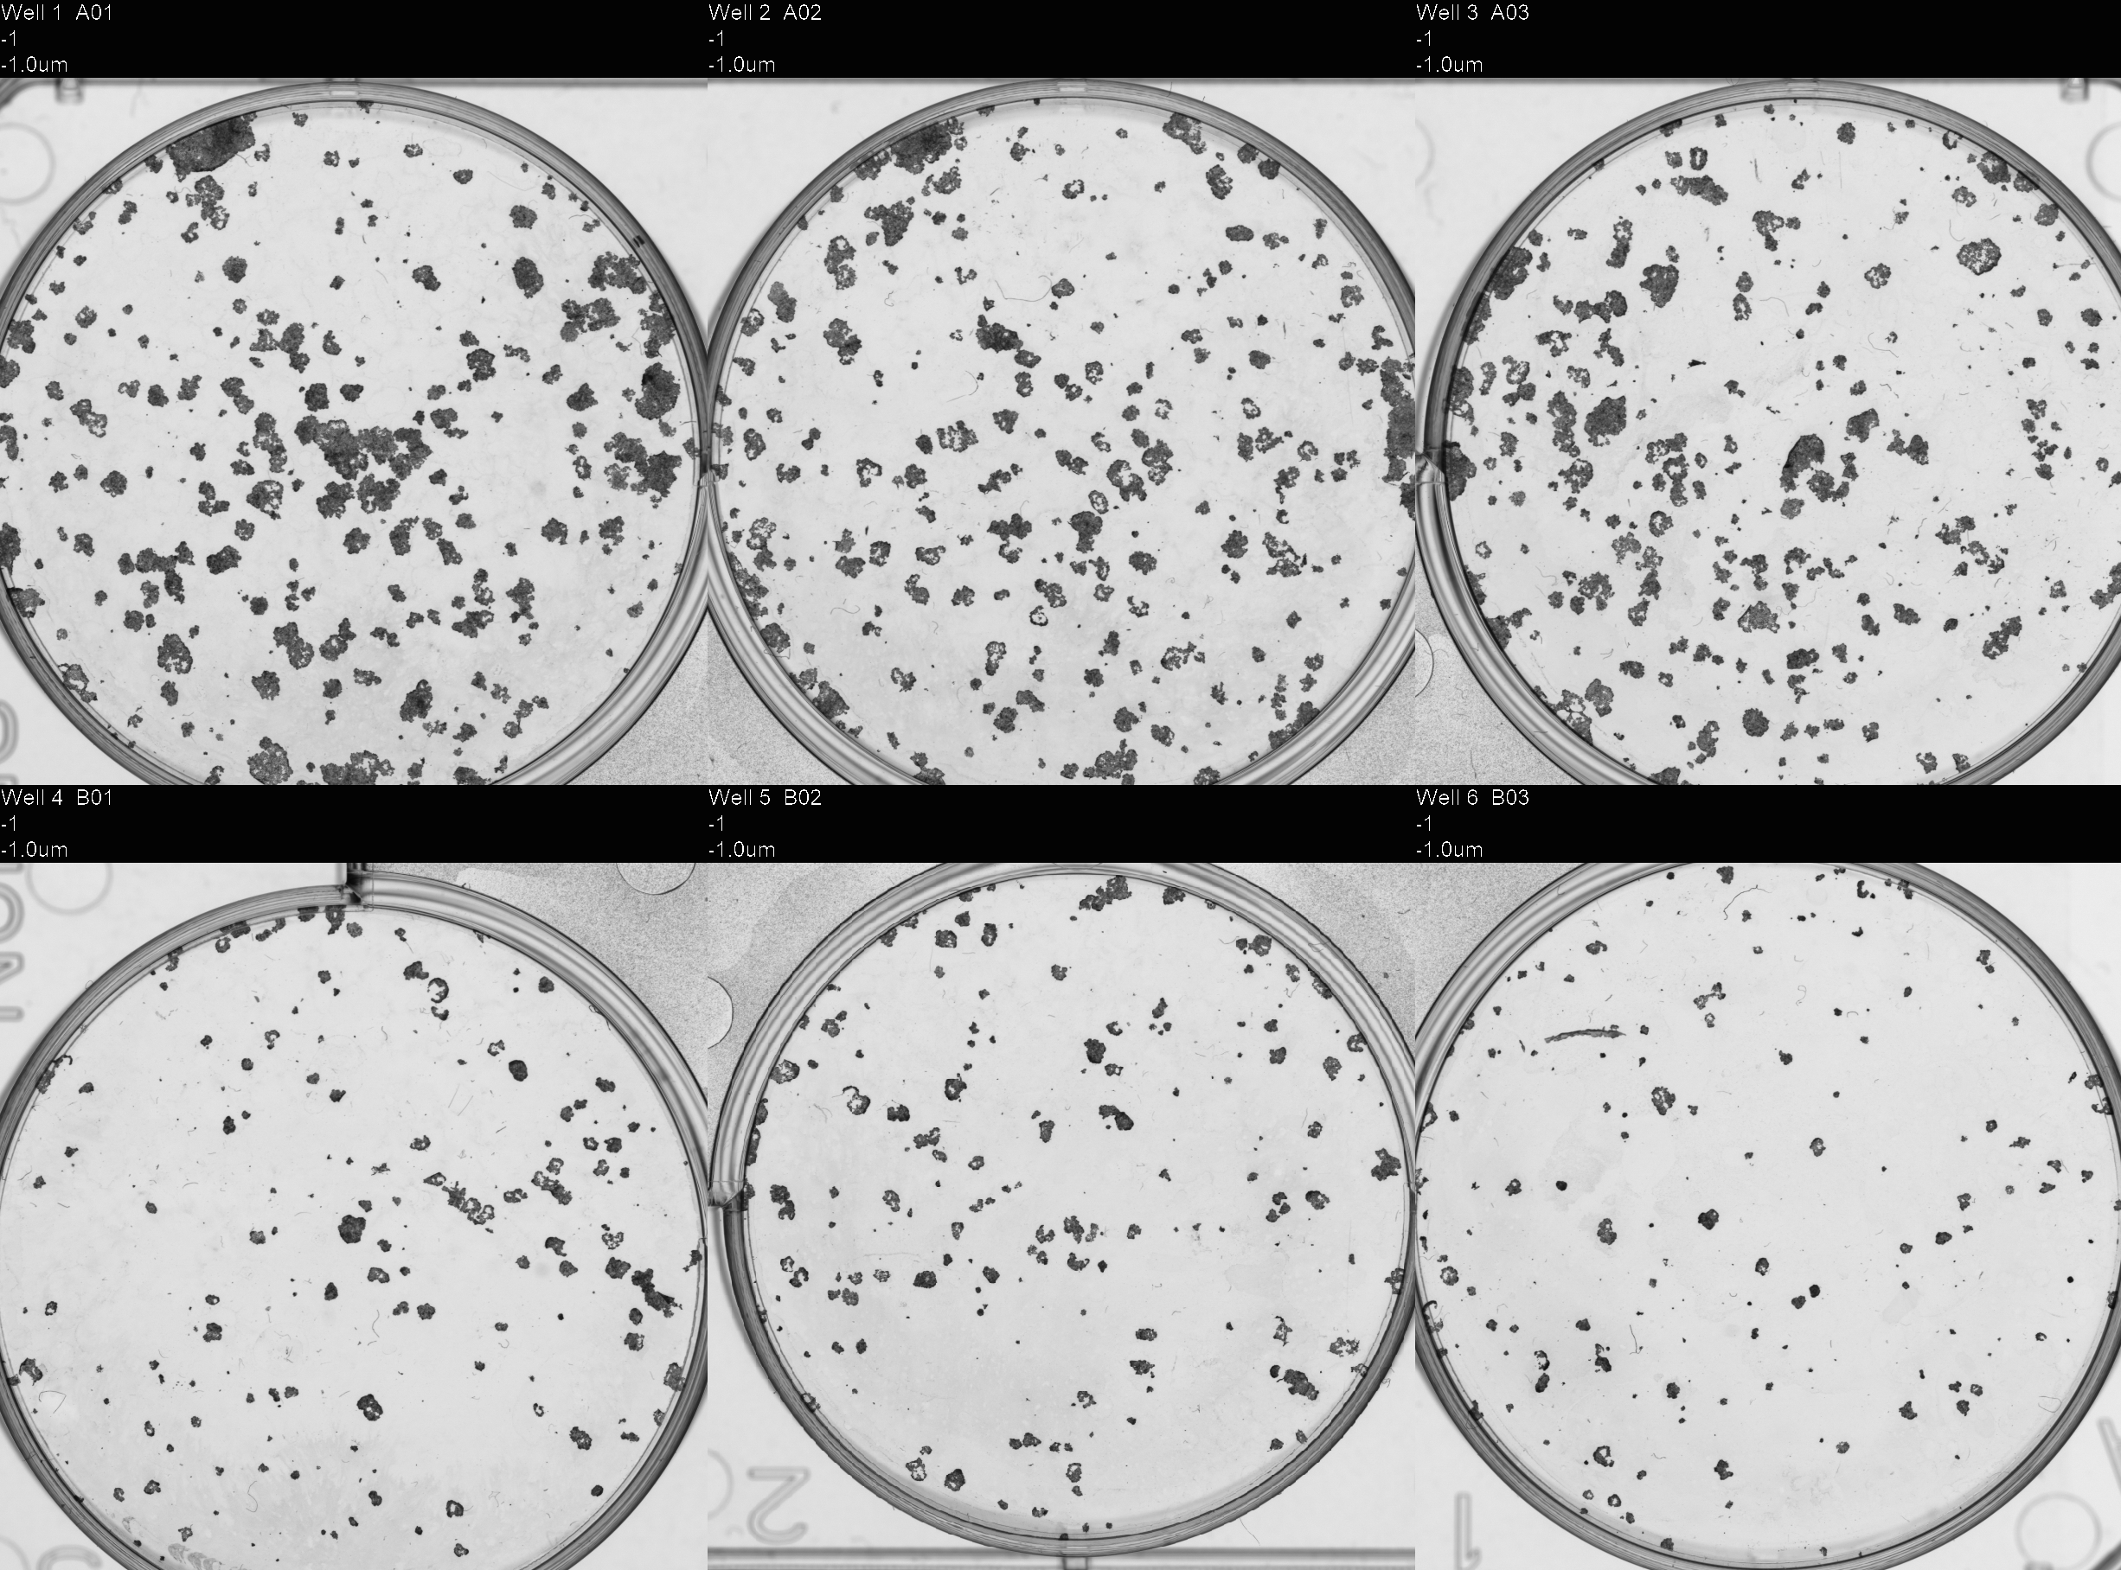
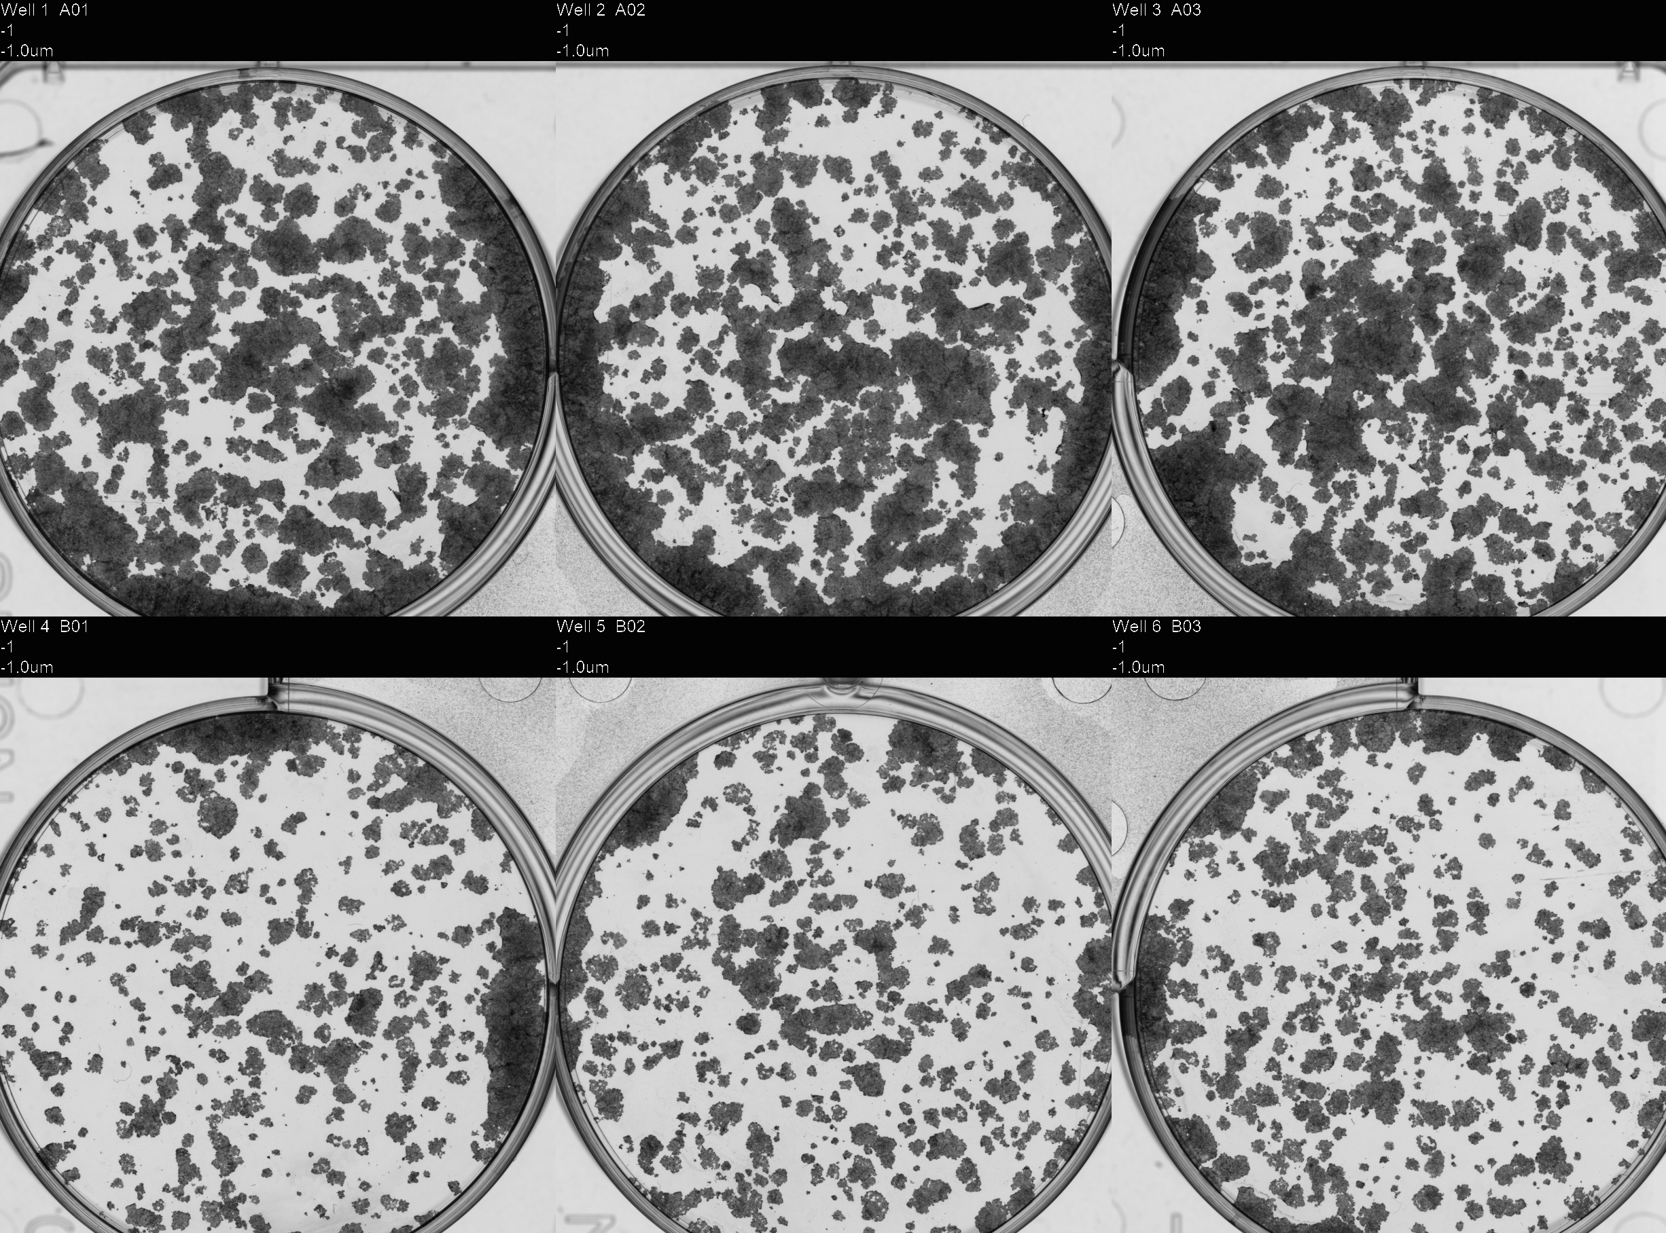
07.11.2025
SCAPA Dry Run
Prepared for irradiation
(lids/holder)
Left vertically for 15-20min
Replated
250
500
1000
2000
10 days post-seeding

Slide 5
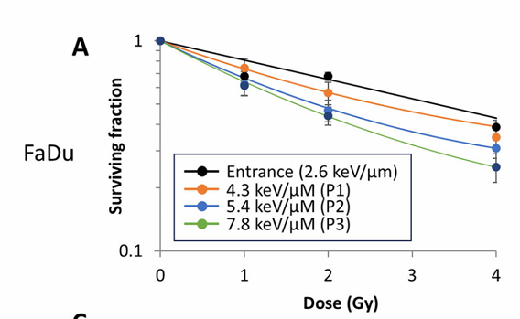
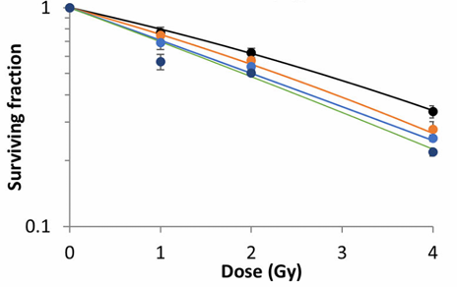
SCAPA Irradiation Plan
HeLa & FaDu
0Gy – 125, 250, 500
1Gy – 250, 500, 1000
2Gy – 500, 1000, 2000
4 Gy – 1000, 2000, 4000
Day 1 – Dose titration 0, 1, 2, 4 Gy
Day 2 – Repeat
Day 3 – Determine shot-to-shot survival reproducibility (3x repeats of 2 Gy [4shots])
HeLa
28MeV Proton Beam (MC-40 Cyclotron, Birmingham)
FaDu
~23MeV
~23MeV
~5MeV
~5MeV
(Fabbrizi, et al. 2025)

Slide 6
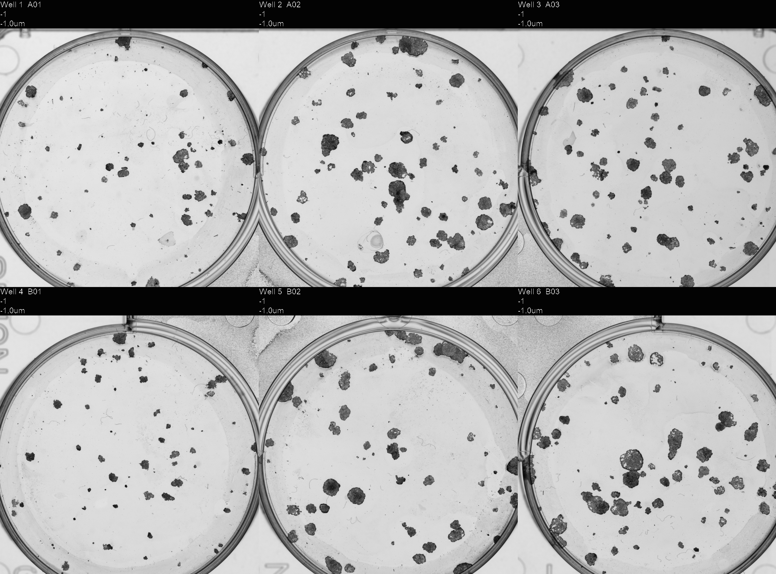
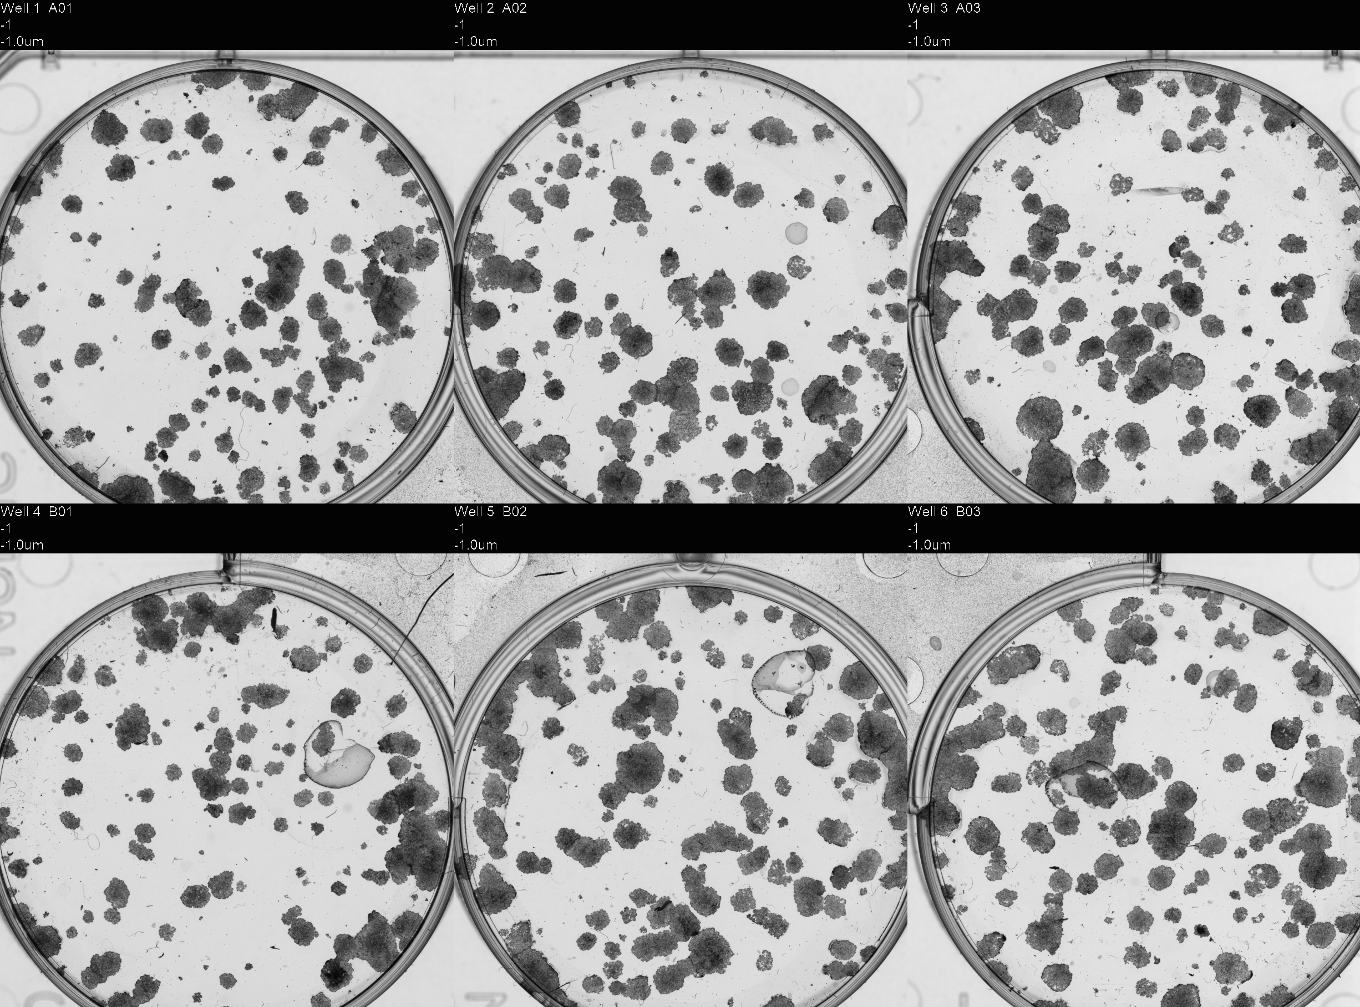
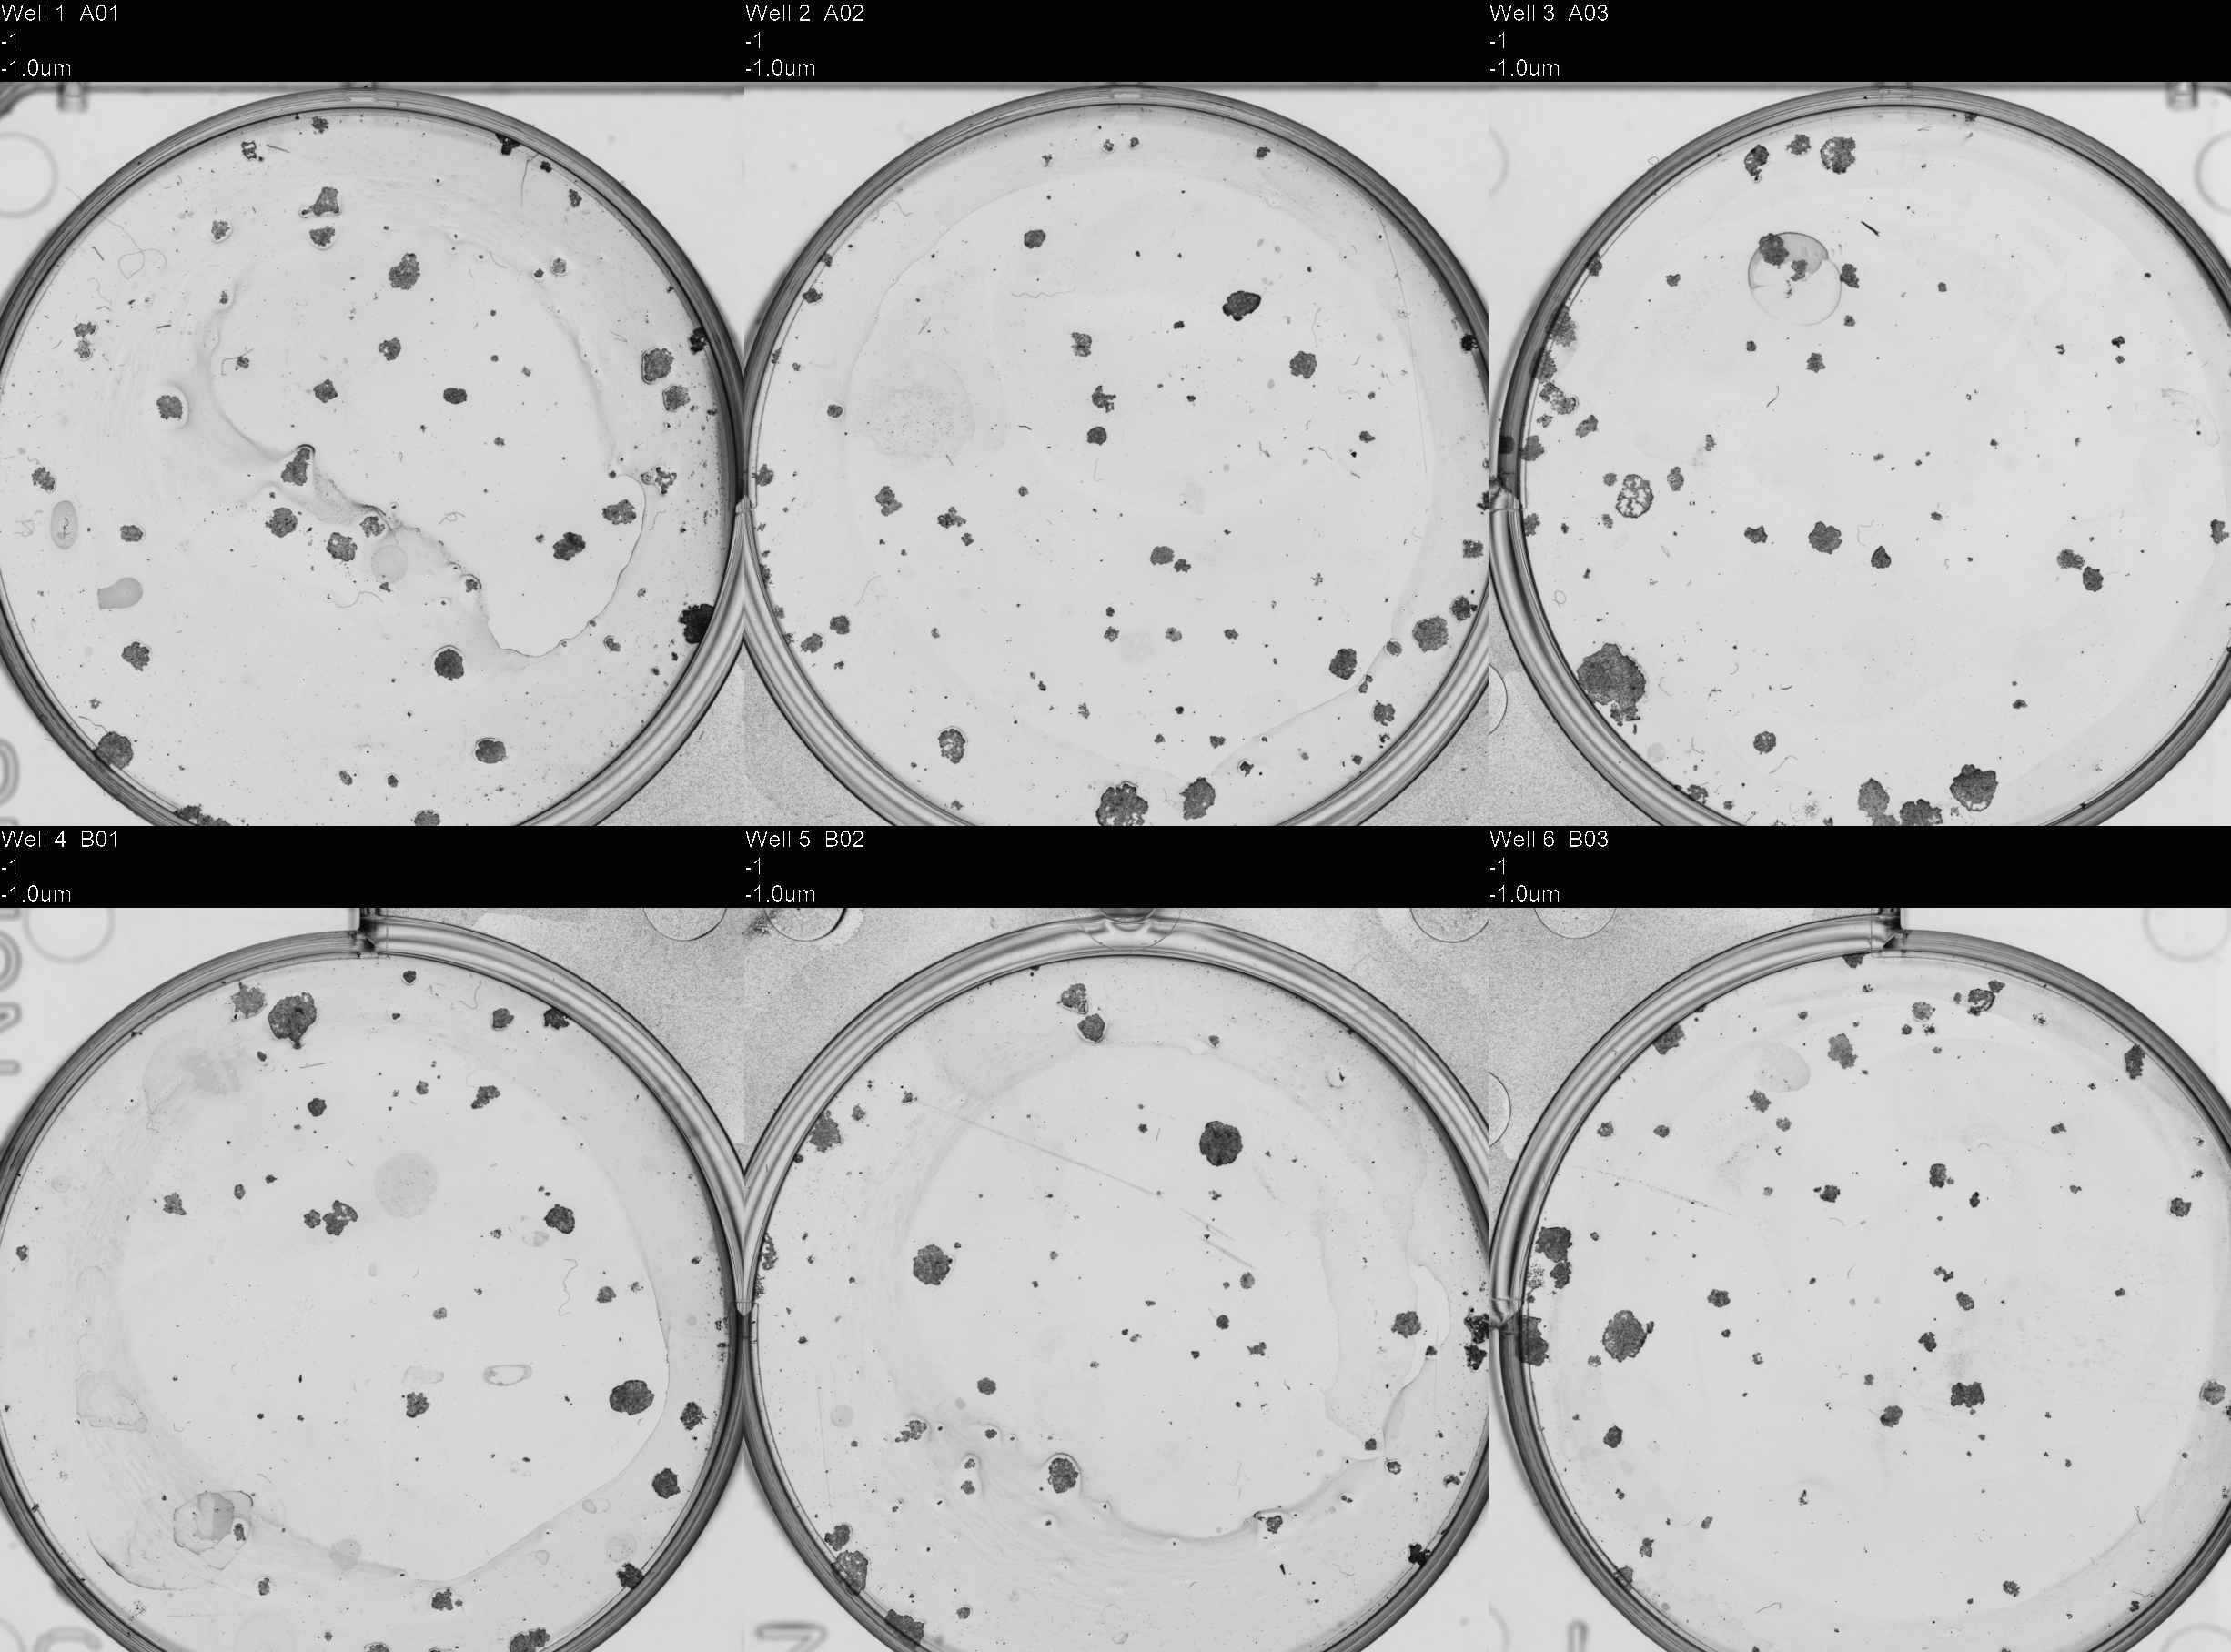
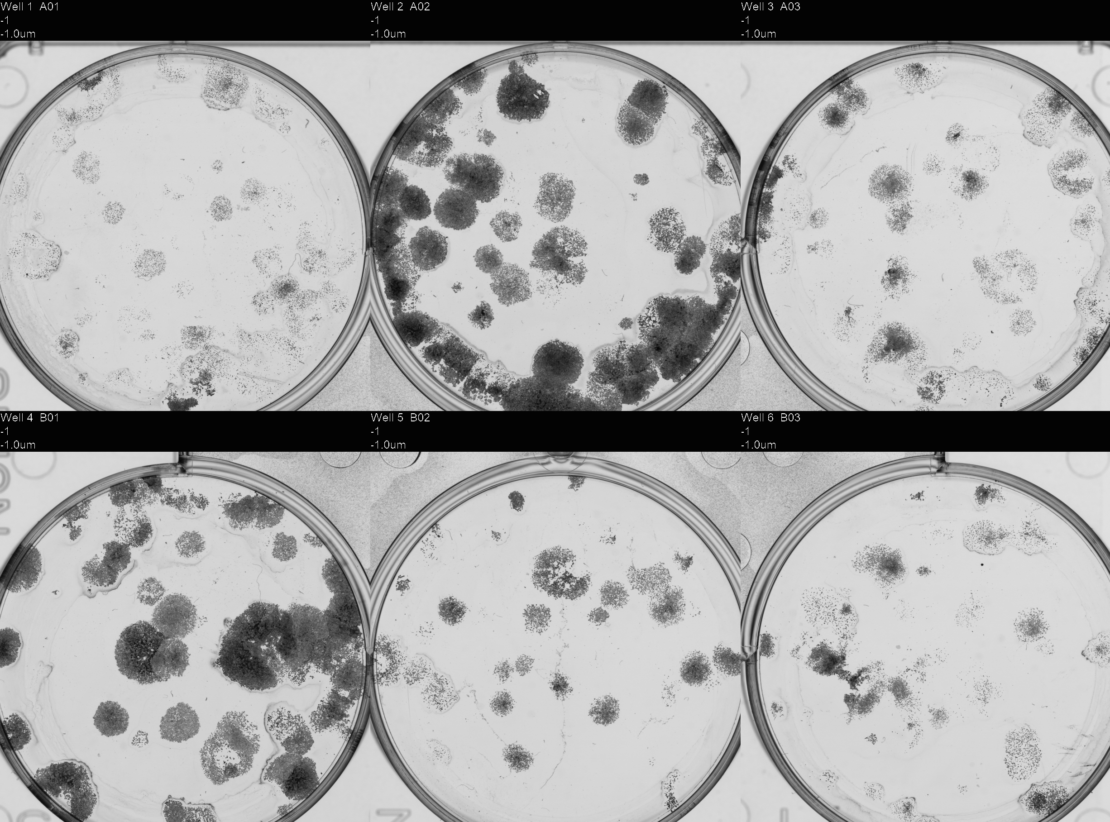
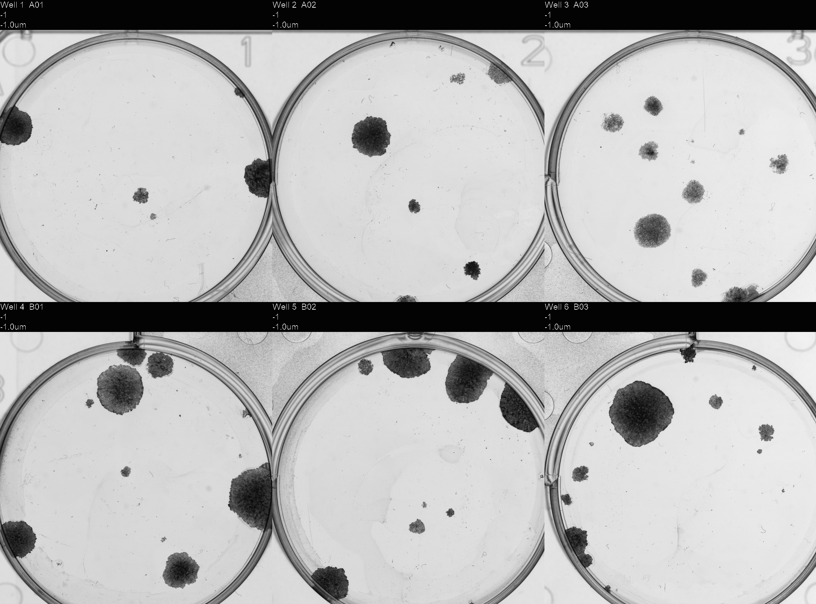
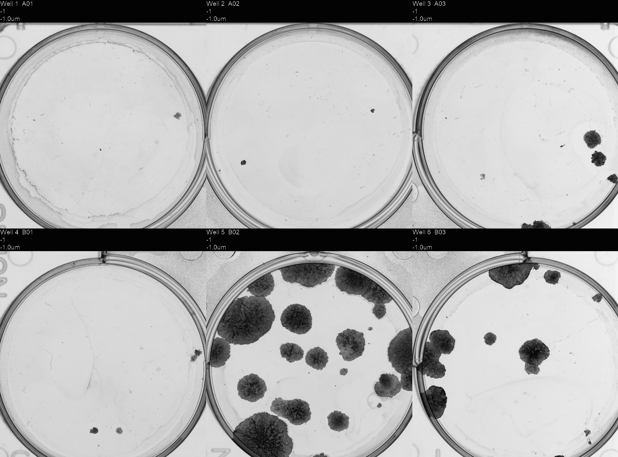
SCAPA Irradiation Plates
Dose Titration
2Gy Shots

Slide 7
SCAPA FaDu Data…
19.11.2025
Average PE: ~33%
 | 250 | 500 | 1000 | 2000 | Average
1Gy | 0.155857 | 0.187423 | 0.269889 | - | 0.20439
1Gy | 0.142047 | 0.181504 | 0.212084 | - | 0.178545
2Gy | - | 0.091739 | 0.118372 | - | 0.105055
4Gy | - | - | - | 0.12651 | 0.12651
20.11.2025
Average PE: ~12%
 | 250 | 500 | 1000 | 2000 | Average
1Gy | - | 0.053505 | 0.276886 | - | 0.165195
2Gy | 0.080257 | 0.077582 | 0.117175 | 0.082263 | 0.089319
Shots | Mean Dose (Gy) | 1sigma Min Dose (Gy) | 1sigma Max Dose (Gy)
4 | 2.28 | 1.42 | 3.14
7 | 3.99 | 2.79 | 5.19
14 | 7.97 | 6.07 | 9.87
(Fabbrizi, et al. 2025)

Slide 8
SCAPA FaDu Data…
21.11.2025
 | 500 | 1000 | 2000 | 4000 | Average
Shot 1 (2Gy) | 0.126174 | 0.111502 | 0.111796 | 0.095731 | 0.111301
Shot 2 (2Gy) | - | 0.173856 | 0.057952 | - | 0.115904
Shot 3 (2Gy) | 0.161385 | 0.126761 | 0.168721 | 0.096464 | 0.138333
Average PE: ~11%
Shots | Mean Dose (Gy) | 1sigma Min Dose (Gy) | 1sigma Max Dose (Gy)
4 | 2.28 | 1.42 | 3.14

Slide 9
Discussion Points:
Uniform dose across the culture area
Reduce irradiation time:
- 1 dish & 1 RCF
- One set of dishes followed by one set of RCF separately
- Reduce time between shots (risk some data not saving?) – currently working at 20sec
Once cells are trypsinised and counted, keep in the fridge rather than on ice?
Warm dishes during irradiation
Gas dishes during irradiation
Incubator monitoring – water, gas etc

