Slide 1
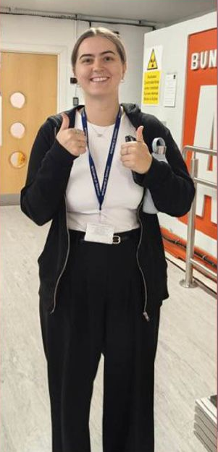
Congratulations Emma!

