Slide 1
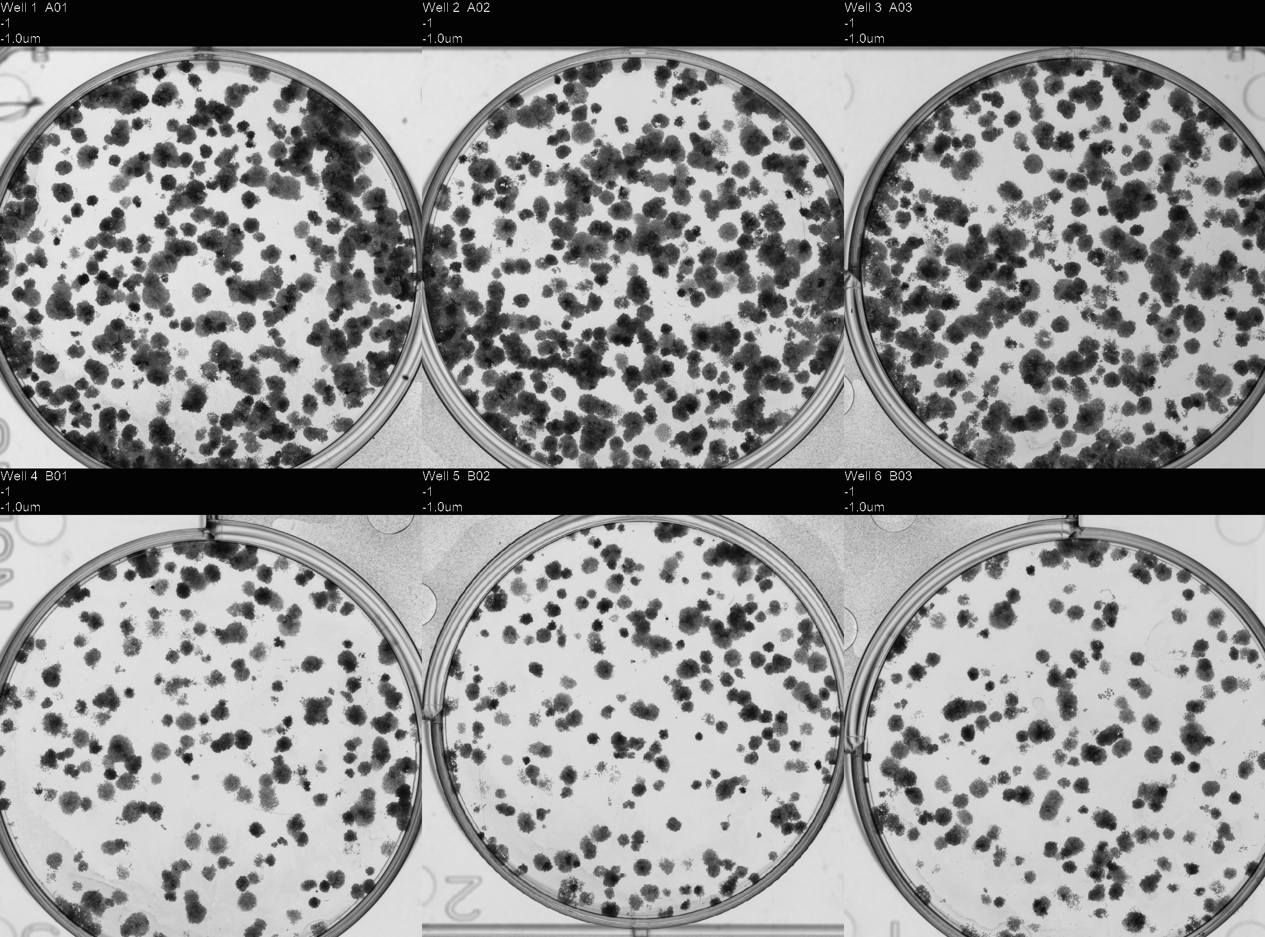
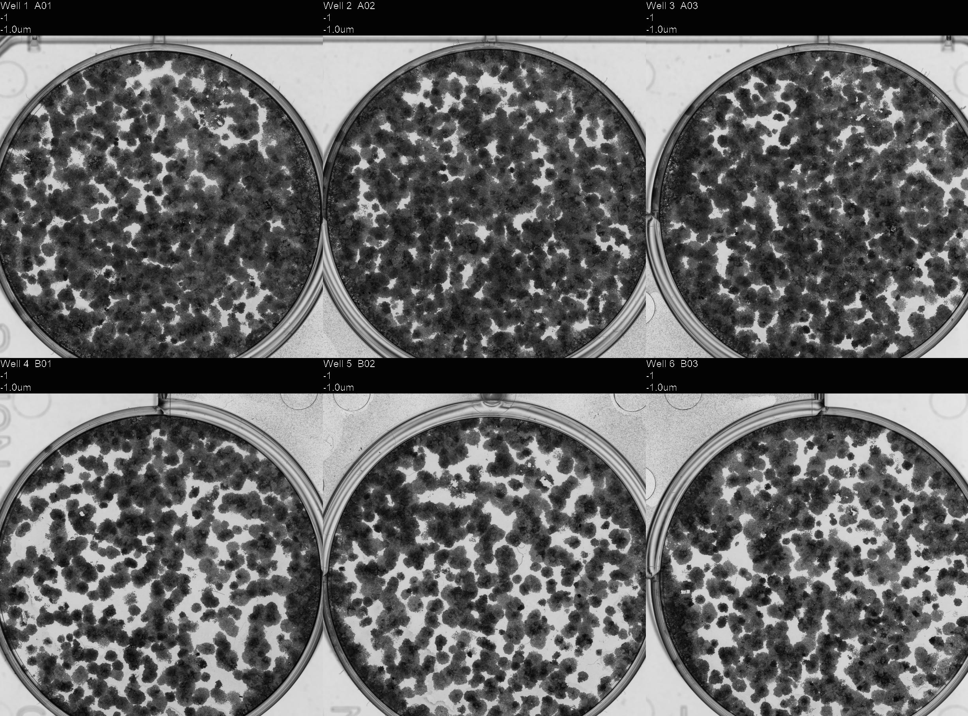
HeLa
PE:~40-50%
500
2000
250
1000

Slide 2
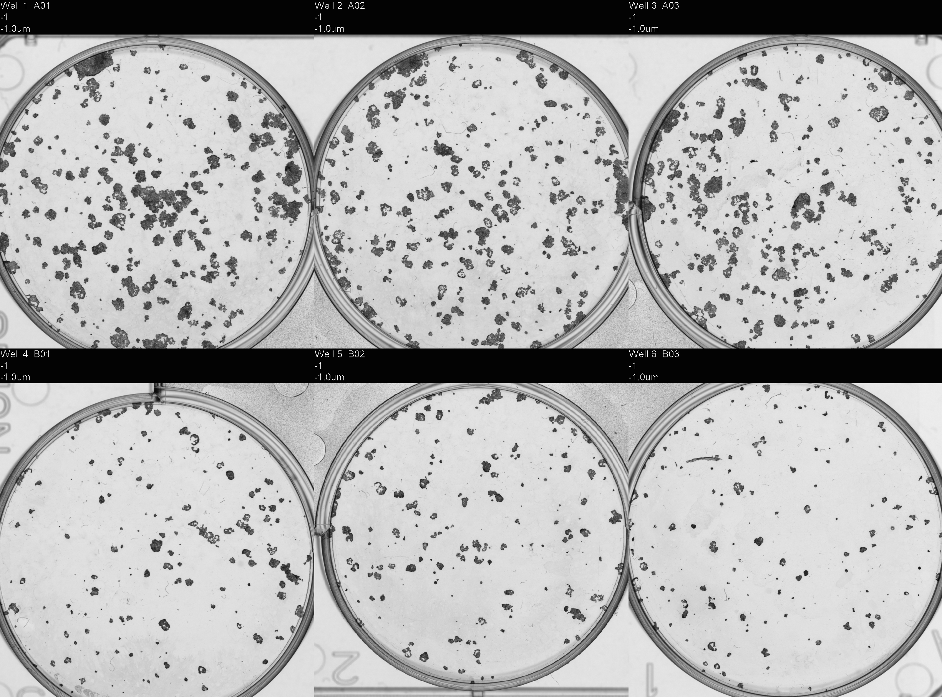
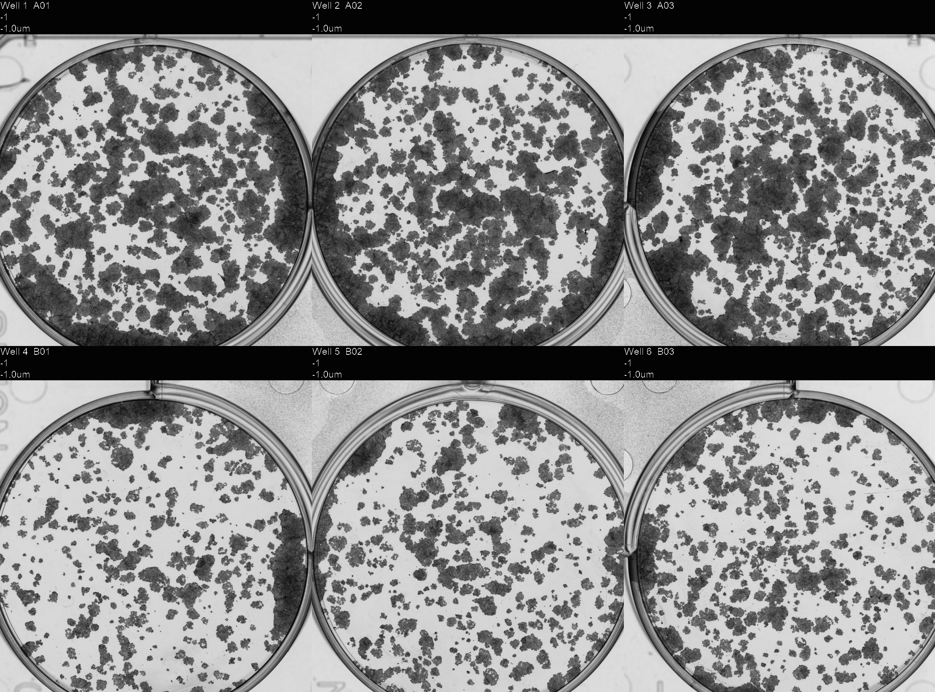
FaDu
PE:~30%
500
2000
250
1000

Slide 3
Day 1 – 19.11.25
First Run – HeLa Clonogenic R1
(Based on ~0.3Gy/shot)
4 Shots (Expected Dose ~1.2Gy)
RCF Dose: 4.83Gy
250, 500, 1000
7 Shots (Expected Dose ~2.1Gy)
RCF Dose: 5.30Gy
500, 1000, 2000
14 Shots (Expected Dose ~4.2 Gy)
RCF Dose: 12.85Gy
1000, 2000, 4000
Second Run – FaDu Clonogenic R1
4 Shots (Expected Dose ~1.2Gy)
RCF Dose: 4.75Gy
250, 500, 1000
7 Shots (Expected Dose ~2.1Gy)
RCF Dose: 5.33Gy
500, 1000, 2000
14 Shots (Expected Dose ~4.2 Gy)
RCF Dose: 15.56Gy
1000, 2000, 4000
Third Run – HeLa/FaDu R2
7 Shots (Expected Dose ~2.1Gy)
RCF Dose: 4.97Gy
500, 1000, 2000
14 Shots (Expected Dose ~4.2 Gy)
RCF Dose: 8.16Gy
1000, 2000, 4000
Day 2 – 20.11.25 – R3

Slide 4
Day 3 – 21.11.25
HeLa/FaDu
2Gy – 4 shots (~0.5Gy/shot)
3x repeats for each cell line
500, 1000, 2000, 4000

