Slide 1
RCF Calculations

Slide 2
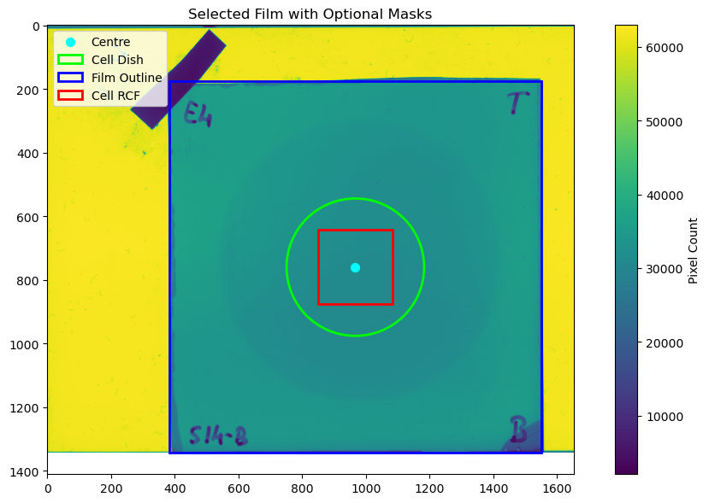
Method
Align film outline with blue square
Determine centre of film
Use to calculate position of cell dish

Slide 3
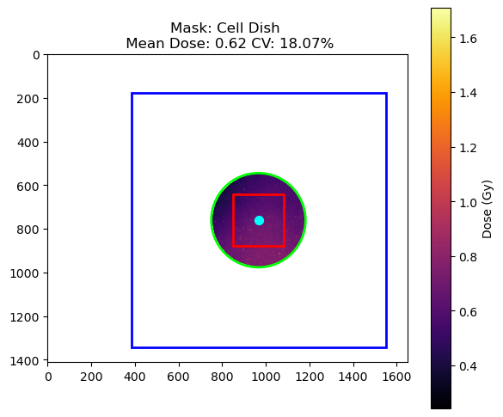
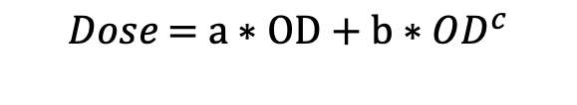

Convert to Dose and Select ROI
$Optical Density= {Log}_{10}(\frac{I_{0}}{Pixel Count (Red channel)}$)
$$Dose\text{ = }\text{a}∗\text{OD}\text{ + }\text{b}∗{OD}^{c}$$

Slide 4
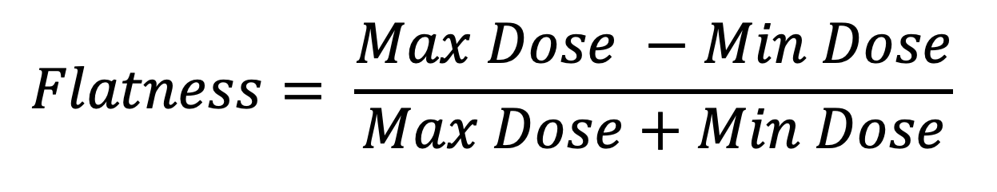
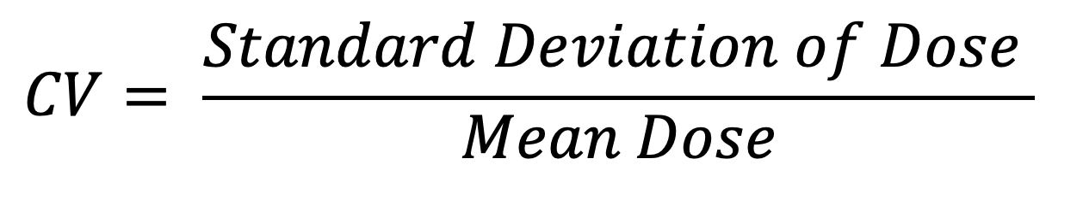
Metric Explanations
$$CV= \frac{Standard Deviation of Dose }{Mean Dose}$$
$$Flatness= \frac{Max Dose −Min Dose}{Max Dose+Min Dose}$$

Slide 5
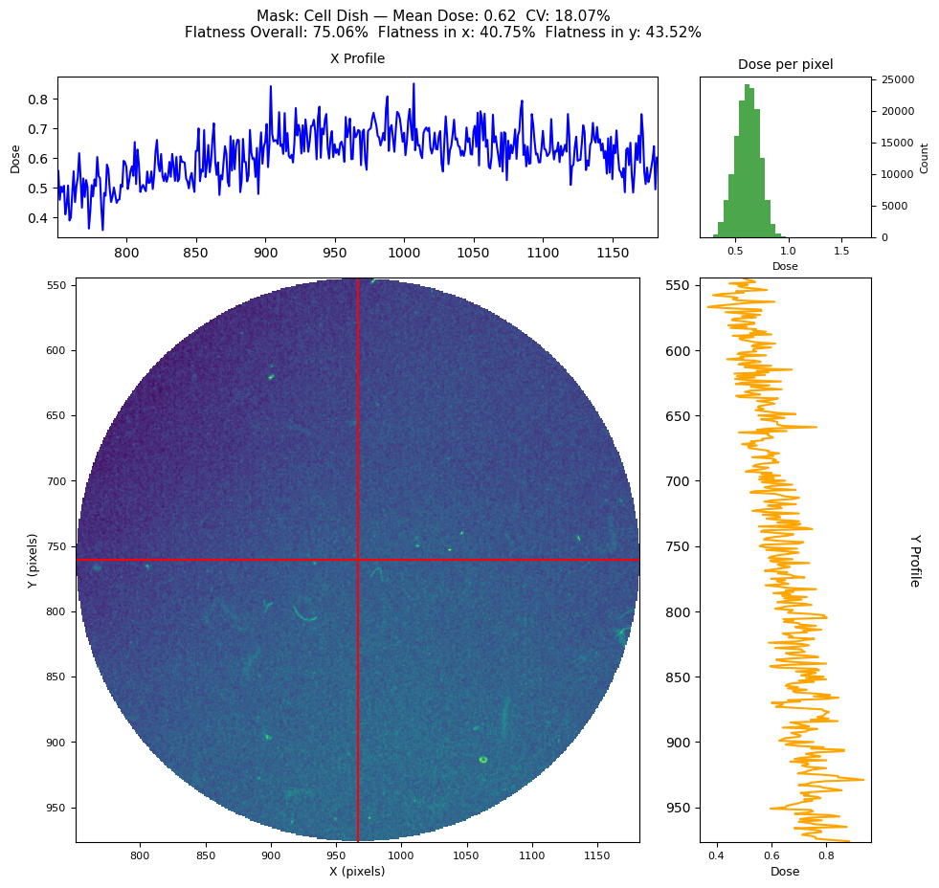
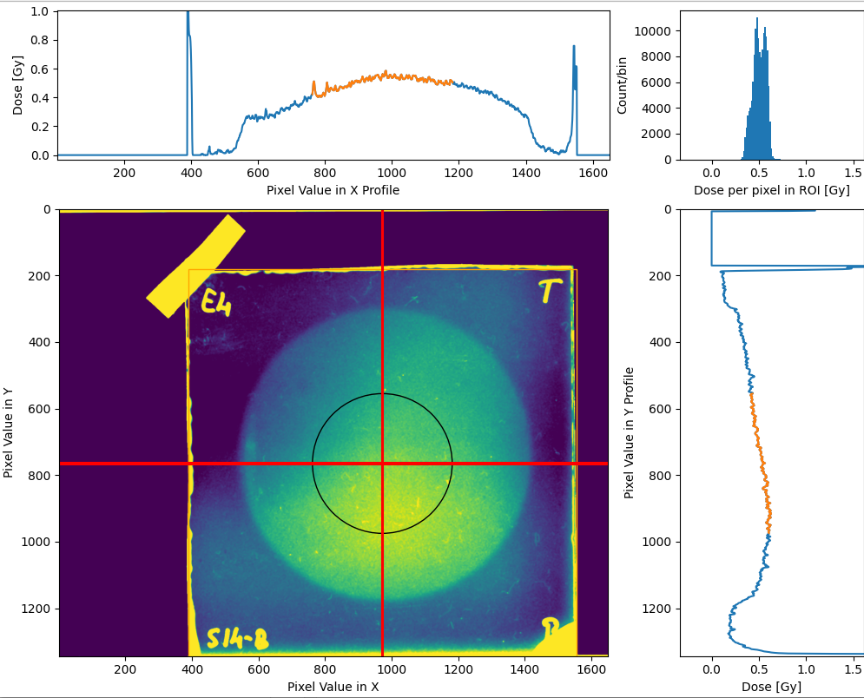
Result for 10 Shot gold 4th film
Flatness in x: 20.9% Flatness in y: 18.6% CV: 15.6%

Slide 6

Effect of Calibration

Slide 7
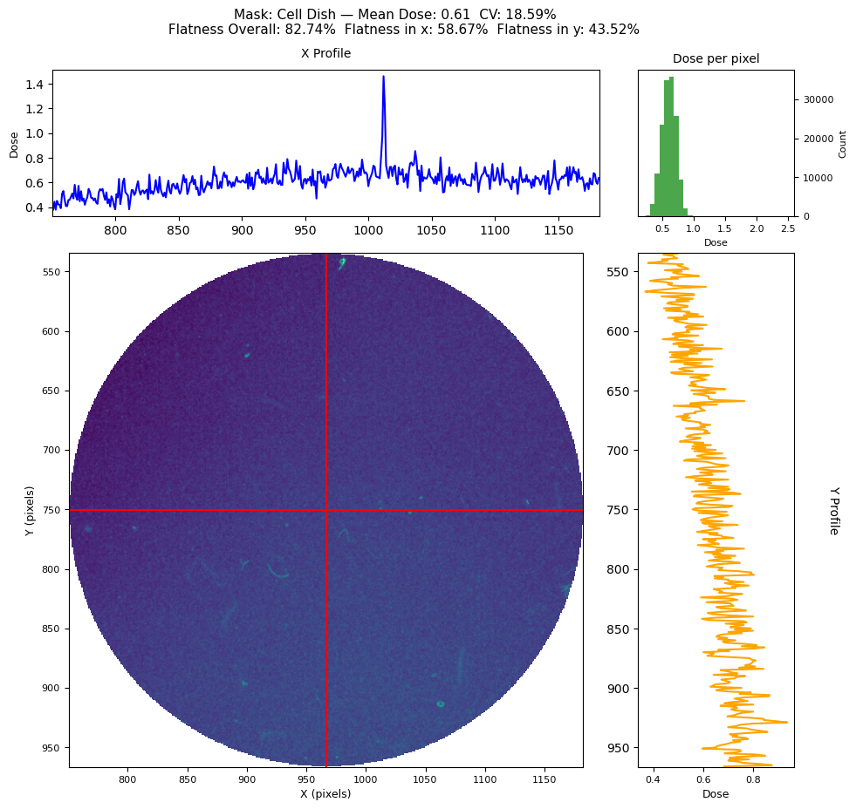
Sensitivity of Flatness in Profile

Slide 8
Conclusions
Fix the calibration
If we are to use Flatness need to clearly define and must remove the scratch marks from calculation
Need to fix the position of the RCF in the film better
Too much variability pixel to pixel/cell to cell?

