Slide 1
Best Set-Up with gold foil

Slide 2
Optimisation varying, d1, d2, d3, d5
Vacuum
Air
d5
FQ (150T/m)
FQ (150 T/m)
Mylar (50um)
Gold Foil (10um)
20mm
40mm
20mm
d1
d2
d3
420mm
LsrDrvn Source
40mm
20mm
Beamline End

Slide 3
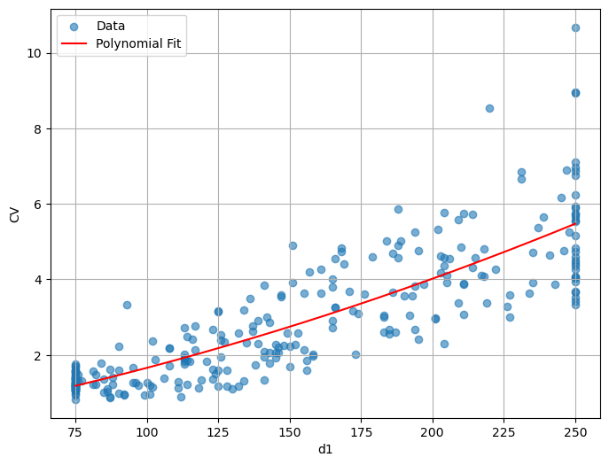
Effect of d1

Slide 4
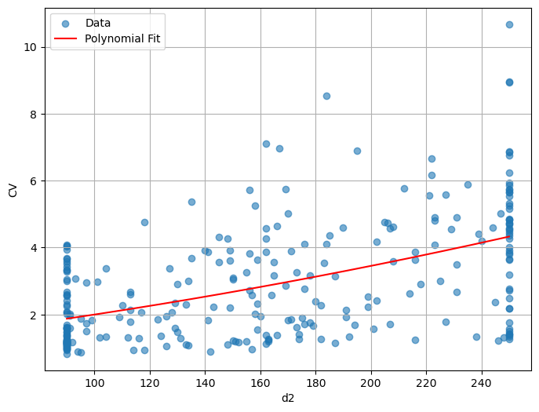
Effect of d2

Slide 5
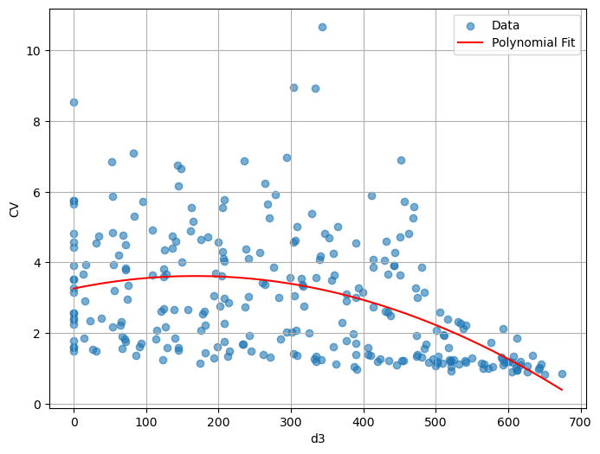
Effect of d3

Slide 6
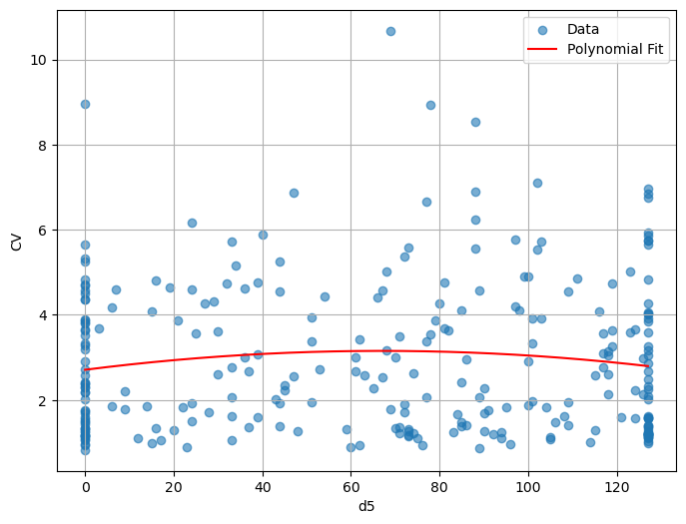
Effect of d5

Slide 7
Optimisation fix: d1, d2 and vary d3, d5
Vacuum
Air
d5
FQ (150T/m)
FQ (150 T/m)
Mylar (50um)
Gold Foil (10um)
20mm
40mm
20mm
85mm
100mm
d3
420mm
LsrDrvn Source
40mm
20mm
Beamline End

Slide 8
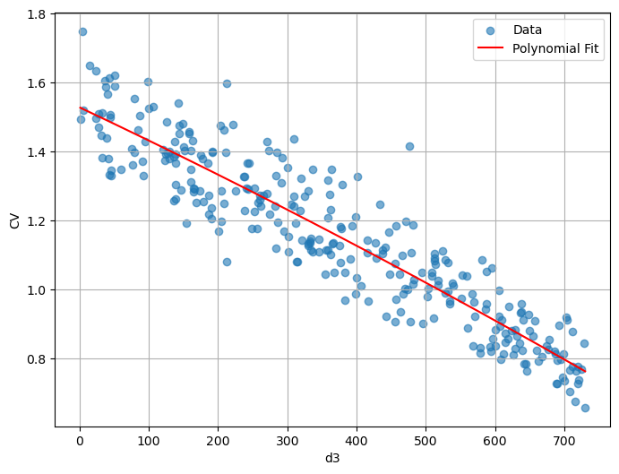
Effect of d3

Slide 9
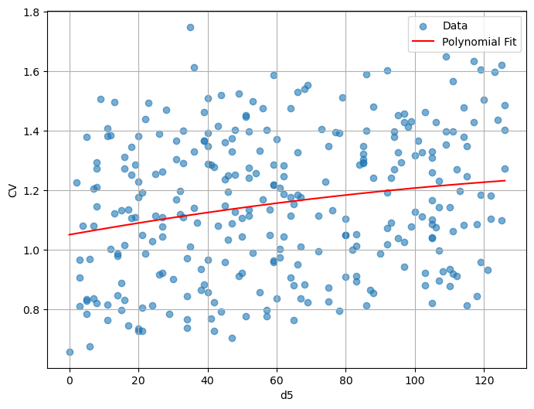
Effect of d5

Slide 10
Optimisation fix: d1, d2 and d3, and vary d5
Vacuum
Air
d5
FQ (150T/m)
FQ (150 T/m)
Gold Foil (10um)
Mylar (50um)
20mm
40mm
20mm
85mm
100mm
420mm
730mm
LsrDrvn Source
40mm
20mm
Beamline End

Slide 11
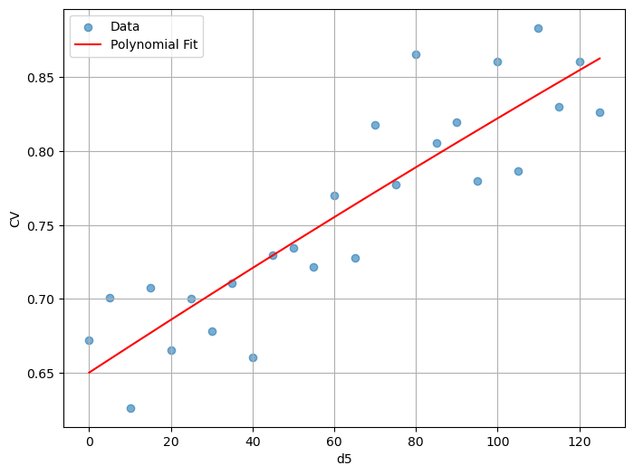
Effect of d5

Slide 12
Optimal setup:
Vacuum
Air
d5
FQ (150T/m)
FQ (150 T/m)
Gold Foil (10um)
Mylar (50um)
20mm
40mm
20mm
85mm
100mm
420mm
730mm
LsrDrvn Source
40mm
20mm
Beamline End

Slide 13
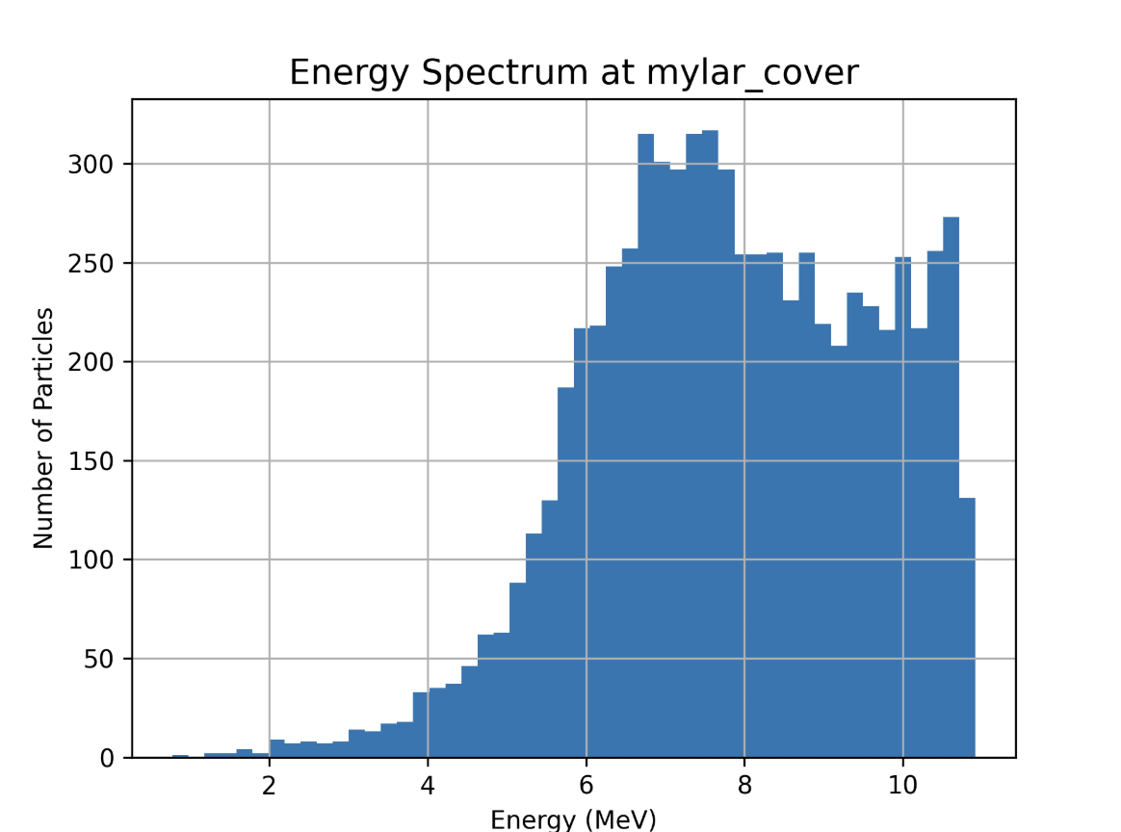
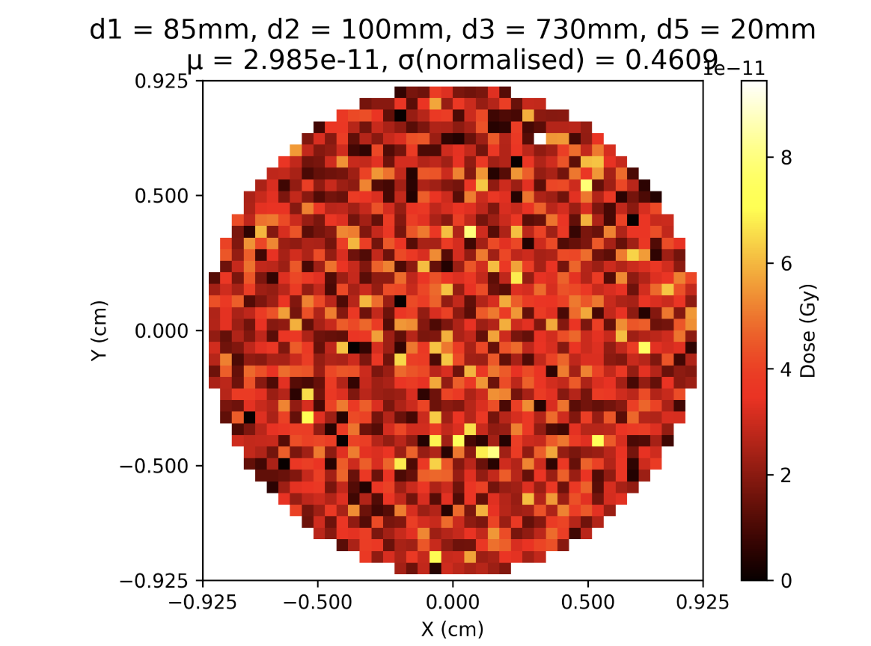
Optimal setup:

Slide 14
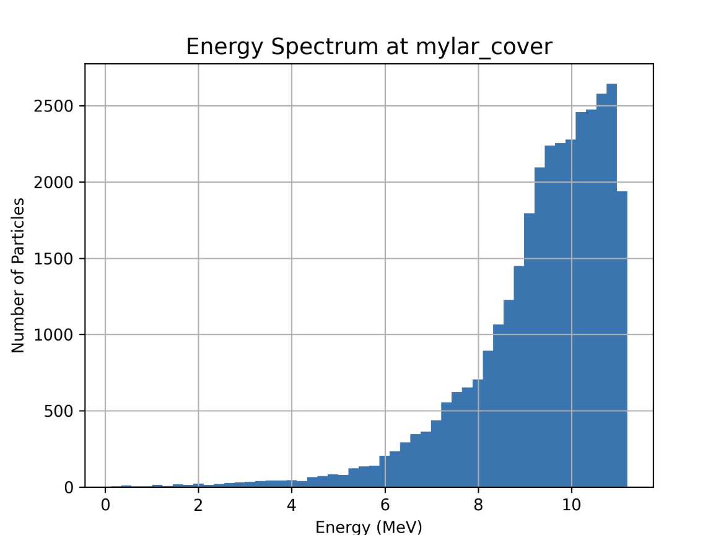
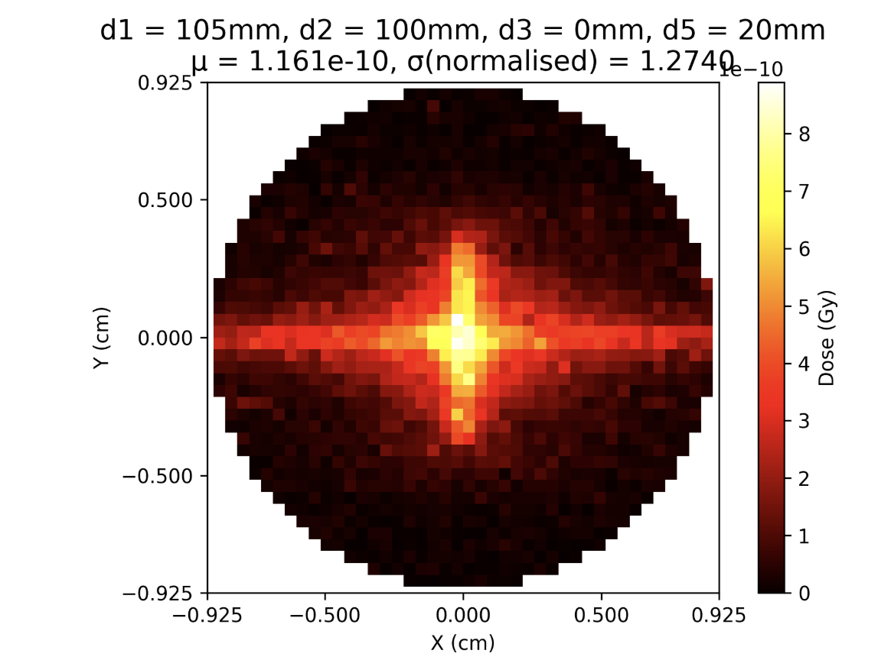
Phase 1 setup:

Slide 15
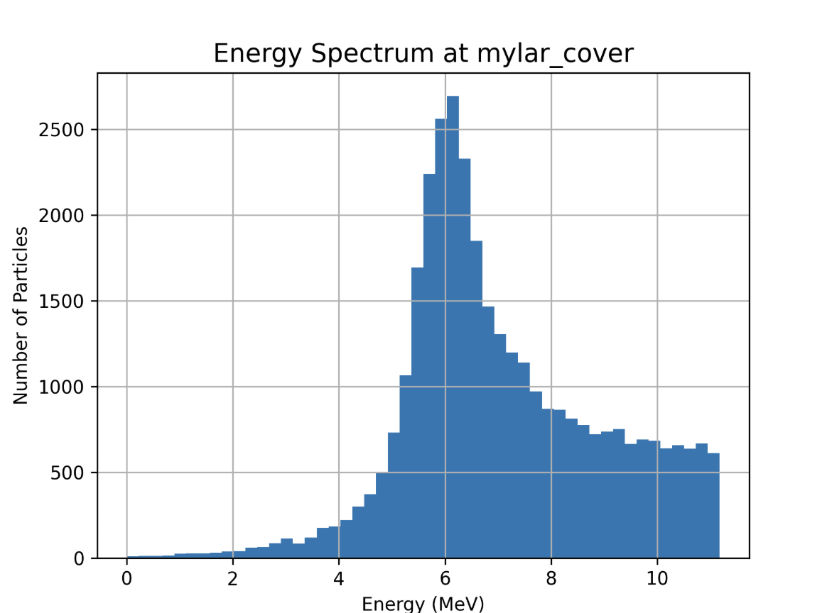
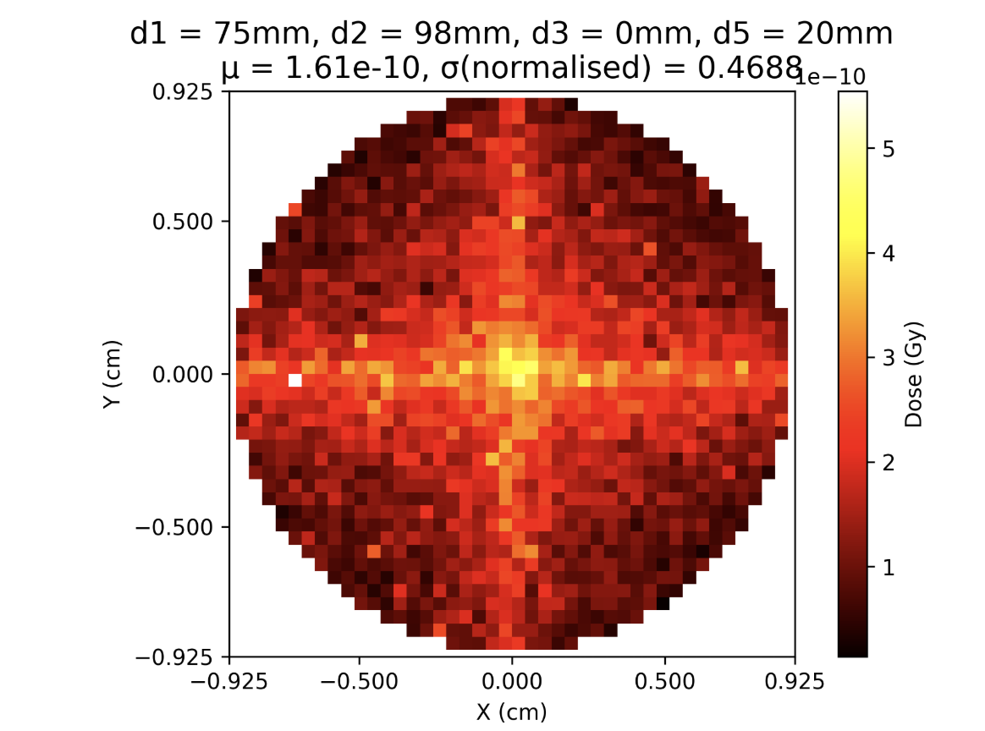
Optimal setup (no gold scatterer):

Slide 16
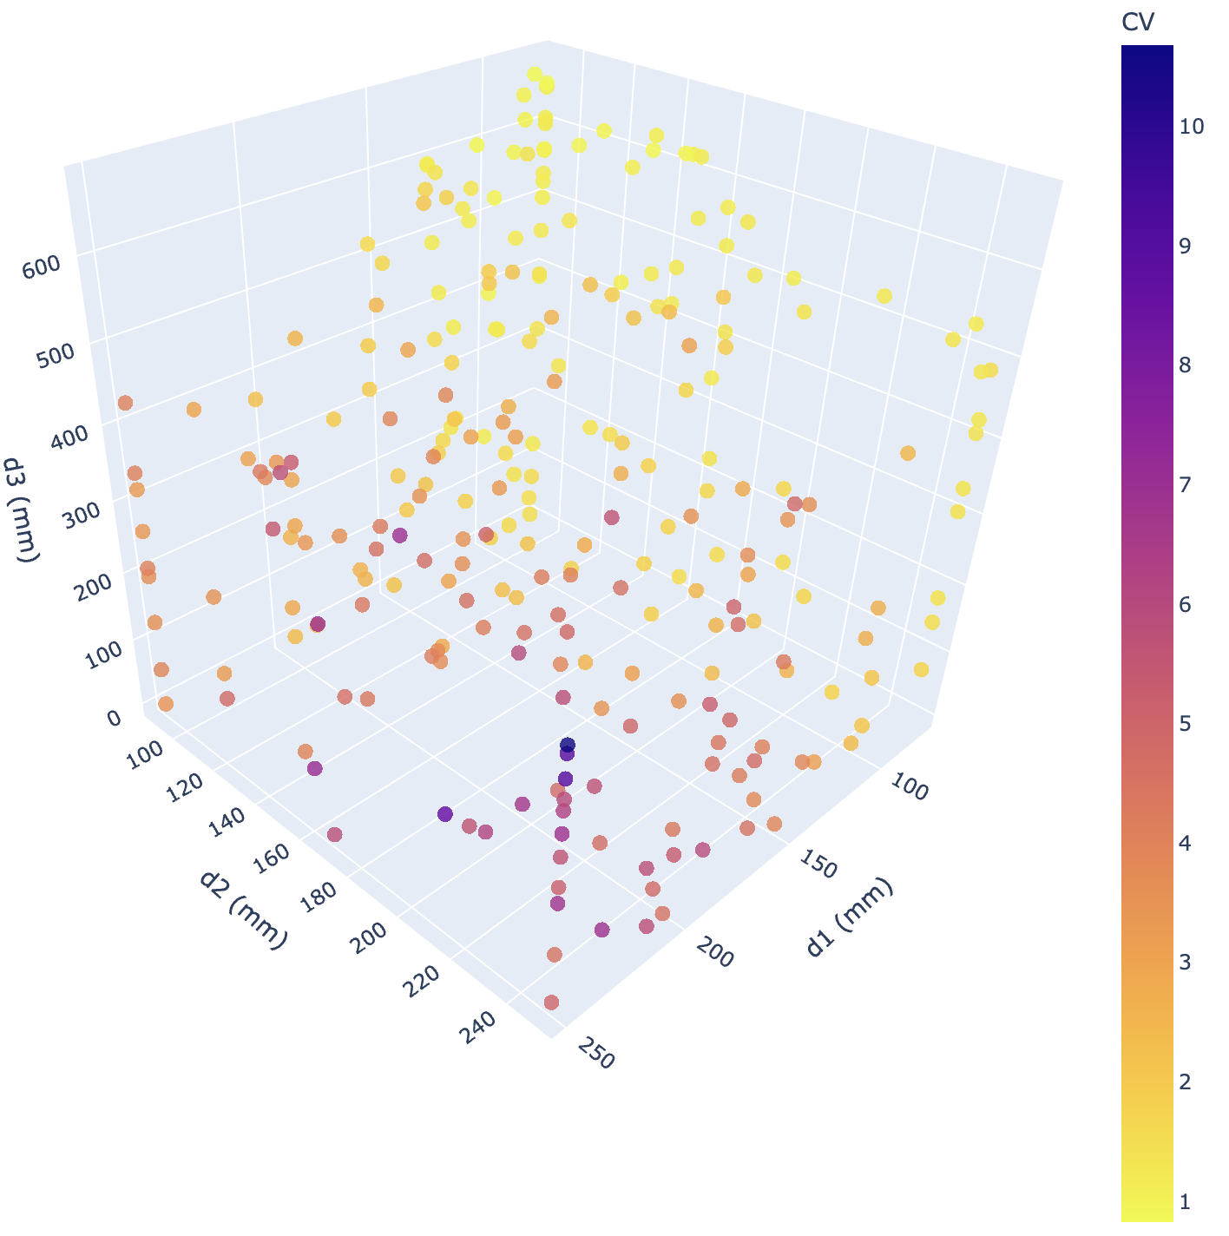
Option 1: Fix d5=20mm, and vary d1, d2, d3

Slide 17
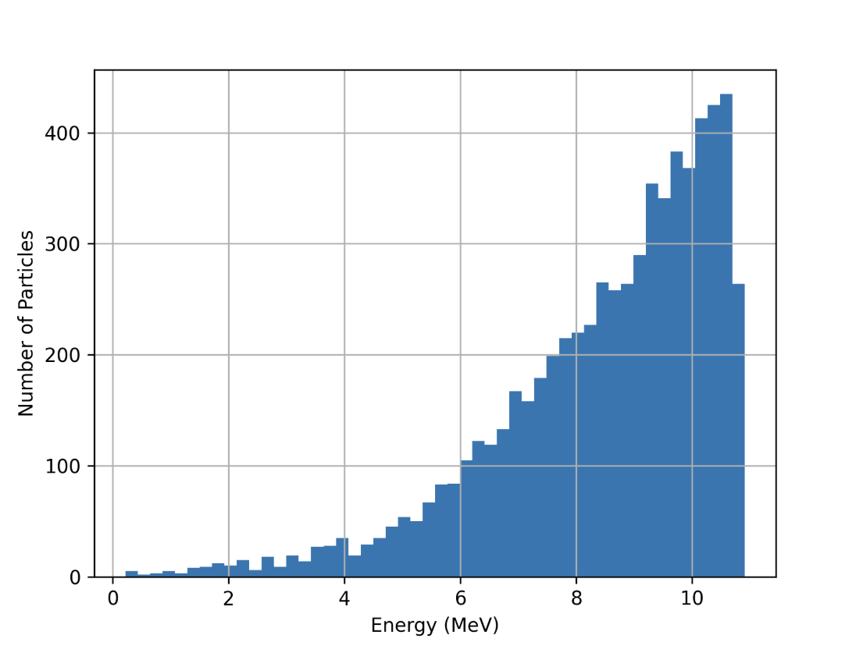
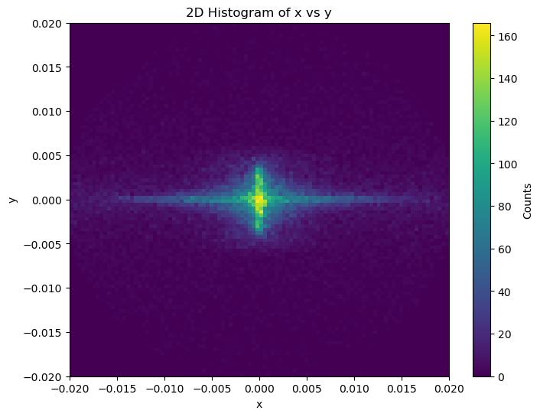
Energy Spectrum after passing through scattering material
Alfredo setup

Slide 18
2cm
1.7cm
2.5mm

