Slide 1
Uniformity through Defocussing

Slide 2
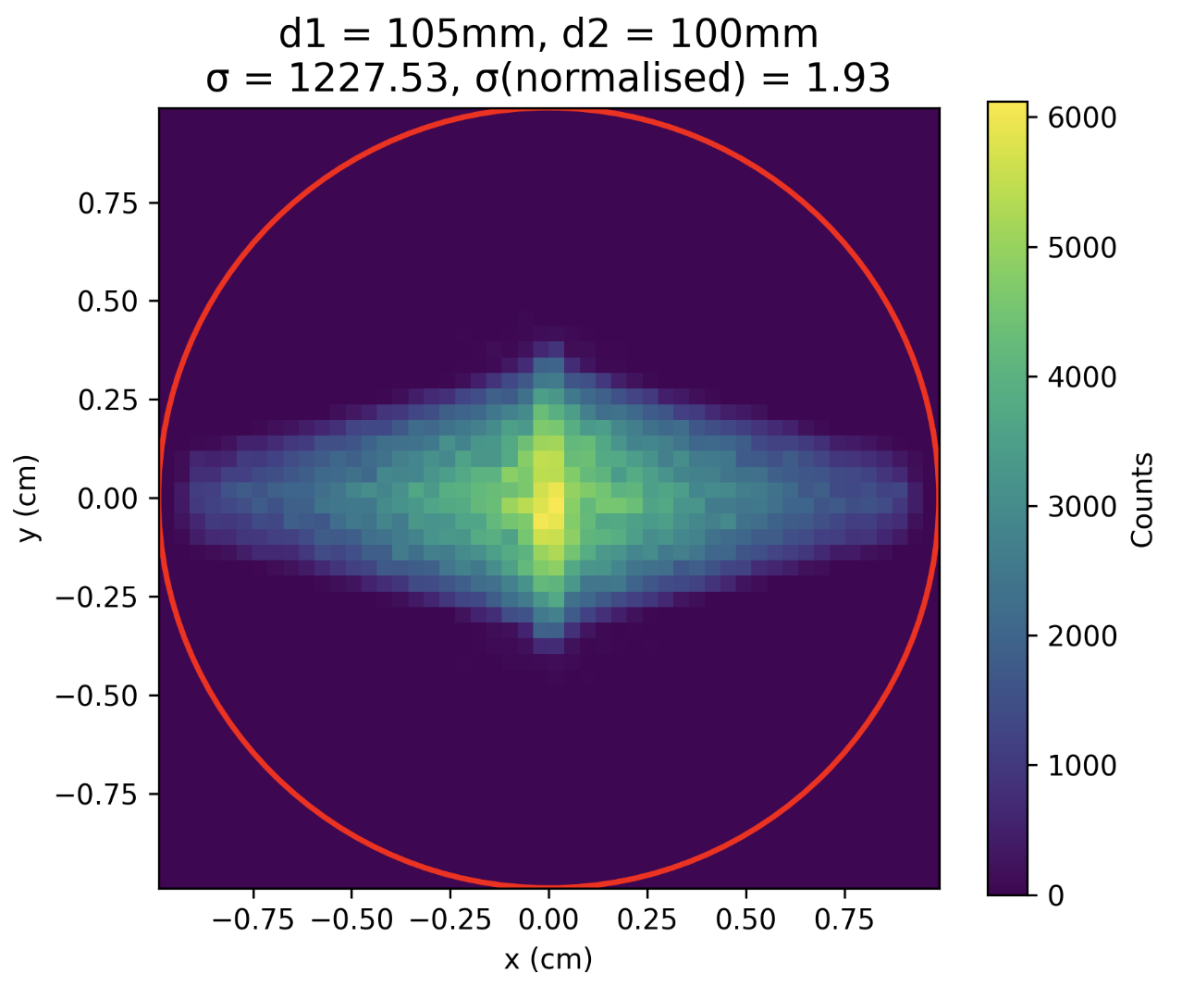
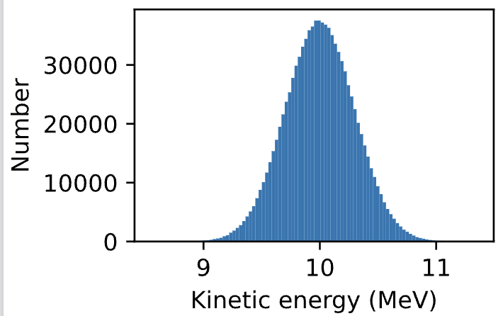
Using an energy spectrum of 10MeV Gaussian
Profile of proton energies before entering the cell dish

Slide 3
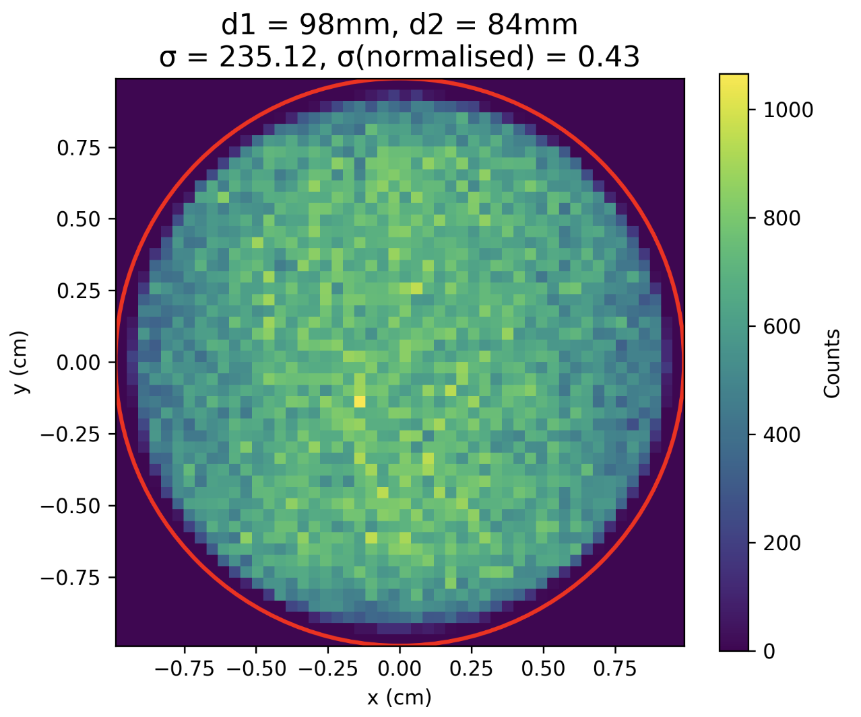
Applied optimisation to minimize normalised standard deviation
Normalised Standard Deviation: std/mean
  Equals Coefficient of Variation / 100
Result of 10MeV Gaussian Beam:

Slide 4
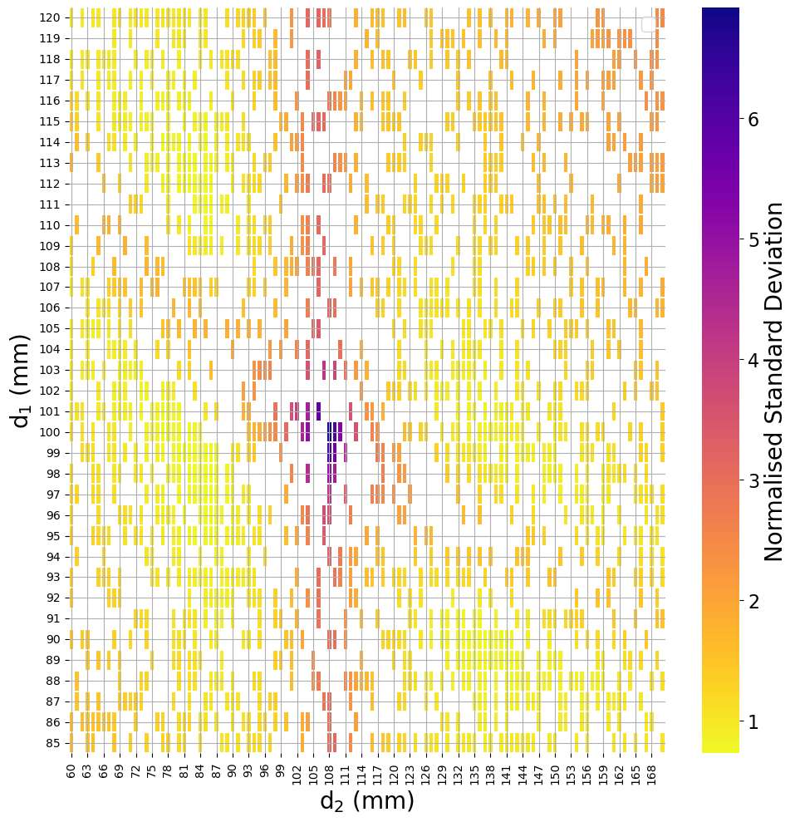
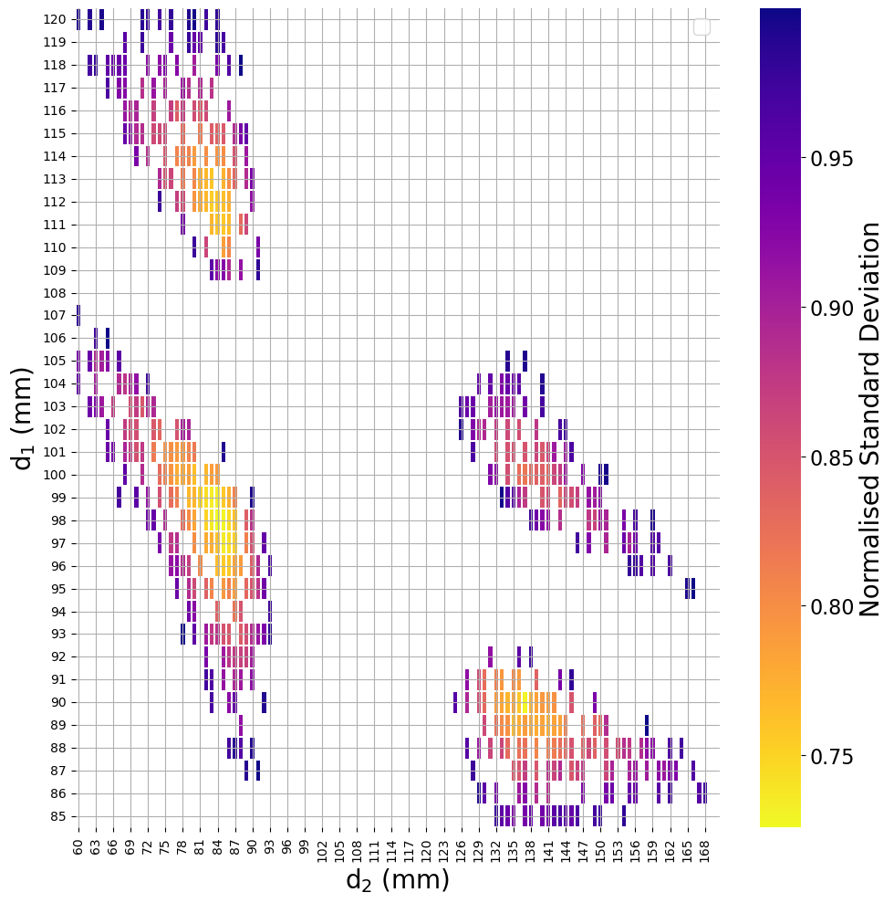
Applied optimisation to minimize normalised standard deviation
Current Setup
Optimal Transmission
Optimal Uniformity

Slide 5
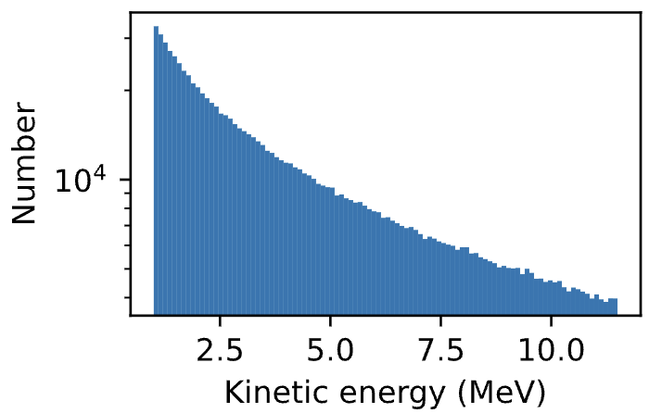
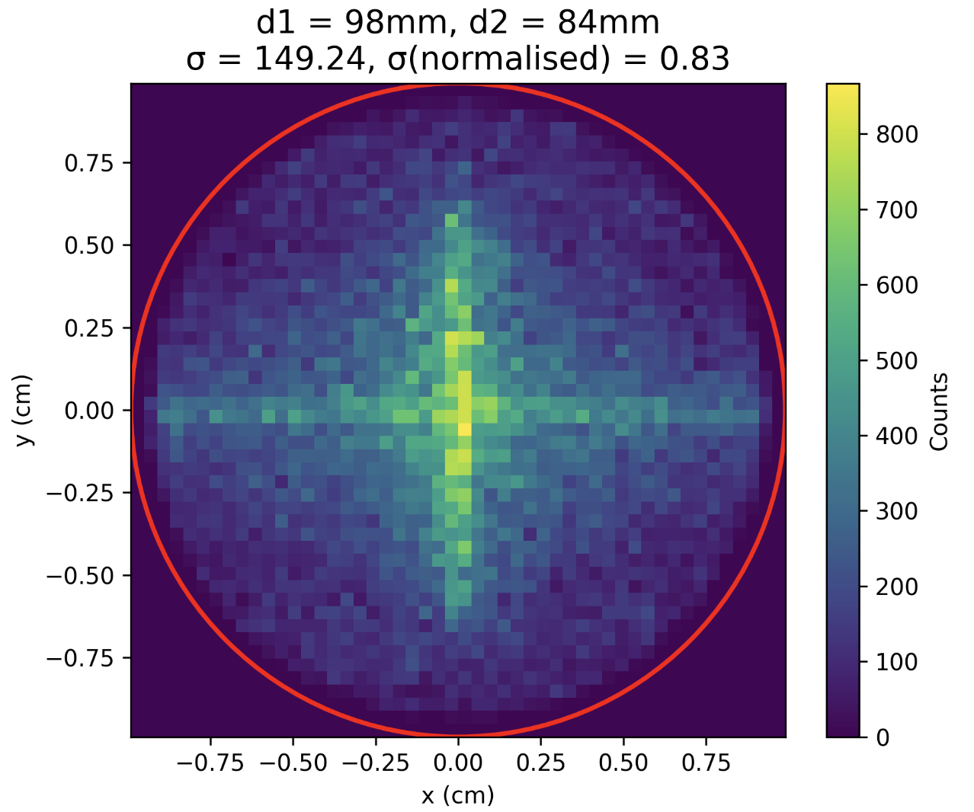
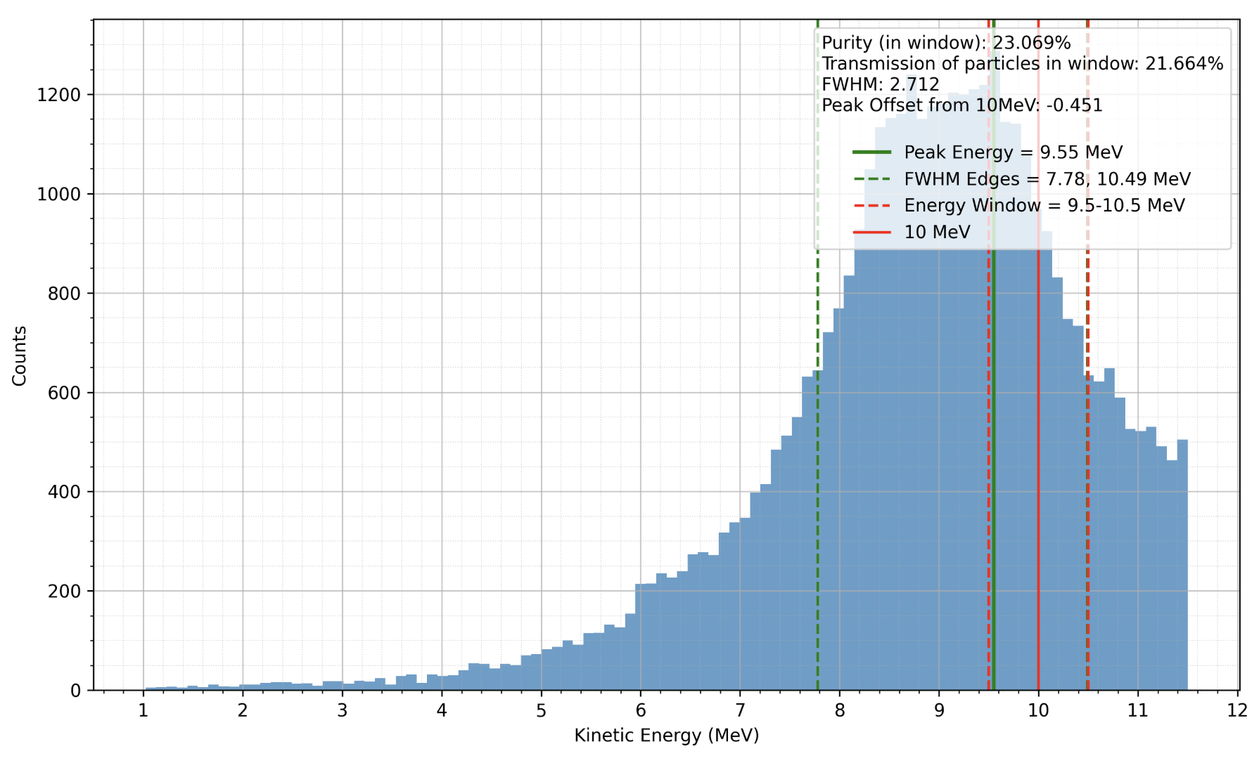
Inputted the full spectrum

Slide 6
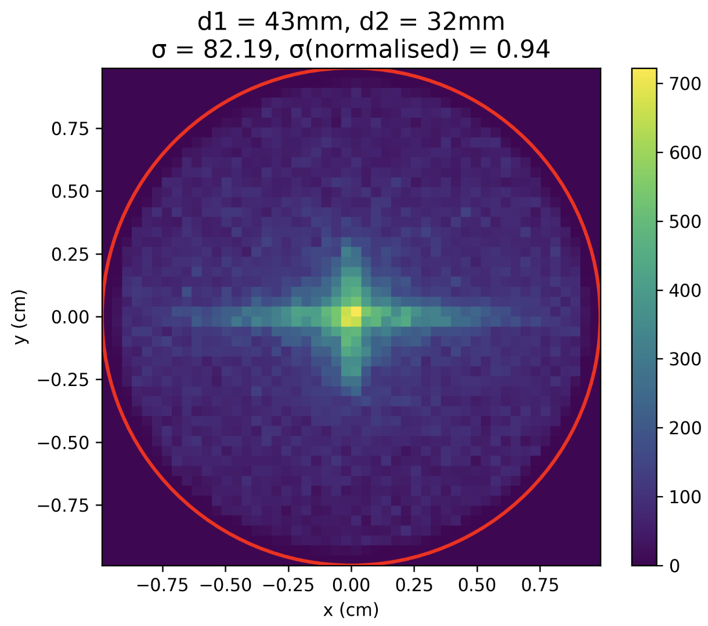
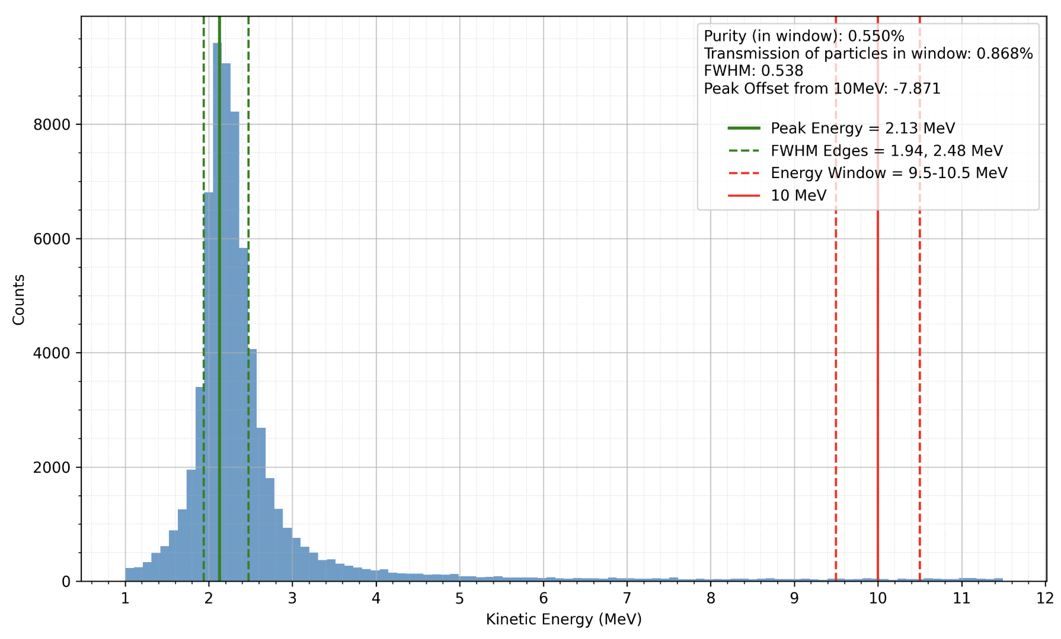
What if: Optimise normalised standard deviation for the full spectrum?

