Slide 1
Update from SCAPA
Based on LhARA-TN-2025-05

Slide 2
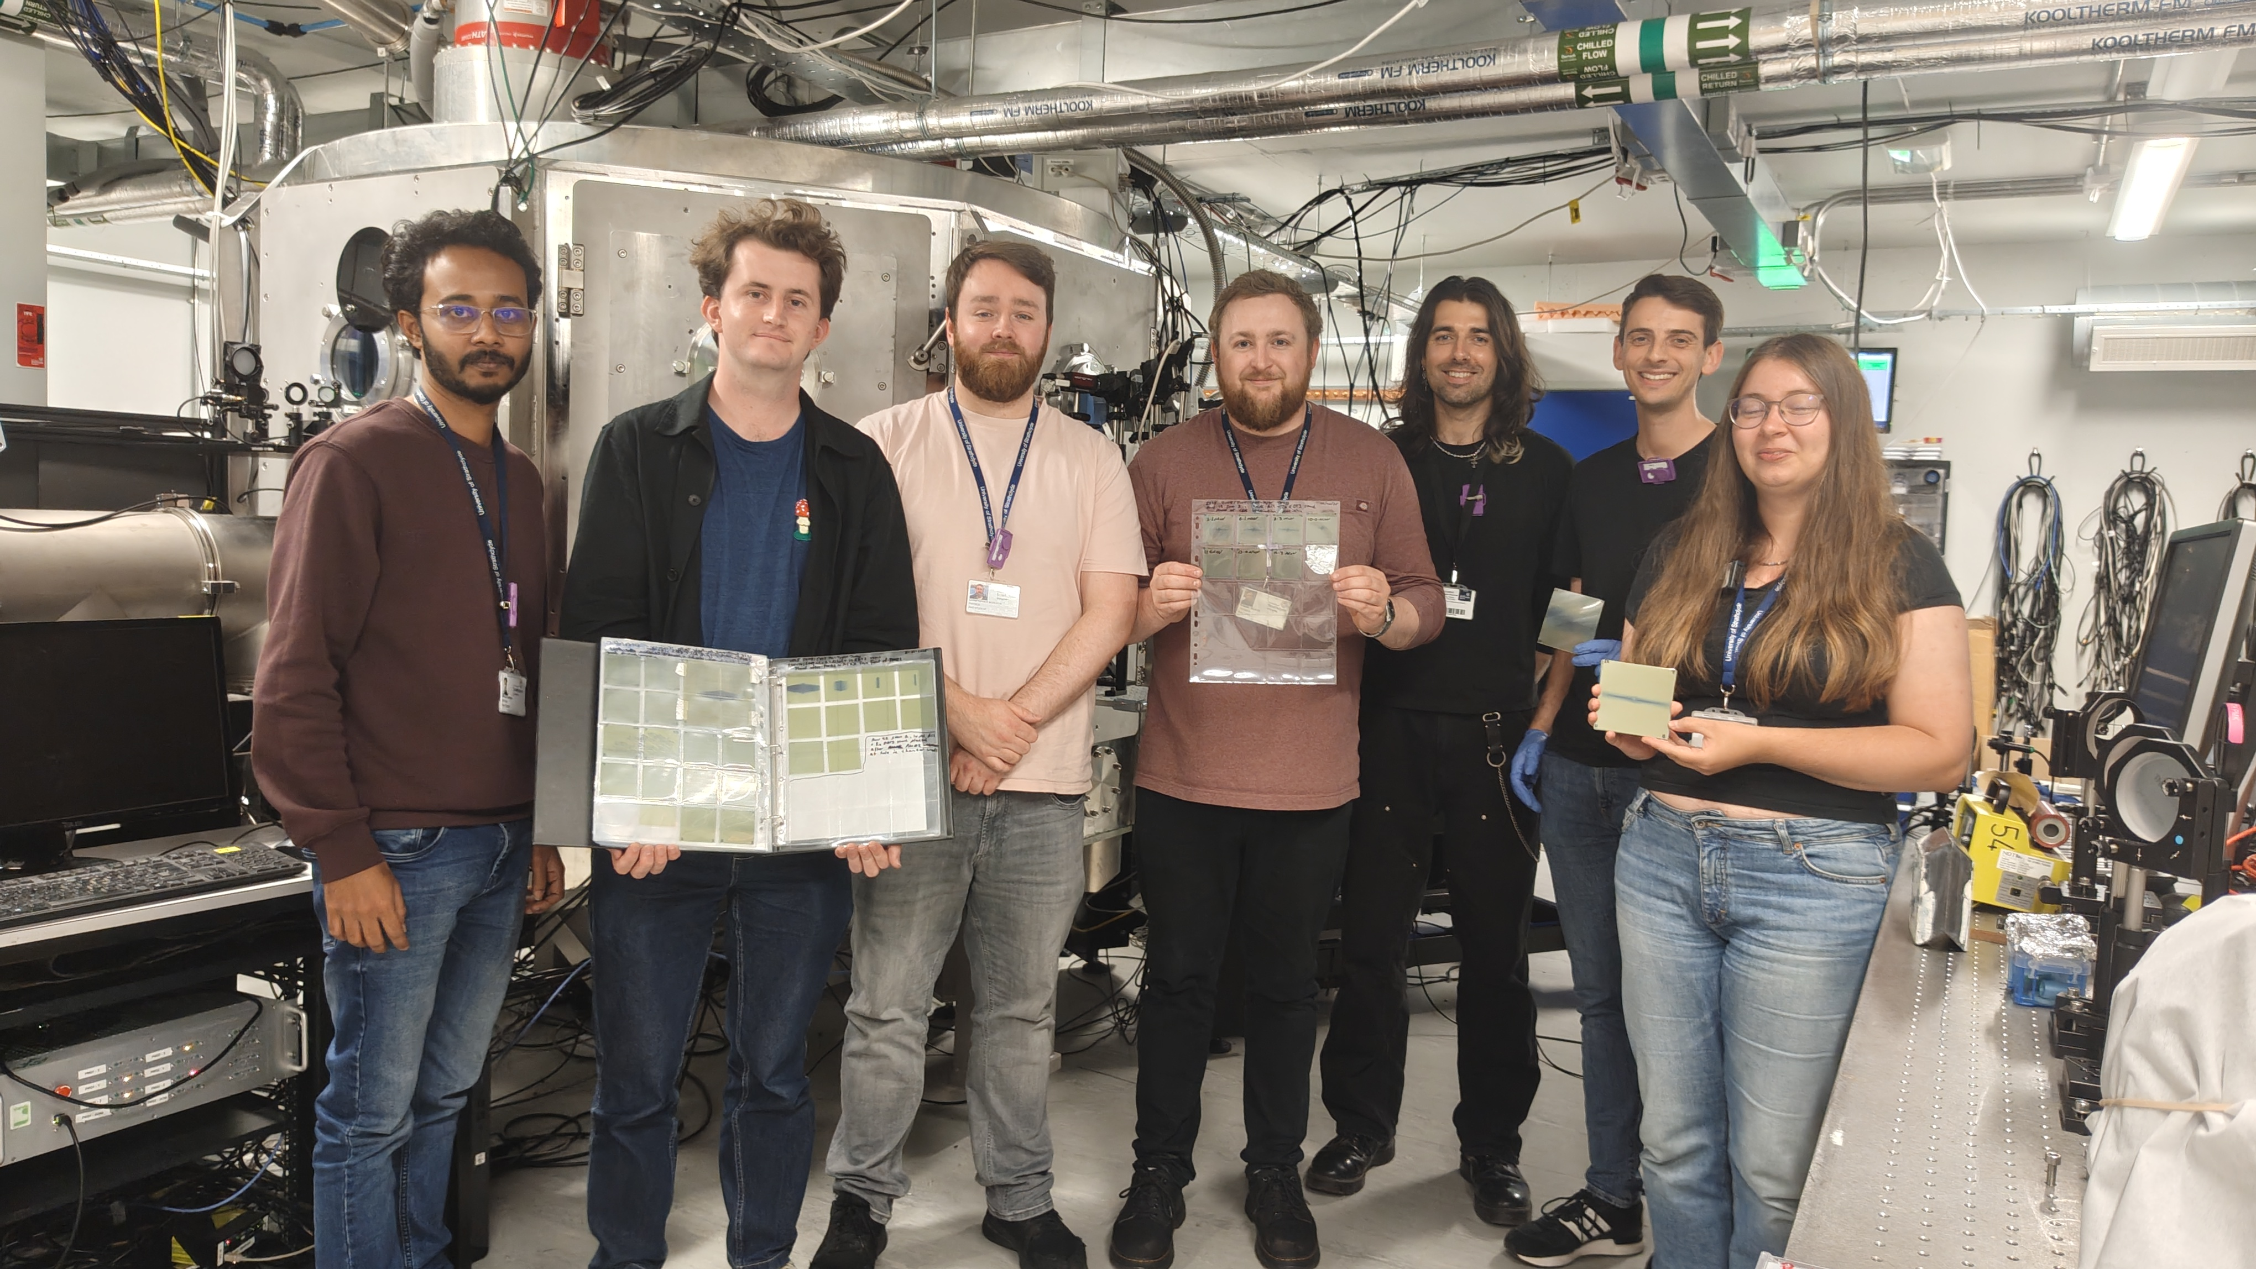

Slide 3
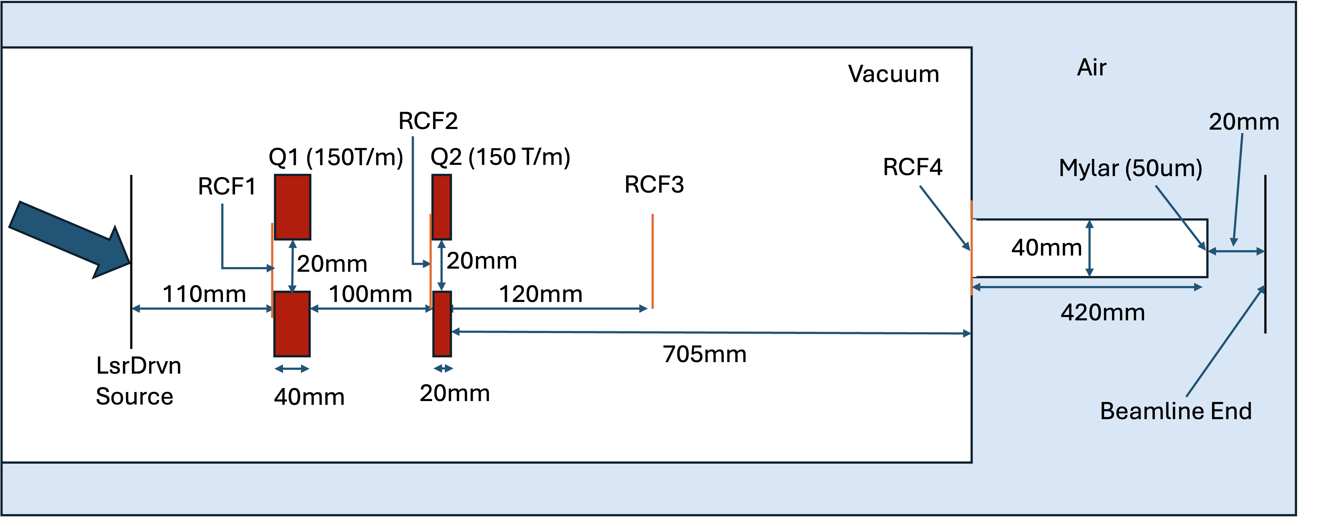
Setup 1
Laser-target set up “consistent” with 13 MeV endpoint

Slide 4
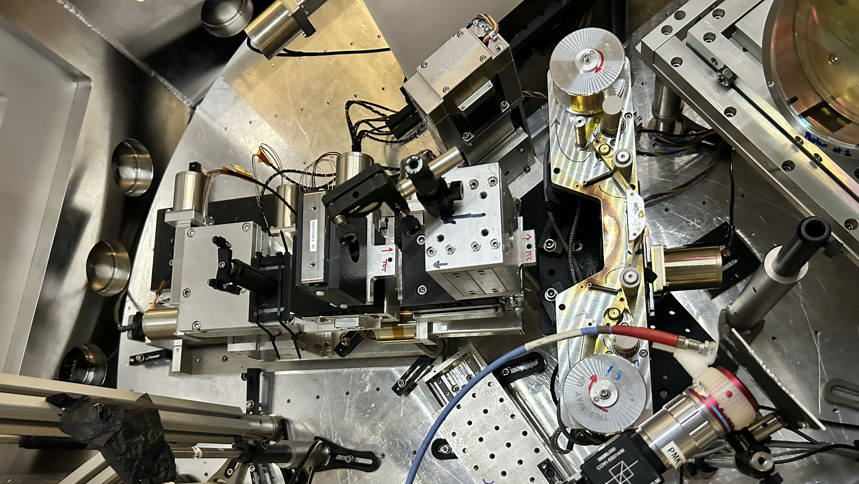
Setup 1

Slide 5
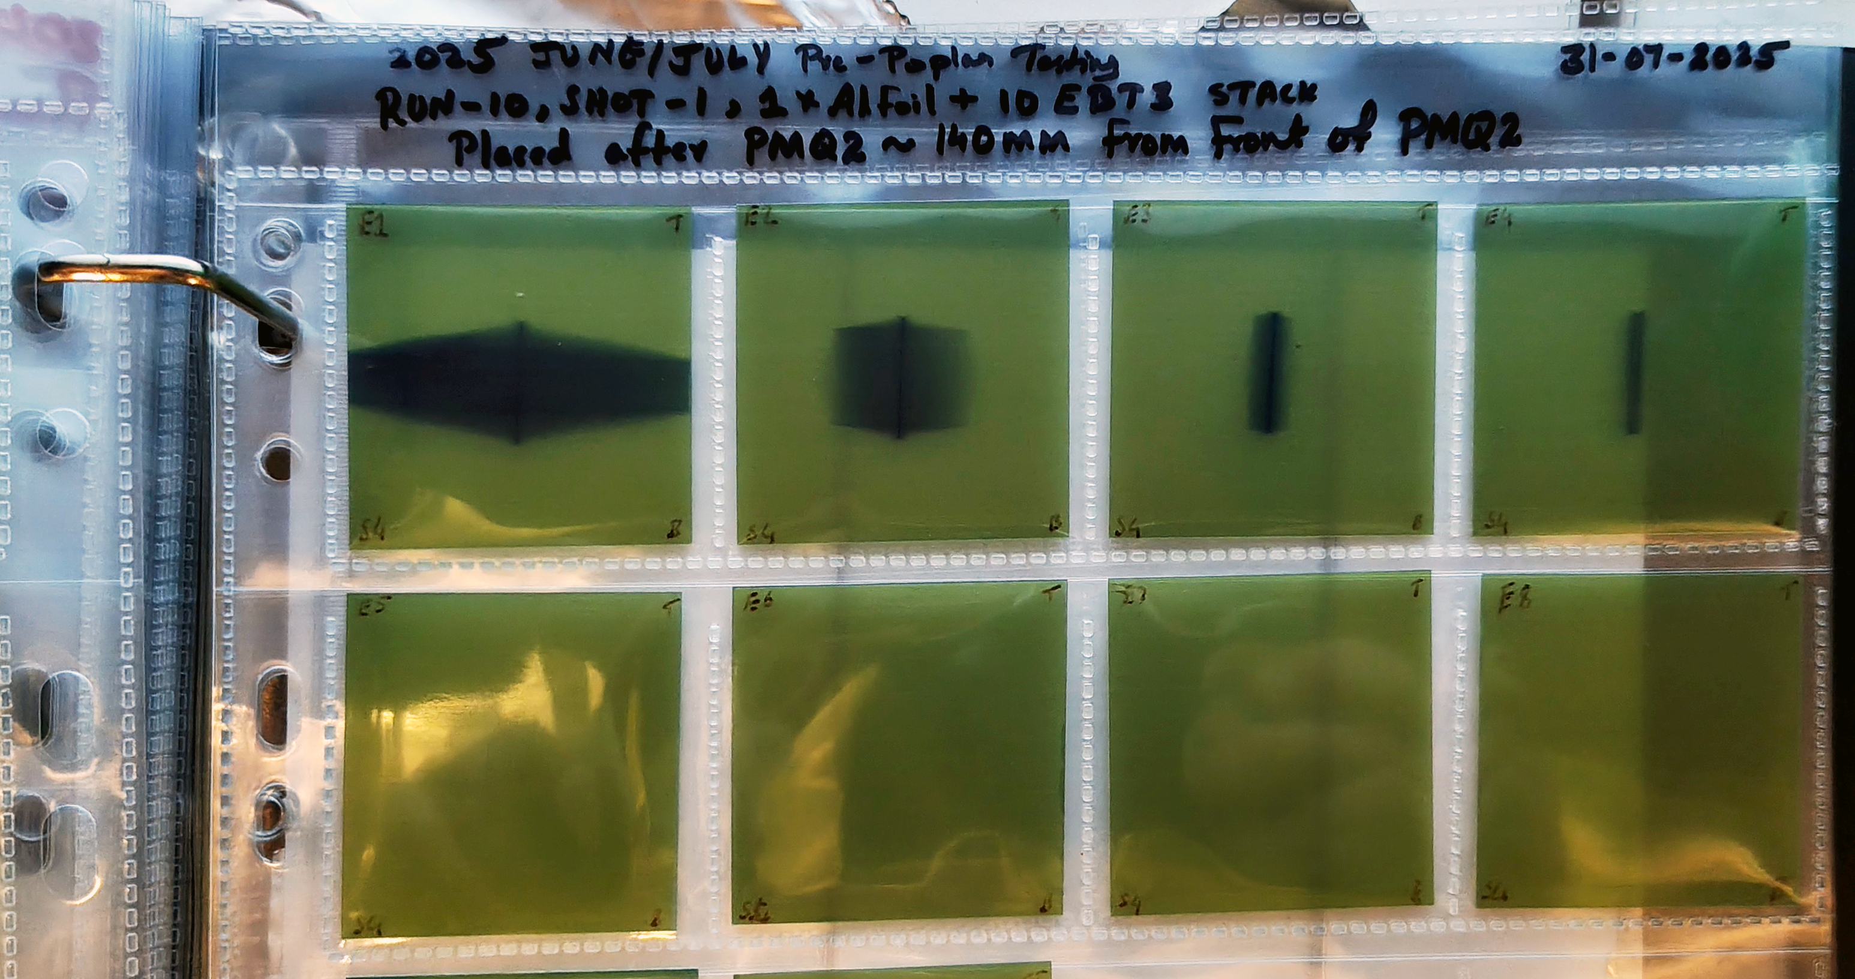
Initial RCF measurement
2025 June/July Pre-Poplar testing
Run-10, Shot-1, 1xAl Foil + 10 EBT3 stack
Placed after PMQ2 ~140 mm from front of PMQ2

Slide 6
Initial RCF measurement @ 12 cm (RCF3)
With RCF stack at RCF3, found that maximum energy of beam was between 11.4 and 12.7 MeV

Slide 7
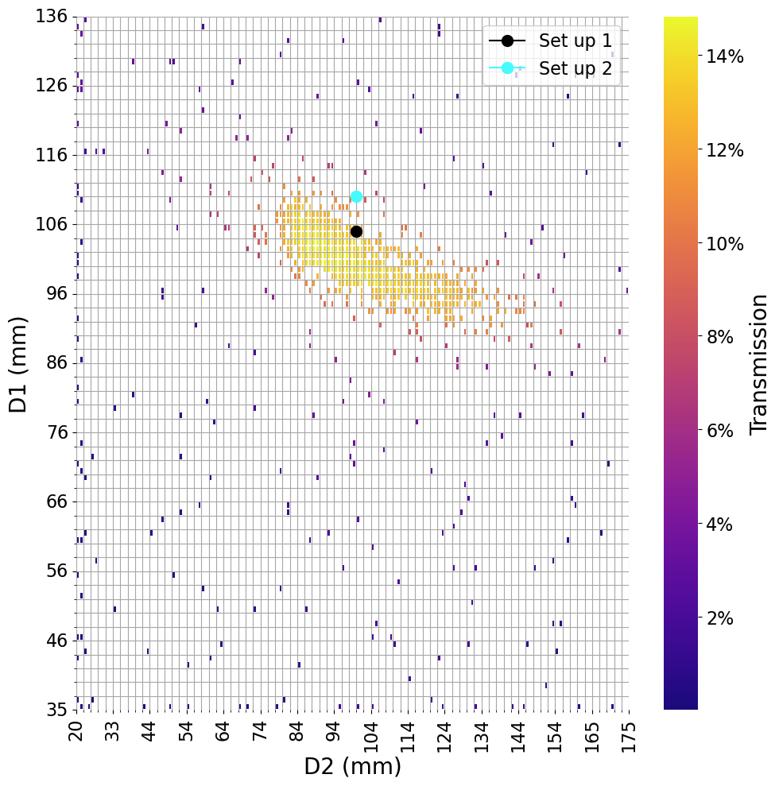
Beam @ exit window (RCF4)
Best transmission of
Gaussian energy spectrum
beam centred on 10MeV.
Spatial distribution indicated focus inside vacuum chamber
ds

Slide 8

Setup 2
Q1 5 mm closer to target

Slide 9
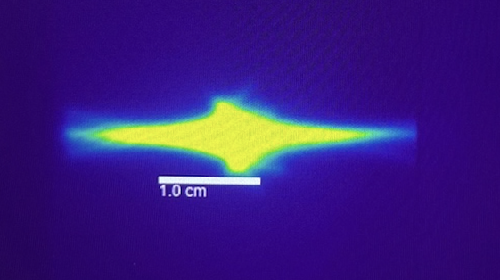
z scan
Keep distance between quads fixed, scan position of Q1 (source to upstream surface) from 105 mm to 115 mm
Observation:
  “Cross” observed @ z = 105 mm; transition to “horizontal distribution” (with no vertical line) at
  z ~ 110 mm
Simulation:
  Trend seen in simulation in
  agreement with
  measurement
Lanex d/s of exit window
Setup 1

Slide 10
Conclusion
Great start!
Mis-alignment scan performed; broadly in line with simulation
Need to establish quantitative agreement between measurement and simulation

