Slide 1


ITRF - LhARA
PoPLAR
1272-pa1-meng-prs-0024-v1.0- Permanent Quadrupole Magnets
Date 14/02/25
Clive Hill & Neil Thompson UKRI-STFC-Daresbury Laboratory
Notes:
The abstract pattern can be removed or repositioned if required. Be careful to ‘Send to Back’ so that it does not obscure any important information.

Slide 2
PoPLAR Halbach Quads – Doubling Up
Modelled in Radia code (from ESRF)
Conclusions:
  Integrated gradient of two quads is exactly double the integrated gradient of a single quad, independent of the spacing between them.
  Force between two quads can be significant.
Neil Thompson –STFC DL

Slide 3
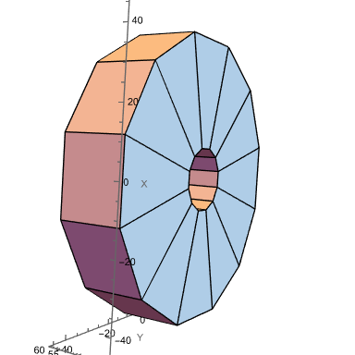
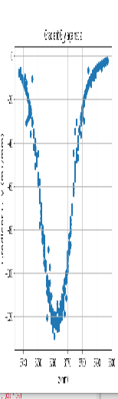
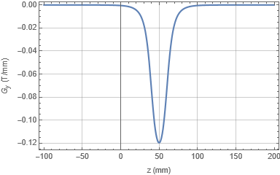
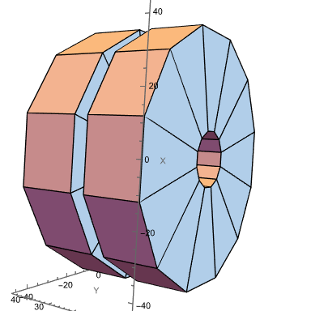
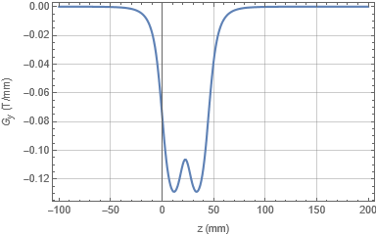
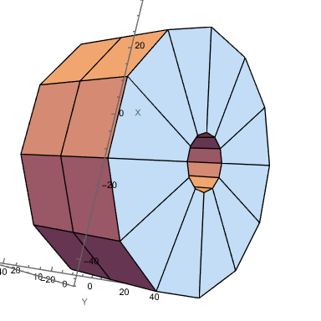
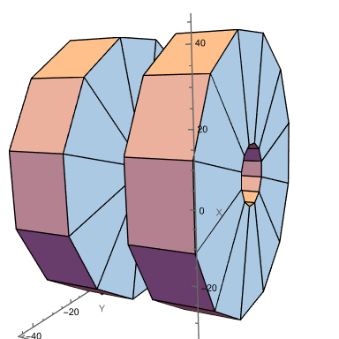
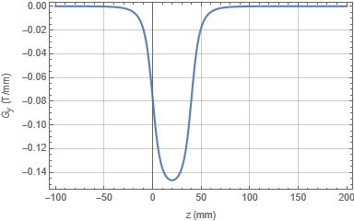
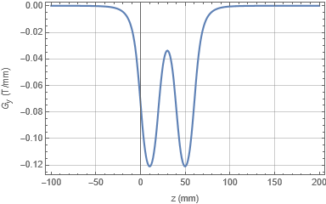
Neil Thompson – STFC DL
Measurement
(same scale)
ONE QUAD
TWO QUADS, 5mm GAP
Integrated Gradient G1 = -3.12883 T
Integrated Gradient = -6.26385 T = G1*2.002
TWO QUADS, NO GAP
TWO QUADS, 20mm GAP
Integrated Gradient = -6.25824 T = G1*2.0002
Integrated Gradient = -6.25036 T = G1*1.9997

Slide 4
Neil Thompson – STFC DL
Force Between Two Quads (N)
(along beam axis)
Integrated Gradient relative to single quad.
Variation is within numerical solution error of RADIA

Slide 5
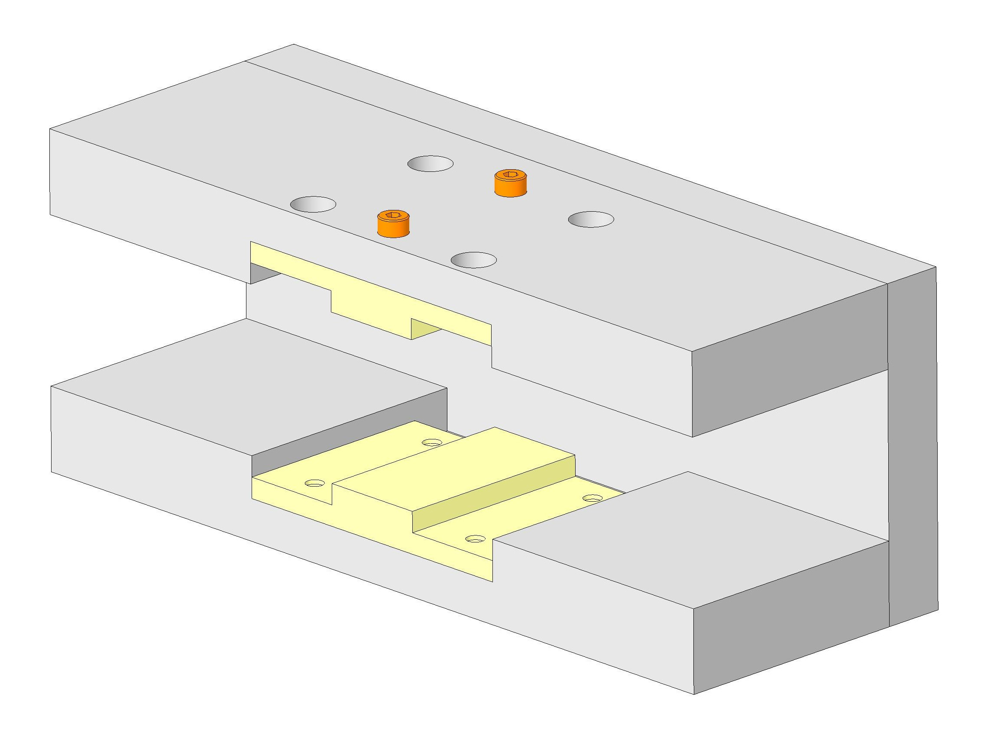
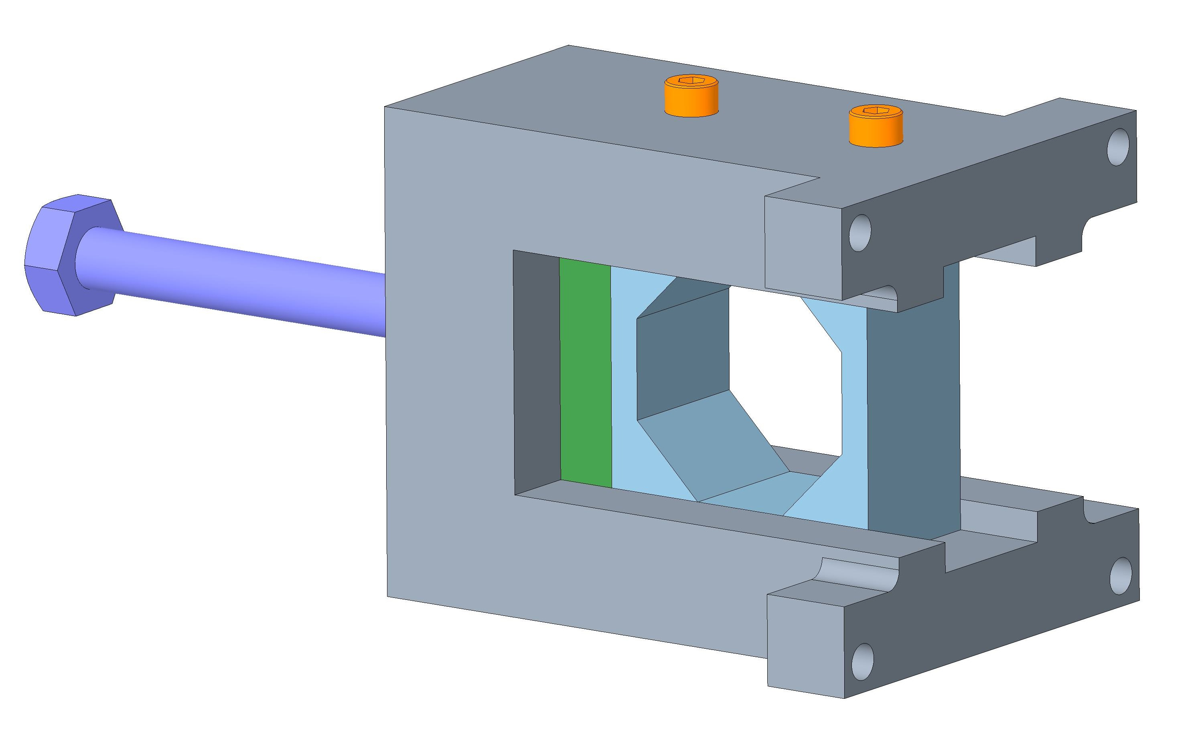
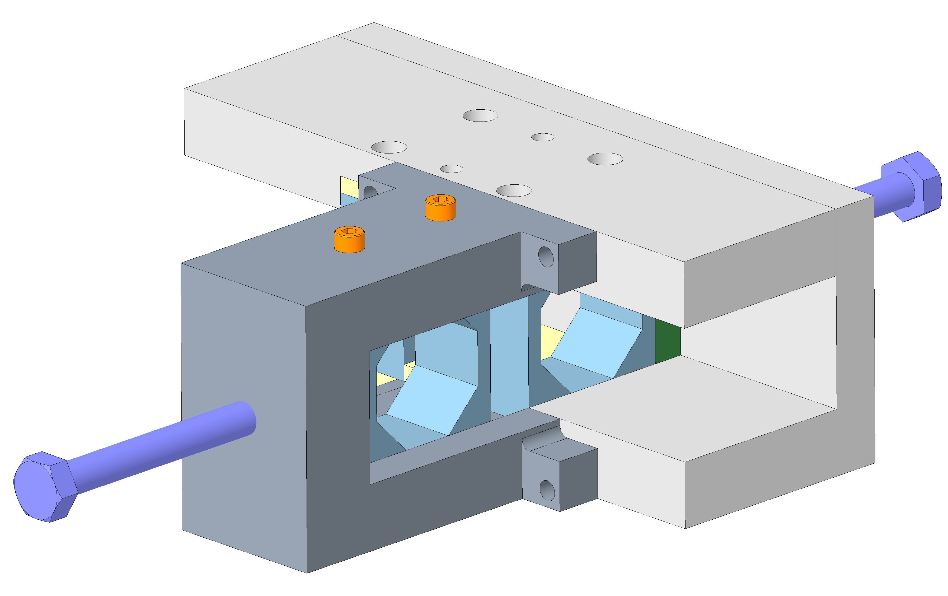
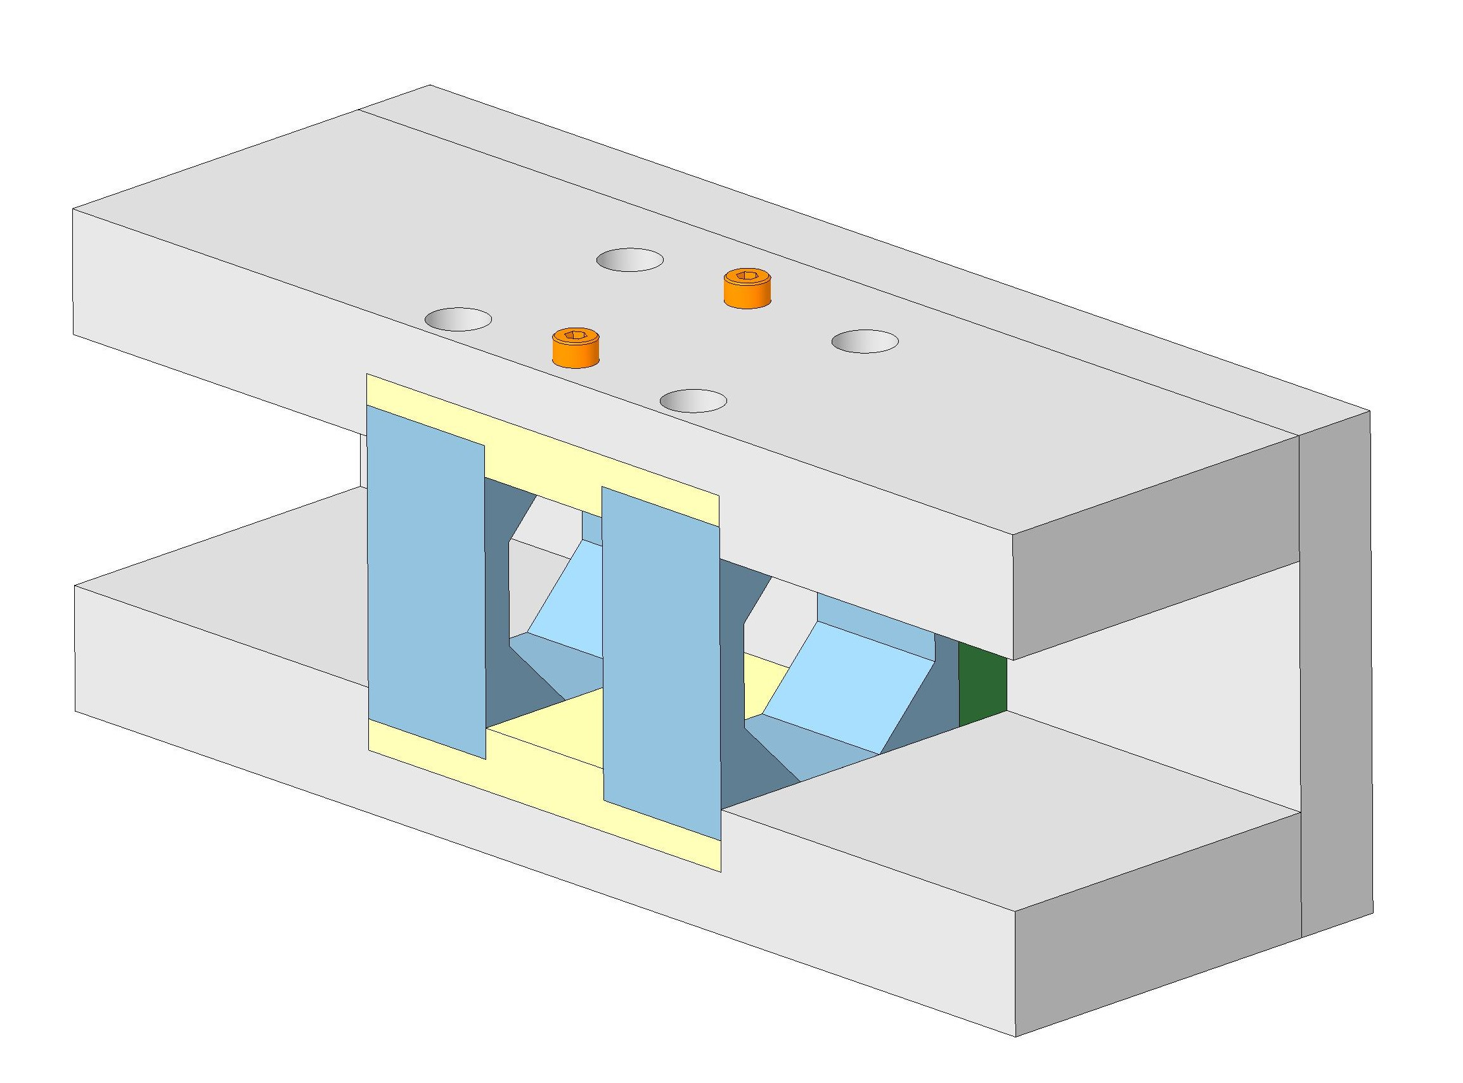
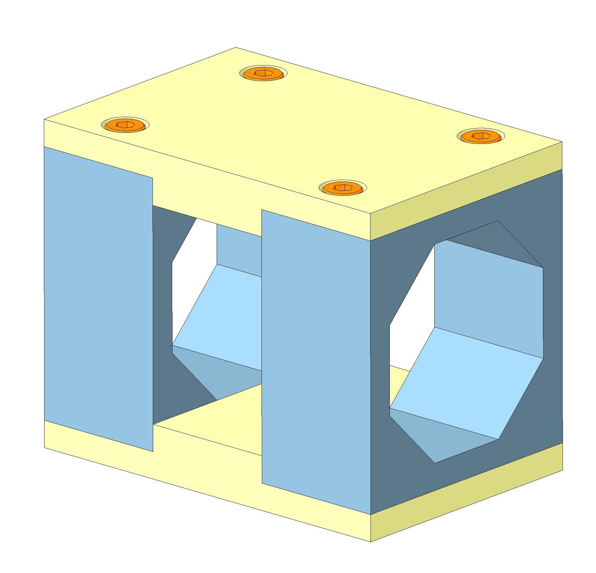
PoPLAR – Permanent Quadrupoles Assembly Concept
Fasteners securing top plate
Assembly fixture
Quadrupole magnet
Stage 1
Stage 2
Assembly tooling (hand held)
Screw acting as a constraint to control loading of quadrupole
Stage 3
Stage 4
Stage 5
Screw for loading of quadrupole

Slide 6
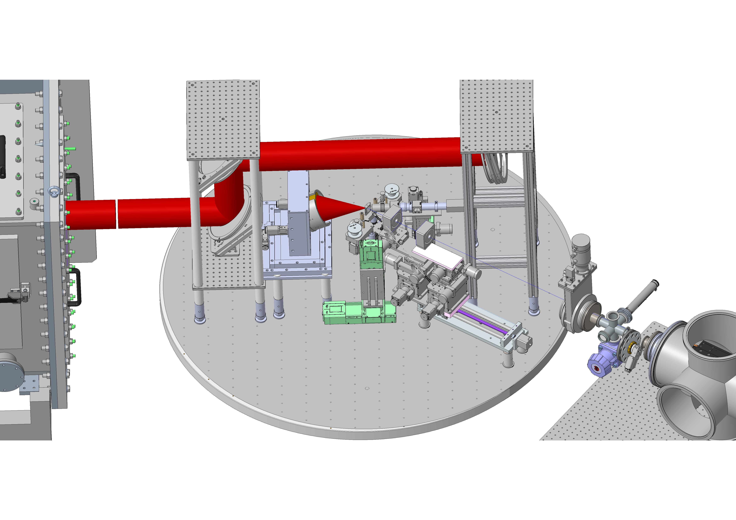
PoPLAR - PM Quadrupoles SCAPA Facility Chamber
Permanent quadrupole magnets

