Slide 1
Update

Slide 2
Following-up last week’s discussion …
We agreed parallelised approach:
  Exploit existing facilities to do relevant experiments:
    As being done by (e.g.) ND, RG, …; JMcG, Jpar, TP, …
  Permanent magnet quad doublet on SCAPA to advance first laser-driven rbio experiments
  Develoment of staged-implementation concept for LhARA bioPoP
This update about “PMQ” option to advance start:
  First study:
    Quad doublet as at LMU
    Beam optics: Riddhi/Alfredo
      Updates in weeks to come
    Feasibility:
      Working towards magnet quotes

Slide 3
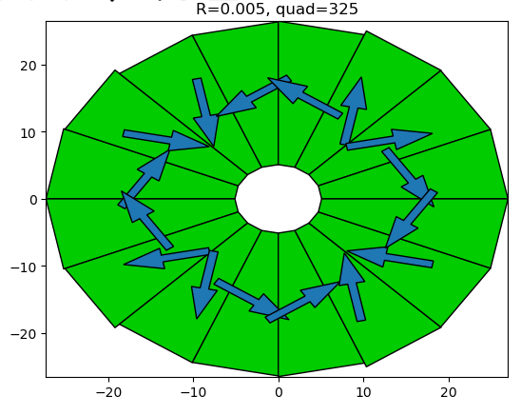
PMQs form Ben Shepherd and Neil Thompson (DL)
Initial sketch from BS:
  Halbach array concept
Design opposite gave:
  325 T/m gradient
  Aperture 10mm
For comparison, LMU:
  330 T/m gradient
  Aperture 10mm
BS, KL, NT, CW:
  Met, 13Nov23:
    Feasibility discussed
    Gradients up to 400 T/m
    possible
    Cost for fixed poll-tip
    separation may be ~£20k
    NT has some modelling for
    EPAC (next couple of slides)

Slide 4
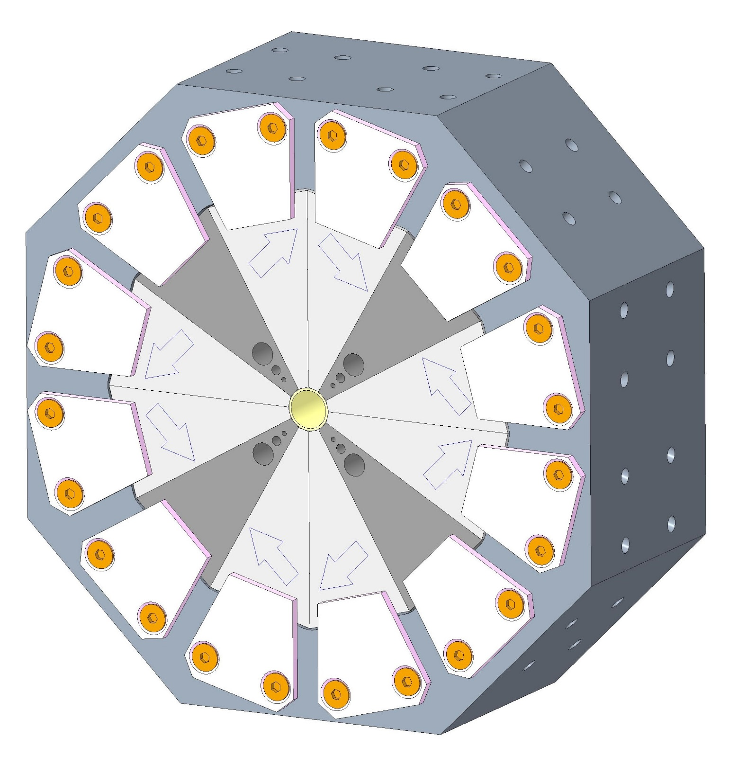
Hybrid Permanent Magnet Quadrupoles For EPAC
Blocks clamped rather than glued to allow block sorting/adjustment after measurement
Tapped holes for locating blocks against central pipe
We have designed, and are building, four compact, in-vacuum, high-field hybrid permanent magnet quadrupoles for the Extreme Photonics Application Centre (EPAC) Project at RAL
The quads will be used to capture highly divergent electron bunches as they exit a plasma acceleration stage at up to 5GeV.
They are mountable in two orientations so can be used as F-Quads and D-Quads
Main Parameters:
Pole pieces: 1006 Steel
NdFeB Magnet Blocks: Vacuumschmelze VACODYM 745 TP,
Br = 1.37T, with a <6um titanium nitride coating
Peak Gradient | ~500 T/m
Physical Length | 50 mm
Integrated Gradient | > 25 T
Internal Radius | 4 mm
Tuning Holes: 3 holes with insertable 1006 steel rods

Slide 5
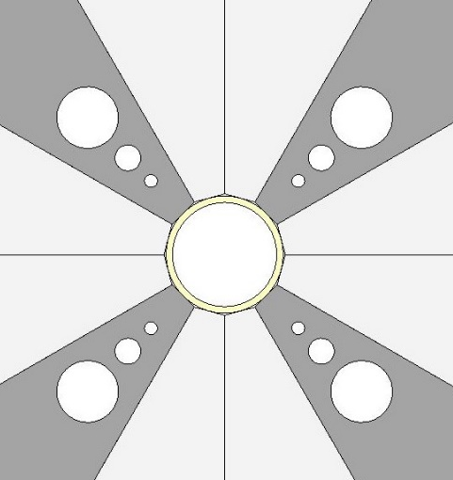
3-Bit Tuning System
Tolerance studies indicate that for perfectly assembled magnets the gradient variation over 4 quads will be up to 1.8%
The specification, from beam dynamics studies, is that maximum allowed variation is 1%.
We have therefore designed a 3-Bit Tuning System, using 3 insertable steel rods, that allows the gradient to be varied in 8 steps of 0.8% over a full range of 6% - this should allow all quads to be brought within specification.
Rod/Hole 3
Rod/Hole 2
Rod/Hole 1
Rod combination ID # | Rod-3* | Rod-2* | Rod-1* | Peak Gradient (T/m)
0 | 0 | 0 | 0 | 484.6
1 | 0 | 0 | 1 | 490.1
2 | 0 | 1 | 0 | 493.5
3 | 0 | 1 | 1 | 498.8
4 | 1 | 0 | 0 | 502.4
5 | 1 | 0 | 1 | 506.9
6 | 1 | 1 | 0 | 509.9
7 | 1 | 1 | 1 | 514.1
* 0 = Rod OUT, 1 = Rod IN

Slide 6
SCAPA protons from RG
Expect phase-space delivered to sample to be determined by focusing and collimation, but …
Would like to understand better relation between “theory” and measurement
Used in present simulation
on advice of J.Schreiber, LMU

