Slide 1
Plasma Trap Instructions

Slide 2
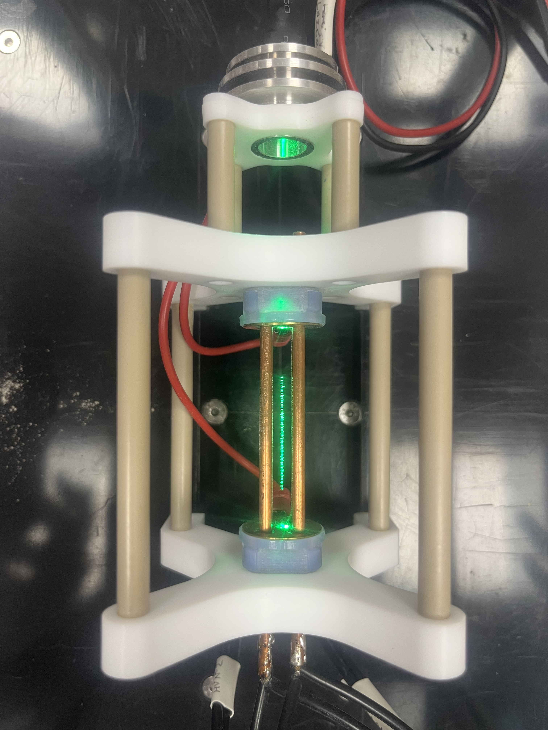
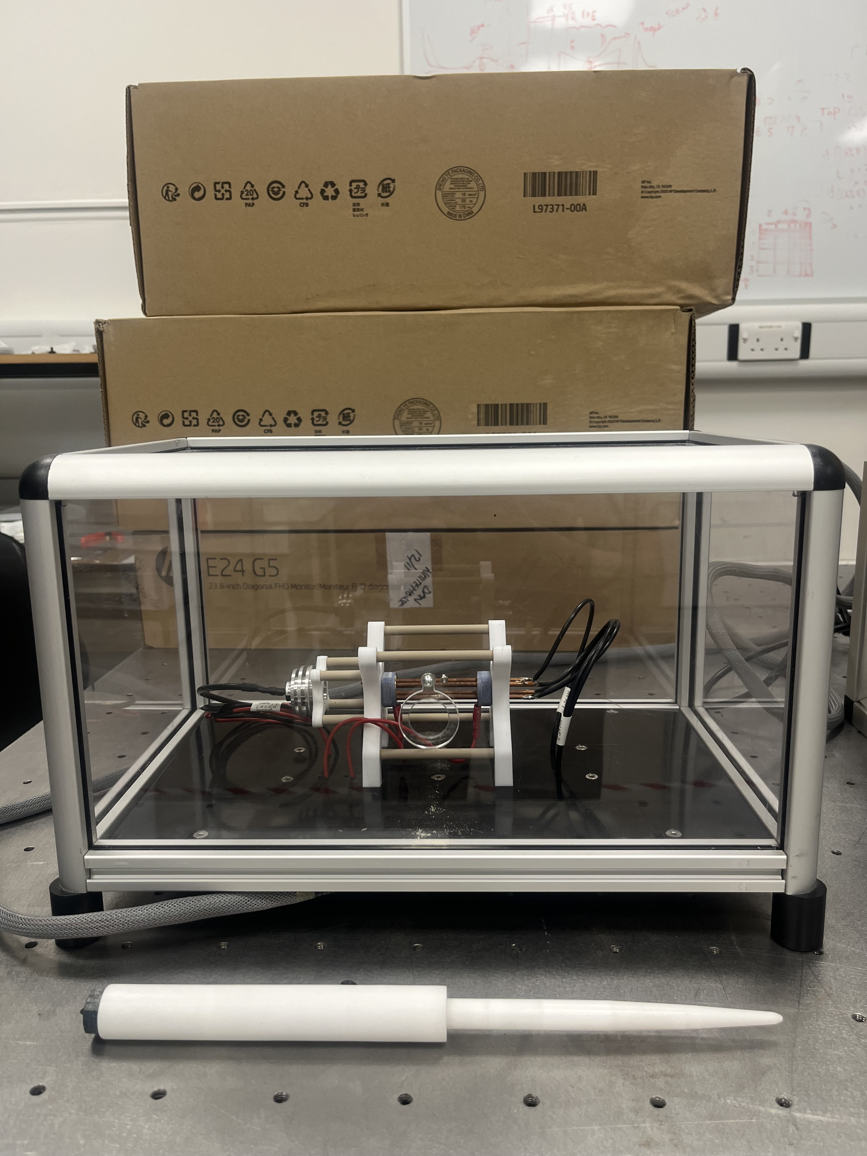
General Idea
Visitors see the pollen particles suspended in mid-air by electric fields
In this trapped state, the pollen should still look like a little square as it oscillates with the quadrupole oscillations.
The end cap voltages can be varied to move the pollen, letting it expand and contract as the voltages change.

Slide 3
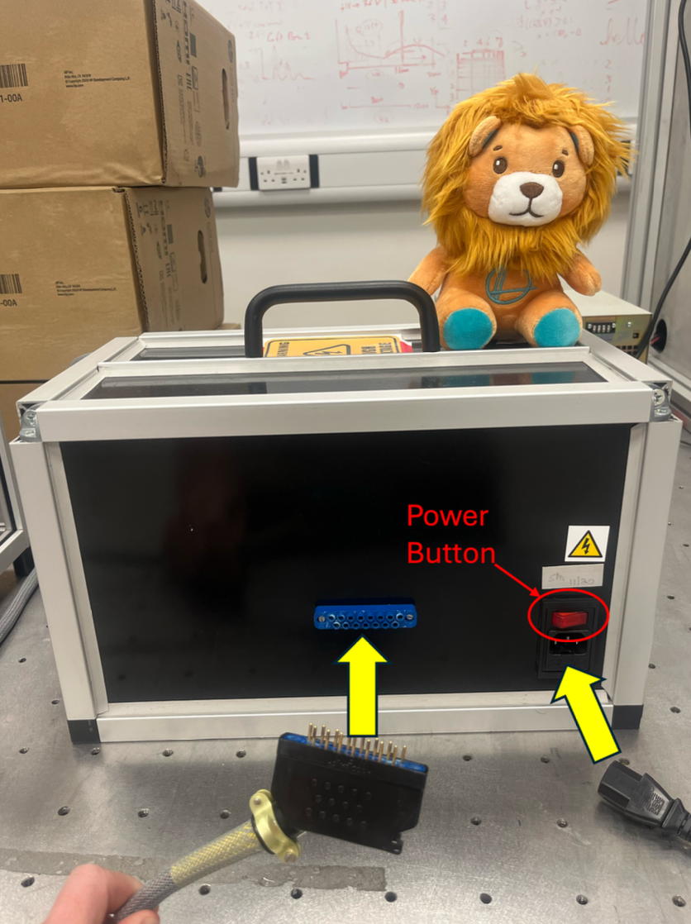
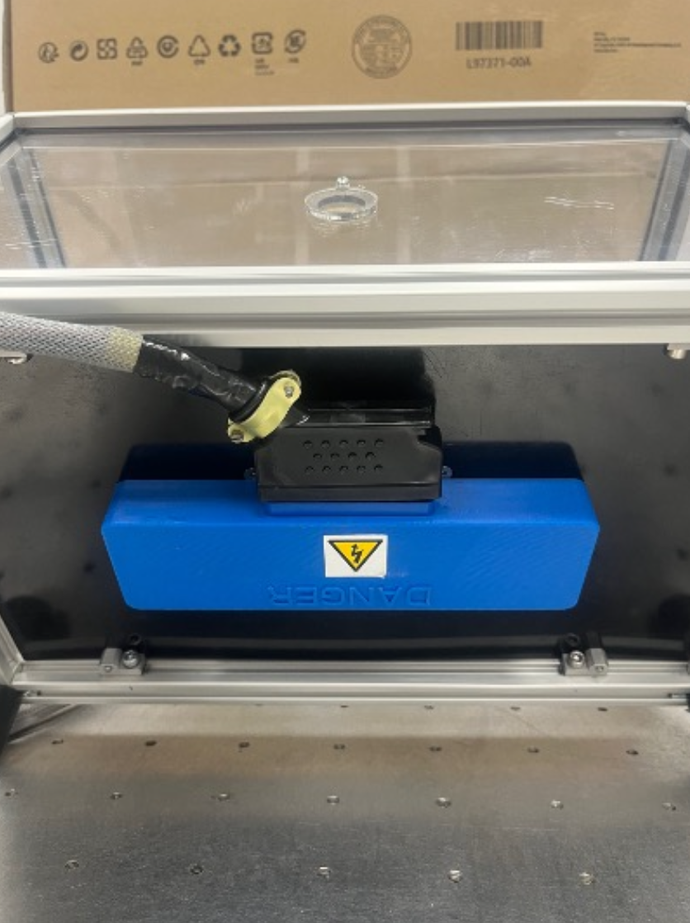
Operation – Turning On
There are 3 components: Power unit/control box, grey cable and plasma trap
The pins end goes into the power unit
  Requires a bit of a push
The other end goes into the bottom of the plasma trap
  Be careful lifting and rotating the trap

Slide 4
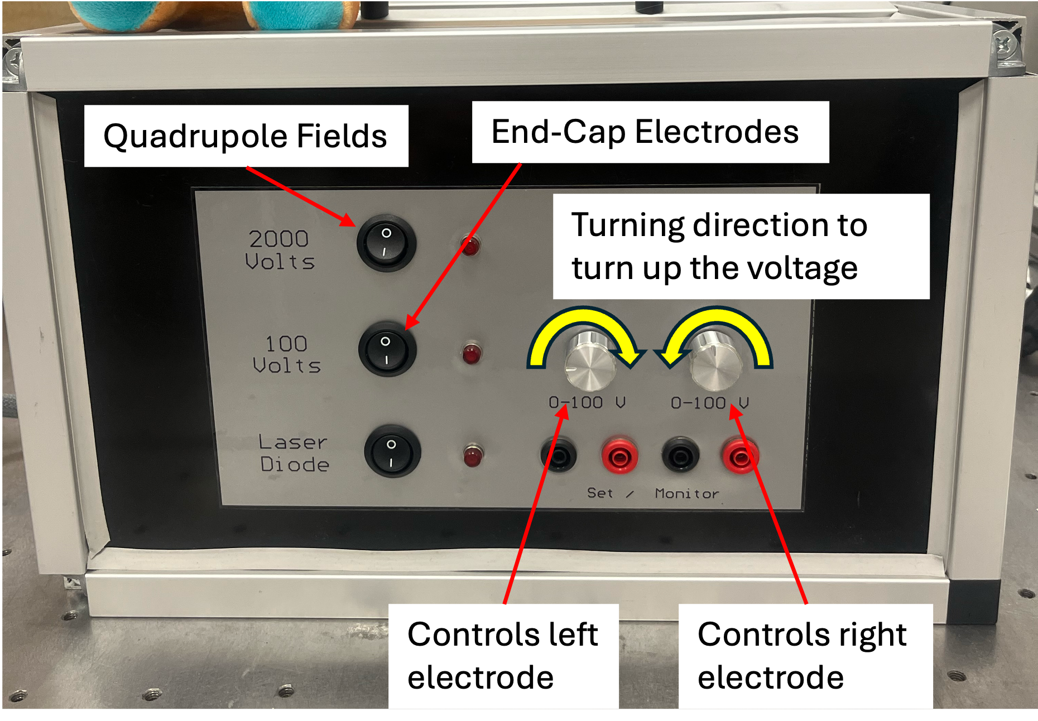
Operation - Controls
On switches control the quadrupoles, the electrodes and the laser which illuminates the pollen
The knobs control the electrode voltages
  Turning inwards increases the voltage
  Left controls left and right controls right

Slide 5
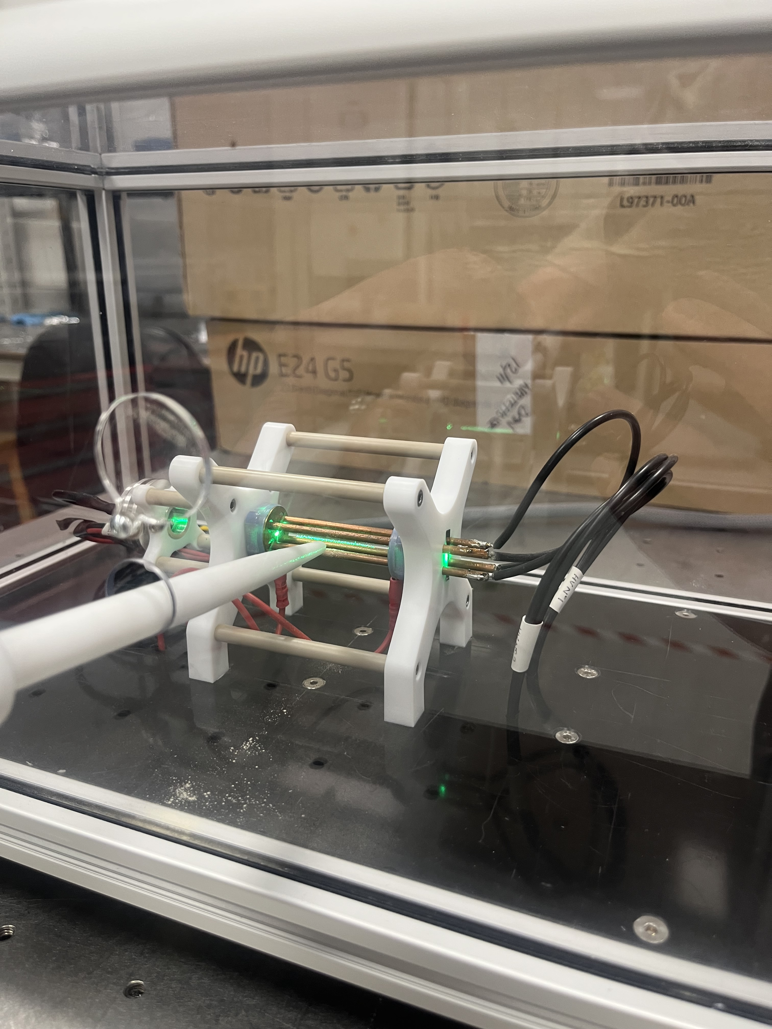
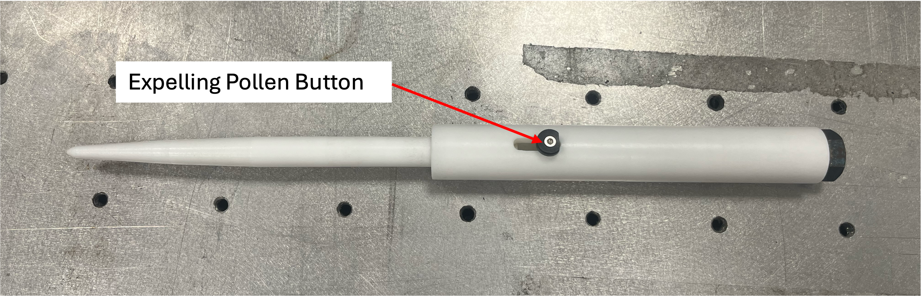
Operation - Pollen Controls
Insert the pollen using the wand
Make sure the electrodes are turned on/at their max
Dip the wand into the pollen, which is in a little Tupperware
Open the window to the trap, insert the wand and push the button on the wand forwards
Pollen is released when you release the button
Close the trap window to avoid wind dislodging the pollen in the trap

Slide 6
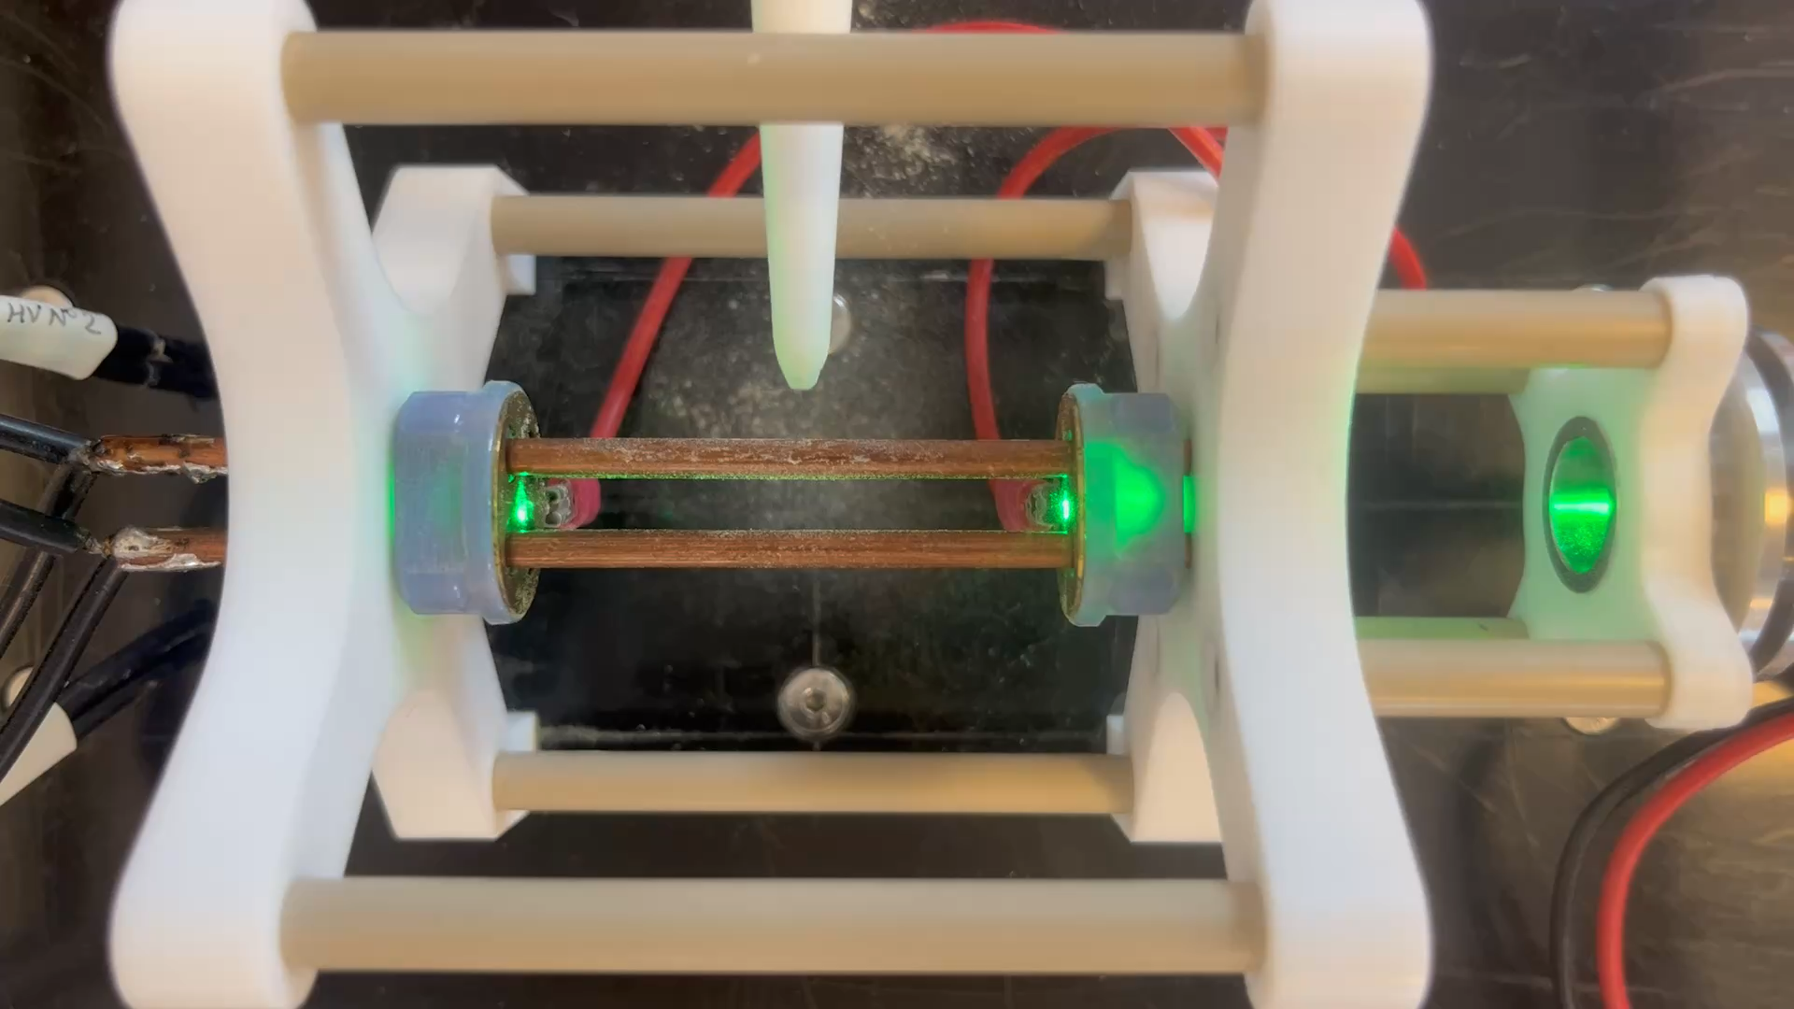
Operation - Pollen Controls

Slide 7
Operation – Deconstructing
Turn off at the mains
Wait a couple of minutes before removing the grey cables
To remove the cable from the power unit requires some wiggling
I’d suggest leaving the cable in the plasma trap as that connection is the most likely failure point of the demo

Slide 8
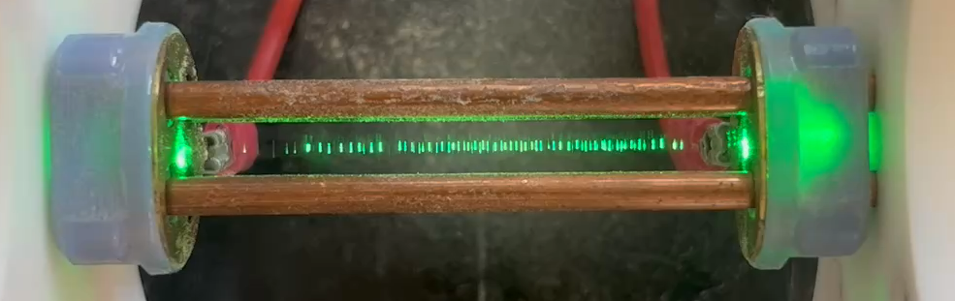
Things to look out for
Pollen particles oscillating with the field
Pollen “plasma” expanding and contracting with the electrode voltages

Slide 9
Scripts - General
Explain the confinement due to the quadrupole fields and the end-cap electrodes
Point out the particle motion
Use the electrodes to expand and squeeze the pollen
Link to controlling beams for radiotherapy
Say how LhARA plans on manipulating the beam to deliver a wider range of beam characteristics and research different radiotherapy delivery styles
Link to Gabor lens since we trap electrons using fields like we have with the pollen
Discuss positives of Gabor lens and its applications outside of LhARA
  Symmetrical focussing, same focal strength as high-field pulsed solenoid and multiple applications like semi-conductor production

Slide 10
Scripts - Children
Show the levitating particles
Point out the particles wiggling as they get squeezed in different directions
Use the electrodes to expand and squeeze the pollen and reference the pollen being “trapped” or “escaping”
Link to controlling particles even smaller than these (10¹⁰ ) we can make super-high precision tools for killing cancer without damaging healthy parts.
Notes:
If a proton were the size of a pea a pollen grain would be 300,000km across
Better at and smaller

Slide 11
Scripts – Physicist/More curiosity (better understanding)
Explain the confinement due to the quadrupole fields and the end-cap electrodes
Point out the particle motion
Use the electrodes to expand and squeeze the pollen
Link to LhARA manipulating the beam to deliver a wider range of beam characteristics and research different radiotherapy delivery styles
Link to trapping in a Gabor lens
  Trap electrons kind of like we trap the pollen
Discuss positives of Gabor lens and its applications outside of LhARA
  Symmetrical focussing, same focal strength as high-field pulsed solenoid and multiple applications like semi-conductor production

