Slide 1
LhARA introduction …
… and discussion

Slide 2
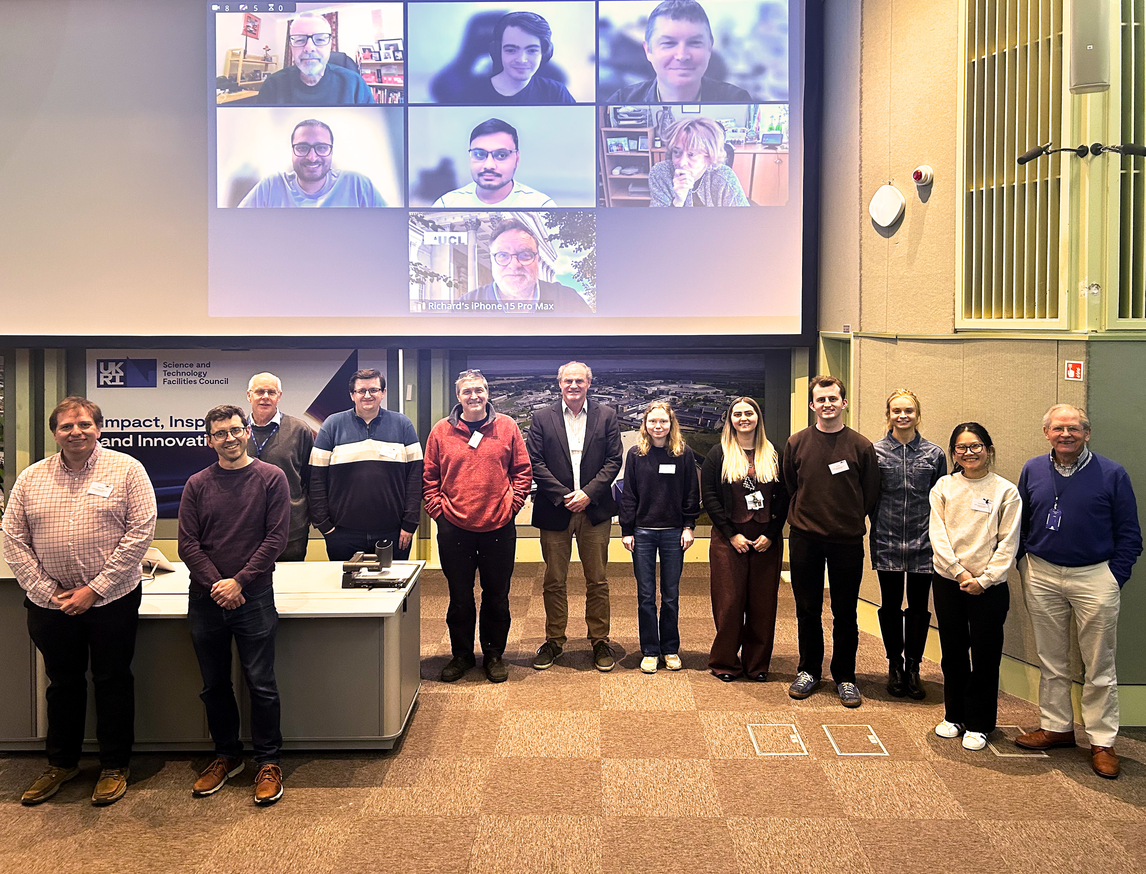
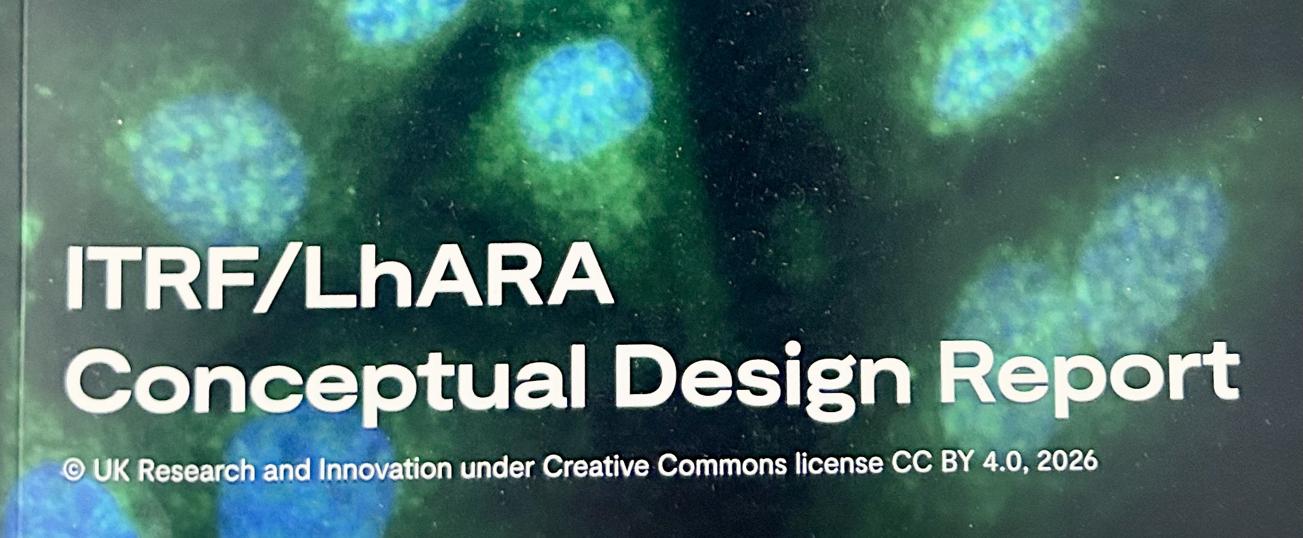
International, multidisciplinary collaboration
DOI: 10.5286/stfctr.2026007
Hot off the press!

Slide 3
The LhARA initiative

Slide 4
The LhARA initiative

Slide 5
The LhARA initiative

Slide 6
The LhARA initiative

Slide 7
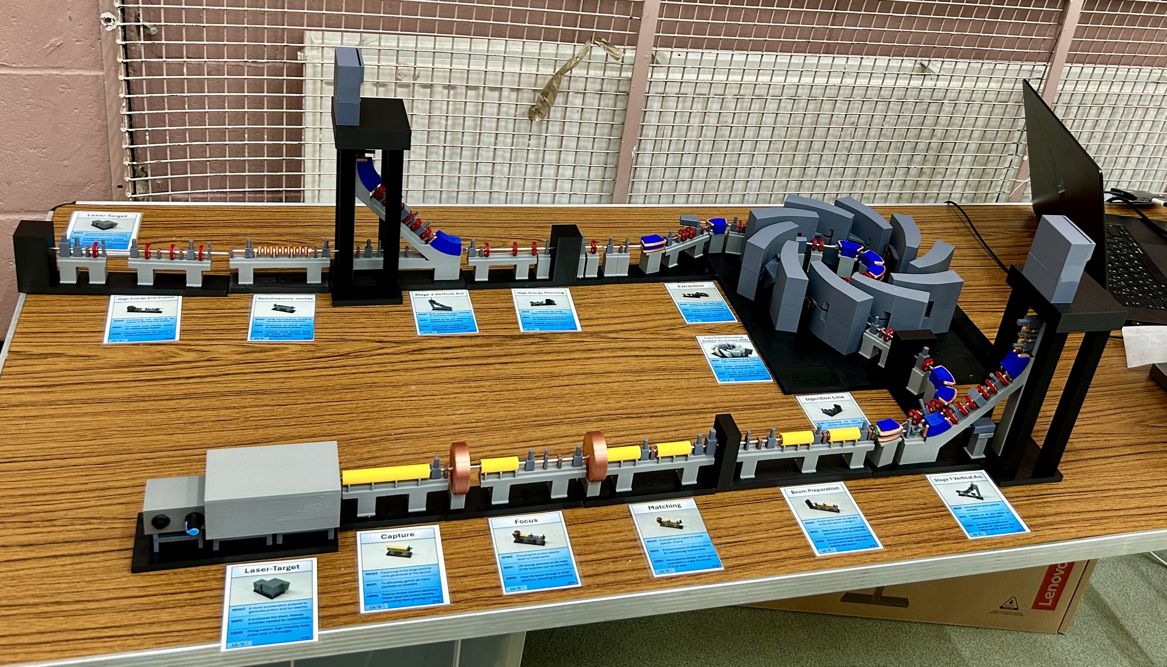

Slide 8
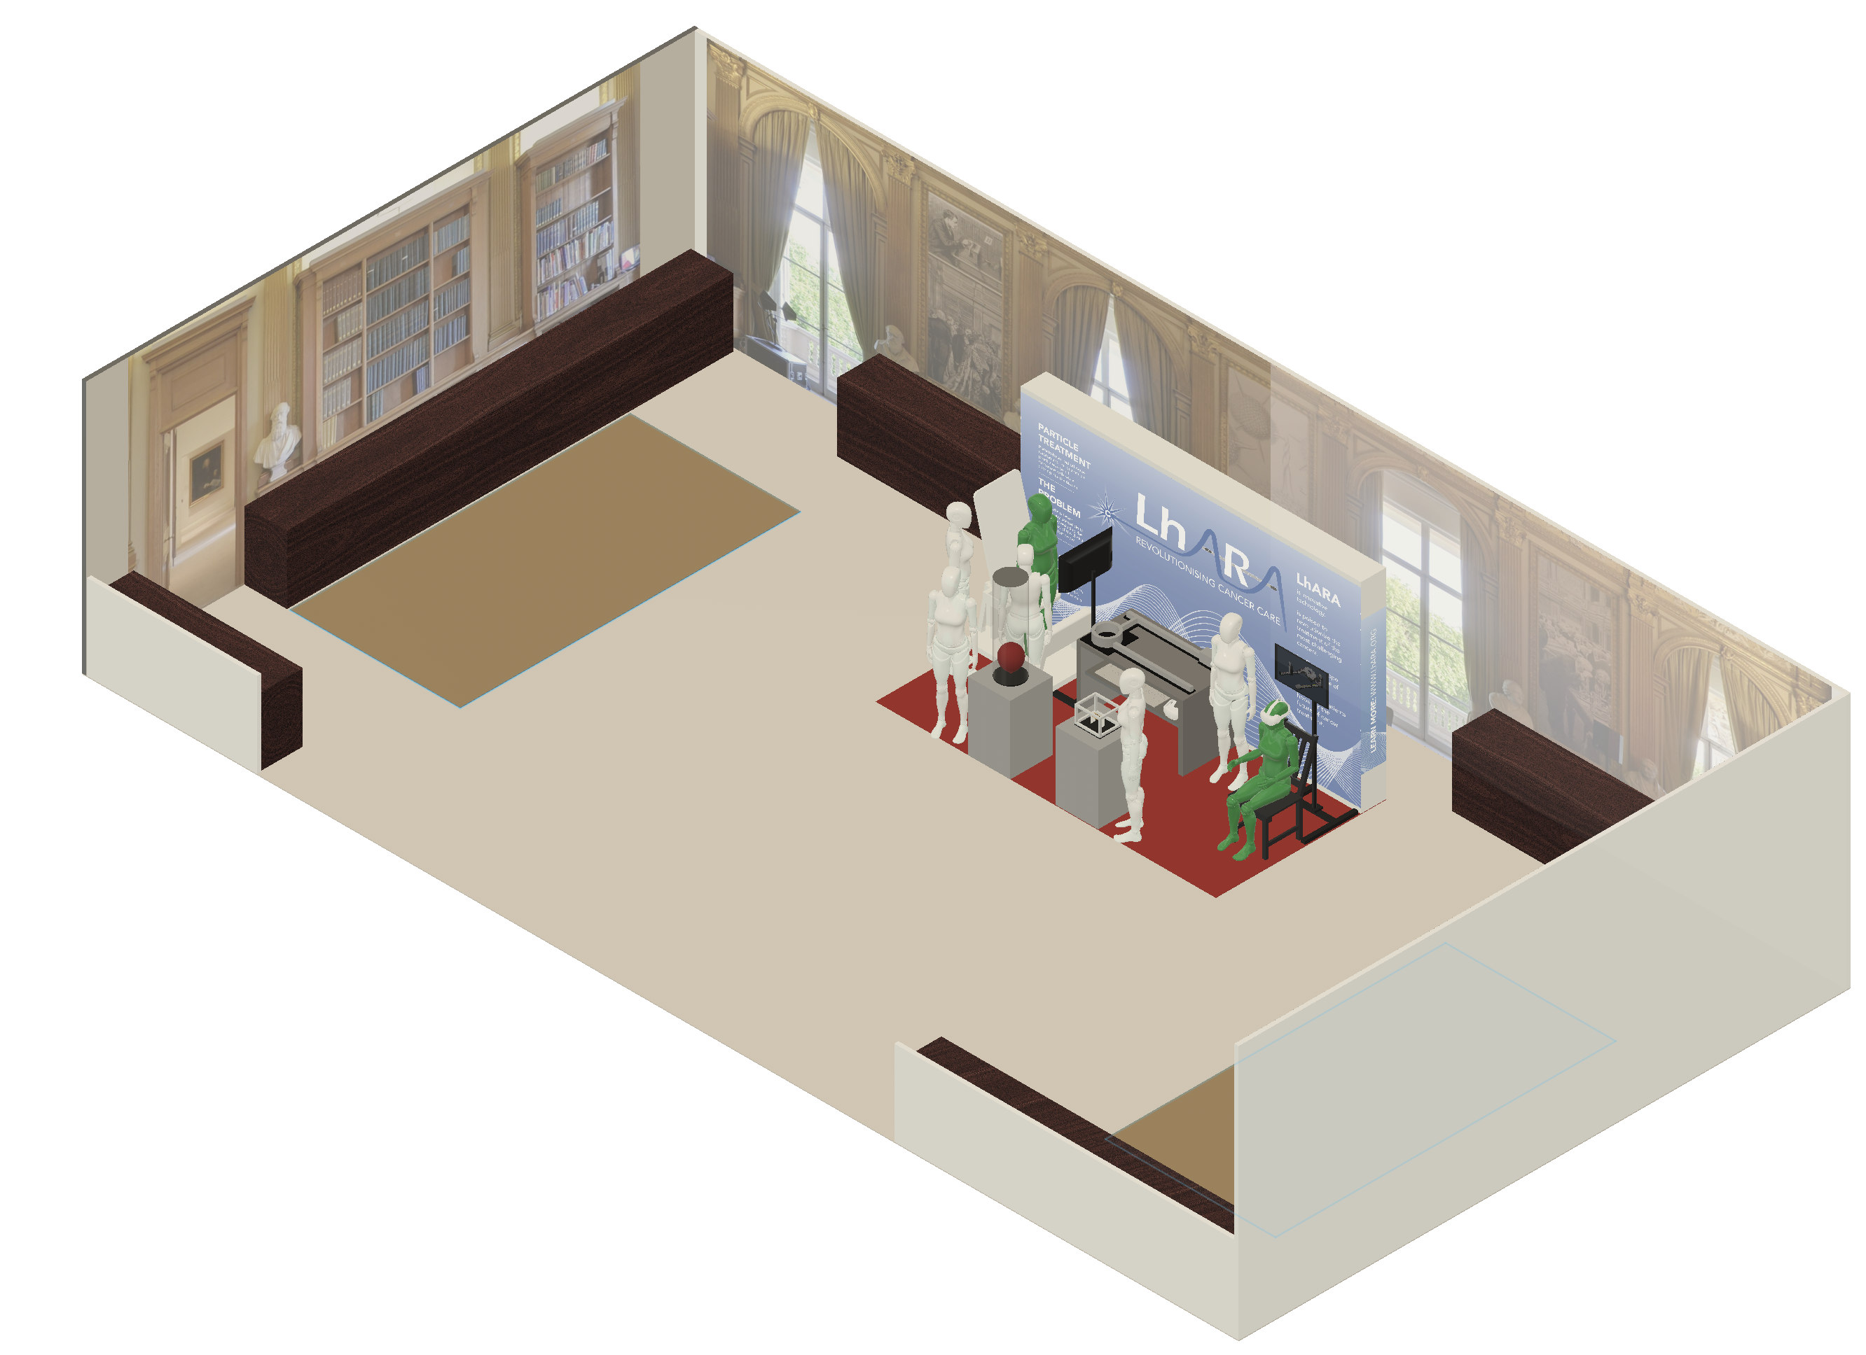
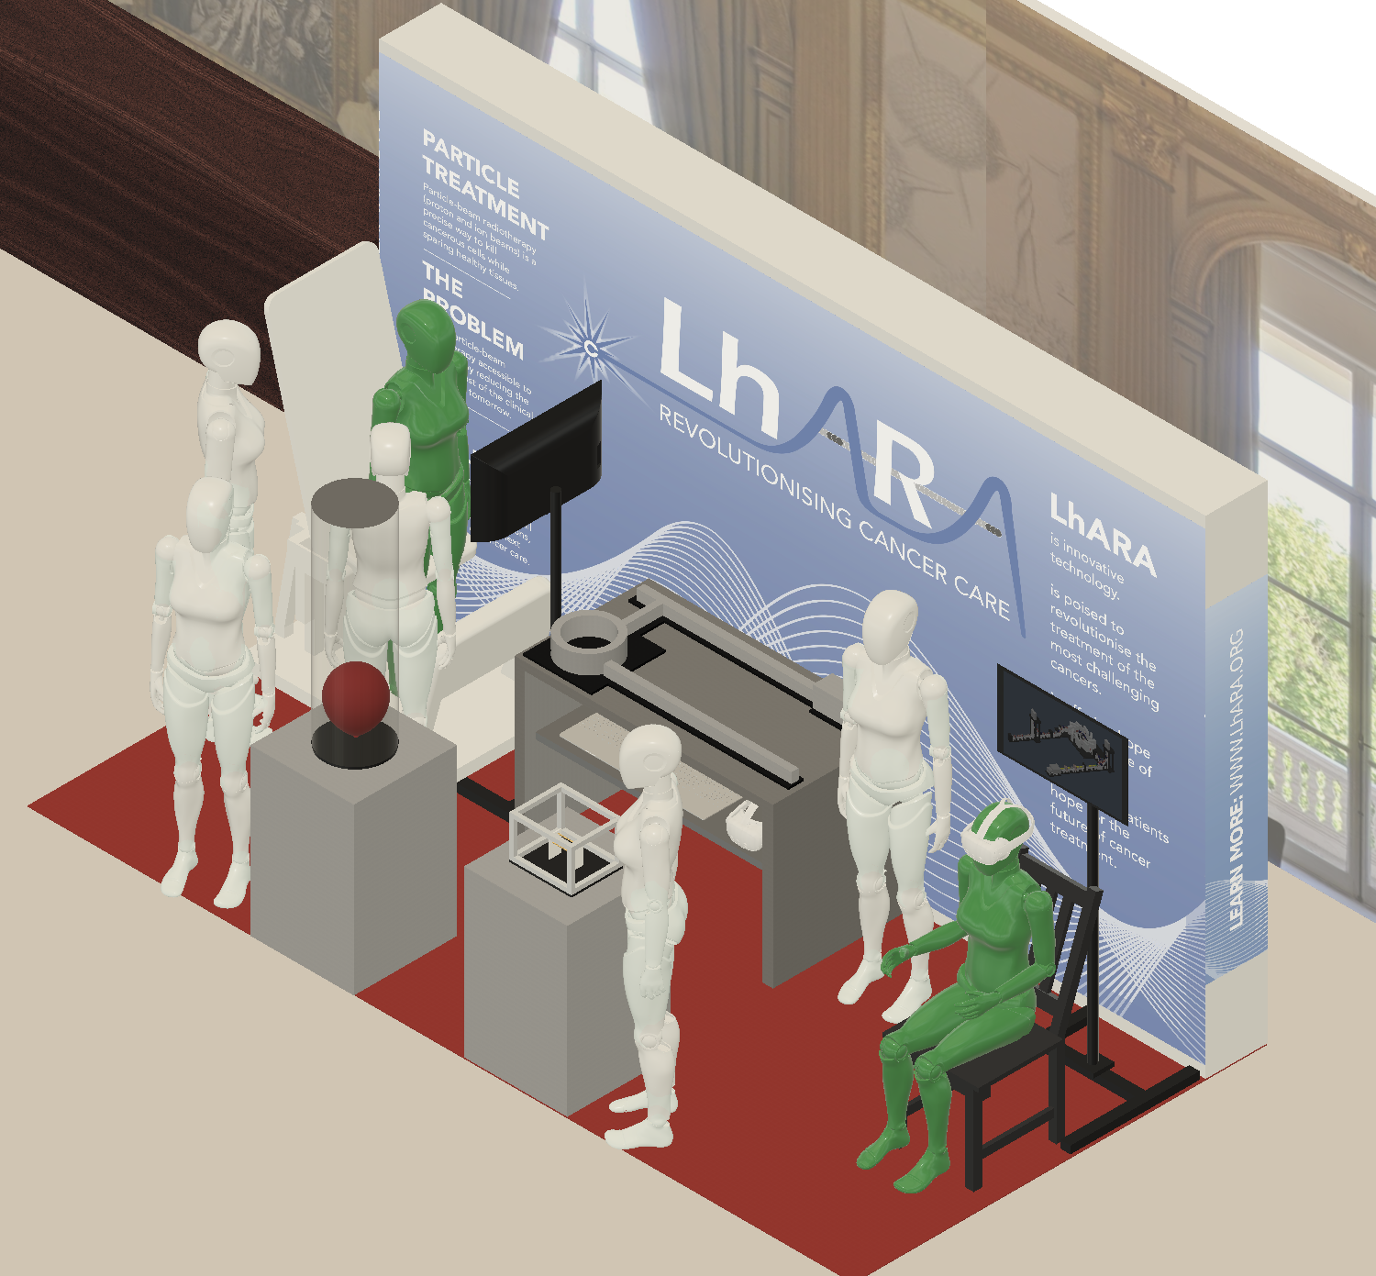
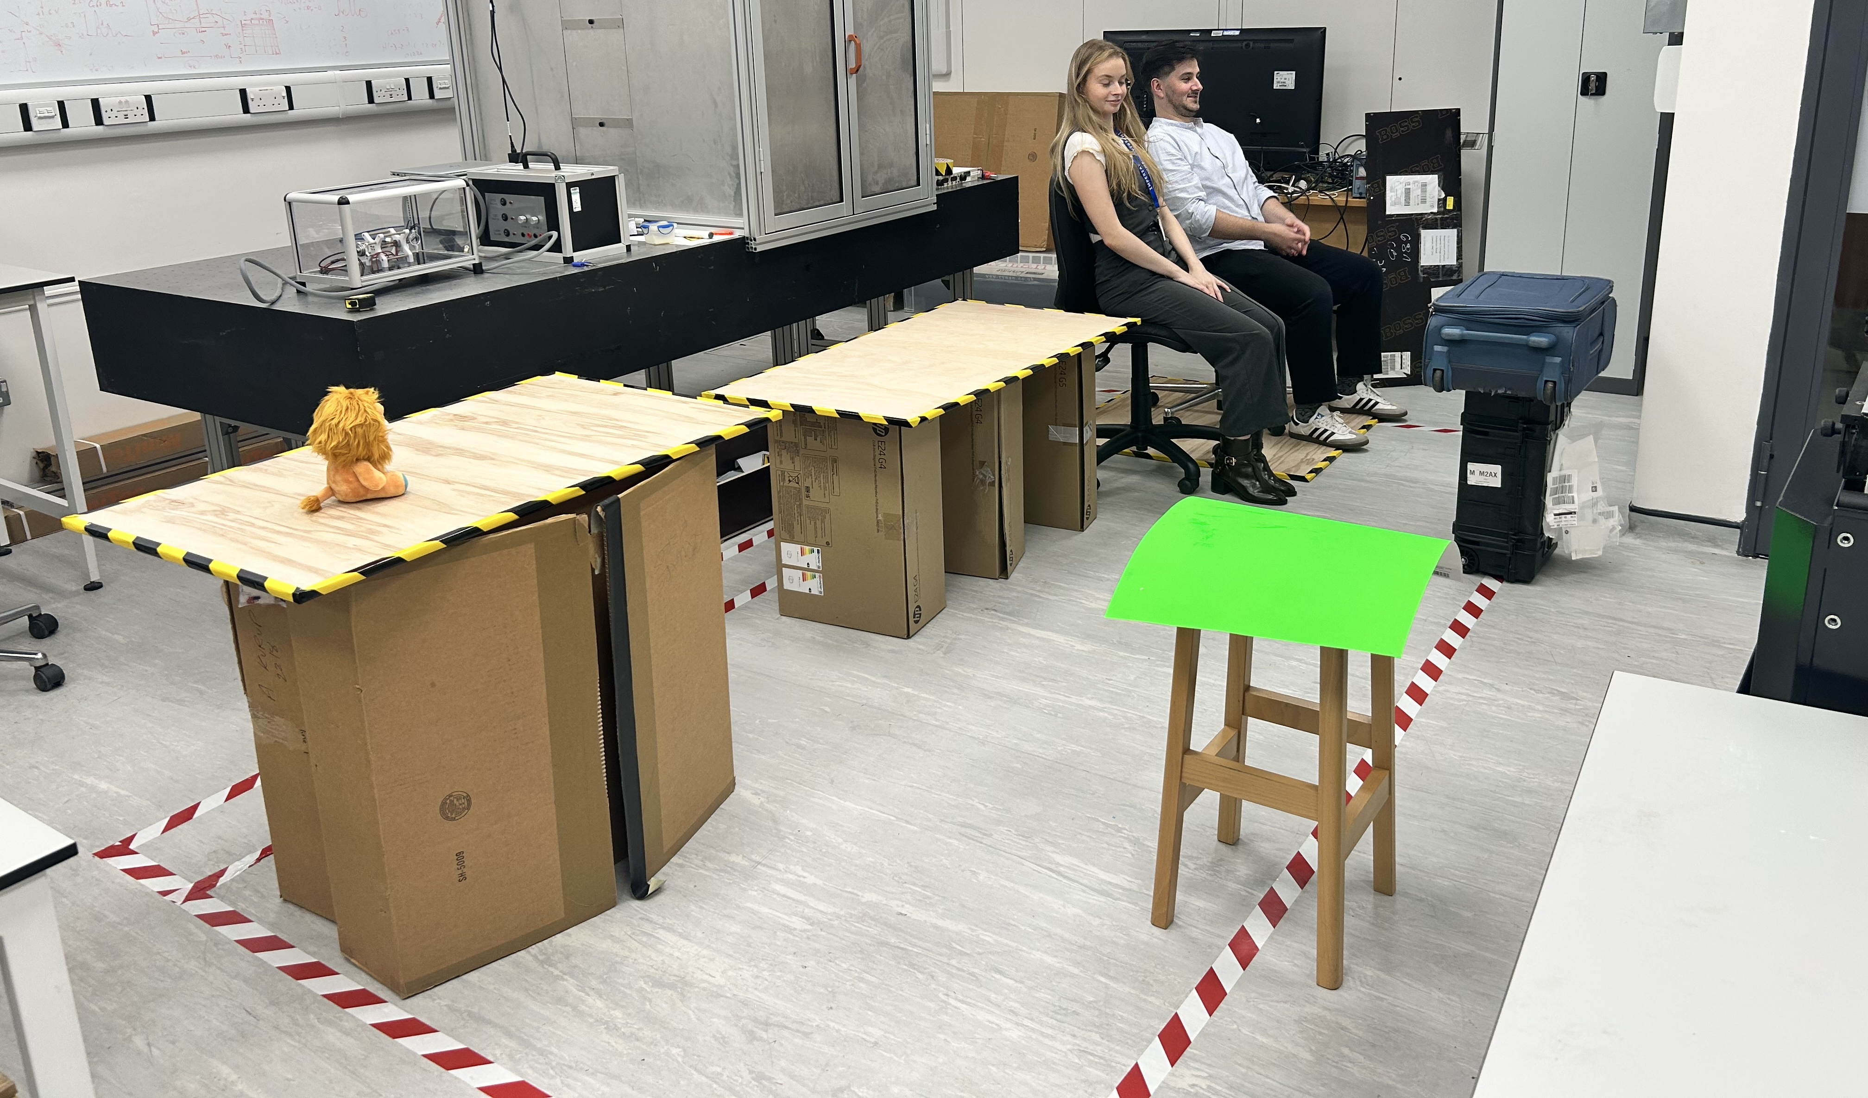

Slide 9
Discussion …
Comprehensive introduction to the initiative:
https://indico.stfc.ac.uk/event/1927/
Last comment from me before discussion:
  Radiotherapy today is:
    Advanced, effective, curative, …
  LhARA initiative seeks to:
    Improve accuracy, specificity, accessibility, throughput…
    Reduce investment cost and cost per treatment, side-effects/toxicity, time on couch …

