Slide 1
News and update
K. Long
July 28, 2026

Slide 2
Continuing refresh
Urgent:
  Matt Periera
    Logo slide! – ready!
      Used on 21May26 and now for RS Summer Science Exhibition
      And on lhara.org
Not so urgent:
  Ongoing (also Matt):
    IB list update, not so urgent, but underway
      Stalled, need to restart
No progress!
Seek to pick up now that RS SSE is passed

Slide 3
Updates:
Engagement with O. Glover, MP for Didcot and Wantage:
  Harwell Science and Innovation Campus in his constituency
    KL/PP met with OG on Harwell Campus on 21Jul26
      Very positive discussion; focused on opportunity for the future
      Taking engagement forward …

Slide 4
EB report
https://ccap.hep.ph.ic.ac.uk/trac/wiki/Research/LhARA/Governance/ExecutiveBoard

Slide 5

Building on the RS SSE; a two-year plan …
Now:
  Have strong endorsement/engagement based on RS SSE
  Recognised in “our institutions” and, to some extent, in community
  Beginning on political engagement (O.Glover, etc.)
Responsive mode resources:
  Next slide, but need to secure resources for near-term programme
Two-year plan:
  Goal:
    Autumn 2028: meeting @ Royal Society to launch LhARA initiative
      I.e. start of sustainable development of the initiative
  Programme for the two years:
    4-nation approach to development of scientific, impact & benefit case
    Year 1:
      Through learned societies, engage with communities in each of the 4 nations to:
        Review science and innovation case
        Identify drivers for generation of impact and benefit
      Develop funding model and secure initial resources
    Year 2:
      Bring discussions together into 4-nation plan for international collaboration
      Refine funding model and engage with funders and stakeholders
      Culmination: meeting at the Royal Society to launch the well-found initiative

Slide 6
Raising resource
IAA:
  Impact analysis, benefits map as input to business case (? via UKRI IAA at Imperial)
  Bio-programme development
  Need to consider support for D.Laird comms.
STFC SPARK (25Aug26):
  RS SSE on tour, our regional outreach, D.Laird comms, schools outreach
STFC PPRP (27Aug26):
  "Talk to programme manager before submitting", conversation worthwhile, long shot?
STFC/EPSRC KTP (no closing date):
  Worth discussing?
EPSRC Collaborate with researchers in Norway (no closing date):
  Plasma lens; discuss after 11Sep26 meeting?
EPSRC Programme grant; also outline stage proposal (no deadline):
  Next "gathering" date 01Dec26.
  Worth doing to bring together our programme.
  Focus on development of bio and med-tech aspects?
  Potential also to bring forward a proposal on plasma lens post 11Sep26 meeting.
EU MCSA:
  Restarted!
Discussed in EB
Propose a coordinated
approach!

Slide 7
Peer-group meeting series
Past:
  CP4CT w/s: International strategic workshop; what will be the unique advantages of laser driven charged particles
    https://indico.stfc.ac.uk/event/1703/
Coming up:
  Cylindrically-symmetric strong focusing of ion beams;
    11Sep26; IoP HQ in London
  Novel time-resolved, high-resolution imaging;
  Biology, measurement, simulation and interpretation of ion beams

Slide 8

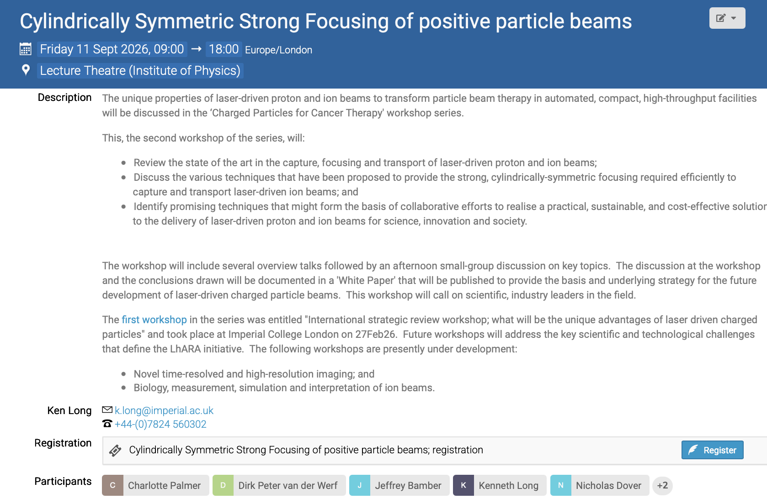
Please:
Register
Circulate
Now taking initial steps in organisation of third in series:
Novel time-resolved and high-resolution imaging

Slide 9
Going forward
Next fortnightly:
  28Aug26
Next collaboration meeting:
  Week of 14Dec26; Imperial – SK or White City

