Slide 1
News and update
K. Long
March 24, 2026

Slide 2
Continuing refresh
Urgent:
  Matt Periera
    Logo slide! – needed for RS Summer Science Exhibition “landing page”
Not so urgent:
  Ongoing (also Matt):
    IB list update, not so urgent, but underway

Slide 3
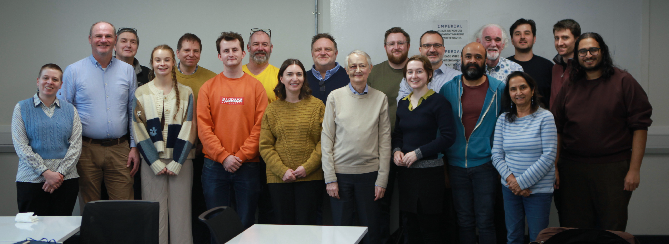
We are going to …
Communication training:
26Feb26; IC
Success!
Fund raising:
£7k of ~£24k raised from RS
Some contributions from Imperial; QMUL …
… begging bowl on the way!
Excellent day! It was fun; lots to think about …
Need ~10 more volunteers (well, 9, thanks Marie!)
Sign up here: https://forms.gle/YKs9isQ48Zxr1enZ9

Slide 4
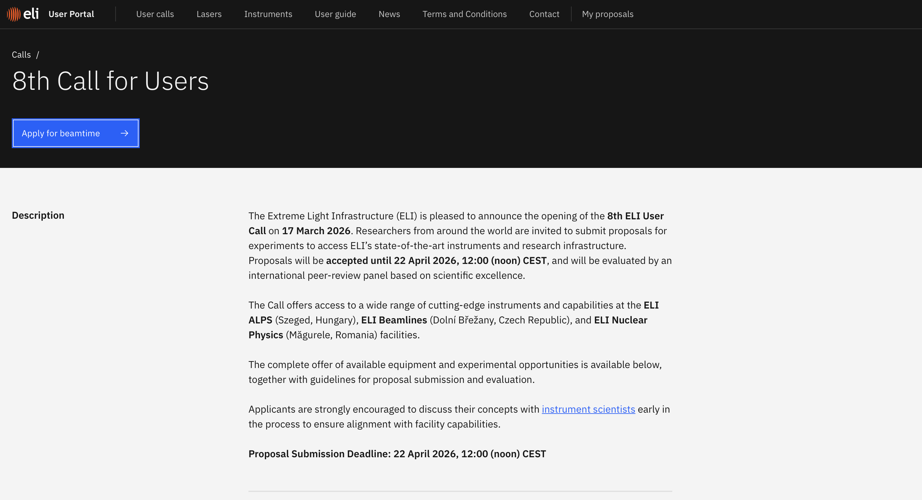
ELIMED part of this call;
Drafting committee:
Jason, Emma, me (from last time) + Josie
Marie Boyd (to be asked) … volunteers

Slide 5
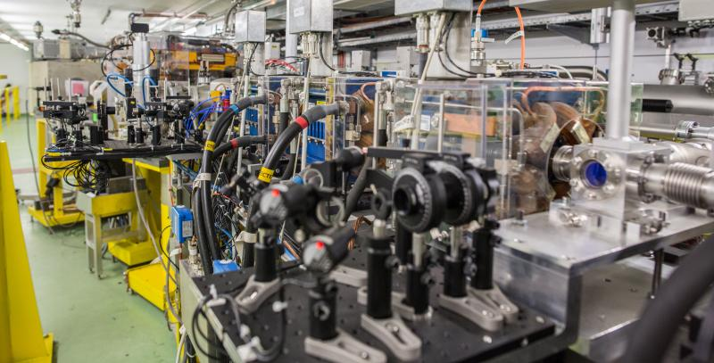
CLEAR at CERN
Electron beam:
VHEE, High charge, short pulse, FLASH capable
“Bragg peak”:
Focus expanded beam onto sample; gives pseudo Bragg peak

Slide 6

Programme, project and business plans
Agreed to develop business plans; now start “for real” …
Agreed with STFC/RAL/PPD that Christopher Townsley will be our consultant
Begin to prepare for CM#9

Slide 7
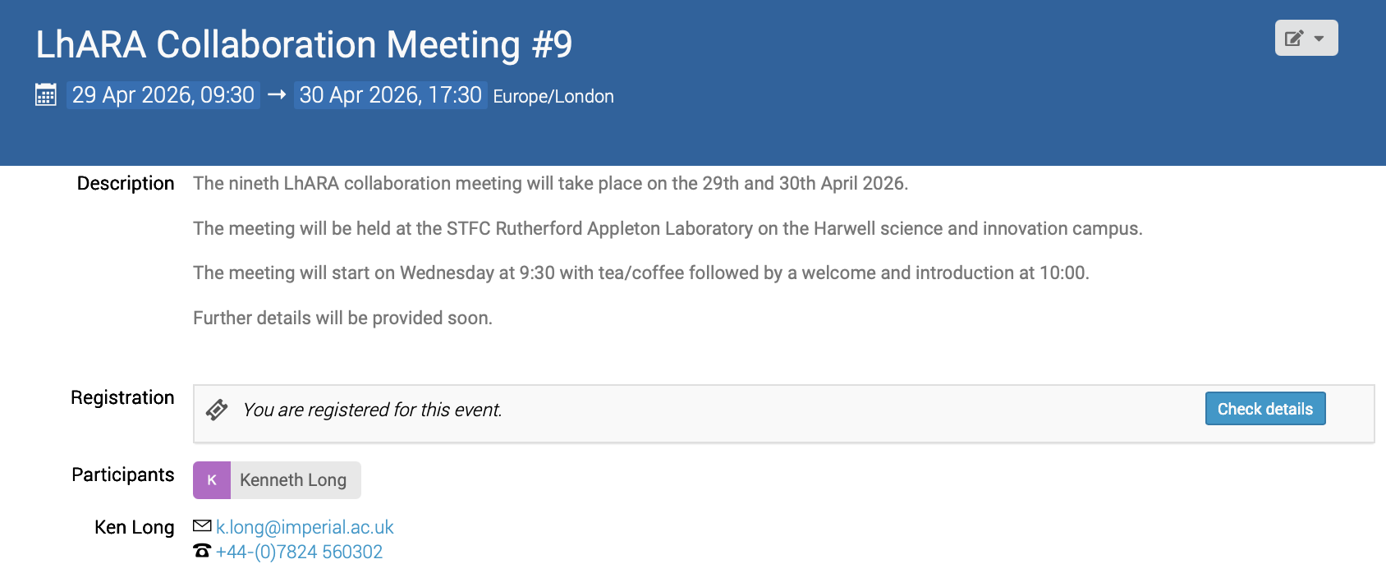
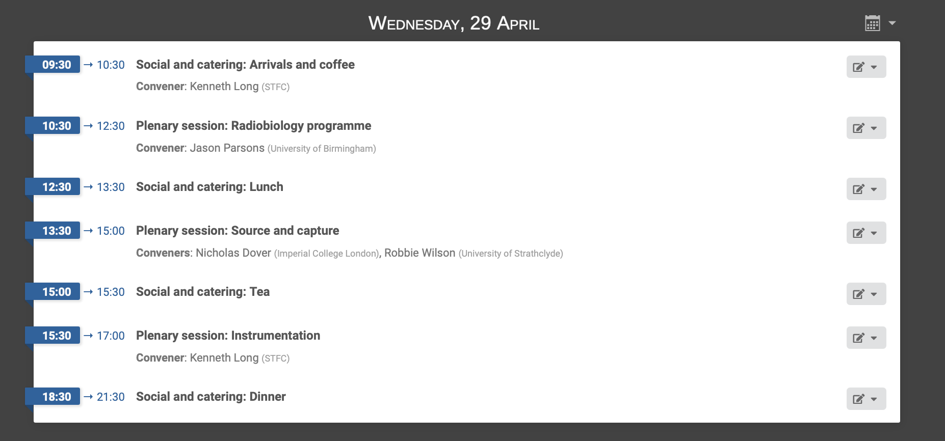
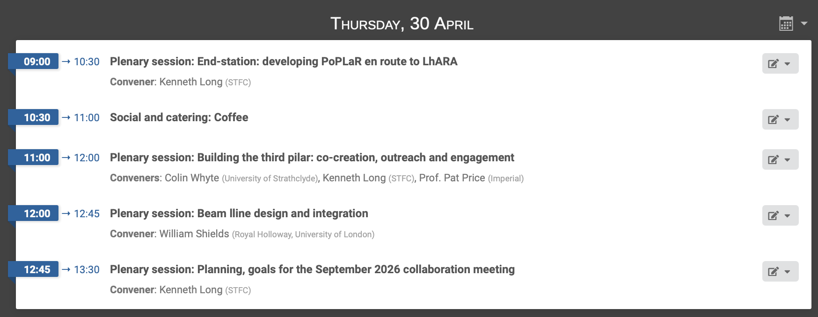
https://indico.stfc.ac.uk/event/1783/
Registration is live!
Please register, needed to get
on site if you don’t have a site
pass

Slide 8
Going forward
Fortnightly 05Apr26
Simulating the electron plasma and lens-programme update!
Discussion with Christie medical physics:
→ Jason Parsons agreed to coordinate
Next collaboration meeting:
  RAL; 29—30Apr26
RAL lecture and discussion of LhARA initiative:
  RAL; 21May26

