Slide 1
UKRI
Intro to discussion
K. Long
February 10, 2026

Slide 2
UKRI mission …
… to advance knowledge, improve lives and drive growth
Focusing ”… investment across three ‘buckets’: curiosity-driven research; strategic government and societal priorities; and supporting innovative companies to start and scale.”
  Outcomes-driven approach: “... includes more clearly aligning with national and societal priorities to ensure public money is invested to deliver outcomes for the nation and its people."

Slide 3
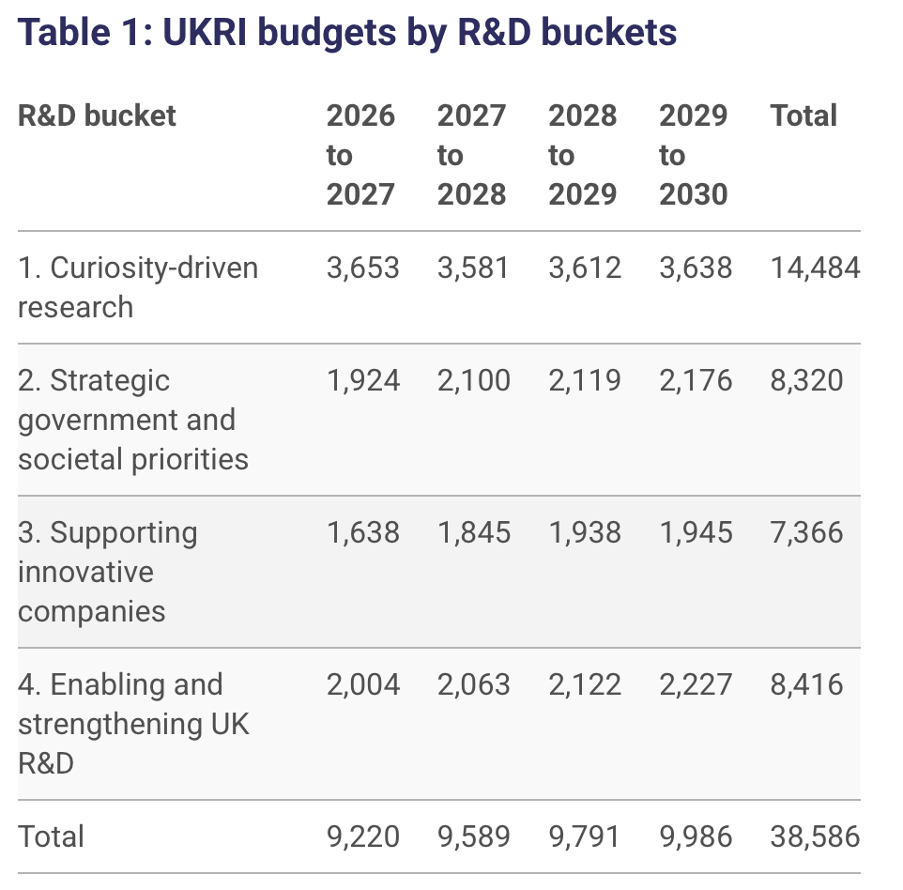
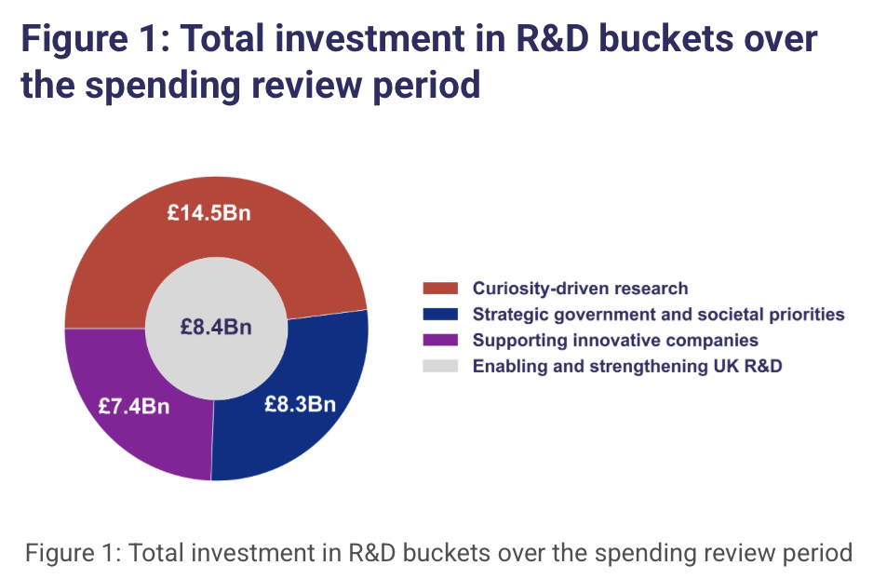
Budget allocations for UKRI
https://www.ukri.org/publications/explainer-ukri-budget-allocations/budget-allocations-for-uk-research-and-innovation/
*
*
*

Slide 4
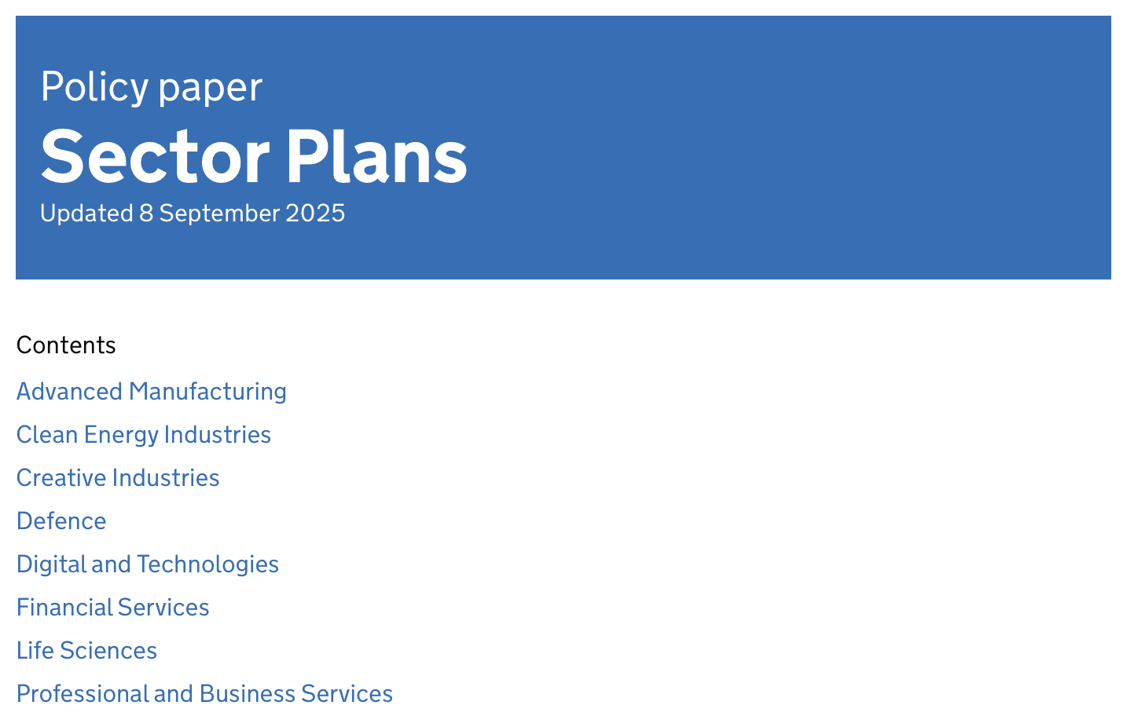


Bucket 2: strategic government and societal priorities
Investment aligned with eight Industrial Strategy Sector Plans

Slide 5
Timeline:
From my notes on Prof. Sir Ian Chapman’s evidence to HoC Sel. Comm. Sci. & Tech:
  Do fewer things better
  Transparency from investment to outcomes (outcomes driven approach)
Delivery plan: goal to finalise for June 2026

