Slide 1
News and update
K. Long
February 10, 2026

Slide 2
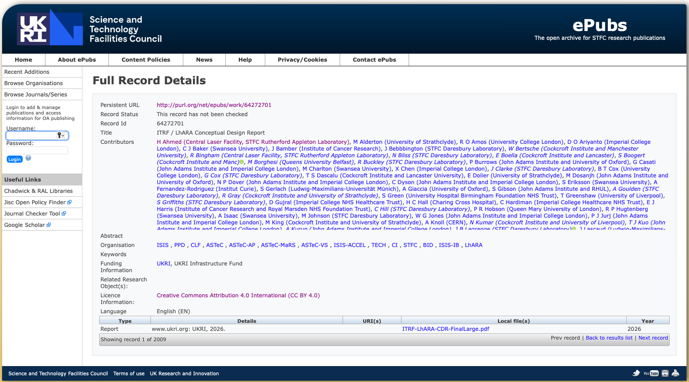

Slide 3
Continuing refresh
With CDR in hand:
  Refresh
    Logo slide and IB list
    Lists and graphical presence on lhara.org and wiki

Slide 4

Building on CDR
PoPLaR
as part of
systematic
programme
Science: radiobiology
Project: LhARA
Impact: co-creation

Slide 5
LhARA collaboration business plan
Vision that encompasses institutional business plans
LhARA
collaboation
Institutes
UKRI
EU/ERC
Industry
partners
Philanthropists
Foundations
…
First drafting discussion!
Long, Parsons, Whyte
Prepare draft ahead of next collaboration meeting

Slide 6
Looking forward
Fortnightlys to planning for the medium term …
  UKRI as part of portfolio approach
    This meeting: take stock of what we know of UKRI restructuring
    Going forward:
      Review-style approach to topic:
        Status and progress;
        Immediate next steps;
        Using CDR: review of programme required to deliver specification required for LhARA
    First example:
      Radiobiology programme: Jason et al; 24Feb26
        As part of PoPLaR in person meeting
    Subsequent programme to be defined

Slide 7
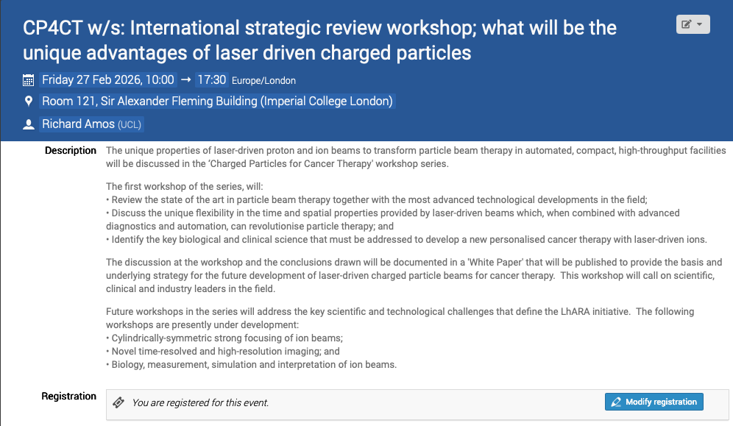
Peer-group meeting series
First of series: 27Feb26
  Plasma lens meeting planning restarted
https://indico.stfc.ac.uk/event/1703/

Slide 8

We are going to …
OUR
30th June to 6th July 2026
Communication training:
26Feb26; IC
Also deadline for decision on contents:
Trying to make budget soon to help with raising money!

Slide 9
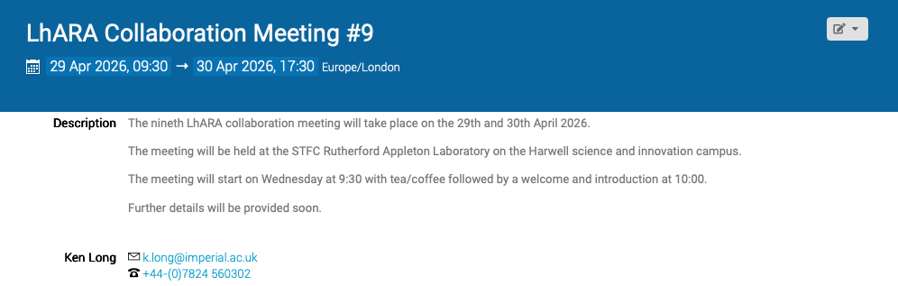
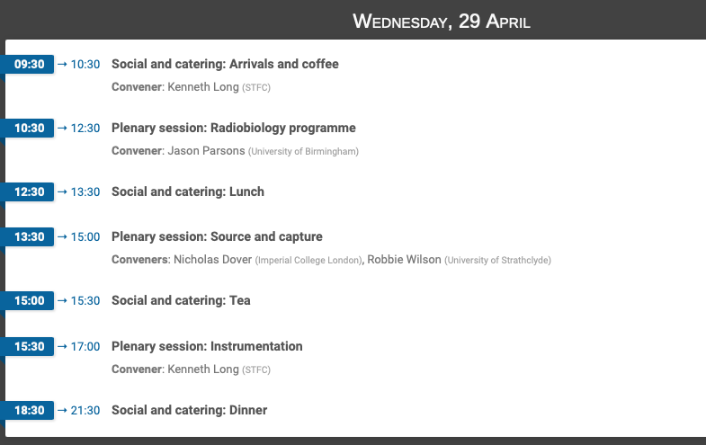
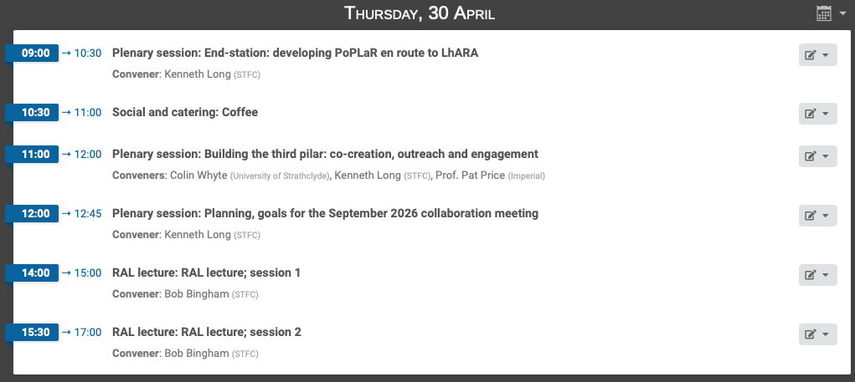
In reach and outreach event!

Slide 10
Going forward
Fortnightly 24Feb26
Radiobiology programme!
➔ then need to lay out the programme going forward…
Discussion with Christie medical physics (and CERN?)
Next collaboration meeting:
  RAL; 29—30Apr26

