Slide 1
News and update
K. Long
January 13, 2026

Slide 2
CDR
Almost final:
Final check on vacuum section: HO/JMcG
Author list:
LMU wish to sign!
  Working to get LMU authors
Acknowledgements!

Slide 3
Cover Draft H. Owen

Slide 4
Publication plan
Under development:
  Coordinated by Science Board chairs (Bob Bingham, Kevin Prise)
    Review articles
    Subject specific:
      E.g. LhARA accelerator, ion-acoustic PoP, ITRF synchrotron
Make the best of all the work we’ve done!

Slide 5
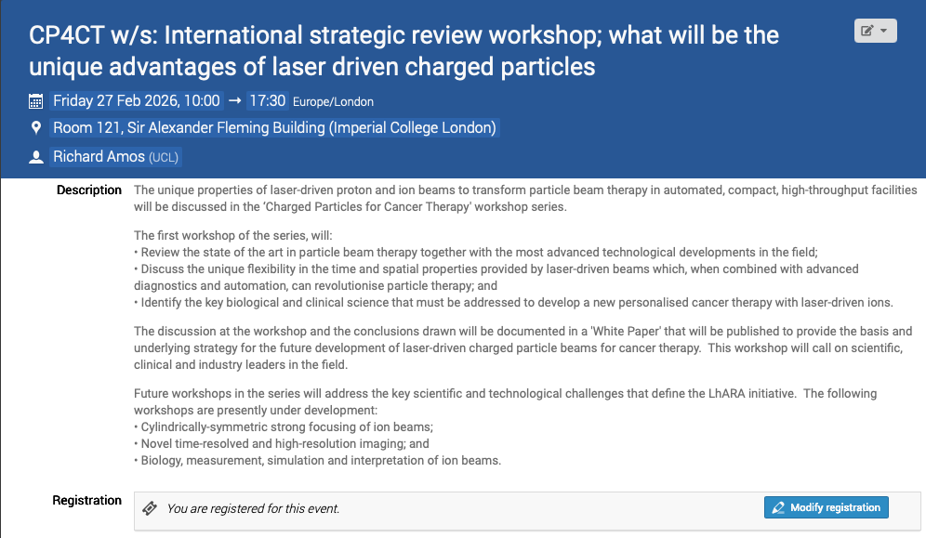
Peer-group meeting series
First of series: 27Feb27
  Start on plasma lens meeting soon
https://indico.stfc.ac.uk/event/1703/

Slide 6
Going forward:
Need to develop:
    Solutions for:
      Flexible beam delivery to end stations:
        FLASH, uniform/mini/micro beams, line focus, spot focus, spot/line scanning
      Ions other than proton:
        Need to consider source and beam delivery
    Development of radiation biology programme:
      PoPLaR programme development at SCAPA
        Seek to expand, e.g., at ELIMED
        Make comparison and reference measurements; MC40 Brm, Christie/UCLH, photon, electron
        Cell handling and diagnostics!!
    Med-tech engagement and co-creation:
      Perhaps the new strand for 2026
        Example; concrete collaborative developments with Leo Cancer Care

Slide 7

We are going to …
OUR
30th June to 6th July 2026

Slide 8
Going forward
Fortnightly 27Jan26
Capture?
Next collaboration meeting:
  RAL; 29—30Apr26

