Slide 1
Update and news

Slide 2
CDR

Slide 3
CDR; status:
https://ccap.hep.ph.ic.ac.uk/trac/raw-attachment/wiki/Research/LhARA/2025-09-23-CDRdraft.pdf
Almost there!
Comments~done
Collaboration/author list refresh underway
  Deadline for institute Pis 24Nov25
  Reminder to be sent to those that haven’t responded today/tomorrow
Will post final draft with final comment deadline when Josie ready!

Slide 4
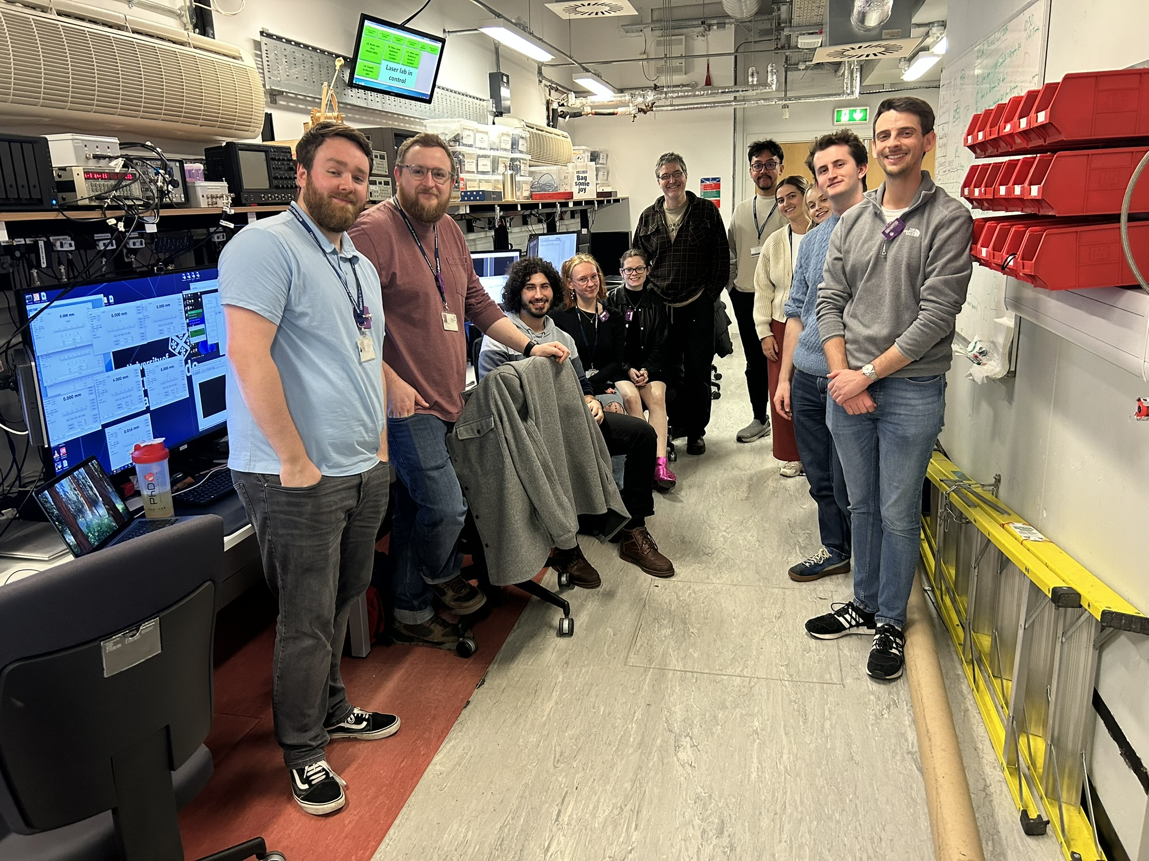
Building momentum

Slide 5
Going forward
Fortnightly 02Nov25
Rolling w/p reports:
  Design & integration
Next collaboration meeting:
  RAL; 29—30Apr26

