Slide 1
Update and news

Slide 2
CDR

Slide 3
CDR; status:
https://ccap.hep.ph.ic.ac.uk/trac/raw-attachment/wiki/Research/LhARA/2025-09-23-CDRdraft.pdf
Almost there!
Final comments being incorporated
Author list restart prepared (“database” and s/w)
  Emailing start this week

Slide 4

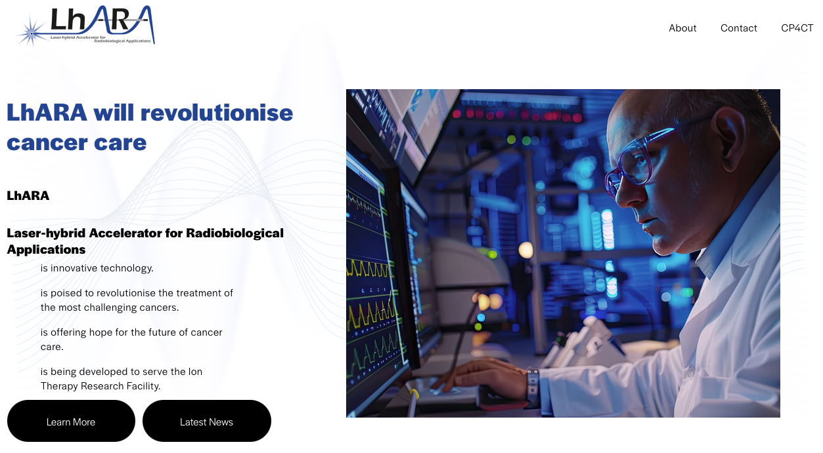
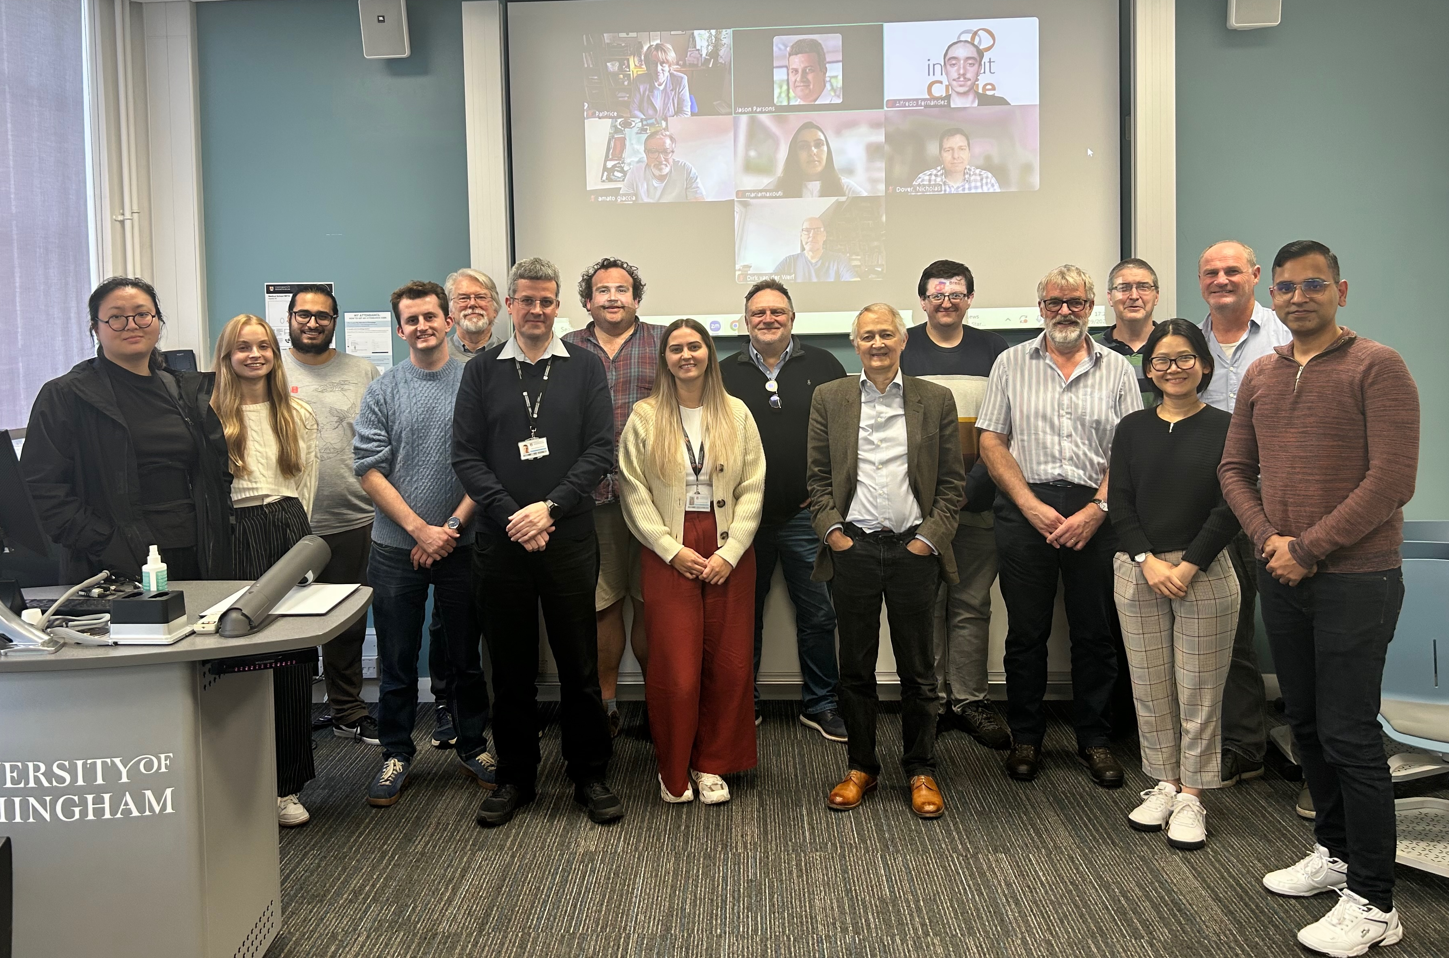
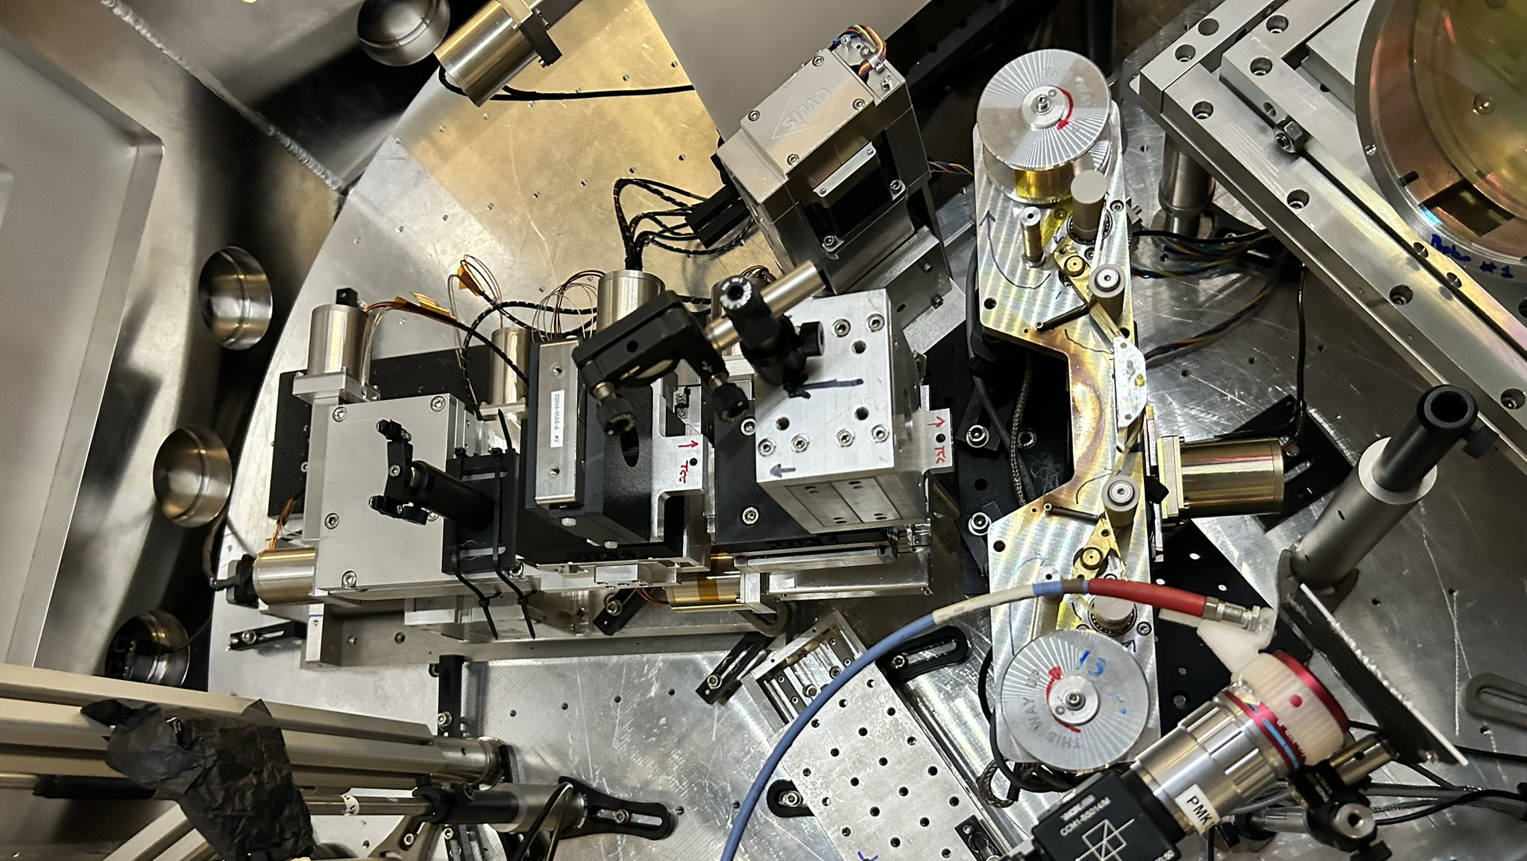
Building momentum

Slide 5
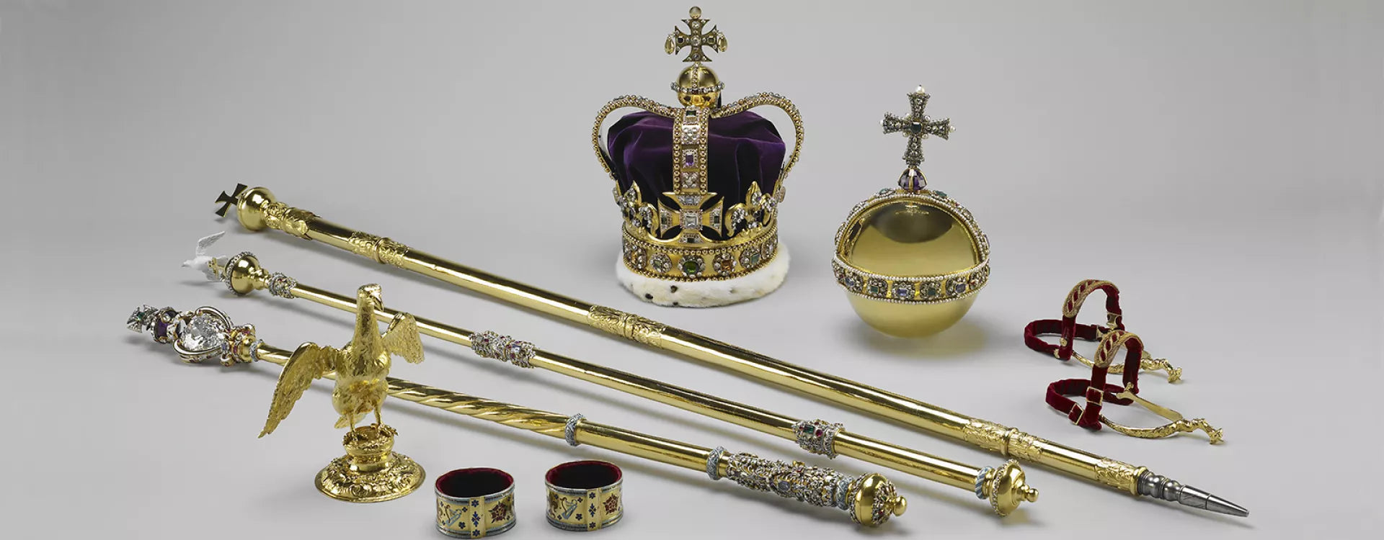
Collaboration property, growing
CDR:
  Collaboration document
  Intellectual property co-owned as in our collaboration agreement
PoPLaR & papers in preparation:
  Need to consider approach:
    Common goal ➔ LhARA provides context
    E.g. prototypes smaller author list (?) and clear acknowledgements
  And, from PoPLaR we hope for “firsts”:
    Technique (not quads, but other features)
    DATA, as initial step in systematic programme
Conference contributions (e.g. IPAC, deadline early Dec25):
  Need to consider approach

Slide 6
Going forward
Fortnightly 28Nov25
Rolling w/p reports:
  Ion-acoustic; goal paper before Christmas
Next collaboration meeting:
  RAL; 29—30Apr26

