Slide 1
Update and news

Slide 2
Peer group meetings
Encouragement to submit pitch for “series” @ IoP
Need to pick date for clinical/preclinical
  For last week of Feb26

Slide 3
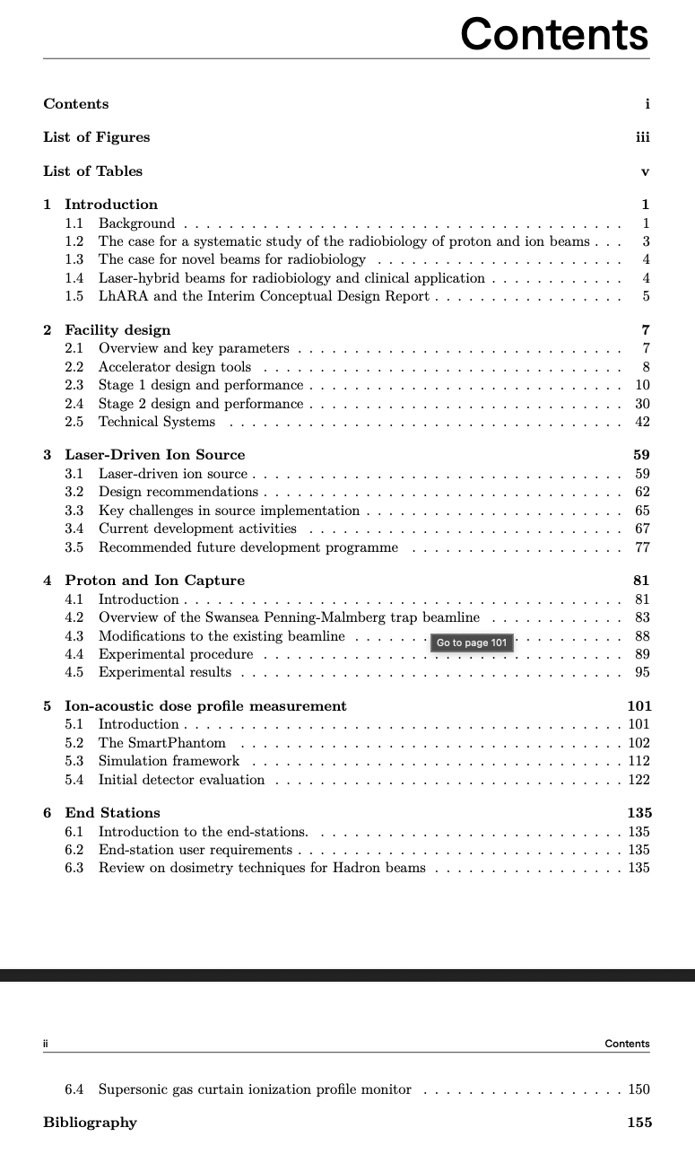
CDR update
Editing pass complete
Loop back started!

Slide 4
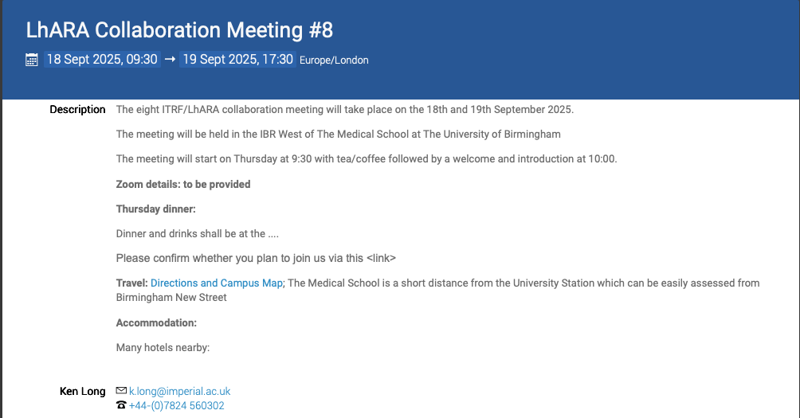
Agenda being created by WPM
https://indico.stfc.ac.uk/event/1627/

Slide 5
Going forward
Fortnightly 26Aug25
Rolling w/p reports:
  Reset!

