Slide 1
Update and news

Slide 2
Peer group meetings
Pre-clinical and clinical researchers:
  Now moved to Feruary 2026
Cylindrically symmetric strong focusing:
  Now getting more serious,
  Second organization meeting done

Slide 3
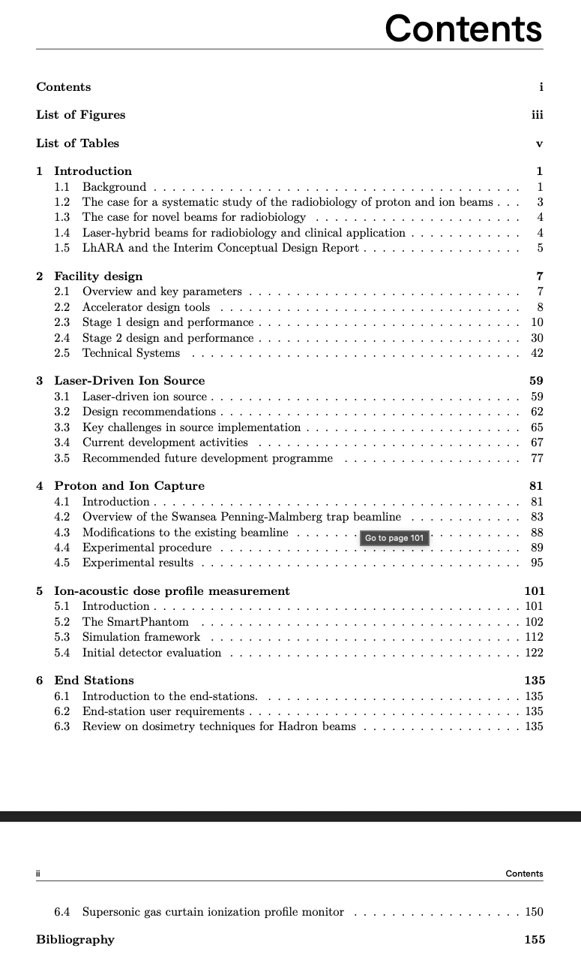
CDR update
Now editing End-station chapter
Then appendices:
  Costing
  Synchrotron alternative
And, of course, Executive Summary
On track to “sign off” at the Sep25 collaboration meeting

Slide 4
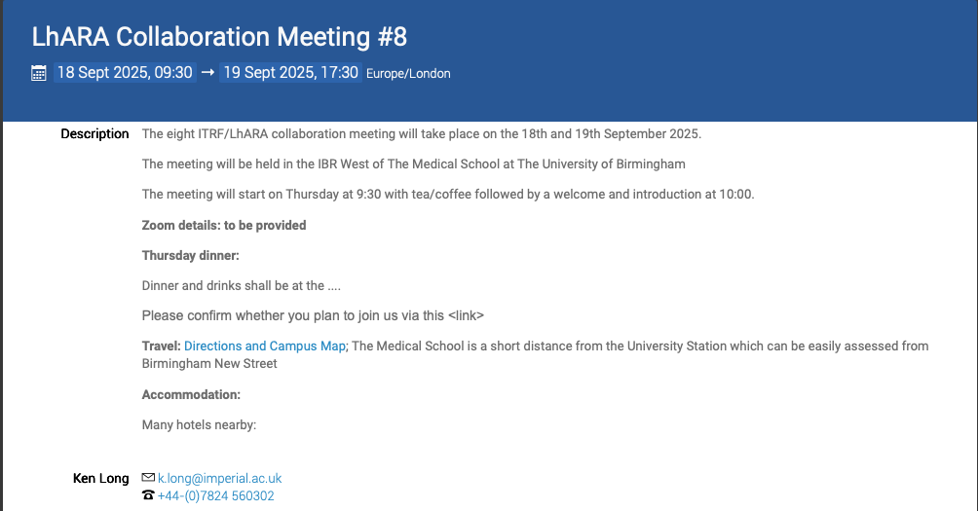
Some details to be updated, but
registration will open soon!
https://indico.stfc.ac.uk/event/1627/

Slide 5
Going forward
Fortnightly 12Aug25
Rolling w/p reports:
  Ion-acoustic

