Slide 1
Update and news

Slide 2
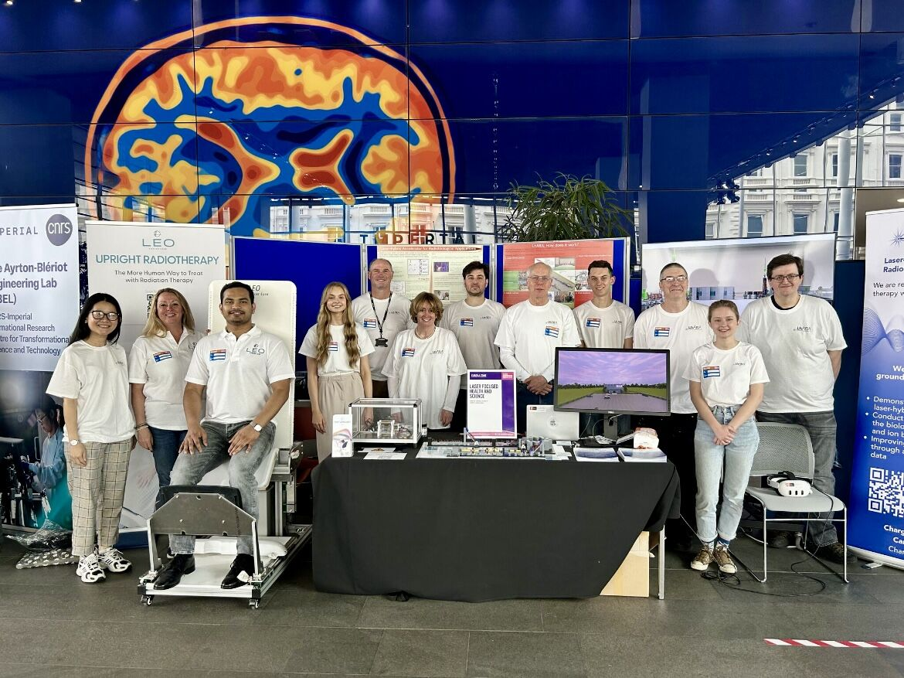
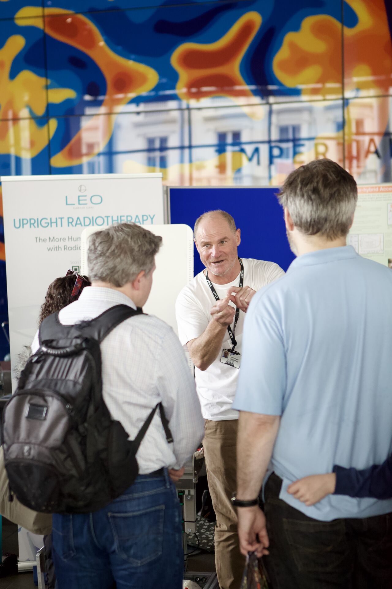
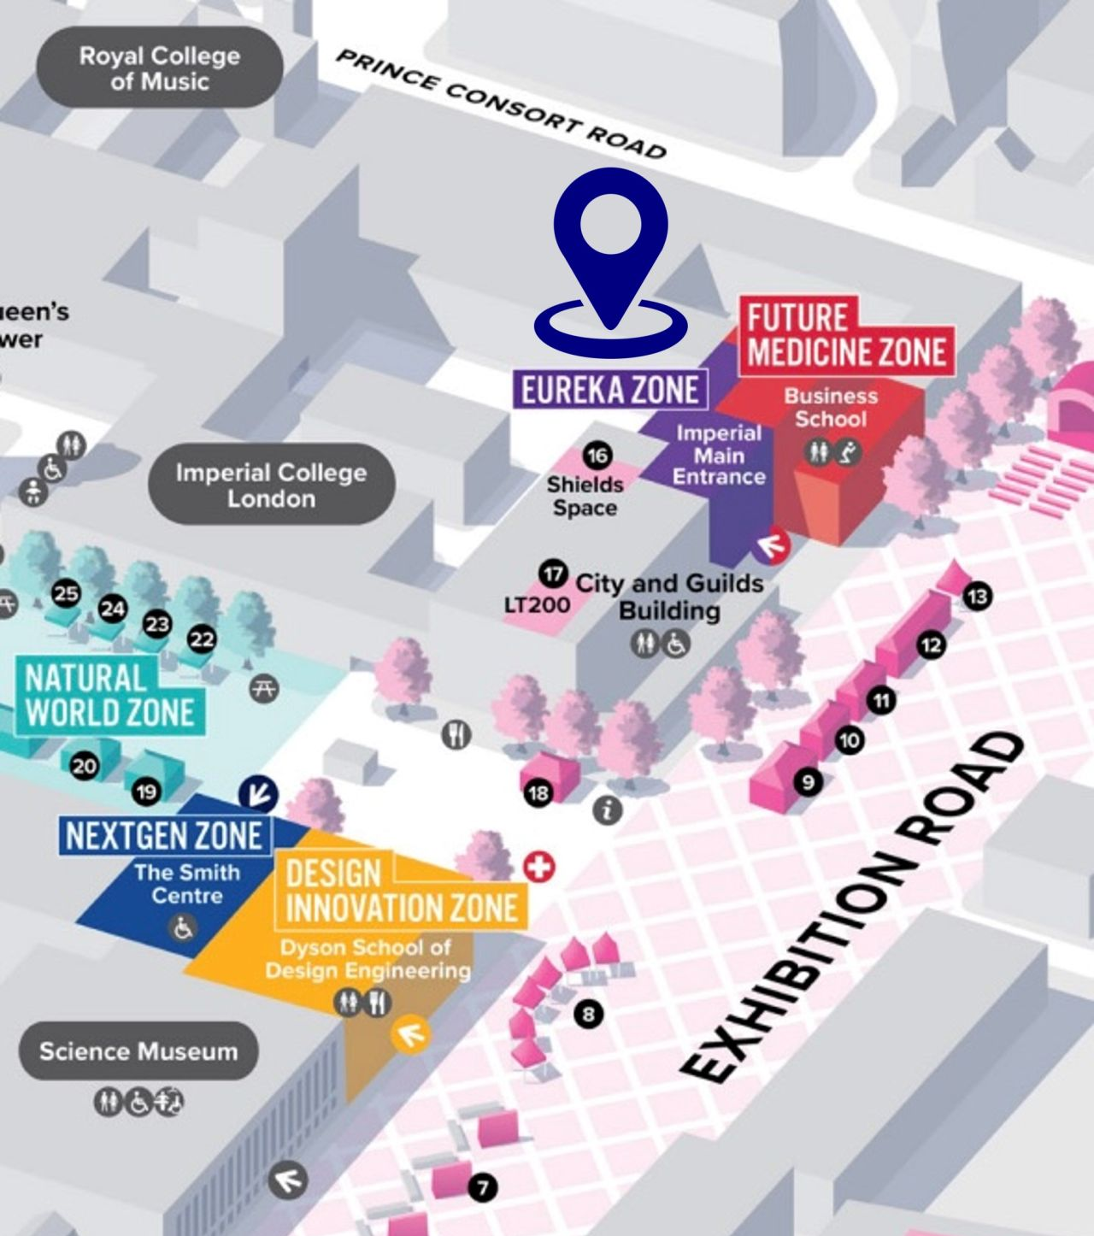
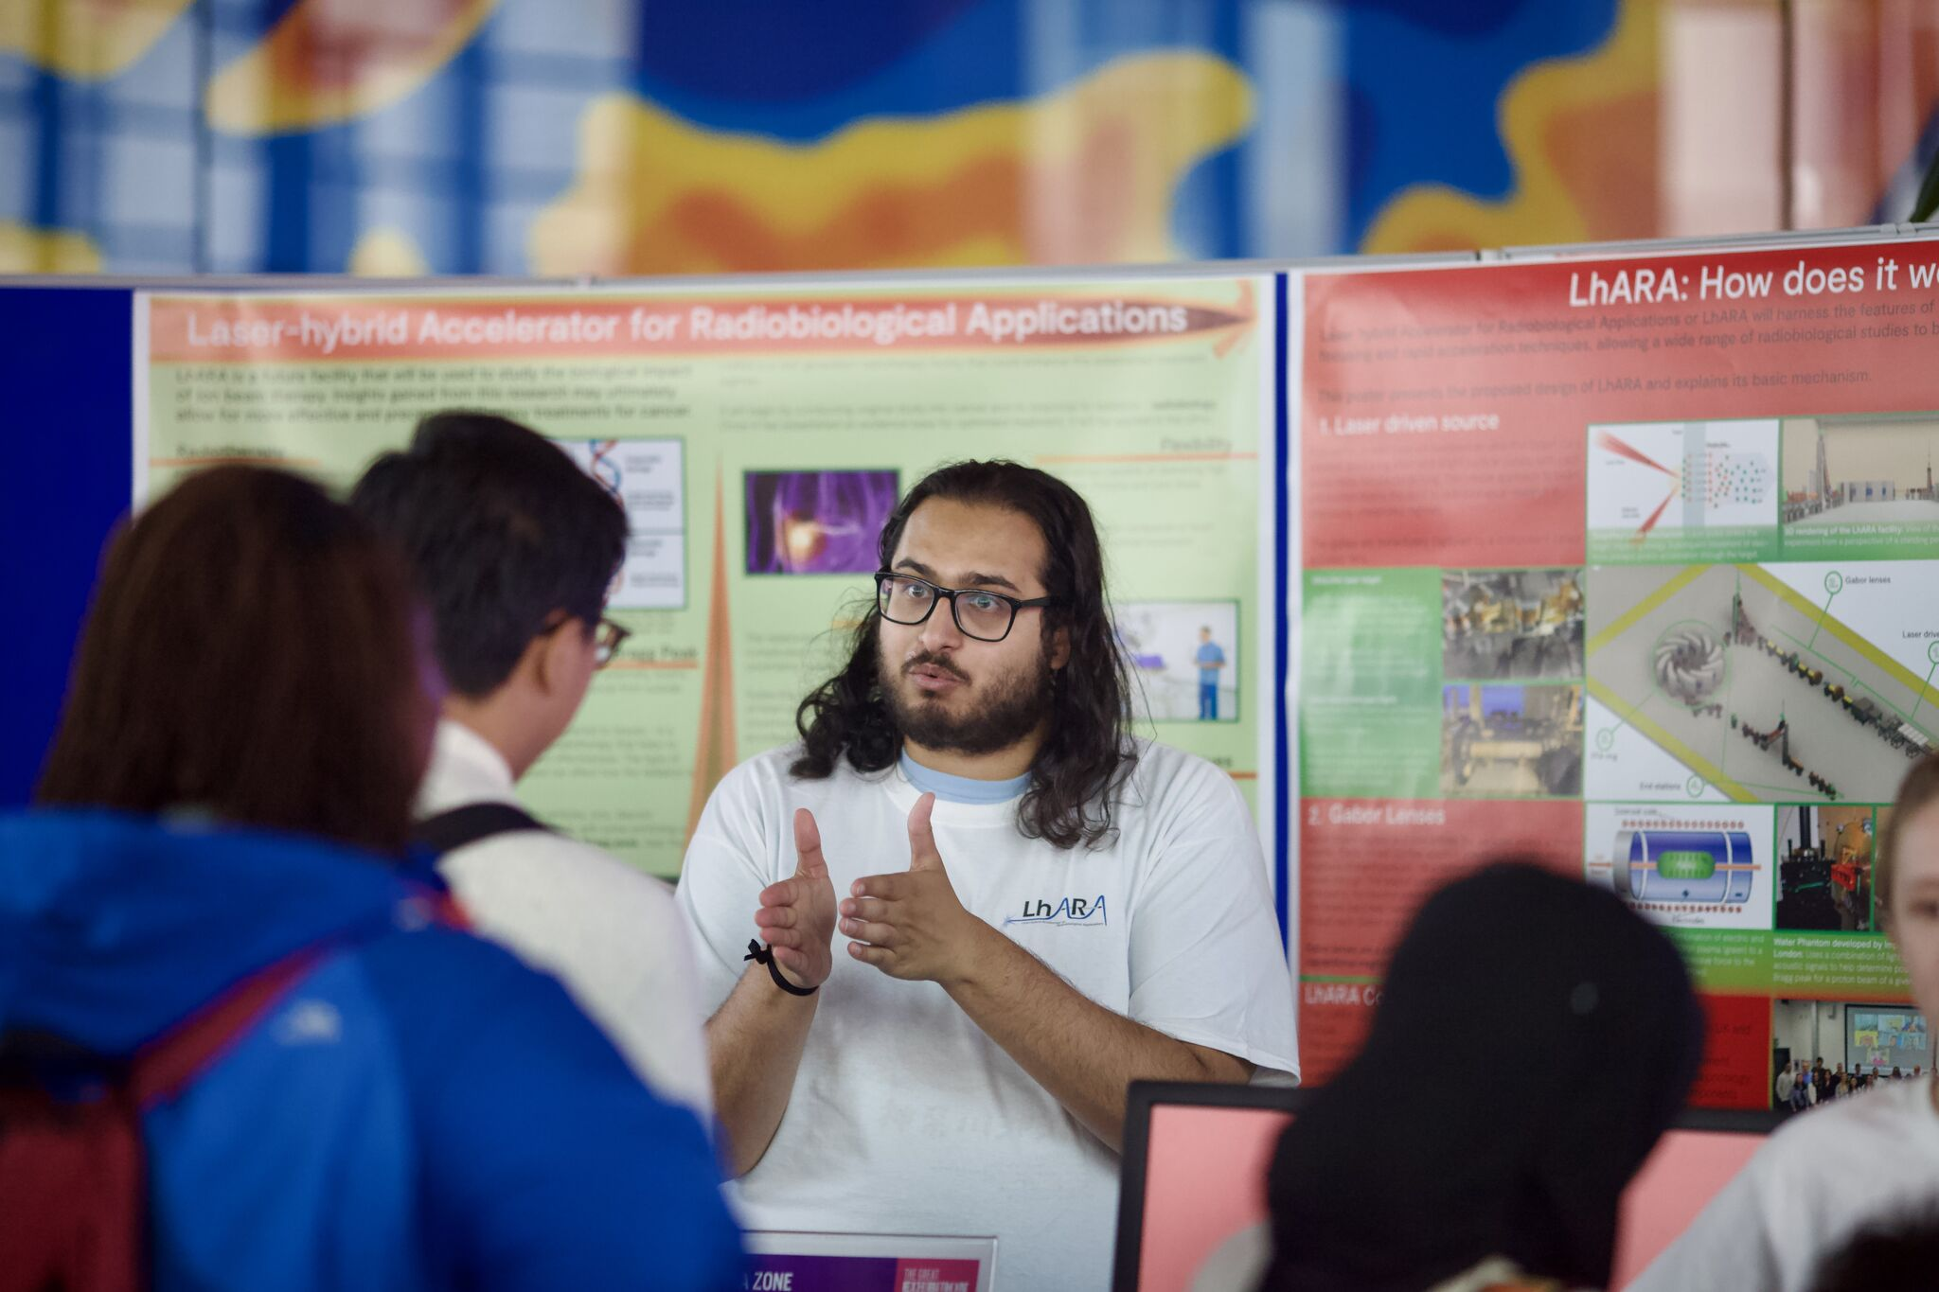
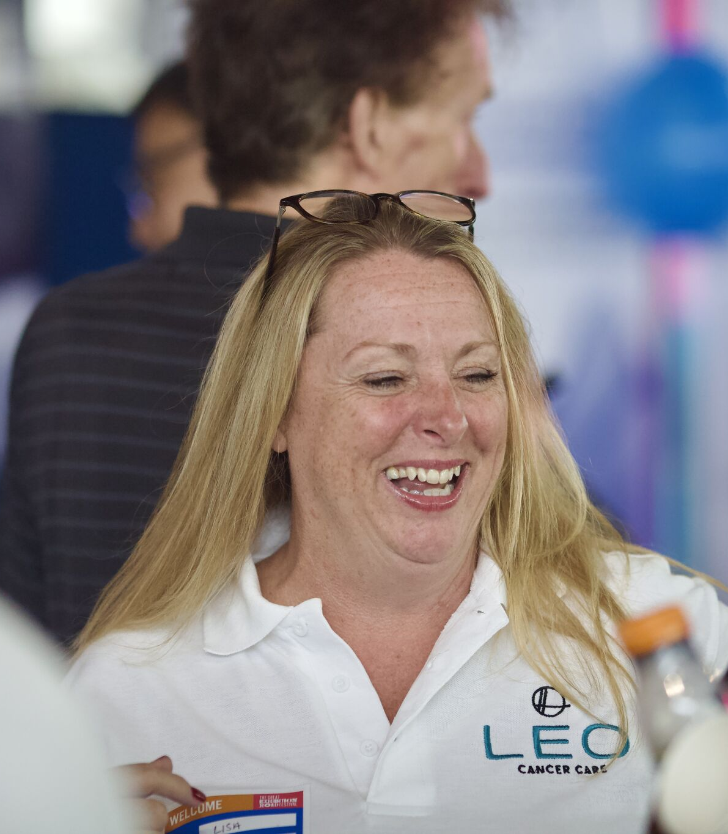
Because we did the Great Exhibition Road Festival

Slide 3
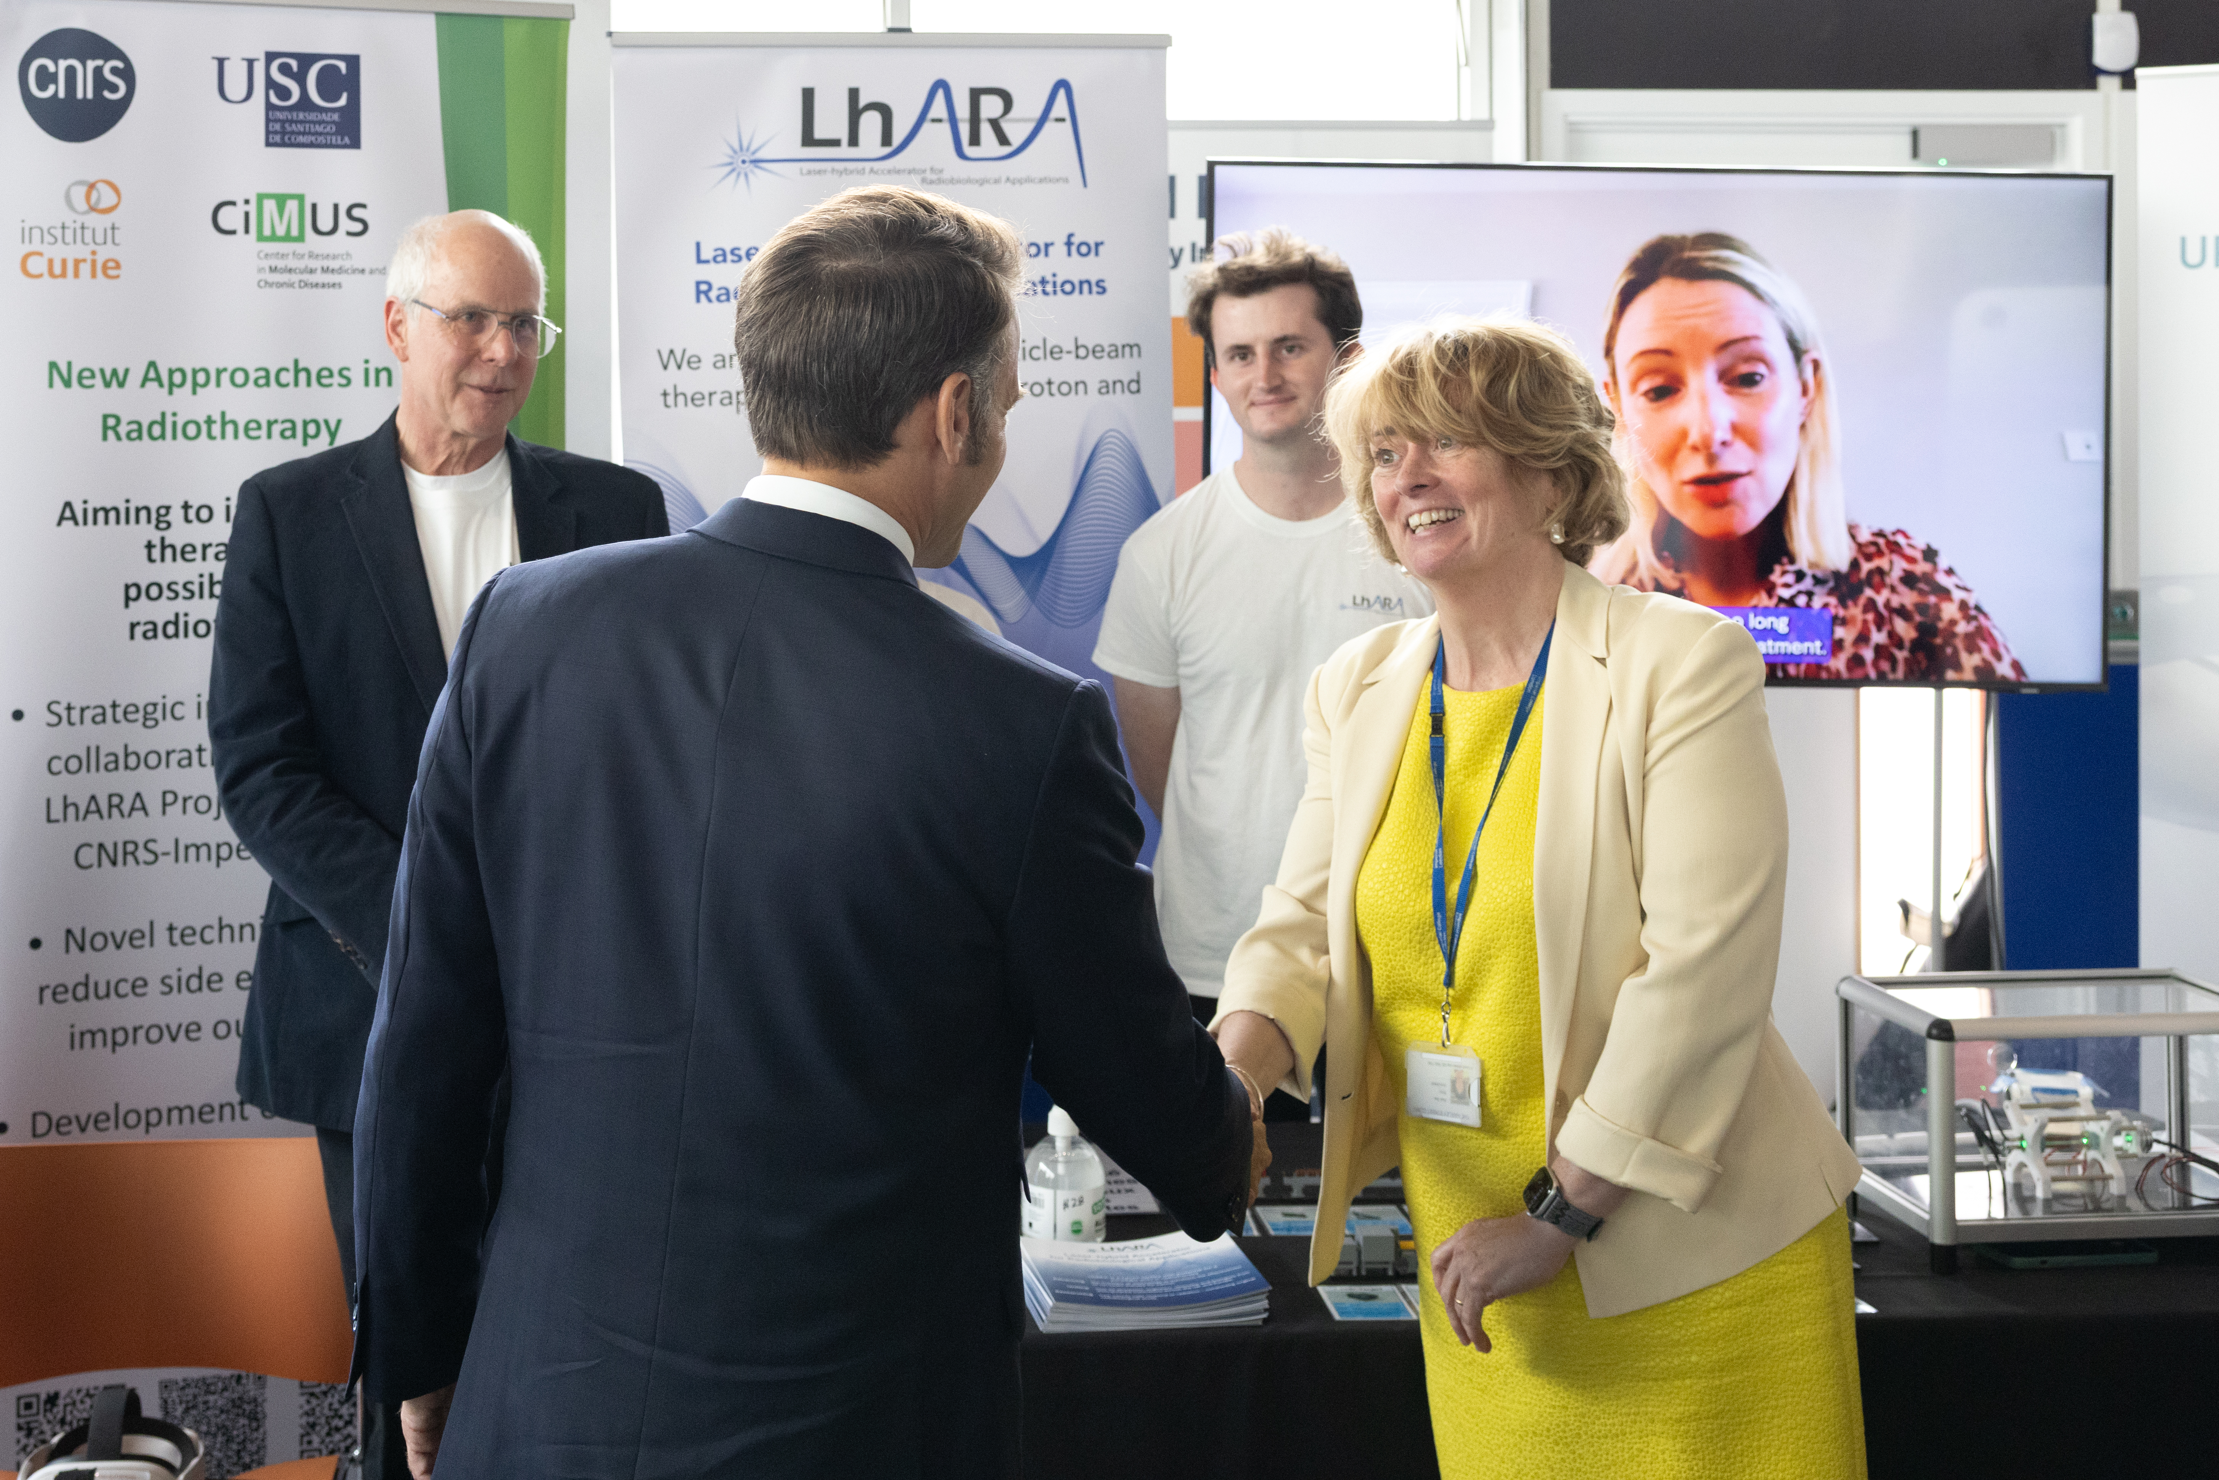
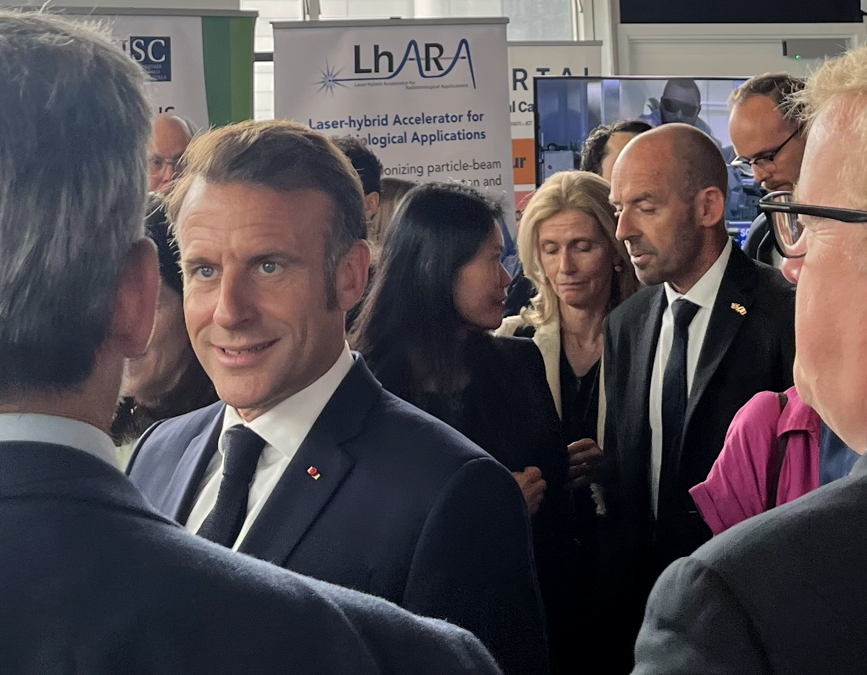
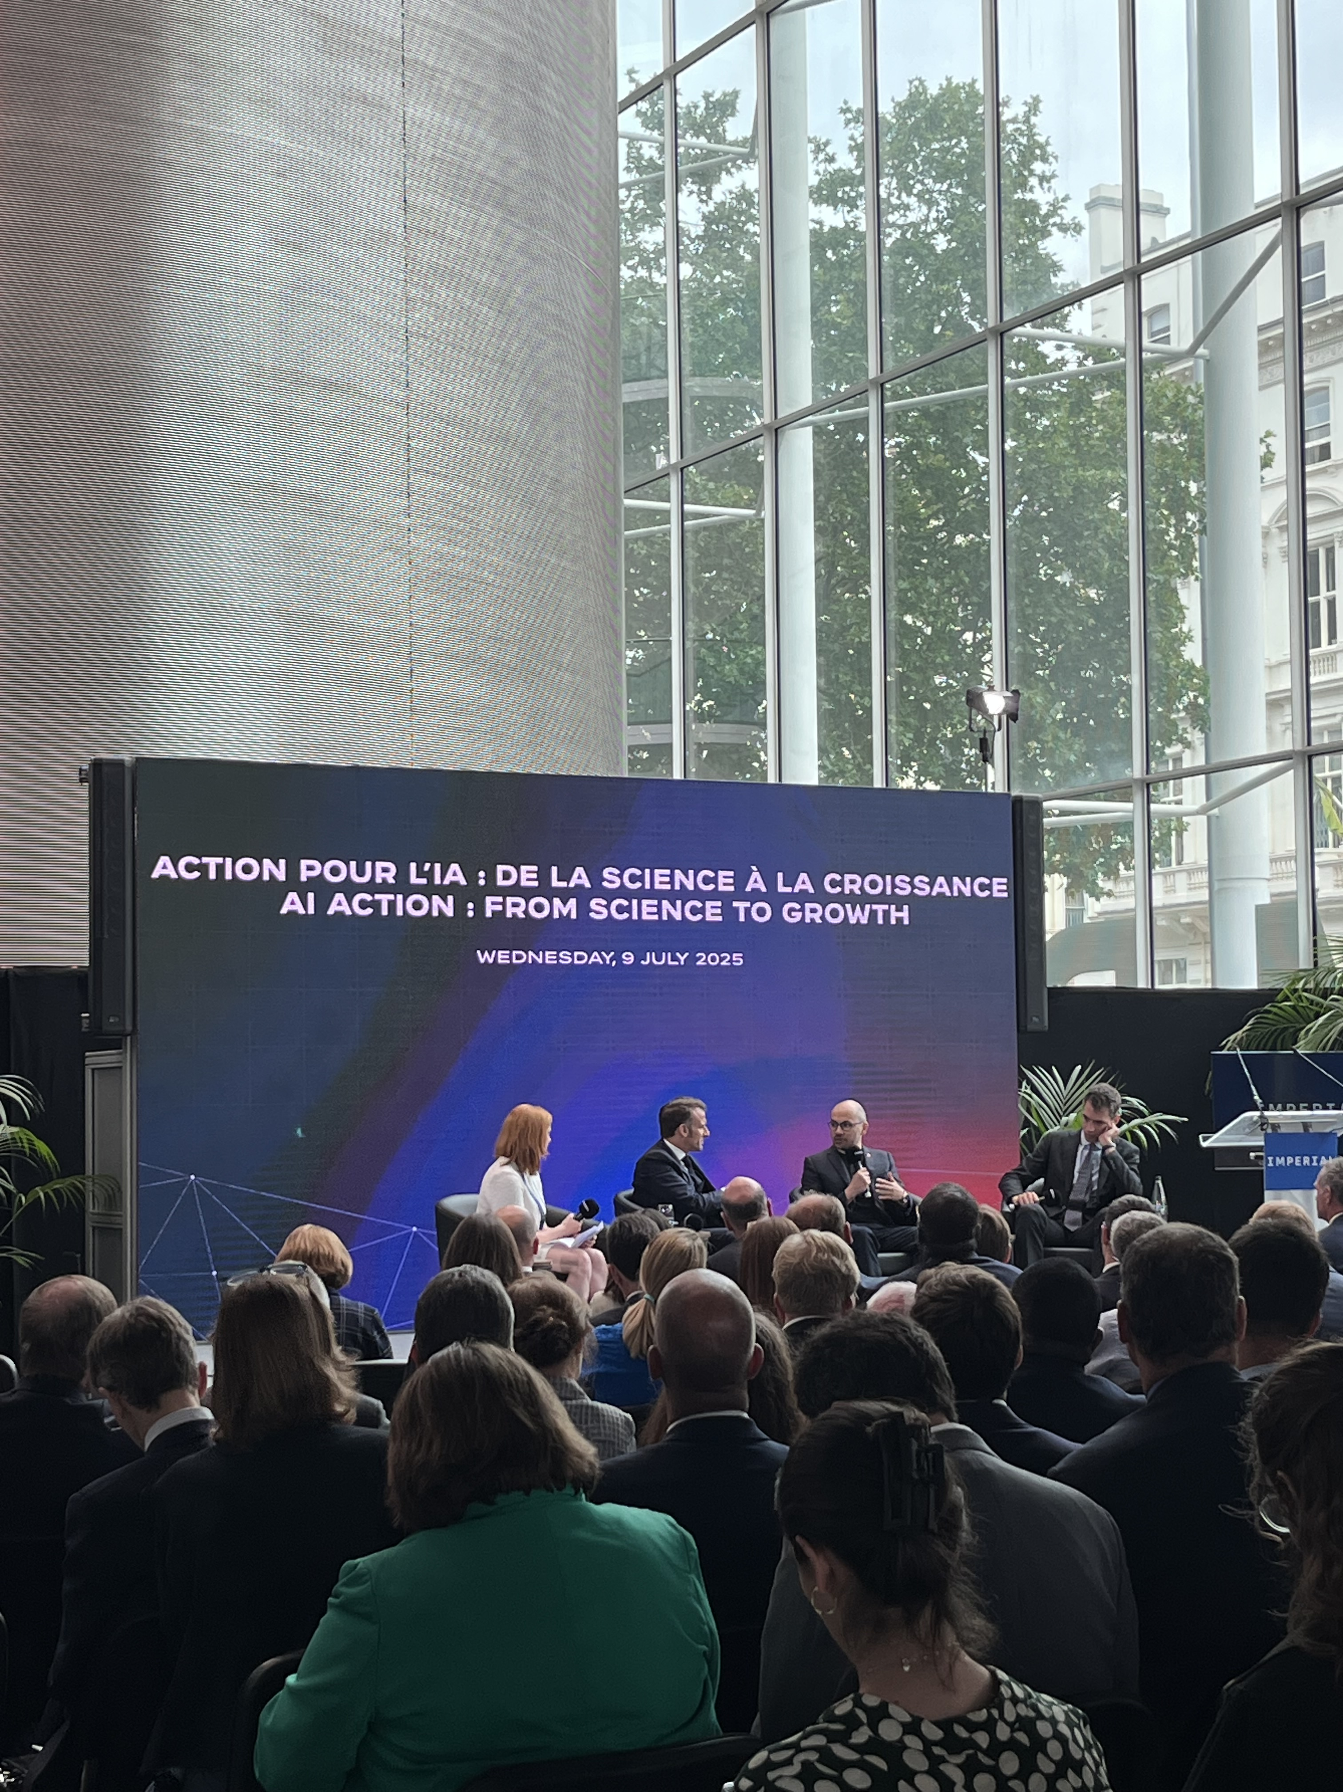
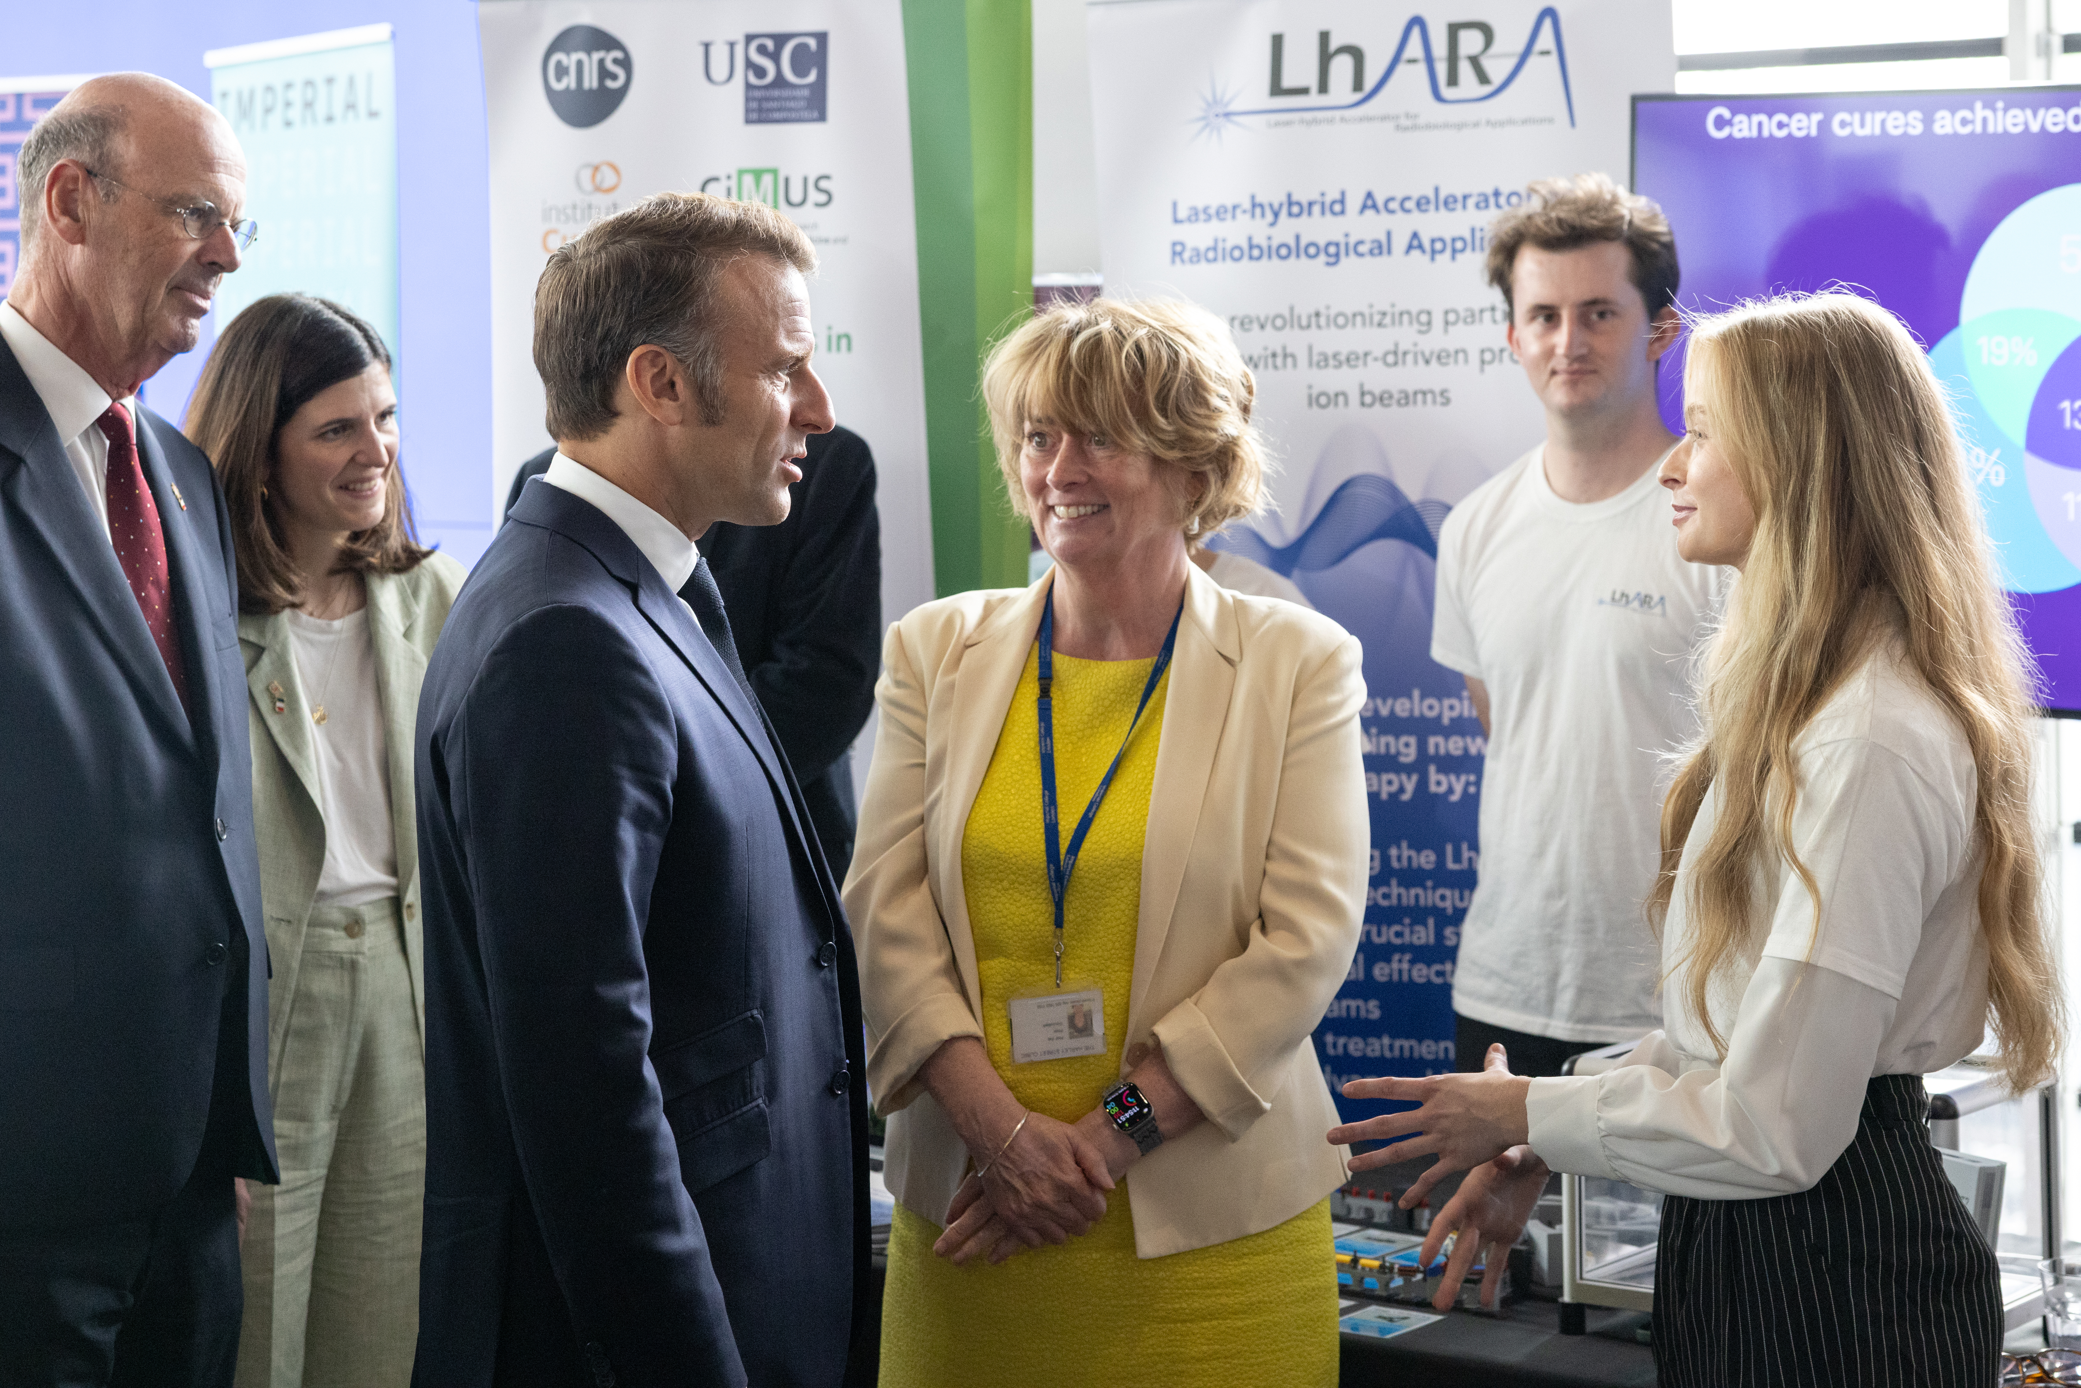

Slide 4
Key take-aways
Science for growth:
  UK government
Co-creation/co-investment, collaboration:
  New instruments and eco-systems to nicubate co-creation, co-investment and collaboration
… and … for our RS Summer Exhibition application …

Slide 5
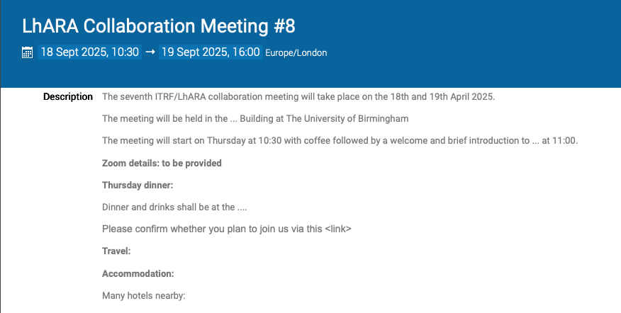
https://indico.stfc.ac.uk/event/1627/

Slide 6
Going forward
Fortnightly 21Jul25
Rolling w/p reports:
  Source/capture

