Slide 1
Update and news

Slide 2
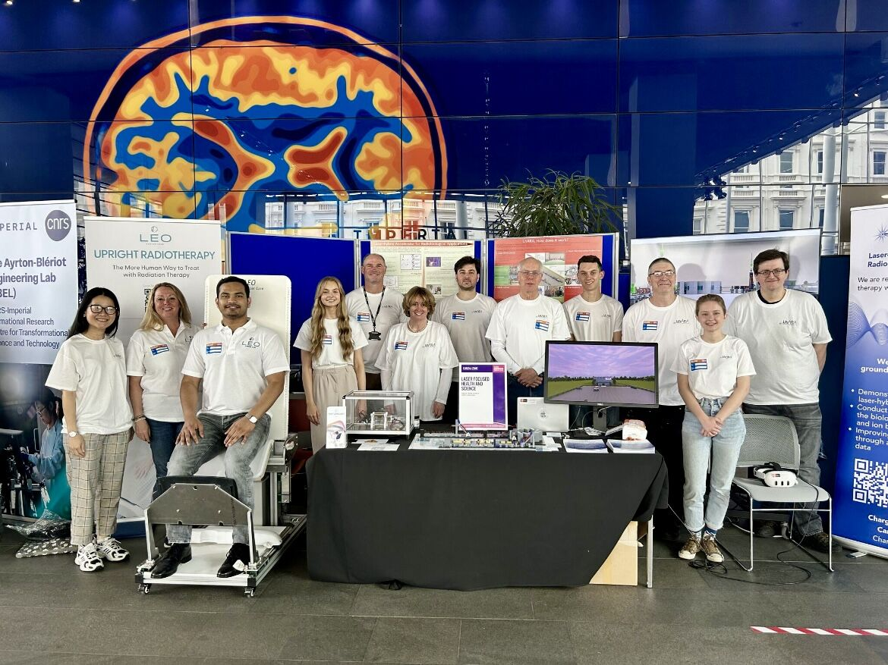
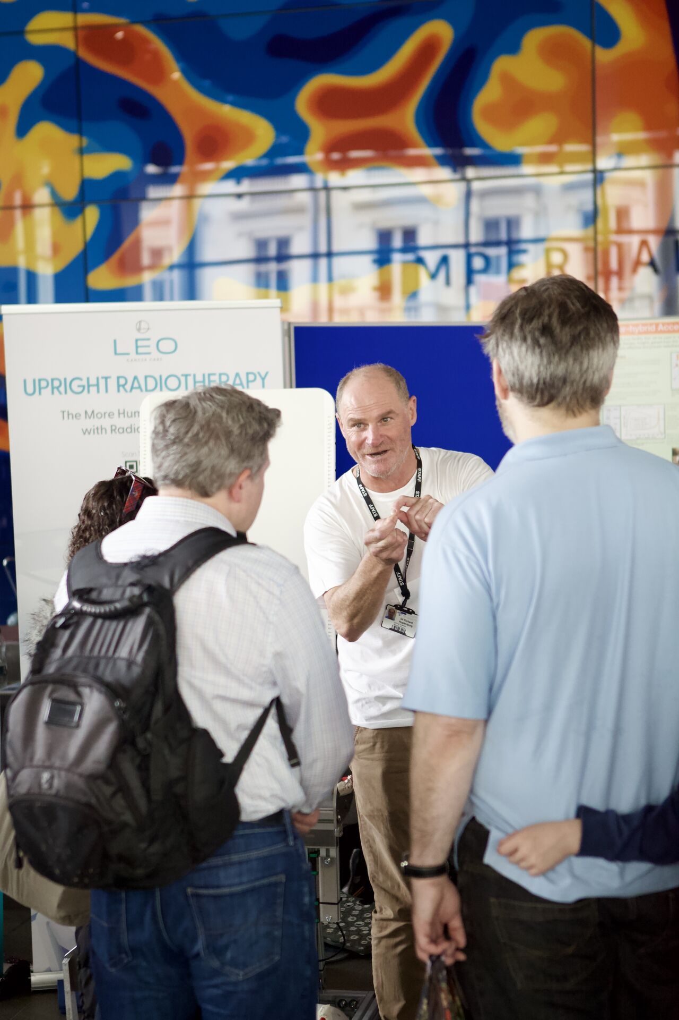
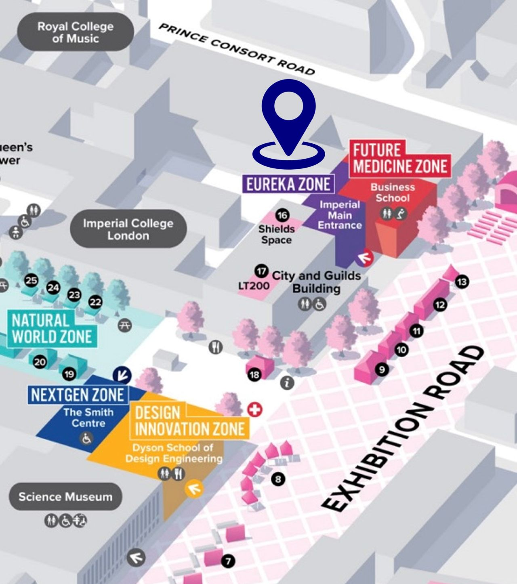
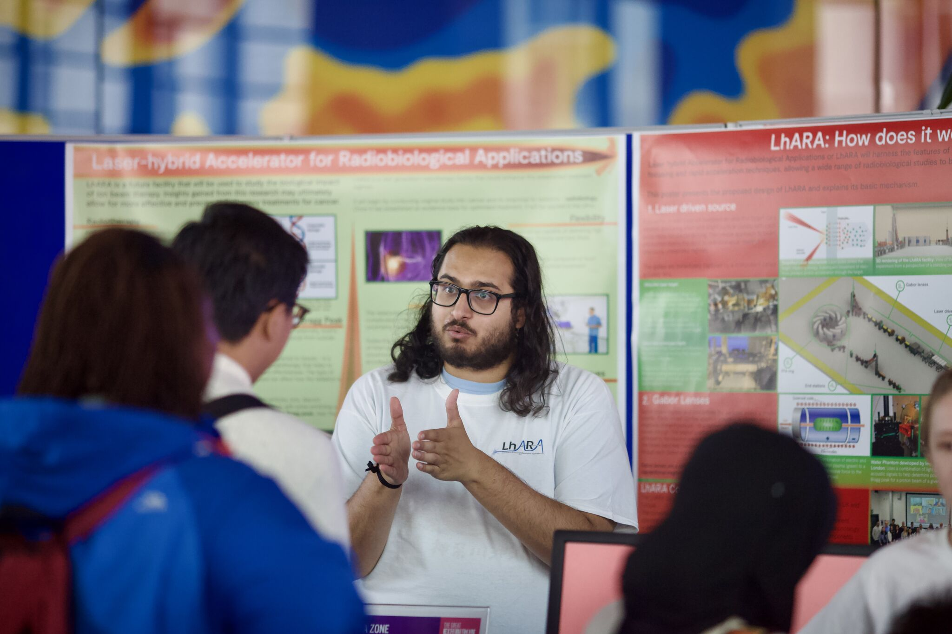
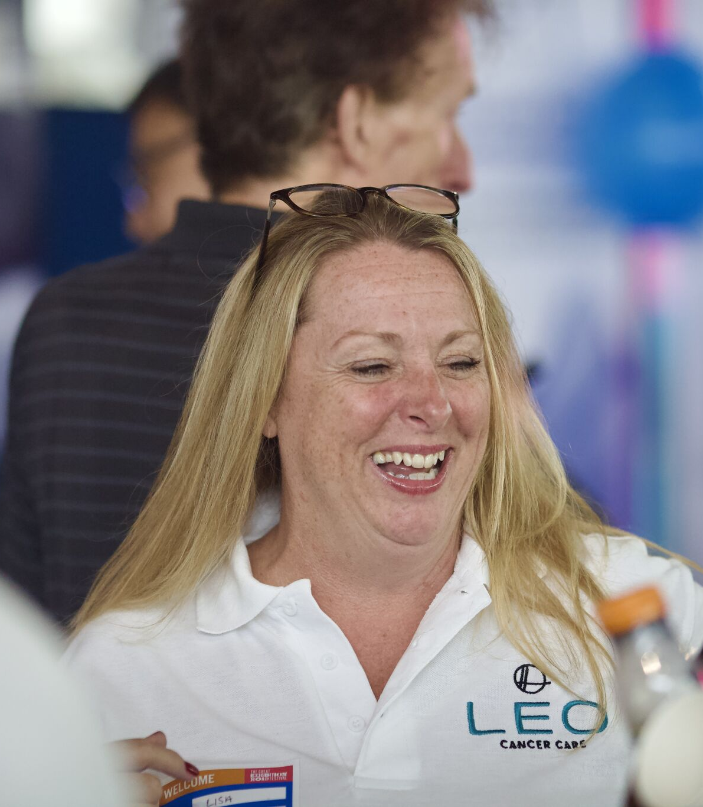
Great Exhibition Road Festival

Slide 3
Next steps …
Immediate:
  STFC RAL – Open Day; 01Aug25
    Kai Gregory
Next:
  Begin to prepare proposal to RS Summer Exhibition 2026
    Due wk1 Oct25
Medium term:
  Glasgow Science Festival 2026
  Seek opportunities in Belfast and Swansea
  Suggested to CNRS/Yolanda:
    Paris
    Santiago de Compostella

Slide 4
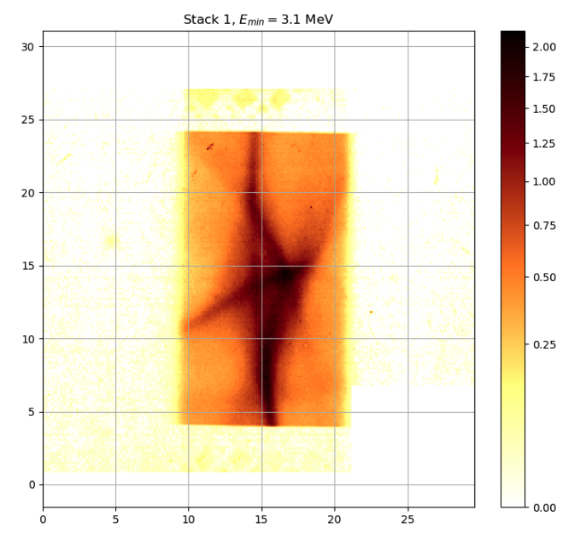
Publications
Start to work towards paper:
2 issues:
Calibration of scintillator
Beam profiles

Slide 5
Going forward
Fortnightly 01Jul25
Rolling w/p reports:
  Design and integration

