Slide 1
Update and news

Slide 2
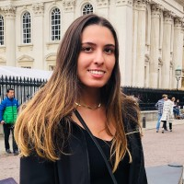
Maria Maxouti (PhD)
Congratulations!

Slide 3
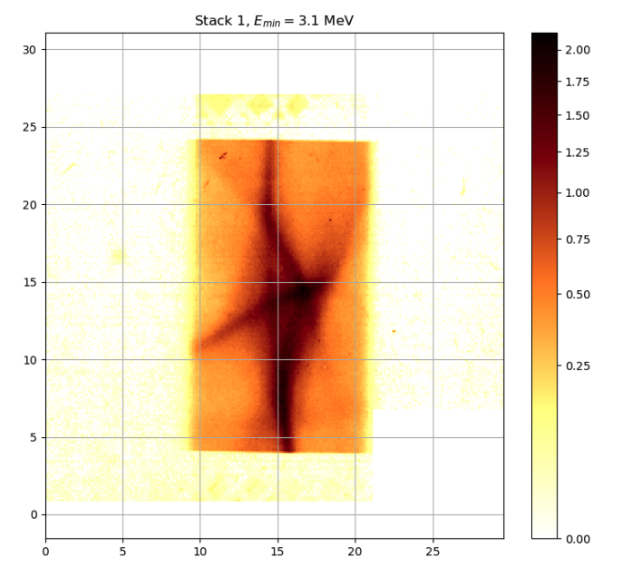
Publications
Start to work towards paper:
2 issues:
Calibration of scintillator
Beam profiles

Slide 4
Looking forward
Positive; continuing dialogue, meet again
in autumn.
Push from CNRS: MCSA DN 2026
Initial discussions underway
Industrial engagement
Discussions with Imperial Innovation initiated
Opportunities! Requires a proactive approach
Build on Great Exhibition Road Festival

Slide 5
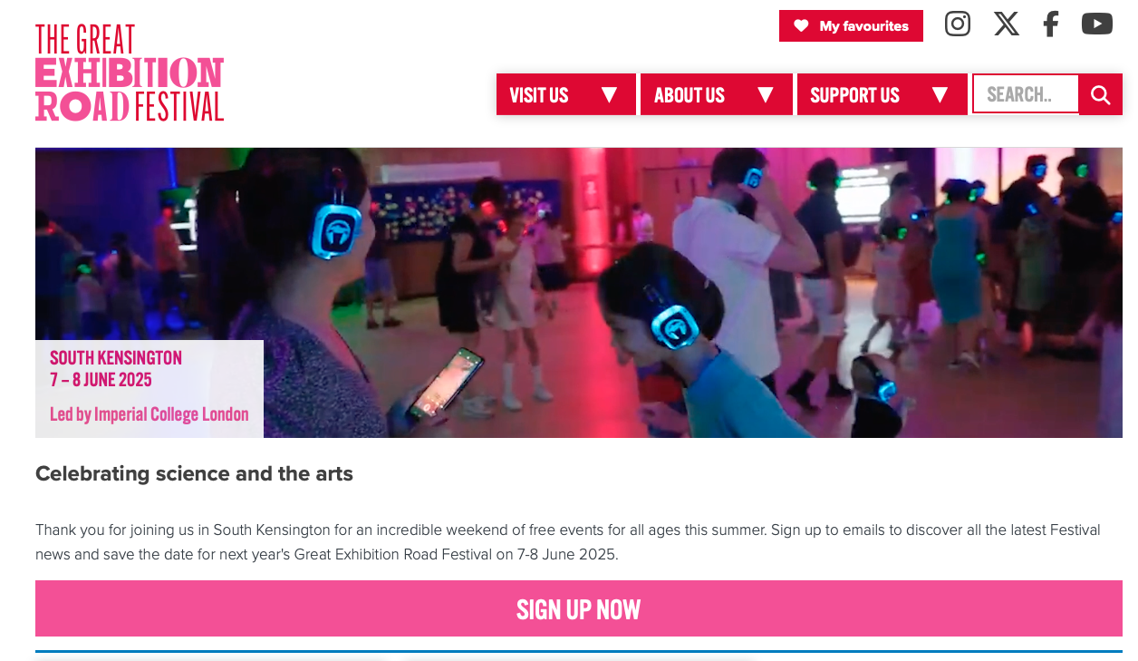
Great Exhibition Road Festival
Please come if you can!
Still time to volunteer to present
Quadrupole trap at Imperial
Deadline only 1.5 weeks away!
All welcome:
Email with details to follow

Slide 6
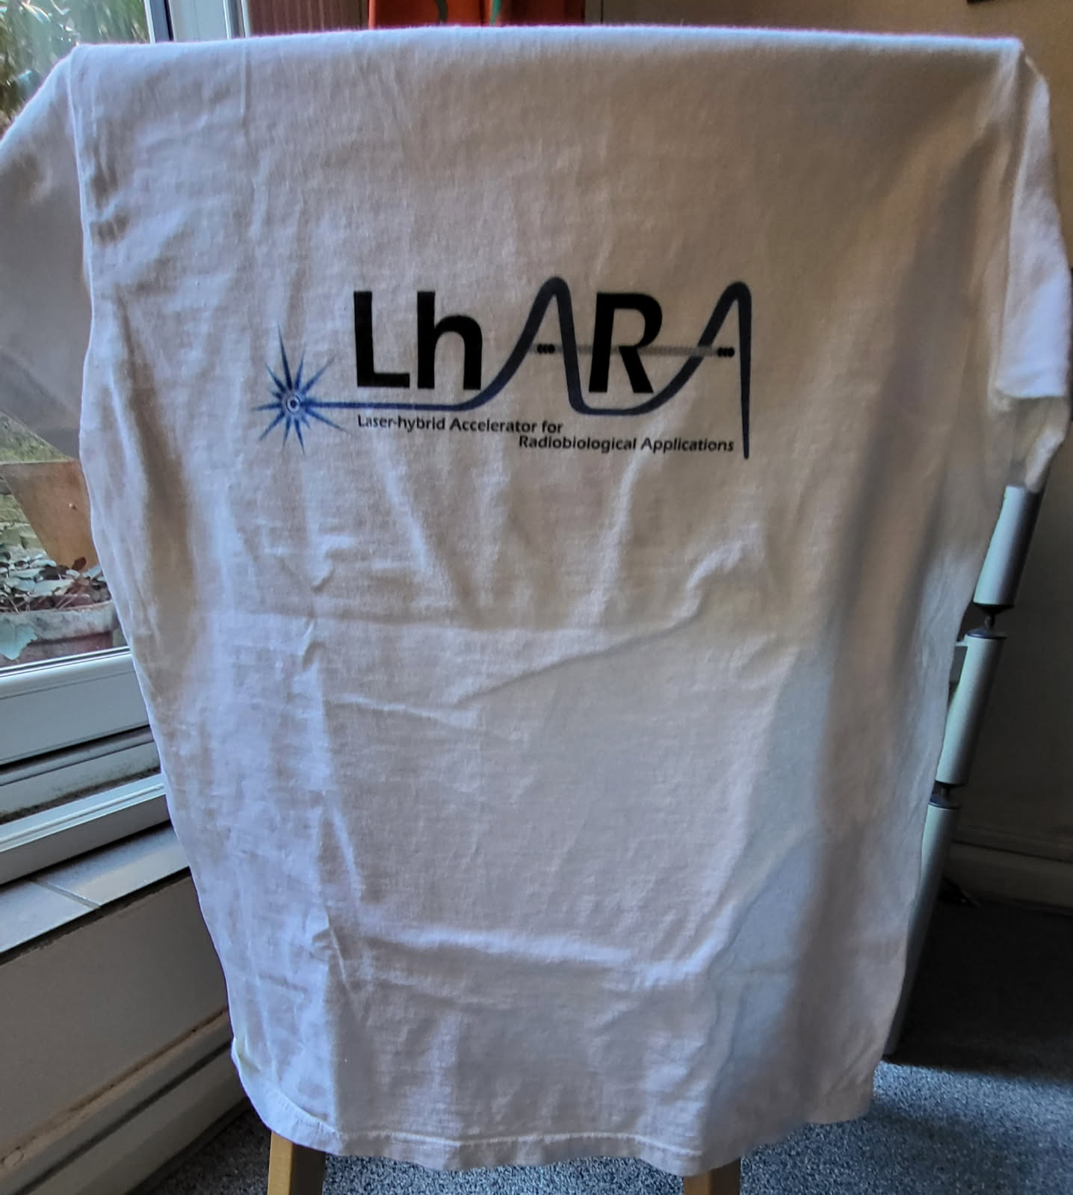
Great Exhibition Road Festival
Propose LhARA dinner Saturday 07Jun. Details to be
posted; come if you can! Satallite dinners elsewhere?
Celebrate milestone in engagement programme.
Mark transition to new phase of project …
— UKRI Infrastructure Fund Preliminary Activity ends
— LhARA collaboration moves forward to
deliver LhARA initiative!
Peter Hobson’s excellent initiative

Slide 7
Going forward
Fortnightly 03Jun25
Rolling w/p reports:
  Capture

