Slide 1
Results update
05/2025

Slide 2
Simulation
Python
optimisation
Setup reproduction in TOPAS
Scoring at target

Slide 3
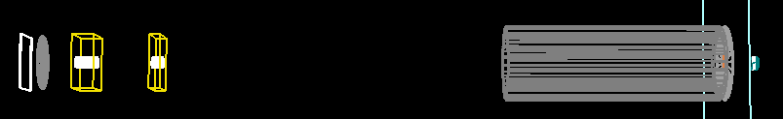
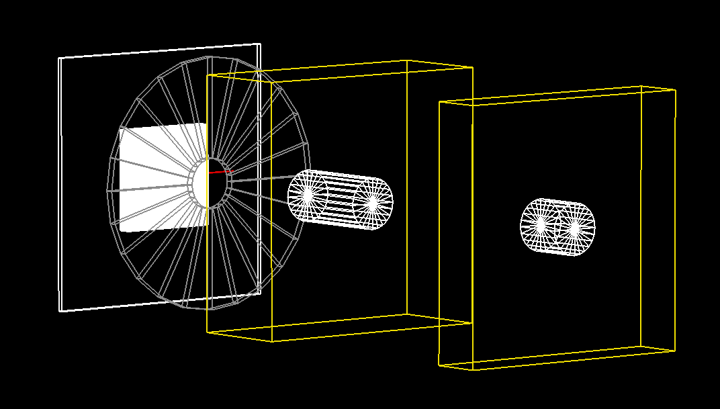
Setup design
First Collimator: R=1cm
Square quads: 8cmX8cm outline, 2cm inner diameter
Target after 5cm of air (d=135cm)
Vacuum window: 10um mylar. Rmax?

Slide 4
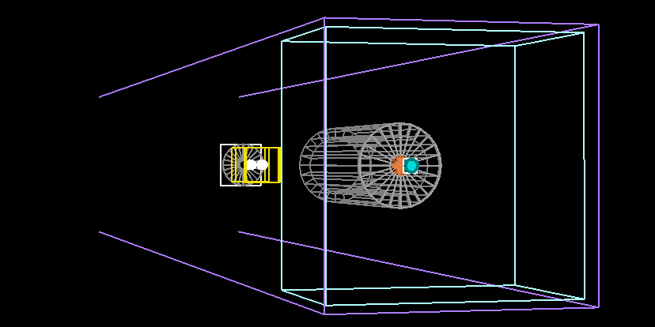
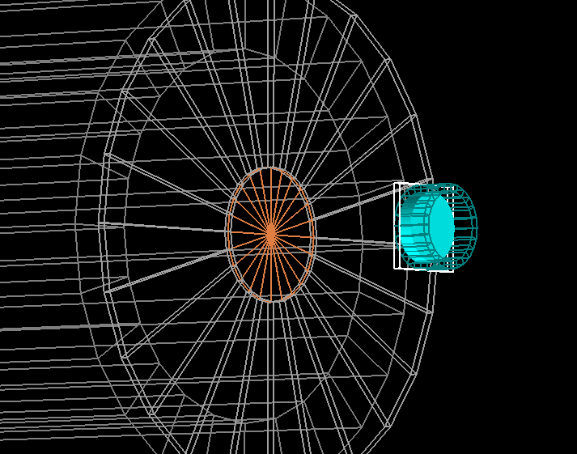
Setup design
First Collimator: R=1cm
Square quads: 8cmX8cm outline, 2cm inner diameter
Target after 5cm of air (d=135cm)
Vacuum window: 10um mylar. Rmax?

Slide 5
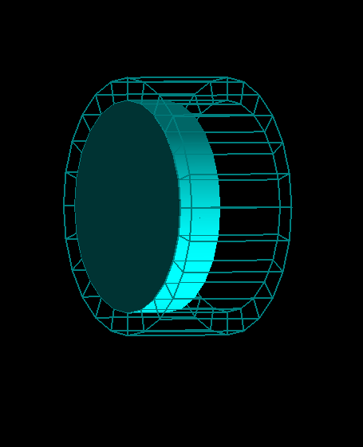
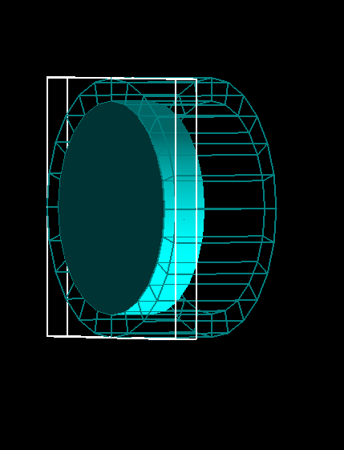
Scoring
Glass ring:
18.5mm inner diameter
22.5mm outer diameter
2.5um mylar
4mm water
Dose and LET scoring:
0.1mmx0.1mmx25um
Mylar + first 2mm of water
Phase space at entrace of scorer

Slide 6
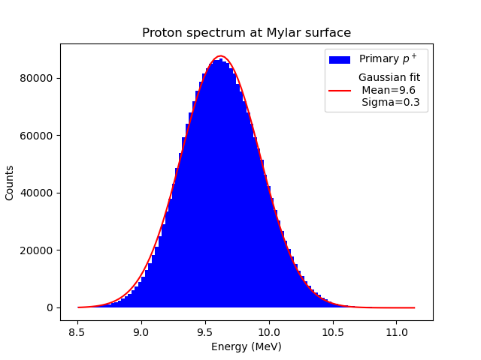
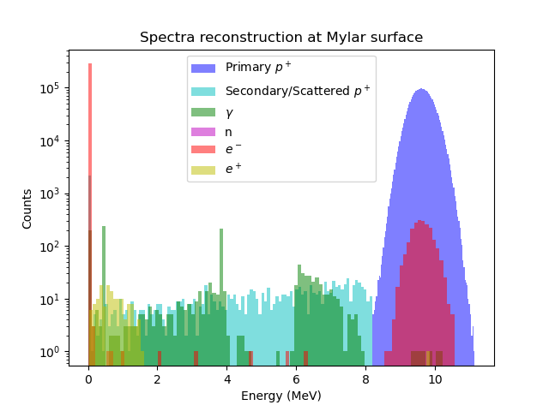
Spectra at target

Slide 7
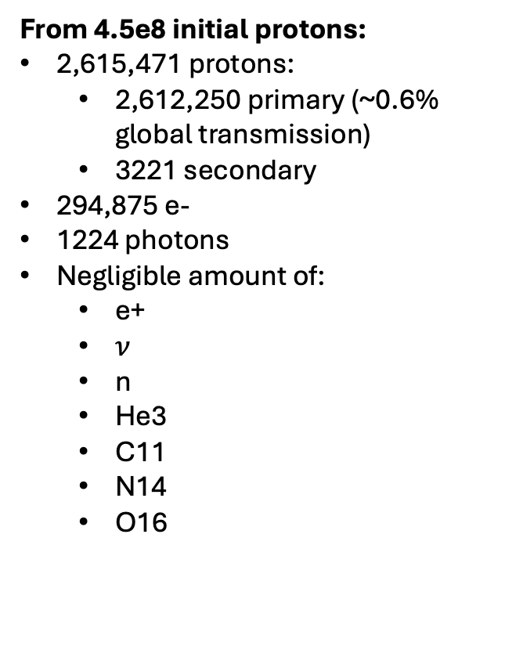
Spectra at target
From 4.5e8 initial protons:
2,615,471 protons:
  2,612,250 primary (~0.6% global transmission)
  3221 secondary
294,875 e-
1224 photons
Negligible amount of:
  e+
  $ν$
  n
  He3
  C11
  N14
  O16

Slide 8
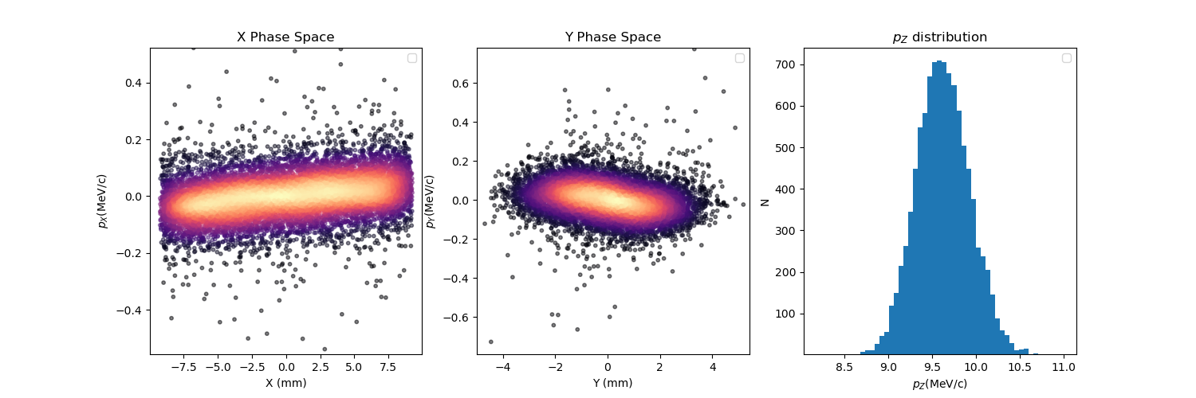
Phase space

Slide 9
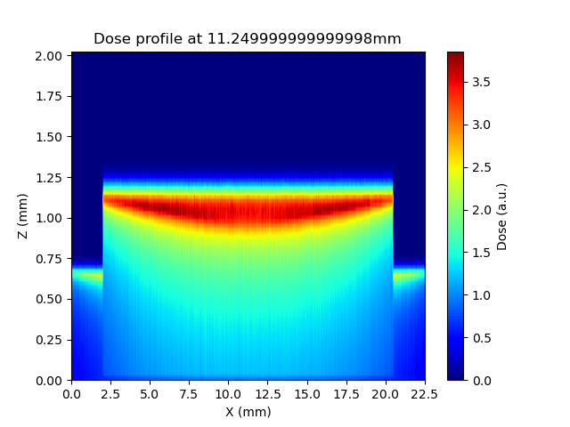
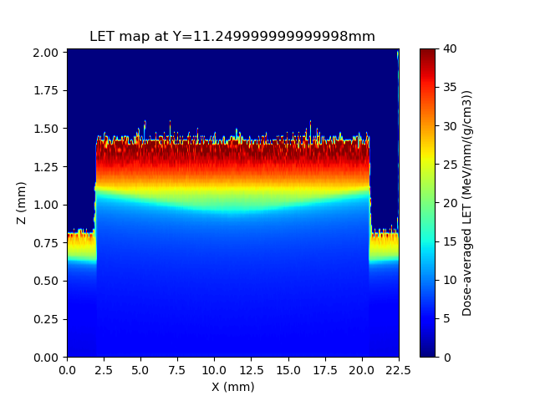
Dose and LET distributions

Slide 10
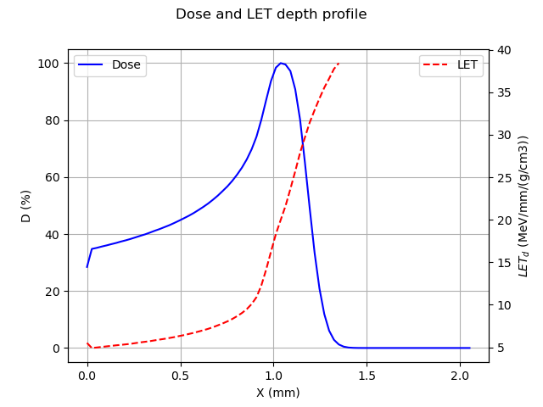
Dose and LET distributions

Slide 11
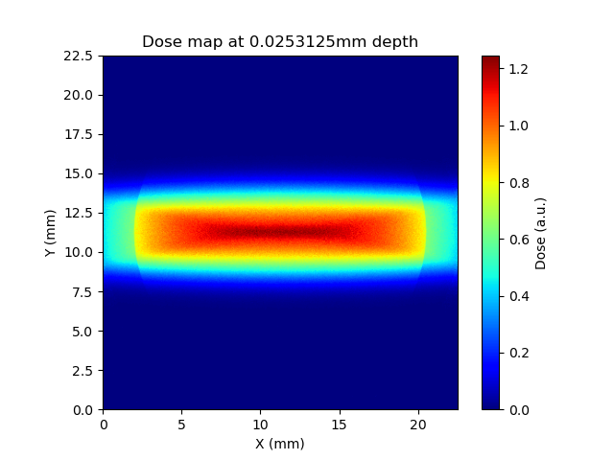
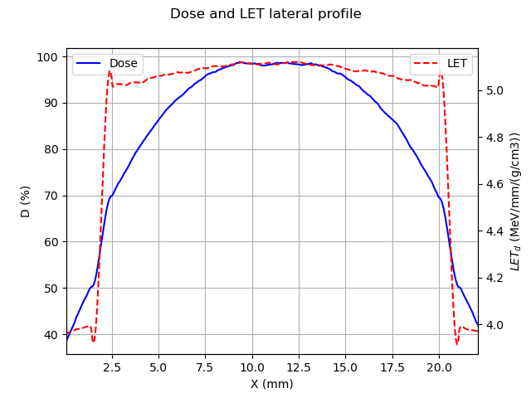
Dose and LET distributions

Slide 12
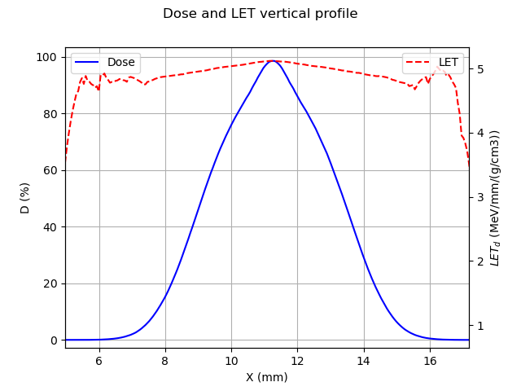
Dose and LET distributions

Slide 13
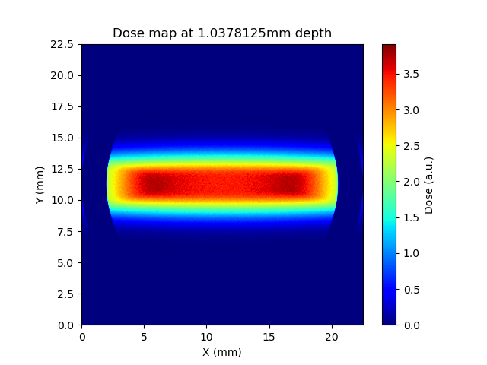
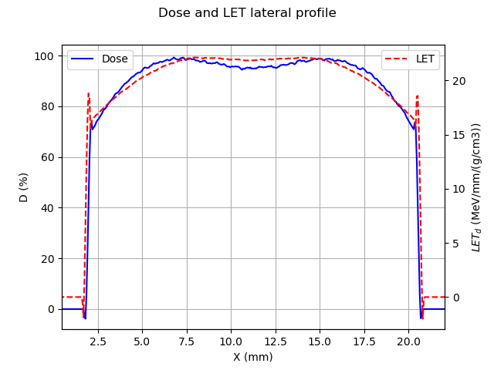
Dose and LET distributions

Slide 14
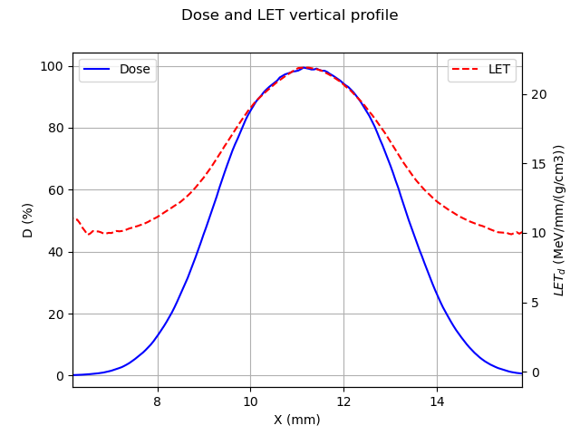
Dose and LET distributions

