Slide 1
Evaluation of a Laser-Driven Proton Beam for Biomedical Applications
Supervisor: Prof Kenneth Long
Zaynab Sadur and Nadirah Zakhir
(Presented by Calvin Dyson)
24/03/2025
Notes:
Hello everyone
I will be presenting work by two MSci students, Zaynab and Nadirah, that have been working with me at Imperial
• • Since it is their holiday now we thought it best to let them rest before they begin exams

Slide 2
Research Objectives
Investigate and explore laser-driven sources, proton acceleration and beam transport
Evaluate LharaLinearOptics (LLO) simulation model with N. Dover experiment
Investigate Quadrupole-induced beam shaping and energy deposition
Notes:
Their work split into two sections
Firstly, they investigated modelling laser-driven sources through the LhARA Linear Optics code
• • Then they studied the effects of quadrupole offsets and tilts in final distributions, comparing the results to RCF stacks at LION

Slide 3
Project Part 1
Proton Energy Spectra

Slide 4
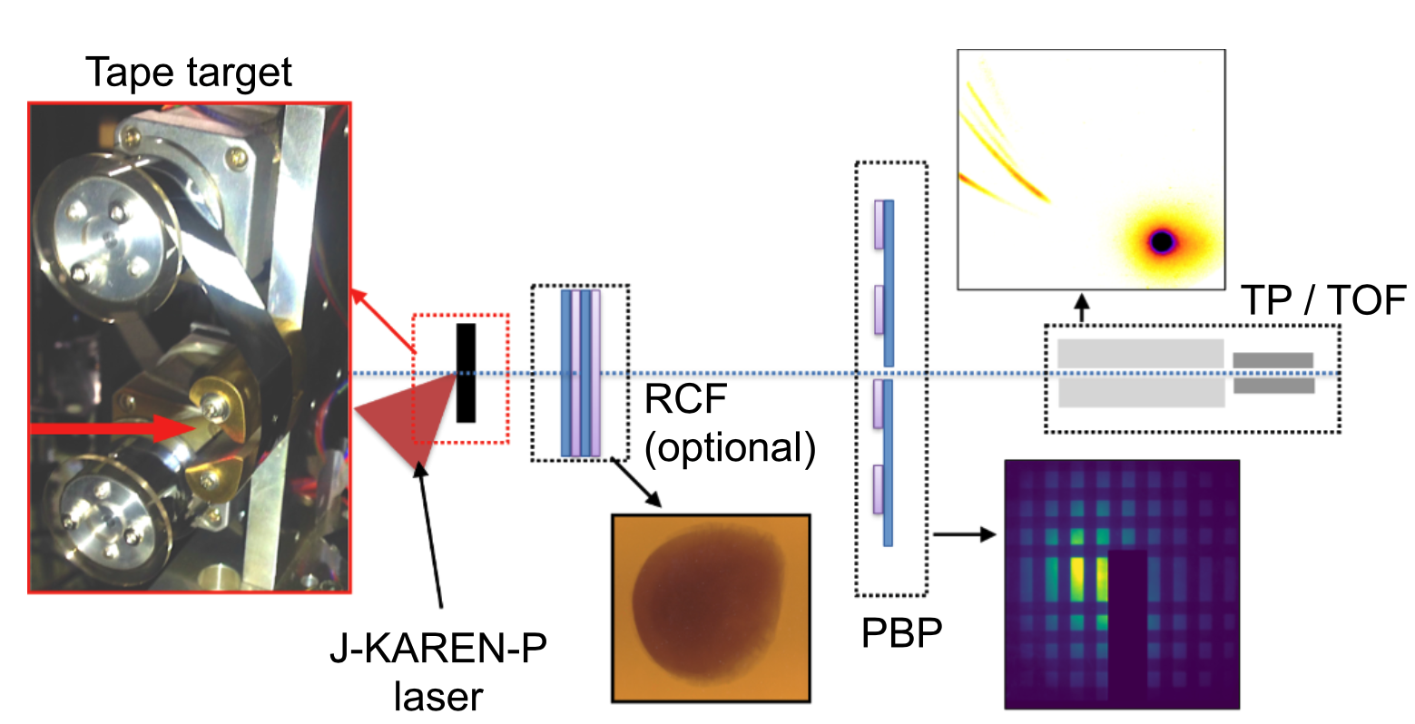
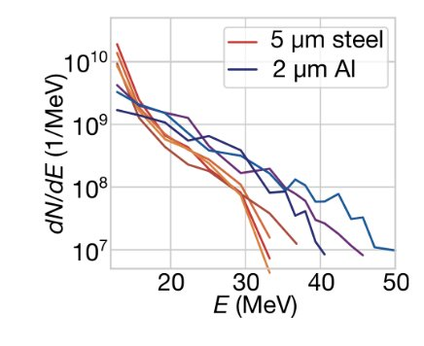

Experiment Overview
Nick Dover’s experiment conducted in 2020 uses J-KAREN-P laser
Laser Parameter | Value
Wavelength | 800 um
Pulse Duration | 40 fs
Intensity | 5 x 10²¹ Wcm⁻²
Energy | 10 J
Setup
Targets: 5$μ$m Steel, 2$μ$m Aluminium
Measurement technique: Radiochromic Film (RCF) used to record energy deposition
N. P. Dover et al., “Demonstration of repetitive energetic proton generation by ultra-intense laser interaction with a tape target,” High Energy Density Physics, vol. 37, p. 100847, Jun. 2020, doi: 10.1016/j.hedp.2020.100847.
Notes:
In 2020 it was shown that repetitive energetic proton generation via laser irradiation on a thin target is possible
• • In the experiment they compared with a recently devleoped analytical model

Slide 5
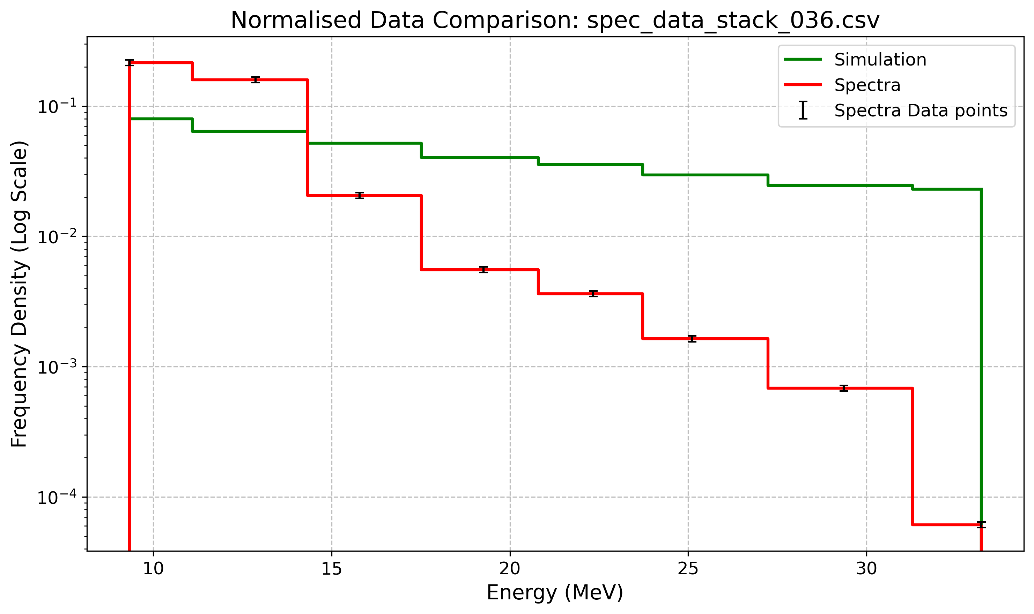
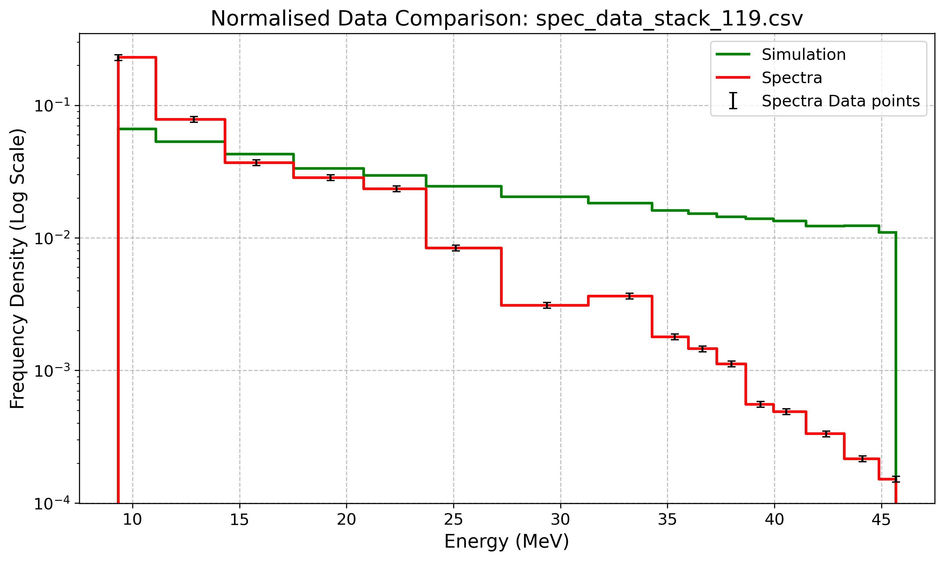


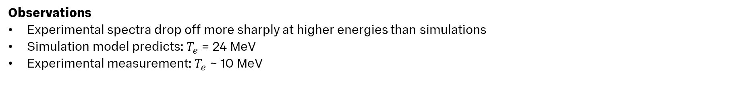
Preliminary Results
Stack 036: 5 $μ$m Target
Stack 119: 2 $μ$m Target
Observations
Experimental spectra drop off more sharply at higher energies than simulations
Simulation model predicts: $T_{e}$ = 24 MeV
Experimental measurement: $T_{e}$ ~ 10 MeV
Notes:
Talk about how the electron temperature influences the energy distribution – hotter electrons lead to higher energy protons
In their early attempts the simulation did not match the drop-off from experiment
Model also calculates an incorrect electron temperature
• • This is important as a higher electron temperature will lead to higher energy protons

Slide 6

1. Simulation Model
Laser Intensity
LLO uses the ponderomotive scaling to determine the electron temperature:
            $$T_{e}=m_{e}c^{2}\left[\sqrt{1+\frac{{Iλ}^{2}}{1.37×{10}^{18} }}−1\right] =m_{e}c^{2}\left[\sqrt{1+{\left(\frac{p_{y}}{m_{e}c}\right)}^{2}}−1\right]$$
Ponderomotive scaling is accurate for laser intensities around $×{10}^{20} \text{Wc}{\text{m}}^{−2}$
N. Dover experiment uses $I_{L}=5×{10}^{21} \text{Wc}{\text{m}}^{−2}$ potentially causing observed discrepancy
Problems:
Overestimation of Electron Temperature
  The electron temperature is estimated to be 25MeV, but it is actually 10MeV
  → The model does not account for energy constraints imposed by transverse acceleration limits.
Breakdown at small focal sizes
  The initial model assumes an infinite acceleration length, which is unrealistic for small focal spot sizes.
N. Dover et al., “LhARA linear optics documentation,” 2024.
Notes:
The model is based on the ponderomotive scaling to determine the electron temperature
However this model is only accurate for intensities up to 10^20
In his experiment Nick Dover the laser intensity was 10^21
So the model overestimates the Te
• • Also it assumes an infinite acceleration length causing a problem with small focal spot sizes

Slide 7
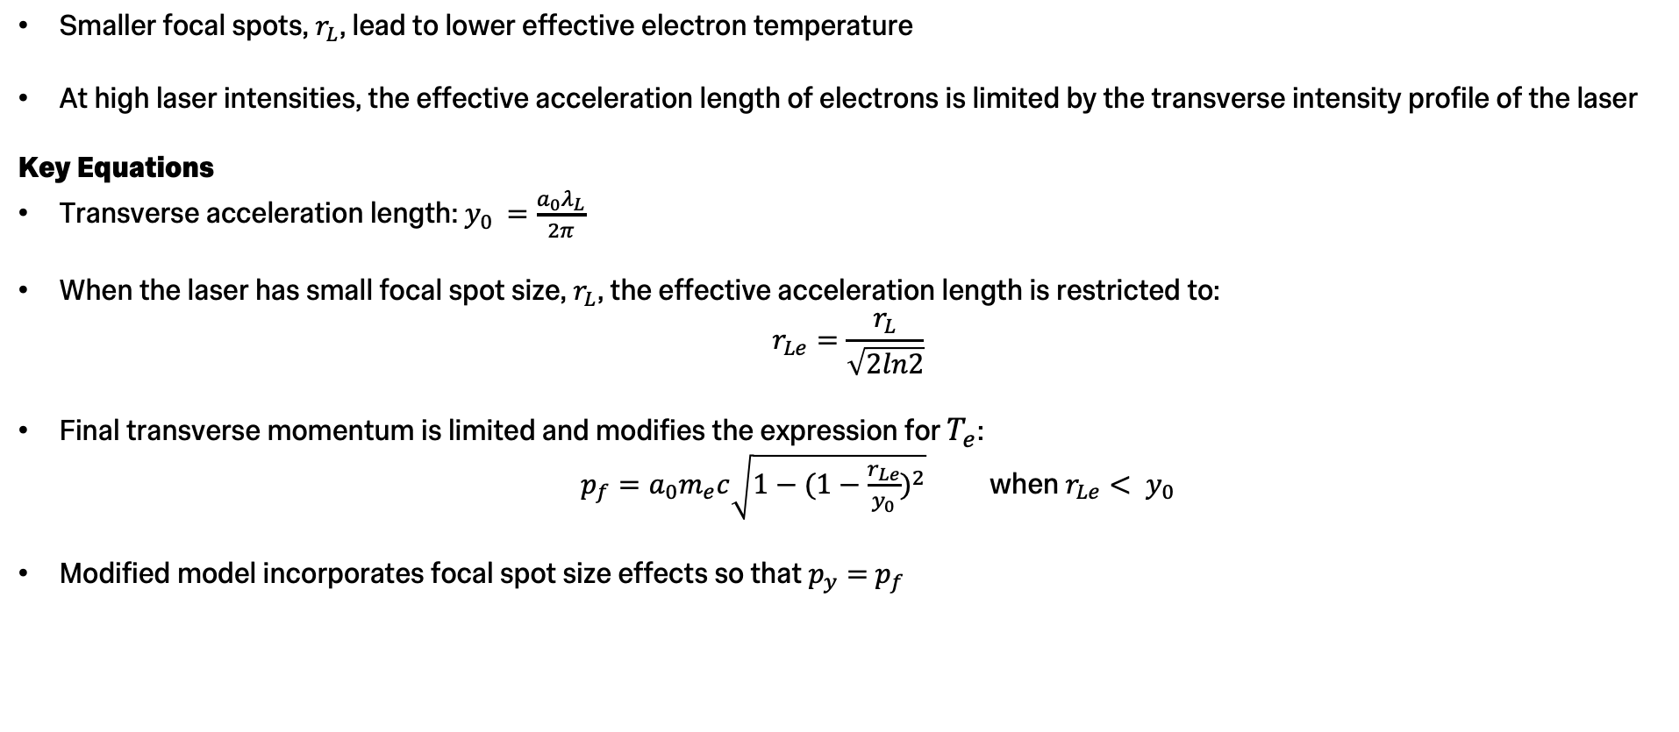
2. Focal Spot Size Dependence
Smaller focal spots, $r_{L}$, lead to lower effective electron temperature
At high laser intensities, the effective acceleration length of electrons is limited by the transverse intensity profile of the laser
Key Equations
Transverse acceleration length: $y_{0 }=\frac{a_{0}λ_{L}}{2π}$
When the laser has small focal spot size, $r_{L}$, the effective acceleration length is restricted to:
$$r_{Le}=\frac{r_{L}}{\sqrt{2ln2}}$$
Final transverse momentum is limited and modifies the expression for $T_{e}$:
$p_{f}=a_{0}m_{e}c\sqrt{1−{(1−\frac{r_{Le}}{y_{0}})}^{2}}$ when $r_{Le}< y_{0 }$
Modified model incorporates focal spot size effects so that $p_{y}=$ $p_{f}$
N. P. Dover et al., “Effect of small focus on electron heating and proton acceleration in ultrarelativistic Laser-Solid interactions,” Physical Review Letters, vol. 124, no. 8, Feb. 2020, doi: 10.1103/physrevlett.124.084802.
Notes:
y0 represents the characteristic transverse acceleration length
rLe is the effective focal spot size
If focal spot size > transverse length , then electrons can fully experience the transverse acceleration, and the ponderomotive scaling remains valid.
If focal spot size <transverse acceleration length , the transverse acceleration is cut short, leading to lower electron temperatures than predicted by simple models.
A small focal spot size limits the effective acceleration length
This modifies the expression for Te
• • New model incorporates focal spot size so that the transverse momentum equals the final momentum

Slide 8
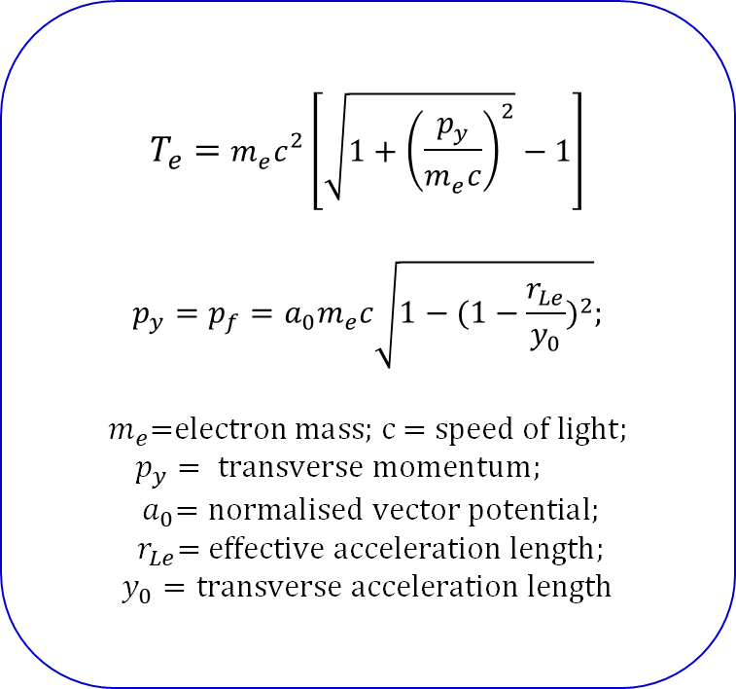
3. Implemented Model
$$T_{e}=m_{e}c^{2}\left[\sqrt{1+{\left(\frac{p_{y}}{m_{e}c}\right)}^{2}}−1\right]$$
$$p_{y}=p_{f}=a_{0}m_{e}c\sqrt{1−{(1−\frac{r_{Le}}{y_{0}})}^{2}};$$
$$m_{e}\text{=}\text{electron} \text{mass}\text{; }\text{c}\text{ = }\text{speed} \text{of} \text{light};$$
$$p_{y}= \text{transverse} \text{momentum}\text{;} \\ { a}_{0}=\text{normalised} \text{vector} \text{potential}\text{;}$$
$$r_{Le}\text{= }\text{effective} \text{acceleration} \text{length}\text{;}$$
$y_{0}=\text{transverse} \text{acceleration} \text{length}$
LLO model now correctly calculates electron temperature as 10 MeV

Slide 9
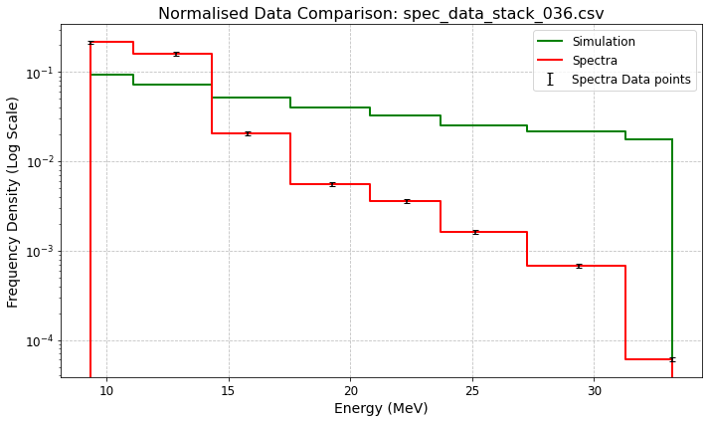
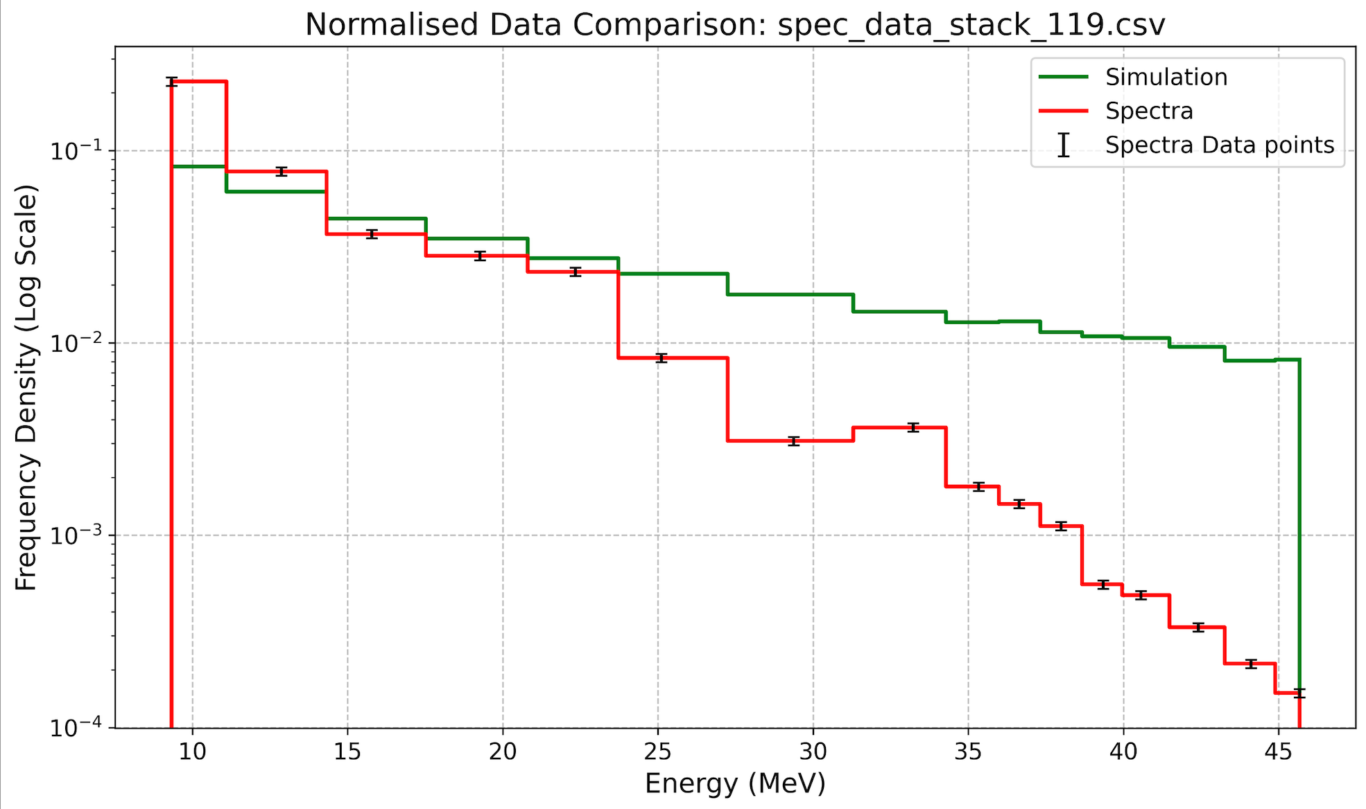


Plots with implemented Electron Temperature Model
$$T_{e}=10 \text{MeV}$$
Stack 036: 5 $μ$m Target
Stack 119: 2 $μ$m Target
Key observation:
Discrepancy still persists
Notes:
• • Discrepancy still present when using Te=10MeV

Slide 10
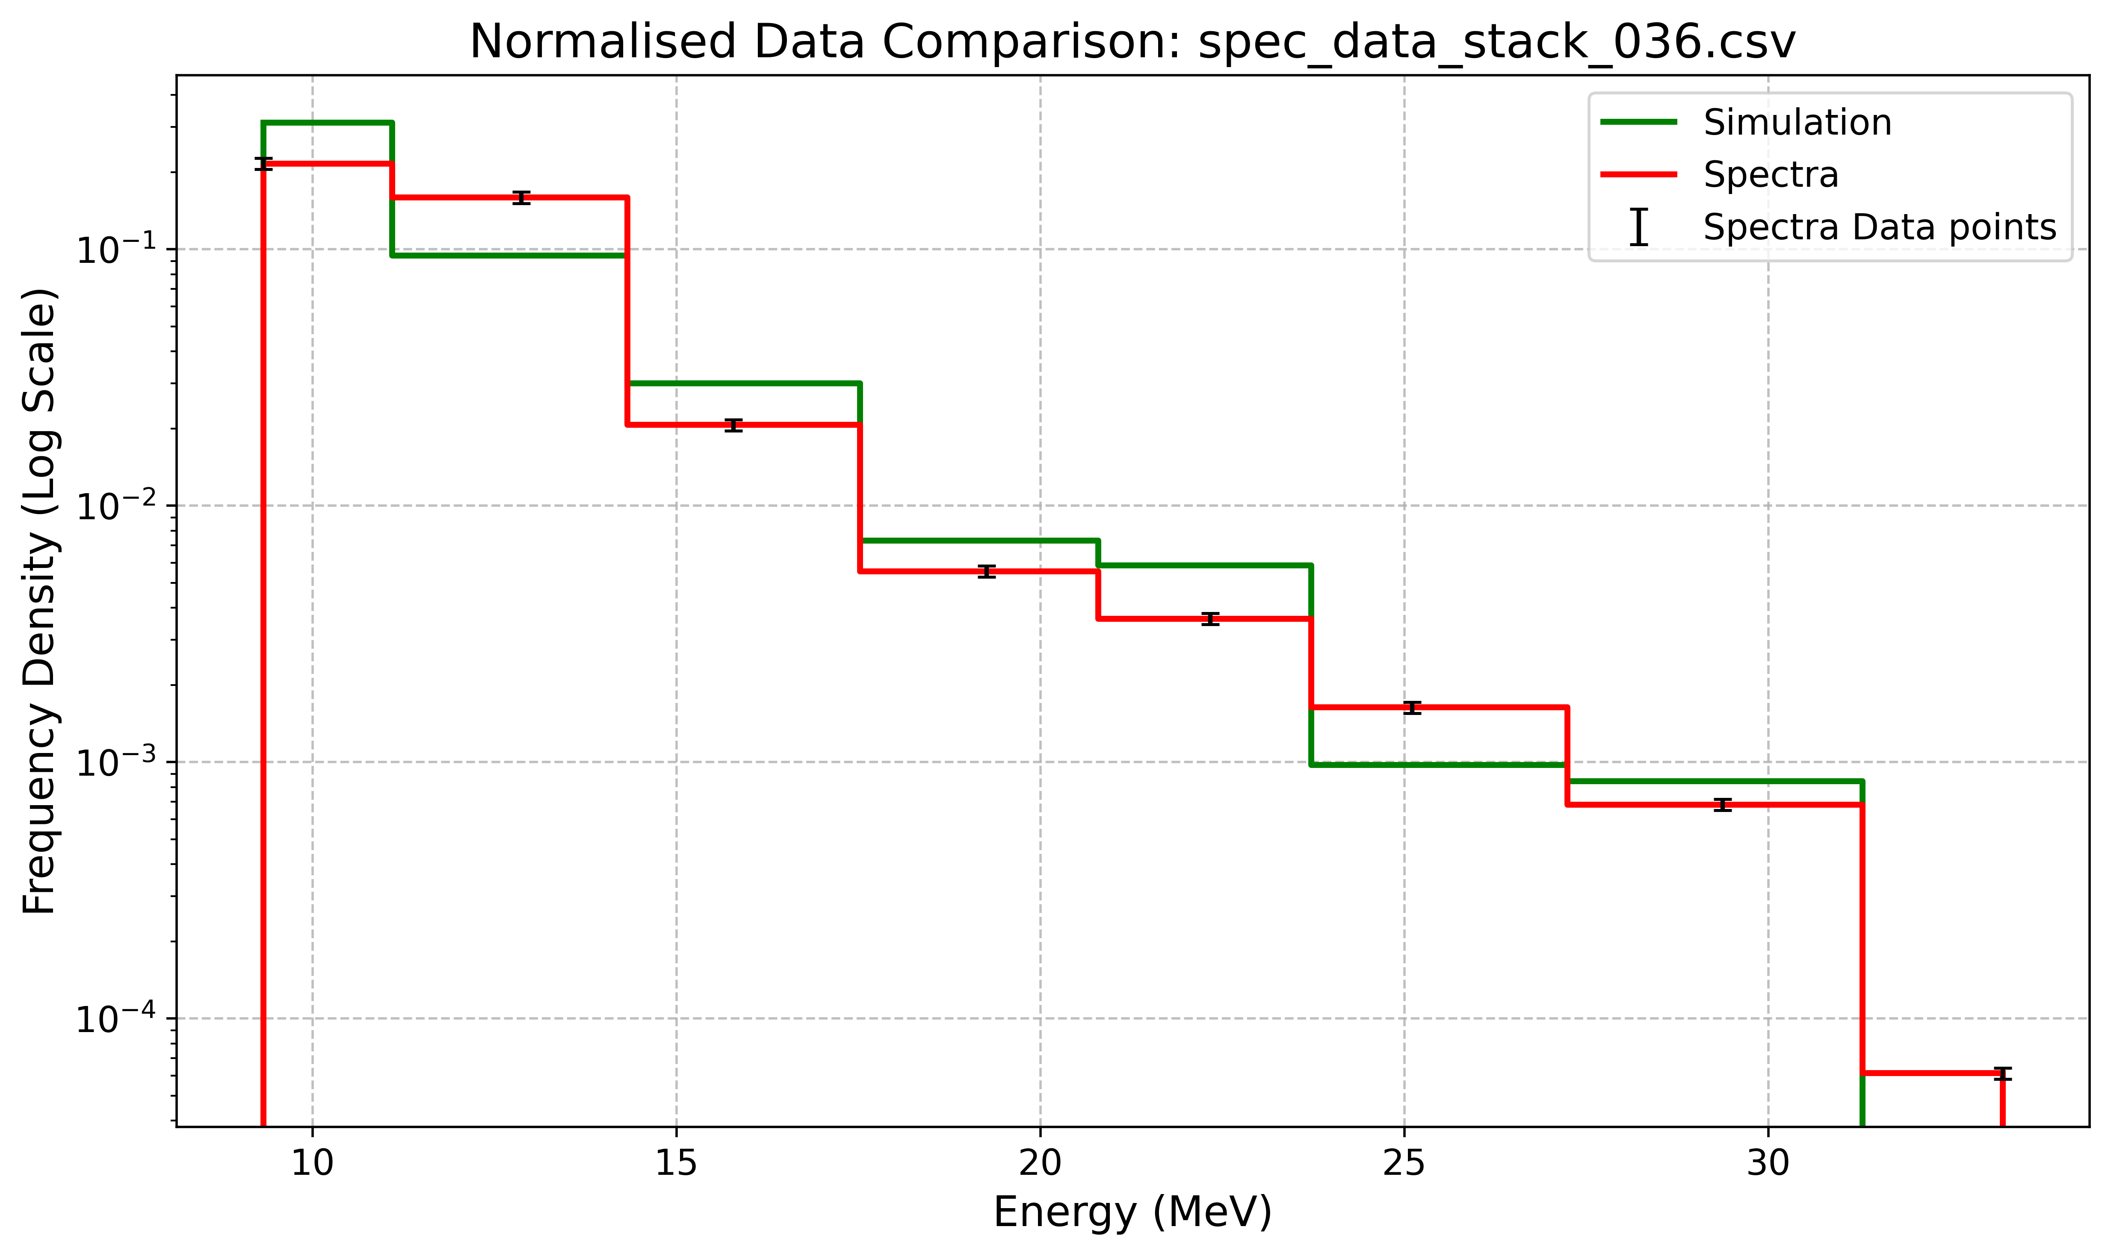
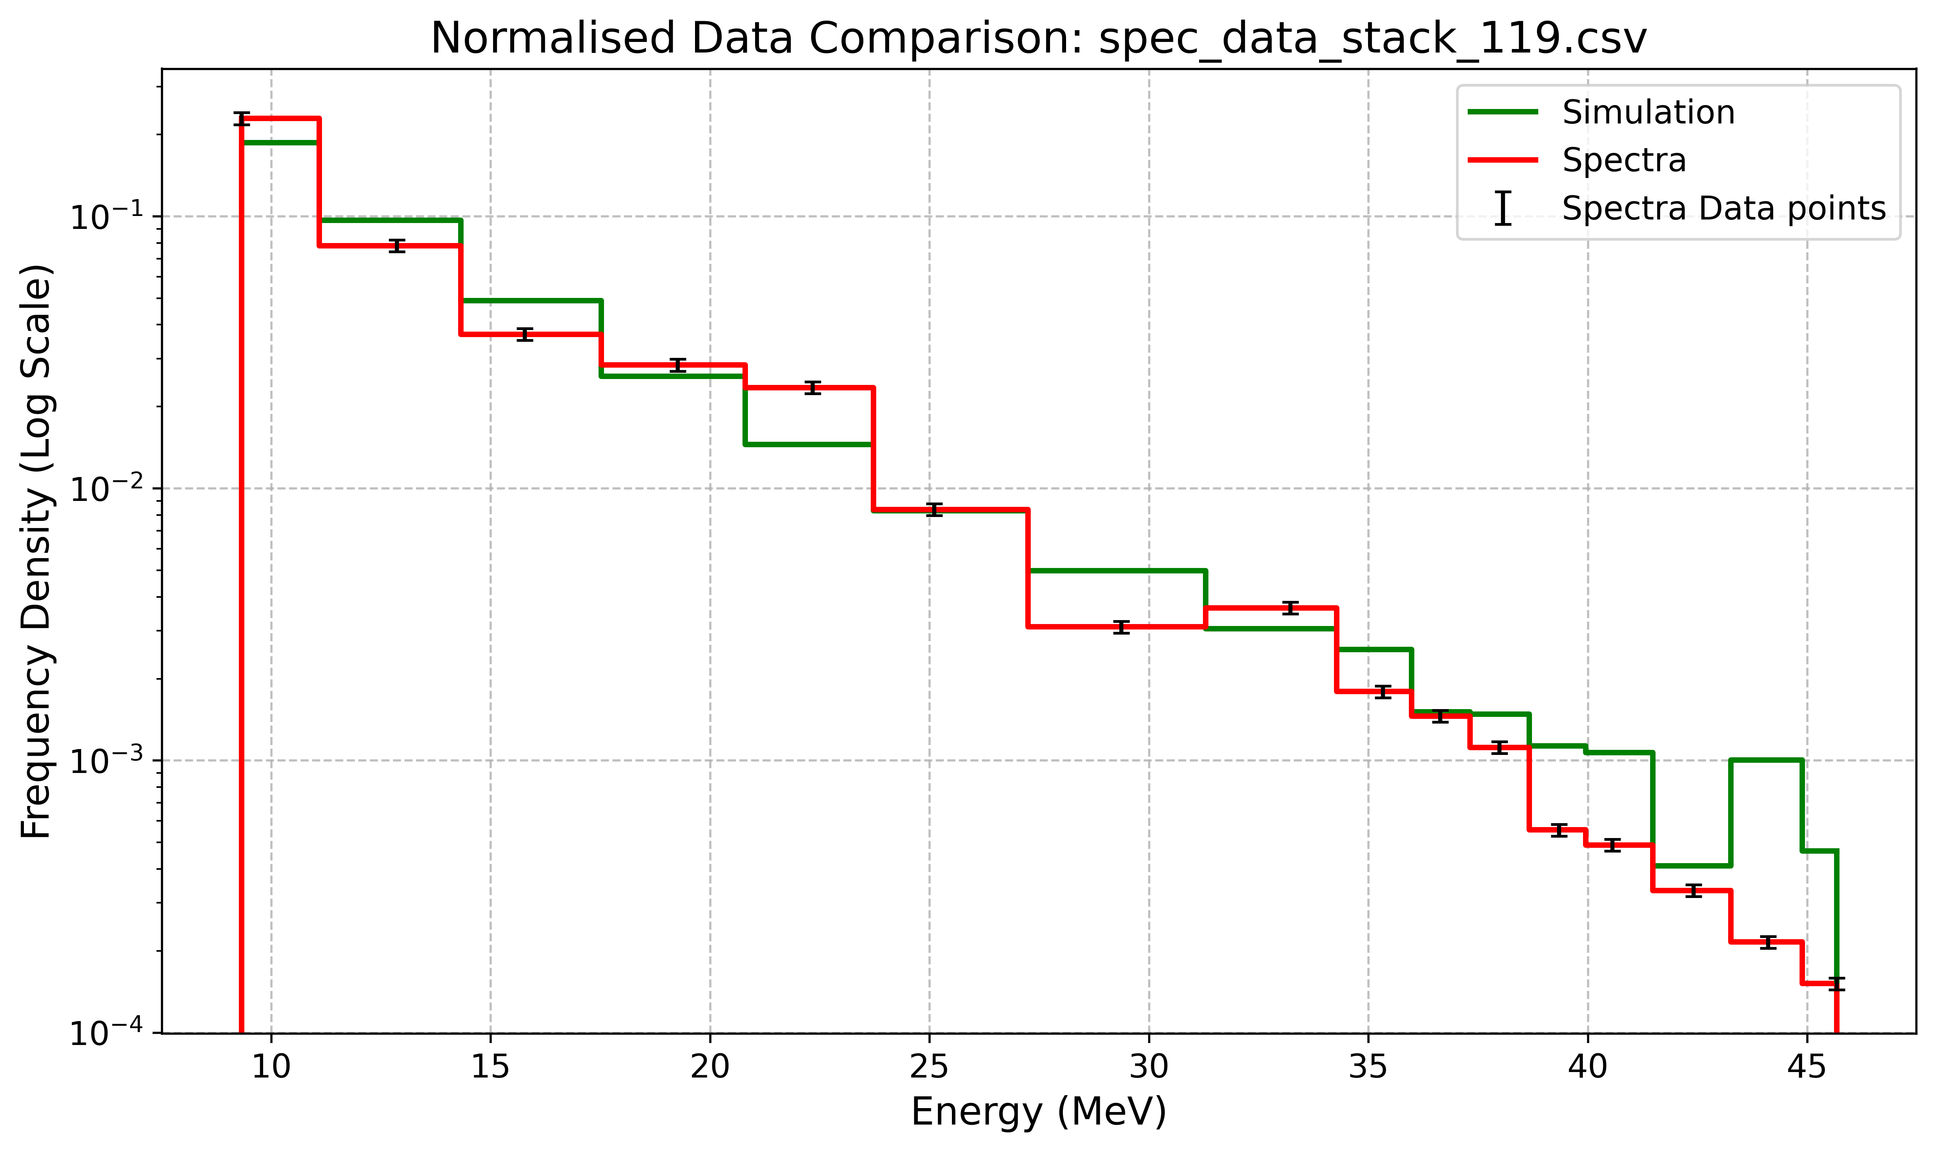
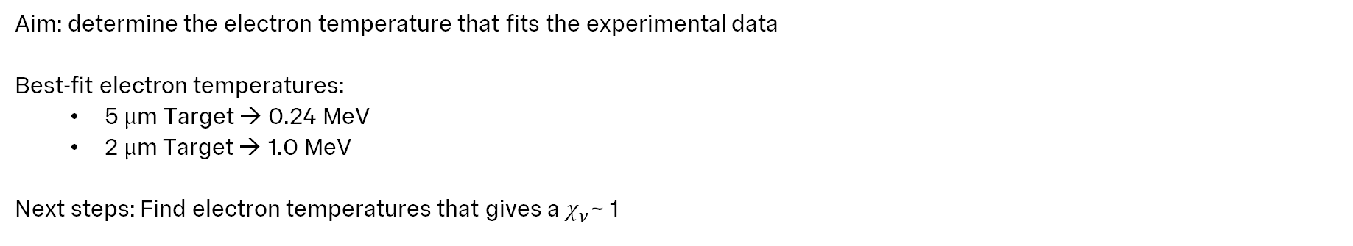


Electron Temperature
Matched Plots
Stack 036: 5 $μ$m Target
Stack 119: 2 $μ$m Target
Aim: determine the electron temperature that fits the experimental data
Best-fit electron temperatures:
  5 $μ$m Target → 0.24 MeV
  2 $μ$m Target → 1.0 MeV
Next steps: Find electron temperatures that gives a $χ_{ν}$~ 1
Notes:
It was decided to find the electron temperature that fits the experimental data
This was found to be 0.24MeV and 1 MeV for the respective plots
Roughly an order of magnitude away from experimentally measured value
• Reduced chi-squared was investigated to try and get a range of acceptable electron temperatures

Slide 11
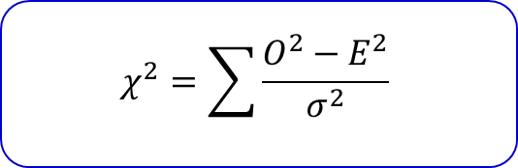

Statistical Analysis
$$χ^{2}=\sum{\frac{O^{2}−E^{2}}{σ^{2}}}$$
$$σ_{total}^{2}=σ_{data}^{2}+σ_{bin}^{2}+σ_{residual}^{2}$$
3 sources of uncertainty:
5% uncertainty in data points
Binning uncertainty from binomial statistics
Residual analysis
Notes:
Statistical Fluctuations
Due to the limited number of proton counts per bin, some degree of randomness affects the data.
To account for this, uncertainty in each bin is estimated using statistical methods such as binomial binning uncertainty. Sqrt(N)
There were three sources of ucnertainty
Nick gave an experimental uncertainty of 5% on the data points
Get an ucnertainty from binning which can be judged via binomial stats
Binomial binning uncertainty
• • Uncertainty on residual?

Slide 12
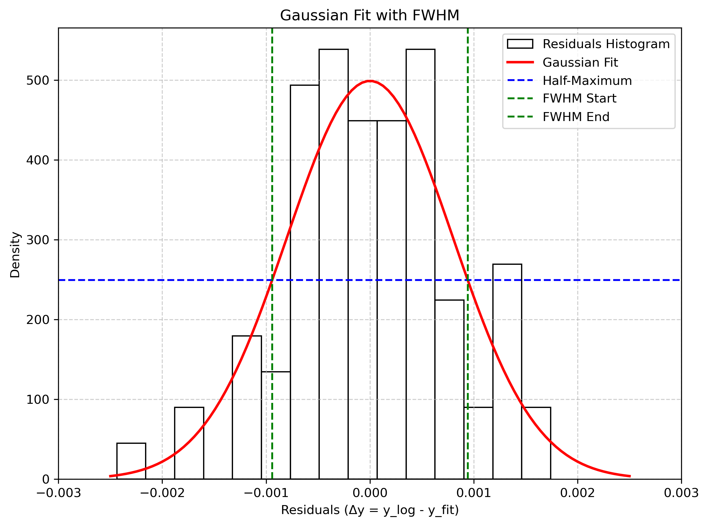
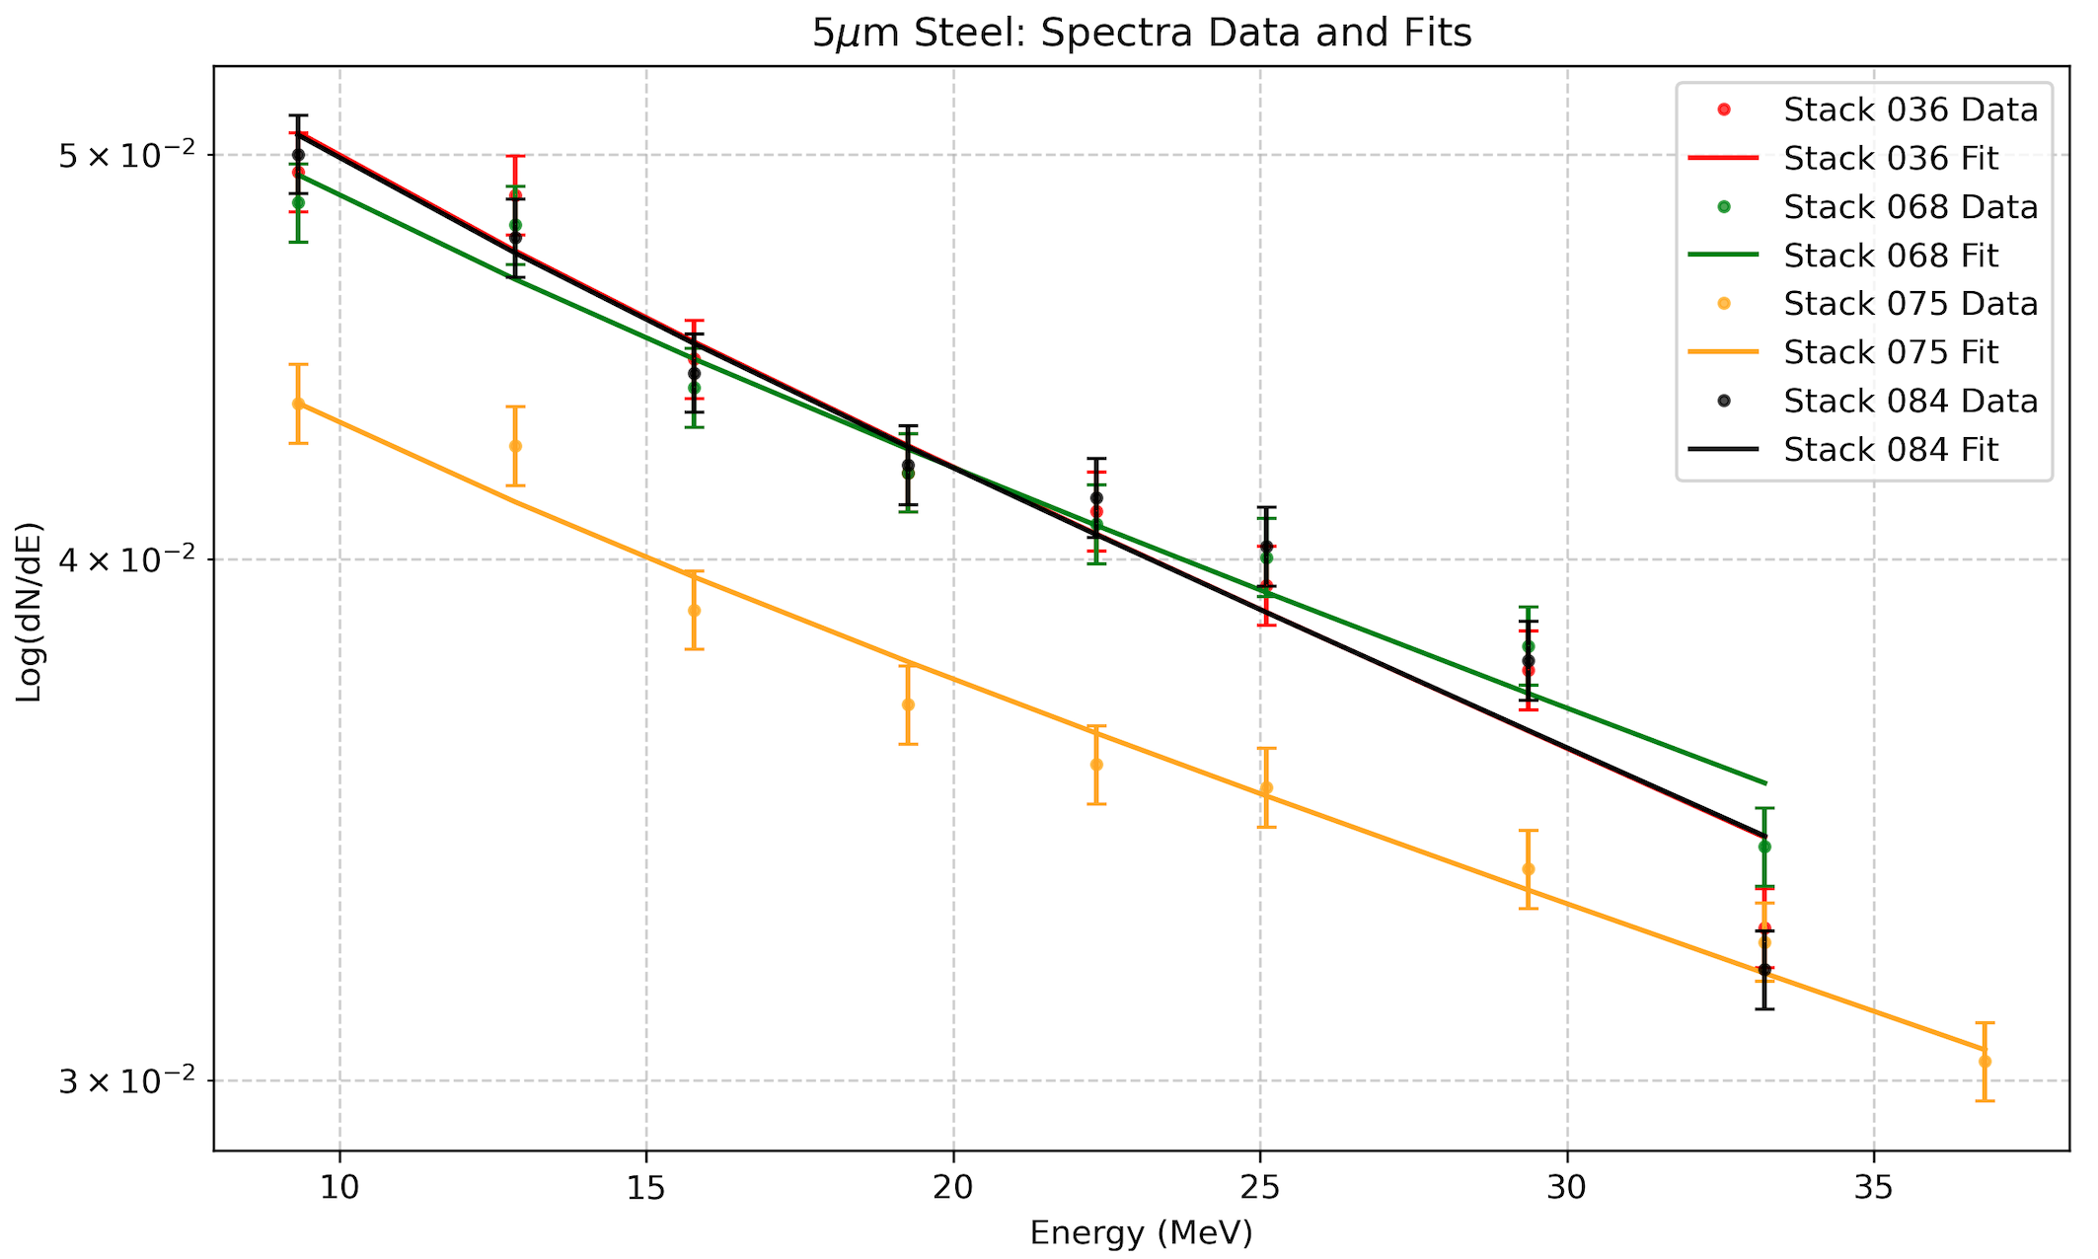
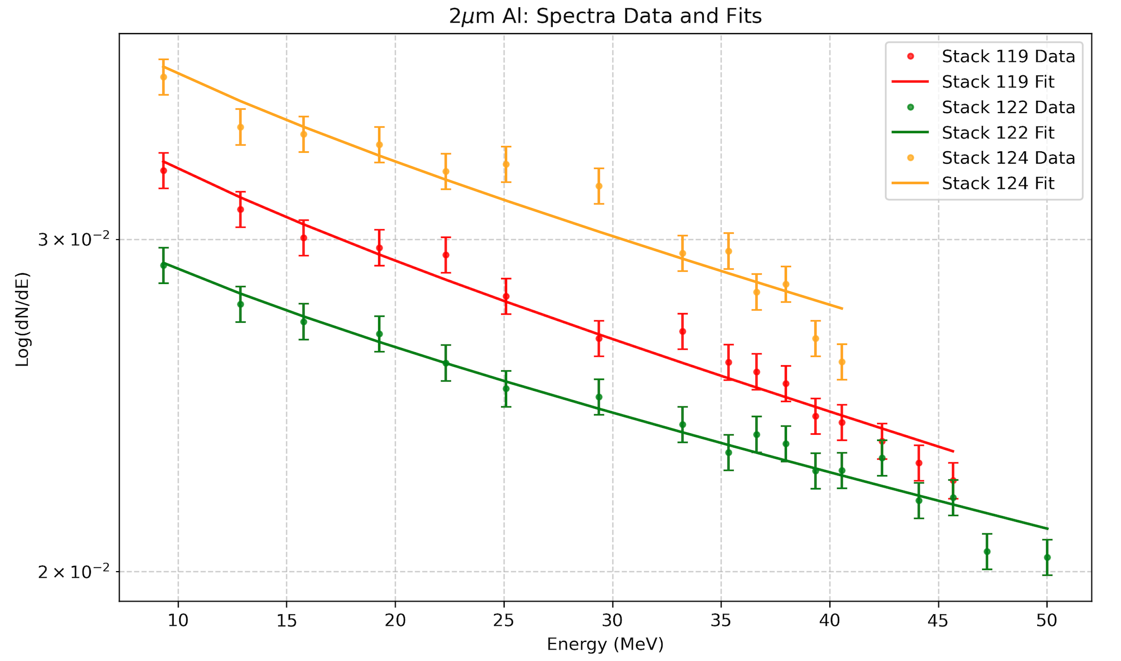
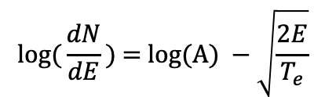
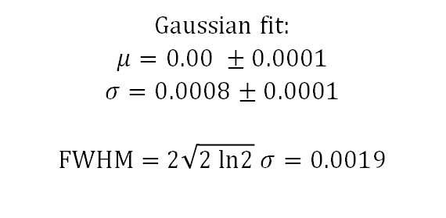
Statistical Analysis
Residual Analysis
Residual analysis assesses the deviations between the simulated and experimental data
$$l\text{og}\text{(}\frac{dN}{dE}\text{) = }\text{log}\text{(}\text{A}\text{) }−\sqrt{\frac{2E}{T_{e}}}$$
Gaussian fit:
$$μ=0.00 ±0.0001$$
$$σ=0.0008±0.0001$$
$$\text{FWHM}\text{ = 2}\sqrt{2 \text{ln}2} σ=0.0019$$
Fitted a logarithmic function of the form:
Notes:
Simulated the results from multiple different stacks
Plotted the residual between the model and the experimental results?
• • Used that to obtain an uncertainty…

Slide 13
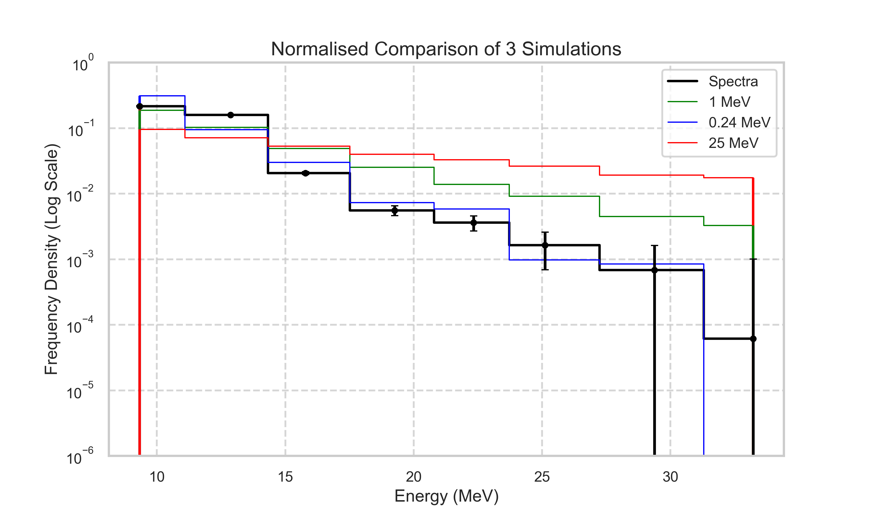
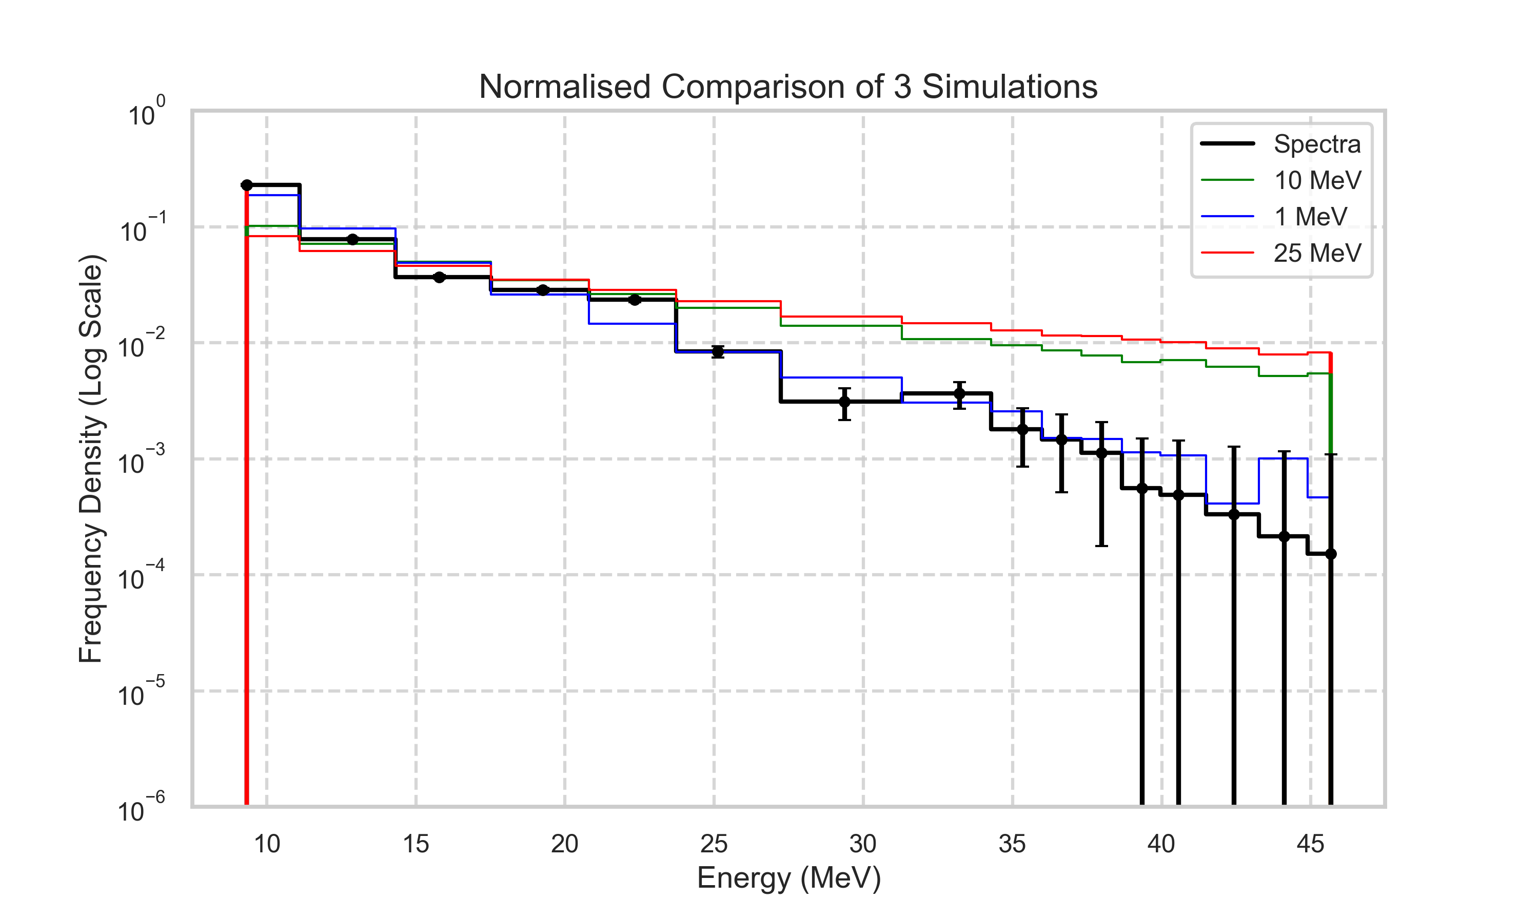




Statistical Analysis
Methodology and Final Plots
Stack 036: 5 $μ$m Target
Stack 119: 2 $μ$m Target
$$χ_{ν}^{2}=32.8$$
$$χ_{ν}^{2}=8.17$$
Method employed:
Chi-squared statistic was computed for each simulated electron temperature
DOF = number of data points – number of fitting parameters
Reduced Chi-squared = Chi-squared/ DOF
Conclusions:
Simulation cannot capture the complexity of the experimental data comprehensively
Assumptions used to describe real life data analytically is too simplified;
Proton acceleration is very complex and dynamic process, making it difficult to describe it fully analytically
Notes:
Statistical analysis Methodology
The reduced chi-squared was used to determine the best electron temperature for the fit
Allows a quantitative approach for which temperature most accurately describes the results
Note that none achieve a reduced chi-squared near 1
The lower side of the errors extend below zero and while unphysical do not significantly impact the analysis
Overall:
Simulation struggles to capture the complexity of the experimental data comprehensively
Assumptions made in the model make the simulation too simplified for high level precision
• • Isothermal plasma
• Future work
The simulation remains above the experiment
In fact when temperatures below 0.24MeV or 1MeV were attempted the simulation would cut-off too quickly, leading to an incomplete energy range
• Not an issue since still mostly above the 10/15MeV for LhARA
Reduce the Te further and get a range of acceptable electron temperatures
The aim is to then show that the kinematic distributions at the end of the beamline do not vary across this range of electron temperatures

Slide 14
Project Part 2
Quadrupole Analysis

Slide 15
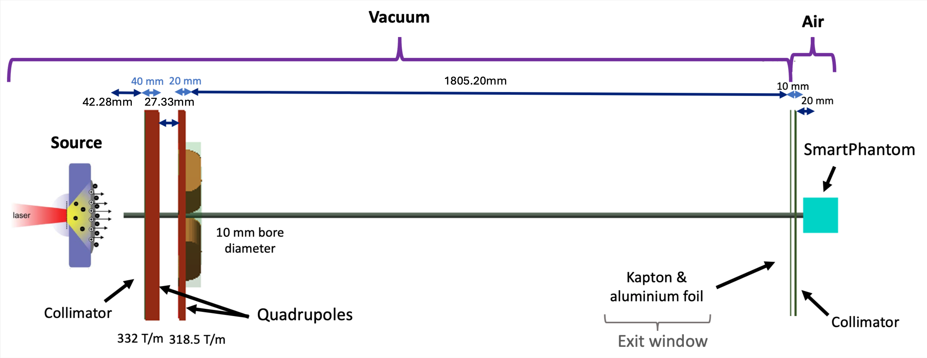



Experiment Overview
1775.20mm
46.94mm
32.33mm
$$y$$
32.33mm
$$x$$
$$z$$
Laser Parameter | Value
Wavelength | 0.8 um
Pulse Duration | 28 fs
Intensity | 4 x 10²⁰ Wcm⁻²
Energy | 70 J
Notes:
The second part of the research was to attempt a reconstruction of the beam at LION in the hopes of having a better undertsnaind before POPLAR
This is the set-up at LION with a laser driven source of these parameters, a quadrupole doublet and a kapton window
The Smart Phantom was replaced by RCF stacks
Nick analysed the stacks and the students were trying to recreate the energy deposition seen at each stack

Slide 16
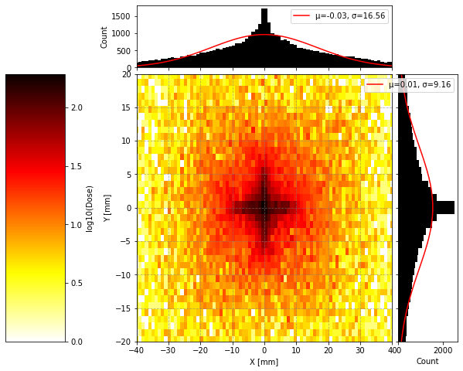
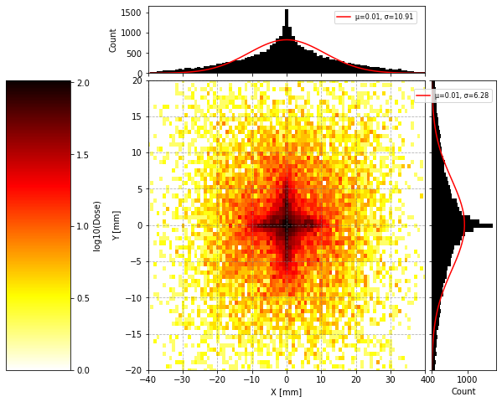
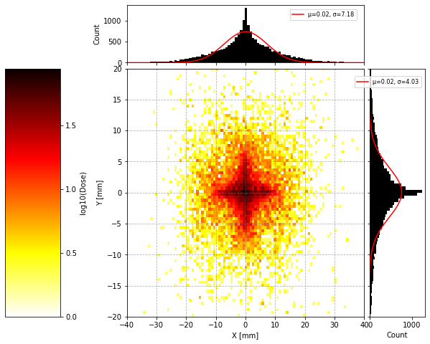
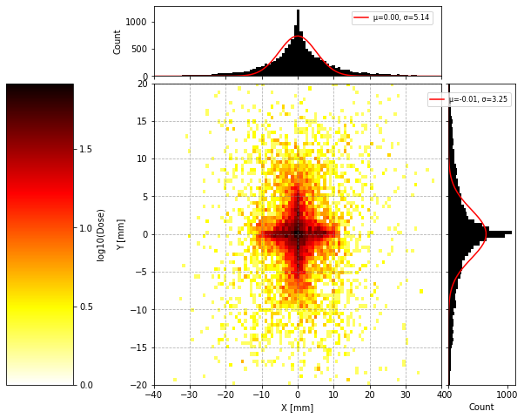
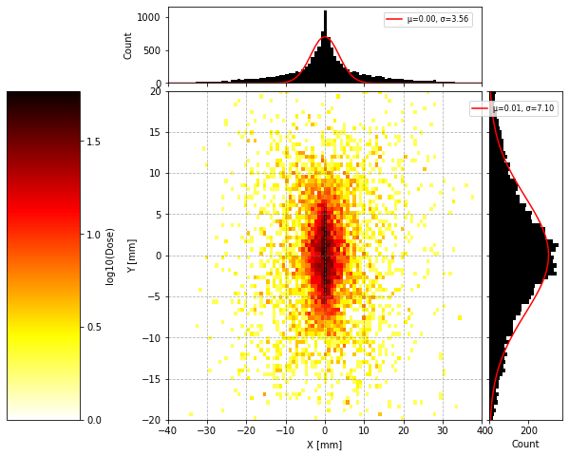
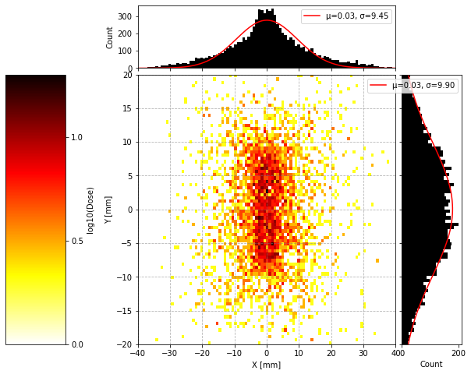
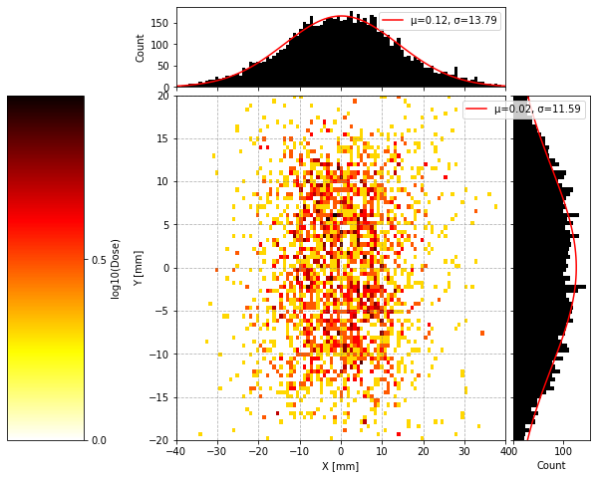
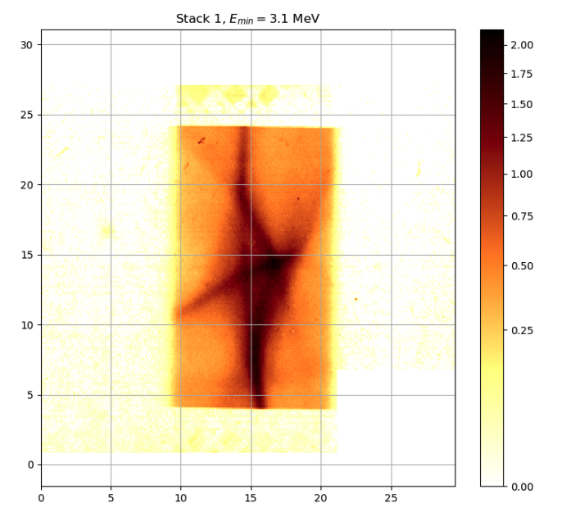
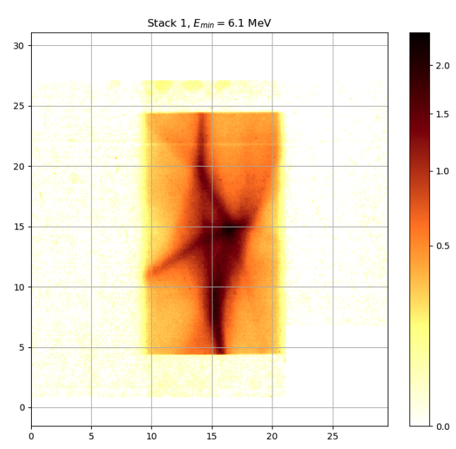
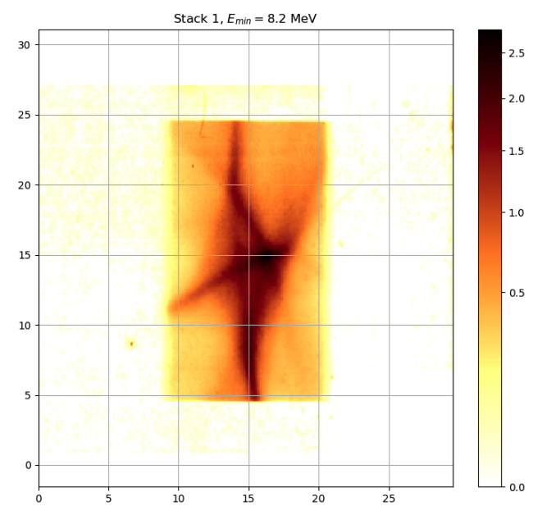
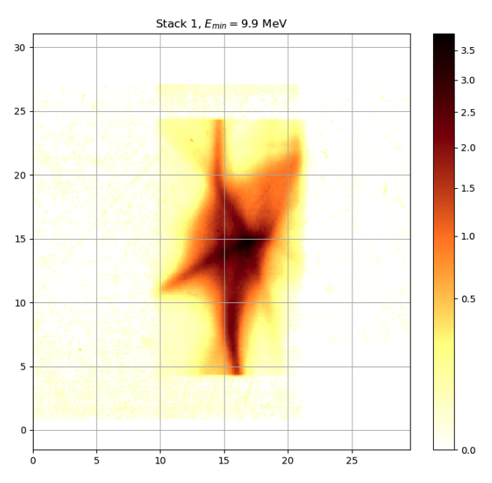
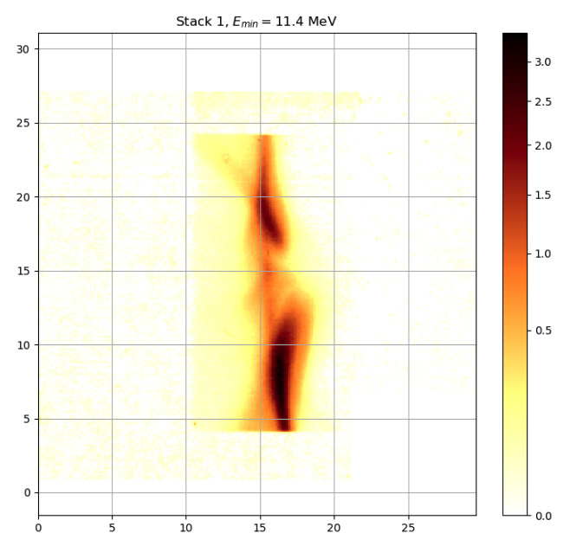
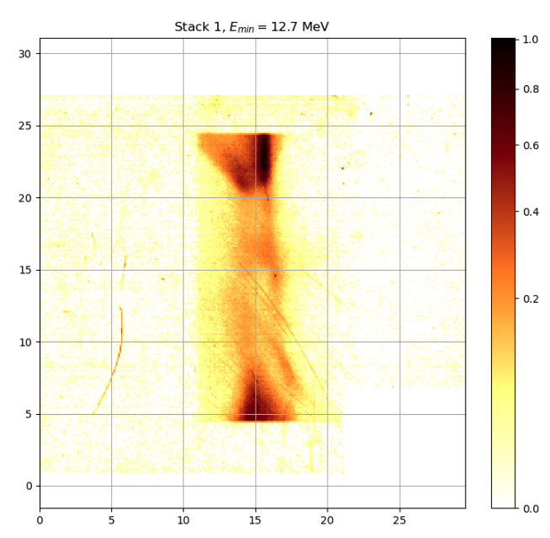
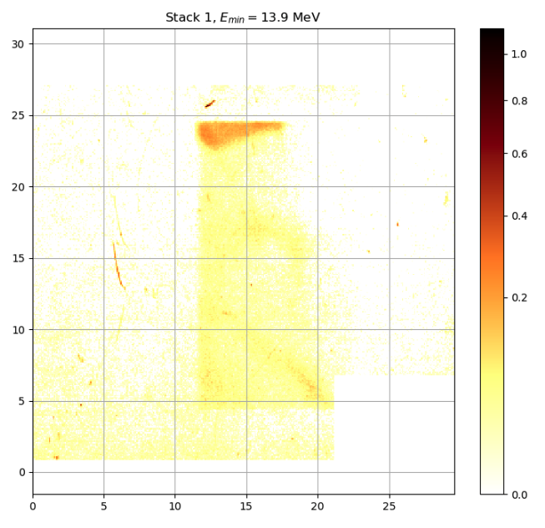







Data and Key Observations
Preliminary Simulation Results
Simulation of 1x10⁵ particles with no shifts or tilts of quadrupoles
${\text{E}}_{\text{min}} \text{=} \text{3.1 }\text{MeV}$
${\text{E}}_{\text{min}} \text{=}\text{ 6}\text{.1 }\text{MeV}$
${\text{E}}_{\text{min}} \text{=}\text{8.2} \text{MeV}$
${\text{E}}_{\text{min}} \text{=}\text{ 9.9} \text{MeV}$
${\text{E}}_{\text{min}} \text{=}\text{ 11.4} \text{MeV}$
${\text{E}}_{\text{min}} \text{=} \text{12.7 }\text{MeV}$
${\text{E}}_{\text{min}} \text{=}\text{ 13.9} \text{MeV}$
Key Observations
  Rectangular-shaped distribution seen in the simulation
  Logarithmic scale closely matches experimental data
  Notable shape change between layers 4 and 5,
Notes:
At the bottom row are the experimental results from Nick Dover as seen on the RCF stacks
• • Crucially the sim recreates the rectangular shape of the experiment as well as the shape change as seen in the layers highighted here

Slide 17
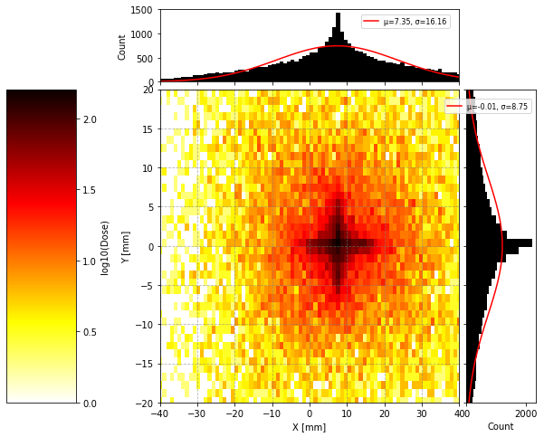
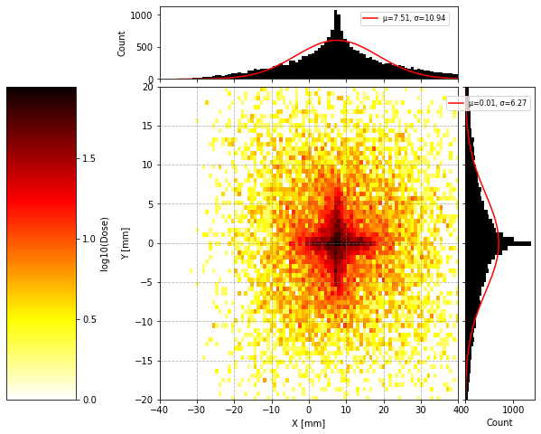
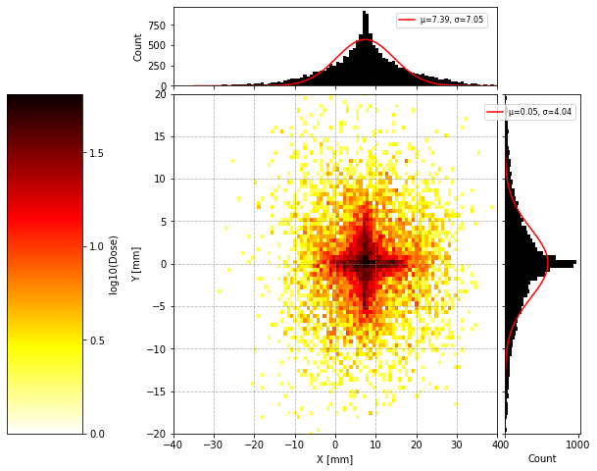
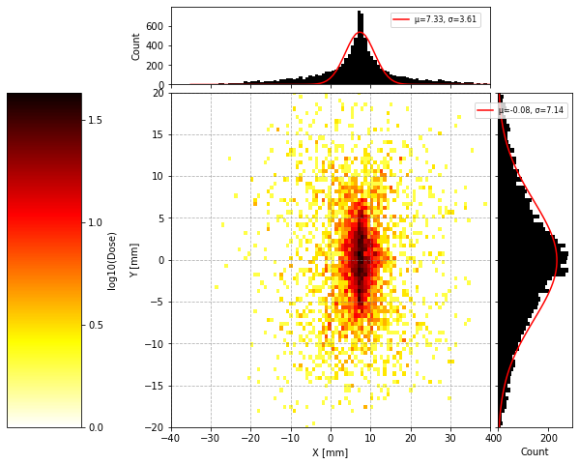
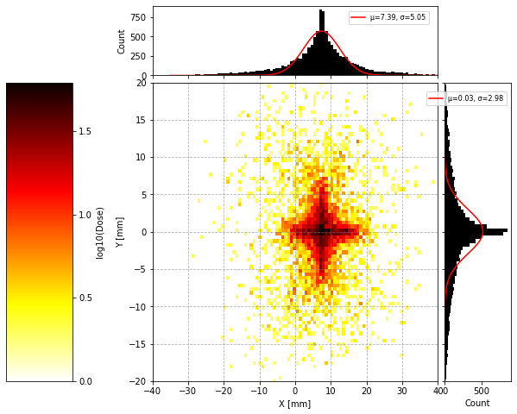
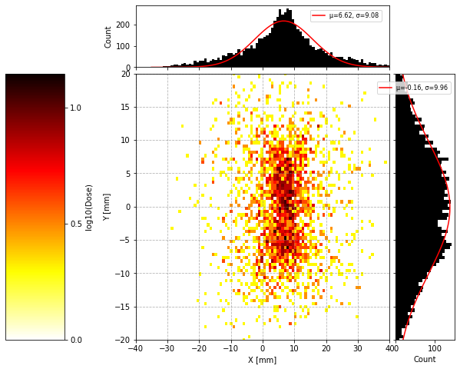
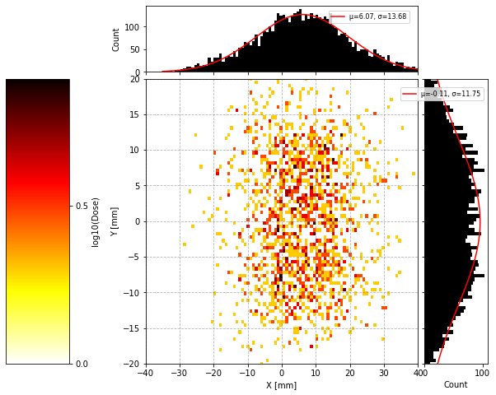



Focusing Quadrupole Shift
Shift: x = +0.1mm
Simulation of 1x10⁵ particles
${\text{E}}_{\text{min}} \text{=} \text{3.1 }\text{MeV}$
${\text{E}}_{\text{min}} \text{=}\text{ 6}\text{.1 }\text{MeV}$
${\text{E}}_{\text{min}} \text{=}\text{8.2} \text{MeV}$
${\text{E}}_{\text{min}} \text{=}\text{ 9.9} \text{MeV}$
${\text{E}}_{\text{min}} \text{=}\text{ 11.4} \text{MeV}$
${\text{E}}_{\text{min}} \text{=} \text{12.7 }\text{MeV}$
${\text{E}}_{\text{min}} \text{=}\text{ 13.9} \text{MeV}$
Key Observations:
Asymmetry in the focusing effect – lateral shift
Lower energy particles are more susceptible to small deviations
Notes:
a shift in x creates a dipole effect in the quad creating a lteral shift in the transverse profile
Most visible for lower energies since dipole effects have more of an impact on them
• • This shows that even a small shift can cause a difference

Slide 18
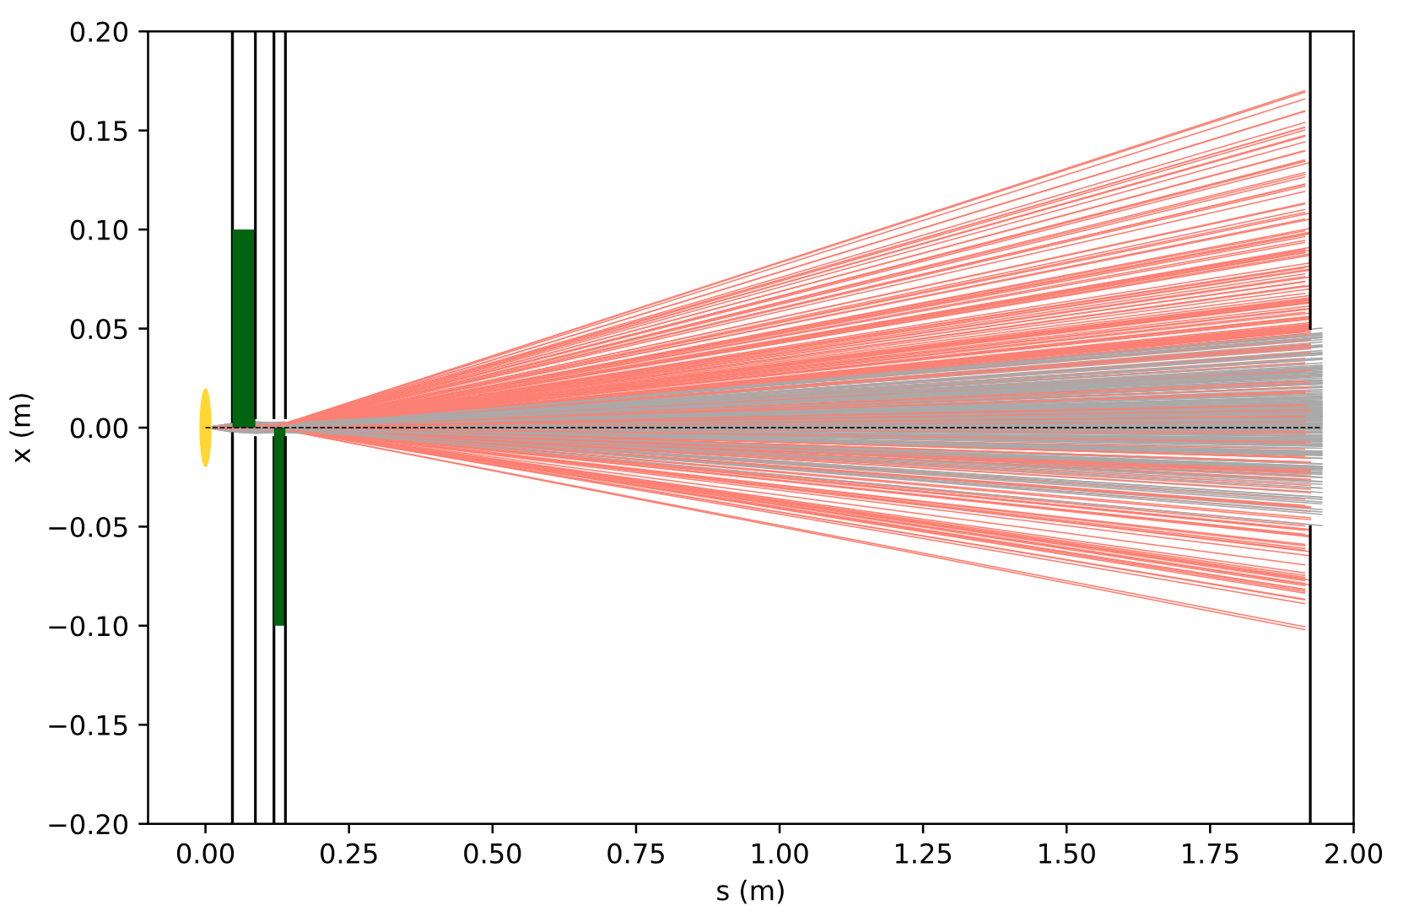
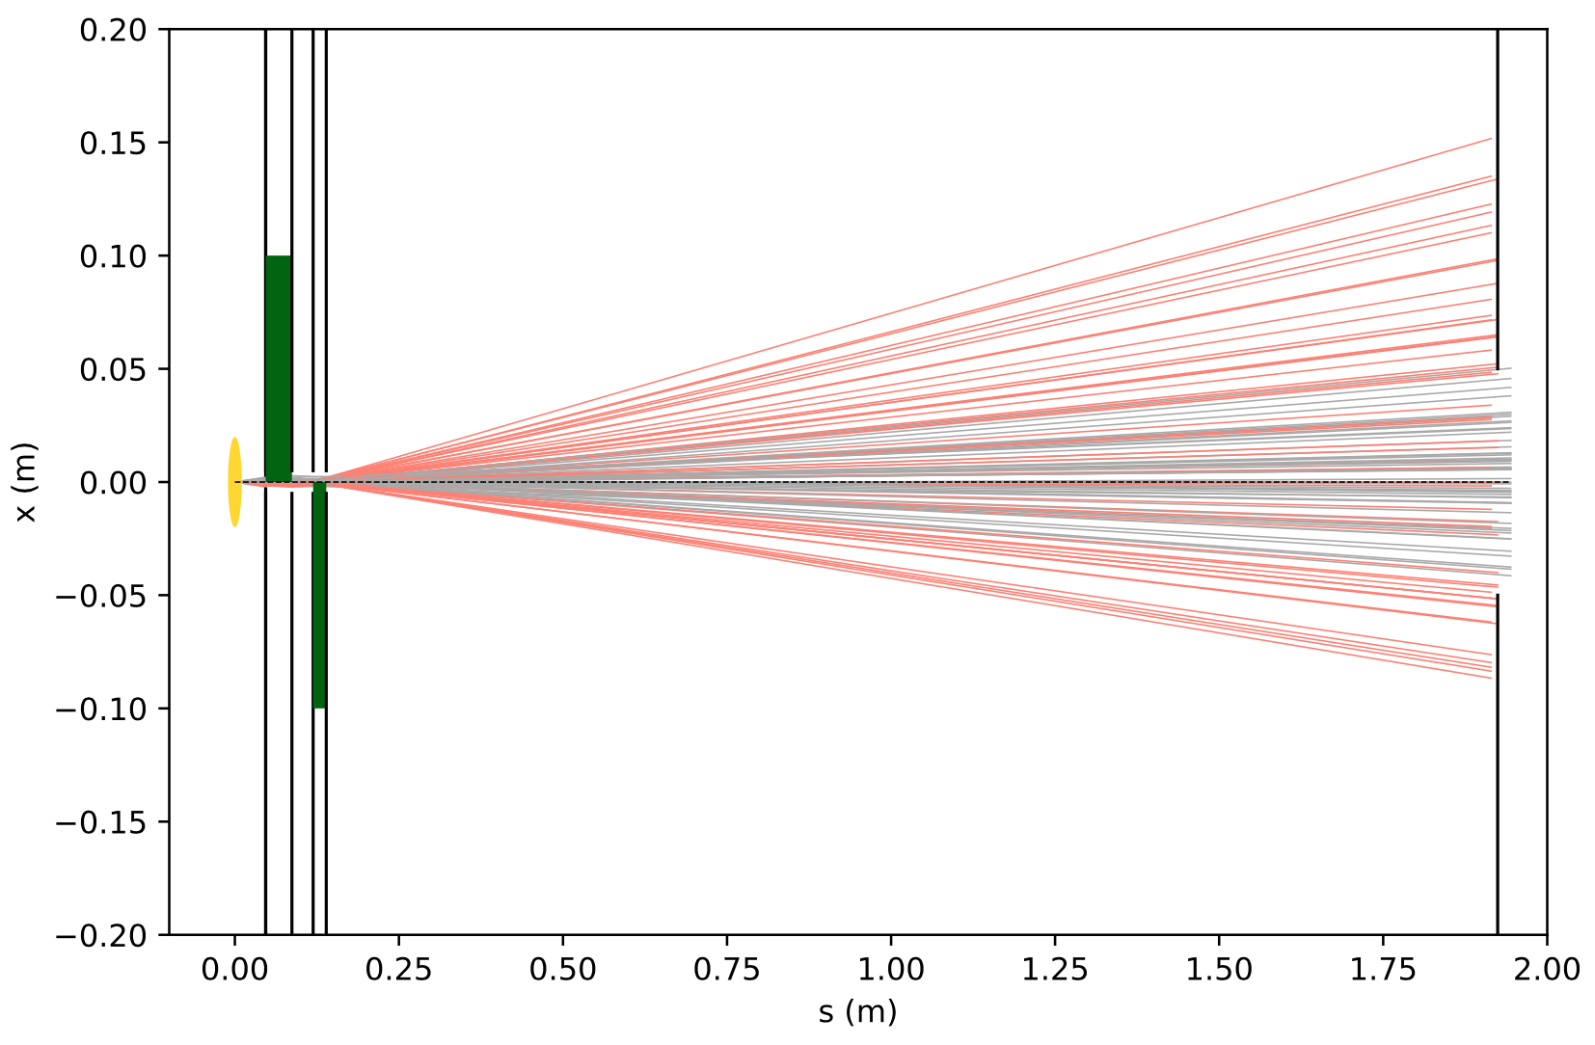
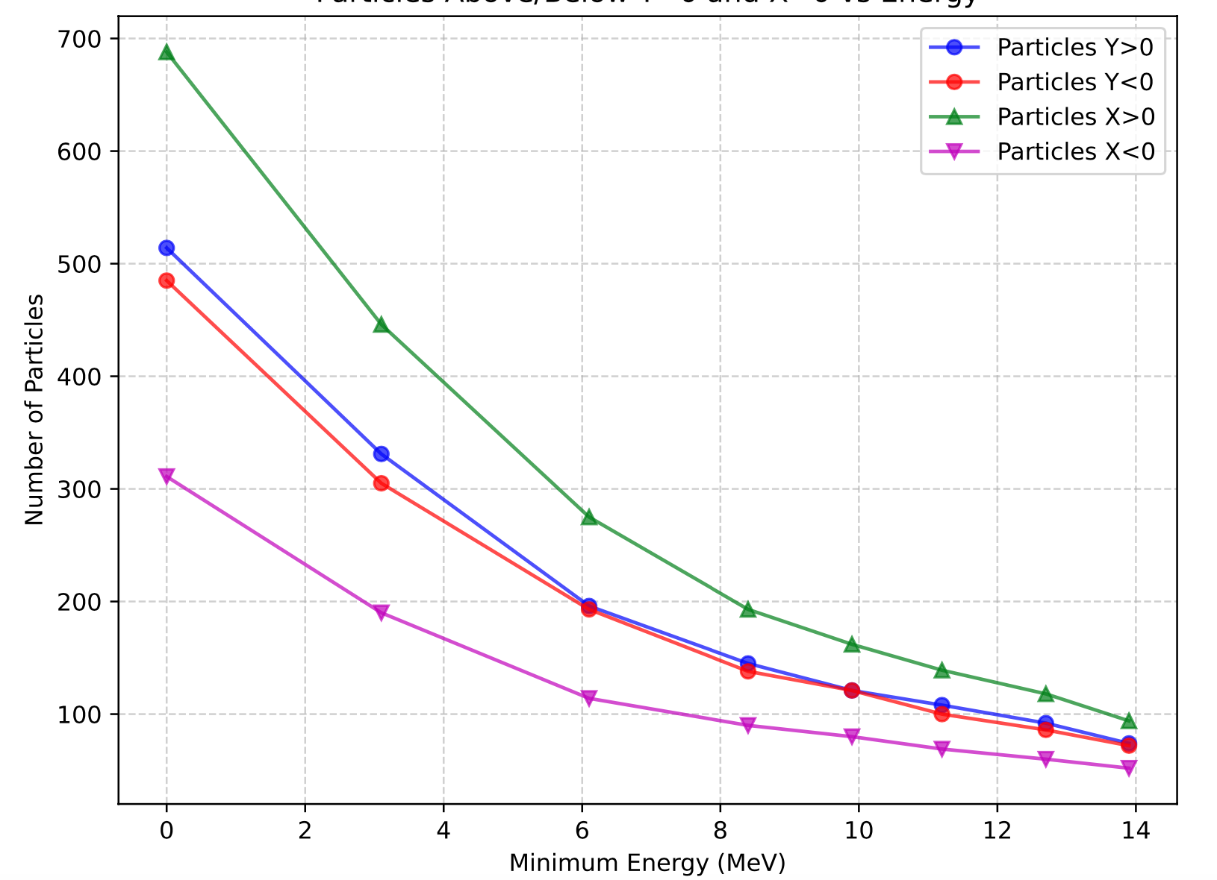
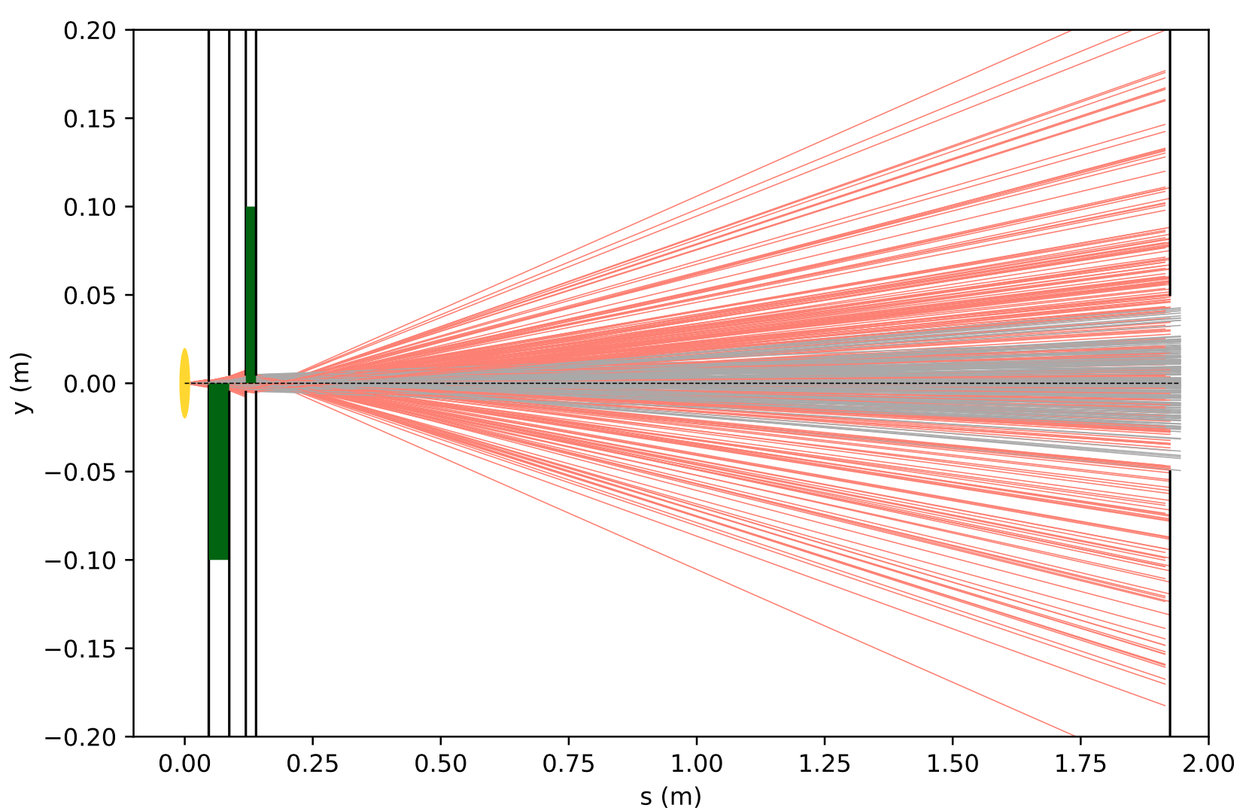
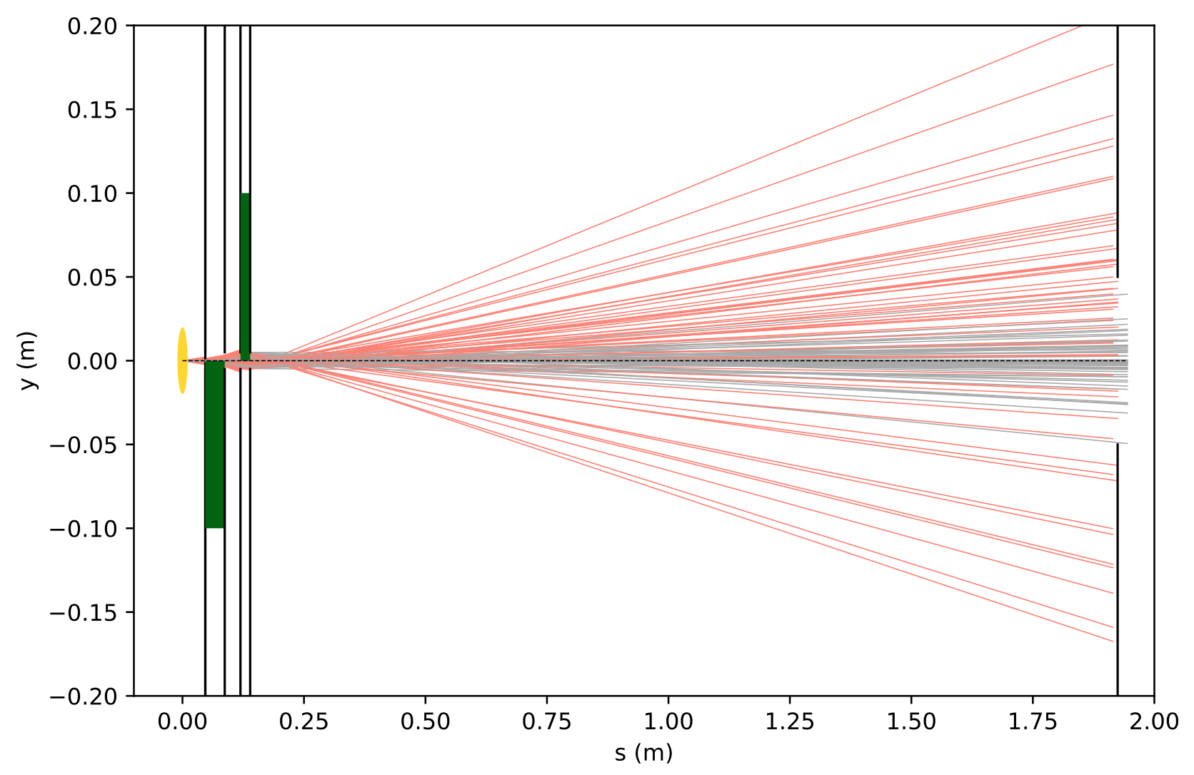


Visualising Beam
Shift: x = +0.1mm
${\text{E}}_{\text{min}} \text{=} \text{3.1 }\text{MeV}$
${\text{E}}_{\text{min}} \text{=}\text{ 13.9} \text{MeV}$
Notes:
This is the beam as seen by the simulation
The graph on the right again describes the effect of the shift in x
Not much difference between y greater than or equal to 0
• • Many more particles at x>0

Slide 19
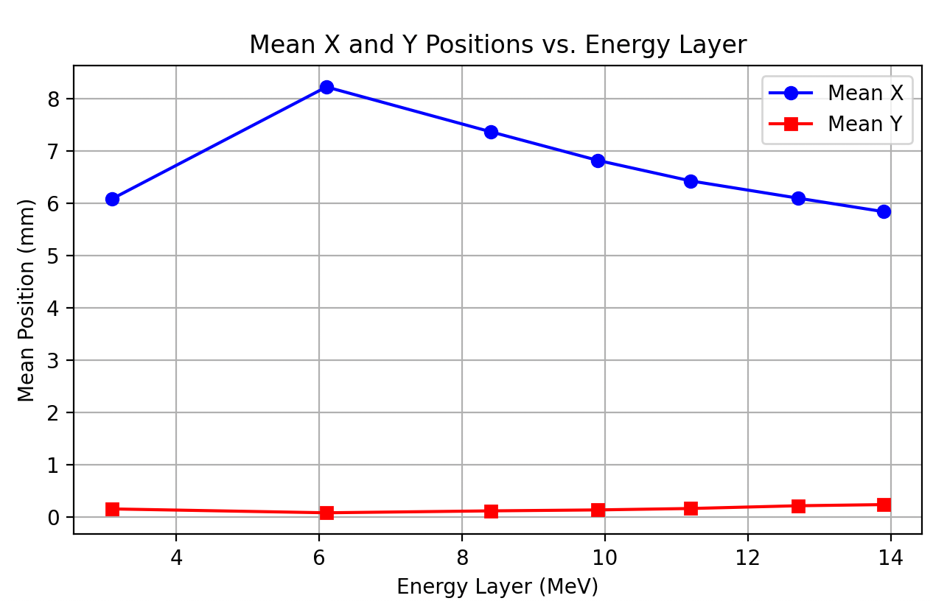

Focusing Quadrupole Shift
Simulation of 1x10⁵ particles
Shift: x = +0.1mm
Misalignment of the first quadrupole causes systematic horizontal displacement of protons.
Lower-energy protons (early RCF layers) shift more.
Higher-energy protons (deeper RCF layers) shift less.
As low-energy protons stop, the remaining beam shifts back to center, explaining the X-position trend.
Notes:
Another description of this shift
• • Again showing a stronger effect for lower energy particles and in the x axis

Slide 20







Focusing Quadrupole Tilt
Tilt: $α$= +0.1 rad
Simulation of 1x10⁵ particles
${\text{E}}_{\text{min}} \text{=} \text{3.1 }\text{MeV}$
${\text{E}}_{\text{min}} \text{=}\text{ 6}\text{.1 }\text{MeV}$
${\text{E}}_{\text{min}} \text{=}\text{8.2} \text{MeV}$
${\text{E}}_{\text{min}} \text{=}\text{ 9.9} \text{MeV}$
${\text{E}}_{\text{min}} \text{=}\text{ 11.4} \text{MeV}$
${\text{E}}_{\text{min}} \text{=} \text{12.7 }\text{MeV}$
${\text{E}}_{\text{min}} \text{=}\text{ 13.9} \text{MeV}$
Tilt changes angle at which proton enters the quadrupole field
Results in uneven focusing effect – some particles experiences stronger focusing while other are deflected in unintended
directions
Notes:
This is a tilt around the z-axis
Causes a tilt in the transverse profile too
Starting to produce a similar star shape
• • Has a disproportionate effect on particles towards the edge of the distribution causing an overall growth

Slide 21









Visualising Beam
${\text{E}}_{\text{min}} \text{=} \text{3.1 }\text{MeV}$
${\text{E}}_{\text{min}} \text{=}\text{ 13.9} \text{MeV}$
$$y$$
Q2
Q1
$$x$$
Q3
Q4
Notes:
tilt causes a focussing more particles in Q2 and Q4
• • Since the axis of the quad tilts it defocus across Q1 and Q3

Slide 22







Focusing and Defocusing Quadrupole Combination Tilt
FQ: $β$ = -0.005 rad, $γ$ = 0.005 rad;
DQ: $β$ = -0.005 rad, $γ$ = 0.005 rad
Simulation of 1x10⁵ particles
${\text{E}}_{\text{min}} \text{=} \text{3.1 }\text{MeV}$
${\text{E}}_{\text{min}} \text{=}\text{ 6}\text{.1 }\text{MeV}$
${\text{E}}_{\text{min}} \text{=}\text{8.2} \text{MeV}$
${\text{E}}_{\text{min}} \text{=}\text{ 9.9} \text{MeV}$
${\text{E}}_{\text{min}} \text{=}\text{ 11.4} \text{MeV}$
${\text{E}}_{\text{min}} \text{=} \text{12.7 }\text{MeV}$
${\text{E}}_{\text{min}} \text{=}\text{ 13.9} \text{MeV}$
Key Observations:
Vertical, curved section of star-shaped arm can be seen in the simulation
Notes:
By combining a tilt in both quads the curve on the LHS of the star can be recreated
See the curved arm on the LHS
• • Just for calrity, the rotation axis here are euler angles following the intrinsic Z-Y-Z convention

Slide 23








Visualising Beam
${\text{E}}_{\text{min}} \text{=} \text{3.1 }\text{MeV}$
${\text{E}}_{\text{min}} \text{=}\text{ 13.9} \text{MeV}$
$$y$$
Q2
Q1
$$x$$
Q3
Q4
Notes:
The visualsalisation at different Emin values shows that higher-energu protons still maintain a relatively collimated shape, but lower energy protons are significantly more scattered, as seen by the plot on the right where lower energy particles in each quadrant has a varying number of particles, whilst the higher energy particles numbers in each quadrant stay roughly the same.

Slide 24

Focusing and Defocusing Quadrupole Combination Tilt and Shift
FQ: $β$ = -0.005 rad, $γ$ = 0.005 rad;
DQ: $β$ = -0.005 rad, $γ$ = 0.005 rad
Simulation of 1x10⁵ particles
Tilting quadrupoles couples horizontal (X) and vertical (Y) motion, introducing a transverse force.
Unlike simple misalignment, this cumulative shift increases continuously along the beamline.
No restoring force → Mean X-position increases with energy instead of restoring.
Notes:
Explanantion for larger shift as enery grows
A lower energy particle gets a larger kick due to the tilt
Because it is then further from the centre of the second quad, the second quad applies a stronger force restoring it.
The reason the second quad is a restoring force is that it has exactly the same tilts as the first quad, but a different axis on which it focusses and defocusses.
• • Because lower energy particles get a larger kick originally they feel a larger restoring kick

Slide 25







Focusing and Defocusing Quadrupole Combination Tilt
FQ: x = +0.1mm, $α$ = +0.004 rad, $β$ = 0.004 rad, $γ$ = -0.003 rad;
DQ: x = +0.1mm, $α$ = -0.004 rad,$β$ = 0.004 rad, $γ$ = -0.003 rad
Simulation of 1x10⁵ particles
${\text{E}}_{\text{min}} \text{=} \text{3.1 }\text{MeV}$
${\text{E}}_{\text{min}} \text{=}\text{ 6}\text{.1 }\text{MeV}$
${\text{E}}_{\text{min}} \text{=}\text{8.2} \text{MeV}$
${\text{E}}_{\text{min}} \text{=}\text{ 9.9} \text{MeV}$
${\text{E}}_{\text{min}} \text{=}\text{ 11.4} \text{MeV}$
${\text{E}}_{\text{min}} \text{=} \text{12.7 }\text{MeV}$
${\text{E}}_{\text{min}} \text{=}\text{ 13.9} \text{MeV}$
Key Observations:
Vertical, curved section of star-shaped arm can be seen in the simulation
Notes:
Finally after searching many different orientations and combinations, this combination appeared to recreate the RCF stack profile the best
Explanantion of SD graph
Expect a dip in the middle around the 12MeV mark
Also expect a larger deviation for lower energy particles causing the rise towards that end
I believe the tilts cause the minima to occur at lower than 12 MeV
Difference in x and y
x has more deviation becuase of the offset in x
offset also causes the minima to occur at higher energy in x
• • Finally, worth noting the number of particles reduces significantly increasing the standard deviation with particle energy

Slide 26

Focusing and Defocusing Quadrupole Combination Tilt and Shift
FQ: x = +0.1mm, $α$ = +0.004 rad, $β$ = 0.004 rad, $γ$ = -0.003 rad;
DQ: x = +0.1mm, $α$ = -0.004 rad,$β$ = 0.004 rad, $γ$ = -0.003 rad
Simulation of 1x10⁵ particles
Low Energy (3-6 MeV) – Large SD
  More sensitive to tilts/shifts → larger SD at low energy.
Mid Energy (8-10 MeV) – Smallest SD
  Protons reach their natural focal point → tightest beam, smallest SD.
High Energy (12-14 MeV) – Large SD
  Weaker early focusing → retains initial divergence → SD increases past the focal point.
Notes:
Finally after searching many different orientations and combinations, this combination appeared to recreate the RCF stack profile the best
Explanantion of SD graph
Expect a dip in the middle around the 12MeV mark
Also expect a larger deviation for lower energy particles causing the rise towards that end
I believe the tilts cause the minima to occur at lower than 12 MeV
Difference in x and y
x has more deviation becuase of the offset in x
offset also causes the minima to occur at higher energy in x
• • Finally, worth noting the number of particles reduces significantly increasing the standard deviation with particle energy

Slide 27
Discussion on Fringe Fields
Realistic vs. Hard-Edge model in quadrupole magnets:
Hard-edge model assumes the magnetic field abruptly starts and stops at the quadrupole boundaries
    Neglects fringe fields that extend beyond the physical edge of mag
Realistic model accounts for gradual field decay
    Essential for modelling higher-order effects
Need for better magnetic field modelling:
Second order aberrations arise from nonlinear variations in the magnetic field
Fringe fields can introduce unexpected focusing shifts
Notes:
Finally, there are factors that need to be considered in the cause of these effects.
These include the fringe field effects in the PMQs, since LnOps is a matrix transformation model it means it is hard-edged.
• • To study these effects a reproduction of these results in BDSim is required

Slide 28








Discussion for SCAPA
FQ: x+0.1mm
FQ: $α$+ 0.01rad
FQ: x+0.1mm, $α$+0.004 rad, $β+$0.004 rad, $γ$-0.003 rad
DQ: x+0.1mm, $α$-0.004 rad,$β+$0.004 rad, $γ$-0.003 rad
DQ: x+0.1mm
DQ: $α$+ 0.01rad
Notes:
• I also used their simulations on the beamline at SCAPA to see the results
• The tilts and shifts produce the same distributions
• The final distribution they found that best suited the RCF stack so far reproduced similar results
Possibly do not expect as sensitive a set-up in SCAPA due to the reduced quadrupole strengths employed
• • Josie did a sensitivity study with a gaussian beam previously and found that the set up is more sensitive to movements in the first quad.

Slide 29
Conclusion and Future Work
Successfully investigated proton acceleration using a laser-driven source
Evaluated the LLO simulation model against experimental data from N. Dover’s experiment
      Found that the analytical model does not accurately describe the experimental data due to the complexity of the acceleration process
Analysed quadrupole effects on beam transport, demonstrating their impact on spatial energy deposition patterns
Further refinement of quadrupole modelling, including fringe field effects, could enhance simulation accuracy
Notes:
The students successfully evaluated the simulation model of the laser driven source
Began to reconstruct the profiles seen in the RCF stacks by making adjustments to quadrupoles
Avenues for future work are numerous with considerations needed in:
Fringe field effects
Potential variance in the source and movement of the emittance position
Finally, there was a realisation that the students had been plotting the x and y distributions of the particles
• • A Bayesian Optimisation approach is planned with a loss function required before further progress can be made

Slide 30
Thank you
Evaluation of a Laser-Driven Proton Beam for Biomedical Applications
20/03/2025

