Slide 1
Update and news

Slide 2
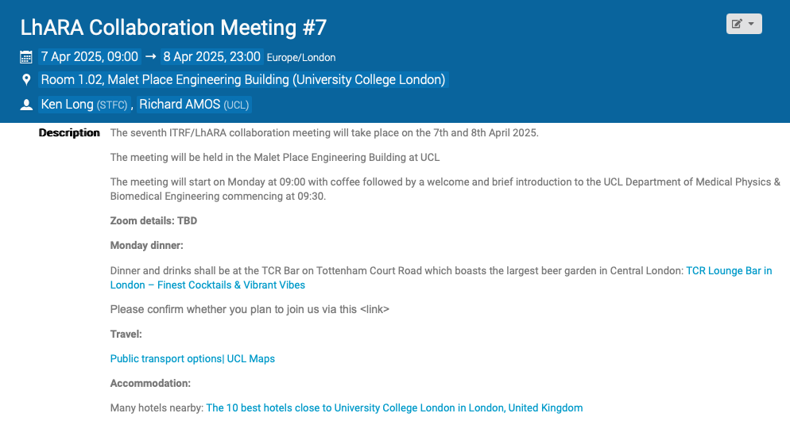
https://indico.stfc.ac.uk/event/1438/

Slide 3
Going forward
Next CM … UCL, 7—8 Apr25
  Please register
  Progress and planning
  Towards the future
https://indico.stfc.ac.uk/event/1438/

