Slide 1

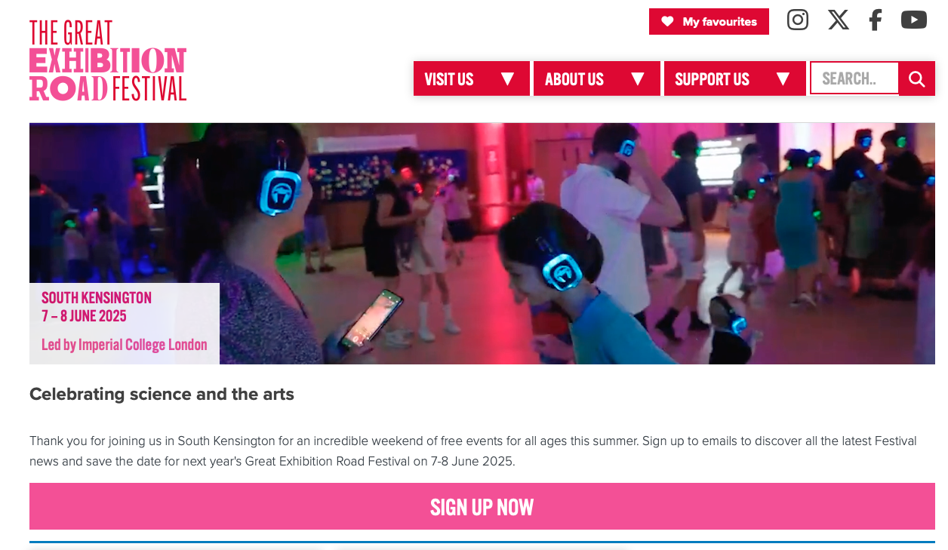
Great Exhibition Road Festival of Science

Slide 2
Initial planning [1]
Working time-line; for discussion:
  GERFoS: 07/08 June 2025
  February:
    Identify key elements in presentation/stand, identify leads and ask them to prepare a timeline so a schedule can be generated.
  Exhibits/stand to be ready, and set up at IC, one week before:
    30May25
  “Rehearsal session”, e.g. in Level 8 Common Room:
    04Jun25
  Actions:
    KL/PJ: find location at Imperial for test set-up of stand;
    KL/PJ: find if can set up stand, e.g., in Level 8 common room for rehearsal in afternoon of 04Jun25.

Slide 3
Getting going
First planning document:
  https://ccap.hep.ph.ic.ac.uk/trac/raw-attachment/wiki/Research/LhARA/GERF25/Meetings/2025-02-19/2025-02-05-GERF-001-r1.pdf
Elements of exhibit w/ coordinators:
  Extended reality : W. Shields
  3D model : W. Shields
  Lego model : Kai Gregory (STFC/PPD; science communicator), WS
  Eve Chair : K. Long interfacing to Leo Cancer Care;
    Leo personnel engaged; hope they take the lead going forward
  Posters : R. Amos, KG ← need LhARA volunteer(s)
  TriFold/WWW doc : ??, KG ← need LhARA contact + volunteer(s)
  Videos : KG ← need LhARA contact + volunteer(s)
    Perhaps exploit collaboration meeting at UCL in April to collect material
  Plasma demonstrator : W.Bertsche; KL needs to engage with Will!
  [Top Trumps : KL]
    Square brackets, probably dropping this … too many issues?
  Gathering statistics: ← need LhARA contact
    What questions?
    Implimentation coordination WS

Slide 4
Getting involved:
We meet every second Wednesday at 15:00
  Next meeting next week
Am populating mailing list:
  Will email LhARA list to invite people to register

