Slide 1
Update and news

Slide 2
Taking stock

Slide 3

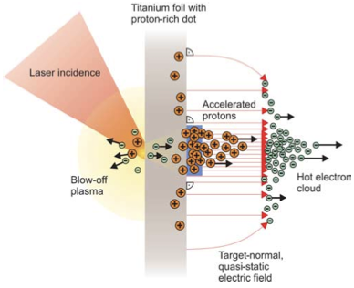
LhARA initiative; mission:
Deliver a systematic and definitive radiation biology programme
Prove the feasibility of laser-driven hybrid acceleration
Lay the technological foundations for the transformation of PBT
  automated, patient-specific proton and ion beam therapy

Slide 4
LhARA project; vision
International facility based in the UK
£225M investment (present “fully loaded” estimate)
Transform radiation biology & transform clinical practice in PBT

Slide 5
LhARA; the full Monte

Slide 6
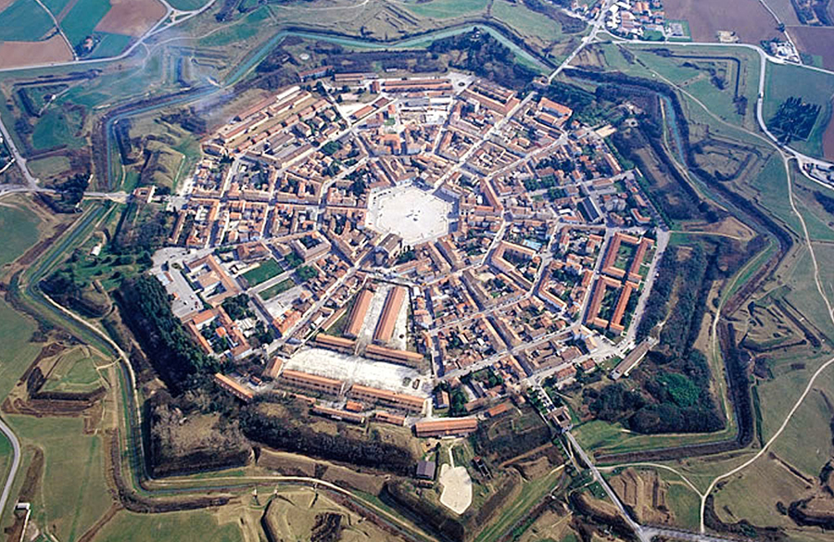
LhARA; Stage 1
Stage 1 of LhARA
Laser-hybrid, in-vitro radiobiology
World-leading technology
Industrial incubation
National & international visibility:
Collaborators and “users”
“Not just accelerator”;
instrumentation, diagnostics
imaging, fast-feedback, control
Fundamental science
AI, multi-body problem
Real-time AI; treatment planning on the fly

Slide 7
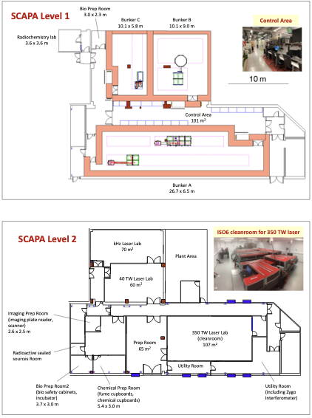
PoPLaR
Summer 2025 …

Slide 8
Taking stock
Substantial record of achievement to date
Its an excellent vision, an excellent project,
and an excellent team!
Under pressure (it’s a test):
  UKRI/IF/STFC funding ends 31May25
    Letter to new Executive Chair sent, “asking for meeting”
    Collaboration/STFC continue to work to create continuity of funding
Self-confidence under pressure:
  Pushing hard now to diversify funding:
    Philanthropic, industrial, …
  “Compartmentalised”, multi-application proposals
  A positive:
    UKRI cash-flow situation means we’ve a little time to prepare …

Slide 9
More concretely:
“Our own charity”: CP4CT:
  Slow burn, still in set up phase:
    Vision to provide resource/promote multidiscinary activity across our four nations
  Initially working with Imperial Advancement to work out avenues
Responsive mode proposal preparation:
  End-station/biomed-tech:
    Seeking routes to partner with RFI:
      Leads for LhARA: Jason and Richard
  Source and capture:
    Seeking to generate discussion of scope of proposal
      Initial contacts with relevant PIs (Strthclyd, Blfst, IC, CLF) underway
  Timescale:
    Think the financial situation implies we are working on a 12—18 month timescale

Slide 10
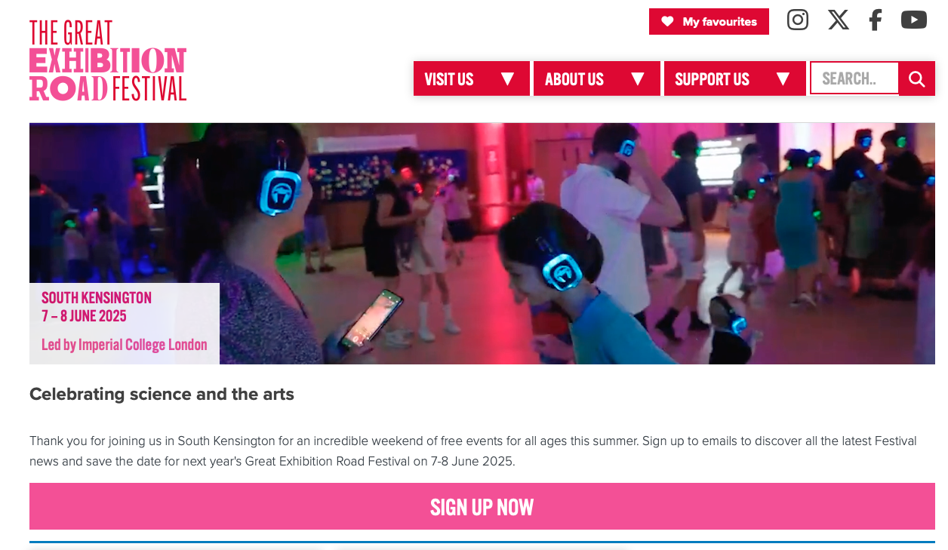

Slide 11
The Great Exhibition Road Festival of Science
07-08Jun25 …
  Step on the way in Will S’s SPARK proposal
Public engagement
VIP event(s):
  An opportunity to communicate “outside our bubble”
Our stand:
  In “European collaboration” themed area
  Lobby space at Imperial – prime location!
  CNRS & Uni Santiago on board; I’ve reached out to LMU
Opportunity!
  Planning kick-off tomorrow …
  Please do be involved!

Slide 12
Evolving our activity
Realpolitik (from German real ‘realistic, practical, actual’ and Politik ‘politics’)
Energetically working to restore resource:
  Need to plan activity beyond May25 in various scenarios
  Topic for Apr25 collaboration meeting
Not all bad:
  Provocation to work to improve what we do

Slide 13
“Future of Particle Therapy”: international meeting
Initiated by Pat
Goals:
  To define current status of particle therapy internationally; production of particles/biological science/clinical development
  What have we learnt from Flash /lattice therapy etc
  What are main challenges/priority challenges going forward; barriers and solutions
  What are main biological and clinical questions
  What is the immunological evidence to support different biological mechanism of action/stimulate interest form immune-oncology community/pharma
  Is there a case for assisting current RT and stimulation of economic growth in countries (the document)
  How do we develop the technology and benefit from the rapid developments in photon beam delivery form the commercial sector
  How could LhARA act as an international research facility
Organising committee so far:
  Pat Price (PPP/IC/RtUK, GlbCoal), Matt Williams (IC NHS h/c Trst), Jason Parsons (Brm), Richard Amos (UCL), Neil Burnett (Manch, emerit)
  Included for continuity and information:
    Massimo Noro (STFC/DL), Heather Burgess (MRC)
Target date: Apr25
Venue: Hybrid
  Will pick a central location as want international participation; but no money for travel!

Slide 14
Going forward
This “all hands”: 28Jan25
Next CM … UCL, 7—8 Apr25
Rolling w/p reports:
  Restart 2025: this time; source

