Slide 1
Update and news

Slide 2
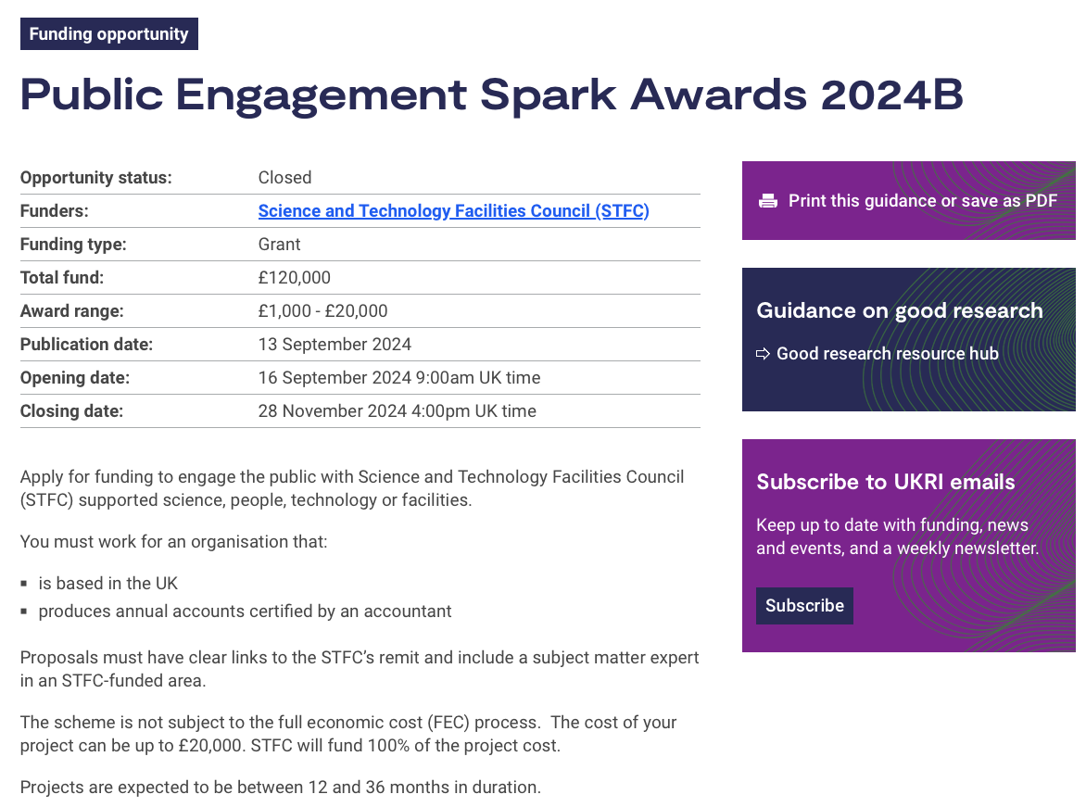
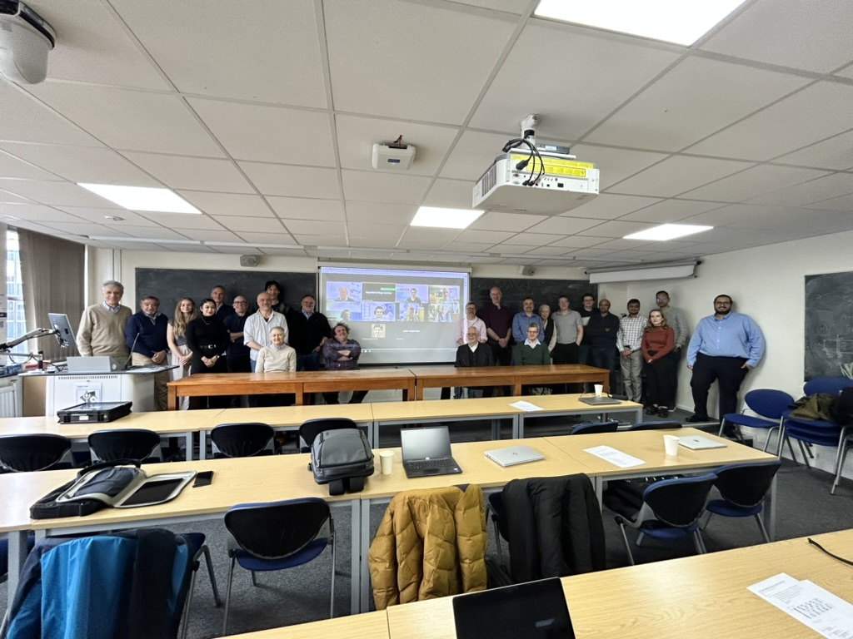

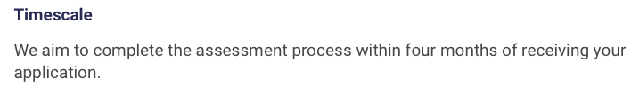
Kudos:
Will Shields

Slide 3
Bridging Period
No change; still working to ameliorate consequences of IF decision:
ITRF Project Board:
  Disappointed about decision;
  Recognises financial situation;
  Engaging in negotiations

Slide 4
MRC
Thanks to H. Burgess (MRC)
MRC’s Infrastructure and Capital Strategic Advisory Group (ICSAG) (advisory group of external experts) reviewed the outline for a full bid for UKRI’s Infrastructure Fund. ICSAG was excited by the technology and its potential but noted the proposal was high risk for MRC because the application of the technology in terms of biology had not been proven. Further, the evidence of use case for MRC and link to patients was not sufficient. In terms of scale, the current proposal required £225M and 10 years to build the infrastructure, with further investment and years needed to reach clinical relevance. Therefore, ICSAG questioned what else might develop in the timeframe to make the technology redundant in terms of application within MRC remit. ICSAG would be prepared to look at a revised bid in later years, which would need to include modelling of the proposed benefits against those of other therapies and clear evidence of the use case for MRC.

Slide 5
Going forward
Discussions continue … propose we make a hybrid “all-hands” style meeting in the Tuesday slot late January 2025:
  Propose: 28Jan25 … central venue & ZOOM
Important to take “cautious but optimistic” point of view for the moment

Slide 6
Going forward
Next “all hands”: 28Jan25
Next CM … UCL, 7—8 Apr25
Rolling w/p reports:
  Restart 2025

