Slide 1
LhARA fortnightly
3/12/2024

Slide 2
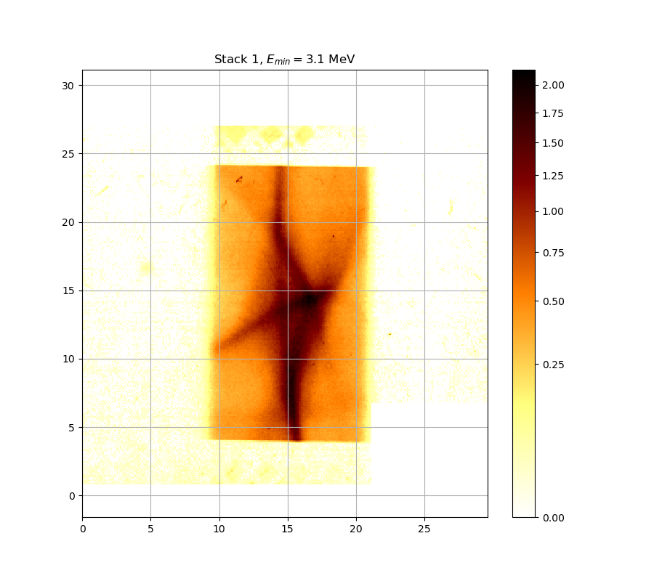
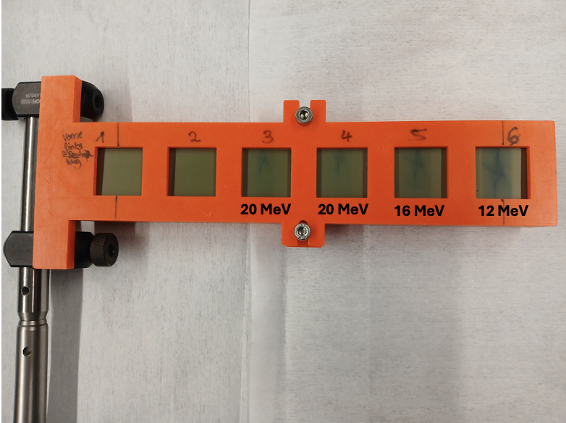
RCF Stacks

Slide 3
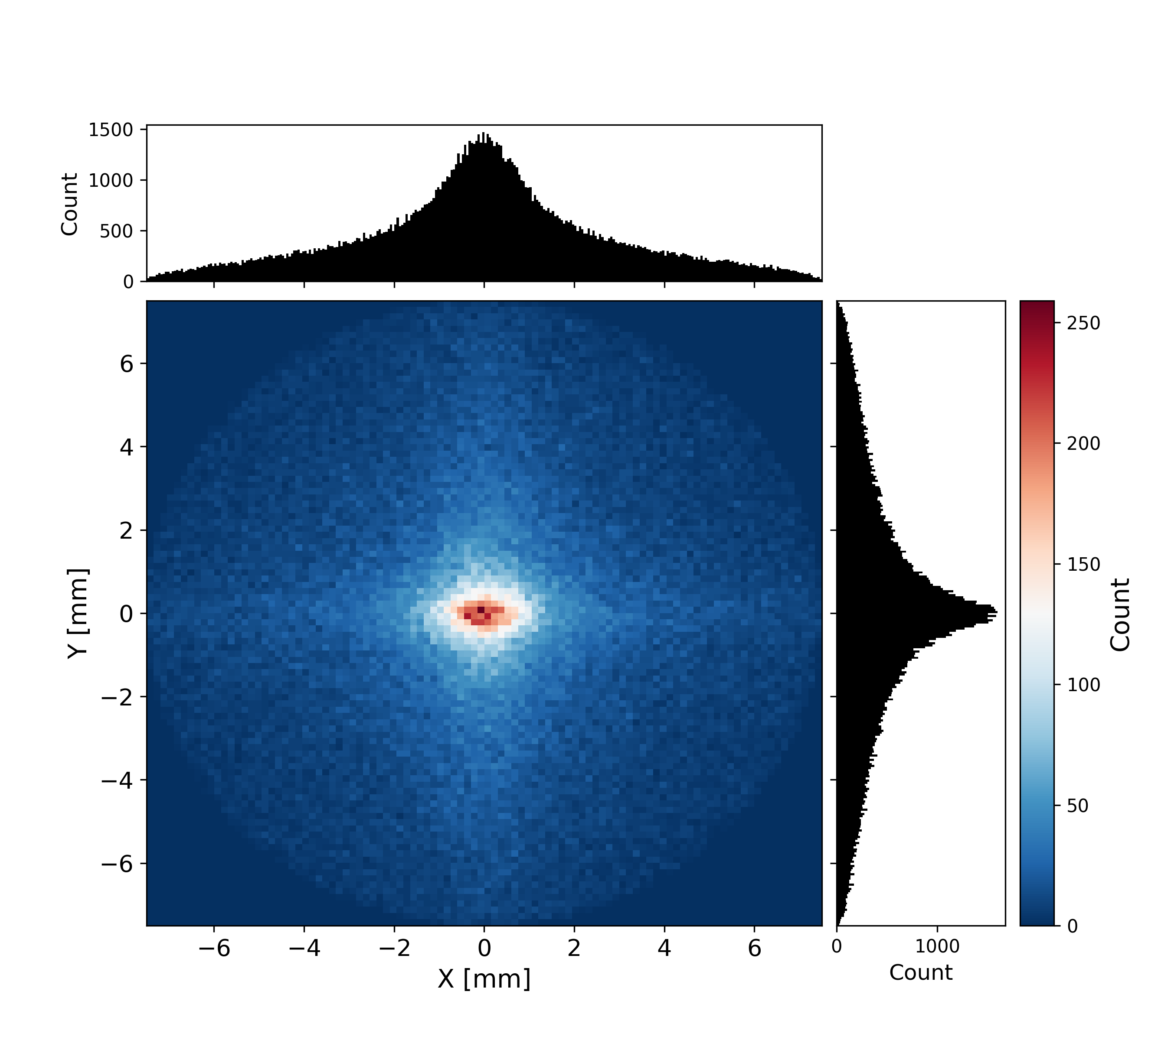
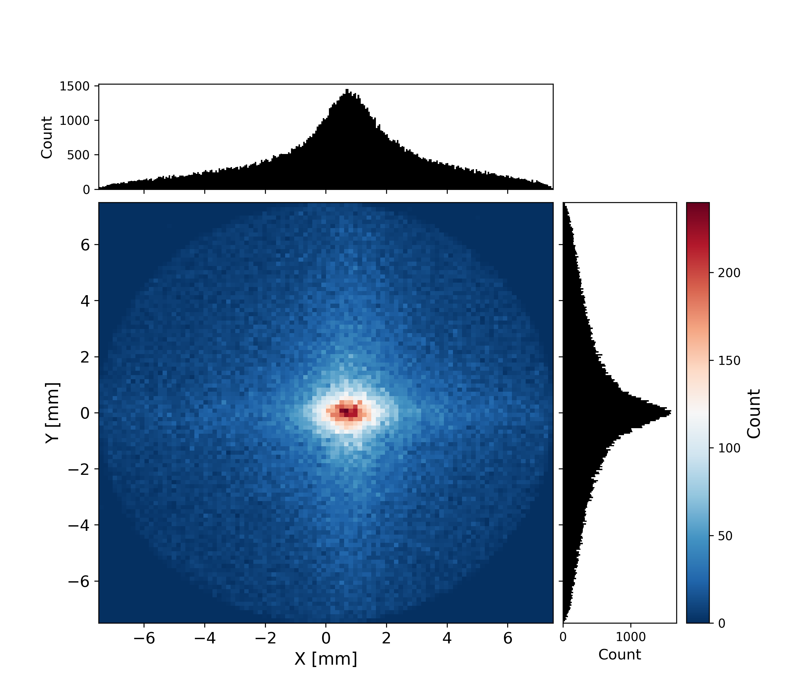
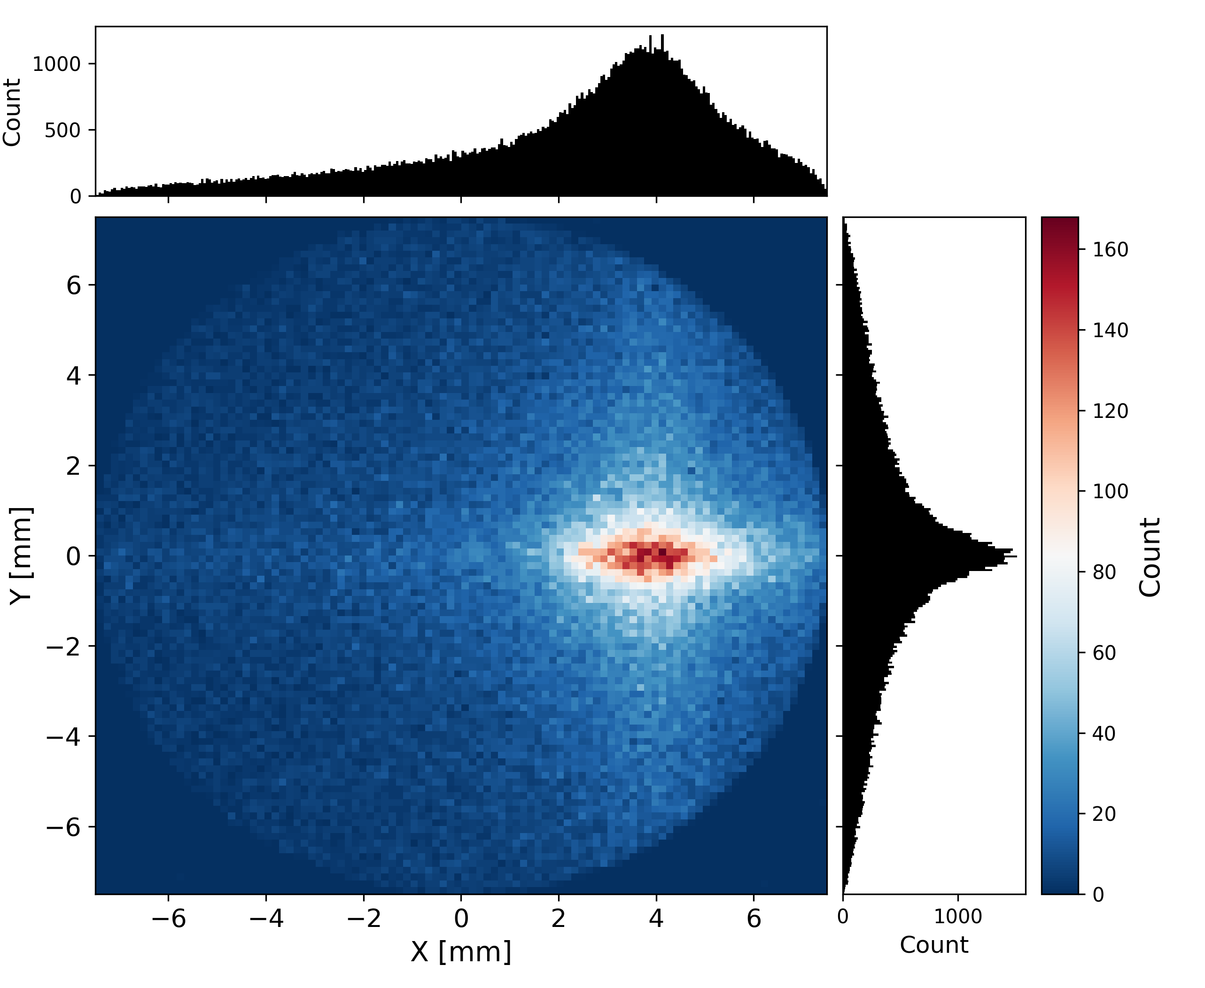
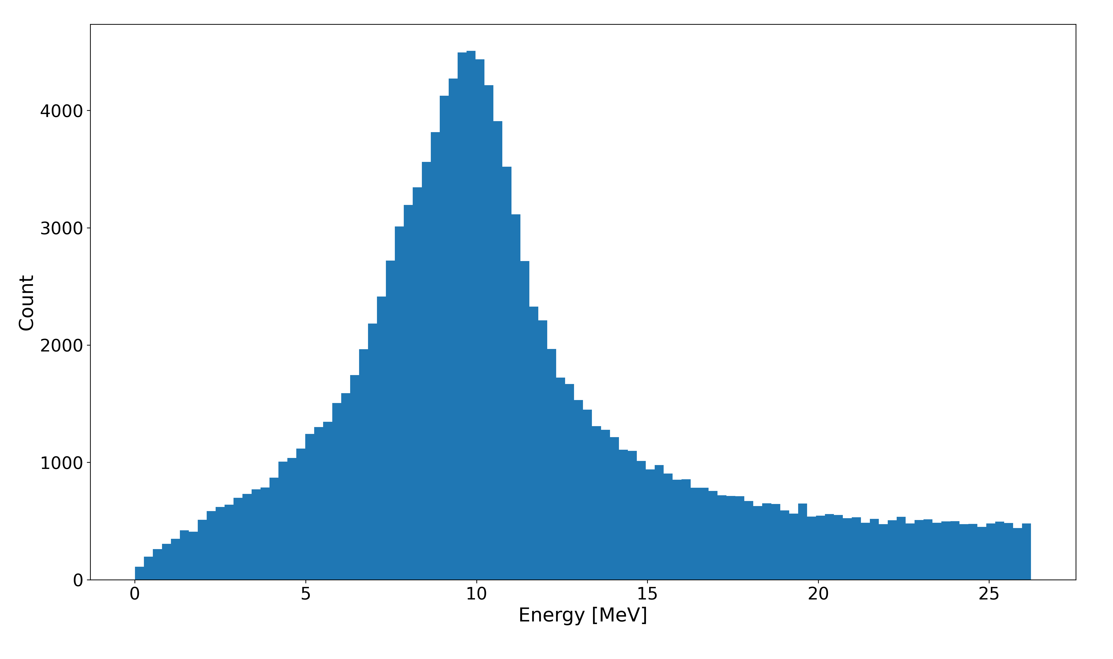
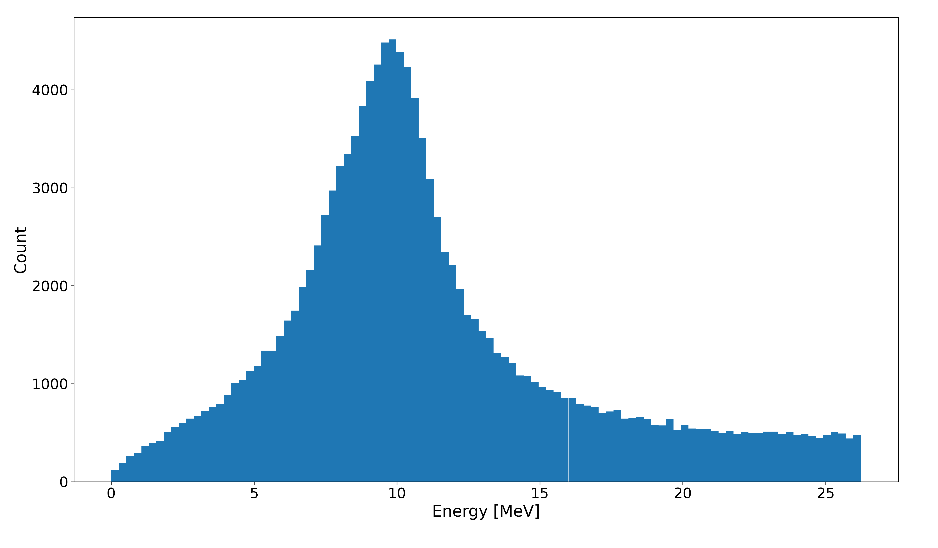
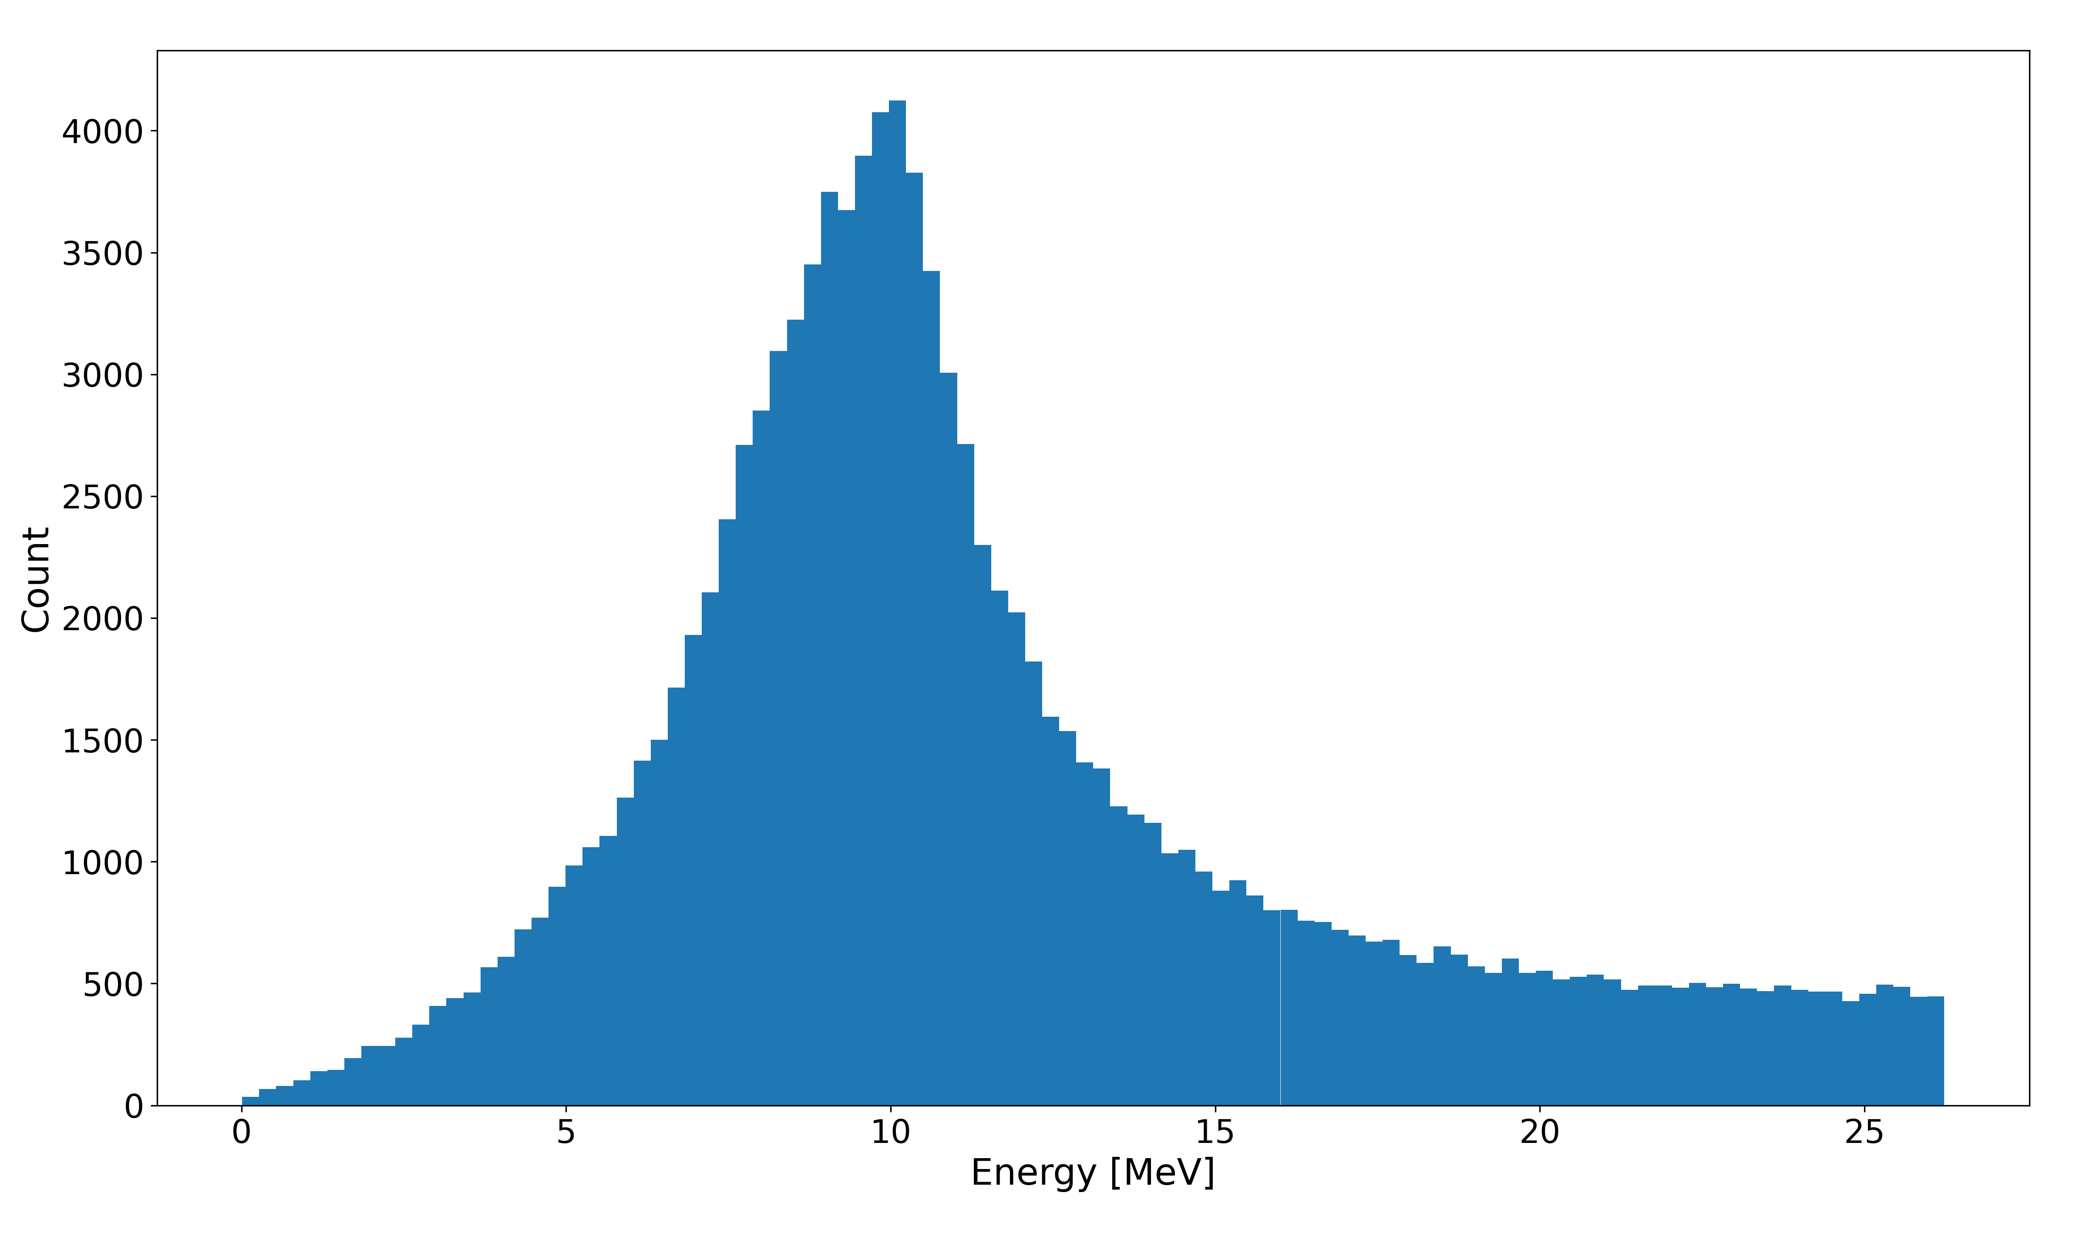
10 MeV: Horizontal Movement
Q1: x = 0, y = 0
Q2: x = 0, y = 0
Q1: x = + 0.01 mm, y = 0
Q2: x = 0, y = 0
Q1: x = + 0.05 mm, y = 0
Q2: x = 0, y = 0

Slide 4

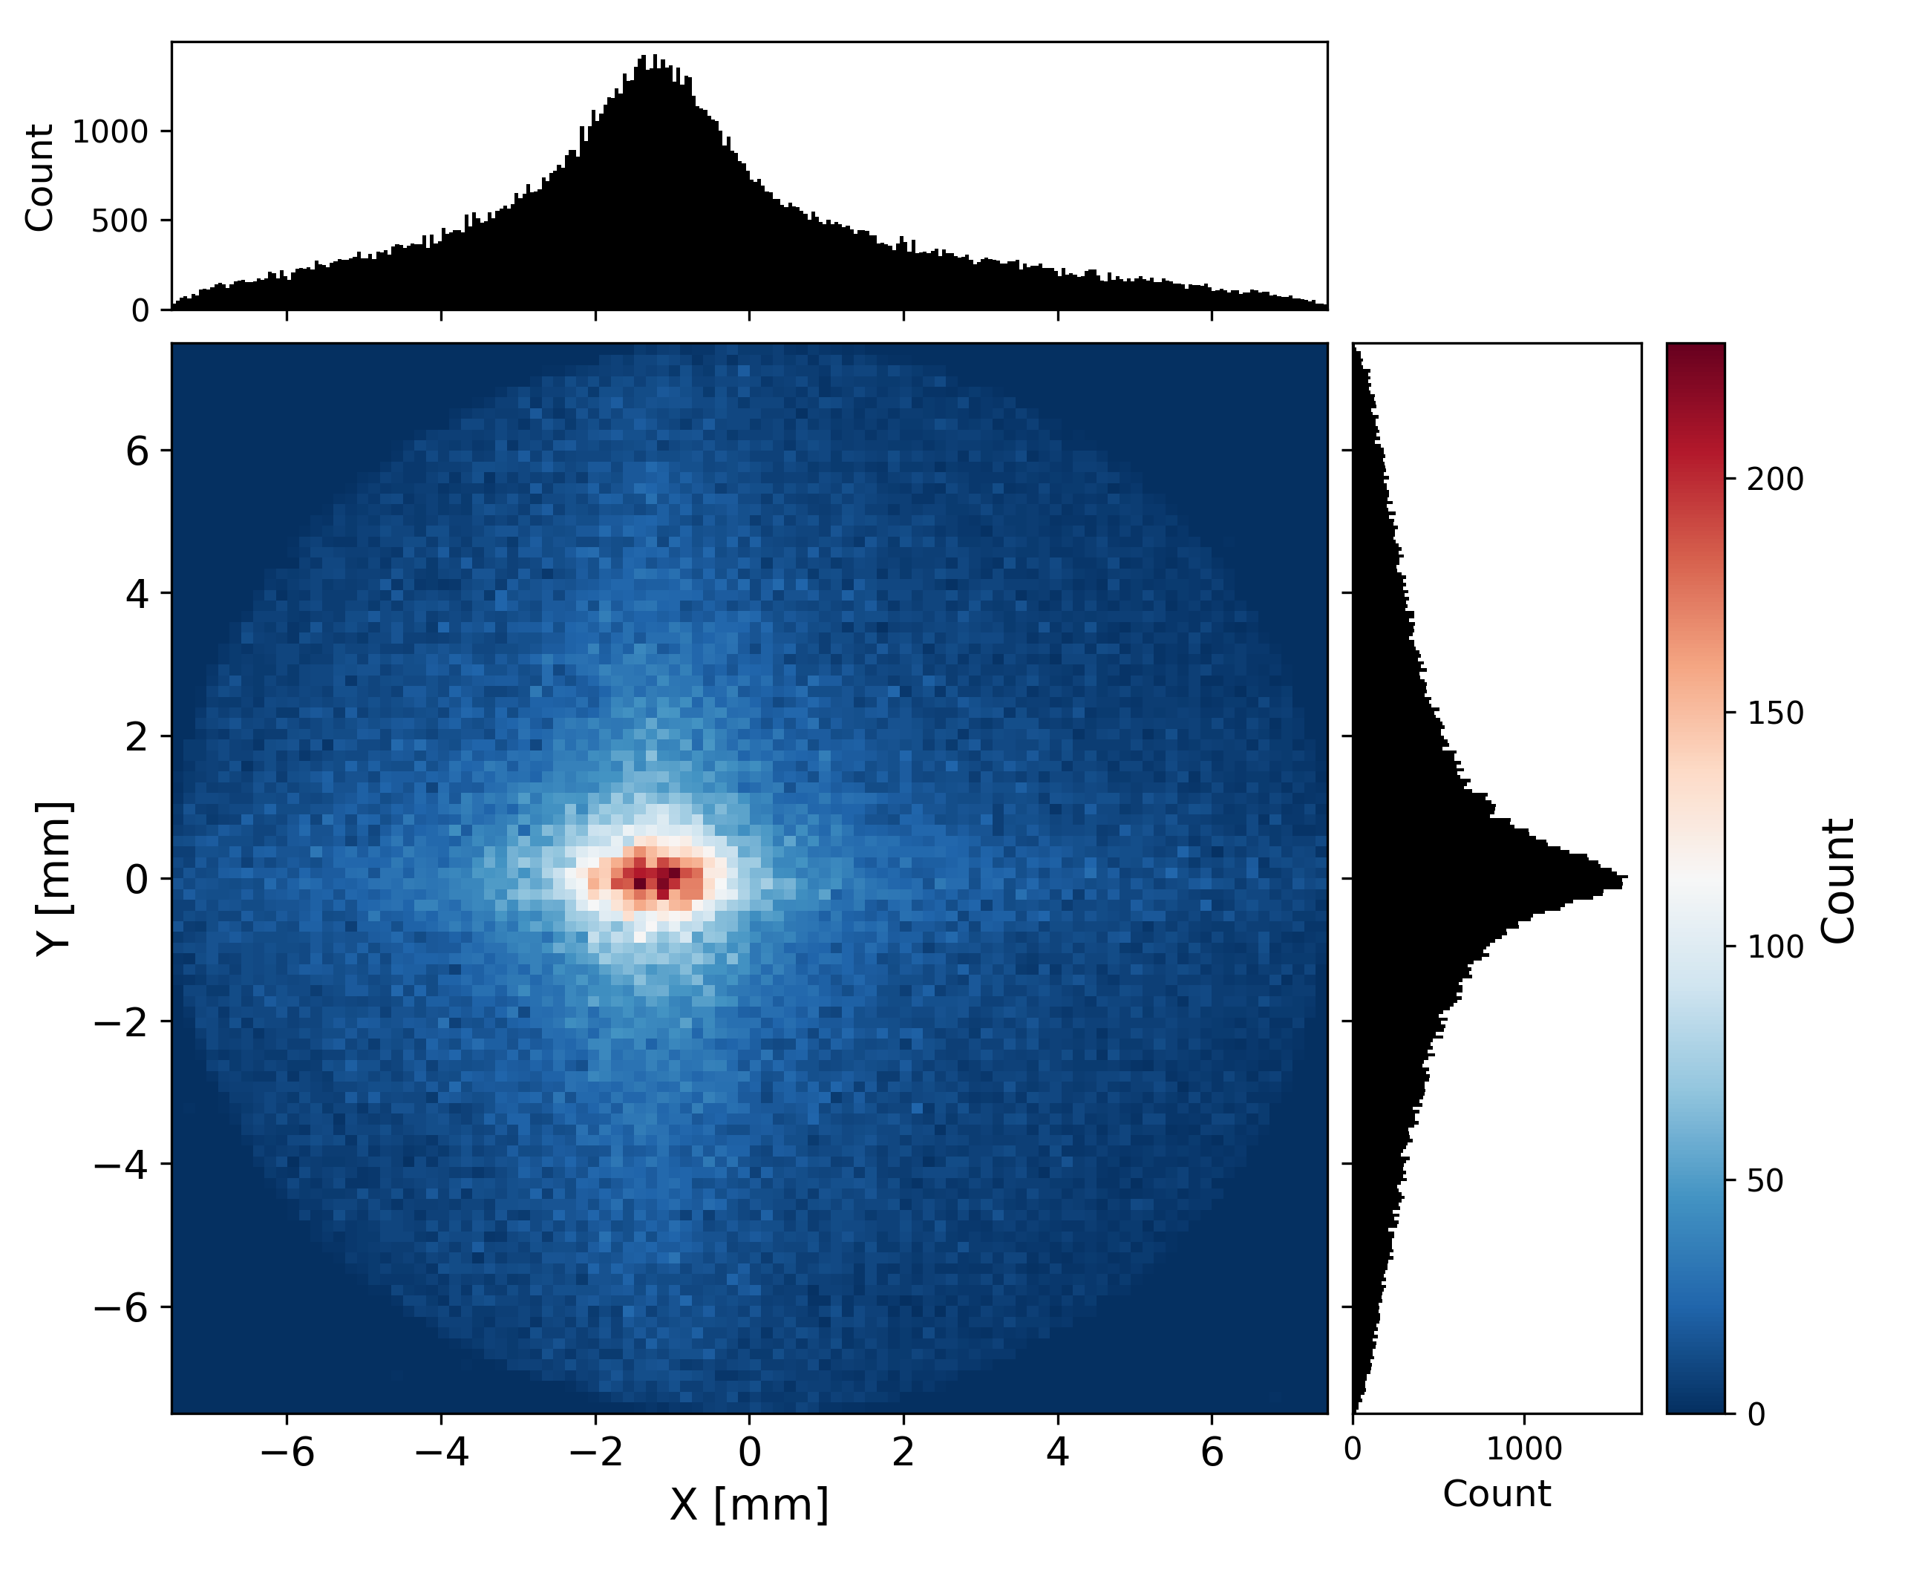


10 MeV: Horizontal Movement
Q1: x = 0, y = 0
Q2: x = 0, y = 0
Q1: x =0, y = 0
Q2: x = + 0.01 mm, y = 0
Q1: x = 0, y = 0
Q2: x = + 0.05 mm, y = 0

Slide 5
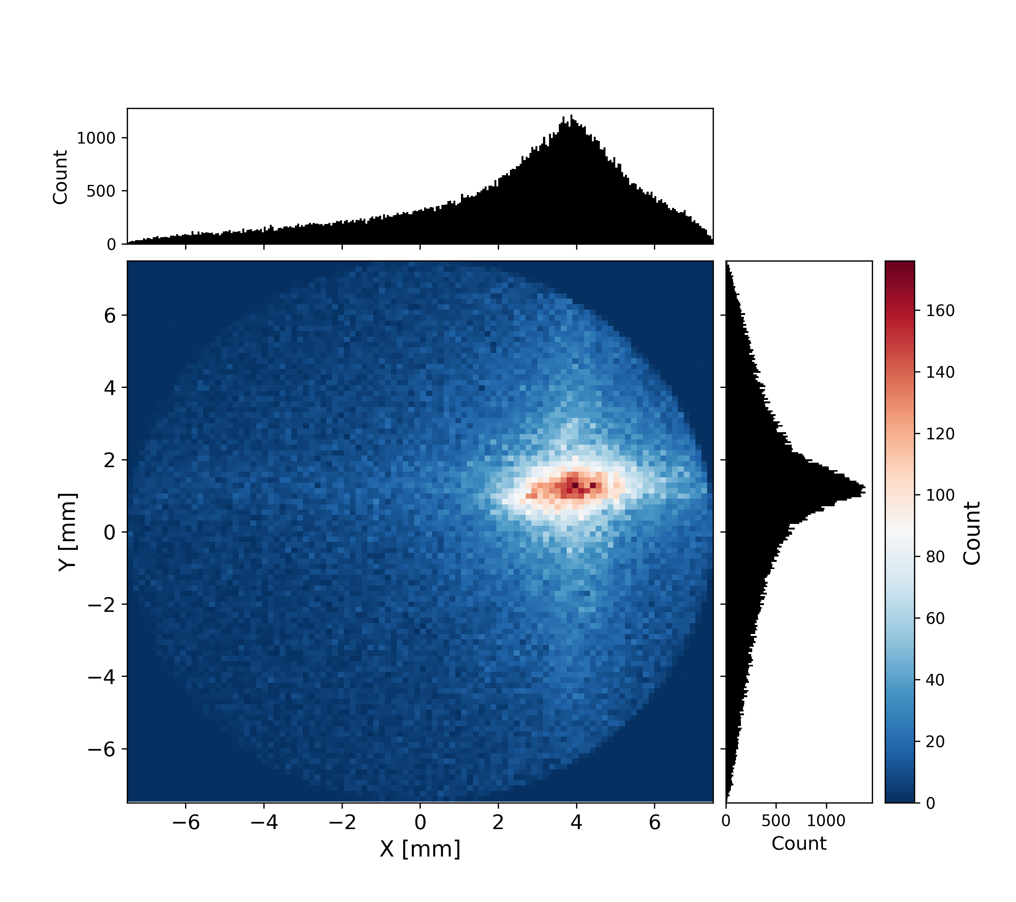
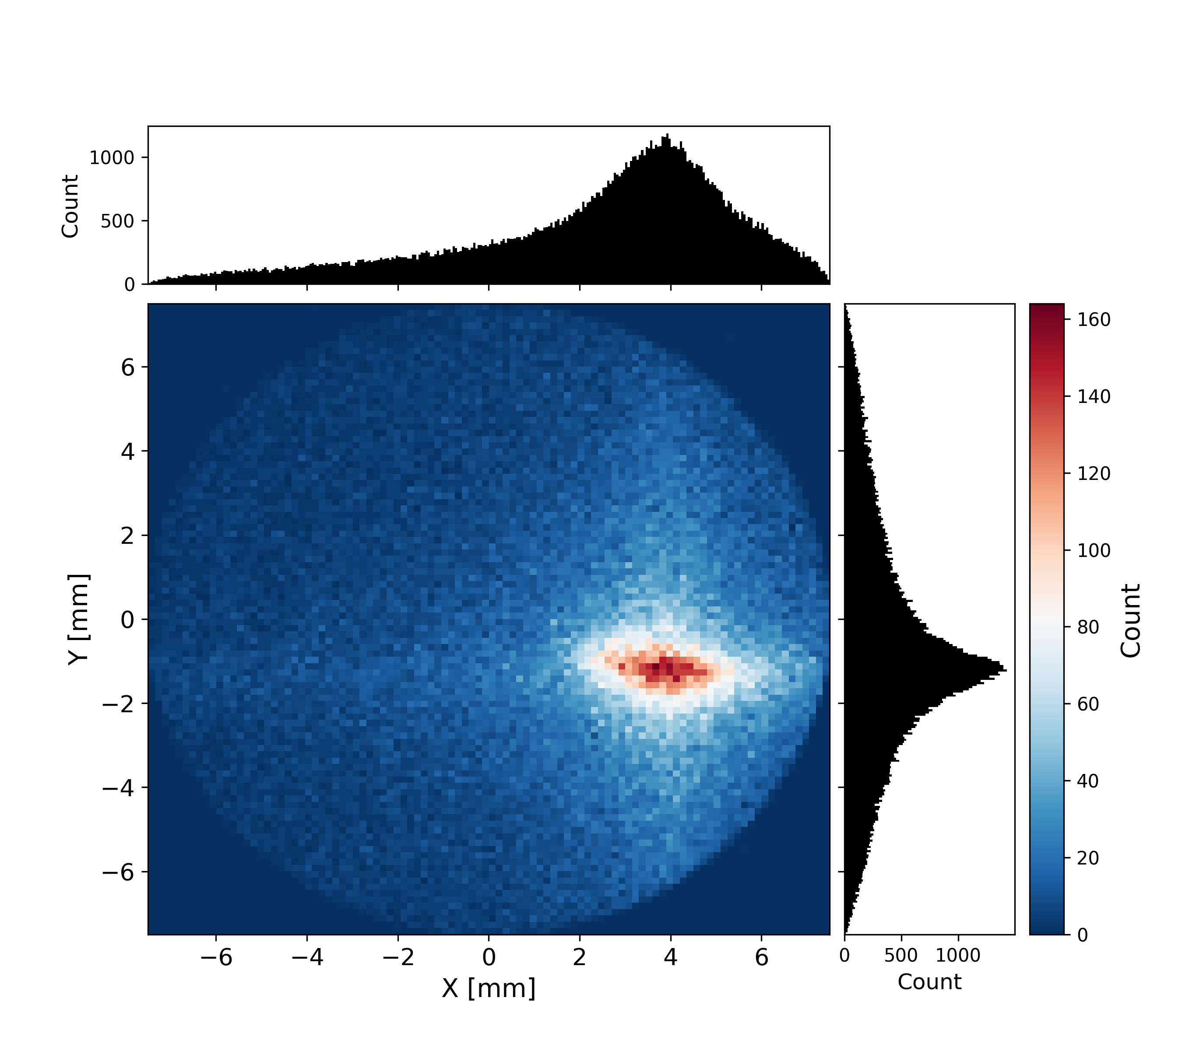


10 MeV: Horizontal Movement
Q1: x = 0, y = 0
Q2: x = 0, y = 0
Q1: x = + 0.05 mm, y = 0
Q2: x = 0, y = + 0.05 mm
Q1: x = + 0.05 mm, y = 0
Q2: x = 0, y = - 0.05 mm

Slide 6

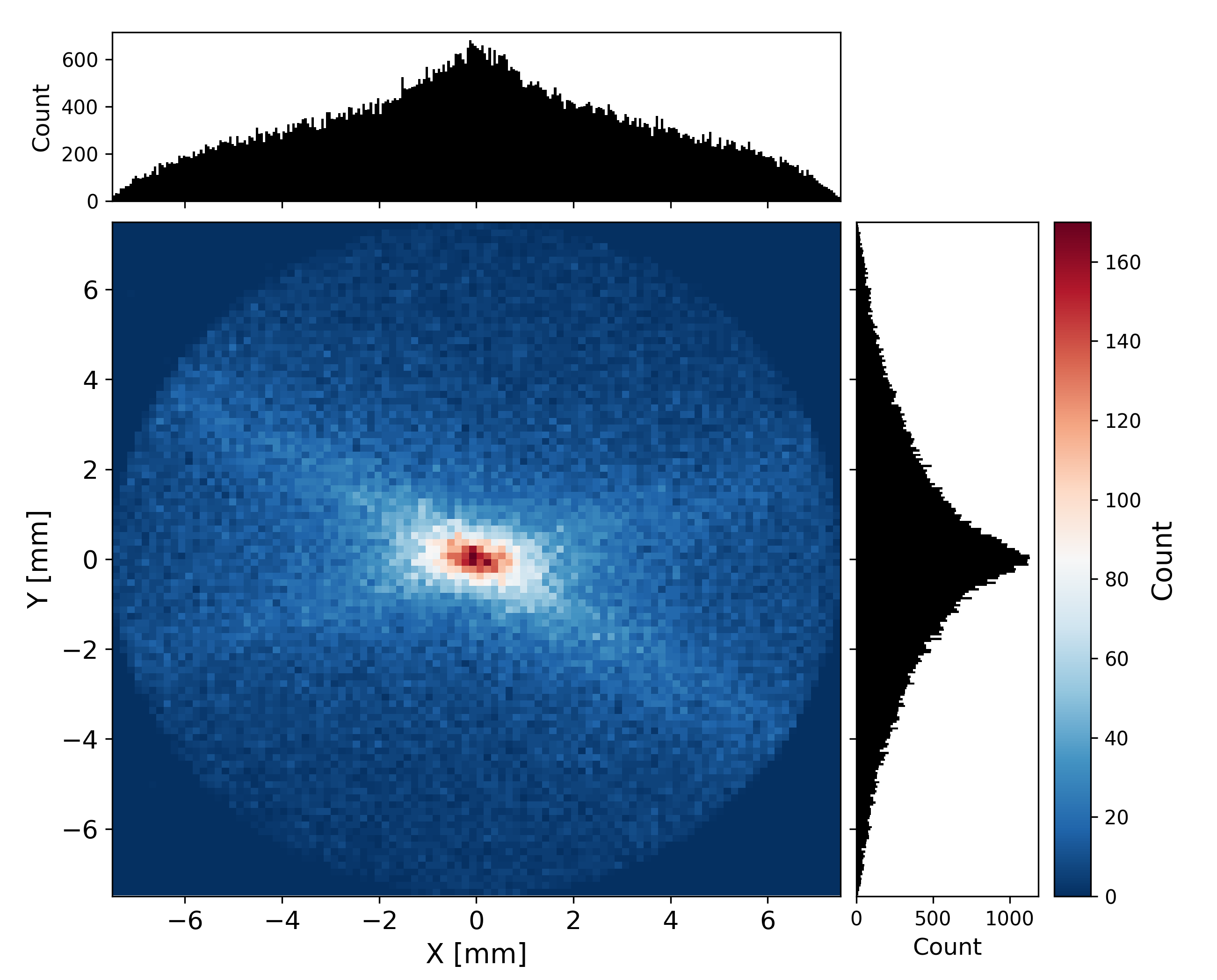

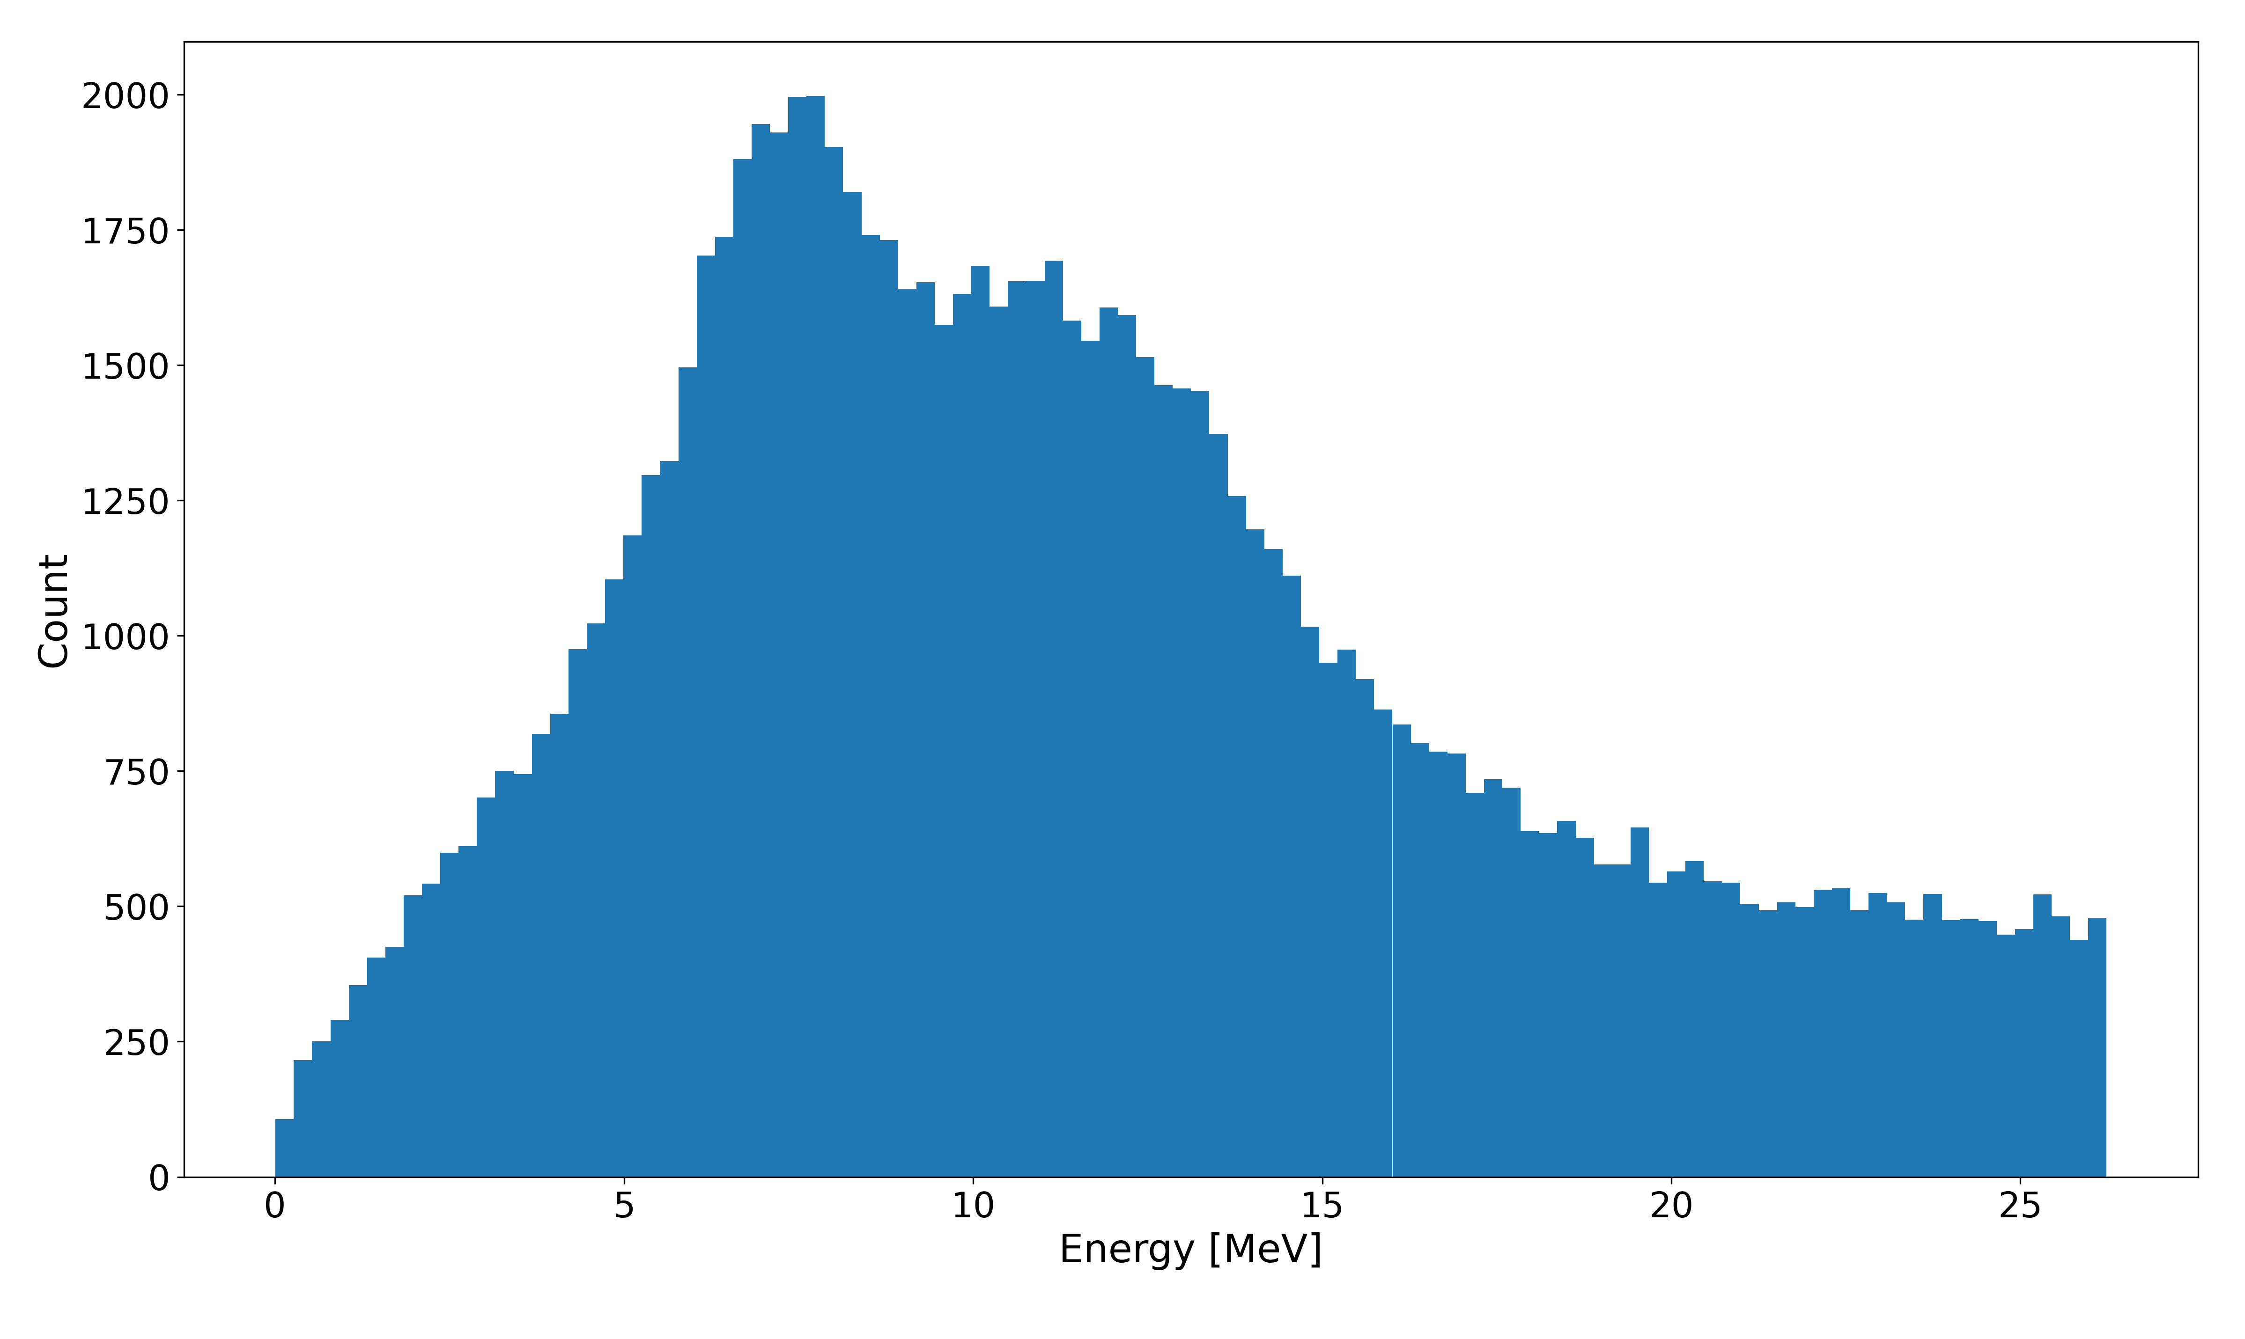
10 MeV: Quadrupole tilt (x-axis & y-axis)
Q1: tilt = 0
Q2: tilt = pi/2
Q1: tilt = + 0.01
Q2: tilt = pi/2
Q1: tilt = + 0.1
Q2: tilt = pi/2

Slide 7
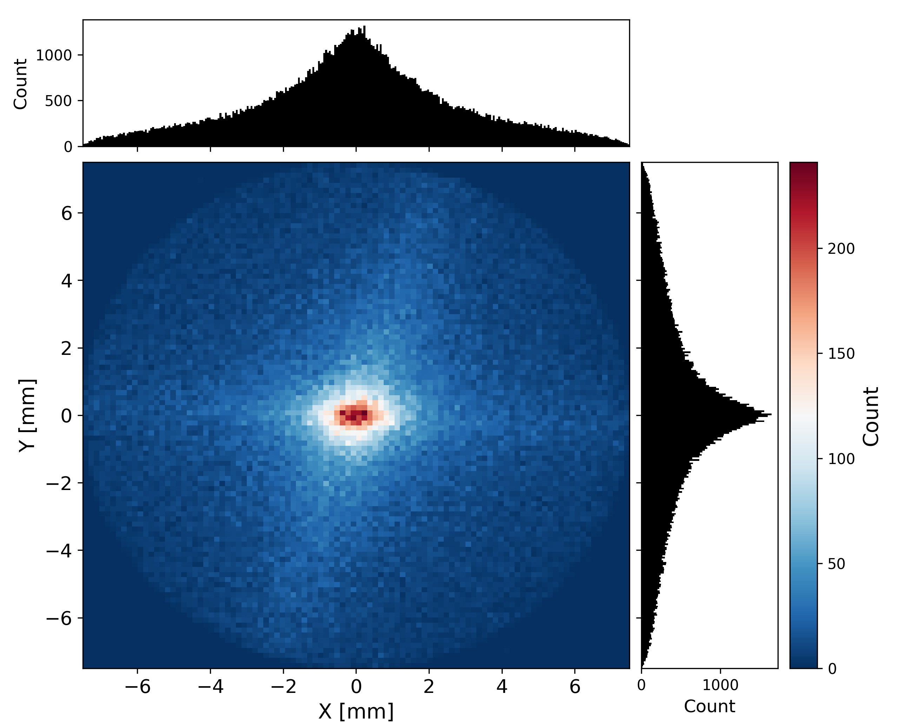
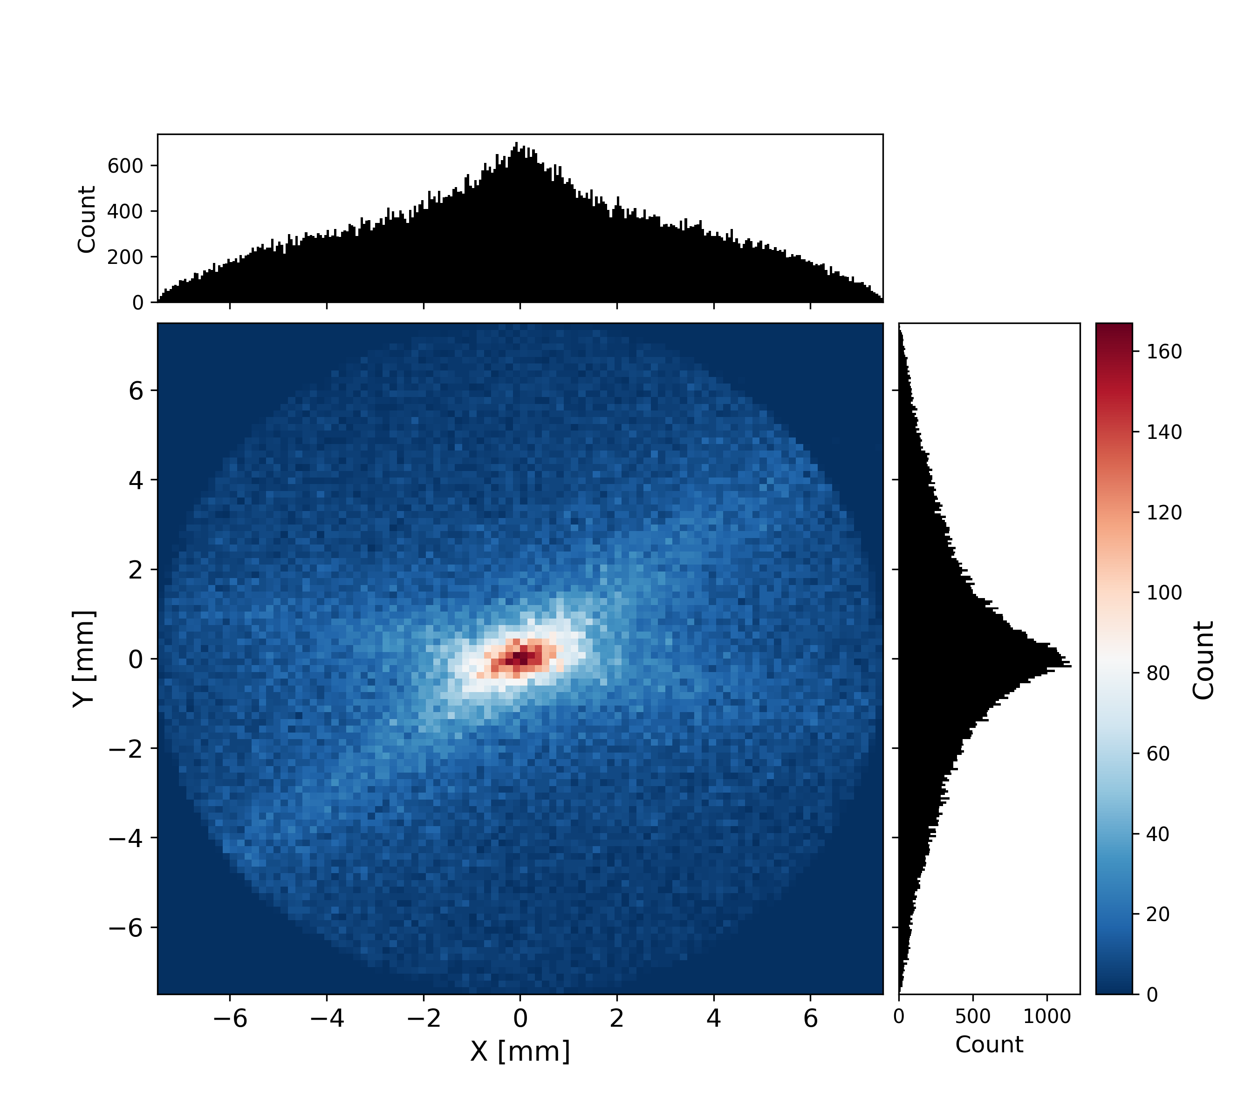


10 MeV: Quadrupole tilt (x-axis & y-axis)
Q1: tilt = 0
Q2: tilt = pi/2
Q1: tilt = 0
Q2: tilt = pi/2 + 0.01
Q1: tilt = 0
Q2: tilt = pi/2 + 0.1

