Slide 1



WPB.6: Update on Design and Integration
William Shields
(william.shields@rhul.ac.uk)
LhARA Fortnightly Meeting
05th November 2024

Slide 2
WPB Meeting: Integration Challenges
Proton source description
  Parameterised distribution - unmodelled features (e.g. pre-plasma)
  Ion distributions & spectra (simulation)
Electron spectrum
  Co-propagating beams – space charge neutralisation
  Simulation program to establish electron beam sensitivity (GPT / RF-Track)
Injection line redesign
  Spatial constraints (FFA spiral angle, septum magnets)
  FFA field leakage
PMQs for improved capture efficiency
  Engineering challenges - optimal target configuration
  Demagnetisation, shielded / unshielded?
  Charge neutralisation / beam dynamics
Gabor lens field description
  Monte Carlo transport modelling (BDSIM)
  Confinement EM fields for low energy protons & electrons.
    Geometry dependant

Slide 3
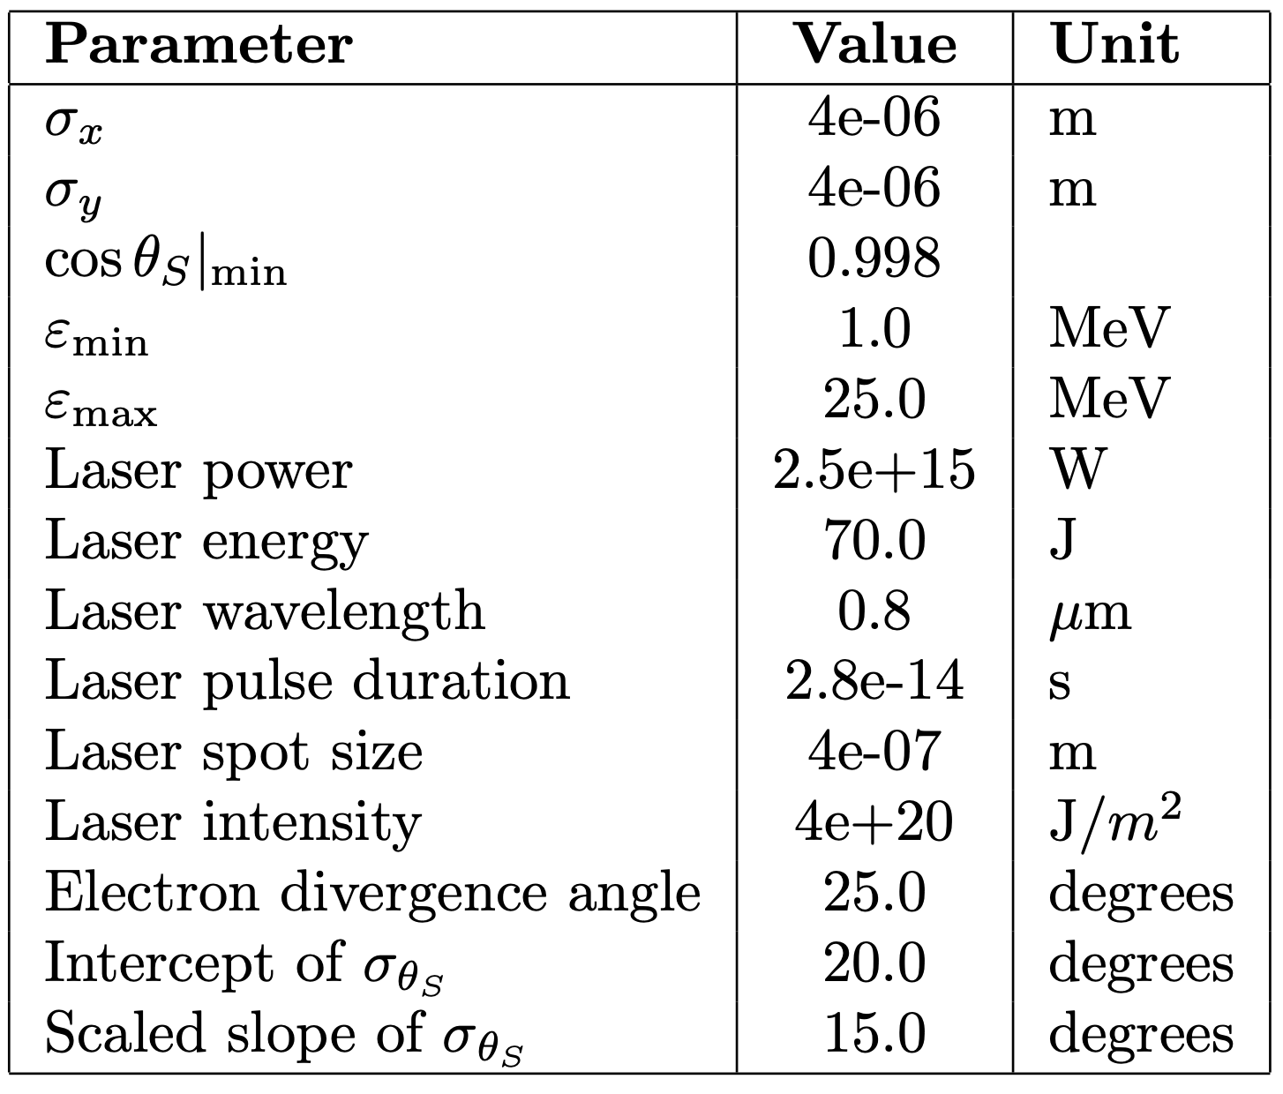
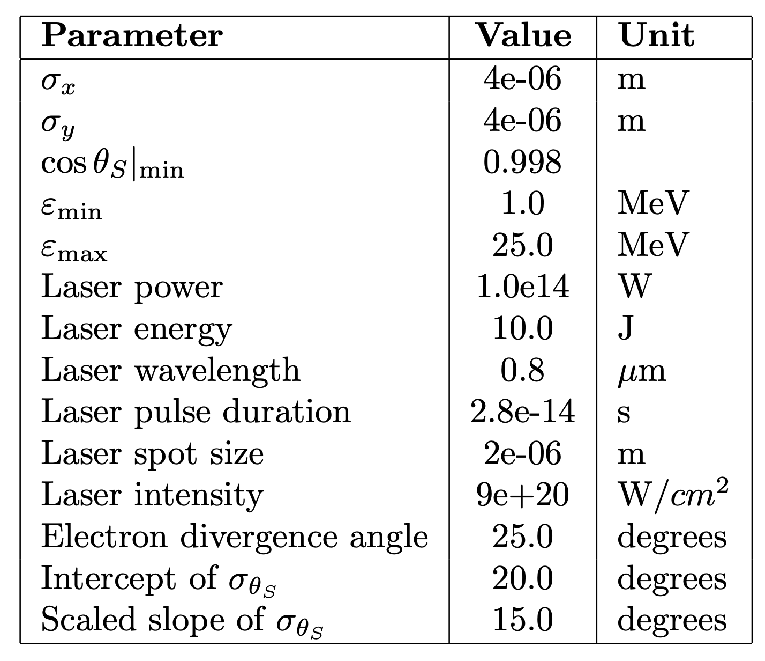
WPB.6: Source Description
Old laser parameters (LION)
Updated laser parameters (LhARA)
Peak energies comparable to observations.
Model breaks down for spot sizes ~ > 5um.
Spot-size – max energy relationship offers flexibility.

Slide 4
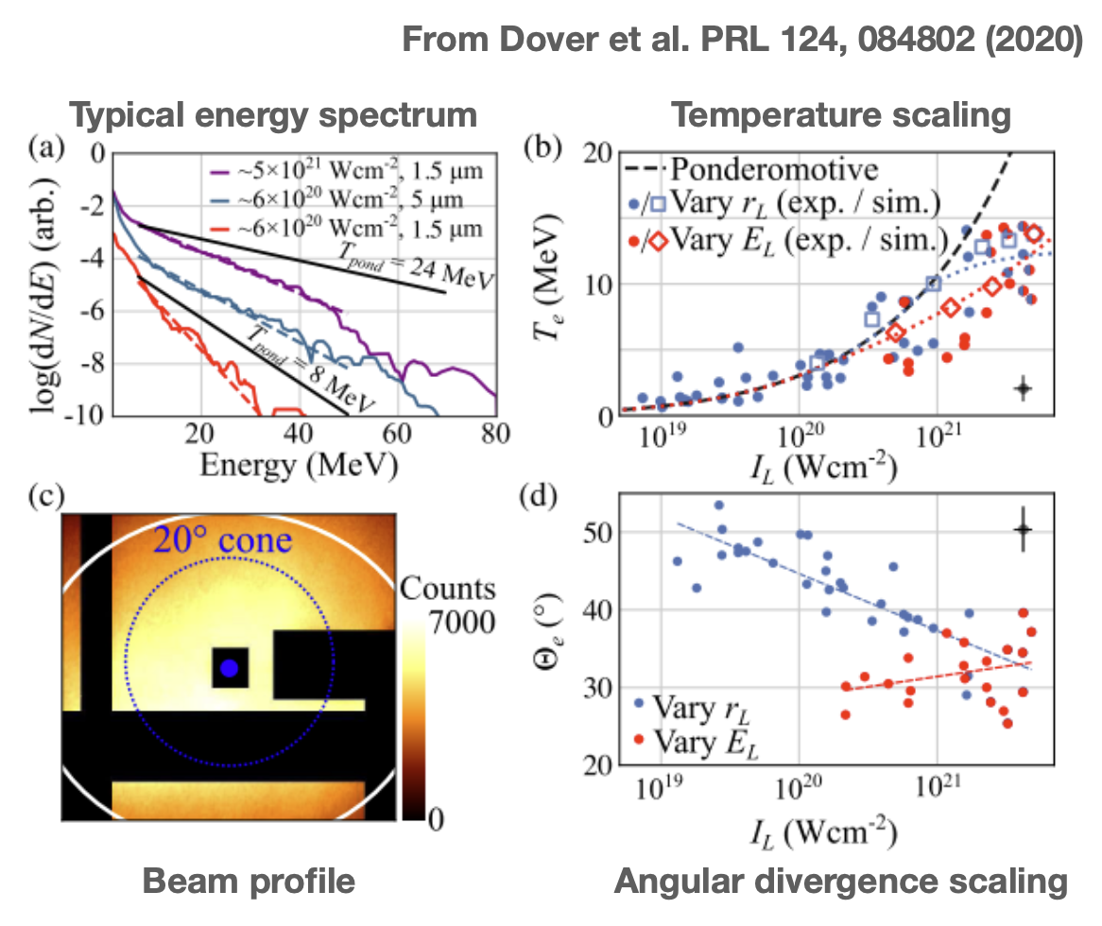
WPB.6: Source Electron Spectrum
Two electron populations: ”fast” and “co-moving”.
“Fast” electrons:
  MeV, moving ahead of protons, centred along laser axis.
  ~50-80% of laser energy.
  divergence (FWHM of emission cone) ~ 30-40 degrees.
    ~1x10⁹ electrons enter capture.
“Co-moving” electrons:
  keV, moves with protons, centred along target normal.
  same numbers and velocity spectrum as ions at nozzle.
    15 MeV protons ≈ 8 keV electrons.
  Less well studied - rarely measured directly.
Impact on LhARA:
  Fast electrons –> capture.
  Co-moving electrons -> ion beam dynamics.

Slide 5
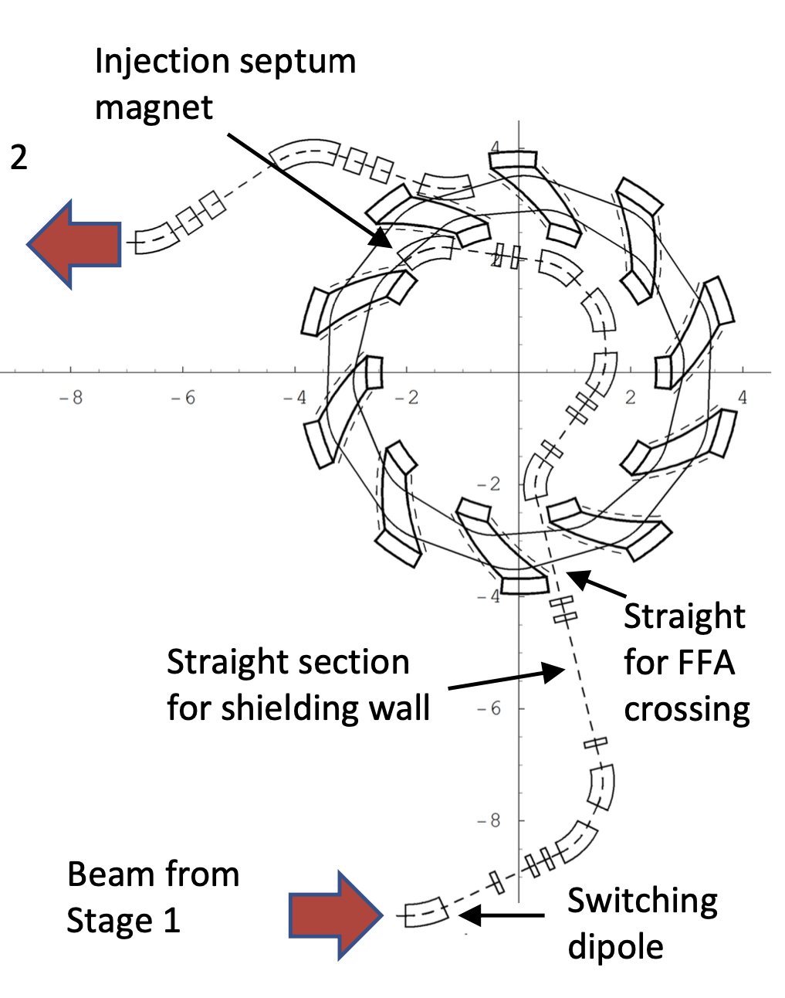
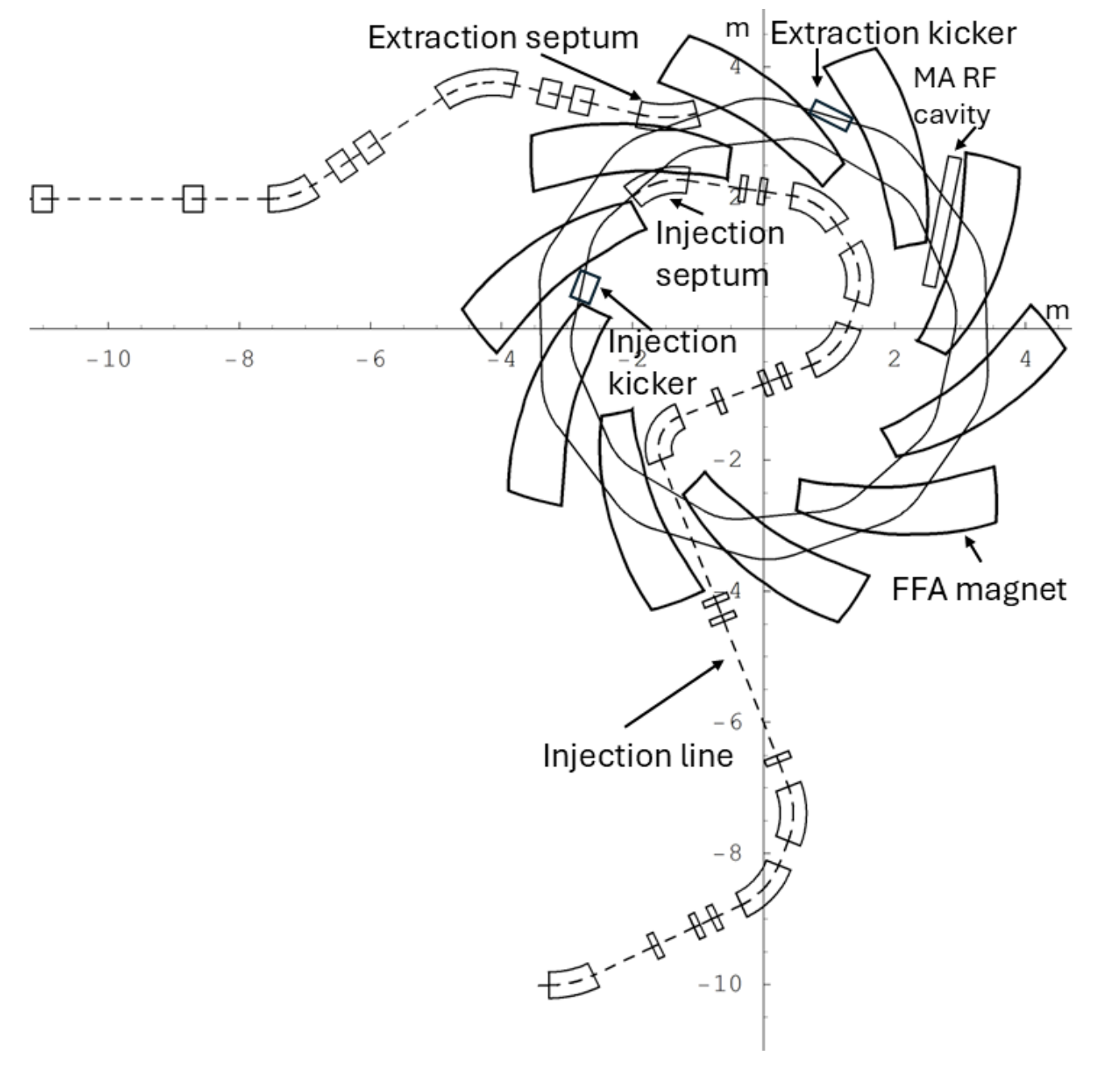
WPB.6: FFA Injection Line
Previous FFA and injection line layout
Revised design
  FFA magnet spiral angle change

Slide 6
WPB.6: R&D Efforts
FFA:
  Cavities:
    Spatial constraints, angle & impact on tracking (cyclotron-like oscillation).
    Proximity of the FFA magnets to the MA cavity core
  Kickers:
    Possibly shorter & stronger.
      Worst case, 2 kickers will be needed instead of 1.
    Maximum field on ferrite cavity should be kept < 0.05T (from kicker).
  Good field region being extended to cover 15 MeV.
Stage 1 final focus:
  4-quad configuration (mini-beam scheme)
  Octupoles in regions with asymmetric beam
  Field map generation for GPT
    Non-standard elements (octupole)
    Cross-code consistency
PMQs for LhARA beam capture:
  Geometry & material provided
  Field maps to be generated & converted (Poisson Superfish).
  Impact on proton and electron dynamics….

Slide 7



Thank you
William Shields
william.shields@rhul.ac.uk

