Slide 1
Update and news

Slide 2
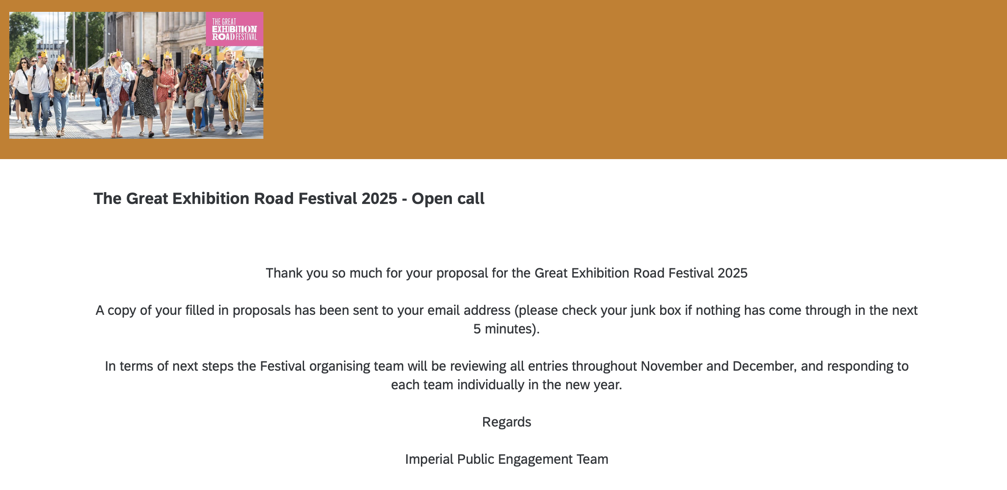
Great Exhibition Road Festival
Proposal submitted
Many tanks to:
  Will S, Jason, Pat, & Colin

Slide 3
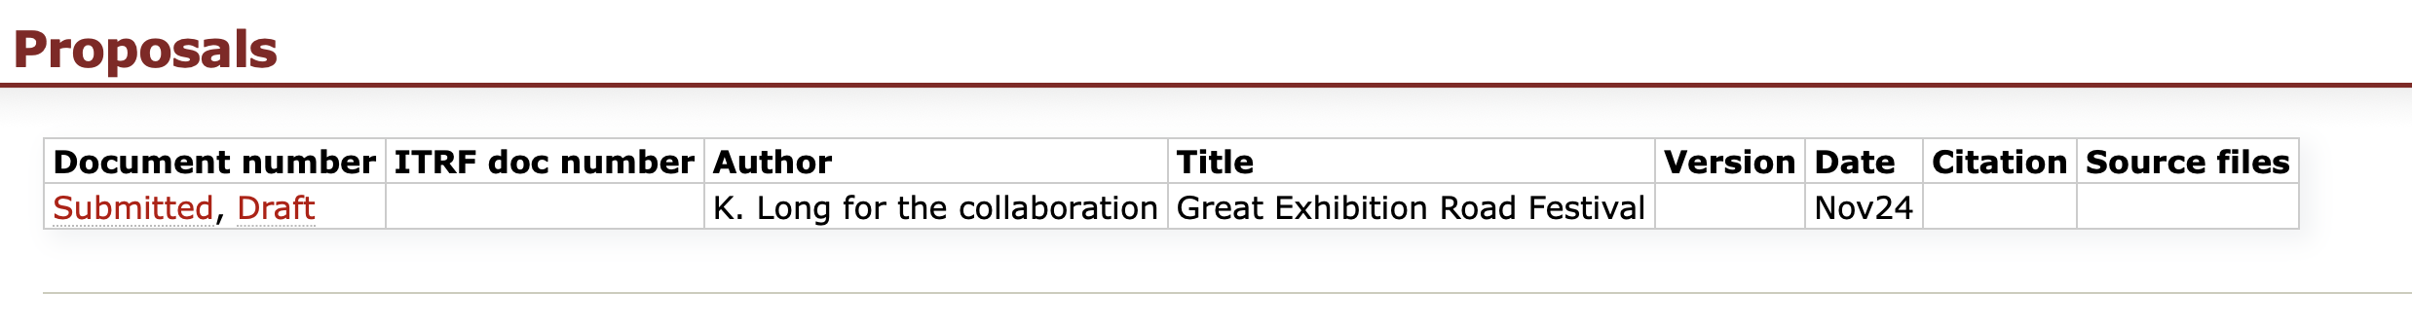
Added to ”Documentation” tab
Other proposals “owned” by, e.g. EB
Created new heading:
  wiki:Research/LhARA/Documents/Proposals

Slide 4
Bridging Period: costing …
Still (!) working through the end game:
  Waiting for STFC …
Bridging Period document:
  Still polishing milestones …
Benefits analysis:
  Need to take hold …

Slide 5
Research councils
MRC:
  Informal feedback:
    MRC Council “need to be convinced”; not priority for investment
    MCR EB “recognise opportunity”; not priority for investment, but:
      Need to engage more strongly with clinical/pre-clinical communities
Also, informal recognition of “falling between stools”
Engagement, generally, important going forward

Slide 6
ITRF/LhARA conceptual design report
Still some gaps;
we keep going!

Slide 7

Collaboration meeting #7:
UCL 7—8 Apr25

Slide 8
Going forward
Next CM … UCL, 7—8 Apr25
Rolling w/p reports:
  WPA, Tsk 5; & WPB, Tsk 3

