Slide 1
LION Beamline Experiment
18/9/2024 – 20/9/2024

Slide 2
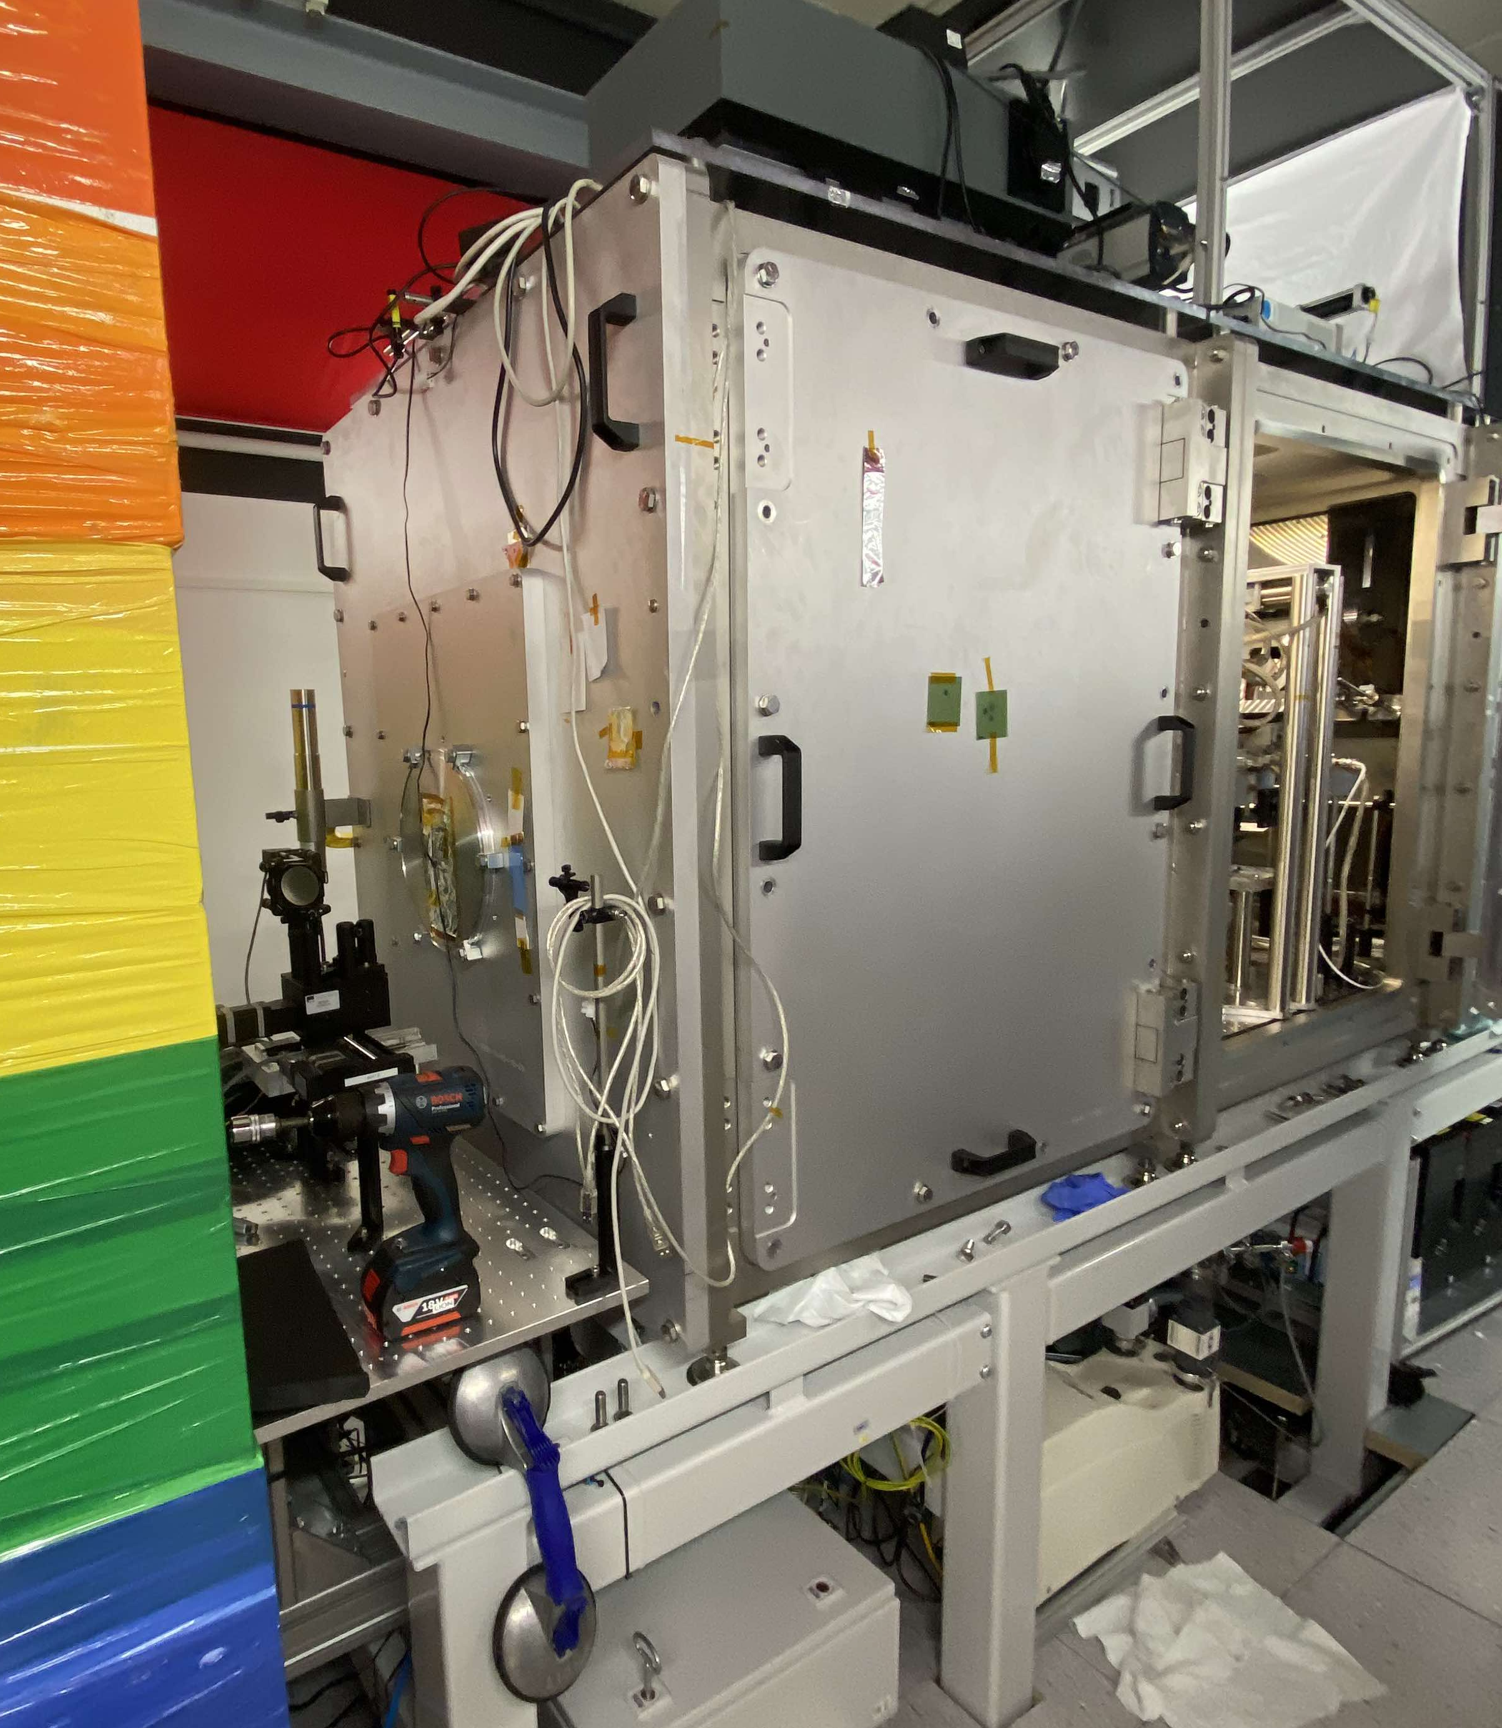
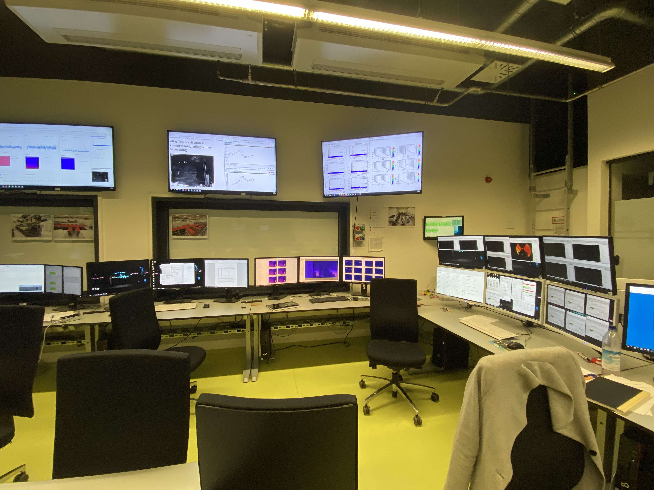
Centre for Advanced Laser Applications (CALA)
LION beam line
CALA control room

Slide 3
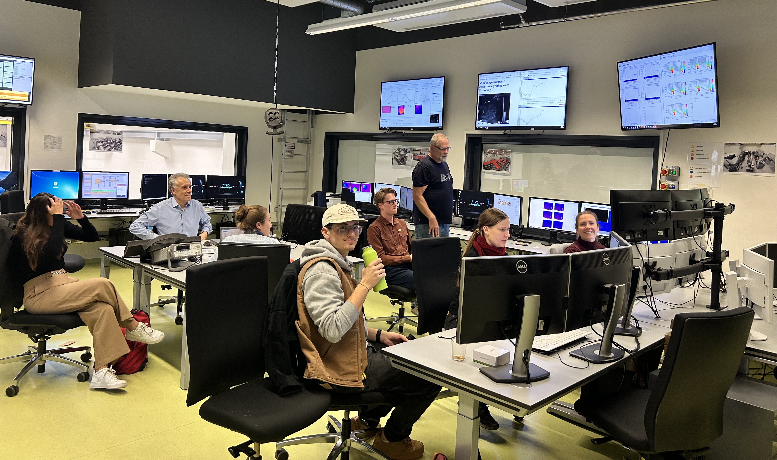
Control Room

Slide 4
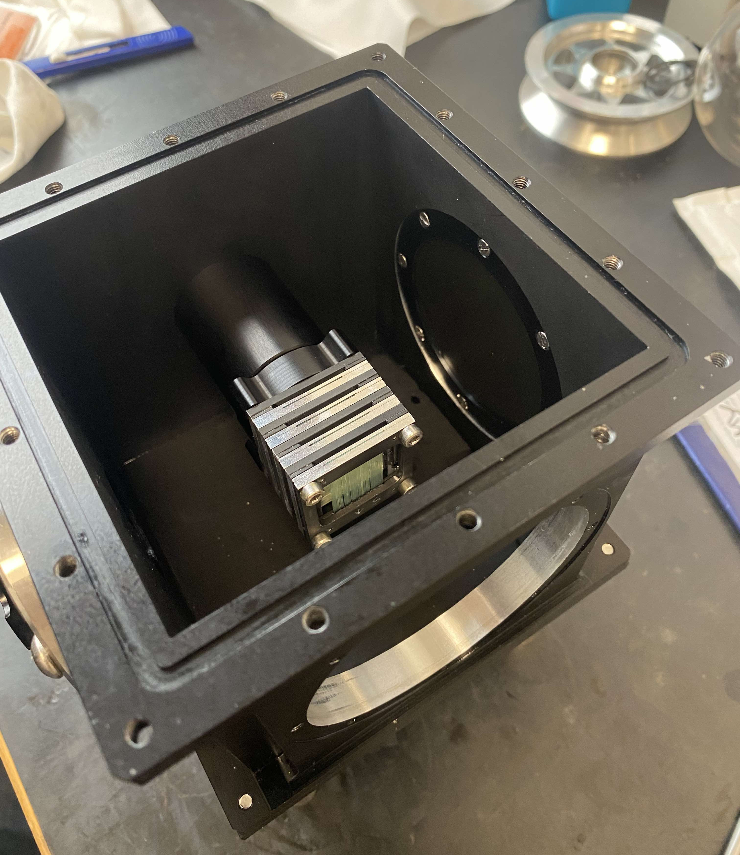
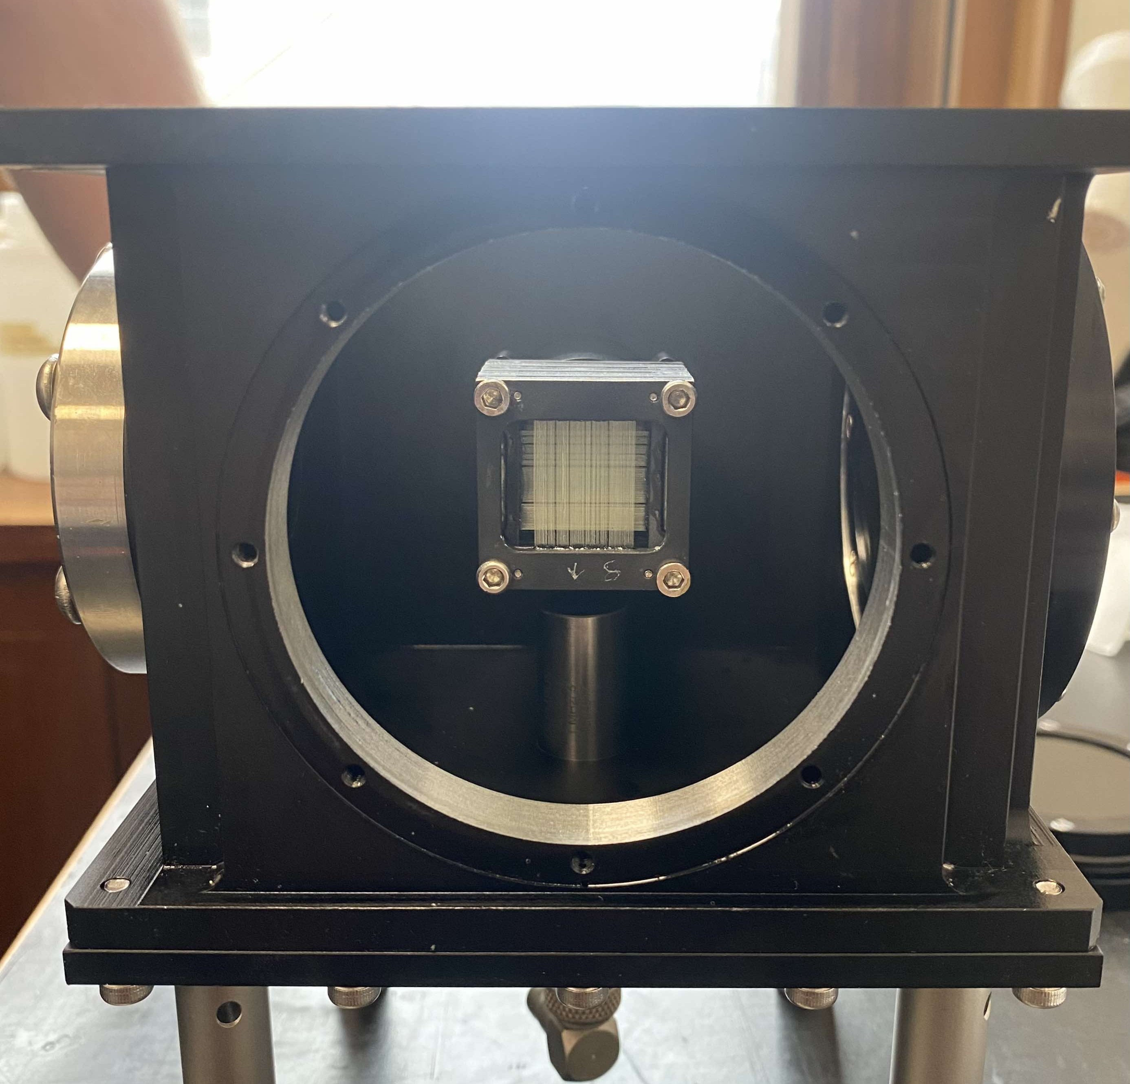
Day 1: Scintillating Fibre Detectors
Scintillating Fibre Detectors

Slide 5
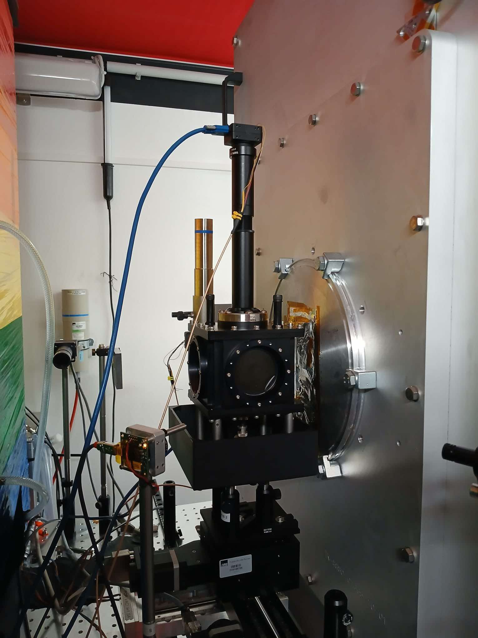
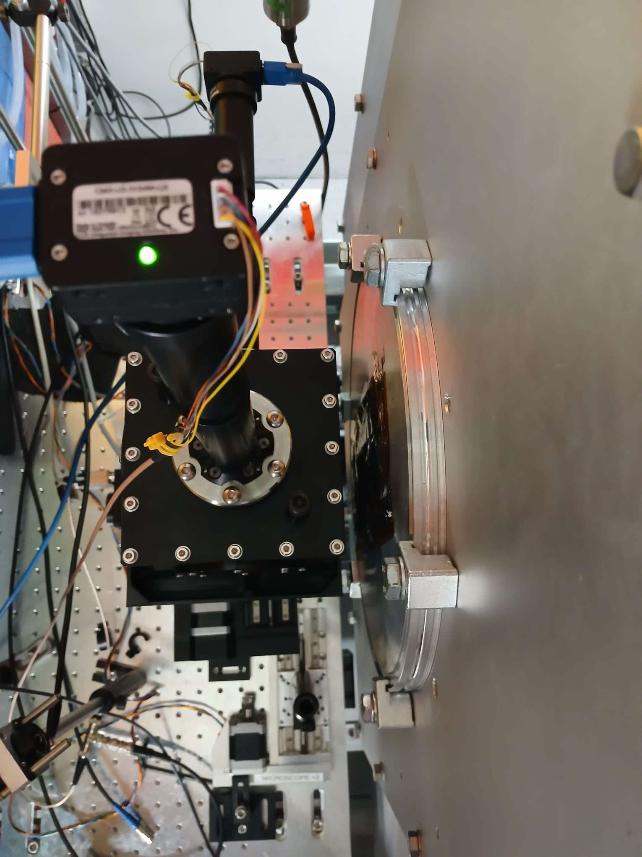
Day 1: Scintillating Fibre Detectors
Camera 1
Camera 2
Exit Window
SmartPhantom

Slide 6
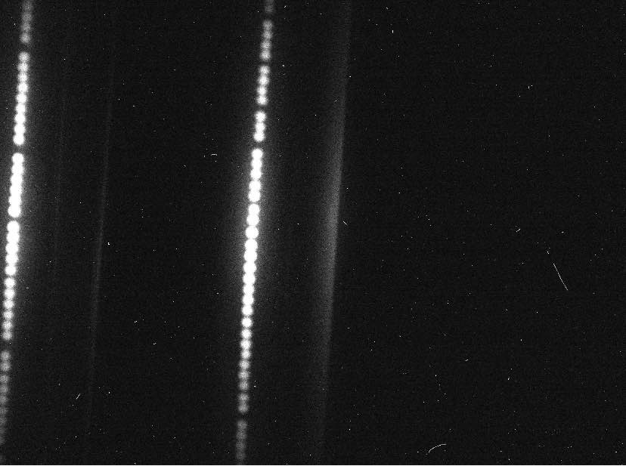
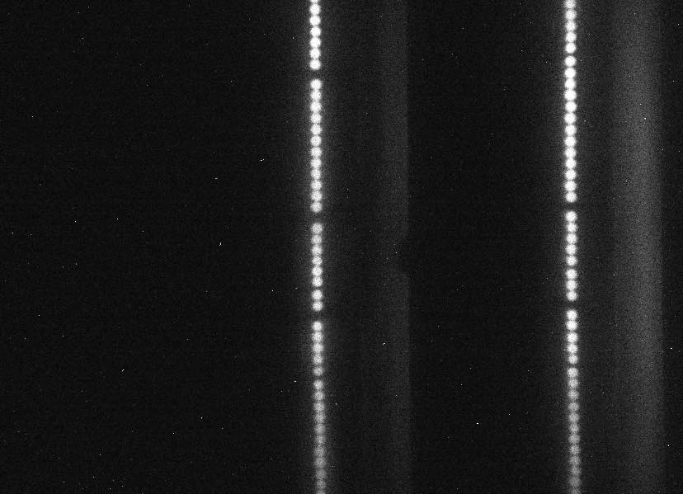
Day 1: Scintillating Fibre Detectors
Camera 1: Top
Camera 2: Side
20 MeV example

Slide 7
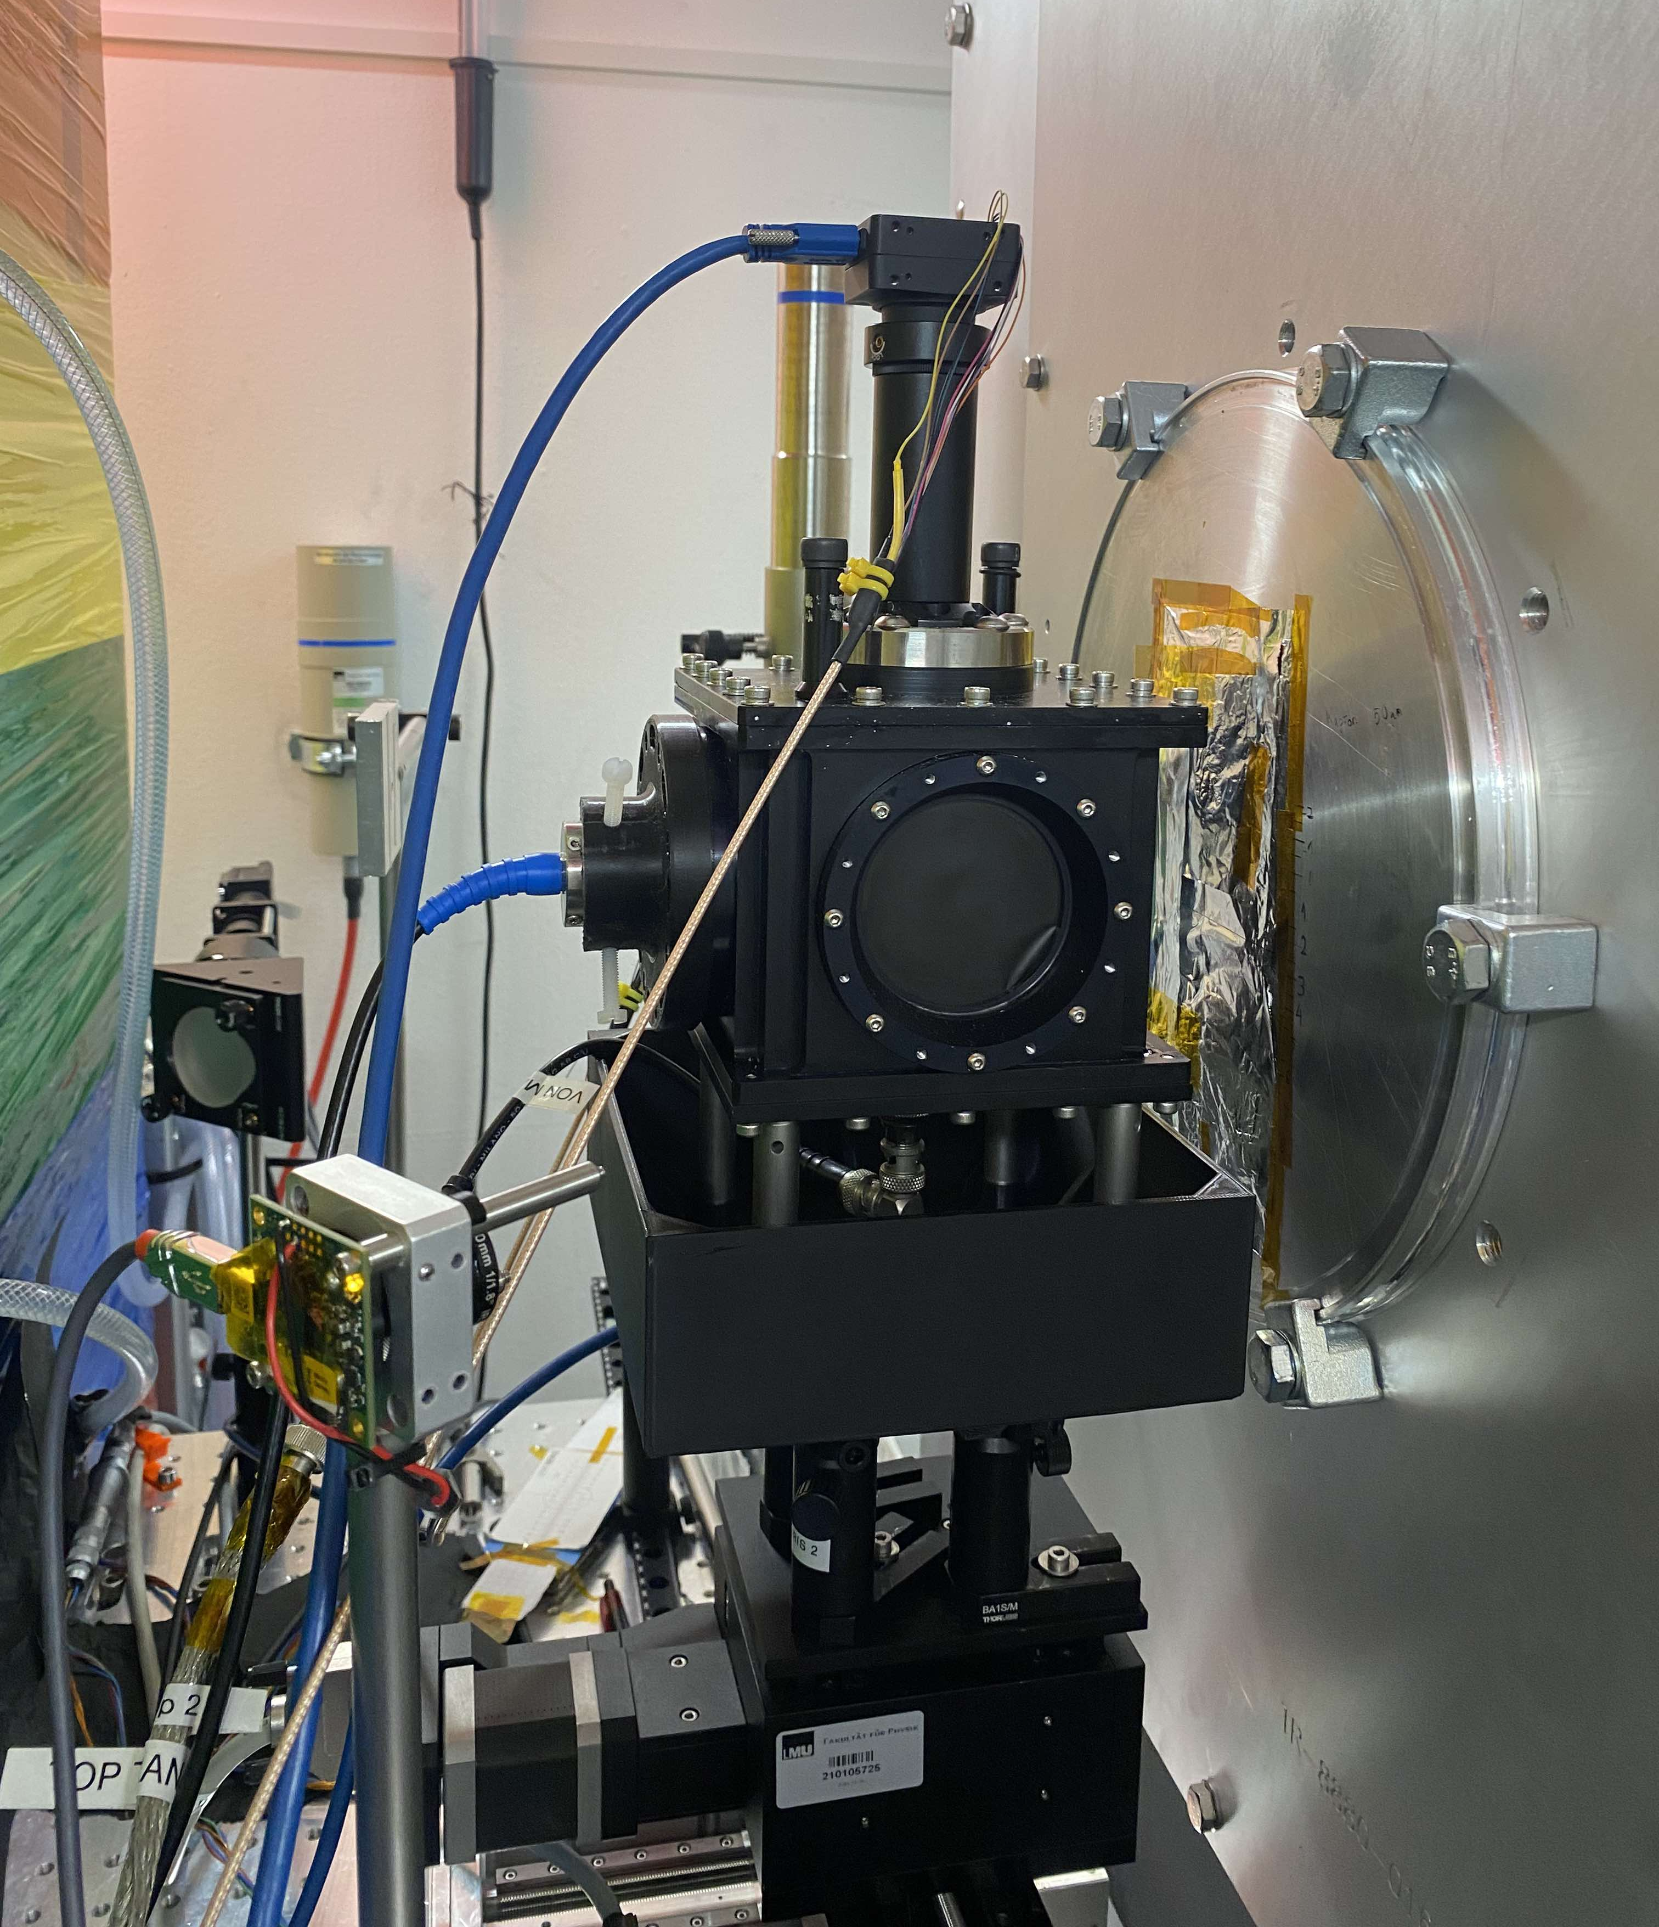
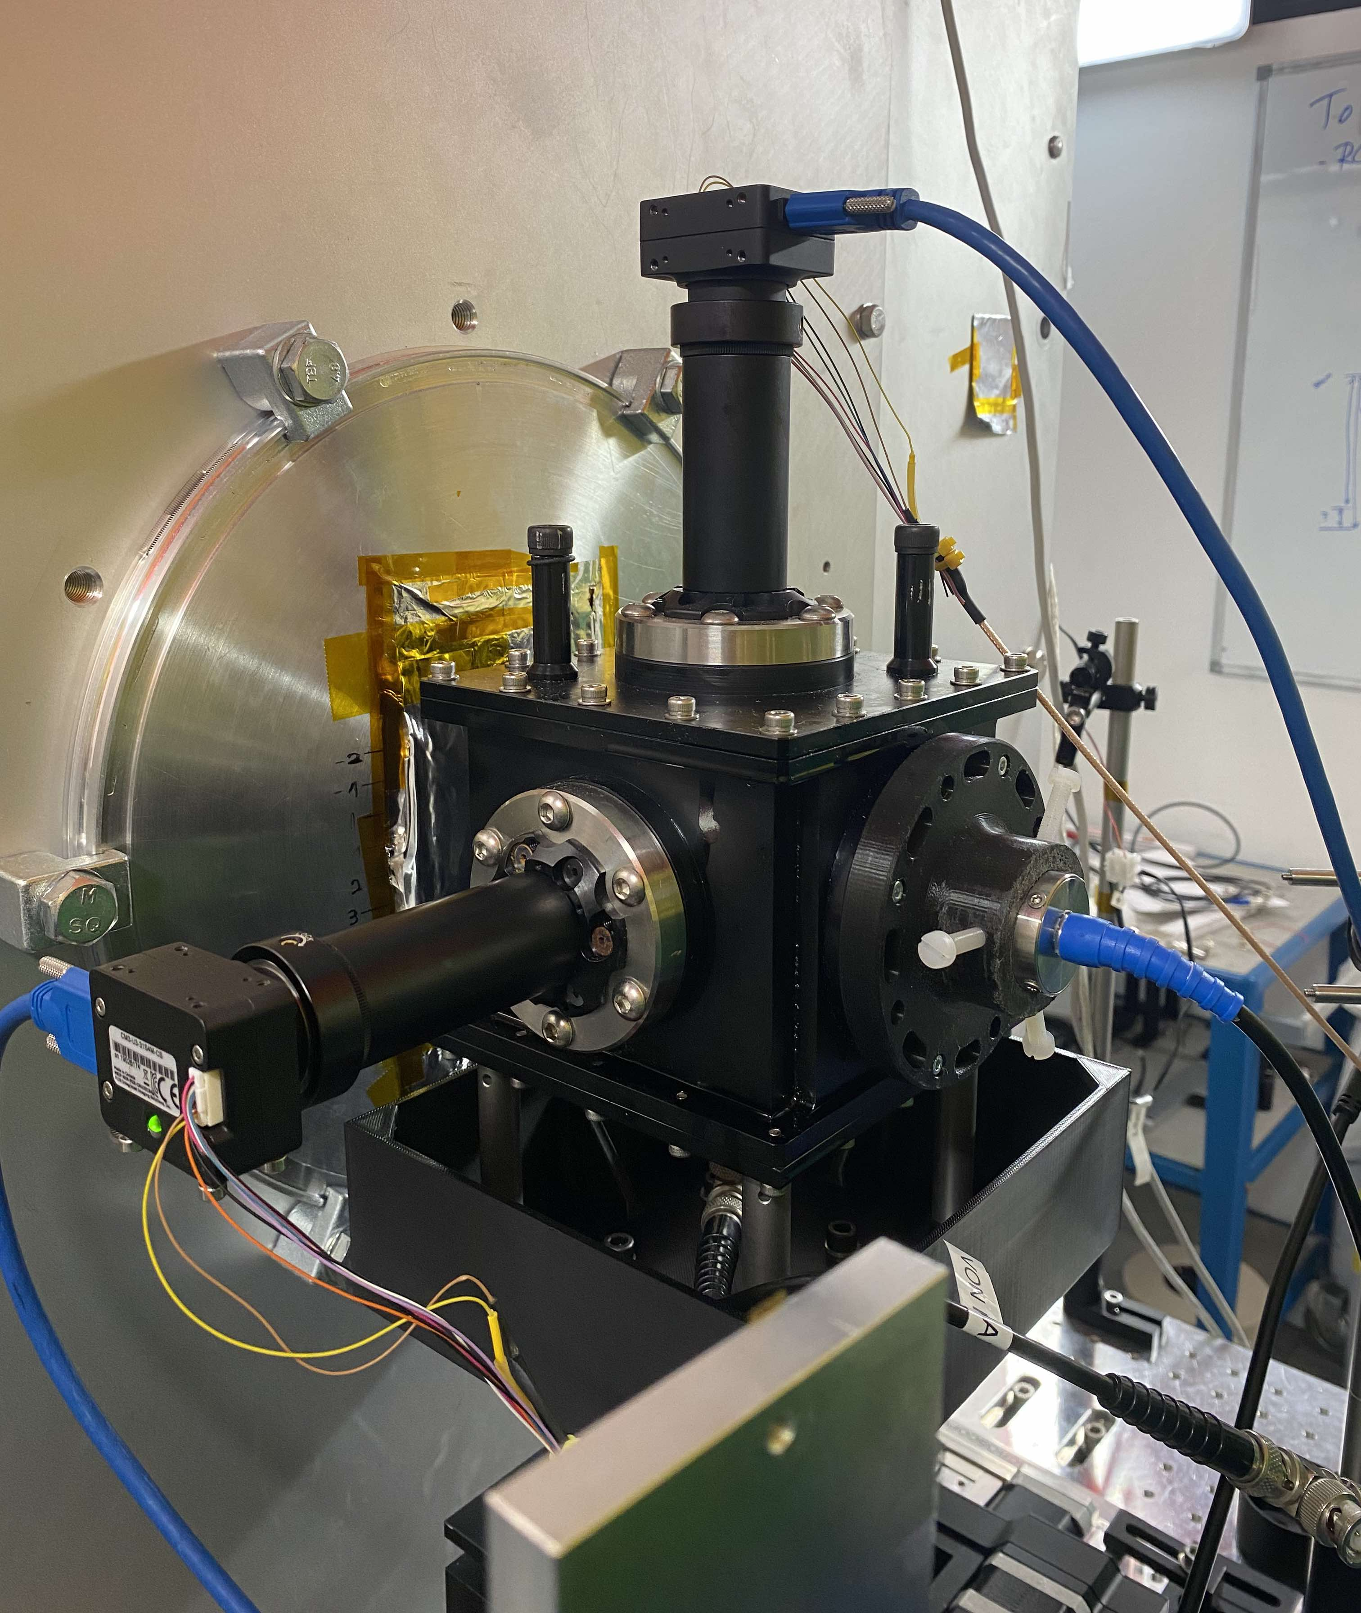
Day 2 & 3: Liquid Scintillator & Transducers
Camera 1
Camera 2
Piston hydrophone
Olympus hydrophone

Slide 8
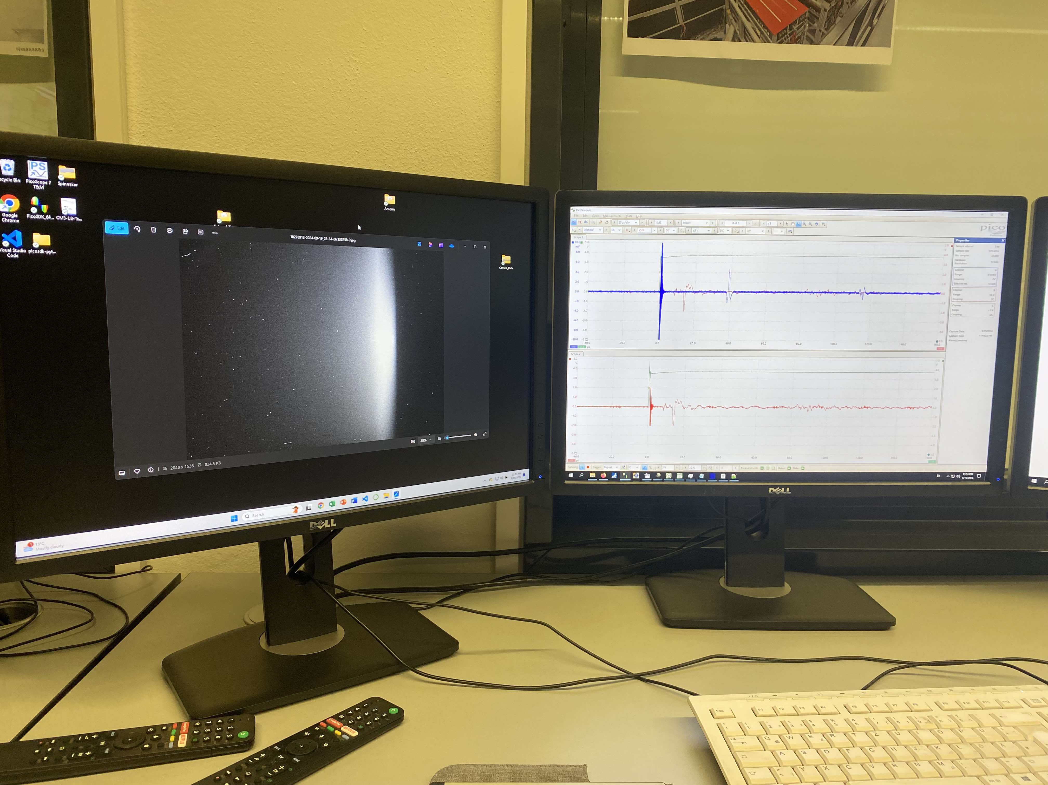
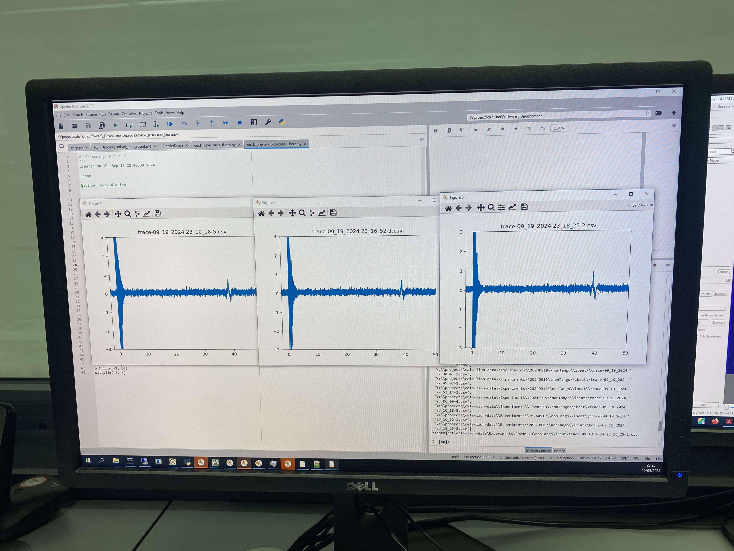
Day 2 & 3: Liquid Scintillator & Transducers
Example image & acoustic traces

Slide 9
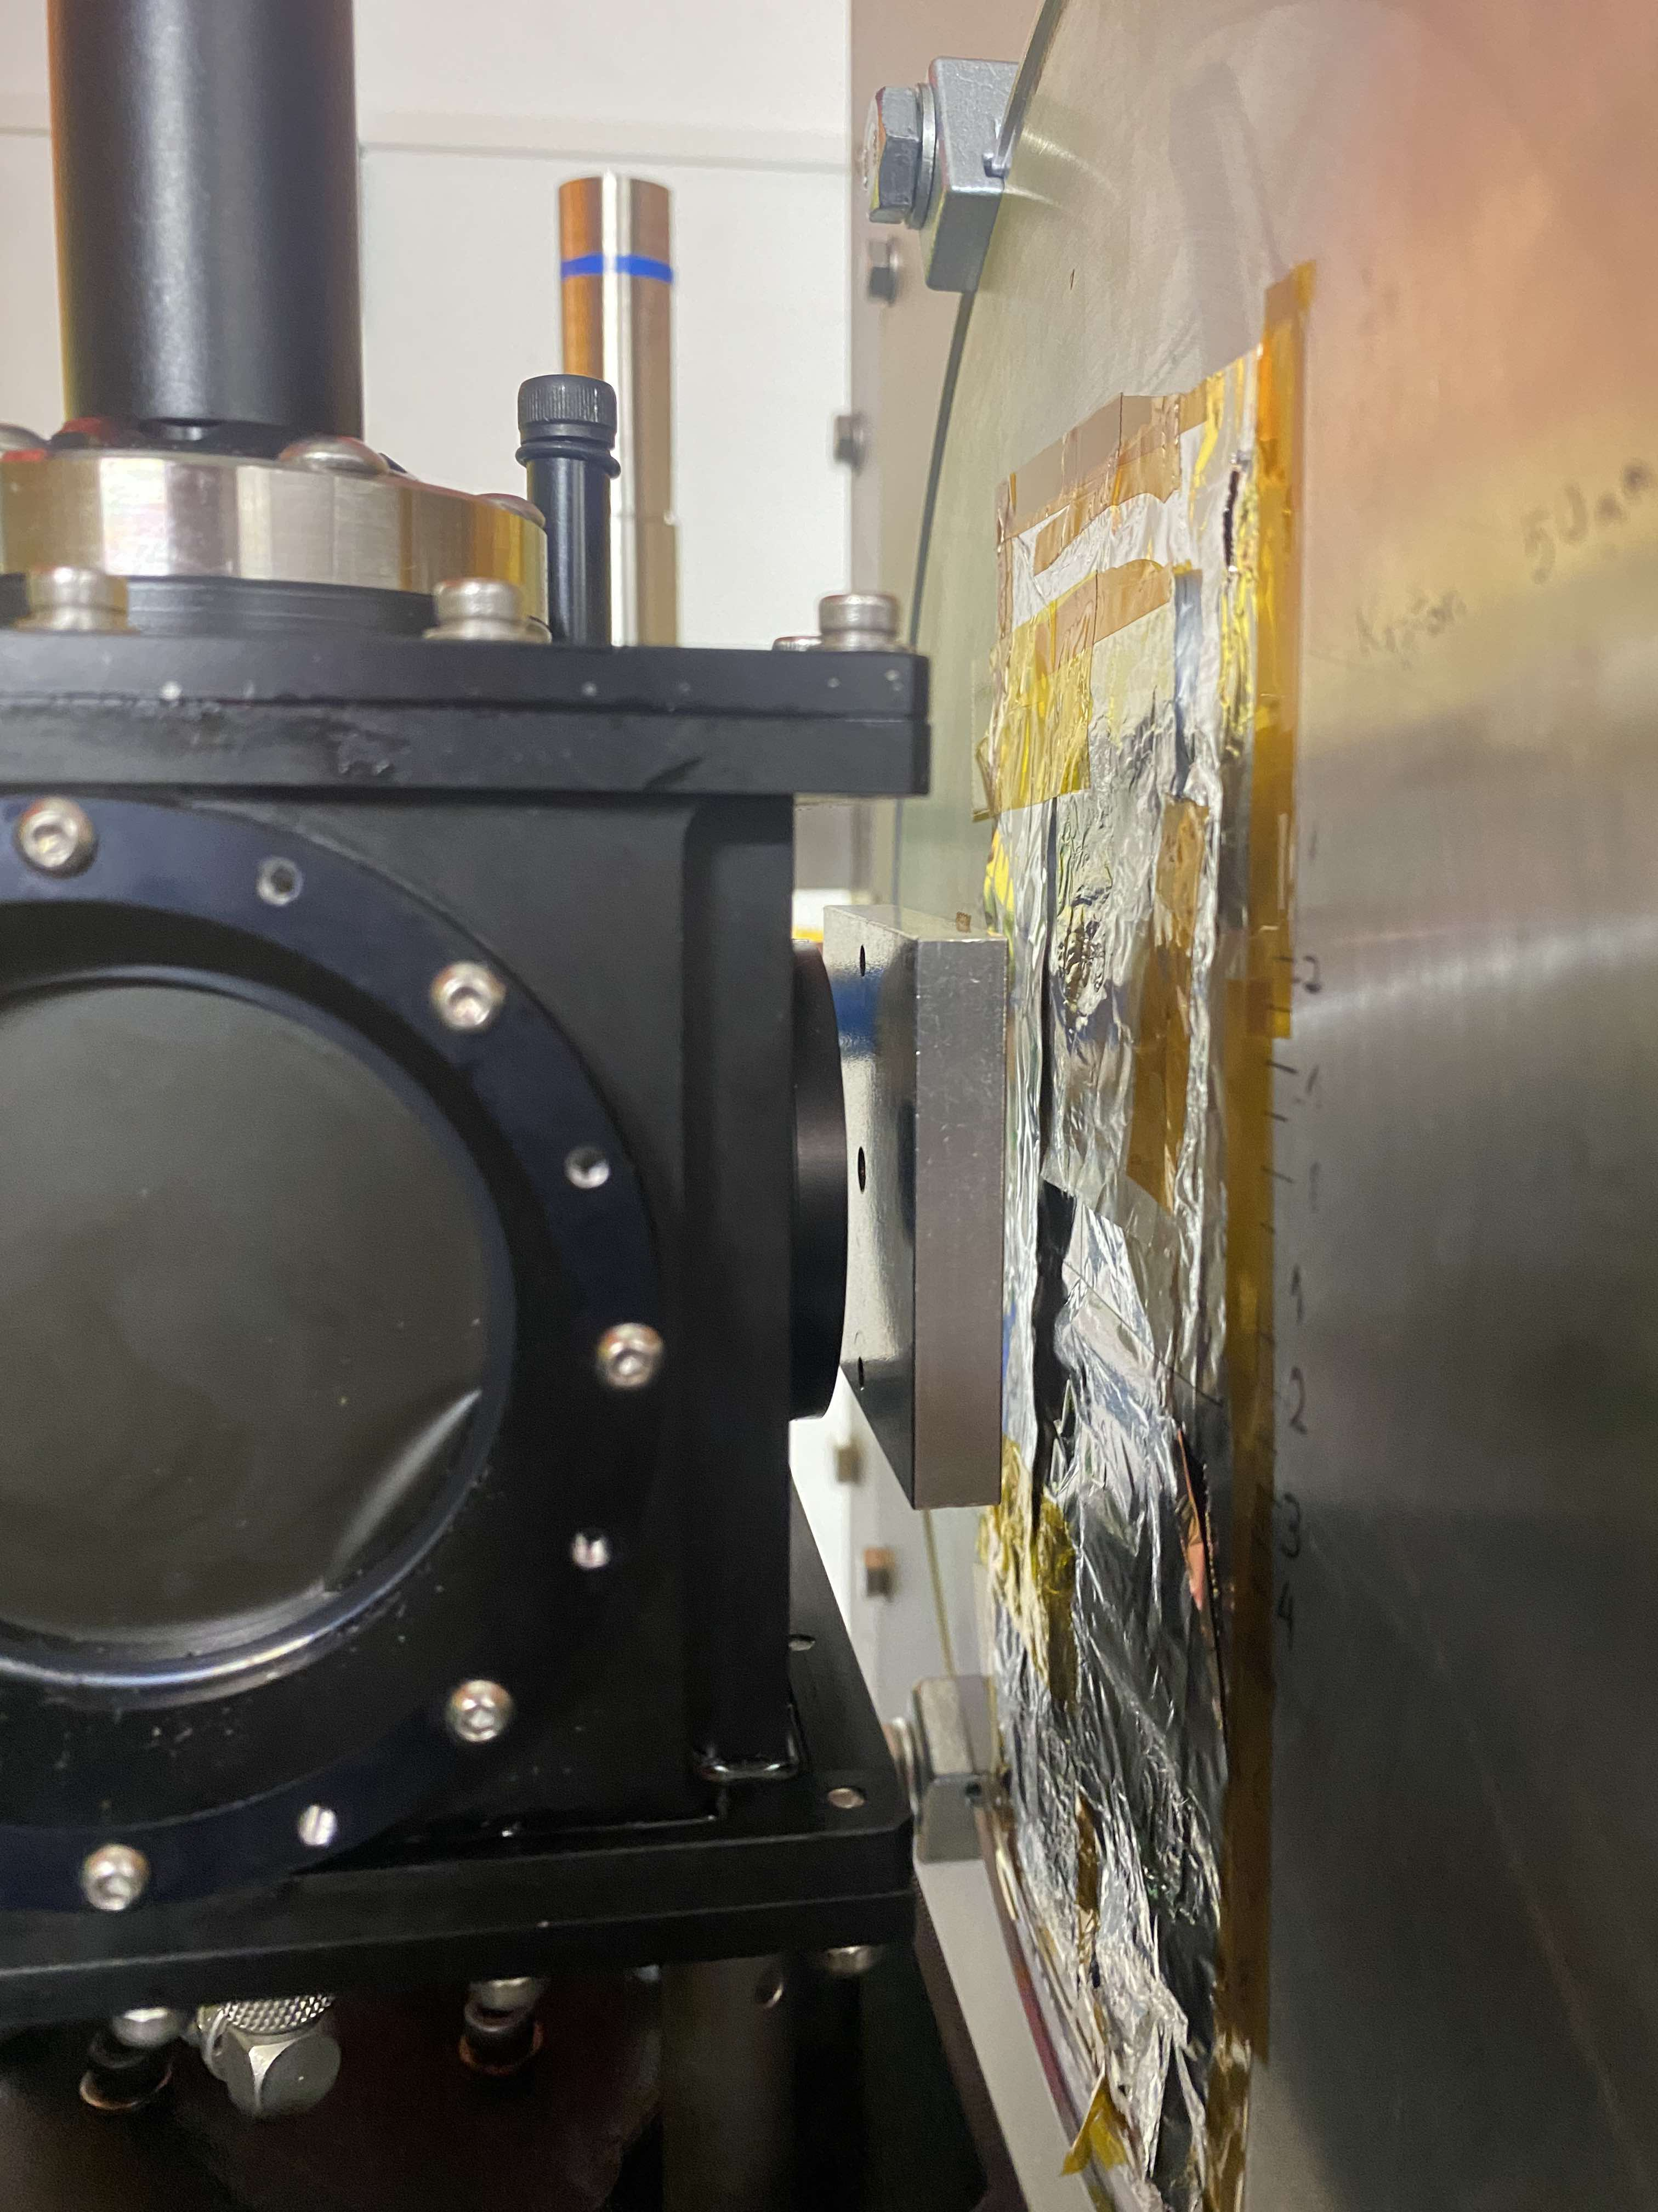
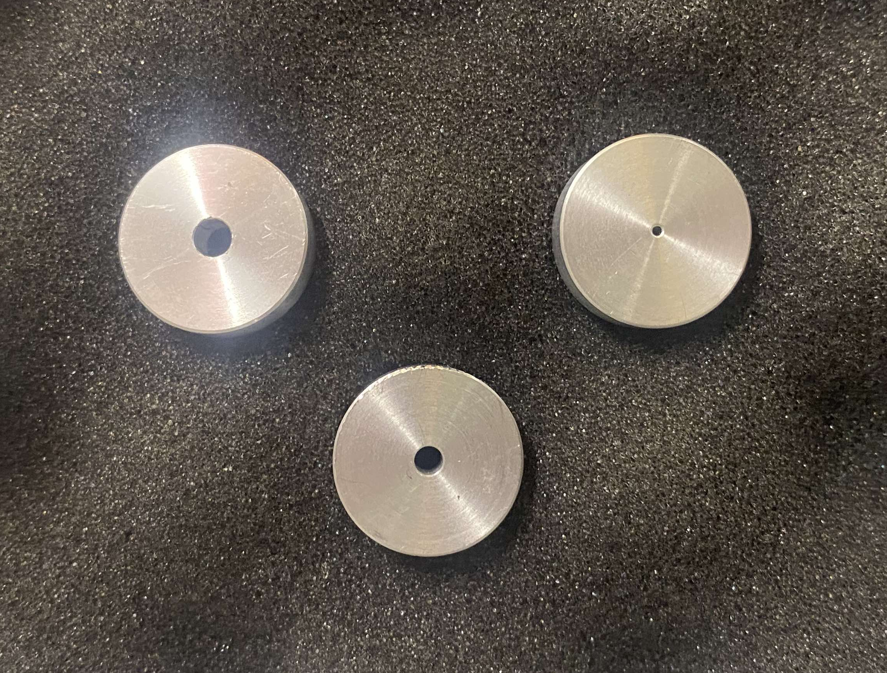
Day 2 & 3: Liquid Scintillator & Transducers
Collimators

Slide 10
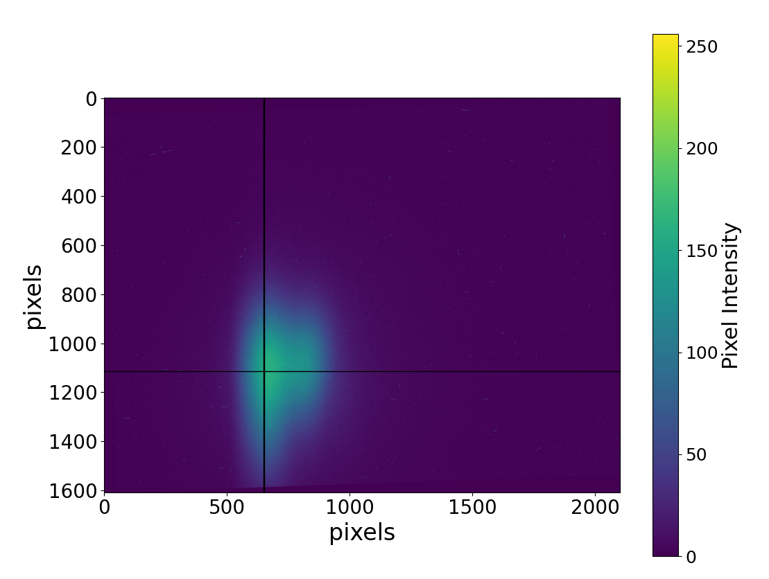
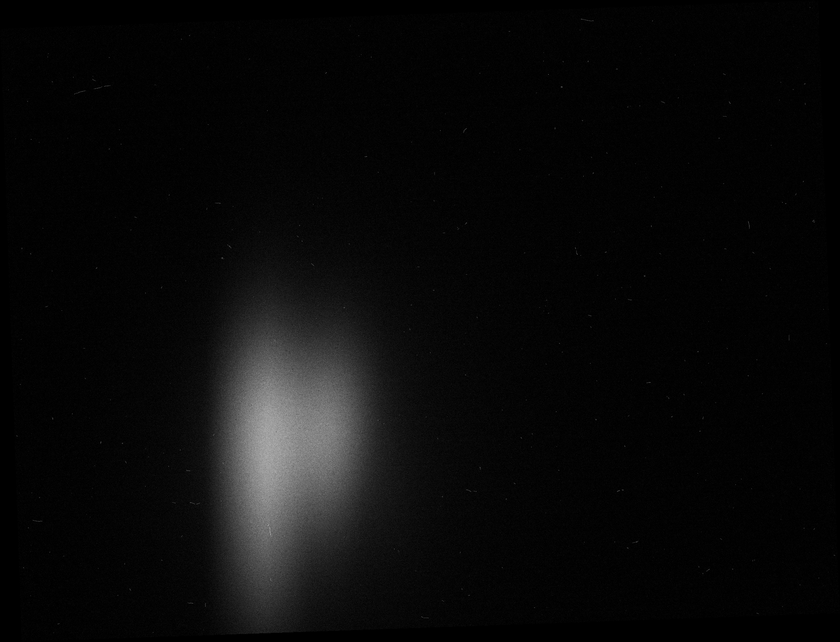
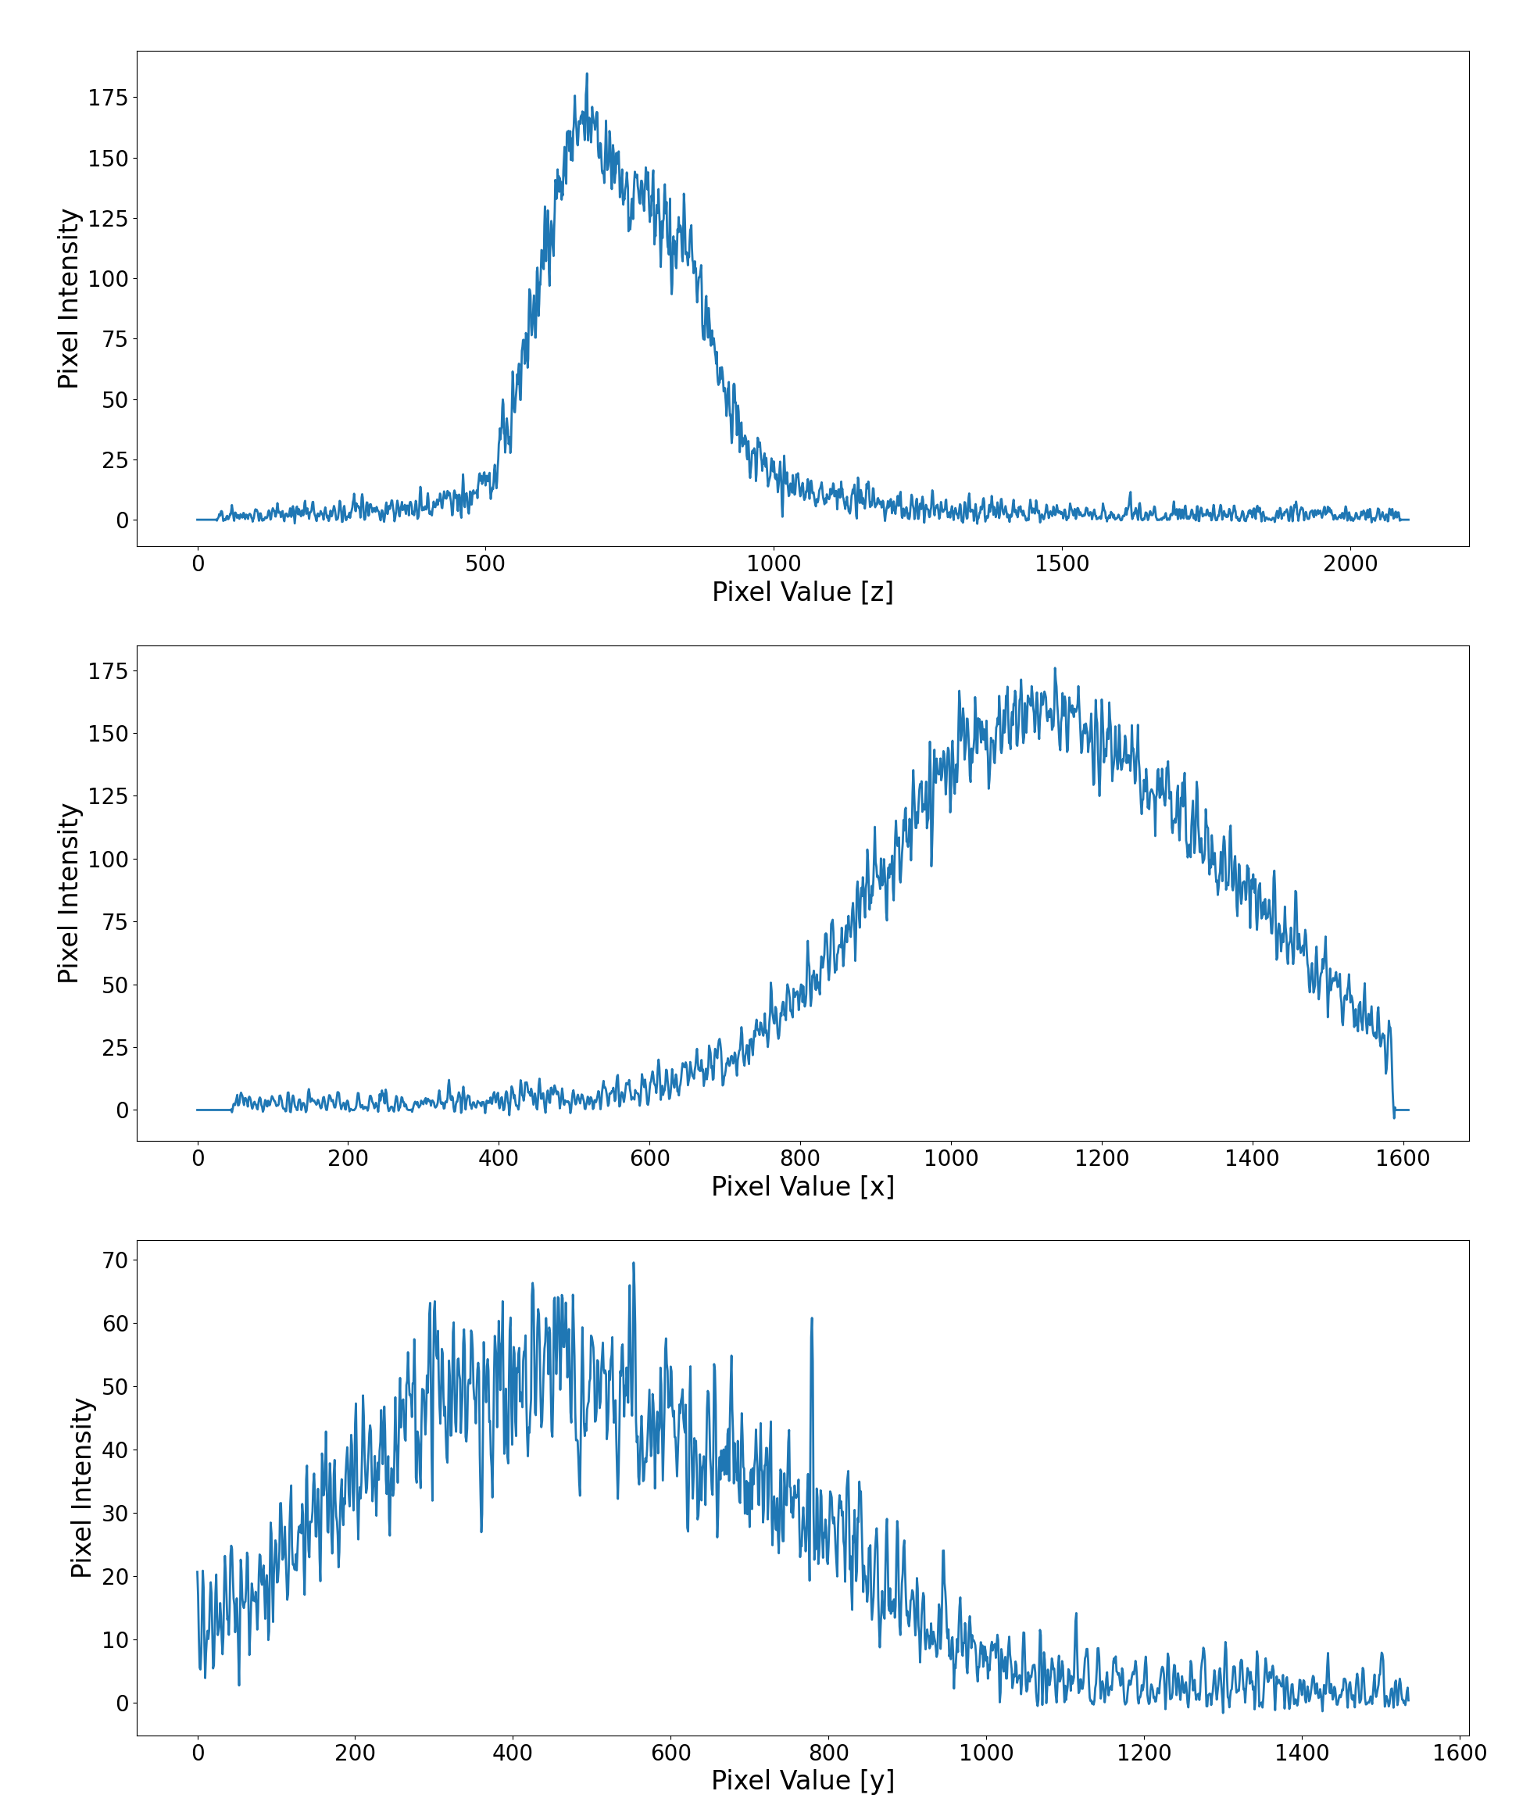
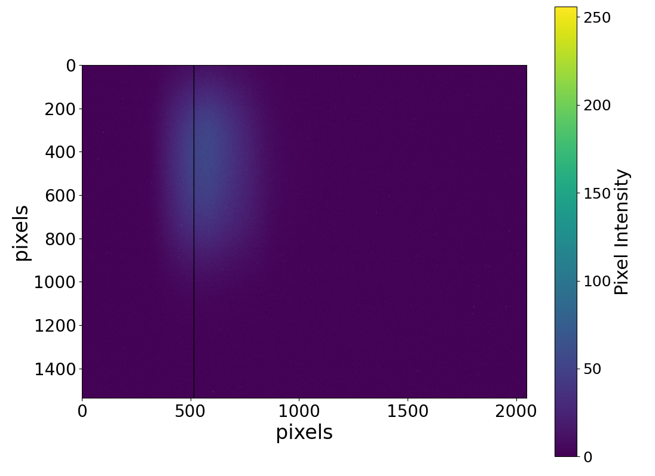
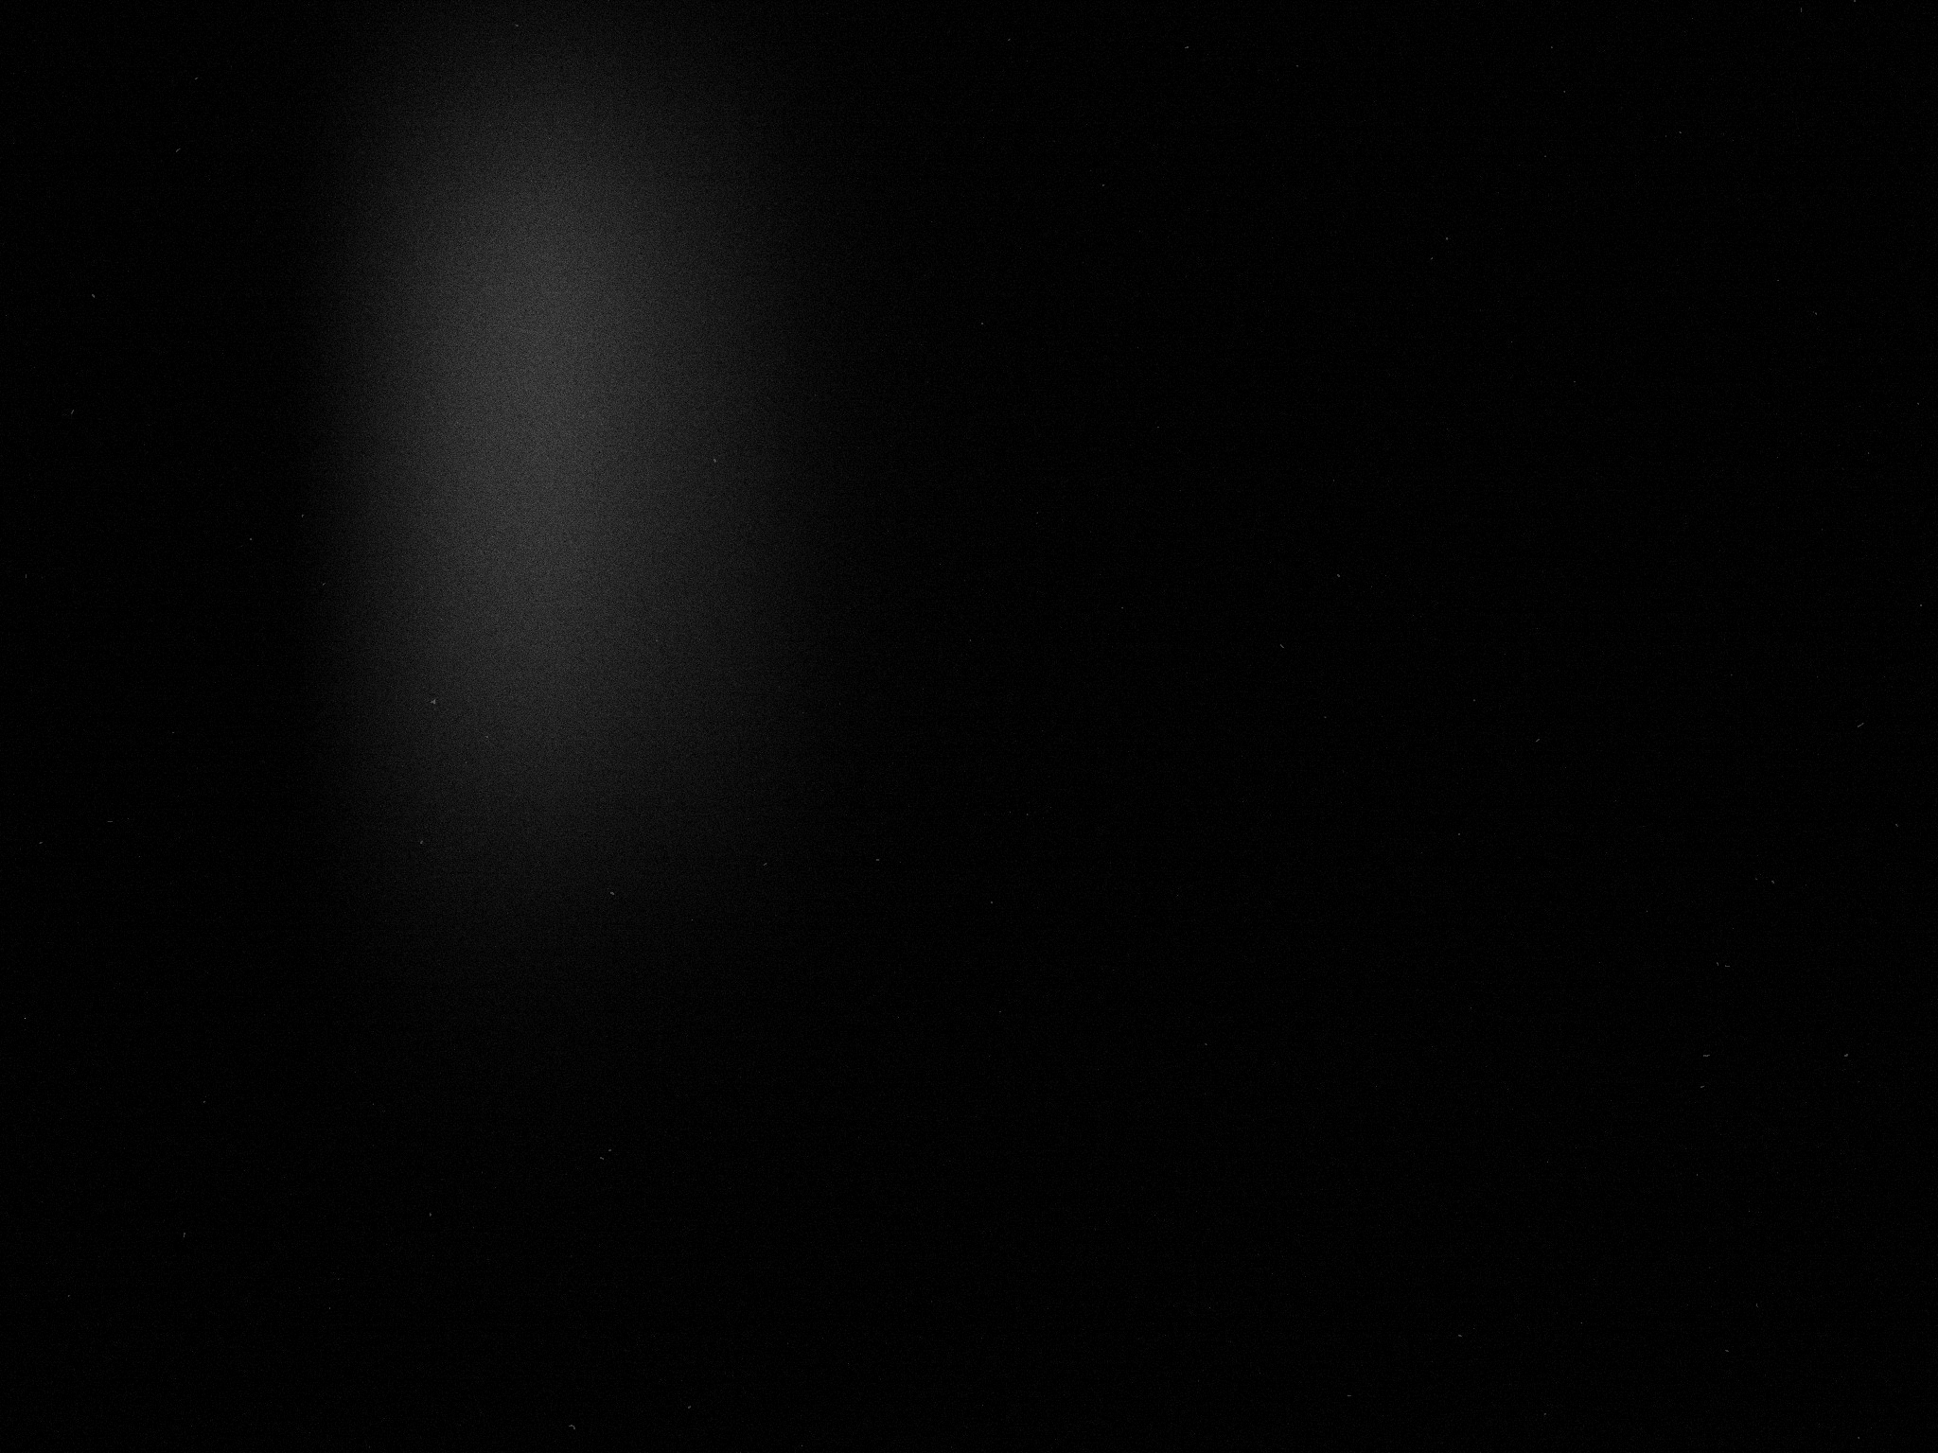
Day 2 & 3: Liquid Scintillator Data
z
Beam
x
Beam
y

