Slide 1
LhARA FFA magnet design
30/07/24
Ta-Jen Kuo
Supervisor: Jaroslaw Pasternak, Jean-Baptiste Lagrange
Imperial College London, STFC

Slide 2
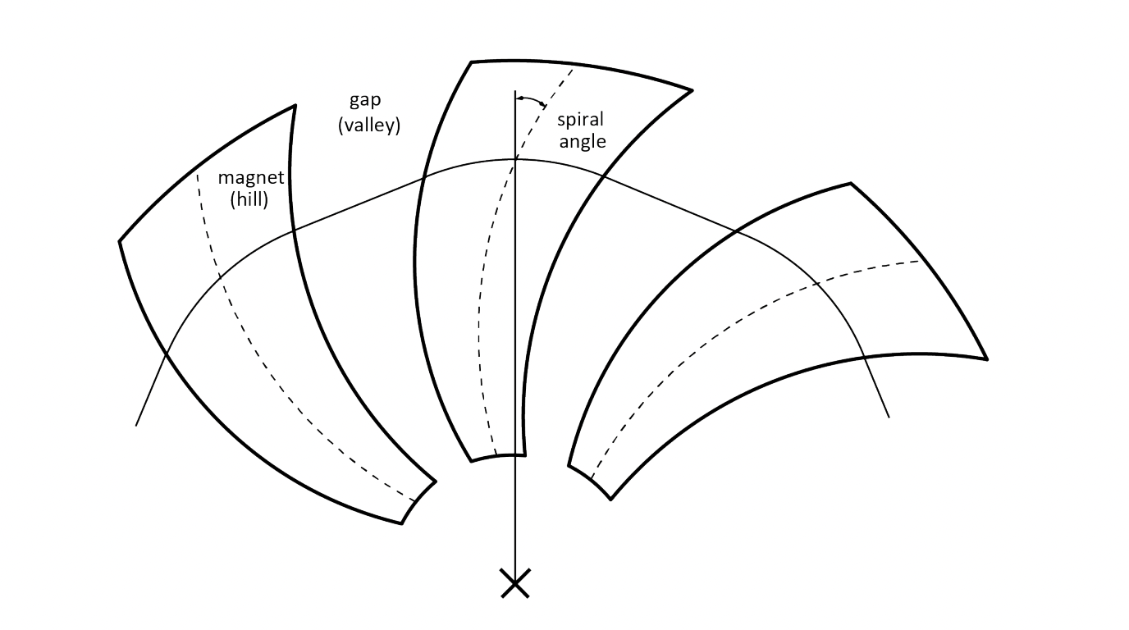
Spiral FFA
Radially varying magnetic field
LhARA magnet: Ability to change magnetic field profile between accelerations
Due to the spiral angle, particles experience edge focusing at either ends of the pole
Providing vertical focusing and no ‘defocusing’ magnet is required.

Slide 3
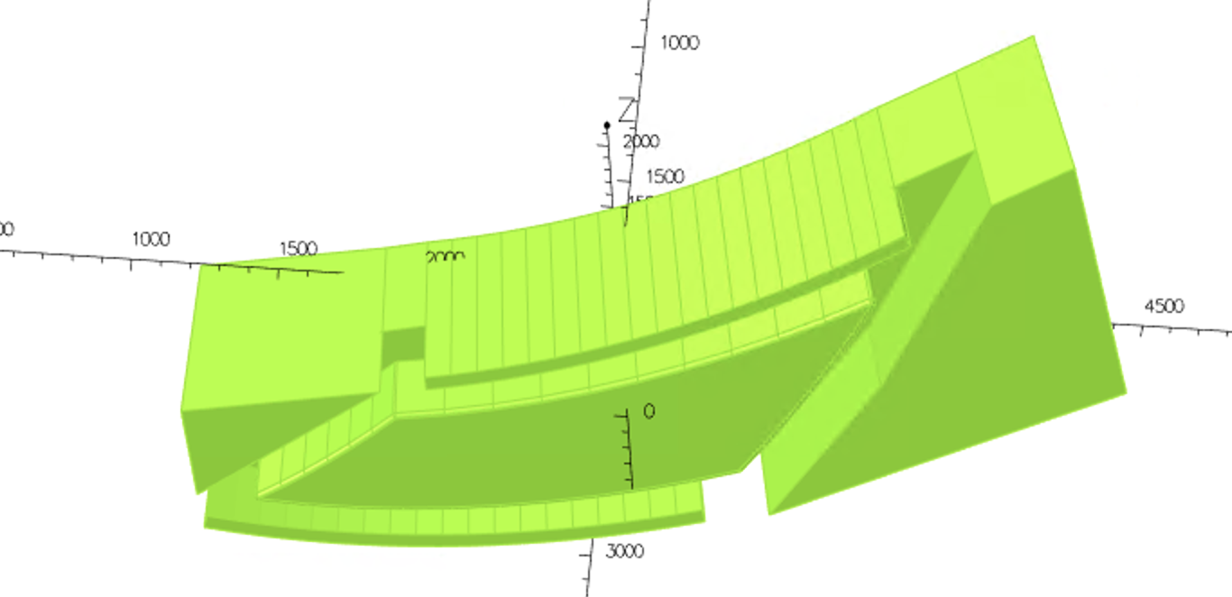
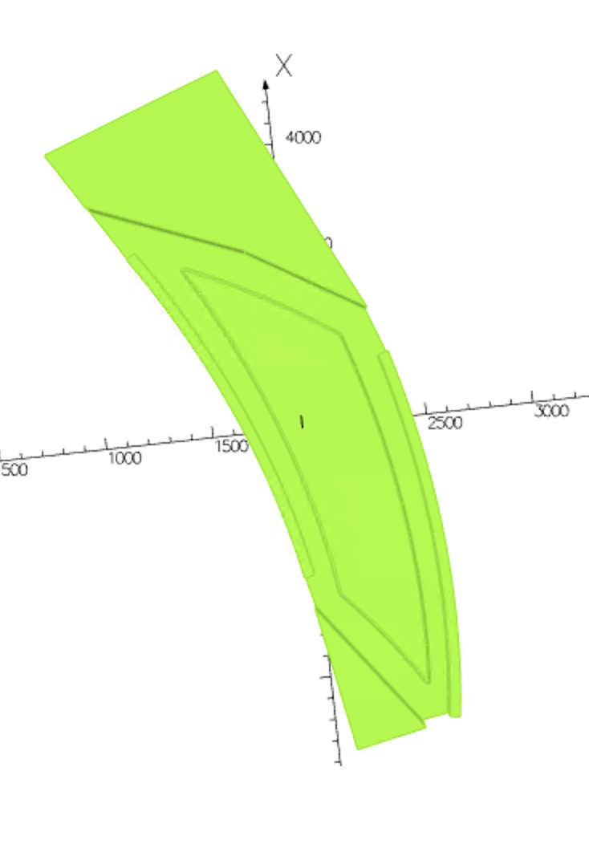
3D model of the LhARA magnet
View of the pole
(Midplane looking up at the magnet)
Side view of the magnet
H type magnet with return yokes on either side
Spiral shaped pole
Field clamps either side of the pole to control
fringe field of the magnet

Slide 4
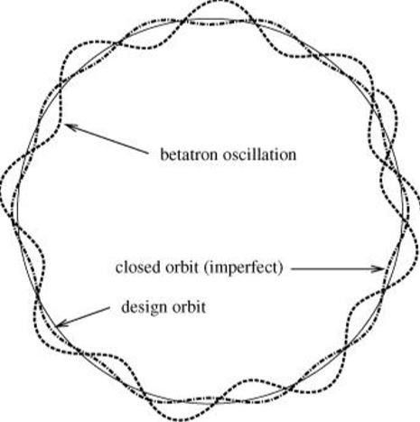
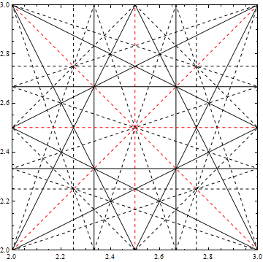
Betatron Oscillation and Tune
Particles oscillate around the designed orbit in the field
Tune is the number of betatron oscillations
per revolution. Avoid resonance tune points to
prevent beam loss
Not only do we want to avoid resonance, we are also changing the tune for different working points.

Slide 5
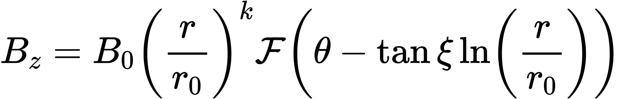
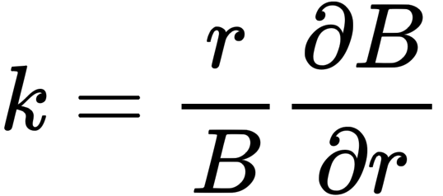
Magnetic field required
One of the ways to achieve the zero chromaticity requirement is to arrange the
Field with the ’Scaling Law’:
where 𝐵₀ is the field at the reference radius 𝑟₀, 𝜉 the constant logarithmic spiral angle
and 𝑘 the constant geometrical field index. F is an arbitrary longitudinal function that
describes the fringe field fall off

Slide 6
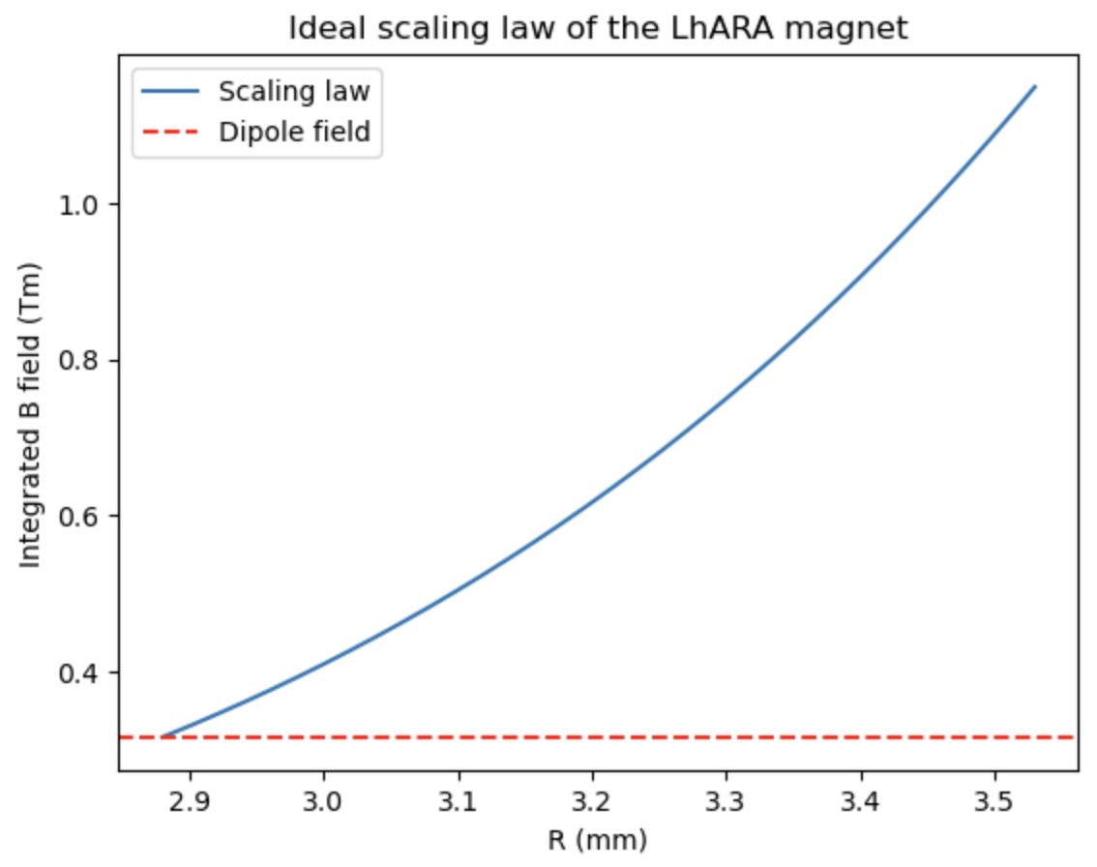
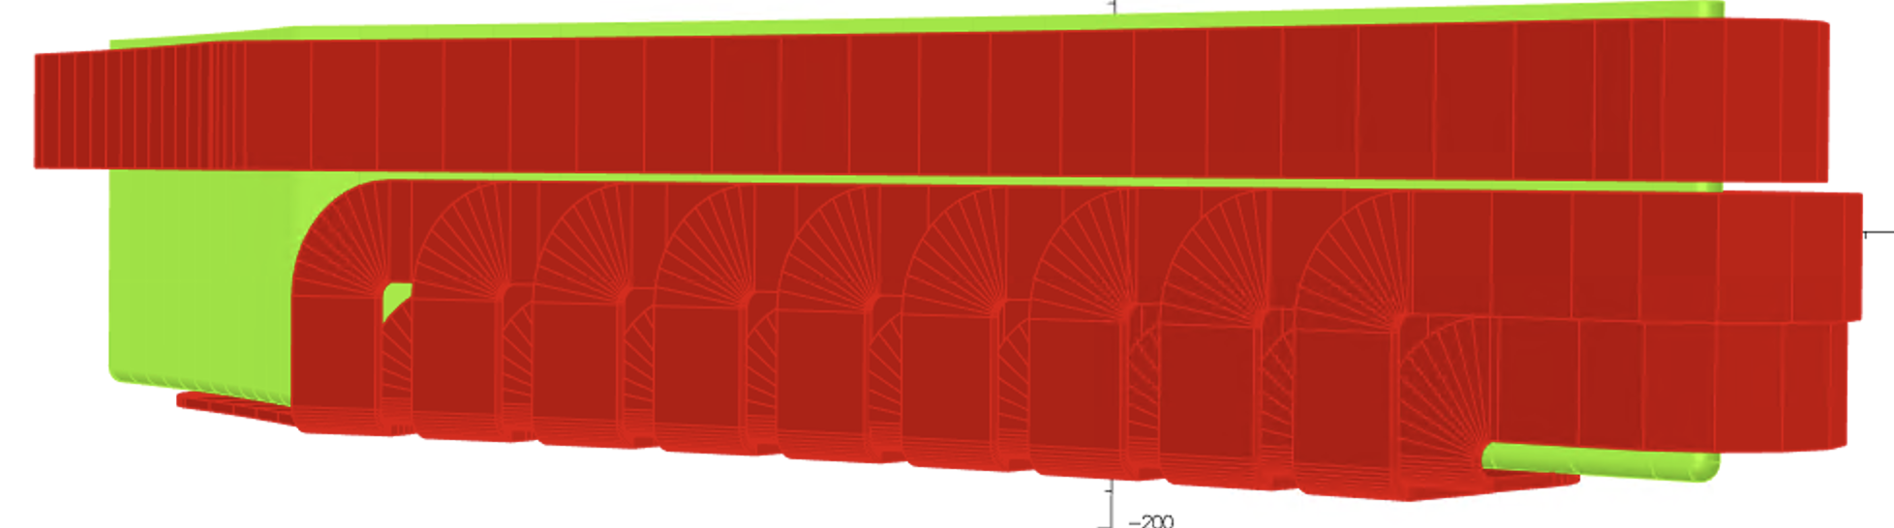



How is the scaling law achieved
A main coil provides the dipole field
Trim coils cross the pole face at constant radii and return around the side of the pole.
Gradient of the magnetic field achieved by adjusting the set of currents through the coils
$$↑$$
$$↑$$
Beam travels out of the page
$$↑$$

Slide 7
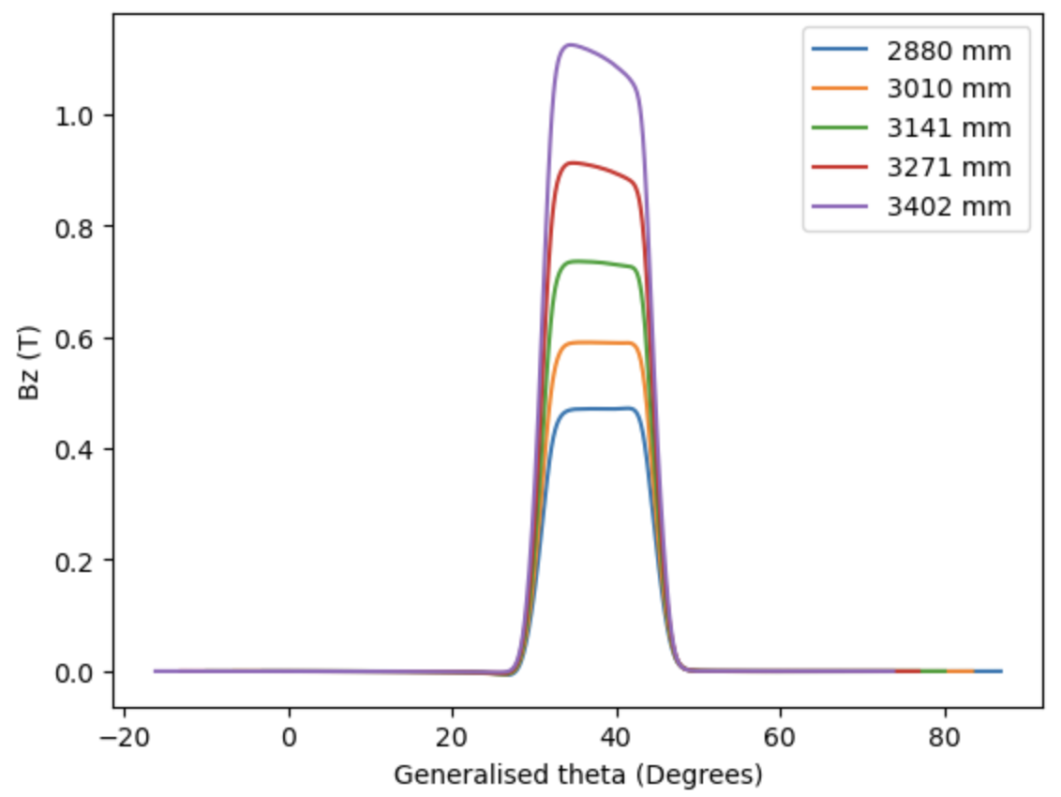
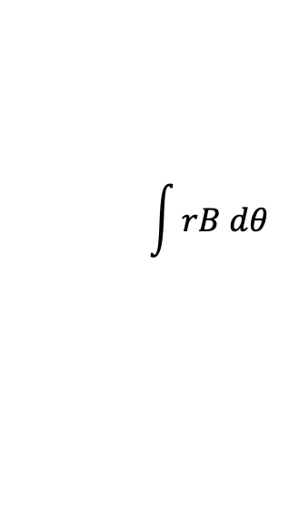

Bz on the midplane with constant radius varying theta
Instead of making the field scaling everywhere
make the integrated field scaling
$$\int{rB dθ }$$

Slide 8
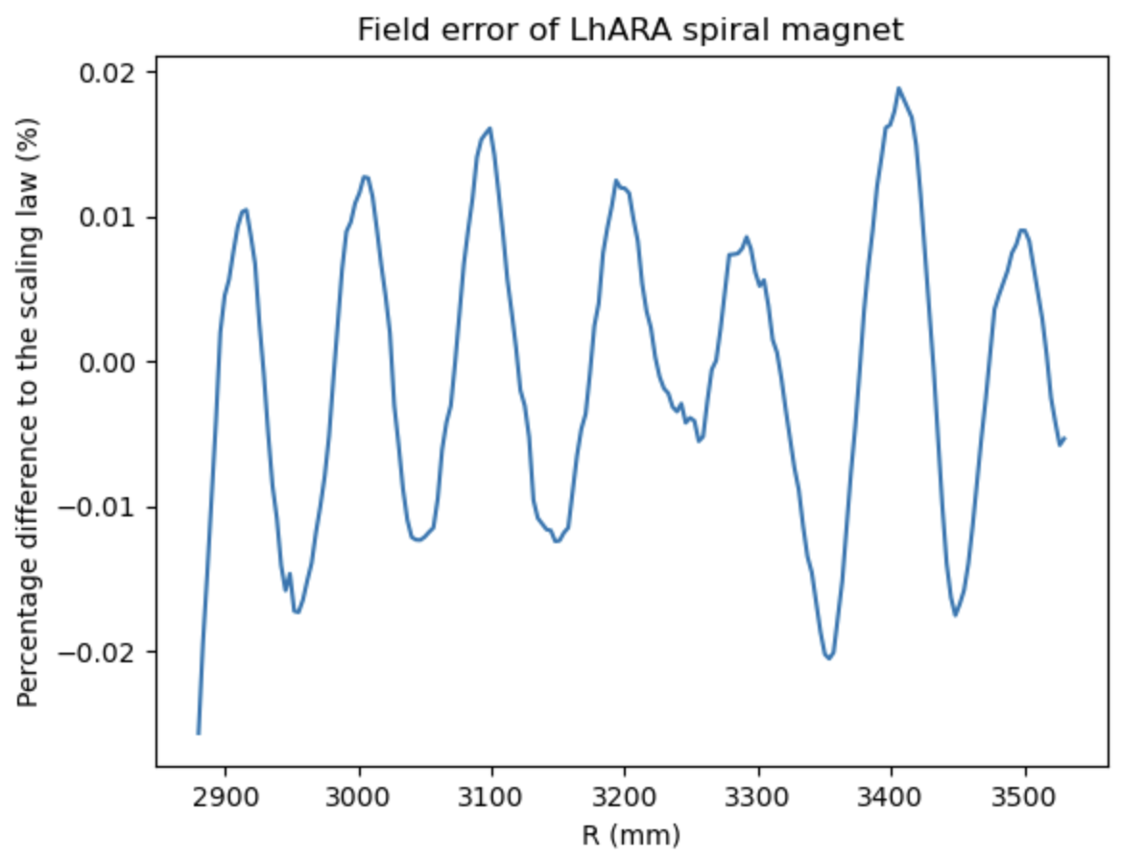
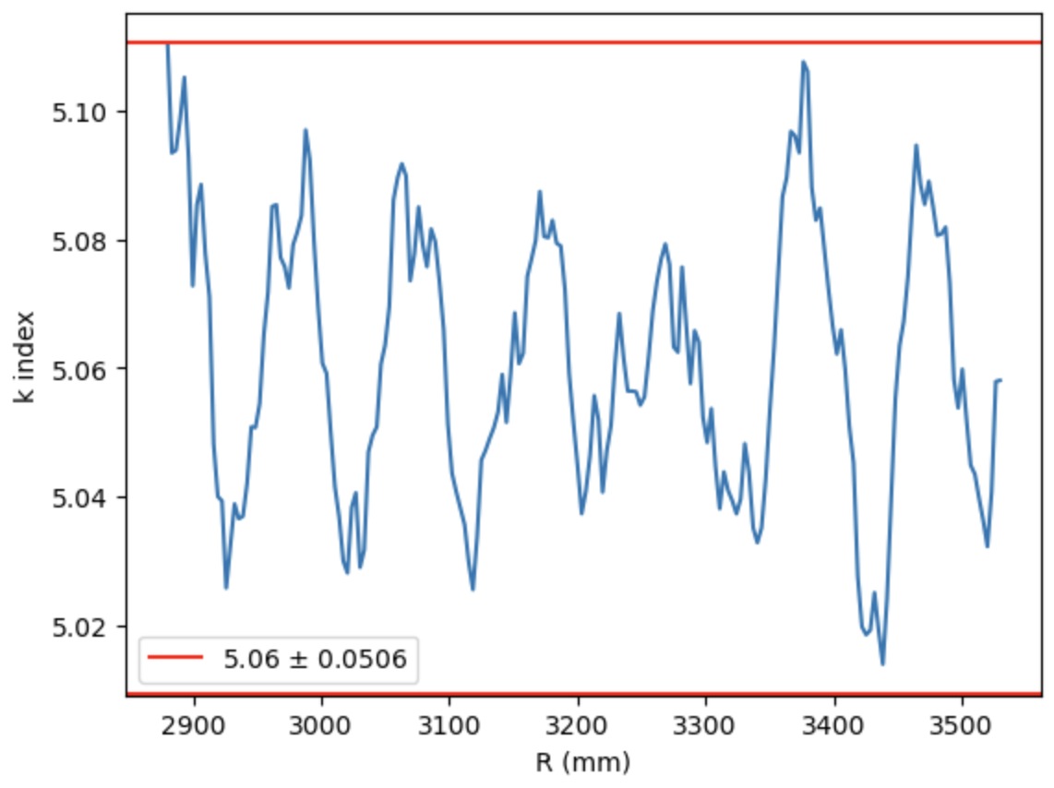

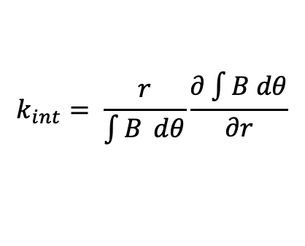
Field error after optimizing integrated B field
Central scenario: BL₀ : 1.044 Tm, r₀ : 3.477m, k : 5.06
$$k_{int}= \frac{r}{\int{B} dθ}\frac{∂\int{B dθ}}{∂r}$$
$$BL={BL}_{0} {(\frac{r}{r_{0}})}^{k+1}$$
Oscillation is expected due to the discrete trim coils

Slide 9
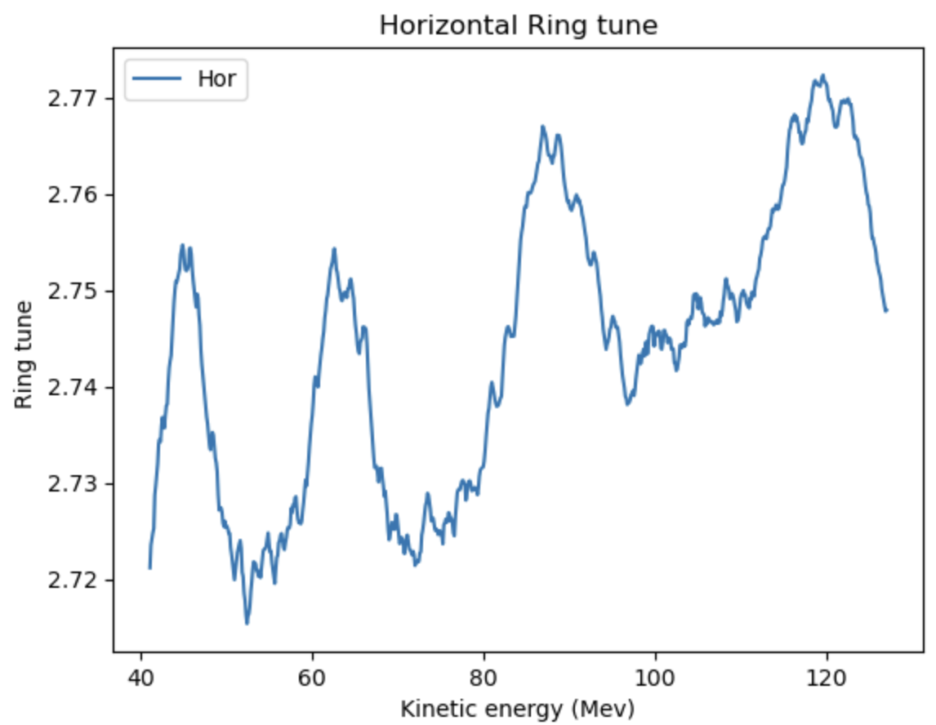
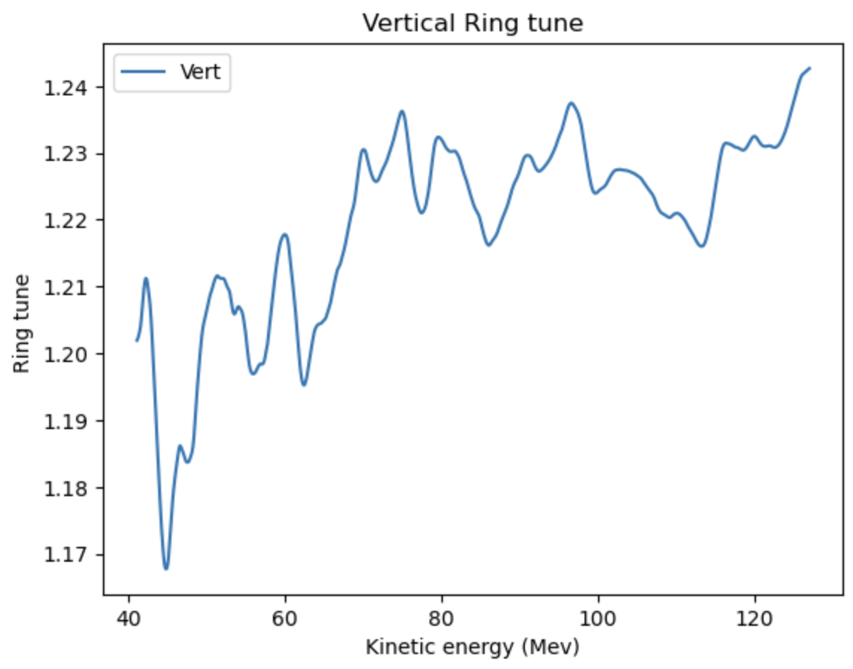
Ring tune
Target horizontal tune: 2.83
Target vertical tune: 1.22
Need to optimize the clamps to flatten the growing trend.
Tune at lower energy not yet available due to modification of tracking code required.

Slide 10
Power Consumption
Trim |  |  |  | Main
Coil width | 0.01 | m |  | Coil width | 0.075 | m
Coil height | 0.0925 | m |  | Coil height | 0.117 | m
Coil area | 0.000648 | m^2 |  | Coil area | 0.006143 | m^2
Cu Resistivity | 1.68E-08 | Ohm.m |  | Cu Resistivity | 1.68E-08 | Ohm.m
Trimcoil | Length (m) | Current (AT) |  | Resistance (Ohm) |  | Power (W)
0 | 4.812 | 17147.34743 |  | 1.32E-05 |  | 3.87E+03
1 | 2.37 | 6595.830751 |  | 6.14E-05 |  | 2.67E+03
2 | 2.61 | 4623.416506 |  | 6.77E-05 |  | 1.45E+03
3 | 2.85 | 3765.645397 |  | 7.39E-05 |  | 1.05E+03
4 | 3.09 | 3109.023381 |  | 8.02E-05 |  | 7.75E+02
5 | 3.33 | 2623.532675 |  | 8.65E-05 |  | 5.95E+02
6 | 3.58 | 2219.711986 |  | 9.28E-05 |  | 4.57E+02
7 | 3.82 | 1904.53631 |  | 9.90E-05 |  | 3.59E+02
8 | 4.06 | 1645.606888 |  | 1.05E-04 |  | 2.85E+02
9 | 4.30 | 1450.452966 |  | 1.12E-04 |  | 2.35E+02
10 | 2.77 | 6595.830751 |  | 7.20E-05 |  | 3.13E+03
11 | 3.02 | 4623.416506 |  | 7.82E-05 |  | 1.67E+03
12 | 3.26 | 3765.645397 |  | 8.45E-05 |  | 1.20E+03
13 | 3.50 | 3109.023381 |  | 9.08E-05 |  | 8.77E+02
14 | 3.73 | 2623.532675 |  | 9.69E-05 |  | 6.67E+02
15 | 3.98 | 2219.711986 |  | 1.03E-04 |  | 5.09E+02
16 | 4.22 | 1904.53631 |  | 1.10E-04 |  | 3.97E+02
17 | 4.46 | 1645.606888 |  | 1.16E-04 |  | 3.14E+02
18 | 4.70 | 1450.452966 |  | 1.22E-04 |  | 2.57E+02
 |  |  |  |  |  | Total Power (W)
 |  |  |  |  |  | 2.08E+04
Total power for one magnet: 41.6kW,
416 kW for magnet power for the ring
These are not the final number,
working on trying to lower the total
power consumption

