Slide 1
Update and news

Slide 2
Now all but done

Slide 3
Bridging period update
Outline of financial breakdown agreed;
  Being refined
Initial draft of milestones drafted;
  Being refined
Project definition document in preparation
Session at DL to finalise:
  14/15 August 2024

Slide 4
ITRF/LhARA conceptual design report
Deadline for completion of report 31Sep24 (!)
Preparation started PMB, CW & HO
Spotlight focus on CDR preparation as soon as BP1 project plan is finalized
CM#6/24-month review 02/03 September 2024
  Queens University, Belfast

Slide 5
Engagement with MRC and bio/clinical peers
Opportunity:
  ITRF/LhARA as MRC-led project delivered by STFC
What’s happened:
  Contacts STFC → MRC at Exec Dir level
    Positive; need to convince MRC of:
      Benefits;
      Peer-group commitment/pull
      Scientific and technical excellence
      International positioning – partnership, competition …
      Industrial engagement
We need to step up across the “stakeholder community”:
  Bio/clinical peers
  HEI partners, national labs (and lab departments!)
  Funders, decision makers, policy makers, …
  Public
  Patients

Slide 6
Engagement: broad and deep
Pat Price & Work package 8 have engagement/ outreach plan
OK!
  … but, need to create resonance through concrete project(s)
Propose as a target:
  Royal Society Summer Exhibition 2026
Consider as preparation/rehearsal:
  Exhibition Road Science festival 2025
Create “exhibit(s)” that can go on the road or be reproduced across the collaboration

Slide 7
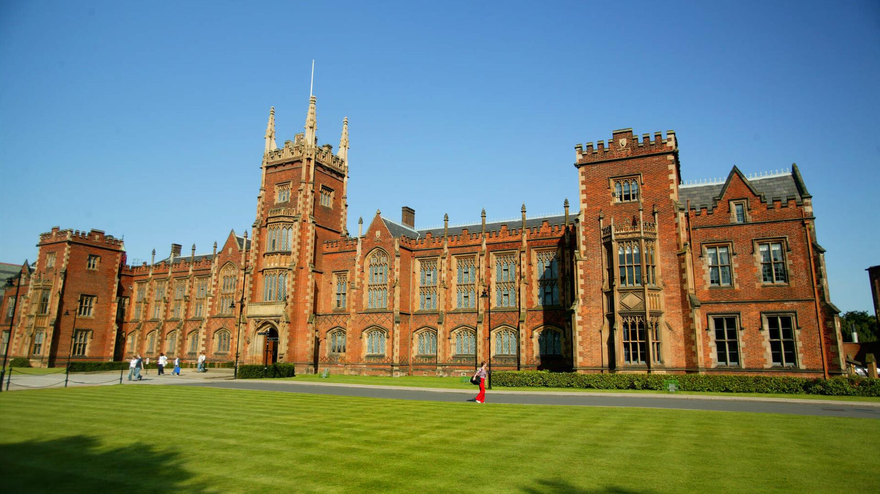


September collaboration meeting
Queens University Belfast:
  02/03Sep 2024
Excellent meeting this morning; Charlotte Palmer taking the reins!
https://indico.stfc.ac.uk/event/1060/
Registration will go live 01Jul24

Slide 8
Going forward
Rolling w/p reports:
  Next time:
    Ion acoustic (WP6)

